Slide 1

Google Play Store Analysis
A Power BI dashboard on app categories, installs, ratings and user sentiment
Data: googleplaystore.csv and googleplaystore_user_reviews.csv
Image source: Font Awesome Free icons (CC BY 4.0), via React Icons - fontawesome.com/license/free
Notes:
Introduce the project: an interactive Power BI dashboard analysing the Google Play Store.

Slide 2

Project objective
The aim is to help an app company understand what drives installs, ratings and reviews on the Play Store, so that decisions on categories, pricing and marketing are based on data.
Questions the dashboard answers
Which app categories and genres are the most profitable in terms of installs and engagement?
What separates highly rated categories from poorly rated ones?
How should free and paid apps be balanced to grow revenue and the user base?
Where are the trends and gaps that suggest opportunities for new apps?
Image source: Font Awesome Free icons (CC BY 4.0), via React Icons - fontawesome.com/license/free
Notes:
These questions come from the problem statement document.

Slide 3

Dataset and tools
File | Records | Key columns
googleplaystore.csv | 10,839 apps | Category, Rating, Reviews, Installs, Type, Price, Content Rating, Genres, Android Ver
googleplaystore_user_reviews.csv | 64,294 rows | App, translated review, sentiment, polarity, subjectivity
Preparation in Power BI
Cleaned installs, price and size columns into numeric fields
Created a Calendar table for the Year and Month Name slicers
Related the app data to the review data
Built KPI cards, slicers and a two-page report with page navigation buttons
Image source: Font Awesome Free icons (CC BY 4.0), via React Icons - fontawesome.com/license/free
Notes:
Adjust the preparation steps to what you actually did in Power BI.

Slide 4
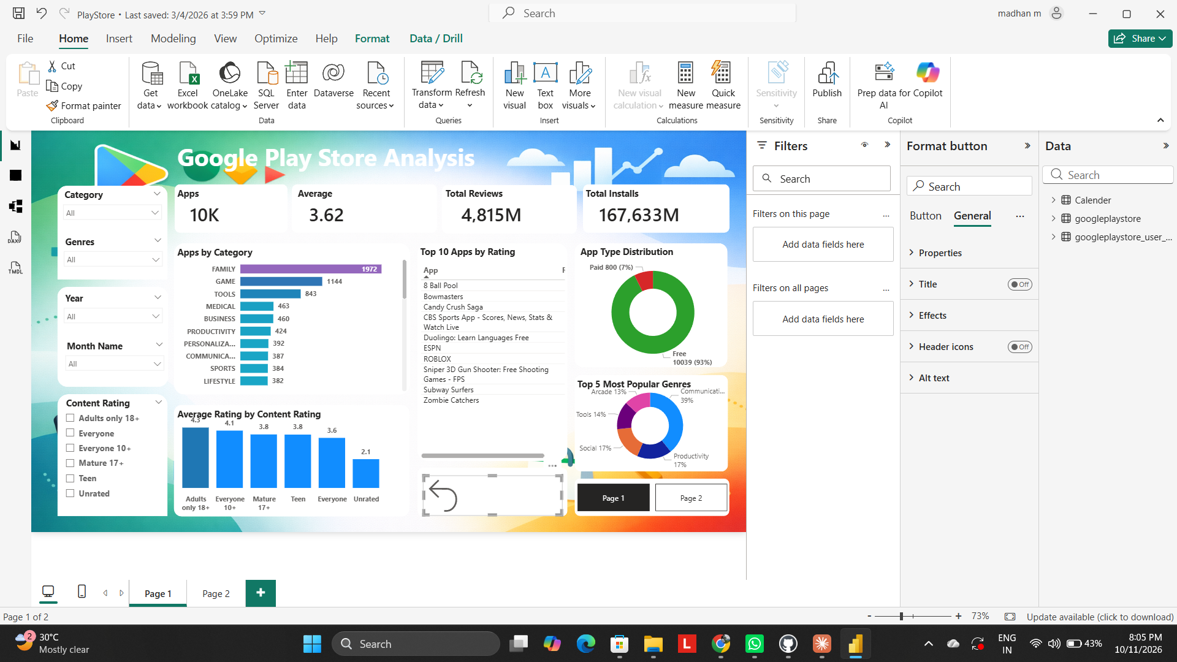
Dashboard page 1: app overview
10K apps with an average rating of 3.62
4,815M total reviews and 167,633M total installs
Slicers for category, genre, year, month and content rating
Visuals for apps by category, top apps by rating, app type and popular genres
Image source: author's own screenshot of the Power BI report (page 1)

Slide 5
Family and Game dominate the catalogue
Family (1,972) and Game (1,144) together make up about 29% of all apps.
Tools, Medical and Business form a second tier with 450 or more apps each.
A crowded category means stronger competition, so installs per app should be checked before entering.
Notes:
App counts per category come from the dashboard.

Slide 6

Games and Communication drive installs
Game (35.1B) and Communication (32.6B) account for about 40% of the 167.6B total installs.
Family has the most apps but only 10.3B installs, so each app earns far fewer installs.
Games and communication apps offer the widest reach.
Image source: Font Awesome Free icons (CC BY 4.0), via React Icons - fontawesome.com/license/free
Notes:
Installs are the sum of the Installs column per category. The total matches the dashboard card.

Slide 7
Free apps dominate the market
93% of apps are free (10,039) and 7% are paid (800). Unrated apps average only 2.1, which pulls the overall average down to 3.62.

Slide 8
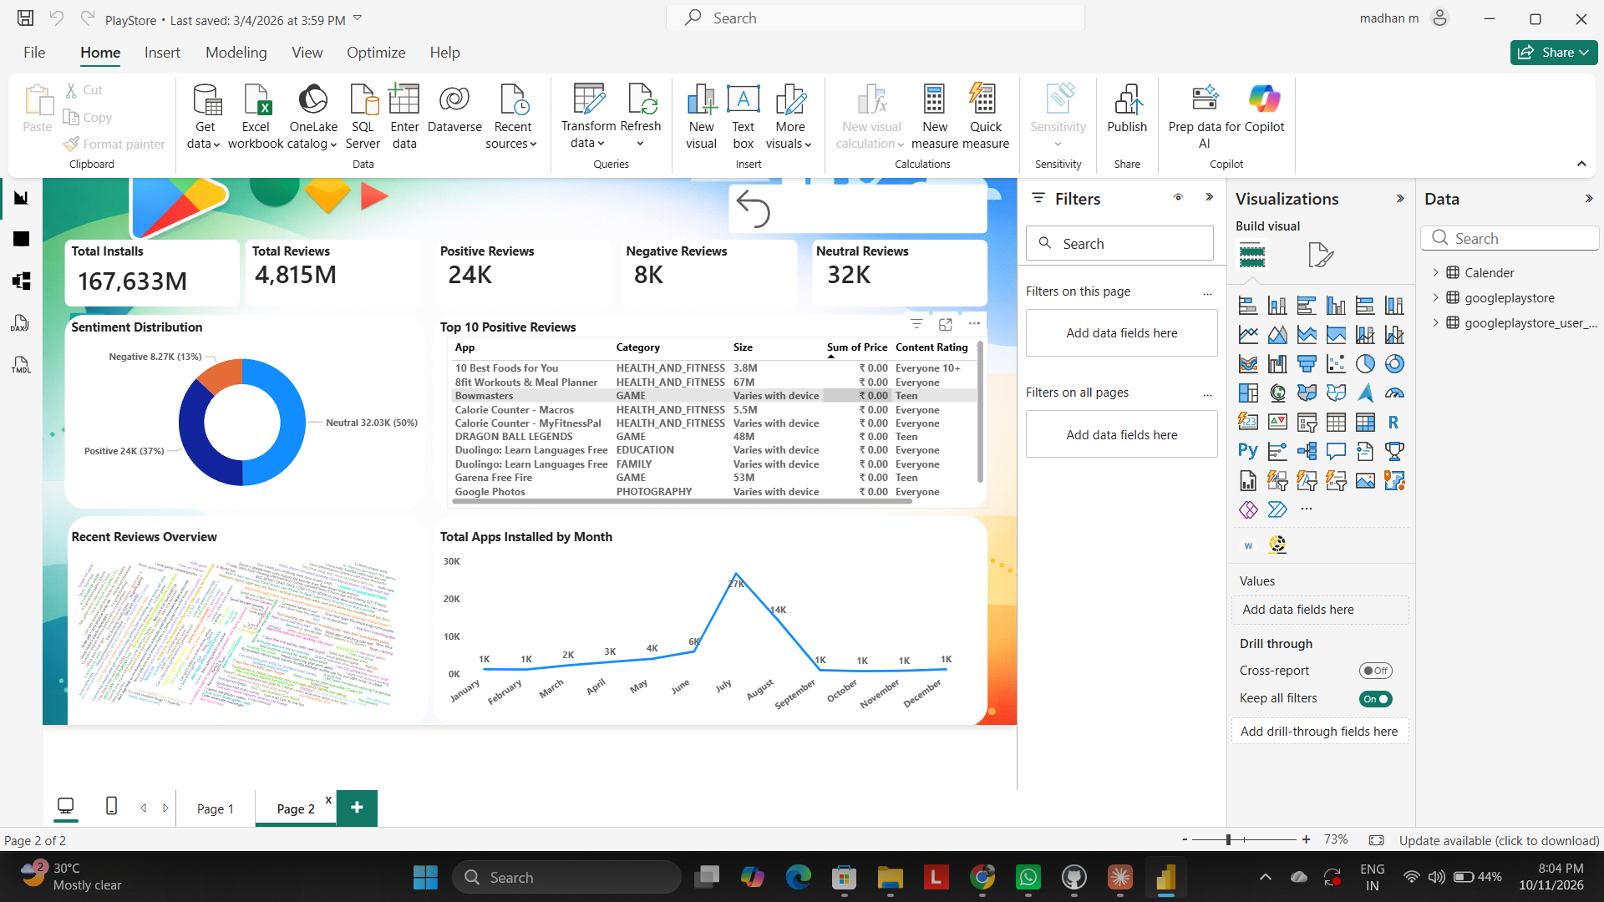
Dashboard page 2: reviews and sentiment
Positive reviews 24K, neutral 32K, negative 8K
Top 10 positive reviews by app, category, size, price and content rating
Word cloud of recent reviews
Monthly view of app activity
Image source: author's own screenshot of the Power BI report (page 2)

Slide 9

Sentiment and monthly activity
Only 13% of reviews are negative (8.27K), against 37% positive. Activity jumps in July (27K) and August (14K), then returns to about 1K.
Image source: Font Awesome Free icons (CC BY 4.0), via React Icons - fontawesome.com/license/free
Notes:
Values read from the page 2 visuals of the dashboard.

Slide 10

Key insights and recommendations
1 | Target high-install categories | Game and Communication offer the most reach.
2 | Look for gaps | Categories with strong ratings but few apps leave room for new, high-demand apps.
3 | Stay free-first | Most apps are free; rely on in-app revenue and keep paid apps for niche value.
4 | Improve low ratings | Encourage early reviews and respond to complaints, especially for unrated apps.
5 | Plan around July and August | Time releases and marketing campaigns before the seasonal peak.
6 | Prioritise popular Android versions | Support the versions with the largest share of apps first.
Image source: Font Awesome Free icons (CC BY 4.0), via React Icons - fontawesome.com/license/free
Notes:
Recommendations map back to the problem statements.

Slide 11
Conclusion
The dashboard shows where installs, ratings and reviews are concentrated across the Play Store.
Game and Communication lead on installs, free apps dominate, and sentiment is largely neutral to positive.
Next steps: add revenue estimates, an Android version analysis and category growth over time.
Thank you

