Slide 1
SMART VOTERS
Team Members Faculty guide
GOWSALYA .m Ms.Suganthi.a
MADHAN KUMAR.R
JAYADURAI.c
BHALAJI.K

Slide 2
ABSTRACT
The main objective is to vote through online for people living abroad and in different states and cities.
Involving every citizens to ensure vote in easy way.
Polling every ones vote in secure form.

Slide 3
EXSISTING SYSTEM PROPOSED SYSTEM
In India, voting is been done only in booths arranged by the Election Commission.
After voting if any technical problems or damages occurs with the machines it may leads to the re election.
The machine is not able to recognize the eligibility of a candidate so the corrupted officers may misguide the people.
A online voting system in Digital India in a simple and more easier way.
The system is highly reliable and secure.
Rigging of votes can be avoided.

Slide 4
MODULE SPLIT-UP REFERENCE
Module 1: Data Collection , Understanding Data , Selection of Variables
Module 2 : Building the prediction model , Implementing the algorithm
Module 3 : Predicting the accuracy
IEEE-Project Websites and various journals
https://www.ijert.org/smart-voting-system
Journal: ” Smart Voting System”,” “Gowtham R , Harsha K N , Manjunatha B”,” INTERNATIONAL JOURNAL OF ENGINEERING RESEARCH & TECHNOLOGY

Slide 5
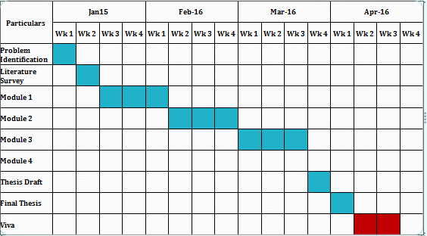
PROJECT PLANNER

Slide 6
THANKYOU

