Slide 1


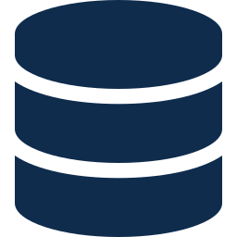


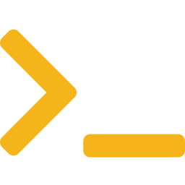

ARCHITECTURE · CONNECTIVITY
How Everything Connects
Every component and the four connections between them — only one leaves the network
CORPORATE NETWORK
PRIVATE VPC
1 · Outbound HTTPS
read-only creds · scheduled pull
OptScale
1
Cloud APIs
Collects + stores cost data, dashboards, recommendations
AWS · Azure
GCP billing
3 · Bridge → OptScale
private REST API · API token
3
Gauss
2
Bridge Service
4
Internal LLM — reasoning layer
CLI
On engineer's
Linux machine
Orchestrates: fetches data, builds prompt, formats answer
4 · Bridge → Gauss
internal API · service credential
2 · CLI → Bridge
VPN/SSH · HTTPS · SSO auth
Only connection 1 leaves the network — read-only billing data, the same call any cost tool makes. Connections 2–4 stay entirely inside the corporate network.

Slide 2

ARCHITECTURE · REQUEST FLOW
What Happens on a Single Query
Six steps round-trip — plus one background process that keeps data fresh
CLI
Bridge
OptScale
Gauss
Run command
REQUEST →
1
Fetch cost data
2
Return JSON breakdown
3
Send assembled prompt
4
Return plain-English reasoning
5
Print formatted answer
6
← RESPONSE
Running in the background · Independently of any query, OptScale continuously polls the cloud billing APIs on a schedule — so the data is always current when someone asks.
The Bridge is the hub — every step passes through it. It talks to OptScale for data and Gauss for reasoning, and the engineer only ever sees the CLI.

