Slide 1
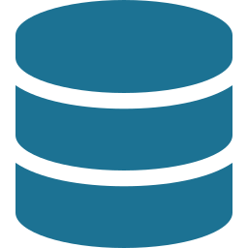


HIGH-LEVEL OVERVIEW
CloudCostOps CLI
AI-powered FinOps that lives inside your network — built on tools you already trust.
OptScale
Gauss
CLI
Architecture · Benefits · Phased rollout

Slide 2

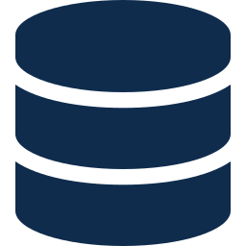
The High-Level Architecture
OptScale collects the data. Gauss reasons over it. The CLI is how engineers ask.
DATA
COLLECT + STORE
REASON
ASK
Cloud APIs
OptScale
Gauss
CLI
AWS · Azure · GCP
Open-source FinOps
Internal LLM
Engineer's terminal
Source of cost and usage data
Collects, stores, and dashboards everything across clouds
Reasons over the data, answers in plain English
Ask questions, get answers — no dashboards required
Behind the scenes · A small Bridge service connects OptScale to Gauss — translating cost data into a prompt and the answer back into the CLI.

Slide 3




How This Will Be Useful
Four reasons this approach delivers real value — for the team, the org, and the business
Private by design
Builds on what works
Every component runs inside the corporate network. Cost data never reaches a third-party AI service — a stronger privacy posture than any external tool.
OptScale already handles multi-cloud collection, anomaly detection, and dashboards. We add intelligence on top instead of replacing what's already proven.
Plain English access
Built to grow
Anyone — engineer, finance partner, leadership — can ask questions in natural language and get clear answers. No dashboards or queries to learn.
The Bridge service is reusable. As needs evolve, the same backend supports chatbots, additional data sources, and automated actions — without rewrites.
In short · A private, practical, and extensible way to bring AI into cloud cost decisions.

Slide 4

Phased Rollout
Start with the core build, then layer in capability as it's needed
PHASE 1
Build the Core
PHASE 2
Expand & Enhance
the foundation everything else builds on
each addition reuses the same Bridge service
OptScale deployment
1
Conversational memory
Multi-cloud cost data collection and dashboards
Remembers past queries and learns the environment
Bridge service
2
Slack / Teams interface
Connects OptScale to Gauss — the only new build
Reach finance and leadership through chat too
Gauss integration
3
Additional data sources
Internal LLM, prompts stay within the network
Layer in deeper Kubernetes and live cloud queries
CLI tool
4
Automated remediation
Engineers ask questions in plain English
Apply fixes automatically, not just recommend them
GUIDING PRINCIPLE · Ship the smallest thing that works. Every later phase builds on the same foundation.

