Slide 1
V1 PROPOSAL · CLI-FIRST
CloudCostOps CLI
OptScale + Gauss + Your Terminal
A private, self-hosted FinOps assistant that lives in the shell — and never leaves your network.
~ / ccops
$ ccops anomaly --last-week --explain
✓ EKS cluster cost +23% week-over-week.
Root cause: node-group-prod-3 (checkout-svc v2.4 deploy, May 6)
Architecture · CLI vs Chatbot · Examples · Security · V2 Roadmap

Slide 2




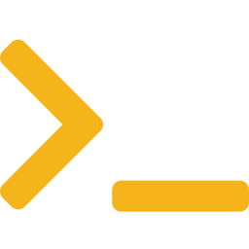
SLIDE 02 · V1 ARCHITECTURE
The V1 Stack: Three Components, One Boundary
Reuse what works (OptScale), add the smallest thin layer possible, expose via CLI
L1
AWS Billing
Azure Cost Mgmt
GCP Billing
DATA SOURCES
L2
OPTSCALE (open source — already does the heavy lifting)
OPTSCALE
Data collection
Anomaly detection
Recommendations
Web dashboard
L3
BRIDGE SERVICE (the only new thing you build — ~500 lines of Python)
BRIDGE
Parse CLI args
Fetch from OptScale
Build Gauss prompt
Format output
L4
GAUSS (internal LLM — runs inside Samsung network)
GAUSS
Receives [SYSTEM + CONTEXT + USER] prompt → returns plain-English reasoning. No data leaves the corporate network.
L5
$ ccops <command>
USER
Engineer in terminal

Slide 3





SLIDE 03 · CLI vs CHATBOT
Why CLI Wins for V1
A chatbot is a great V2 — but the CLI ships in weeks, not months
CLI · $ ccops
CHATBOT · Slack / Teams
Days to ship
Slack/Teams app build
No frontend, no OAuth, no public webhook to secure
OAuth setup, app manifest, distribution, scopes review
Engineer-native
Public-facing webhook
Devs already live in the terminal — zero learning curve
Even with HMAC, that's an externally reachable endpoint
Scriptable
UI / UX design
Pipe into other tools, run in CI/CD, schedule via cron
Conversation state, message threading, error formatting
Trivially secure
User session management
No public endpoint. Access via SSH/VPN to a jump host
Map Slack user → corp identity → cost-center permissions
Auditable
Security review
Shell history + structured logs = full provenance
Every public endpoint triggers an InfoSec ticket
Works offline-ish
Months, not weeks
Runs anywhere your terminal does — no UI server needed
Total scope is 3-5× the CLI for the same conversational value
VERDICT · Ship the CLI first. It delivers 90% of the value at 20% of the build cost — and the Bridge code you write is fully reusable when you add a chatbot in V2.

Slide 4
SLIDE 04 · EXAMPLES
CLI in Action: Four Real Commands
What an engineer actually types — and what they see
Investigate cost spikes
Get plain-English cost breakdown
$ ccops anomaly --last-week
$ ccops cost --service eks --explain
→ EKS cluster +23% WoW (root: node-group-prod-3)
→ S3 us-east-1 +11% (root: log retention)
EKS spend this month: $24,180
Top driver: prod-cluster (62%)
Trending up — check HPA settings.
Triage the most impactful actions
Pipe into existing tools
$ ccops recommend --top 3
$ ccops report --monthly | mail -s 'May FinOps' boss@
1. Rightsize 8 EC2 dev → save $1,840/mo
2. Delete 14 idle EBS → $420/mo
3. Buy SP for stable RDS
Generating May summary... done.
Spend $184,302 (-3.2% MoM)
Sent to boss@
Pattern · Every command follows ccops <verb> [--filters] [--explain] · Reasoning comes from Gauss, data from OptScale.

Slide 5

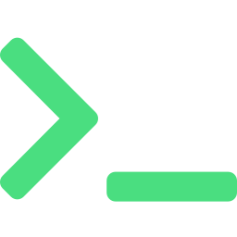
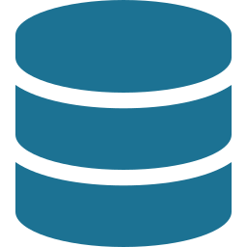


SLIDE 05 · SECURITY
How Your Data Stays Private
Everything inside one trust boundary — and concrete controls at every hop
CORPORATE NETWORK · PRIVATE VPC
CLI
Bridge
OptScale
Gauss API
On engineer's laptop
(via VPN/SSH)
Private subnet
no public IP
Private subnet
encrypted volumes
Internal endpoint
data never leaves
Cloud APIs
AWS / Azure / GCP
(TLS, read-only)
No public endpoints
TLS everywhere
RBAC + SSO
Prompt sanitization
Full audit log
The only data leaving your network is the TLS-encrypted cloud API call OptScale already makes today.

Slide 6
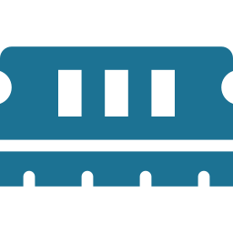


SLIDE 06 · ROADMAP
V2 & Beyond: Where This Goes Next
Ship V1, prove value, then layer these in — each builds on the V1 Bridge code
V1.5
Vector Memory
V2
Slack / Teams Bot
1–2 months after V1
2–3 months after V1
Add ChromaDB to remember past queries, decisions, and your environment's patterns. The bot stops being amnesiac.
Wrap the same Bridge service in a chat interface so non-CLI users (finance, leadership) can ask too. Same code, new front door.
Context across sessions
Reach finance & execs
Faster on repeat questions
Mobile-friendly
Learns your environment
Reuses Bridge entirely
V2.5
Multi-Source Data
V3
Auto-Remediation
3–4 months after V1
6+ months after V1
Layer in Kubecost for pod-level K8s costs and Steampipe for live SQL across clouds. Gauss picks the right source per question.
Close the loop — let the agent apply Cloud Custodian policies, trigger K8s VPA adjustments, and right-size automatically with guardrails.
Pod-level granularity
Insight → action
Real-time queries
Continuous optimization
Cross-cloud joins
Hands-off savings
PHILOSOPHY · V1 is small enough to ship. Every later phase reuses the Bridge service — no rewrites, only additions.

