Slide 1
AI-Powered DevSecOps Pipeline
Next-Gen Secure SDLC · Intelligent Security · Developer-First
Detect every vulnerability → Correlate with AI → Fix fast
Semgrep · SAST
TruffleHog · Secrets
Bearer · API
Trivy · SCA
FossID · License
Gauss AI · Correlate
90→5
94%
6x
Zero
Alerts to insights
Noise removed
Faster triage
Breaches missed

Slide 2
⚠ The Problem With Traditional DevSecOps
Why existing pipelines create security theater, not security
Tool Sprawl
Industry Reality
15-20 disconnected tools — no unified view or correlation
75%
of security alerts
are false positives
Alert Fatigue
80%+ false positives — developers tune out all security alerts
60%
of developers ignore
security findings
No Prioritization
All findings treated equal — critical issues buried in noise
$4.45M
average cost of
a data breach (IBM)
Bottleneck
Security reviews block releases instead of enabling fast delivery
287
days avg to detect
+ contain a breach
No AI Layer
Zero intelligence to connect dots across tools — each silo is blind
Security exists — but is NOT effective

Slide 3
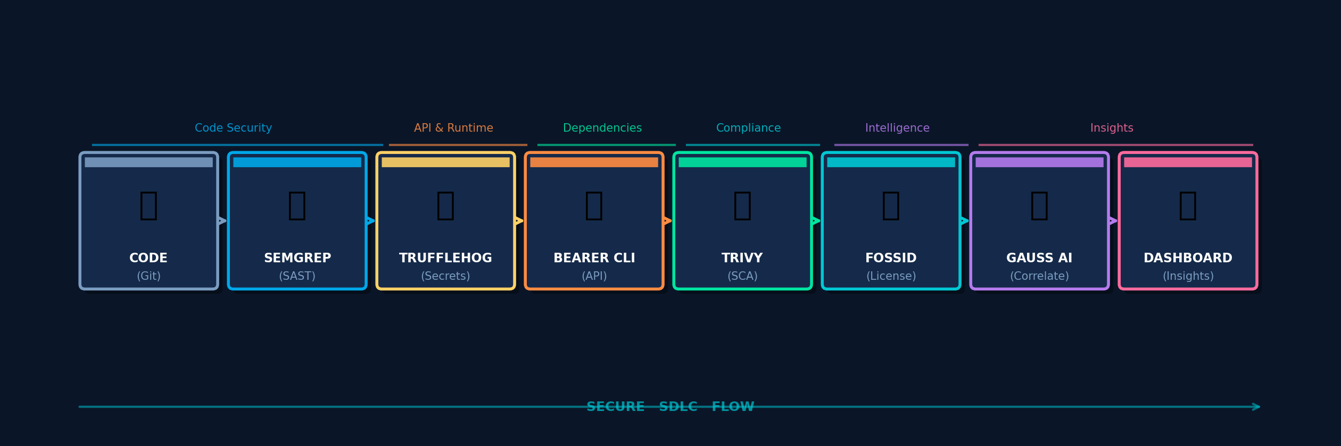
⚙ Proposed Pipeline Architecture
Full-spectrum AI-powered secure SDLC — code to deployment
SAST + Secrets
API + Runtime
Dependencies
Compliance
AI Intelligence
Source code analysis
& credential scanning
Endpoint security
& data exposure checks
SCA, CVE scanning
& container images
OSS license risk
& SBOM generation
Cross-tool correlation
& root cause + fixes

Slide 4
🛠 The Tool Arsenal — What Each Catches
Five specialized scanners covering every attack vector
SEMGREP
TRUFFLEHOG
BEARER CLI
Attack Vector Coverage
Static code analysis
Git history scanning
API security analysis
Attack Type
·
Sg
·
Th
·
Br
·
Tv
·
Fd
SQL Injection (CWE-89)
AWS / GCP / Azure keys
Unauthenticated endpoints
Hardcoded credentials
OAuth tokens & PATs
PII data exposure
Code Injection
✓
·
·
·
·
Broken authentication
Database URIs
Missing rate limiting
Secret Leakage
·
✓
·
·
·
Business logic flaws
SMTP credentials
Broken object auth (IDOR)
API Exploits
·
·
✓
·
·
Detects vulns at commit time — before code merges
Scans entire Git history — catches keys from months ago
APIs are #1 attack surface — Bearer covers it fully
Dep CVEs
·
·
·
✓
·
TRIVY
FOSSID
License Risk
·
·
·
·
✓
Dependency + container CVEs
Open-source compliance
Container Vulns
·
·
·
✓
·
npm / pip / maven vulns
GPL copyleft violations
Docker base image CVEs
AGPL network clauses
Data Exposure
·
·
✓
·
·
OS package exploits
License conflicts
IaC misconfigurations
SBOM generation
Catches Log4Shell, Spring4Shell and 100K+ CVEs
Prevents legal risk from OSS usage in proprietary code

Slide 5
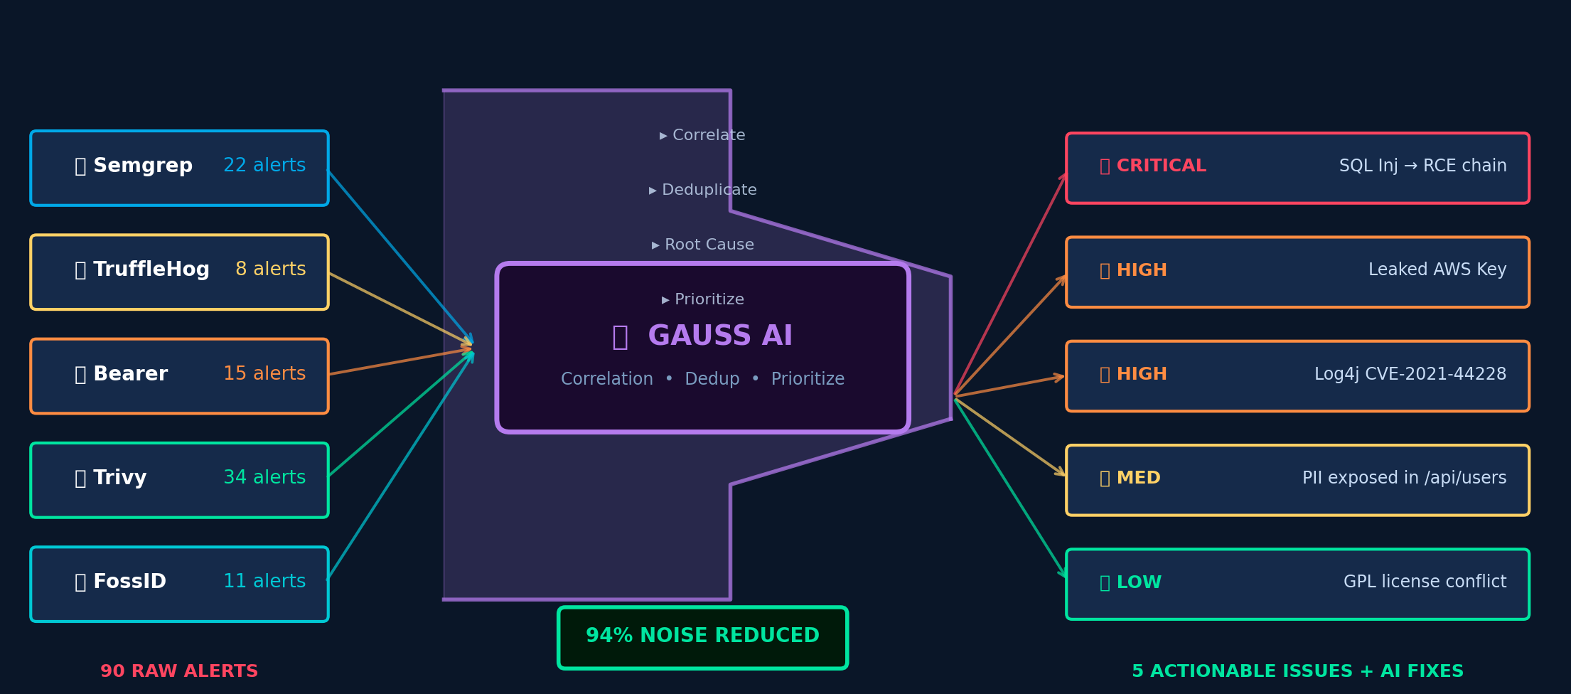
🤖 Gauss AI — The Intelligence Layer
Transforms raw scanner noise into precision security intelligence
Correlation:
Chains related findings across all tools
Deduplication:
Removes 94% duplicate/false positive alerts
Root Cause:
Identifies the single fix that resolves a chain
Auto-Fix:
Generates code-level fix suggestions instantly

Slide 6
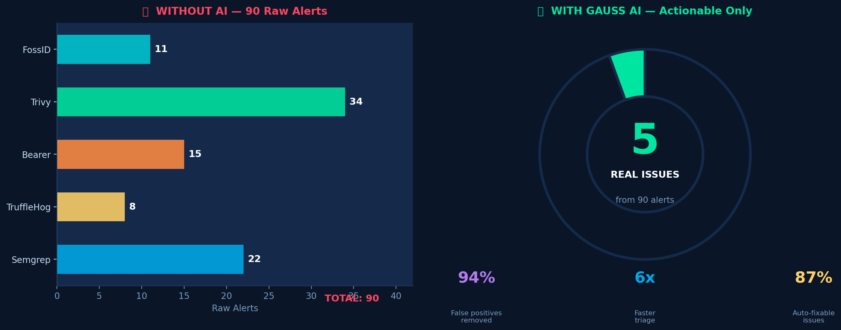
📊 Real-World Impact & Business Value
Measurable outcomes — developer productivity + breach prevention
Traditional vs Your Pipeline
Alerts
✗ 90+ raw
✓ 5 real issues
Fix time
✗ 3-5 days
✓ < 1 hour
Dev UX
✗ Overwhelming
✓ Actionable
Visibility
✗ Per-tool silos
✓ Unified dash
Posture
✗ Reactive
✓ Proactive
60%
40%
70%
100%
Zero
Security cost
reduction
Faster release
cycles
Dev triage
time saved
Compliance
audit-ready
Breaches from
known vulns

Slide 7
Your Pipeline = DevSecOps + AI + Intelligence Layer
Not just scanning — but Understanding + Fixing security at scale
🔍
🧠
⚡
🔧
📈
→
→
→
→
Detect
Correlate
Prioritize
Fix
Improve
Every code, API,
dependency, secret
AI chains related
findings across tools
Focus only on real,
exploitable issues
AI-generated code-
level fix suggestions
Pipeline learns &
gets smarter over time
Roadmap
Now
6 Months
12 Months
2026+
SAST · Secrets · API · SCA · License · AI Dashboard
IDE plugin · Slack/Jira alerts · Real-time feedback
Auto-remediation PRs · Predictive vuln detection
Self-healing pipelines · Zero-touch security
AI-Powered DevSecOps Pipeline · Secure · Intelligent · Developer-First

