Slide 1
Probability

Slide 2
Concept

Slide 3
Concept

Slide 4
Concept

Slide 5
Concept

Slide 6
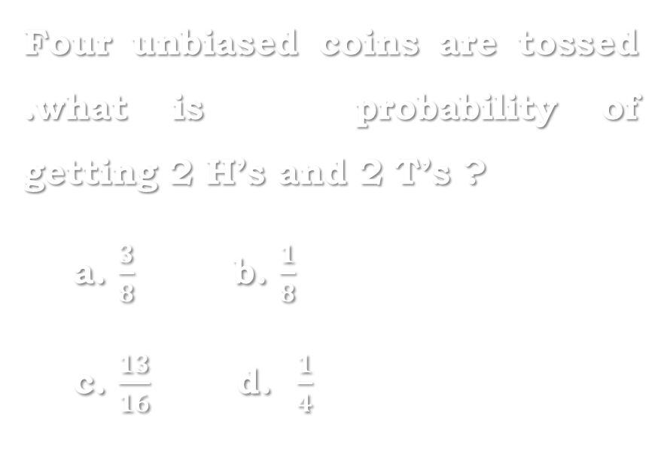
Question
Solution
Four unbiased coins are tossed .what is the probability of getting 2 H’s and 2 T’s ?
a. $\frac{3}{8}$ b. $\frac{1}{8}$
c. $\frac{13}{16}$ d. $\frac{1}{4}$

Slide 7

Question
Solution
Five unbiased coins are tossed. What is the probability of getting 3 H’s and 2T’s
a. $\frac{5}{16}$ b. $\frac{11}{16}$
c. $\frac{5}{32}$ d. $\frac{3}{16}$

Slide 8

Question
Solution
Three fair coins are tossed simultaneously. What is the probability of getting at least 2 heads?
a.$\frac{1}{4}$ b. $\frac{3}{8}$
c. $\frac{1}{2}$ d. $\frac{5}{8}$

Slide 9
Question
Solution
five coins are tossed once. What is the probability of getting at most four heads
a.31/32 b.15/16
c.29/32 d.7/8

Slide 10
Question
Solution
four coins are tossed simultaneously .what is the probability of getting exactly two heads
a. ½ b. ¼ c.1/8 d. 3/8

Slide 11
Question
Solution
An unbiased die is thrown. What is the probability of getting
i. Number 5
ii. Prime number
iii. Multiple of 3

Slide 12
Question
Solution
An unbiased die is thrown. What is the probability of getting
iv. Numbers greater than 4
v. Square value
vi. Cube value

Slide 13
Question
Solution
Two dices are thrown simultaneously. What is the probability of getting
i. Sum or total as 7
ii. Sum as prime number

Slide 14
Question
Solution
Two dices are thrown simultaneously. What is the probability of getting
iii. Sum as multiples of 4
iv. Sum as greater than 8
v. Sum as square value

Slide 15

Question
Solution
A dice is thrown twice. What is the probability that at least one of them comes up with number 4 ?
a. $\frac{11}{25}$ b. $\frac{11}{36}$
c. $\frac{11}{63}$ d. $\frac{1}{3}$

Slide 16

Question
Solution
Two dice are thrown simultaneously. What is the probability of getting 2 numbers whose product is even ?
a. $\frac{5}{4}$ b. $\frac{1}{2}$
c. $\frac{1}{3}$ d. $\frac{3}{4}$

Slide 17

Question
Solution
Two dice, one blue and one orange, are rolled simultaneously. Find the probability of getting equal numbers on both
a.$\frac{5}{6}$ b. $\frac{1}{6}$
c. $\frac{1}{3}$ d. $\frac{1}{2}$

Slide 18

Question
Solution
Two dice, one blue and one orange, are rolled simultaneously. Find the probability of getting Prime numbers on both
a. $\frac{5}{6}$ b. $\frac{1}{6}$ c. $\frac{1}{3}$ d. $\frac{1}{4}$

Slide 19

Question:
Solution
A card is drawn from pack of 52 cards. The probability of getting
diamond’s king
a. $\frac{1}{6}$ b. $\frac{1}{2}$ c. $\frac{1}{52}$ d. $\frac{4}{13}$

Slide 20

Question
Solution
A card is drawn from pack of 52 cards. The probability of getting
A queen of club or a king of heart
a.$\frac{1}{12}$ b. $\frac{1}{14}$
c. $\frac{1}{26}$ d. $\frac{1}{52}$

Slide 21

Question
Solution
A card is drawn from pack of 52 cards. The probability of getting
Face card
a. $\frac{3}{13}$ b. $\frac{6}{13}$ c. $\frac{8}{13}$ d. $\frac{5}{6}$

Slide 22

Question
Solution
A card is drawn from pack of 52 cards. The probability of getting
Either heart’s card or kings
a. $\frac{3}{13}$ b. $\frac{6}{13}$ c. $\frac{8}{13}$ d. $\frac{4}{13}$

Slide 23

Question
Solution
A card is drawn from pack of 52 cards. The probability of getting
a card having prime number
a. $\frac{3}{13}$ b. $\frac{6}{13}$ c. $\frac{8}{13}$ d. $\frac{4}{13}$

Slide 24

Question
Solution
Anil placed a deck of 52 cards. If you pick 2 cards what is the probability that Both are Aces
a. $\frac{3}{221}$ b. $\frac{4}{221}$
c. $\frac{2}{221}$ d. $\frac{1}{221}$

Slide 25

Question
Solution
Anil placed a deck of 52 cards. If you pick 2 cards what is the probability that Both are kings (without replacement)
a. $\frac{3}{221}$ b. $\frac{4}{221}$
c. $\frac{2}{221}$ d. $\frac{1}{221}$

Slide 26
Question
Solution
A bag contains 8 white and 6 black balls. If we taken out two random balls from that bag , then find the probability that
They are of the same colour ?
a.22/91 b. 28/91
c. 34/91 d. 43/91

Slide 27
Question
Solution
A bag contains 8 white and 6 black balls. If we taken out two random balls from that bag , then find the probability that
They are not of same colour ?
a.22/91 b. 48/91
c. 34/91 d. 43/91

Slide 28
Question
Solution
A bag contain 4 red, 6 yellow and 5 green balls. If three balls are drawn randomly , then what is the probability that the balls drawn contain balls of different colours ? a. 19/91 b. 24/91
c.29/91 d. 32/91

Slide 29
Question
Solution
A bag contain 2 red, 6 yellow and 4 green balls . If 3 balls are drawn randomly, then what is the probability that the balls drawn contain no yellow ball ?
a. 1/11 b. 2/11
c. 3/11 d. 4/11

Slide 30
Question
Solution
Among group of 2500 people , 35% invest in municipal bonds. 18% invest in oil stocks and 7% invest in both municipal bonds and oil stocks. If one person is to be randomly selected from 2500 people, what is the probability that the person selected will be one who invests in municipal bonds but not in oil stocks ?
a. 9/50 b. 7/25 c. 7/20 d. 21/50

Slide 31
Question
Solution
From a bag containing a dozen bulbs, of which exactly one half are good , and four bulbs are chosen at random to fit into the four bulb holders in a room. The probability that the room gets lighted is :
a. 2/3 b. 1/33
c. 32/33 d. 31/33

Slide 32
Question
Solution
Two letters are selected randomly from English alphabet simultaneously . what is the probability that one is a consonant and the other a vowel ?
a.10/67 b. 21/65
c. 44/65 d. 2/13

Slide 33
Question
Solution
The letters of the SOCIETY are placed at row what is the probability that three vowels come together ?
a. 3/7 b. 2/7
c. 1/7 d. none

Slide 34
Question
Solution
In a class of 25 students with roll numbers 1 to 25 , student is picked up at random to answer a question. Find the probability that the roll number of the selected student is either multiple of 5 or 7 ?
a. 6/25 b. 4/25
c. 8/25 d. 7/25

Slide 35
Question
Solution
An integer is chosen at random from first two hundred natural numbers . What is the probability that the integer chosen is divisible by 6 or 8 ?
a. ¼ b. ¾
c. ½ d. none

Slide 36
Question
Solution
The probability that a contractor will get a plumbing contract is 2/3rd and the probability that he will not get an electric contract is 5/9th . If the probability of getting at least one contract is 4/5th . What is the probability that he will get both ?
a. 8/45 b. 31/45
c. 14/45 d. none

Slide 37
Question
Solution
In the west Indies, there is a 3-match One Day International tournament between West Indies and India. At the end of every match , either a team wins or loses. There is no draw. Find the probability that India wins the series by winning at least 2 consecutive matches ?
1 b. 5/8
c. 3/8 d. 1/2

Slide 38
Question
Solution
There are 3 boxes A, B and C. A contains 4 red balls and 3 black balls. B contains 5 red balls and 4 black balls. C contains 4 red balls and 4 black balls. One ball is drawn from each of these boxes. What is the probability that the 3 balls drawn consist of 2 red balls and a black ball ?
a. 17/42 b. 25/42
c. 19/42 d. 23/42

Slide 39
Question
Solution
An anti aircraft gun can take a maximum of four shots at an enemy plane moving away from it. The probability of hitting the plane at the first, second ,third and fourth shots are 0.40 , 0.30 , 0.20 and 0.1 respectively. What is the probability that the gun hits the plane ?
0.4379 b. 0.6872 c. 0.6976 d. none

Slide 40
Question
Solution
A subscriber was dialling a telephone number. When he forgot the last 3 digits and remembering that they were different, he dialled at random. What is the probability that he dialled the right number ?
3/10 b. 3/720
c. 1/720 d. cannot be determined

Slide 41
Question
Solution
Three of the men participating in a race are A, B and C. The probability of A wining the race is 1/6 , the probability for B wining the race is 2/5 and for C is 4/13 if dead heat among them is possible . What is the probability that only one of the three winning the race ?
a. 177/380 b. 59/130
c. 39/157 d. 134/390

Slide 42
Question
Solution
Two bucket contain black and white balls. The first has five black and three white and the second one has 4 white and 4 black balls. A ball is picked from the first bucket and put into the second bucket. Next a ball from the second bucket is picked and put into the first bucket. Find the probability of the event that after these actions the composition of first bucket has become that of the second one and the composition of second bucket has become that of first bucket ?
a. 12/19 b.5/18 c.4/9 d. 7/18

Slide 43
Question
Solution
A blind man lives in an apartment containing two rooms . Each day before going to work he enters any one room randomly , picks up a bag and leaves home. One of the rooms contains 3 blue, 4 green and 5 red bags and the other contains 2 blue , 1 green and 3 red bags. What is the probability that he takes a green bag to work ?
a. ½ b. ¼ c. 1/3 d. 1/6

Slide 44
Question
Solution
The probability of rain on any given day in Pune city is 50% then what is the probability that it rains on exactly 3 days in a 5 day period ?
a. 8/125 b. 5/16
c. 8/25 d. 2/25

Slide 45
Question
Solution
Ram speaks the truth 3 out of 4 times while shyam speaks the truth 3 out of 5 times . What is the probability that they contradict each other ?
a. 3/10 b. 9/20
c. 11/20 d. none

Slide 46
Question
Solution
If M and N are independent events such that P(M) = a, P(N) = 1.5a and P(Exactly one of M, N) = 1/2, then a = ______
A. 1/2 B. 1/8 C. ¼ D. 1/9

Slide 47
Question
Solution
What is the probability that 53 Sundays in a
i. Non-leap year
a. 2/7 b. 6/7 c. 1/7 d. none
ii. Leap year
a. 2/7 b. 6/7 c. 1/7 d. none

Slide 48
Question
Solution
A wood casketed box contains 7 white and 10 ivory colored game coins. What is the probability of drawing 2 ivory colored game coins in succession when the coin that is drawn first is not replaced?
45/136 B. 9/16
C. 12/141 D. 10/17

Slide 49
Question
Solution
In the game of shooting, the probability that a bullet will miss the target is 1/7. Three such bullets are released from a gun simultaneously towards the target. What is the probability that the target will be hit?
1/343 B. 342/343
C. 216/343 D. 127/343

Slide 50
Question
Solution
The probability that Nandan will come first in the Math's’ Olympic tour is 1/5 and the probability that Herry will come first in the Math's’ Olympic is 3/4. What is the probability that only one of them will come first in Math's’ Olympic tour?
A. 7/20 B. 2/5 C. 1/5 D. 13/20

Slide 51
Question
Solution
A bag contains 5 brown wrapped, 4 yellow wrapped and 7 mustard wrapped chocolates. Three chocolates are drawn randomly simultaneously. What is the probability that the chocolates are wrapped in different colour?
A. 1/6 B. 1/4 C. 5/16 D. 1/3

Slide 52
Question
Solution
Three trucks P, Q and R moved from Delhi to Mumbai. If the ratio of their arriving safely are 4:5, 7:11 and 9:13 respectively, then the probability of all the trucks arriving safely is:
7/99 B. 6/101
C. 92/99 D. 84/97

Slide 53
THANK YOU ALL!
All the best…

