Slide 1
Directions
LOGICAL REASONING

Slide 2
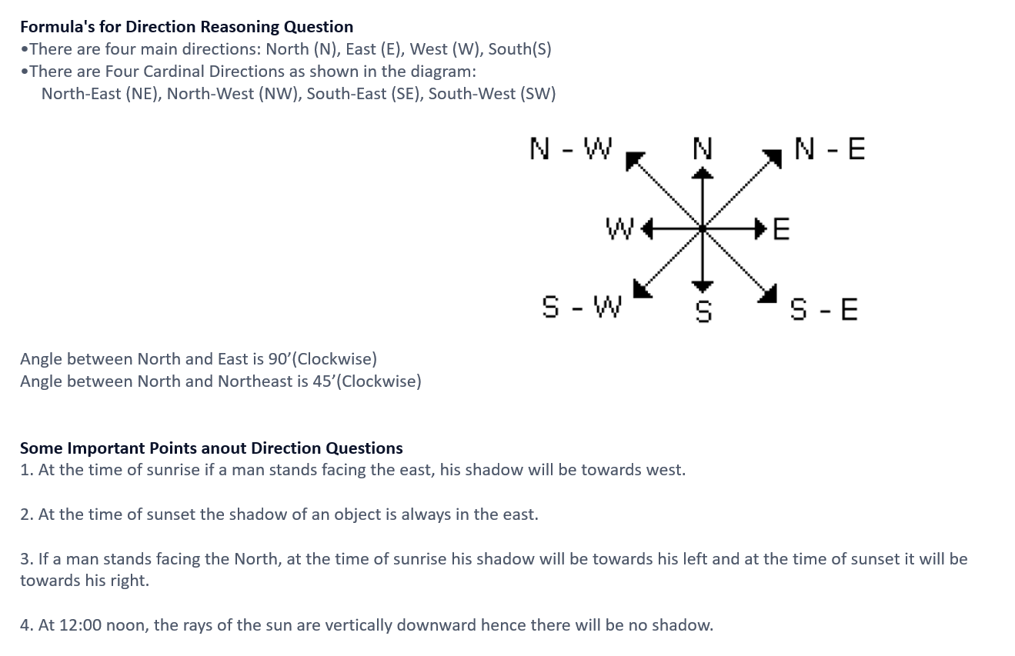

Slide 3
1. A starts walking towards north, turns left, again turns left, turns right, again turns left, and turns right. In which direction is A walking now?
A) East B) South C) West D) South-East

Slide 4
2. Lucy went 15 km to the west from his house, then turned left and walked 20 km. He again turned left and Walked 25 km and finally turned left and covered 20 km, how far is he from his house?
A) 15 km B) 20 km C) 25 km D) 10 km

Slide 5
3. Ramesh drives his car 4 km to East, then takes left turn and drives 6 km. he again turns to his left hand side travels 4 km. how many km is Ramesh away from his standing place?
A) 6 km B) 10 km C) 4 km D) 14 km

Slide 6
4. Tina drives 45 km towards East, turns right and drives 65 kms, then turns left and drives 33 kms. In which direction is she facing now?
A) East B) North C) West D) South

Slide 7
5. A man walked 9 km towards East and then 12 km towards South. How far is he from the starting point?
A) 8 km B) 6 km C) 15 km D) 20 km

Slide 8
6. Rina drives 6 km west from her home and turns left and drives 3 km and then turns left again and drives 10 km. What is the shortest distance between Rina’s home and office?
A) 9km B) 10 km C) 4 km D) 5 km

Slide 9
7. A person walks 9 km to the south. From there he walks 5 km to the north. After this he walks 3 km to the west. In which direction and how far is he now from the starting point?
A) 4 km south B) 4 km North
C) 5 km North-west D) 5 km south-west

Slide 10
8. Radha facing north. She decide to turn 90° in clockwise direction and then 180° in the anti clockwise direction. In which direction is she facing now?
A) North B) west C) East D) south

Slide 11
9. A man is facing towards East and turns 135° anticlockwise, again 45° anticlockwise then turns 90° clockwise. In which direction is he facing now?
A) North west B) South C) North D) Southwest

Slide 12
10. Two friends Ram and Shyam are standing under the clear sky in the morning. Ram’s shadow is falling exactly on shyam’s back. In which direction Shyam is facing?
A) North B) South C) East D) West

Slide 13
11. A and B are standing in a park and facing towards each other early in the morning. A’s shadow is on his right hand side. B is facing in which direction?
A) North B) South C) East D) West

Slide 14
12. P started from his house towards west. After walking a distance of 25 m. He turned to the right and walked 10 m. He then again turned to the right and walked 15 m. After this he is to turn right at 135o and to cover 30 m. In which direction should he go?
West
South
South east
South west

Slide 15
13. Point A is 20m north of point B. Point E is 15m south of point F and 15m east of point D. Point B is 10m north of point D. Point C is 10m west of point B. Point F is 20m west of point G.
Point C is in which direction with respect to point E?
West
South
South east
North west

Slide 16
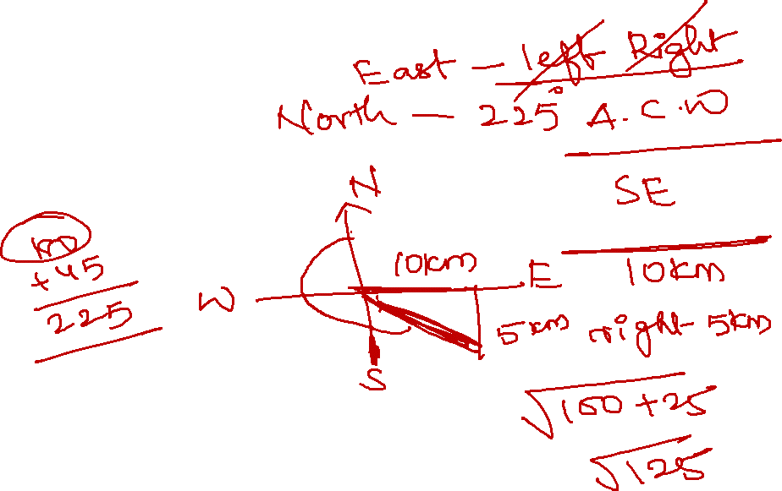
14. Point A is 20m north of point B. Point E is 15m south of point F and 15m east of point D. Point B is 10m north of point D. Point C is 10m west of point B. Point F is 20m west of point G.
What is the shortest distance between B and F?
7√13 m
12m
5√10 m
8 m

Slide 17
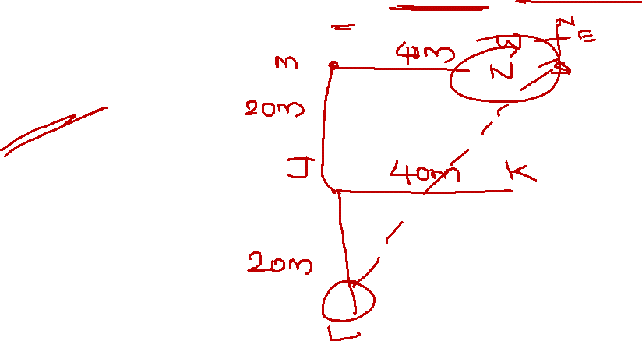
15. J is 40m to the west of K and 20m to the north of L. M is 20m to the north of J and 40m to the west of N .
What is the direction of N with respect to L?
South
North east
South west
North

Slide 18
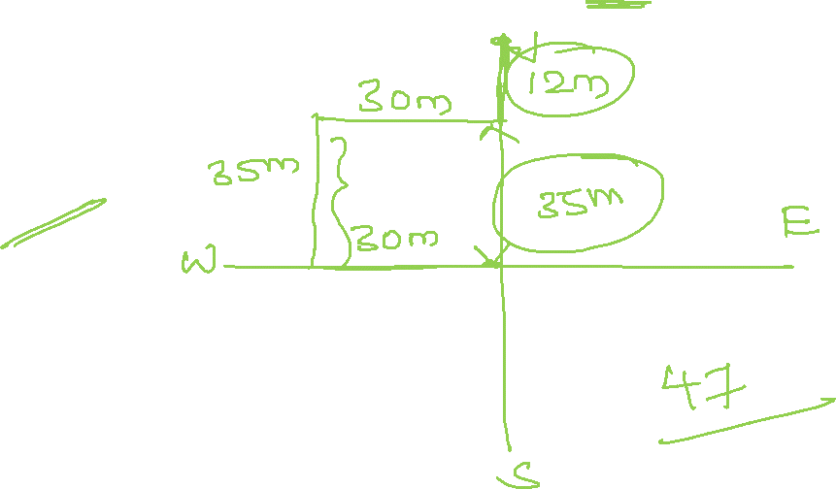
16. A person walks 30m towards west. He turns to his right and walks 35m. He again turns right and walks 30m. Further he moves 12m after turning to the left. How far is he from his original position?
42m
65m
18m
None

Slide 19
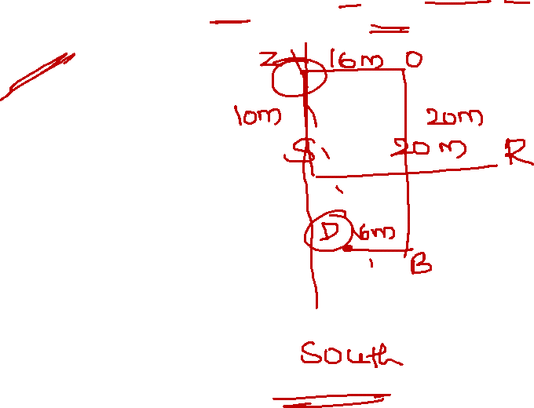
17. Point R is 20m east of point S. Point Z is 16m west of point O. point B is 20m south of point O. Point Z is 10m north of point S. point D is 6m west of point B.
Point D is in which direction of point Z?
South East
North west
South
South west

Slide 20
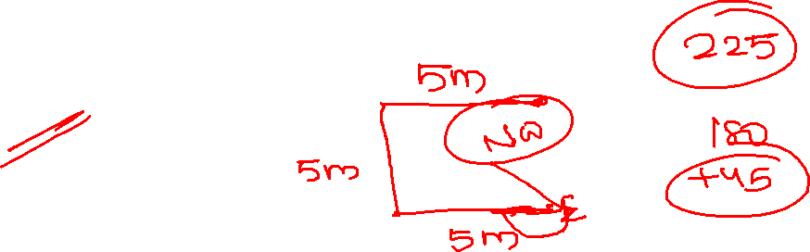
18. Amitha walks 5m towards west, then turns left and walks 5m. She again turns left and walks 5m. She takes a 225 degrees turn rightwards and starts walking straight. In which direction she walking now?
North –East
South east
South west
North west

Slide 21
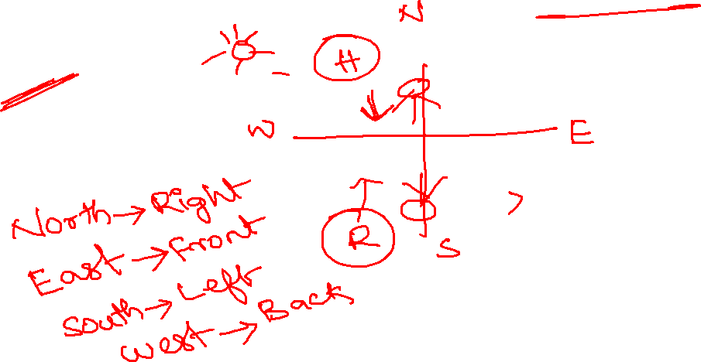
19. Ronald and Harry were discussing each other face to face In the evening before sunset. If Ronald’s shadow was exactly to his right side, which direction was harry facing?
North
South
East
west

Slide 22
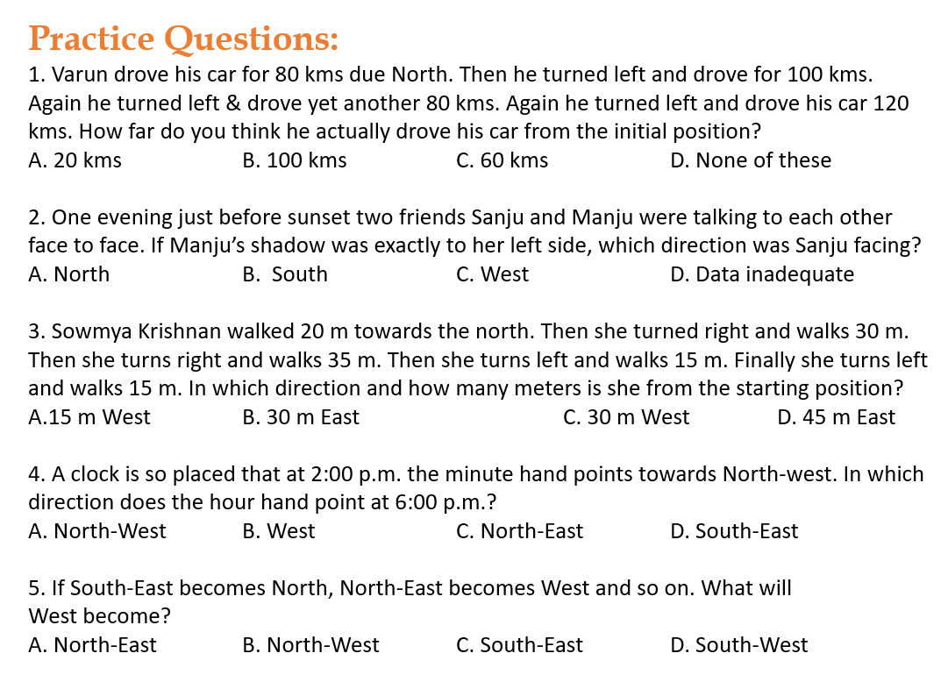
`

Slide 23


