Slide 1
Permutations & Combinations
Quantitative Aptitude

Slide 2
Key points:
Whenever we want to arrange n things at n places, we have total n! ways of arrangement.
Whenever we have to select r things out of n, we have total ^{n}C_{r} ways of selection.
Whenever we have to select r things from n and then arrange those r things at r places, we have total ^{n}P_{r} ways.
^{n}C_{r} = n! / [r! x (n-r)!]
^{n}C_{r} = nC_{(n-r)}
^{n}P_{r} = n!/(n-r)!

Slide 3
1. A room has 5 doors. In how many ways can a man enter the room through one door and come out through different door
15
20
25
30

Slide 4
2. In how many ways can the letters of the word RUDE be arranged
12
18
16
None

Slide 5
3. In how many ways can the letters of the word PATNA be arranged
120
60
180
None

Slide 6
4. In how many ways can the letters of the word CASUAL be arranged
120
60
180
360

Slide 7
5. How many ways different words can be made using letters of PATNA starting with P?
18
12
20
15

Slide 8
6. In a class there are 4 boys and 5 girls. In how many different ways a class monitor can be chosen?
18
9
12
None

Slide 9
7. In a class there are 4 boys and 5 girls. In how many different ways a boy and a girl can be selected for group leaders of two groups?
30
15
20
45

Slide 10
8. An urn contains 5 red and 3 blue balls. In how many different ways, 2 red and 1 blue balls can be drawn?
25
30
35
40
Notes:
5c2*3c1=30

Slide 11
9. There are 7 candidates for 4 different posts. In how many ways we can fill the posts?
720
840
360
None
Notes:
7c4=35 and arranging 4!=24 35*24=840
Or
7p4-840

Slide 12
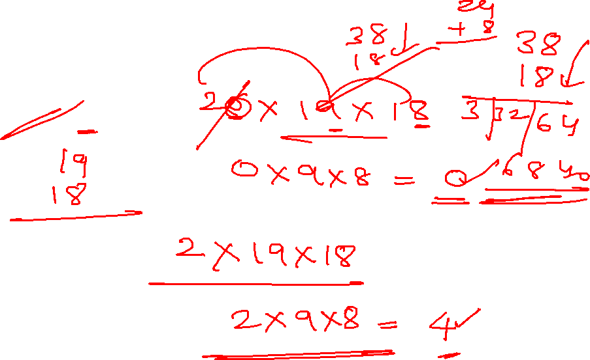
10. Twenty students are participating in a race. In how many ways can the first three prizes be won?
2460
3420
5290
6840
Notes:
20p3- 6840

Slide 13
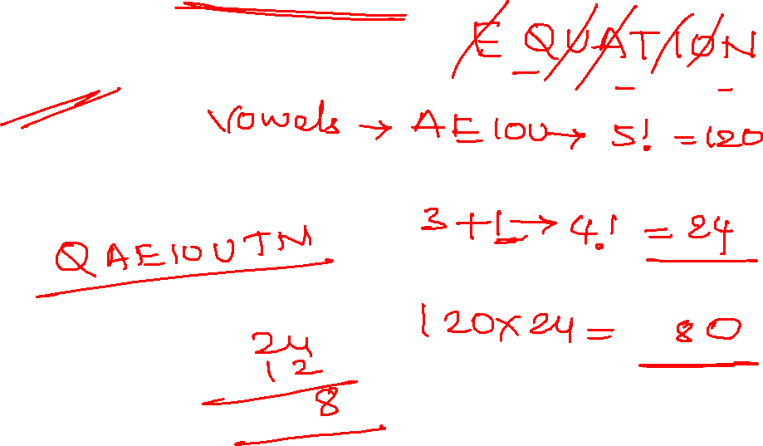
11. In how many ways can the letters of the word EQUATION be arranged so that all the vowels come together?
2000
2560
2880
3460
Notes:
5 vowels now vowels consider as 1 unit
3 constants
3+1=4!= 24
5!*4!=2880

Slide 14
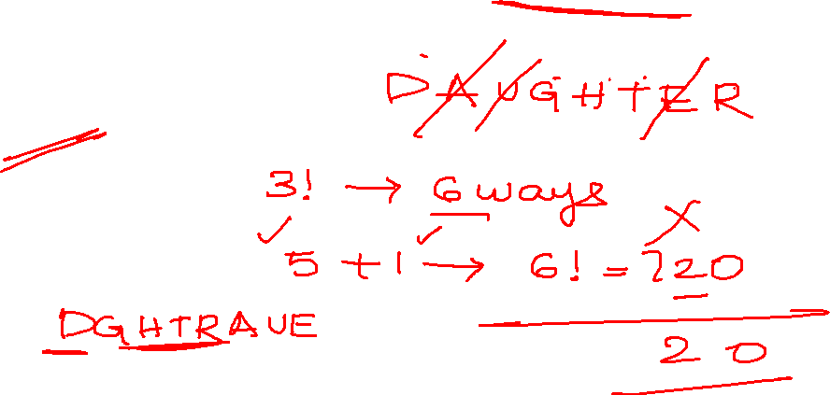
12. In how many ways can the letters of the word DAUGHTER be arranged so that all the vowels come together?
5640
5460
4320
3460
Notes:
C

Slide 15
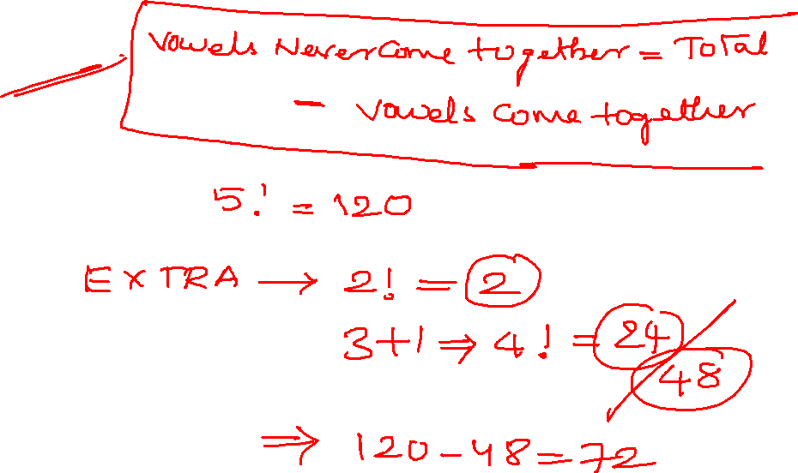
13. In how many ways can the letters of the word EXTRA be arranged so that all the vowels never come together?
84
72
86
56
Notes:
Vowles never come together= total- come together
120-48=72

Slide 16
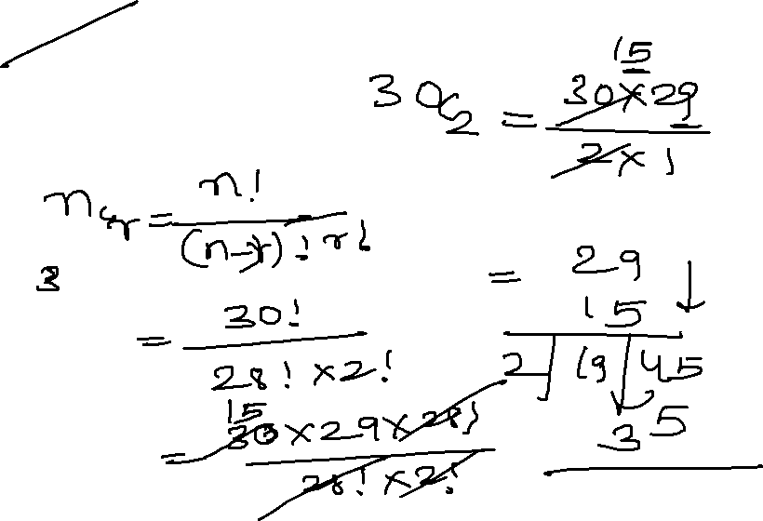
14. There are 30 students in a class how many shake hands are possible
435
450
425
480
Notes:
30c2=435

Slide 17
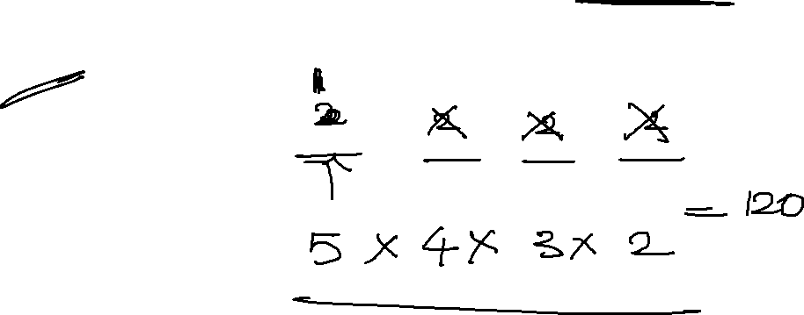
15. How many number of 4 digit can be formed with the digits 1, 2, 3 , 4, 5? ( if repetition of digit is not allowed)
60
120
180
None
Notes:
5!=120

Slide 18
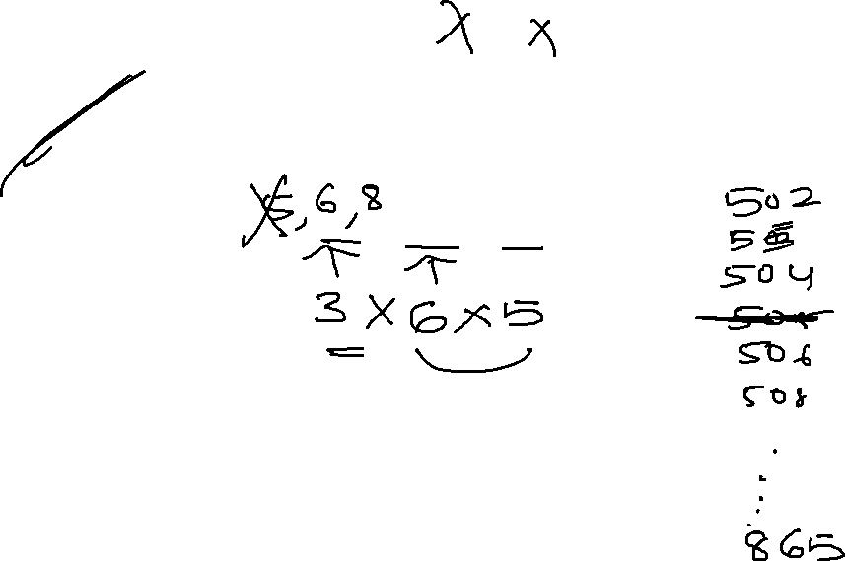
16. With out repetition using digits 2, 3, 4, 5, 6, 8, 0 how many numbers can be made which lies between 500 and 1000
90
180
120
150
Notes:
3*6*5= 90

Slide 19
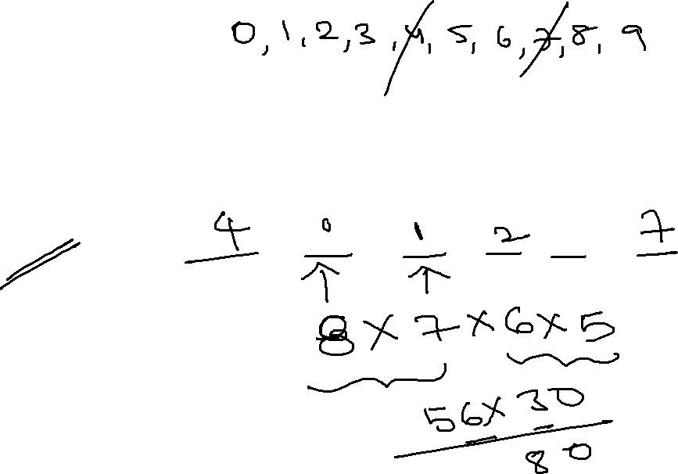
17. A bank has 6 digit number with no repetition of digits with in account number. The first and last digit of the numbers is fixed to be 4 and 7. how many such numbers are possible
1220
1560
1480
1680

Slide 20
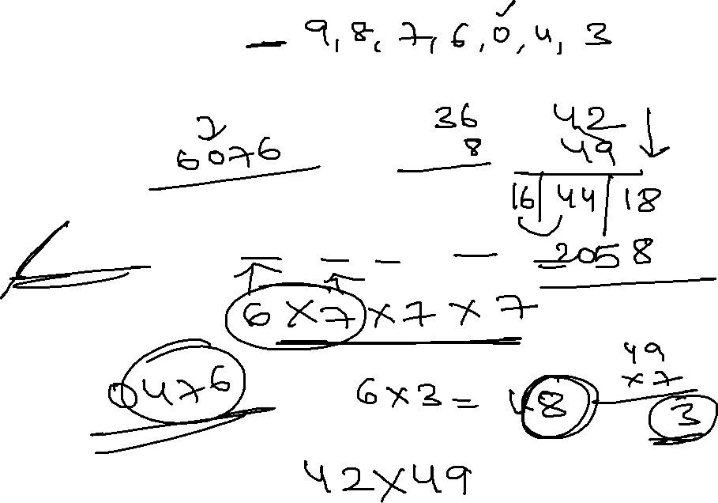
18. How many 4 digit numbers can be formed using the digits 9, 8, 7, 6, 0, 4, 3 such that repetition of digits is allowed
1026
2052
1027
2058
Notes:
6*7*7*7= 2058

Slide 21
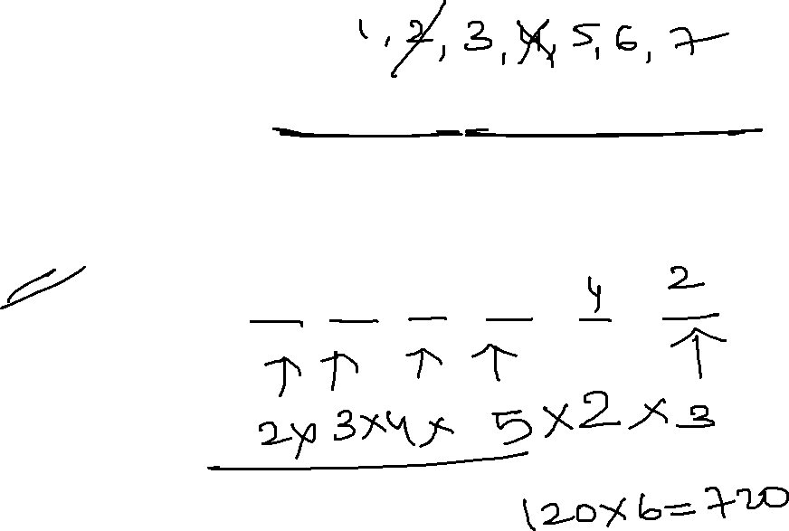
19. How many 6 digit even numbers can be formed from the digits 1, 2,3 ,4, 5, 6, 7 so that the digits should not repeat and second last digit is even?
2160
320
6480
720
Notes:
6*7*7*7= 2058

Slide 22
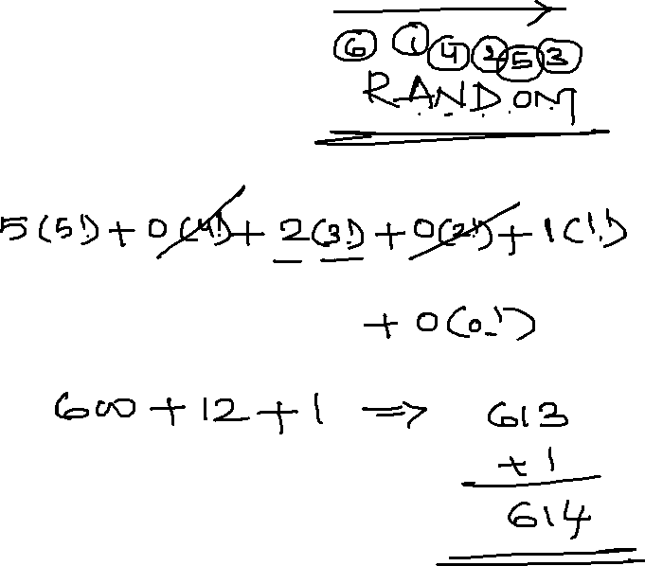
20. What is the rank of the word MOTHER?
309
310
305
none
Notes:
6*7*7*7= 2058

Slide 23
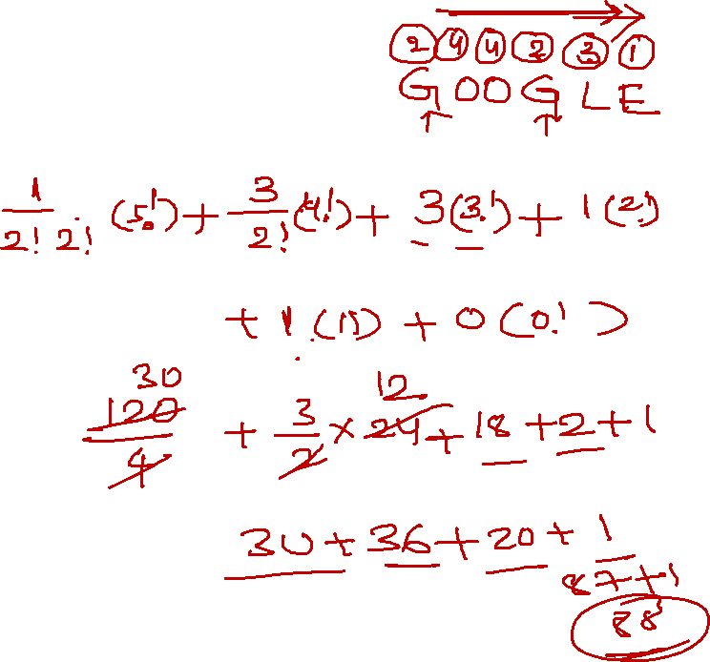
21. What is the rank of the word BANANA?
24
60
35
NONE
Notes:
C

Slide 24
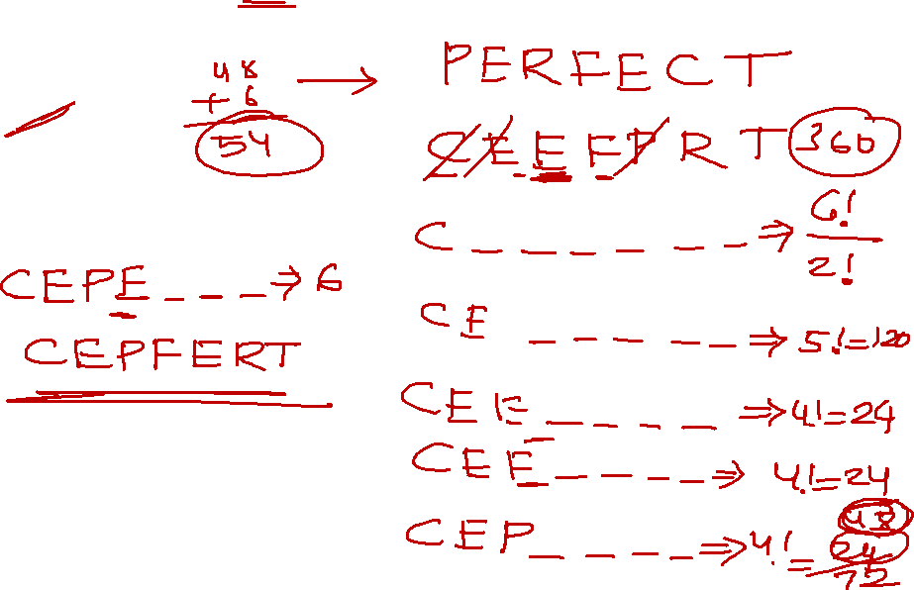
22. What will be the 55th word in the arrangement of the letters of the word PERFECT?
CEPFRET
CEPFERT
CEPERFT
CEPRFET
Notes:
Cee= 4!
CEF-4!
CEPF-3!
55TH WORD CEPFERT

Slide 25
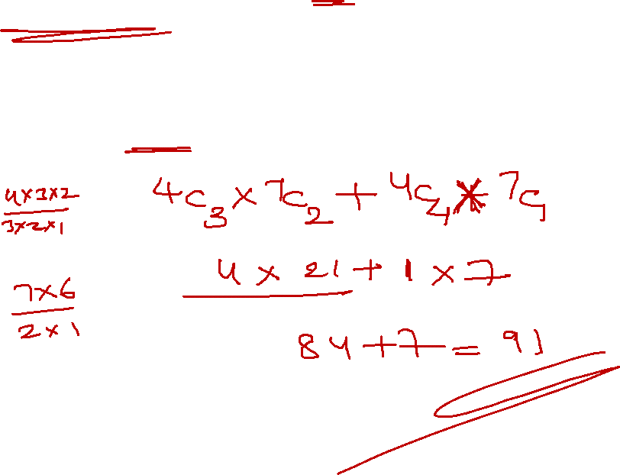
23. A group consists of 4 girls and 7 boys. In how many ways can a team of 5 members be selected if the team has
No girls
At least one boy and one girl
At least three girls
Notes:
4c0*7c5= 21
1 boy 4 girls- 7c1*4c4- 7
2 boys and 3 girls- 7c2*4c3-84
3 boys and 2 girls- 7c3*4c2- 210
4 boys and 1 girl- 7c4*4c1- 140
C. 4c3*7c2+4c4*7c1- 91

Slide 26
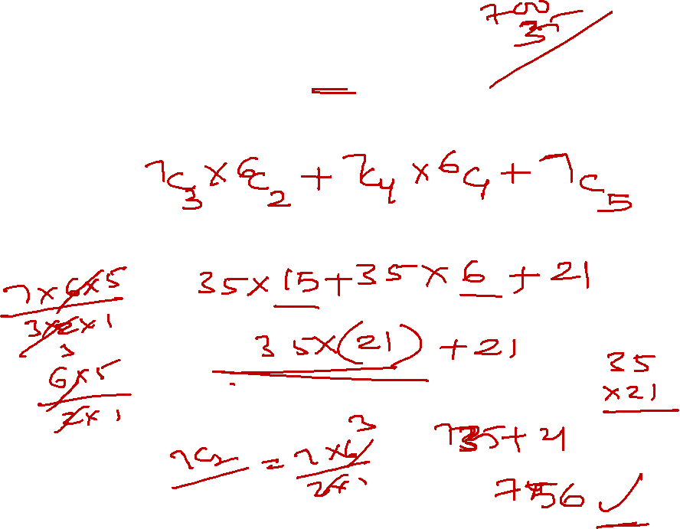
24. From a group of 7 men and 6 women, five persons are to be selected to form a committee so that at least 3 men are there on the committe. In how many ways can it be done?
564
645
735
756
Notes:
7c3*6c2 + 7c4*6c1 + 7c5
756

Slide 27
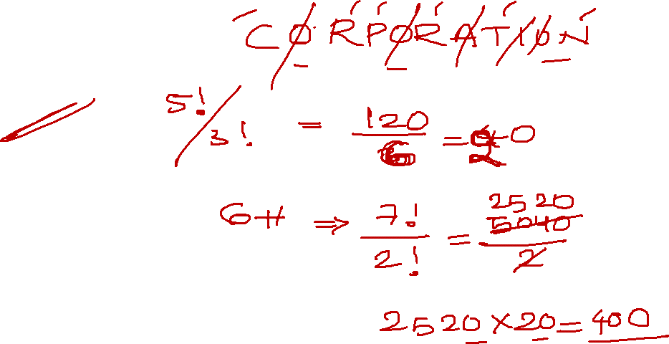
25. In how many different ways can the letters of the word CORPORATION be arranged so that vowels always come together?
810
1440
2880
50400
Notes:
5 vowels – 5!/3!-20
6 consonants + 1 unit vowels- 7!/2!- 2520
2520*20=50400

Slide 28
Practice Questions:
1. how many words ending and beginning with consonants can be formed by using letters of AMUETION.
A. 4542 B. 4320 C. 3240 D. 6540
2. how many words can be formed the letters of the word FATHER so that the vowels always come together?
A. 240 B. 720 C. 144 D. None
3. Number of 6 digit numbers that can be formed only using 0, 1, 2, 3, 4 and 5(each one) and divisible by 6?
A. 96 B. 120 C. 192 D. 312
4. how many numbers of 5 digits can be formed from the numbers 2, 0, 4, 3, 8 when repetition of digit is not allowed
A. 96 B. 120 C. 144 D. 14
5. what is the rank of the word SUCCESS
A. 331 B. 341 C. 351 D. 361

Slide 29


