Slide 1
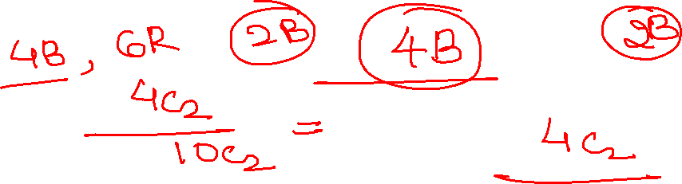
Probability
Quantitative Aptitude

Slide 2
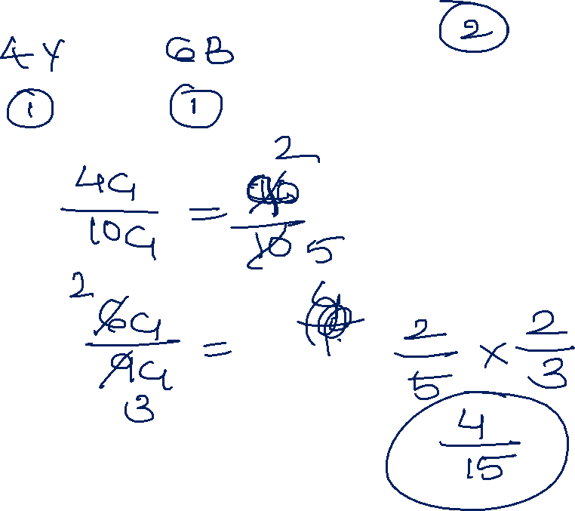

Slide 3
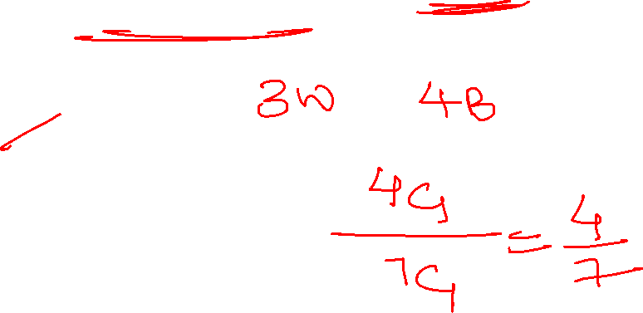
1. There are 3 white and 4 black balls is an urn. A ball is selected randomly. What is the probability to be black
¼
1/7
4/7
3/7
Notes:
4c1/7c1= 4/7

Slide 4
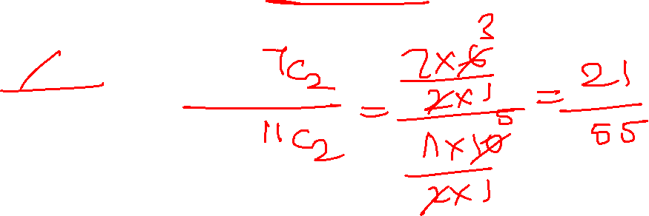
2. A bag contains 7 pen and 4 pencils, if 2 items are drawn at random then what will be the probability that both items are pen
28/55
21/55
4/55
7/55
Notes:
7c2/ 11c2= 7/55

Slide 5
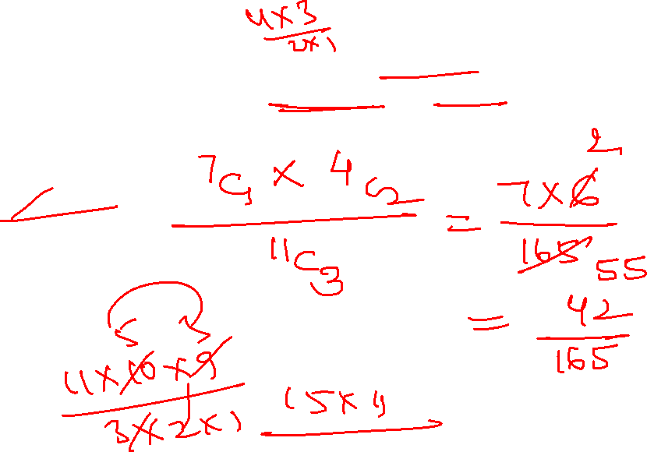
3. A bag contains 7 pink and 4 green pens. Three pens are drawn at random. Find the probability that 1 pen is pink and 2 pens are green
41/125
15/55
14/55
13/55
Notes:
7c1*4c2 / 11c3= 14/55

Slide 6
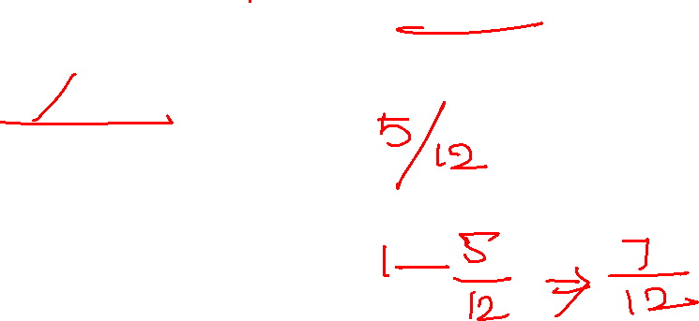
4. A box contains 3 white, 4 red and 5 black balls. If a ball is drawn at random, then find the probability that the ball drawn is not black
7/12
5/12
9/12
None
Notes:
Probabliy of picking black 5/12
Not picking black = 1-5/12= 7/12

Slide 7
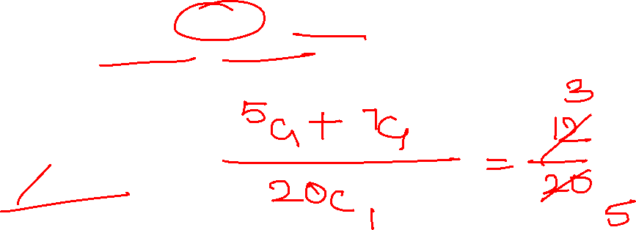
5. There are 8 blue, 5 yellow and 7 red balls. What is the probability of choosing either 1 yellow or red ball?
2/3
¾
4/5
3/5
Notes:
Or - +
7c1 + 5c1 / 20 c1= 3/5

Slide 8
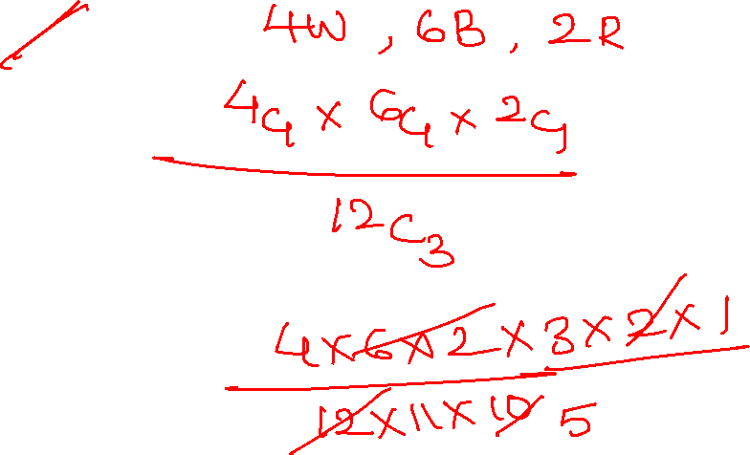
6. There are 4 white, 6 blue and 2 red balls in a buckets, 3 balls are taken out randomly. What is the probability that all three balls are of different colors
12/55
15/55
12/65
12/75
Notes:
4c1 * 6c1 * 2 c1 / 12 c3
12/ 55

Slide 9
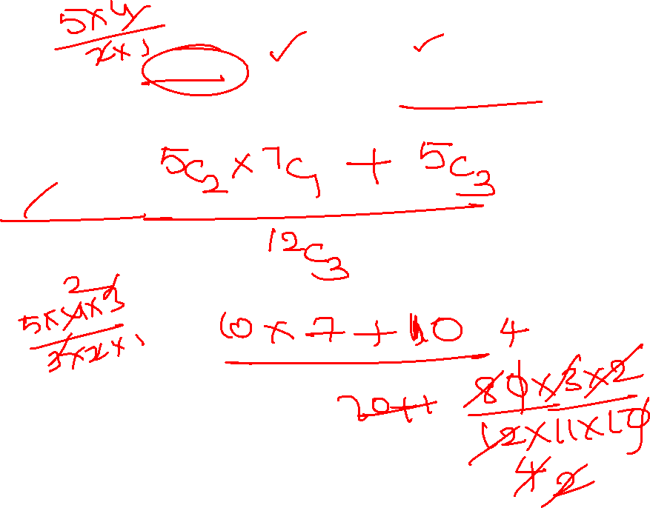
7. A bag contain 5 red balls, 4 green balls and 3 blue balls. Three balls are drawn at random, what is the probability that at least 2 are red
7/22
8/13
4/11
7/11
Notes:
( 5c2 * 7c1) + 5c3 / 12 c3= 4/11

Slide 10
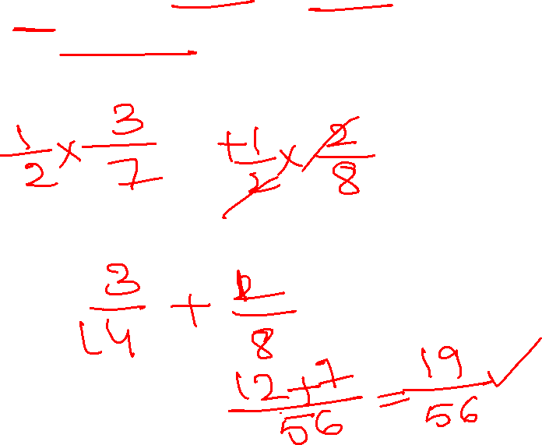
8. If wallet A has 4 gold coins and 3 silver coins and wallet B has 6 gold and 2 silver coins. A coin is taken out from any of the wallets then what will be probability that the coin will be silver
3/8
19/56
3/28
3/56
Notes:
½ * 3/7 + ½ * 2/8
19/56

Slide 11
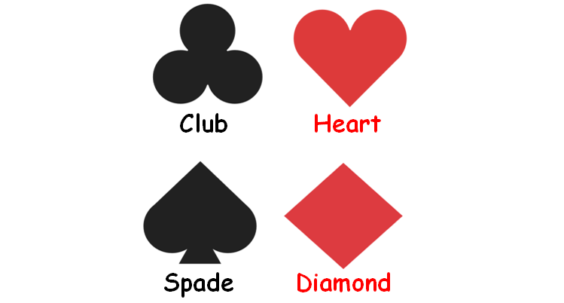
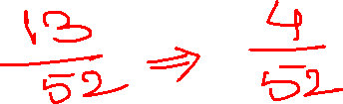
Problems on cards:
Notes:
½ * 3/7 + ½ * 2/8
19/56

Slide 12
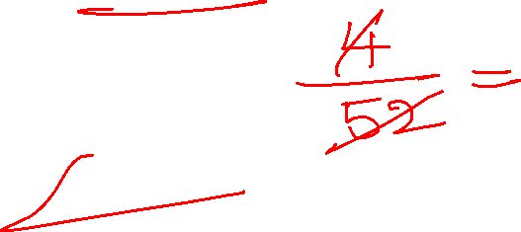
9. A card is drawn from a pack of 52 cards. What is the probability that the card drawn is a queen
5/13
1/52
4/13
1/13
Notes:
4c1/ 52c1= 1/13

Slide 13
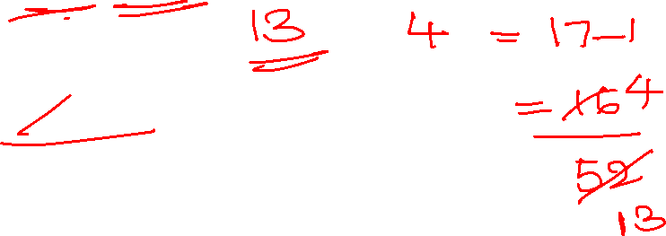
10. The probability that a card drawn at random from a pack of 52 cards is a queen or heart is
3/13
15/52
4/13
17/52
Notes:
Heart cards- 13 cards
Queen- 4
Total 17
17-1/52 = 16/52 = 4/13

Slide 14
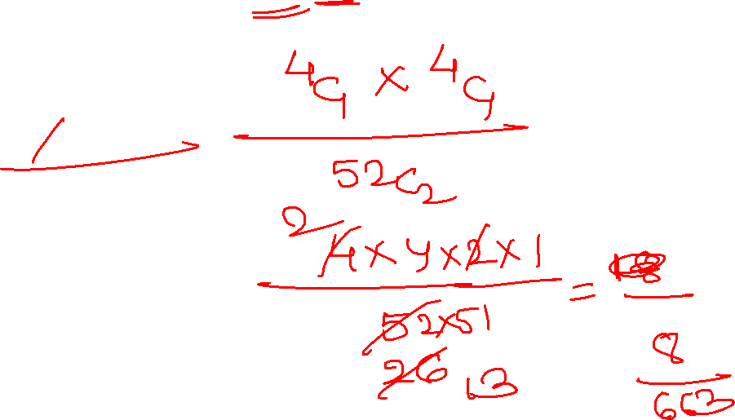
11. From a pack of 52 cards, 2 cards are drawn randomly. Find the probability that drawing a king and a queen take place
5/1326
7/1326
15/663
8/663
Notes:
4c1 * 4 c1 / 52 c2 = 8/663

Slide 15
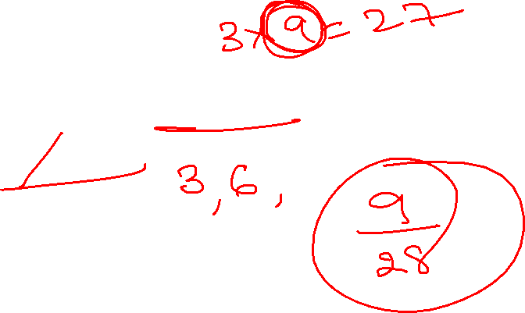
12. One movie ticket is drawn at random from a bag containing 28 tickets numbered 1 to 28. find the probability to obtain a ticket containing number which is multiple of 3
9/28
7/28
8/28
10/28
Notes:
9/28

Slide 16
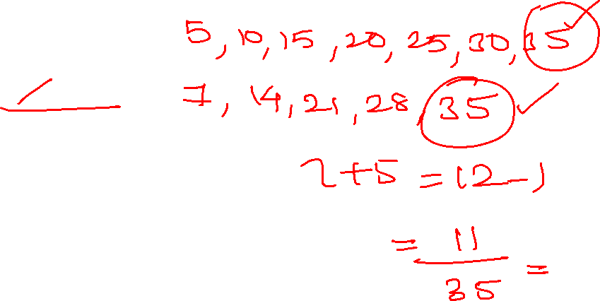
13. A number is selected at random from the first 35 natural numbers. What is the probability that it is either a multiple of 5 or a multiple of 7?
4/35
10/35
11/35
1/35
Notes:
5, 10, 15, 20, 25, 30, 35 | 7, 14, 21, 28, 35
7+5 – 1 = 11/35

Slide 17
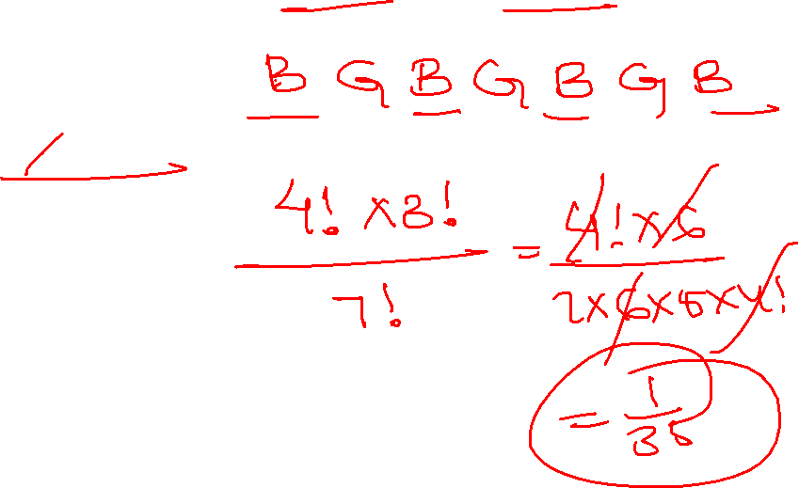
14. What is the probability that four boys and three girls stand in a line alternately
2/7
1/21
1/35
None
Notes:
B G B G B G B
4! * 3 !/ 7 ! = 1/35

Slide 18
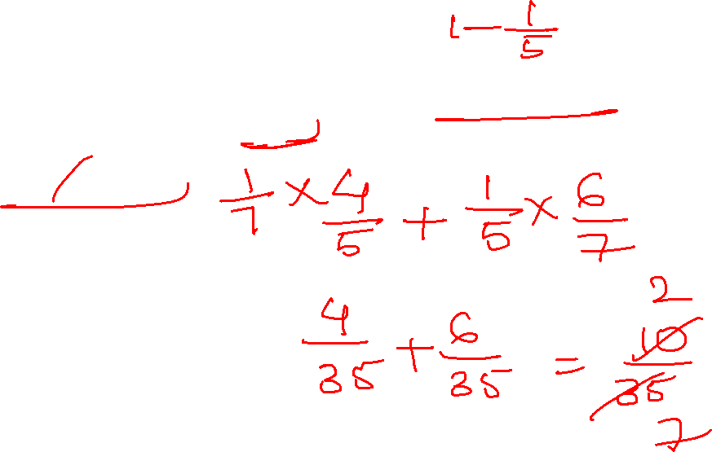
15. A and B appear in an interview for two vacancies in the same post. The probability of A selection is 1/7 and that of B selection is 1/5. what is the probability that only one of them will be selected
2/7
3/7
4/5
1/10
Notes:
A b not select or b select a reject
1/7 * 4/5 + 1/5 * 6/7 = 2/7

Slide 19
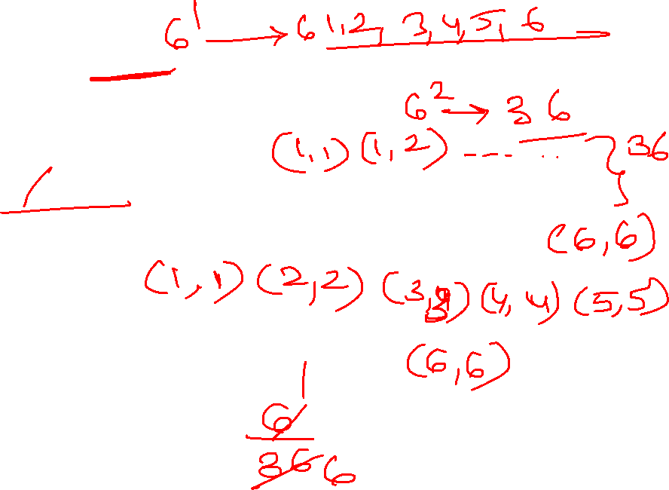
16. Two unbiased dices are thrown simultaneously. What is the probability of getting a same number on each dice
1/3
1/6
¼
2/3
Notes:
(1, 1) ( 2,2 ) ( 3,3) ( 4, 4) ( 5, 5) ( 6, 6)
6/36= 1/6

Slide 20
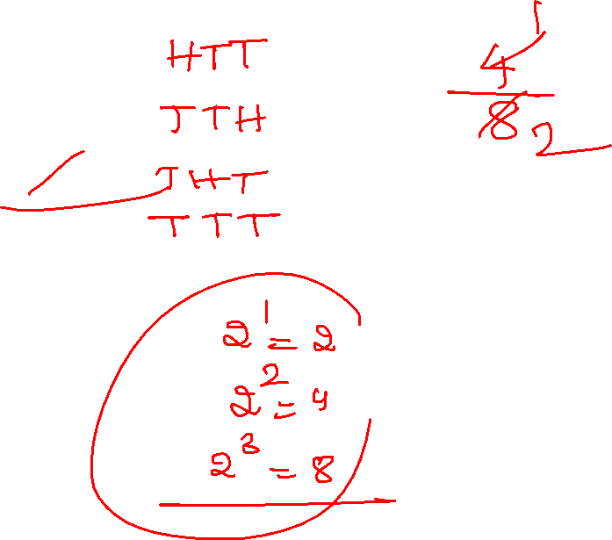
17. Three coins are tossed. What is the probability of getting at least two tails
3/8
5/8
¼
1/2
Notes:
HTT, TTH, THT, TTT
4/8 = 1/2

Slide 21
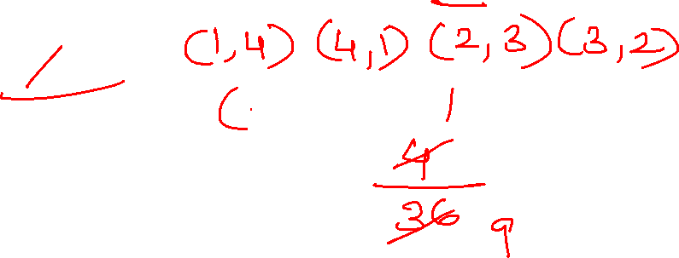
18. Find the probability of getting a sum of five, when two un biased dices are rolled
1/9
2/9
1/8
4/9
Notes:
( 1, 4 ) ( 3, 2) ( 4, 1) ( 2,3)
4/36 = 1/9

Slide 22
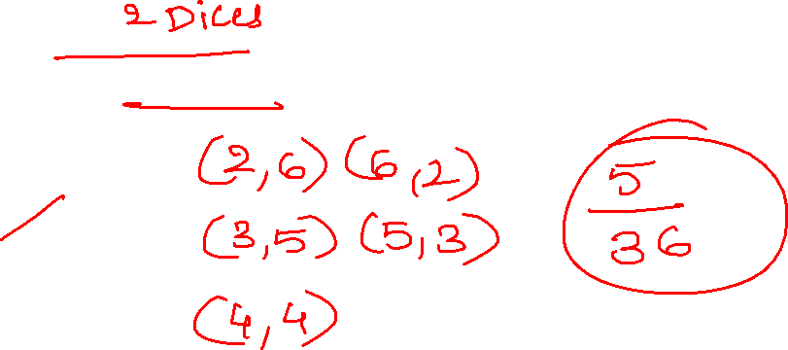
19. 2 un biased coins are thrown randomly. Find the probability for sum of numbers in both dice 8
5/12
1/6
5/36
7/36
Notes:
(4, 4 ) (6,2) ( 2,6) ( 5,3) ( 3,5)
5/36

Slide 23
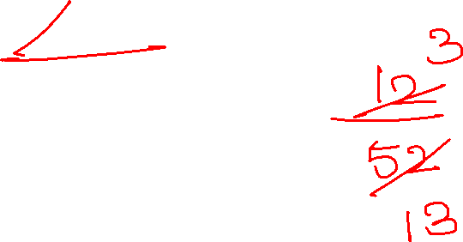
20. Draw a random card from a pack of cards. What is the probability that the card drawn is a face card
3/ 13
2/ 13
4/ 13
5/ 16
Notes:
Face crads- 12 ( jack, queen and king )
12/ 52= 3/ 13

Slide 24


