Slide 1
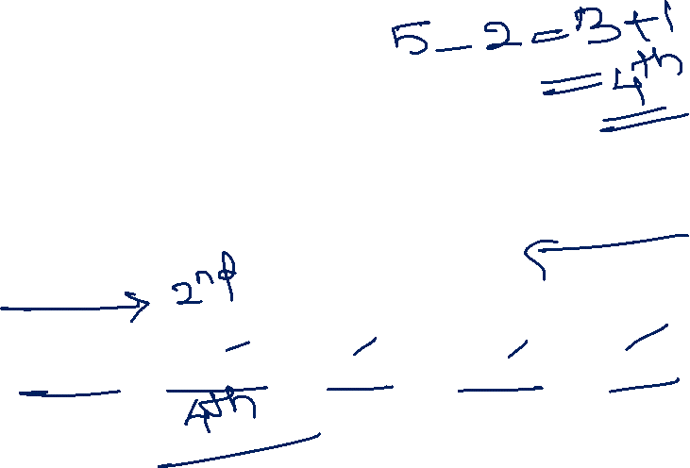
Ranking
Logical Reasoning

Slide 2
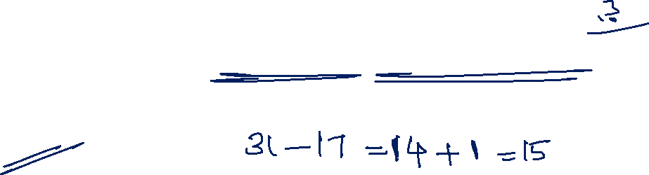
Arun ranks 17th in a class of 31 students. What is his rank from the last
14
15
16
17

Slide 3
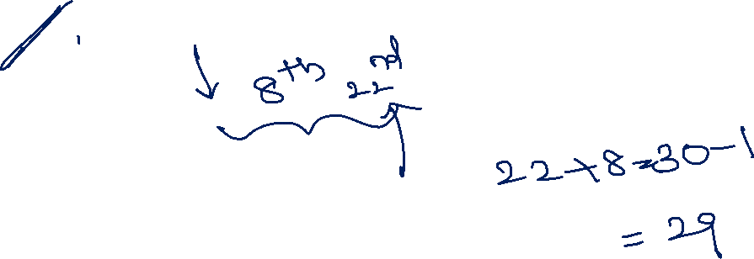
Rahul ranks 8th from the top and 22nd from the bottom in a class how many students are there in the class
29
27
21
22

Slide 4
Manish is 15th from the right end in a row of 50 boys. What is his position from the left end
35
36
32
30

Slide 5
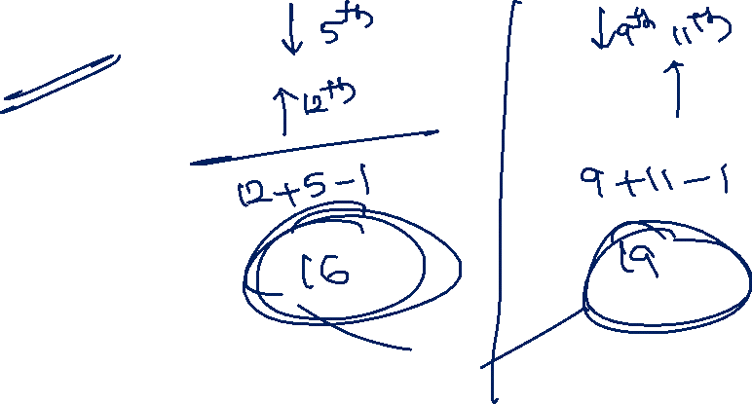
In a row of girls Janvi is 5th from the start and 12th from the end. If other row of girls, Varsha is 9th from the start and 11th from the end. How many girls are there in both the rows together?
30
35
21
19

Slide 6
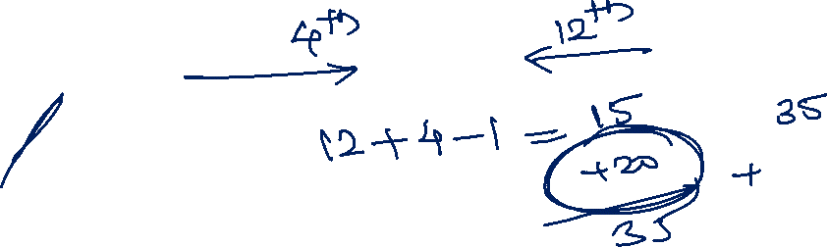
Alex is 12th from the right and fourth from the left in a row of boys. How many boys should be added to row such that there are 35 boys in the row?
22
24
20
35

Slide 7
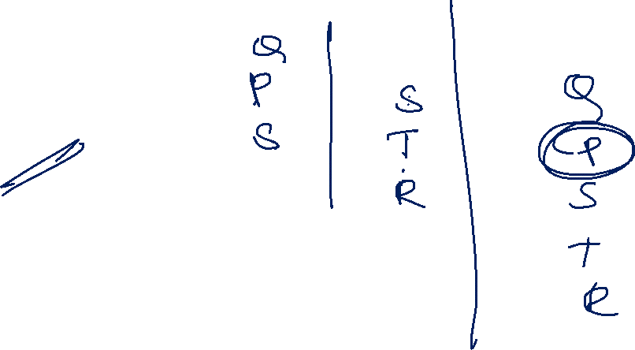
P, Q, R, S and T are standing in a line. P is taller than S but shorter than Q. T is shorter than S but taller than R. who is the second tallest of them all
T
S
R
P

Slide 8
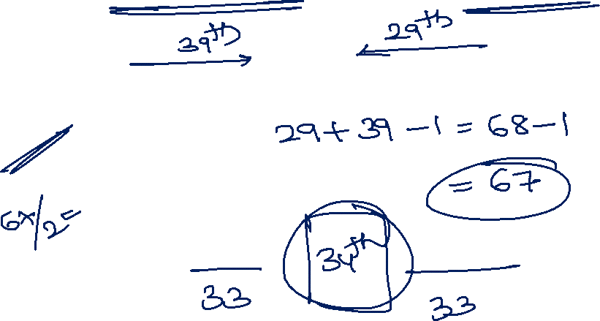
Radha is 29th from the right end and 39th from the left end. Rishaw is exactly in the middle of the row, then what is his place from both ends?
39th
38th
35th
34th

Slide 9
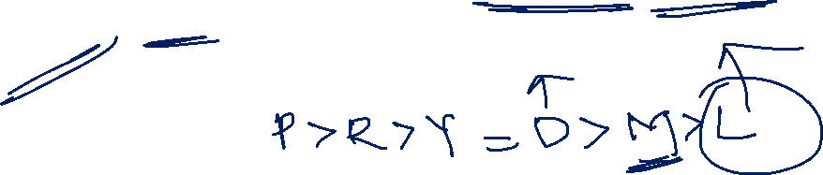
Priti scored more than Rahul. Yamuna scored as much as Divya. Lokita scored less than Manju. Rahul scored more than Yamuna. Manju scored less than Divya. Who scored the lowest
Lokita
Rahul
Manju
Yamuna

Slide 10
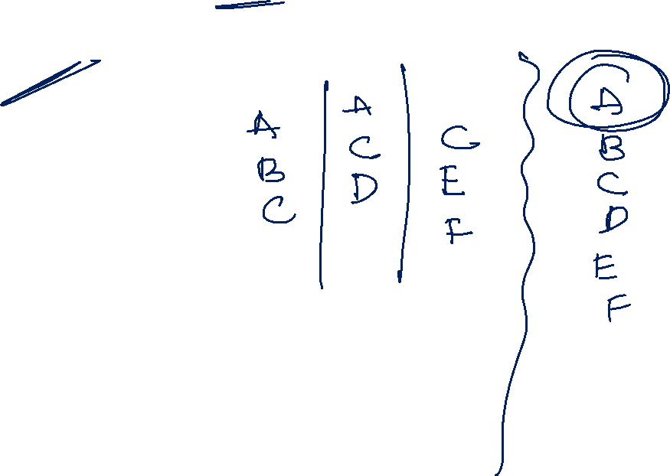
A got more marks than B who got more marks than C. D got less marks than C who got less marks than A. E got less marks than C but more marks than F. who got highest marks
A
B
E
F

Slide 11
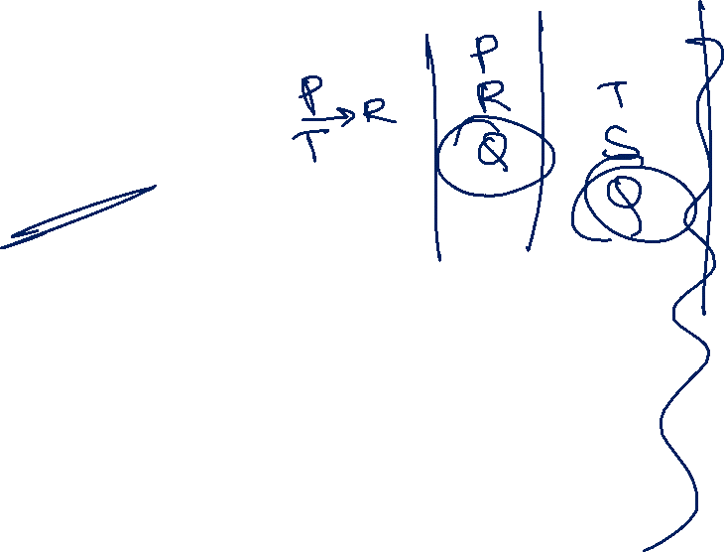
In five persons P is elder than T who is younger than R. R is elder than Q but younger than P. S is younger than T but elder than Q. who is youngest between them
T
P
S
Q

Slide 12
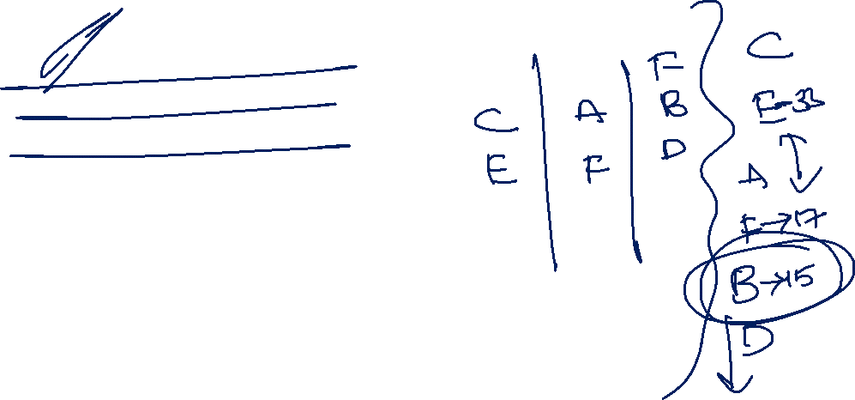
There are six containers in a stack with different volumes. Every container has its volume in odd numbers only. Only C is heavier than E. F is not the lowest. A is heavier than F. second lowest container volume is 15 and the second highest container is 33. B is heavier than D but lighter than F
If F volume is 17, then which of the following is true
A’s volume can be 21
A’s volume can be 37
A’s volume can be 9
A’s volume can be 15

Slide 13
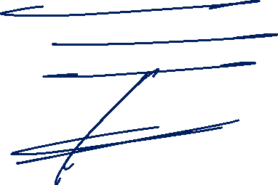
There are six containers in a stack with different volumes. Every container has its volume in odd numbers only. Only C is heavier than E. F is not the lowest. A is heavier than F. second lowest container volume is 15 and the second highest container is 33. B is heavier than D but lighter than F what is the possible weight of D
21
33
41
13

Slide 14
Anology
Logical Reasoning

Slide 15
Select the option that is related to the third word in the same way as the second word is related to the first word
Energy: Joule :: Power
Watt
Energy
Work
Newton

Slide 16
Select the option that is related to the third word in the same way as the second word is related to the first word
Farmer : Plough :: Painter : ?
Brush
Harrow
Axe
Knife

Slide 17
Select the option that is related to the third word in the same way as the second word is related to the first word
SUMO : PRJL :: TAXI : ?
WDXJ
QDVF
QXUF
QDNF

Slide 18
Select the option that is related to the third word in the same way as the second word is related to the first word
OPMN : JKHI :: TURS : ?
OPMN
POMN
OPNM
NMOP

Slide 19
Select the related number from the given alternatives
5 : 124 :: 6 : ?
215
216
217
220

Slide 20
Select the related word from the given alternatives
India : Mango :: New Zealand : ?
Apples
Kiwi
Grapes
Bananas

Slide 21
Select the option that is related to the fourth term in the same way as the first term is related to the second term
EI : VR :: ? : PN
KM
OT
MT
NT

Slide 22
Odd one out
Logical Reasoning

Slide 23
Odd one out
FJKL
IDWG
EMNK
BTGN

Slide 24
Odd one out
65-78
76-89
32-45
73-68

Slide 25
Odd one out
27
64
125
216
384

Slide 26
Odd one out
Eye
Tongue
Ear
Nose

Slide 27
Odd one out
MN
NM
OL
ET

Slide 28
Odd one out
Second
Minute
Time
Hour

Slide 29


