Slide 1

Problems on
Trains

Slide 2
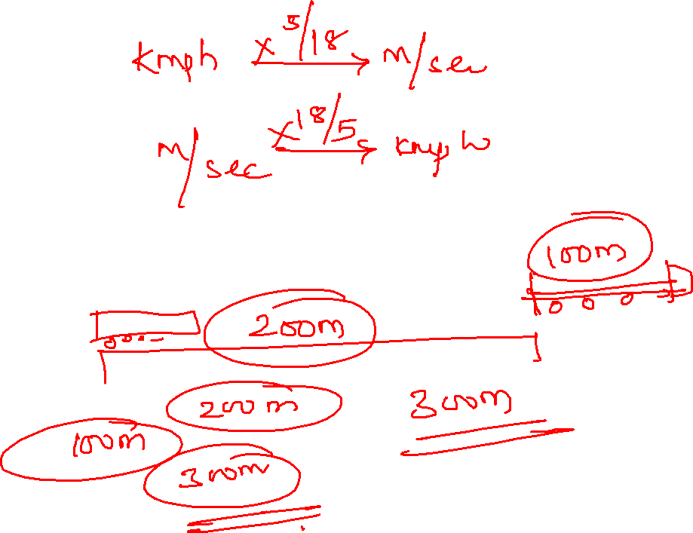

Slide 3
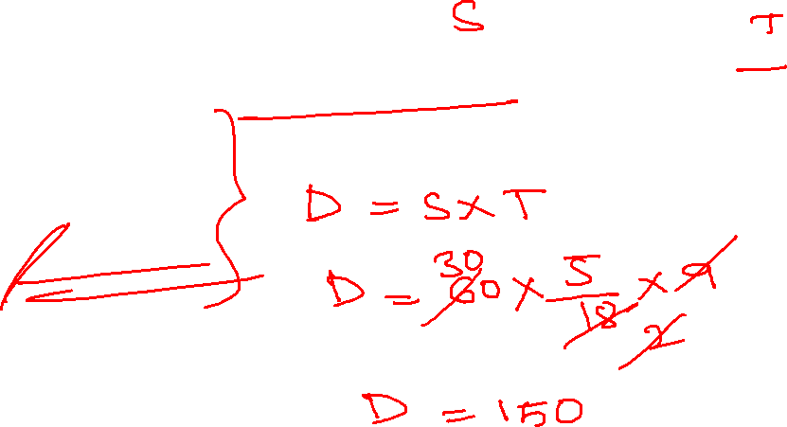
1. A train running at a speed of 60 kmph crosses a pole in 9 seconds. What is the length of the train?
120 meters
180 meters
324 meters
150 meters
Notes:
Speed = 60 kmph, time = 9 seconds
Distance = s*t= 60*5/18*9= 150m

Slide 4
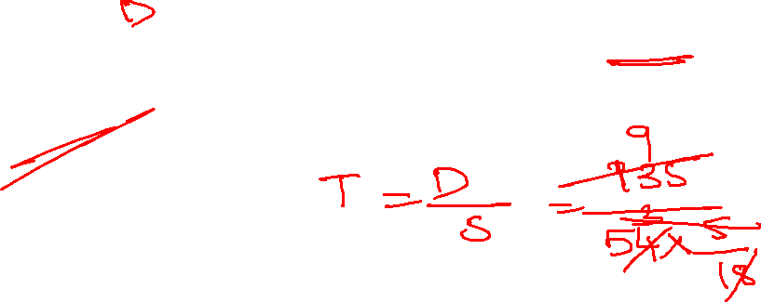
2. A 135m long train running with a speed of 54 kmph. In how much time will the train pass the electric pole
9 sec
10 sec
12 sec
15 sec
Notes:
Time = distance/ speed
Time = 135m/ 54*5/18 = 9 sec

Slide 5
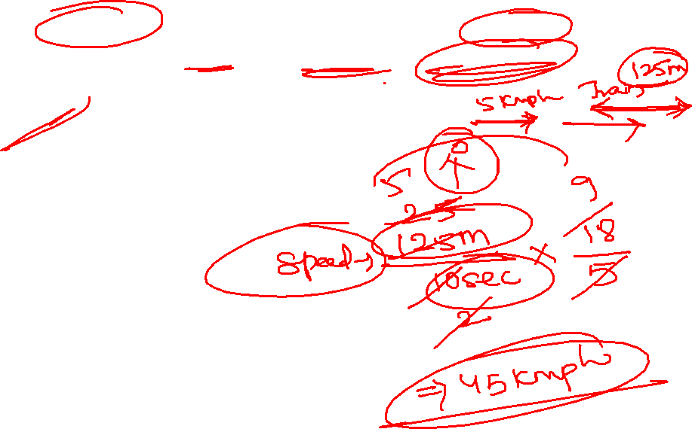
3. A train 125m long passes a man, running at 5 kmph in the same direction in which the train is going, in 10 seconds. The speed of the train is
45 kmph
50 kmph
54 kmph
55 kmph

Slide 6
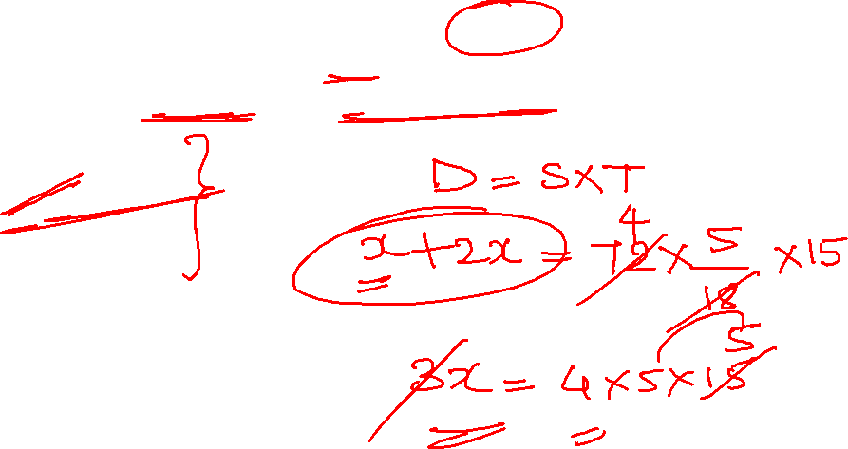
4. A train running at the speed of 72kmph crosses a platform in 15 seconds. What is the length of the train, if the length if the platform is double of the length of the train
200 m
100 m
240 m
300 m
Notes:
X+2x= 72 *5/18 *15
X= 100m

Slide 7
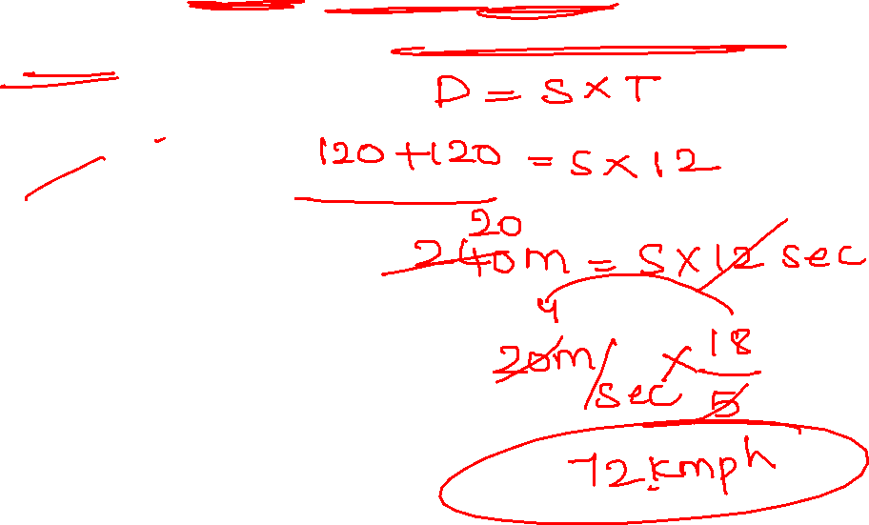
5. Two trains are running in opposite directions with the same speed. If the length of each train is 120 meters and they cross each other in 12 seconds, then the speed of each train (in kmph) is
10
18
36
20
Notes:
120+120= s*12 sec
240= s*12
20=s m/sec
20*18/5 = 72 kmph ~ 32, 32

Slide 8
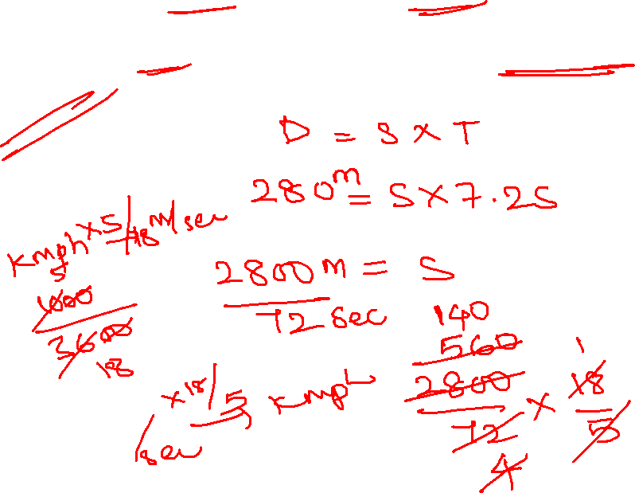
6 Two trains, 153 m long and other 127 m long coming from opposite directions crossed each other in 7.2 seconds. The combined speed of the two trains every hour(in kmph) would then be
140
105
70
280
Notes:
2800/72*18/5 = 140 kmph

Slide 9
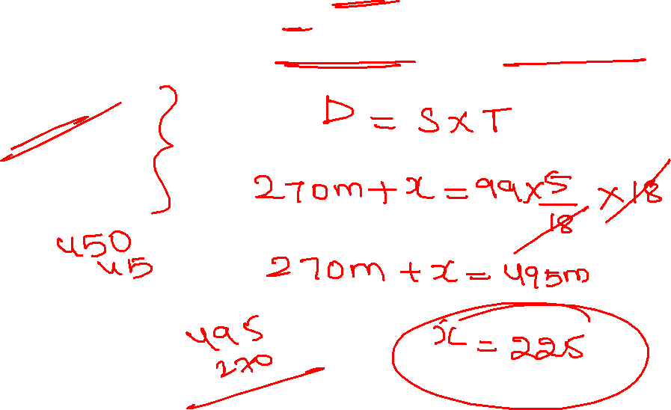
7. Two trains running in opposite directions on parallel tracks, at speeds of 42 kmph and 57 kmph, take 18 seconds to cross each other. If the length of the train is 270m, then the length of the other train is
250 m
225 m
230 m
242 m
Notes:
X+270 = 99*5/18 *18
X+270= 495
X= 225m

Slide 10
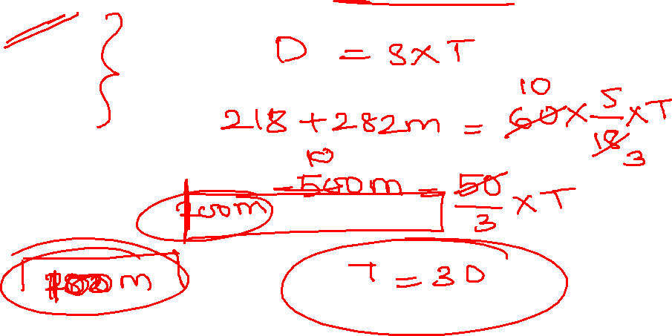
8. A train of length 218m is running at 60 kmph. In what time (in seconds) will it cross a platform of length 282m
30
32
36
40

Slide 11
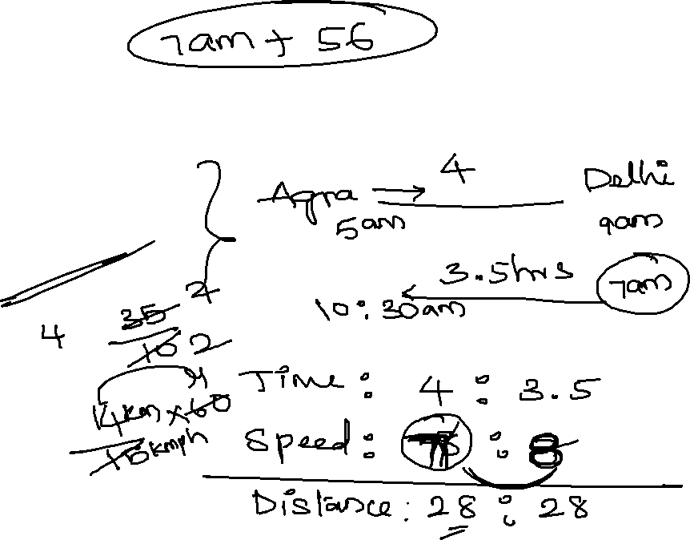
9. A train leaves Agra at 5 am and reaches Delhi at 9 am another train leaves Delhi at 7 am and reaches Agra at 10:30 am. At what time do the two trains cross each other
6:36 am
6:56 am
7 am
7:56 am
Notes:
Time = 4 hrs : 3.5 hrs
Speed= 7 kmph : 8 kmph
7*2= 14 km remaining 14 km
14/15 * 60 = 56 min

Slide 12
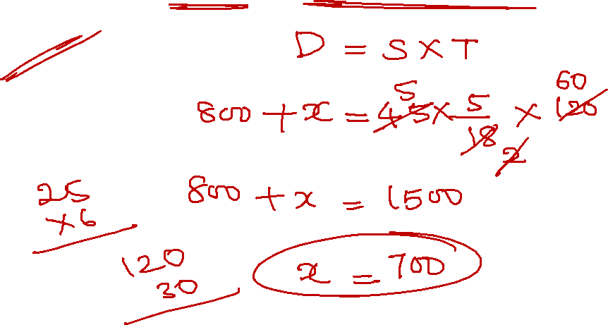
10. A train 800m long is running at a speed of 45 kmph. If it crosses a tunnel in 2 min, then the length of the tunnel(in meters) ?
700 m
850 m
960 m
720 m
Notes:
800+length of train = 45 * 5/18 *120 sec
Length of train = ?

Slide 13
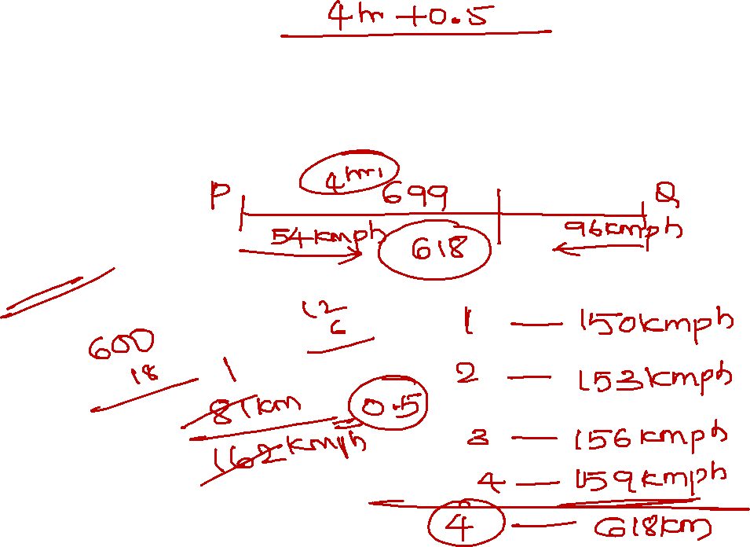
11. Train P and Q are 699 km apart and they started running at the same time towards each other with initial speed of 54 kmph and 96 kmph resp. if train P increases its speed by 9 kmph every hour and train Q decreases its speed by 6 kmph every hour, then find the time after which they will meet
5 hours
5.5 hours
3.5 hours
4.5 hours
Notes:
Relative speed = 54+96= 150 kmph
150, 153, 156, 159 -----618 km
Remaining = 699-618=81 km
4+ 81/162 = 4.5 hrs

Slide 14
12. Train P crosses train Q running in same direction at the speed of 54 kmph in 162 seconds and the ratio of the length train P to Q is 4:5. if the difference between length of train P and Q is 30m, then what is the speed of train P
66 kmph
56 kmph
60 kmph
72 kmph
Notes:
Length of P = 120m length of Q= 150m
120+150= (s-54)*5/18 *162 sec
S=60 kmph

Slide 15
Practice questions:
1. Two trains are running in opposite directions with same speed. If the length of each train is 120m and they cross each other in 12 sec, then the speed of each train(kmph) is
A. 10 B. 18 C. 36 D. 72
2. A train 108 m long moving at a speed of 50 kmph crosses a train 112m long coming from opposite direction in 6 seconds. The speed of the second train
A. 48 kmph B. 54 kmph C. 66 kmph D. 82 kmph
3. a train of length 378m running at 62 kmph crosses another train moving in the opposite at 55 kmph in 26 seconds. What is the length of the other train
A. 450m B. 467 m C. 489 m D. 485 m
4. A train leaves Agra at 8 am and reaches Delhi at 12 noon another train leaves Delhi at 8:30 am and reaches Agra at 12noon. At what time do the two trains cross each other
A. 10:22 am B. 10:08 am C. 9:38 am D. 9:52 am
5. a train 300m long is running at speed of 90 kmph. How many seconds will it take to cross a 200 m long train running in same direction at a speed of 60 kmph
A. 60 sec B. 50 sec C. 80 sec D. 70 sec

Slide 16



