Slide 1
Seating Arrangement
Logical Reasoning

Slide 3
1. Direction: Study the following information and answer the questions.
A, P, R, X, S and Z are sitting in a row. S and Z are in the centre. A and P are at the ends. R is sitting to the immediate left of A. who is to the right of P?
Notes:
P X S Z R A

Slide 4
2. Direction: Study the following information and answer the questions.
Eight friends A, B, C, D, E, F, G and H are seated in a straight line, facing north, but not necessarily in the same order. H sits at the extreme right end of the line. Only four people sit between H and C. Both B and F are immediate neighbours of C. Only two people sit between F and E. E is not an immediate neighbour of H. D sits second to the left of A.
Notes:
E B C F D G A H

Slide 5
What is the position of E with respect to C?
Third to the right
Immediate left
Second to the right
Second to the left
2. Which of the following information is true
Three persons are sit between G and H
Only one person sits to the right of G
A sits on the immediate right of G
None
3. Who among the following represents the person seated at the extreme left of the line?
a) E b) A c) D d) B
Notes:
D
C
A
D
B

Slide 6
4. How many persons are seated between H and A?
Two c) Three
Three d) None
5. Who among the following exactly between F and E?
a) B, A b) B, C c) A, D d) D, E

Slide 7
3. Eight people A, B, C, D, E, F, G and H are sitting around a circle facing the centre. E sits third to the right of A who is to the immediate left of D who is second to the right of G. F is second to the left of A. H is not an immediate enighbour of E. C sits second to the right of B. what is C’s position with respect to A?
A) Third to the Right
B) Second to the Right
C) Fourth to the Right
D) None
Notes:
C E B D A G F H

Slide 8
4. Six- friends- H, I, J, L, K, L and M are sitting around a Triangular table facing inside the centre. Three of them are sitting at middle of the side and other three are sitting at corner of the table. K sits at one of the corner and sitting fourth to the right of L. J sits exactly between I and M. I is immediate right of L. who sits second to the left of I
K
L
H
M
Notes:
L H K M J I

Slide 9
5. Six- friends- C, D, E, F, G and H are sitting around a triangular table facing outside the centre. Three of them are sitting at middle of the side and other three are sitting at corner of the table. H sists at one of the corner and sits exactly between D and F. D sits immediate right of E. E sits second to the right of C. G sits third to the left of H. Who sits second to the left of C?
D
F
H
G
Notes:
C G E D H F

Slide 10
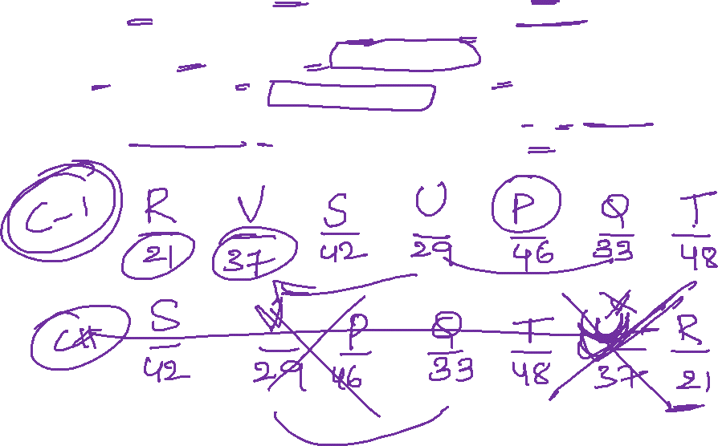
Direction: Study the following data carefully and answer the questions accordingly. P, Q, R, S, T, U and V are sitting in a row facing towards the north. They have different ages - 48yrs,46yrs,42yrs,37yrs,33yrs,29yrs and 21yrs old. R sits at the extreme end of the row. Three people sit between R and the one who is 46 years old. T sits second to the right of the one who is 46yrs old. Three people sit between the one who is 42 years old and T. Two people sit between the one who is 42 years old and Q. P is older than R. Two people sit between Q and S. The one who is 33 years old sits third to the right of S. The one who is 48 years old sits adjacent to Q. U is younger than V. P sits adjacent to the one who is 29 years old. Sum of the ages of immediate neighbours of P is 62. R is the youngest one in the row. T is not the immediate neighbour of V.
Notes:
R V S U P Q T
21 37 42 29 46 33 48

Slide 11
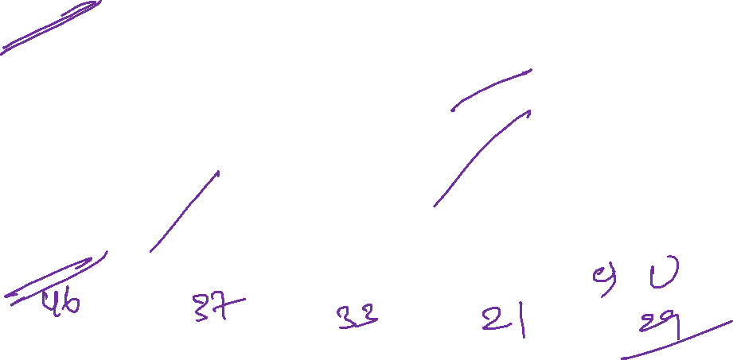
1. How many people sits between the one who is 37 years old and R?
A) None B) One C) Two D) Three
2. What is the sum of the ages of S and R?
A) 81 B) 71 C) 51 D) None
3.Whoamong the following sits second to the left of the one who is 29 years old?
A) U B) T C) Q D) V
4. who among the following people is the youngest?
A) U B) R C) P D) V
5. Odd one out
A) P B) V C) Q D) R
Notes:
A
D
A
A
A

Slide 12
6. Six doctors E, G, I, K, M and 0 are standing in a row facing towards north (Not necessarily in the same order). M is standing to the immediate right of E. K is standing second to the right of 0. Two doctors are standing between I and M. K is towards the left of G. Who is standing to the immediate right of K?
I
E
M
G
Notes:
O I K E M G
B

Slide 13
7. Eight friends L, M, N, O, P, Q, R and S are sitting around a circle facing the centre. There are an equal number of males and females in the group. No two females are immediate neighbours of each other. N is a male and N sits third to the right of R. O is a female and O is not an immediate neighbour of N. L is a male. P sits second to the left of O. S sits fourth to the right of L and S is not an immediate neighbour of R. Q is a female.
Notes:
M-MALE
O- FM
S MALE
P- PM
N- MALE
Q- FEMALE
L-MALE
R- FEMALE

Slide 14
1.What is Q's position with respect to O?
A)Fourth to the left C) Third to the Right
B)Second from the left D) None
2.Four of the following five are alike in a certain way based on their seating positions in the above arrangement and so form a group. Which is the one that does not belong to the group?
A)LO B) OQ C) OP D) MS
3.If all the eight friends are made to sit alphabetically in the clockwise direction starting from L, positions of how many will remain unchanged (excluding L)?
A)One B) Two C) Three D) Four
4.Which of the following is true about M ?
A)M is Male C) M sists on the immediate left of O
B)M sits third to the Right of Q D) None
5.Which of the following groups represents the females in the group?
A)O, P, Q, S B) O, R, P, Q C) Q, L, M, O D) None
Notes:
A
A
A
A

Slide 15
A total of 10 people, 5 men and 5 women are sitting in two parallel lines, facing each other. Five men, namely, Ajit, Bharat, Chirag, Dharam and Ejaz are facing to the south and the five women, Meenal, Neelu, Octavia, Preeti and Arpita are facing towards the north.
Bharat, who is just next to the left of Dharam, is opposite to Arpita.
Chirag and Neelu are diagonally opposite to each other.
Ejaz is opposite Octavia who is just next to Meenal.
Preeti, who is just to the left of Arpita, and opposite to Dharam.
Meenal is at one end of the line
Q 1. Which two people are sitting at the two extreme ends of the line?
Ejaz, Bharat
Ajit, Chirag
Chirag, Dharam
Dharam, Bharat
None of the Above
Notes:
Chirag Ejaz Dharam Bharat Ajit
Meenal Octavia Preeti Arpita Neelu
B. Ajit, Chirag

Slide 16
2. Who is sitting right in front of Dharam?
A. Neelu B. Meenal C. Octavia D. Preeti
Q 3. Who sits exactly in between Meenal and Neelu?
A. Preeti B. Octavia C. Arpita D. Ejaz
Q 4. Who sits opposite to Octavia?
A. Chirag B. Ejaz C. Dharam D. Bharat
Q 5. Who is sitting at the right corner of the women’s line?
A. Meenal B. Octavia C. Arpita D. Neelu
Notes:
Chirag Ejaz Dharam Bharat Ajit
Meenal Octavia Preeti Arpita Neelu
2. D. Preeti
3. A. Preeti
4. Ejaz
5. Neelu

Slide 17
In an exhibition seven brands have put up their stalls
Each of these stalls are facing east
The seven brands which have put up a stall include: Titan, Biba, Landmark, Adidas, Puma, Zara and Reebok
Titan is next to the right of Reebok
Reebok is fourth to the right of Landmark
Adidas is between Biba and Zara
Landmark which is third to the left of Biba, is at one end.
Q 6: Which of the given pairs is correct for the brands displayed at the two ends of the line?
A. Landmark, Zara
B. Titan, Zara
C. Landmark, Puma
D. Puma, Reebok
E. Reebok, Landmark
Notes:
Landmark, zara, adidas, biba, rebok, titan, puma
Option c

Slide 18
7. Which brand is displayed on the immediate right of Titan?
A. Puma B. Reebok C. Adidas D. Zara
8. Zara is to the immediate left of _______
A. Biba B. Landmark C. Adidas D. Puma
9. Which brand is being displayed exactly in between Biba and Titan?
A. Reebok B. Landmark C. Puma D. Zara
10. Which brand is being displayed towards the immediate right of Titan?
A. Adidas B. Cannot be Determined
C. Biba D. Puma
D. Reebok
11. Puma has put up a stall to the immediate right of which brand?
A. Titan B. Zara C. Reebok D. Puma
Notes:
2. Puma
3. Adidas
4. Reebok
5. Puma
6. Titan

Slide 19
Study the following information and answer the questions:
Eight friends, P, Q, R, S, T, V, W and Y are sitting around a rectangular table in such a way that four of them sit at four corners of the square while four sit in the middle of each of the four sides. The ones who sit at the four corners face the centre while those who sit in the middle of the sides face outside.
‘P’, who faces the centre, sits third to the right of ‘V’. ‘T’, who faces the centre, is not an immediate neighbour of ‘V’. Only one person sits between ‘V’ and ‘W’. ‘S’ sits second to right of ‘Q’. ‘Q’, faces the centre. ‘R’ is not an immediate neighbour of ‘P’.
12. Which of the following is true regarding R?
A. R faces the center
B. R sits exactly between T and S
C. Q sits third to left of R
D. None
Notes:
T R S V Q W P U
Ans: B

Slide 20
13. Who sits second to the left of Q?
A. V B. P C. T D. Y
14. what is the position of T with respect to V?
A. Fourth to the left
B. second to the left
C. Third to the left
D. Third to the right
15. odd one out
A. T B. S C. P D. Q E. V
16. who is sitting opposite to T?
A. Q B. S C. U D. None
Notes:
T R S V Q W P U
2. P is second to the left of Q
3. Third to the left
4. All are facing inside except V
5. Q

Slide 21
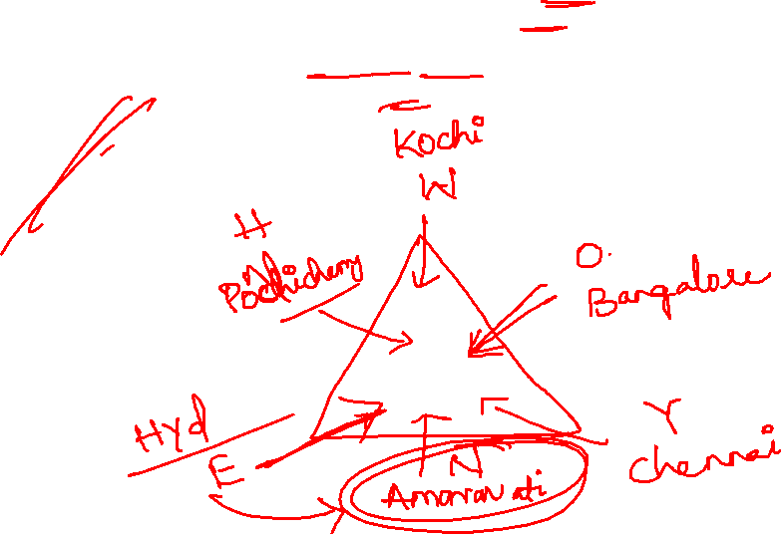
There are six seats i.e. three at the corner of the table and three at the middle of the sides of the table. All of them are facing inside the table. They all are from different cities i.e. Kochi, Pondicherry, Hyderabad, Amaravati, Chennai, and Bangalore. All the information is not necessarily in the same order.
The one who is from Amaravati is facing W. E is sitting 2nd to the right of W. The one who is facing E sits immediately to the left of the one who is from Kochi. The one who is from Pondicherry is an immediate neighbor of both E and the one who is from Kochi. O is from Bangalore and is sitting at the side of the table. The one who is from Chennai sits immediately left the one who is from Bangalore . H is facing Y. Y is not from Pondicherry.
17.N belongs to which of the following cities?
A) hyderabad B) Amaravathi C) Chennai D) Kochi
Notes:
W kochi
O bangslore
Y Chennai
N Amaravati
E Hyderabad
H Pondicherry
17. B

Slide 22
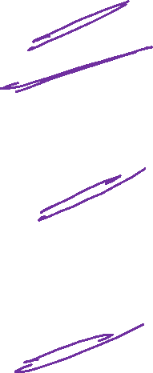
18. Three of the following four are alike in a certain way and hence form a group. Which is
the one that doesn’t belong to that group?
A) N-Y
B) Y-O
C) O-W
D) H-N
19. How many people sit in between the one who is from Pondicherry and N when counted
from the left of N?
A) One
B) Two
C) Three
D) Four
20. Who is sitting immediately right of the one who is sitting opposite of O?
A) The one who is from Amaravathi
B) The one who is from chennai
C) H
D) W
21. Which of the following statements is not true?
A) N is facing the one who is from Kochi
B) E and H are immediate neighbours
C) O sits exactly in between W and the one sho is from chennai
D) H is from hyderabad
Notes:
18. D
19. A
20. A
21. D

Slide 23


