Slide 1
EMAR
PROJECT GUIDE
MRS.M.SathiyaPriya
SUBMITTED BY
S.JananiDevi
K.KalaiVani
R.Nilavarasi

Slide 2
ABSTRACT
Combination of mobile phones with NFC technology used for clinical trials
Based on the automatic patient identification via NFC using the mobile device, physicians can easily edit/add patient information without manually selecting the patient from a list.

Slide 3
Problem Statement
Currently the hospital is using a Notepads to maintain patient details. In some private hospitals uses Barcode System
Maintainability Headache.
Time consuming and Human Errors. (Barcodes can be really difficult to scan)
Portability.

Slide 4
Proposed Solution
Proposed solution combines Android tablet with NFC tags attached to patients wristbands.
Web Application to store and maintain patients medical history.
TAP to view patients information. Fast retrieval of patient data.

Slide 5
System requirements - Hardware
Server to Host eMARs Web application
Intel® processor
2GB Memory
100 GB HDD
Mobile to Host Android App
Any NFC enabled mobile (Nexus 4,5, Galaxy III, IV)
NFC Tag
…

Slide 6
System requirements - Software
Web Application
Windows OS
Java 7
Tomcat 7
Android App
Android 4
PhoneGap

Slide 7
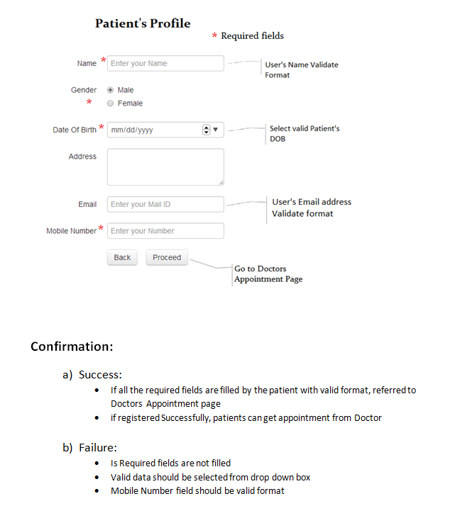
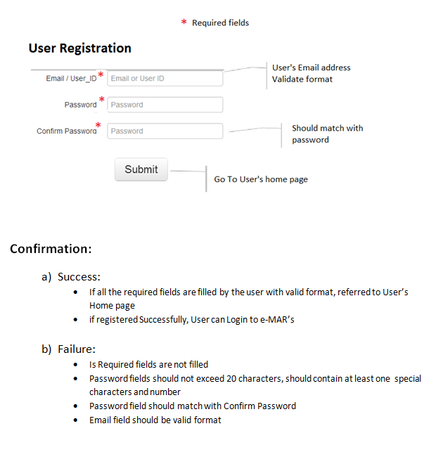
Requirement

Slide 8
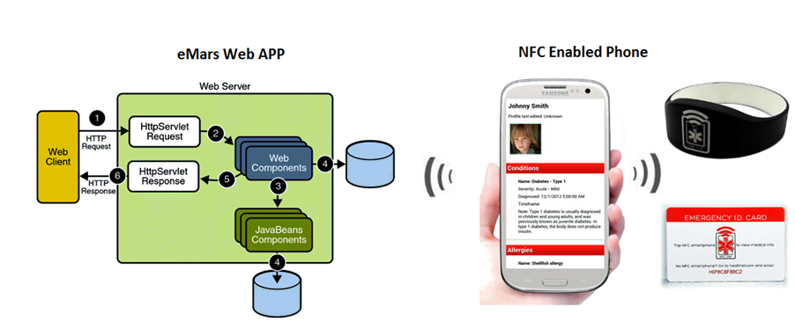
Architecture Diagram

Slide 9
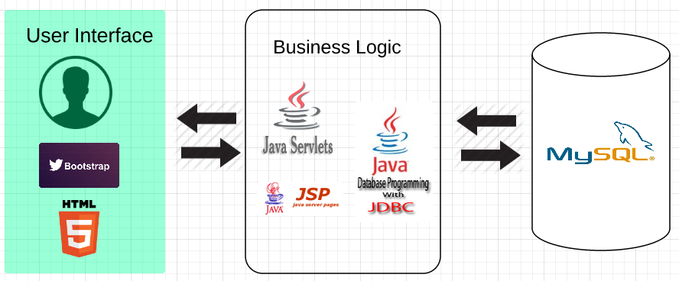
High-Level Design

Slide 10
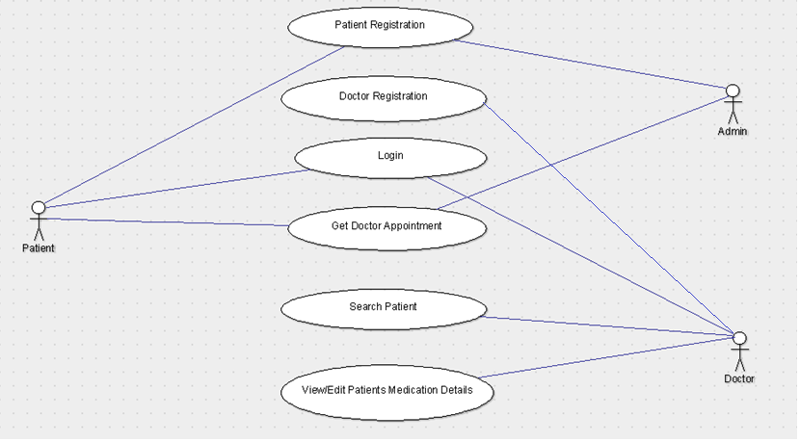
UseCase Diagram

Slide 11
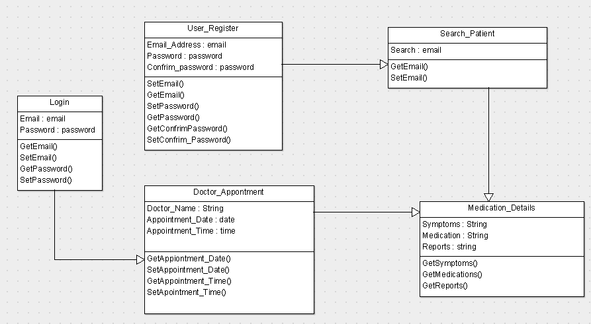
Class Diagram

Slide 12
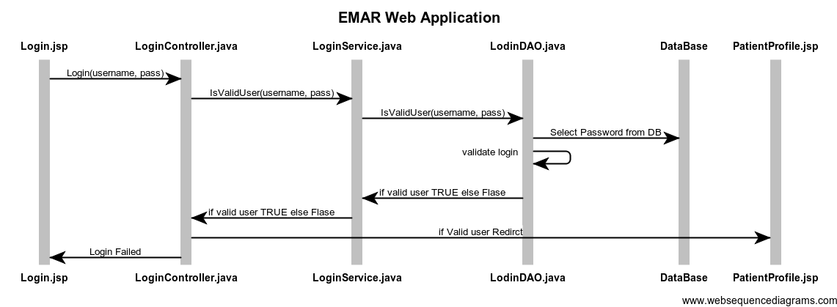
Business Layer

Slide 13
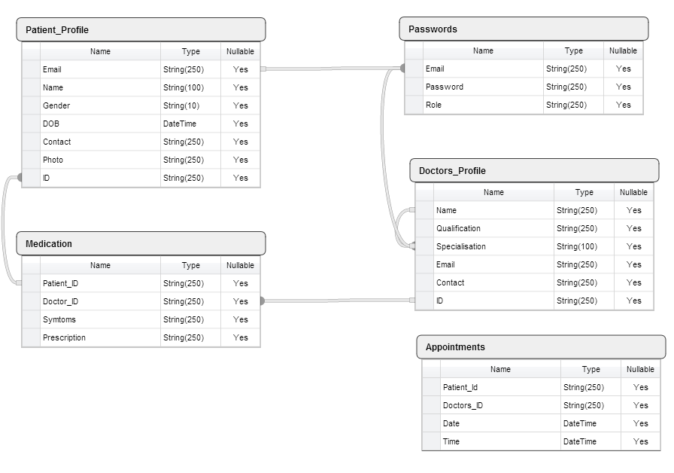
Data Model

Slide 14
eMAR Web Application Modules
Login Module
Registration Module
Patients profile module
Appointment module
Doctors Medication module
…

Slide 15
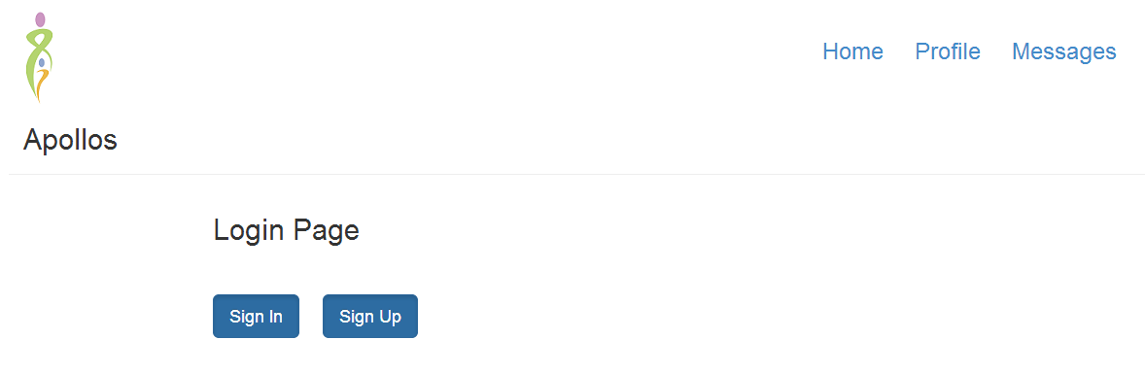
HOME PAGE

Slide 16
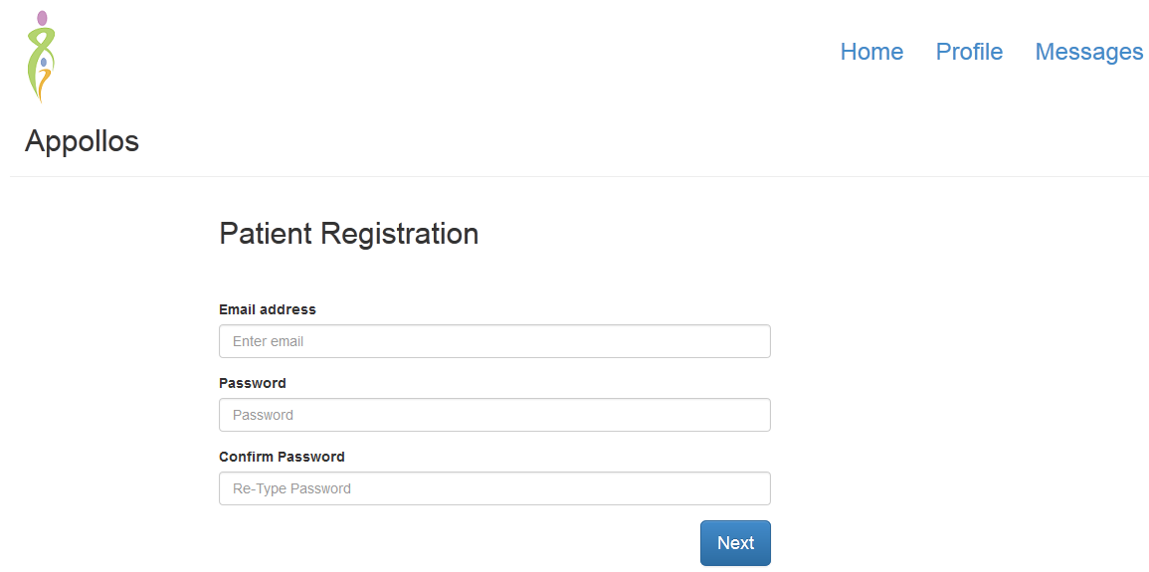

Registration Module

Slide 17
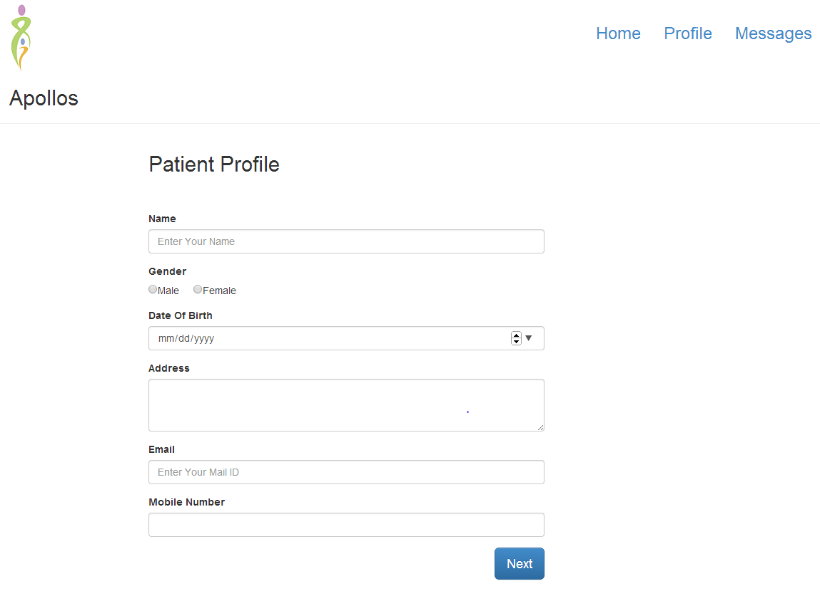
Patient Profile

Slide 18
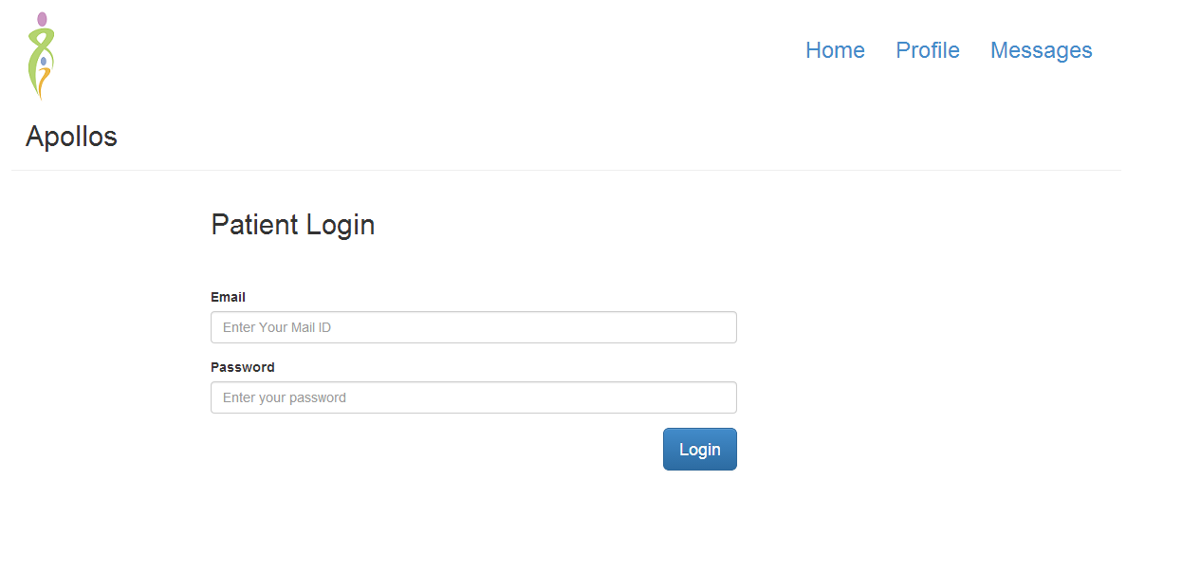
Login

Slide 19
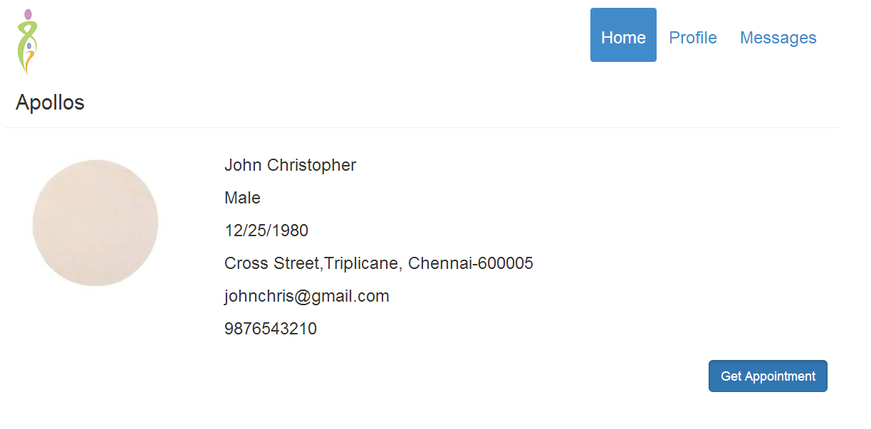
Patient Home Page

Slide 20
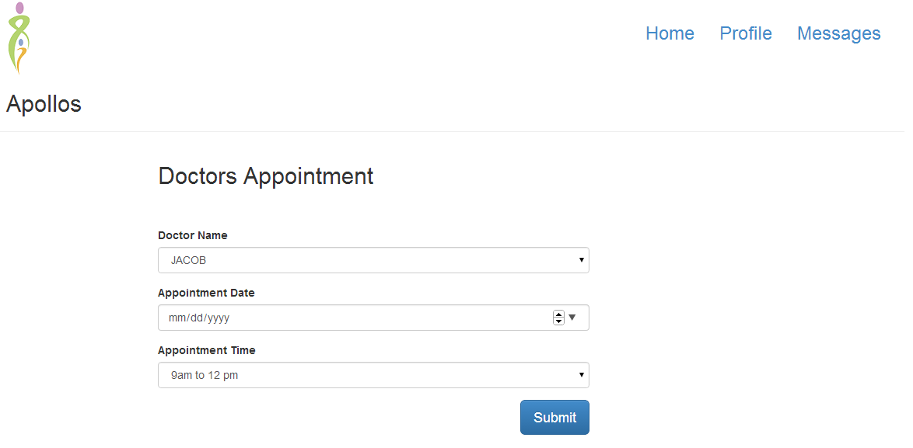
Appointment Module

Slide 21
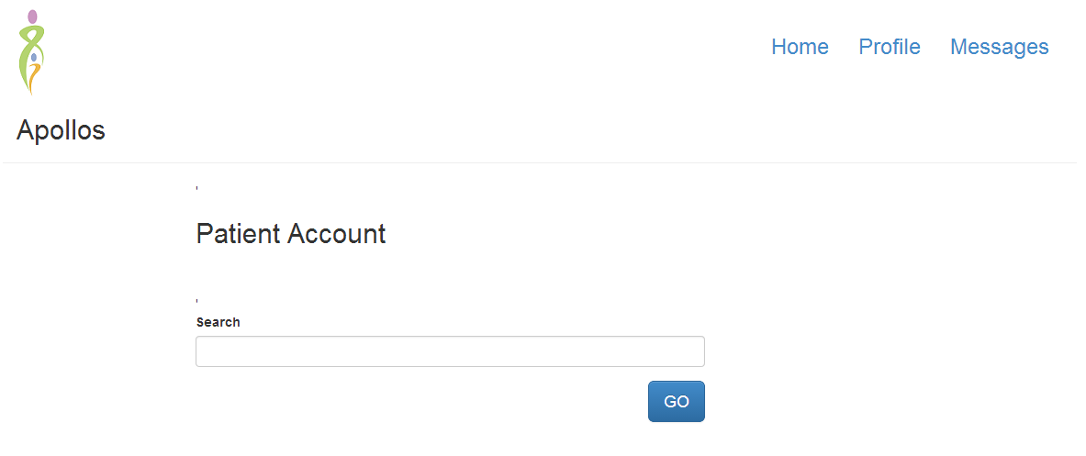
Search Page

Slide 22

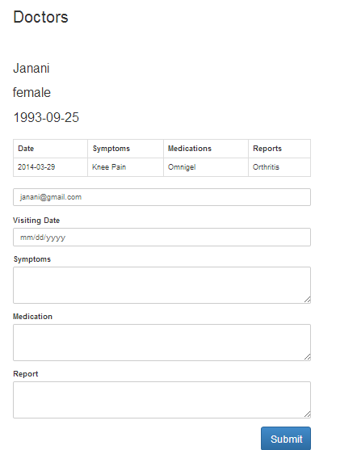
Medication Module

Slide 23
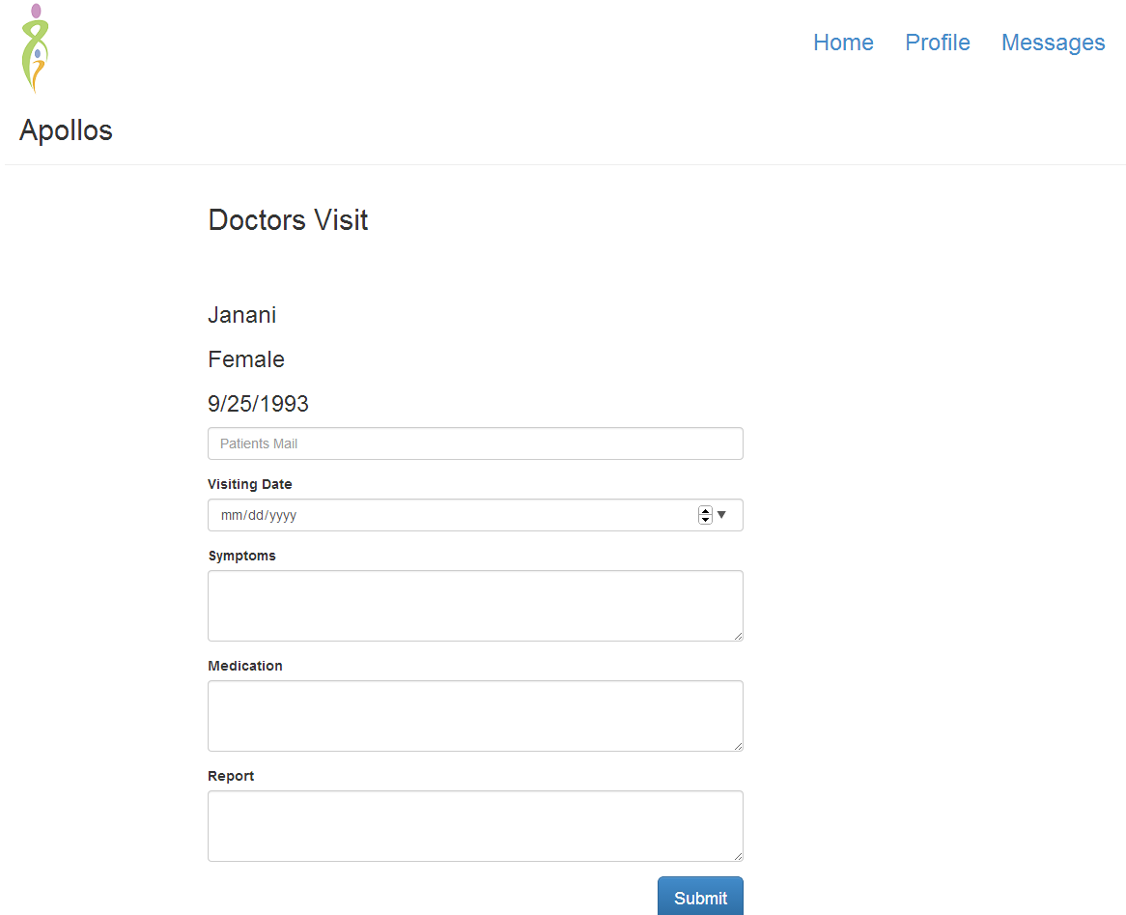
Demo

Slide 24
eMAR Android Application Modules
Login Activity
WRS Home Activity
Patient Detail Activity
Medical History Activity
WRA Activity
Update WRA Activity

Slide 25
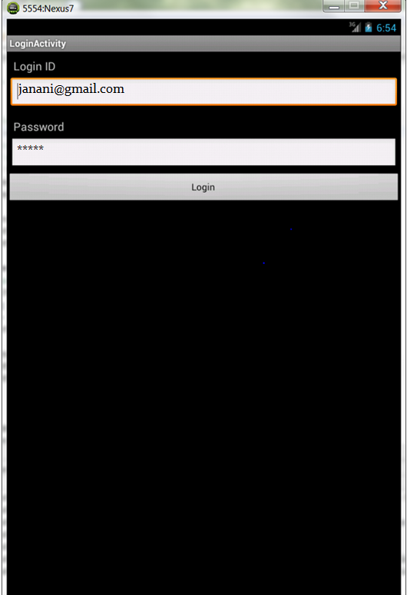
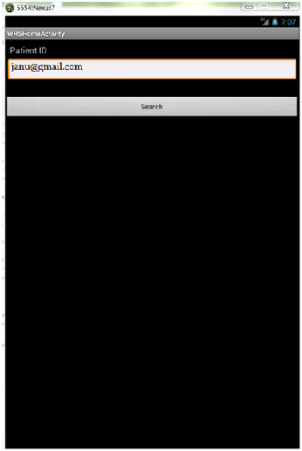
Login Activity WRS Home Activity

Slide 26
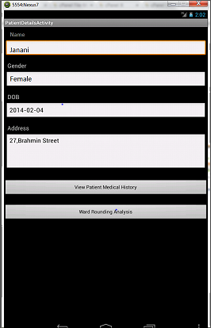
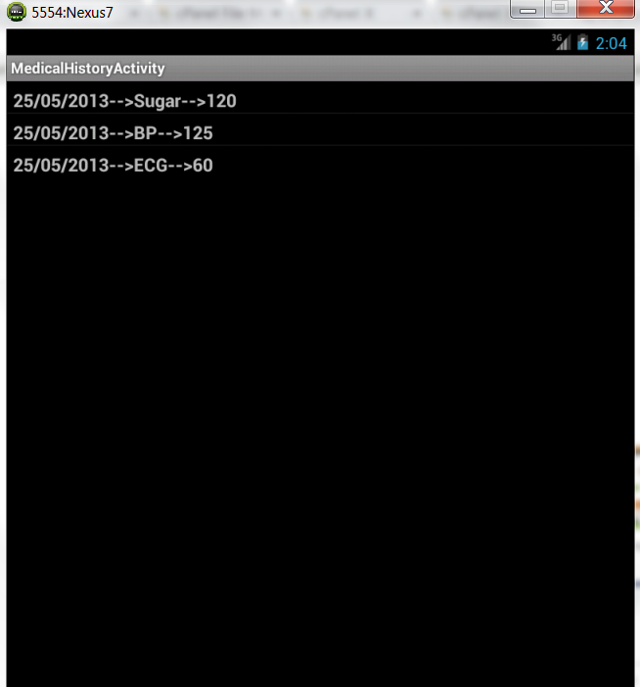
Patient Detail Activity Medical History Activity

Slide 27
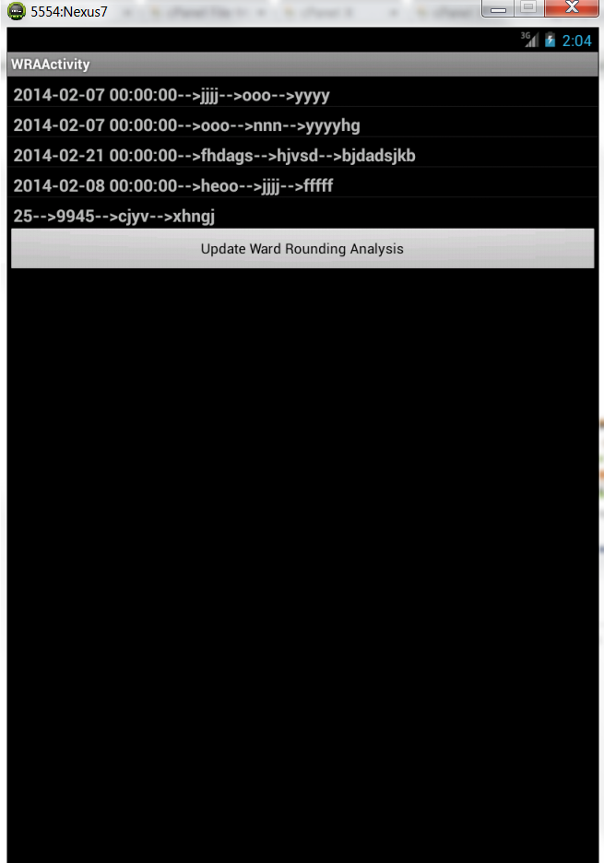
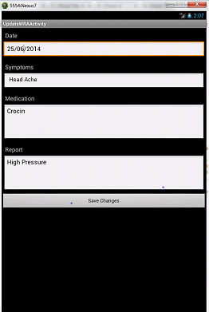
WRA Activity Update WRA Activity

Slide 28
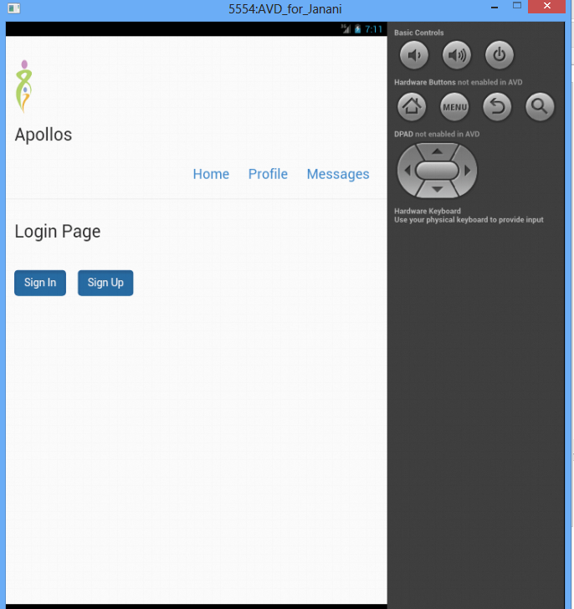
Phonegap: Home Page

Slide 29
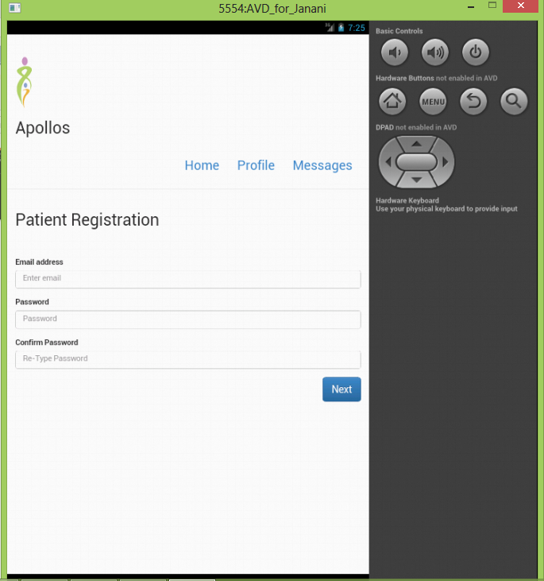
User Registration

Slide 30
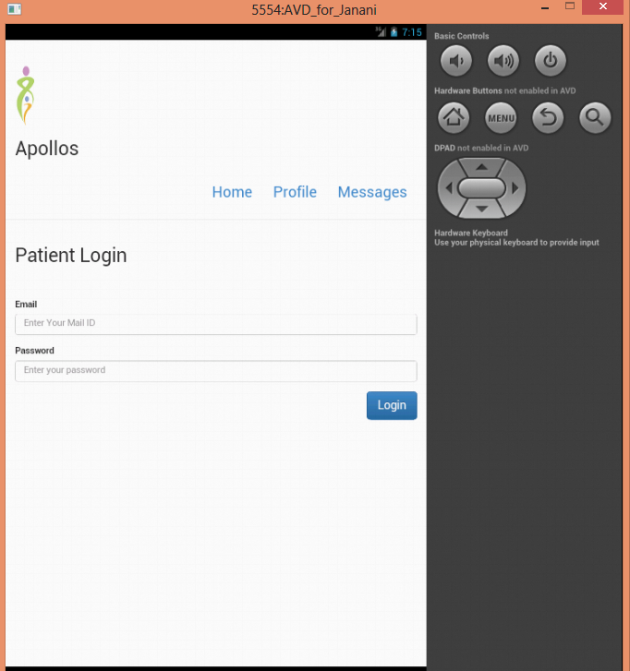
Login Page

