Slide 1
DOCUMENT CLUSTERING

Slide 2
Problem Statement
Design a web application that accepts a text file and clusters the document into the respective topics that originally generated the document.
Method used : TOPIC MODELLING
Algorithm used : LATENT DIRICHLET ALLOCATION
Reference paper :
“Topic Modelling in information warfare domain”

Slide 3
LDA decoded!
In natural language processing, Latent Dirichlet allocation (LDA) is a generative model that allows sets of observations to be explained by unobserved groups that explain why some parts of the data are similar.
For example, an LDA model might have topics that can be classified as CAT_related and DOG_related. A topic has probabilities of generating various words, such as milk, meow, and kitten, which can be classified and interpreted by the viewer as "CAT_related". Naturally, the word cat itself will have high probability given this topic. The DOG_related topic likewise has probabilities of generating each word: puppy, bark, and bone might have high probability. Words without special relevance, such as the (see function word), will have roughly even probability between classes (or can be placed into a separate category).

Slide 4
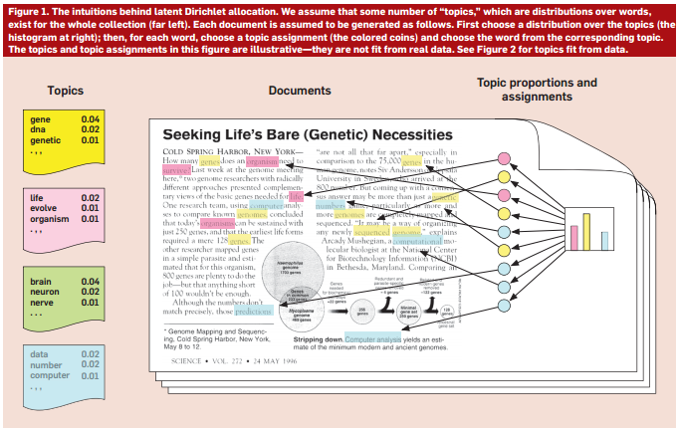

Slide 5
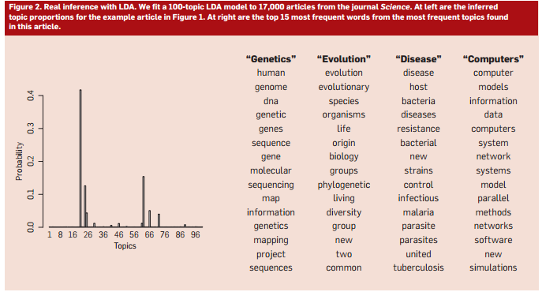

Slide 6
Topic Models
= probabilistic models for uncovering the underlying semantic structure of a document collection based on a hierarchical Bayesian analysis of the original texts (Blei, 2003)
Aim: discover patterns of word-use and connect documents that exhibit similar patterns
Idea: documents are mixtures of topics and a topic is a probability distribution over words

Slide 7
Step 1
So now suppose you have a set of documents. You’ve chosen some fixed number of K topics to discover, and want to use LDA to learn the topic representation of each document and the words associated to each topic.
Go through each document, and randomly assign each word in the document to one of the K topics.
Notice that this random assignment already gives you both topic representations of all the documents and word distributions of all the topics (albeit not very good ones).

Slide 8
Step 2
Go through each word w in d…
And for each topic t, compute two things:
p(topic t | document d) = the proportion of words in document d that are currently assigned to topic t,
p(word w | topic t) = the proportion of assignments to topic t over all documents that come from this word w.
Reassign w a new topic, where we choose topic t with probability p(topic t | document d) * p(word w | topic t) (this is essentially the probability that topic t generated word w, so it makes sense that we resample the current word’s topic with this probability.

Slide 9
Step 3
After repeating the previous step a large number of times, you’ll eventually reach a roughly steady state where your assignments are pretty good. So use these assignments to estimate the topic mixtures of each document (by counting the proportion of words assigned to each topic within that document) and the words associated to each topic (by counting the proportion of words assigned to each topic overall).

Slide 10
Topic Model: Plate Notation
Document specific distribution over topics
Document
α
θ
Topic
Topic distribution over words
z
Word
β
φ
w
N_{d}
T
D

Slide 11
Suppose you have the following set of sentences:
I like to eat broccoli and bananas.
I ate a banana and spinach smoothie for breakfast.
Chinchillas and kittens are cute.
My sister adopted a kitten yesterday.
Look at this cute hamster munching on a piece of broccoli.
What is latent Dirichlet allocation? It’s a way of automatically discovering topics that these sentences contain. For example, given these sentences and asked for 2 topics, LDA might produce something like
Sentences 1 and 2: 100% Topic A
Sentences 3 and 4: 100% Topic B
Sentence 5: 60% Topic A, 40% Topic B
Topic A: 30% broccoli, 15% bananas, 10% breakfast, 10% munching, … (at which point, you could interpret topic A to be about food)
Topic B: 20% chinchillas, 20% kittens, 20% cute, 15% hamster, … (at which point, you could interpret topic B to be about cute animals)

Slide 12
In more detail, LDA represents documents as mixtures of topics that spit out words with certain probabilities. It assumes that documents are produced in the following fashion: when writing each document, you
Decide on the number of words N the document will have (say, according to a Poisson distribution).
Choose a topic mixture for the document (according to a Dirichlet distribution over a fixed set of K topics). For example, assuming that we have the two food and cute animal topics above, you might choose the document to consist of 1/3 food and 2/3 cute animals.
Generate each word w_i in the document by:
First picking a topic (according to the multinomial distribution that you sampled above; for example, you might pick the food topic with 1/3 probability and the cute animals topic with 2/3 probability).
Using the topic to generate the word itself (according to the topic’s multinomial distribution). For example, if we selected the food topic, we might generate the word “broccoli” with 30% probability, “bananas” with 15% probability, and so on.
Assuming this generative model for a collection of documents, LDA then tries to backtrack from the documents to find a set of topics that are likely to have generated the collection.

Slide 13
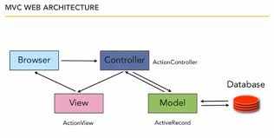
Django framework

Slide 14
Thank You

