Slide 1
ET
Pulse
AI-Native Business News Intelligence
"I can't go back to reading news the old way."
Team: AAM_MUNDE · Builder: Madhav Tiwari
+91-9374105274 · tiwarimadhav2309@gmail.com
linkedin.com/in/madhav-tiwari2309 · github.com/madhav-09
GATE 2026 (CS) Qualified · AWS Certified Cloud Practitioner
Hackathon Track: AI-Native News Experience (#8)
Notes:
Open by introducing yourself and the product name. Pause on the tagline — let it land before moving forward.

Slide 2
Business News in 2026 Still Feels Like 2005
The gap between what readers need and what they get
✅ What Readers Need
❌ What They Get Today
Personalized by role — Investor vs Student vs Founder
One synthesized view of a complex story
News adapted to their language — not just translated
Follow-up questions — real dialogue, not passive reading
Track how a story evolves over weeks
Same homepage for 20 million users
8 separate articles to understand 1 story
English-only — 500M vernacular users underserved
Passive reading — no interaction, no depth
No narrative tracking — stories just disappear
38 min/day
500M
₹835 Cr/yr
wasted on inefficient news consumption
Hindi/Tamil/Telugu/Bengali-first Indians underserved
revenue opportunity untapped
Notes:
Open by showing the ET homepage — same layout for a 60-year-old investor and a 20-year-old student. That's the problem.

Slide 3
ET Pulse — 5 AI-Native Features
Not a filtered feed. A fundamentally different intelligence experience.
🧠 Deep Briefing
📰 My ET Feed
8 articles → 1 AI-synthesised intelligence doc
7 sections: Summary · Market Impact · Timeline · Signals
Live follow-up chat grounded in briefing context
Personalised by Persona: Investor / Founder / Student
Real news via NewsAPI filtered by chosen topics
Sentiment badges + Story Arc on every card
📊 Story Arc Tracker
🔎 Intelligence Search
🌐 Vernacular Engine
AI builds complete visual narrative for any story
Interactive timeline · Sentiment trend chart
Contrarian view + 'What to watch next' predictions
⌘K anywhere → instant AI intelligence page
Sentiment score · Market impact rating
Full story arc + live chat on every search
Real-time: हिंदी · தமிழ் · తెలుగు · বাংলা
Culturally adapted — not literal translation
6 sections translate in parallel simultaneously
Notes:
Each feature solves one specific pain point from the previous slide. Show the onboarding flow — 3 steps, 30 seconds, then you're in your personalized newsroom.

Slide 4
How It Works — User Journey
From onboarding to intelligence in under 60 seconds
01
ONBOARD
02
MY FEED
03
DEEP BRIEFING
04
STORY ARC
05
⌘K SEARCH
Pick persona: Investor
Topics: Markets, IPO
Language: हिंदी
→ Open My ET
8 real articles (NewsAPI)
Filtered by your topics
Sentiment badges on cards
Click 🧠 Deep Briefing
AI synthesises all coverage
7-section intelligence doc
Switch to Hindi → live translate
Ask follow-up in chat
Search: 'Adani Group'
Timeline of events loads
Sentiment trend chart
Key players + predictions
⌘K anywhere in the app
Type any company/topic
Full AI intelligence page
Chat with the data
→
→
→
→
Notes:
This is the demo flow for the pitch video. Walk through each step live. The key moment is Step 3 — switching to Hindi and watching the entire briefing translate in real time.

Slide 5
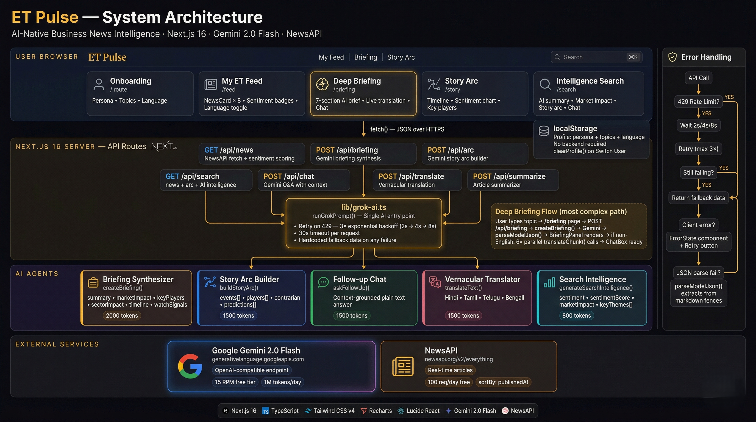
Architecture — How the AI Works
Notes:
The key architectural decision — single runGrokPrompt() function handles all AI calls. Retry logic, error handling, and fallback data are written once and work everywhere.

Slide 6
The Business Case
₹835 crore/year opportunity · 451× ROI · Built in 2 weeks
⏱ Time Saved
💰 Revenue Unlocked
🚀 Cost to Operate
Baseline
38 min/day per user
Session duration
4.2 → 9.5 min (+126%)
Gemini 2.0 Flash (3M DAU)
~$217K/year
With ET Pulse
12 min/day
Ad revenue lift
₹788 crore/year
NewsAPI Business plan
~$5.4K/year
Saved
26 min/day
ET Prime lift (+50%)
₹12 crore/year
Total operating cost
₹1.85 crore/year
At 3M DAU
1.3M hours/day
Vernacular expansion
₹35 crore/year
ROI
451× return
Annual user value
₹19,500 crore
TOTAL
₹835 crore/year (~$100M)
"The MVP was built with 2 API keys, 0 proprietary infrastructure, and 2 days of development."
Notes:
The 451× ROI number is the headline — ₹835 crore revenue on ₹1.85 crore operating cost. The vernacular engine alone opens a 350M-user market that English-only ET cannot reach today.

Slide 7
ET Pulse
The newsroom that thinks with you.
What We Built
The Numbers
My ET — personalised feed (real NewsAPI data)
Deep Briefing — AI intelligence navigator + chat
Story Arc Tracker — visual narrative + sentiment
Intelligence Search — ⌘K, full AI context
Vernacular Engine — 5 languages, culturally adapted
Zero backend — runs on 2 API keys
Production build — 13 routes, 0 TypeScript errors
26 min
saved per user per day
5 AI agents
7 API routes
5 languages
supported
₹835 Cr/yr
revenue opportunity
451×
ROI on operating cost
2 days
to build
"I can't go back to reading news the old way."
Team: AAM_MUNDE · Madhav Tiwari · GATE 2026 (CS) · AWS Certified Cloud Practitioner
+91-9374105274 · tiwarimadhav2309@gmail.com · linkedin.com/in/madhav-tiwari2309 · github.com/madhav-09/-ET-Pulse-
Notes:
End with the tagline — let it sit. Then say: 'We didn't build a better news app. We built a news intelligence engine. The difference is — one you read, the other thinks with you.'

