Slide 1

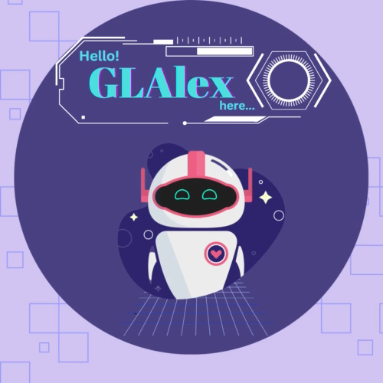
GLAlex
A chatbot which answers FAQs related to GLA !
MINI PROJECT-I
Submitted to:
Mr. Mohd. Amir Khan
Submitted By:
Ana Khan
Madhav Maheshwari
Kalyani Agarwal
Rashi Shivhare

Slide 2
CONTENTS
INTRODUCTION: What is a chatbot?
PROBLEM STATEMENT: Why a chatbot for GLA?
All about GLAlex
Tools used
Code snippets
Outputs
Resources
Thank you

Slide 3
WHAT IS A CHATBOT?
A chatbot or chatterbot is a software application used to conduct an on-line chat conversation via text or text-to-speech, in lieu of providing direct contact with a live human agent.
Benefits of a chatbot
Cuts down cost
Saves time
Amazing experience for customers
Without chatbots companies would otherwise require to hire a fleet of customer care executives

Slide 4
WHY A CHATBOT FOR GLA ?
Many people who seek for admissions in GLA ask repetitive questions such as:
What are the accreditions and rankings of the university?
For how long has the university been established?
What courses are being offered by the university?
What has been the placement record of the university?
Who all are the faculty members working here?
Where is the university situated?
Whom to contact for getting admission details?
and many more…
With our bot, people will get all the answers to such questions very easily.

Slide 5
Introduction to GLAlex
Our Natural Language Toolkit (NLTK) project “GLALex” is a retrieval-chatbot which allows simulating a conversation with a user giving automatic answers to different doubts and common questions about GLA University.
Retrieval-based chatbots use techniques like keywords matching, machine learning or deep learning to identify the most appropriate response
It returns a response to the user depending on the most suitable or we can say most matchable condition that it has fetched from text corpus.
The chatbot are ignoring all the errors and reading the data.txt file. The chatbot will translate and remove the punctuation and loaded and pre-process data file using tokenizing and lemmatizing
The bot is rule-free, it is intelligent enough to provide the most suitable answer based on the corpus.
The responses are based on existing information. Our chatbot completes three main tasks: intent classification, entity recognition, and response selection.
Since the bot gives information regarding the GLA University, so is the name, GLA-Alex!

Slide 6


TOOLS USED
PYTHON: Python is a computer programming language often used to build websites and software, automate tasks, and conduct data analysis. Python is a general-purpose language, meaning it can be used to create a variety of different programs and isn't specialized for any specific problems.
COLAB: Colaboratory, or “Colab” for short, is a product from Google Research. Colab allows anybody to write and execute arbitrary python code through the browser, and is especially well suited to machine learning, data analysis and education.

Slide 7
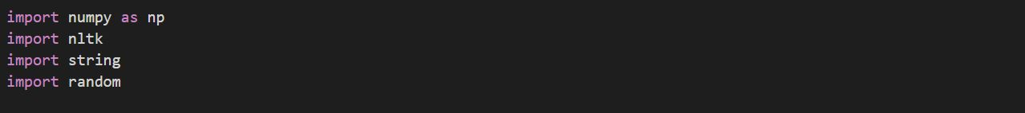
CODE SNIPPETS
Importing the python libraries:
NumPy is a general-purpose array-processing package. It provides a high-performance multidimensional array object, and tools for working with these arrays. It is the fundamental package for scientific computing with Python.
NLTK (Natural Language Toolkit) Library is a suite that contains libraries and programs for statistical language processing. It is one of the most powerful NLP libraries, which contains packages to make machines understand human language and reply to it with an appropriate response.
String This function split the specified string into words using str. split(). Then it capitalizes each word using str. capitalize() function.
Random module is an in-built module of Python which is used to generate random numbers. This module can be used to perform random actions such as generating random numbers, print random a value for a list or string, etc.

Slide 8
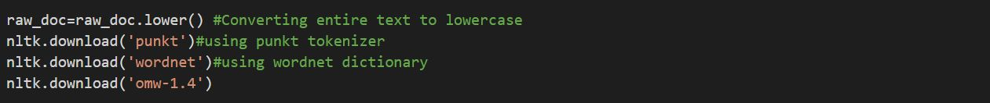
Handling errors and downloading necessary packages
we are ignoring all the error here and reading the data.txt file
f is the object of the file
raw_doc is the variable where all the data of data.txt file is storing
Punkt tokenizer divides a text into a list of sentences by using an unsupervised algorithm to build a model for abbreviation words, collocations, and words that start sentences.
WordNet is a dictionary of English, similar to a traditional thesaurus NLTK includes the English WordNet.

Slide 9
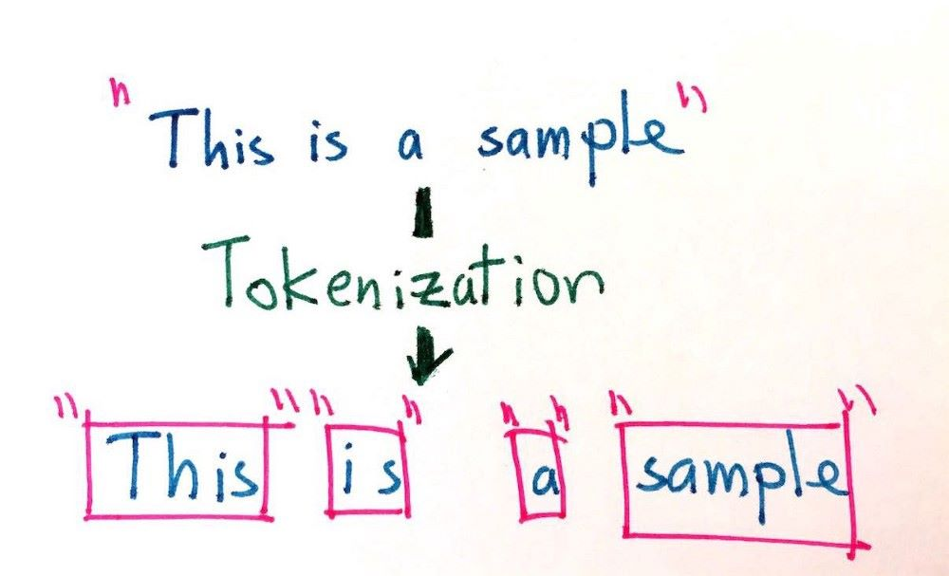
Tokenization
A tokenizer divides a text into a list of sentences by using an unsupervised algorithm to build a model for abbreviation words, collocations, and words that start sentences.
It must be trained on a large collection of plaintext in the target language before it can be used.
The NLTK data package includes a pre-trained Punkt tokenizer for English.

Slide 10
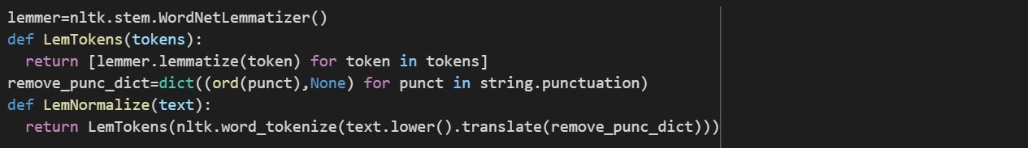
Text processing step
tokenization -> stemming -> lemmatization
it did lemmatizing using wordnet lemmatizer
it will return lemmatized form of tokens
which will remove all the comma stop words
all the non informative word will be removed
we will translate and remove the punctuation and define two functions which will perform the step of lemmatization

Slide 11
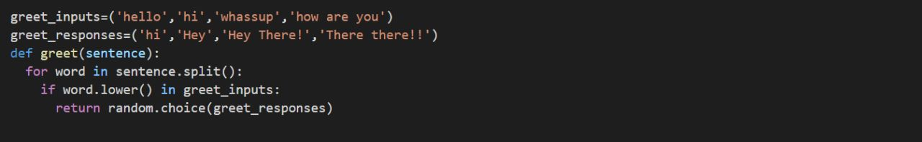
Greetings!
Every chatbot should be started with some greetings
so this portion of the code will give greetings to the end user
user types hi hello or wassup, the bot will reply hi there hey there etc.
it will convert every word lower
it will then compare with the greet inputs
and return any response from greet_response

Slide 12
Intelligence of the bot
used cosine similarity and tfidf vectorizer
term frequency inverse document frequency is a way of converting your text or your word into number and these number are what machine learning models learn from you cant make a model learn from text directly you need to convert your text into a numeric representation so that num vector is what is term frequency inverse doc frequency
it gives more weightage or more value or more strength to those words in your doc which occurs very rarely
so term frequency inverse doc frequency vectorizer basically is going to give more importance to the key words which are rarely seen in a doc and is not very frequent withing the doc
and cosine similarity is measuring the similarity of two vector (the sentences are going to get converted into vector and these are sk learn implementation which im using

Slide 13
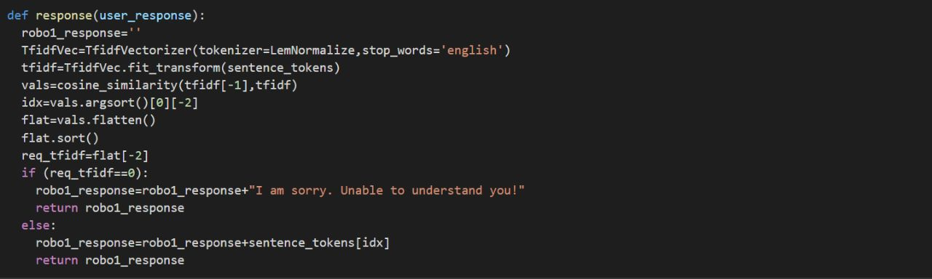
To generate response to every user input
it is going to take the user input ,it performs tokenization using lemnormalise tokenizer
which we have declared above
handle the stop words by the English stop words (every stop words present in the English language is going to be used by default to clean user text)

Slide 14
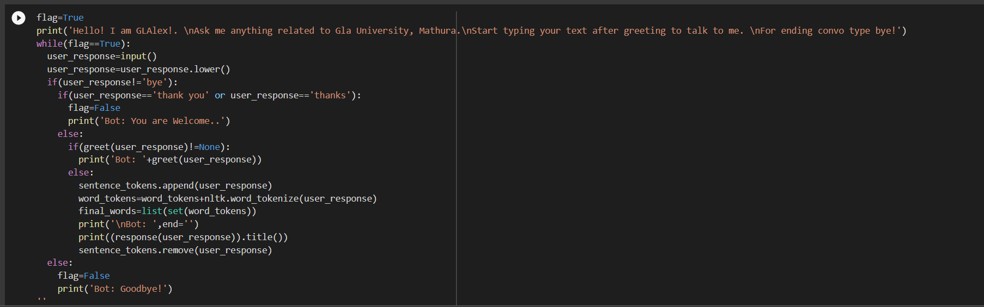
Defining the entire chat flow
creating a flag as true
and with this the bot will start by greeting
the sentence token will get appended with user response and for the sentence token the word token will be found
and final words will be chosen and for the final word there response will be generated
by the logic using cosine similarity and will be returned to the user and at the end I will be removing the user response from the sentence token in order to ensure that corpus is not corrupted

Slide 15
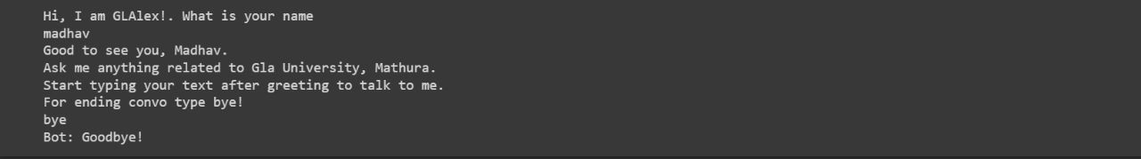
OUTPUTS
Here we have presented few examples of the interactions with our bot:

Slide 16
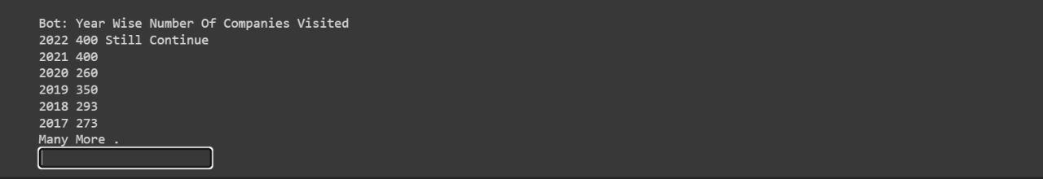
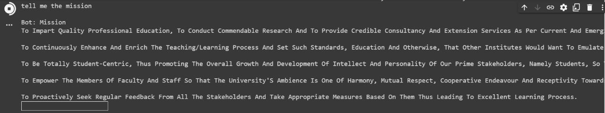

Slide 17




RESOURCES
intellipaat.com
YouTube
GeeksForGeeks
Wikipedia

Slide 18
THANK YOU !

