Slide 1

AAA Medicare
Integration of Health and Insurance enterprises for hassle free experience

Slide 2

Problem
To ensure Integration between Hospital and Insurance enterprises across the network to simplify consultations and test procedures

Slide 3
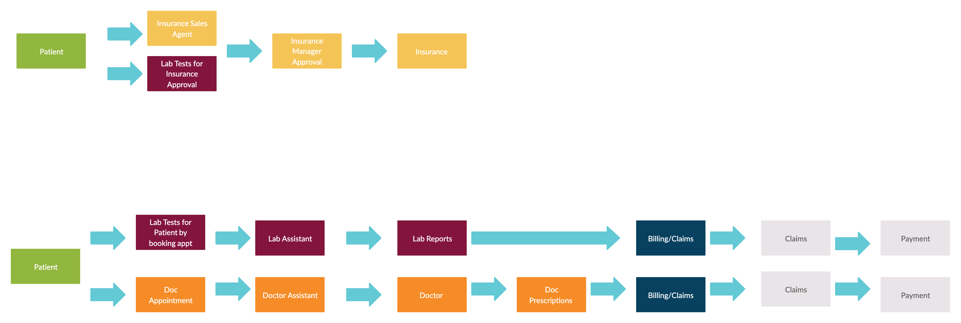
Workflow

Slide 4
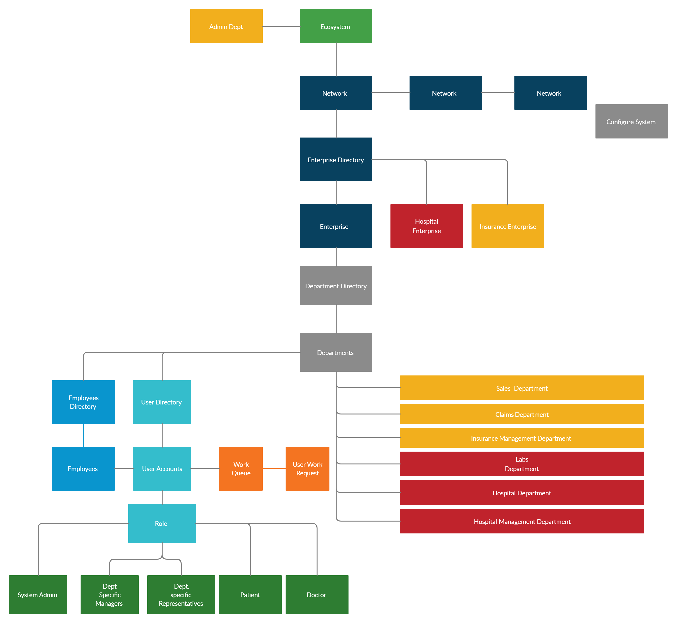
Model Diagram

Slide 5
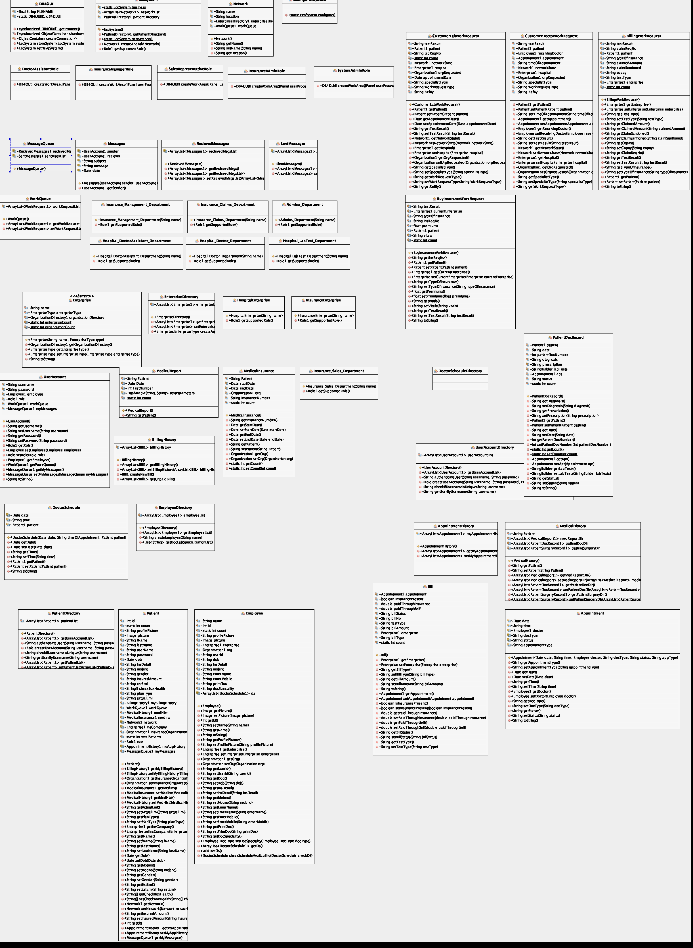
Class diagram

Slide 6
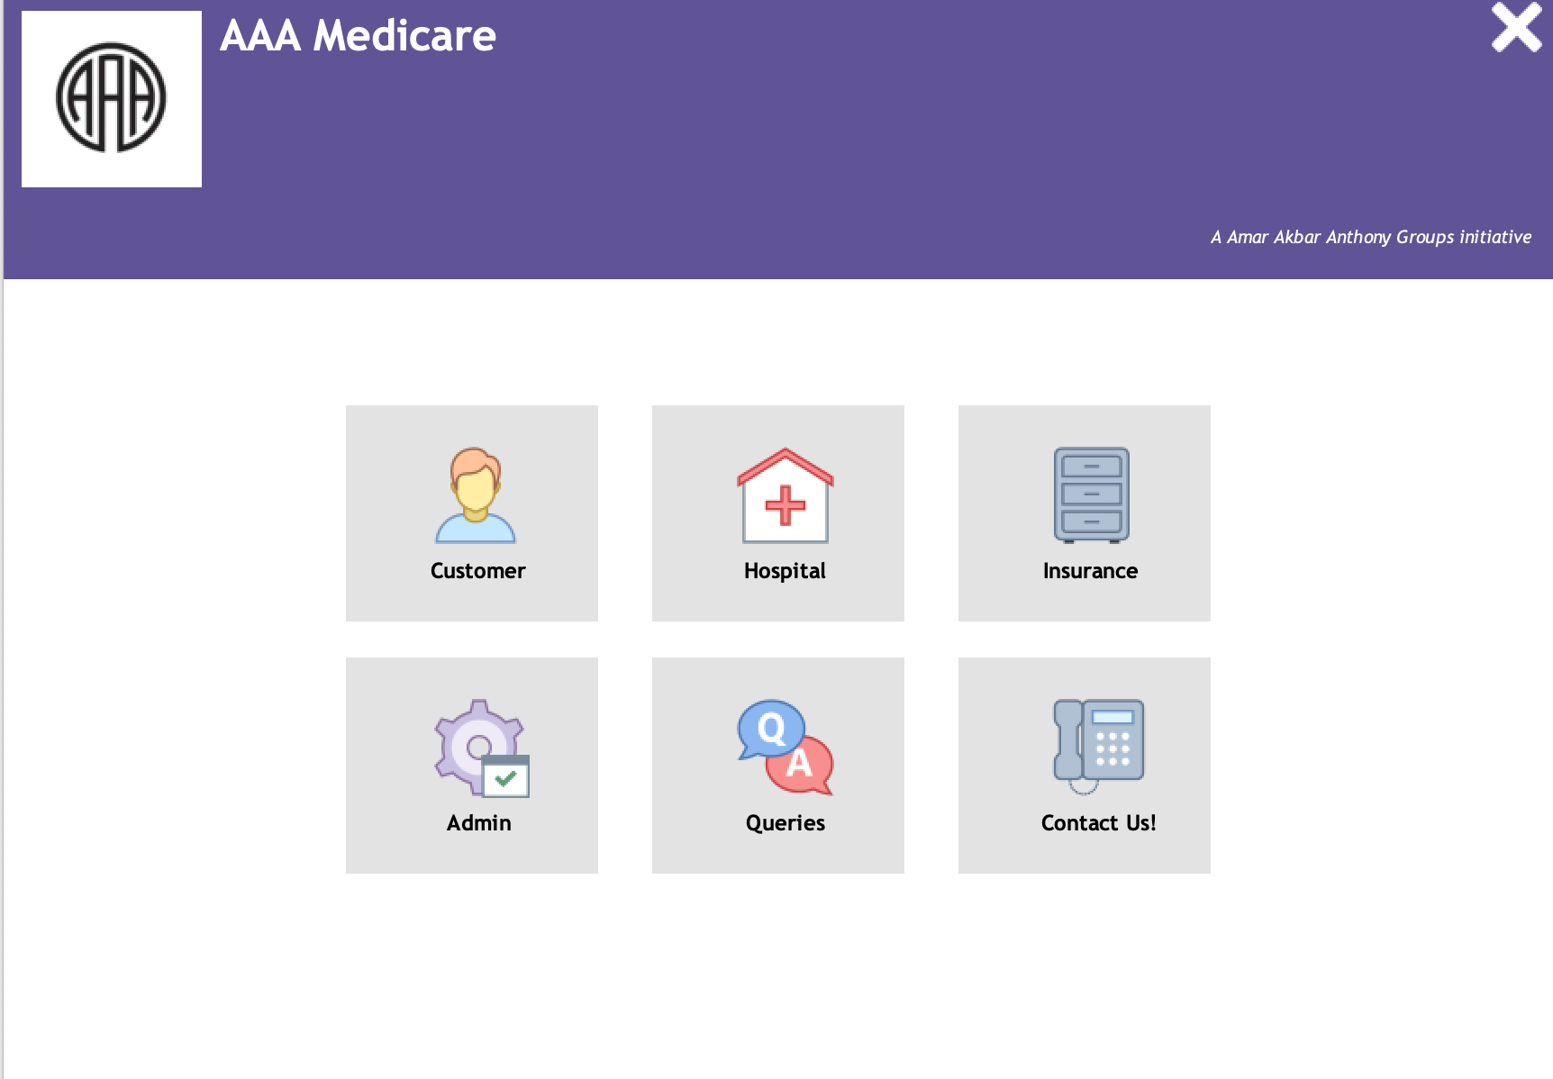
Screenshots of the Application

Slide 7
