Slide 1




INTELLIGENT CANDIDATE RANKING SYSTEM
Ranking 100,000 candidates for a Senior AI Engineer
role
PRESENTED BY:
Madhav Mittal(Solo Participant)
India Runs Data & AI Challenge 2026

Slide 2

OBJECTIVE OF THE
PROJECT
Problem
Our Solution
Recruiters go through 100K profiles manually
Keyword filters miss qualified candidates
Can't detect fake/honeypot profiles
Multi-signal scoring across 5 dimensions
Honeypot + keyword stuffer detection
23 behavioral signals from redrob platform
Output
Top 100 candidates ranked with scores
Human-readable reasoning per candidate
Runs in under 60 seconds on CPU

Slide 3
PROBLEM AND PRIOR
RESEARCH
PROBLEM
PRIOR RESEARCH
100,000 candidates — impossible to review manually
Keyword matching misses hidden gems
No way to detect fake/stuffed profiles
Behavioral signals completely ignored
Basic cosine similarity → misses context
Pure embedding search → ignores experience
TF-IDF → no fraud detection
LangChain wrappers → too slow, needs API

Slide 4




ADDRESSING RESEARCH GAPS
Skill Depth
Fraud Detection
Behavioral Signals
Explainability
Skills weighted by proficiency AND duration
Expert + 1 month < Intermediate + 2 years
6 honeypot detection rules
Keyword stuffer penalty up to −0.40
23 redrob signals used
Recruiter response rate, recency, GitHub
Every candidate gets real reasoning
Not "good candidate" — actual data points

Slide 5


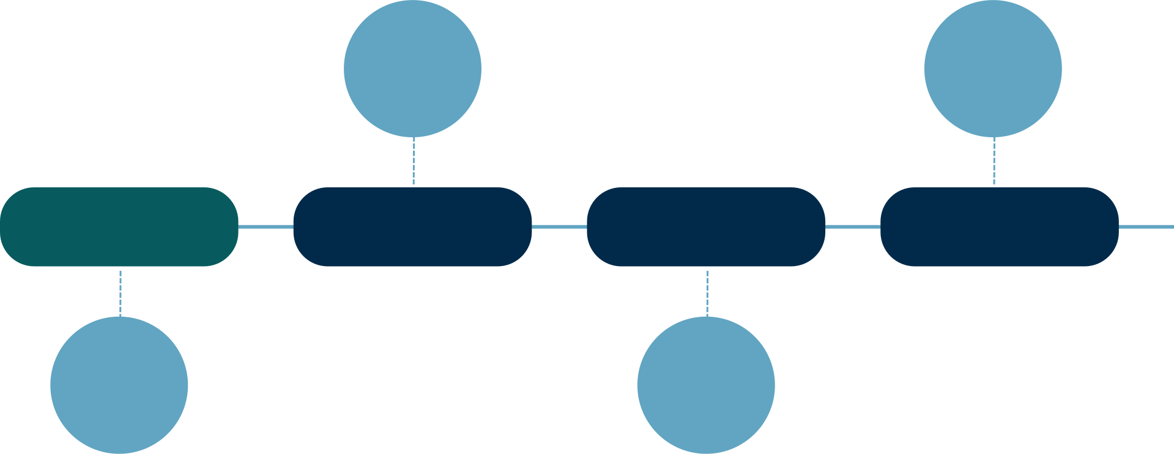
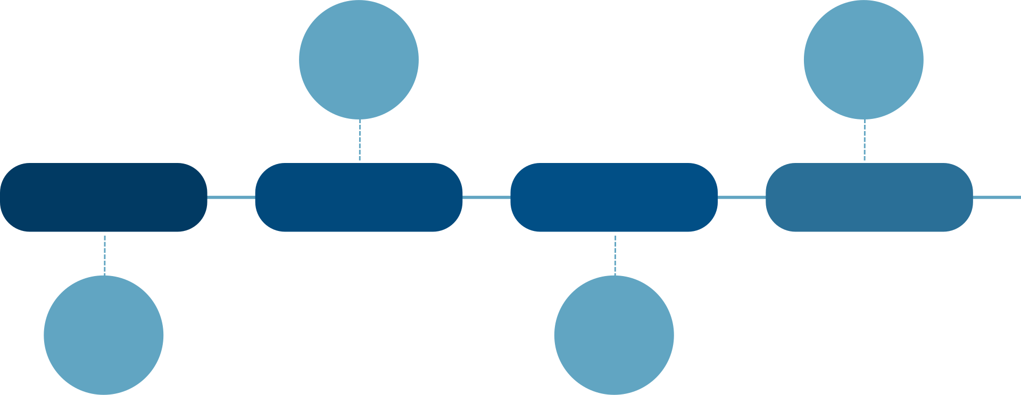








PROJECT METHODOLOGY
Honeypot Detection
Weighted Scoring
Final score 0.0–1.0
Remove ~80 fake profiles
STEP 01
STEP 02
STEP 03
STEP 04
STEP 05
Load Data
Feature Extraction
Output
100K JSONL profiles, 487MB
Top 100 CSV + reasoning
5 scores per candidate

Slide 6
DATASET
DESCRIPTION
Dataset Used:
100,000 candidate profiles in JSONL format
Each profile has: skills, career history, education, redrob signals
Profile Structure:
Skills — name, proficiency, duration_months, endorsements
Career History — company, title, description (free text)
Education — institution, tier (Tier 1 to Tier 4), field
Redrob Signals — 23 behavioral fields
Key Numbers:
100,000 total candidates
~80 honeypots detected and removed
99,920 clean candidates scored
Top 100 selected for submission

