Slide 1
Customer Churn Prediction
A Data-Driven Approach to Retention

Slide 2
Agenda
Presentation Overview
1. Business Context & Problem Statement
2. Data Overview & End-to-End Pipeline
3. Data Cleaning Summary
4. Data Merging & Aggregation
5. EDA Findings
6. Hypothesis Testing Results
7. Feature Engineering (136 -> 61 columns)
8. Model Comparison (10 Models)
9. Best Model & Business Recommendation
10. Dashboard & Next Steps

Slide 3
1. Business Context

Slide 4
Business Context
Why Churn Prediction Matters
Problem: Identify customers likely to churn after renewal so retention teams can act early
Modelling Task: Binary Classification
Won = Retained customer | Churned = Lost customer
Open = Pending (excluded from training)
Scale: 122,082 renewal records across multiple years
Churn Rate: ~11% among the Won/Churned subset
Business Impact: Even 1% improvement in churn detection can save significant revenue through targeted retention campaigns

Slide 5
2. Data Overview
& Pipeline

Slide 6
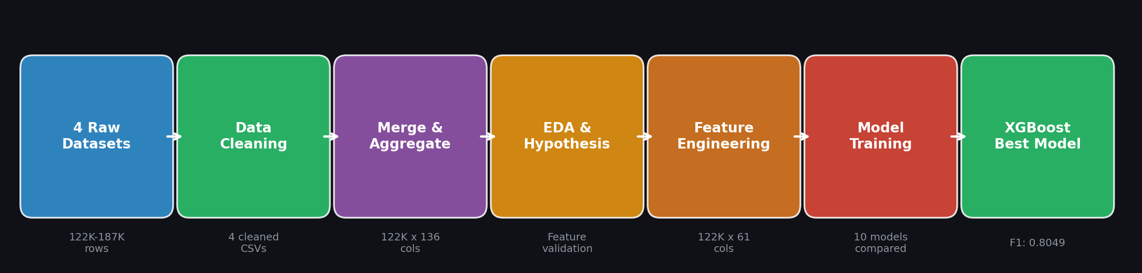
End-to-End Pipeline
From raw data to production model

Slide 7
Raw Data Summary
Four source tables feed the pipeline
Dataset | Rows | Columns | Key Content
billings.csv | 122,082 | 59 | Scores, billing amounts, membership, dates, target
cc_calls.csv | 32,882 | 33 | Issue flags, sentiment, engagement, pricing concerns
emails.csv | 123,389 | 27 | CRM flags, accreditation, churn risk, sentiment
renewal_calls.csv | 186,534 | 41 | Complaints, pricing, competitor, friction, transcripts

Slide 8
3. Data Cleaning

Slide 9
Cleaning Summary - Billings & CC Calls
Standardizing the two core tables
Billings (59 cols -> 53 cleaned):
Dropped empty/sparse columns (Connection_Net, Discount_Amount, etc.)
Parsed 7 date fields to datetime
Standardized booleans: y/n & True/False -> Yes/No
Missing categoricals -> 'Unknown'; Numerics -> 0 or median
CC Calls (33 cols -> 33 cleaned):
Recovered missing Co_Ref via Contact_ID lookup
Collapsed cc_care_package to 5 clean categories
Collapsed cc_contractor_sentiment to 4 levels
Pattern-based logic for questionnaire issues
Sentiment scores -> numeric + median fill

Slide 10
Cleaning Summary - Emails & Renewal Calls
Handling the interaction-heavy tables
Emails / CRM (27 cols -> 27 cleaned):
Standardized Yes/No flags; invalid free text -> 'Yes'
Normalized membership levels to 8 tiers (Gold/Silver/Bronze/...)
Sentiment & chase count -> numeric conversion
Renewal Calls (41 cols -> 45 engineered):
Dropped rows with missing Co_Ref
Engineered from transcripts: asked_for_discount, has_desired_to_cancel, Has_Complaint, Has_Negative_Reaction
Standardized all binary columns to Yes/No/Not Mentioned
Collapsed multi-transcript rows into call-level records
Result: 186,534 raw rows -> 127,307 cleaned records

Slide 11
4. Data Merging
& Aggregation

Slide 12
Merge Strategy
Customer-year level aggregation with temporal filtering
Master Key: (Co_Ref, Renewal_Year) - one row per customer per year
Join: Left join from billings to all interaction tables
Temporal Filtering (prevents data leakage):
Emails: all records aggregated by year (pre-renewal by nature)
CC Calls: only Call_Date < Renewal_Month (pre-renewal signals)
Renewal Calls: only Call_Date > Renewal_Date (post-renewal follow-up)
Aggregation: Counts, proportions, means, max values, mode categories
Null Handling: Counts -> 0, aggregates -> 0, modes -> 'No Interaction'
Result: 122,082 rows x 136 columns (master_churn_dataset.csv)

Slide 13
5. Exploratory Data
Analysis

Slide 14
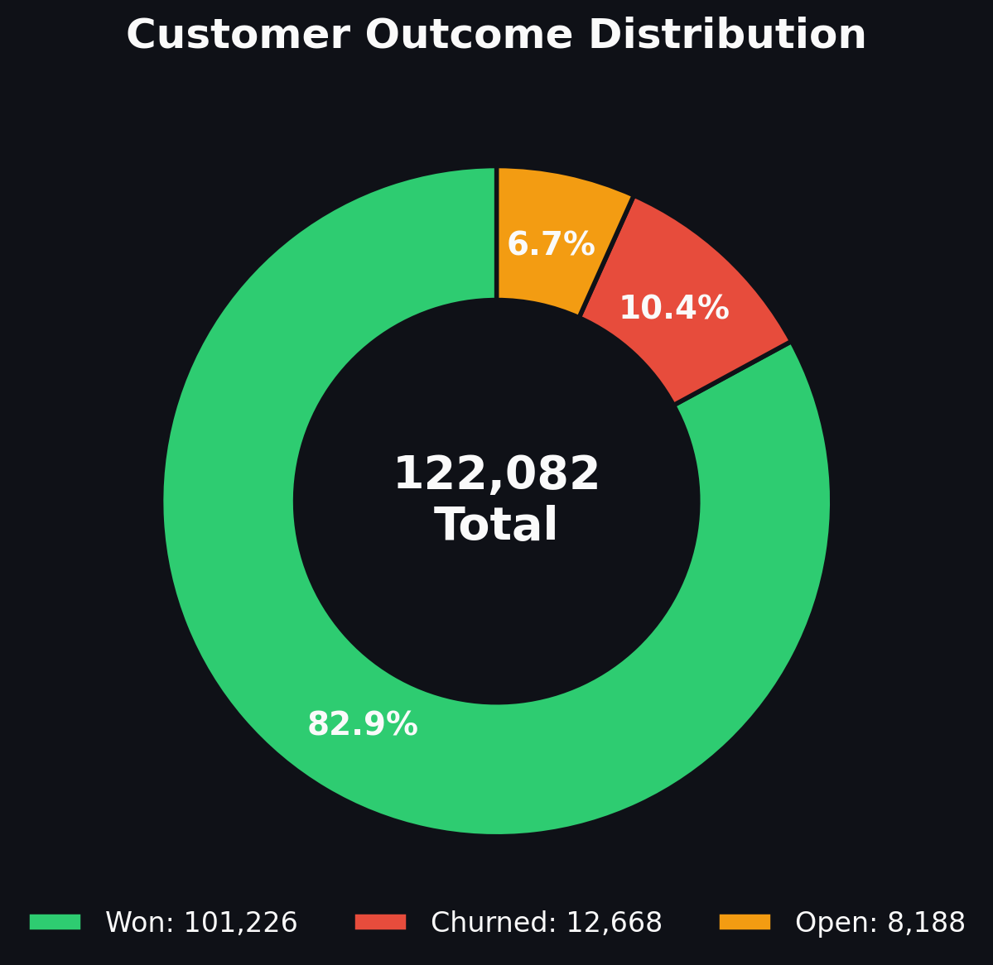
Target Distribution
Imbalanced binary classification problem (~11% churn rate)
Key Observations:
Won: 101,226 (82.9%)
Churned: 12,668 (10.4%)
Open: 8,188 (6.7%)
Binary churn rate: ~11.1%
Implication:
Accuracy alone is misleading
(89% by predicting all Won)
F1 score used as primary
evaluation metric

Slide 15
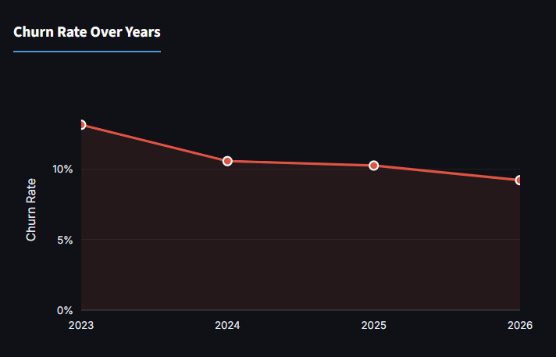
Churn Rate Trend
How churn has evolved across renewal years

Slide 16
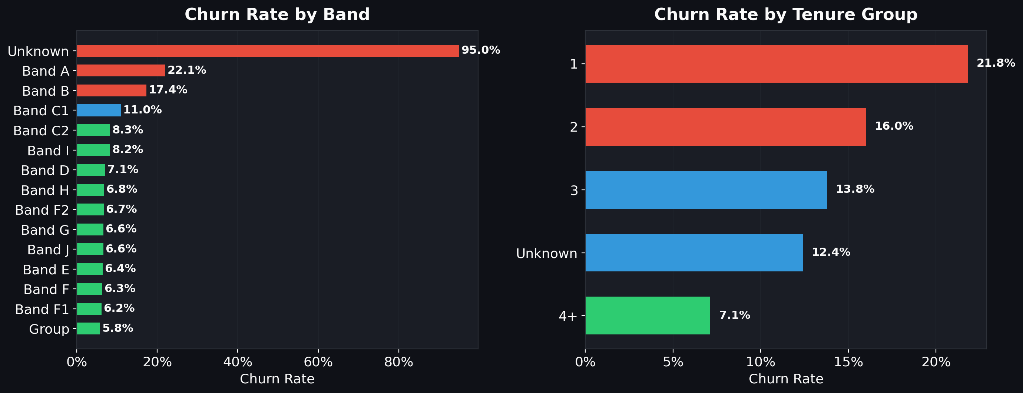
Churn by Customer Segments
Band and Tenure Group breakdown

Slide 17
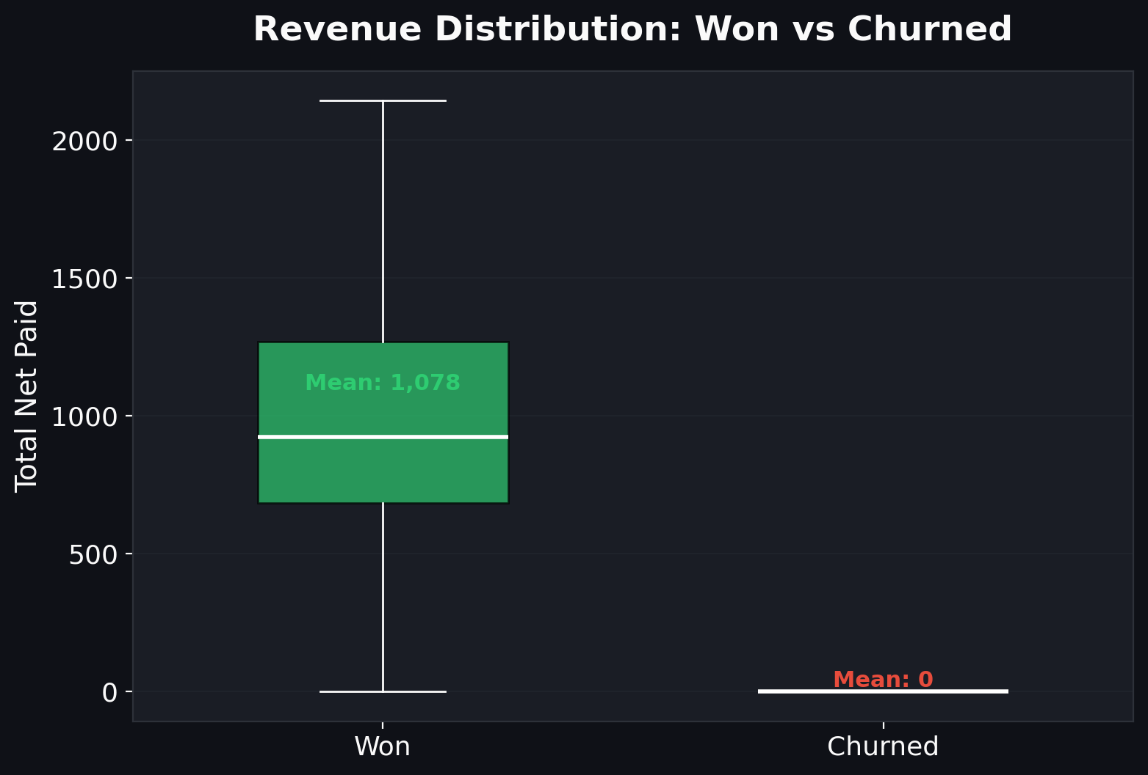
Revenue Impact
Churned customers have lower average revenue
Key Finding:
Retained customers have
significantly higher
average billing values
Business implication:
Churn prevention directly
protects higher-value
revenue streams

Slide 18
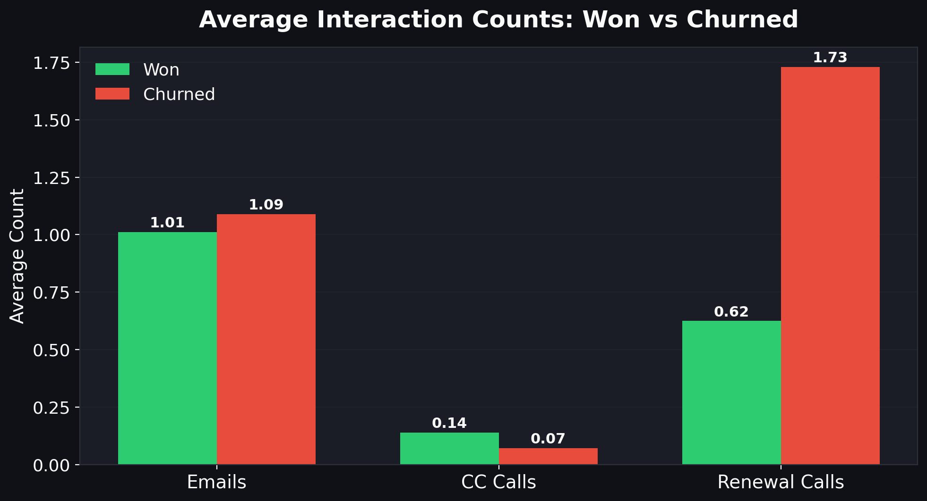
Interaction Patterns
Churned customers show different engagement patterns
Insight:
Higher interaction volume
= distress signal
Churned customers had
more renewal calls
on average
Email & CC patterns
also differ significantly

Slide 19
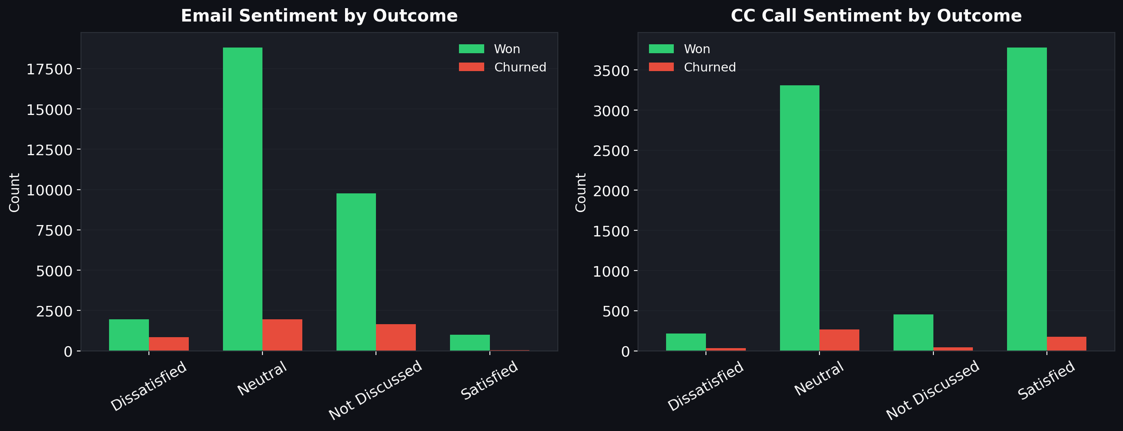
Sentiment Analysis
Email and CC call sentiment distribution by outcome

Slide 20
6. Hypothesis Testing

Slide 21
Hypothesis Testing Results
7 hypothesis groups tested - ALL validated as statistically significant
Hypothesis | Test Used | Features Tested | Result
H1: Billing Scores | t-test | Renewal, Auto Renewal, Tenure, Anchoring scores | HIGHLY SIGNIFICANT
H2: Interaction Volume | Mann-Whitney U | Email count, CC calls, Renewal calls | SIGNIFICANT
H3: Sentiment | t-test | Sentiment scores, dissatisfaction indices | SIGNIFICANT
H4: Churn Risk Signals | t-test | Suggested leave, competitors, platform issues | STRONGEST
H5: Engagement | t-test | Accreditation, engagement signals | SIGNIFICANT
H6: Renewal Friction | t-test | Friction, complaints, discount requests | HIGHLY SIGNIFICANT
H7: Categorical Vars | Chi-Square | Sentiment mode, membership decision, etc. | ASSOCIATED

Slide 22
Hypothesis Testing - Key Takeaways
Every feature group passed statistical validation
Strongest Individual Predictors:
1. Total_Renewal_Score_New (billing score)
2. em_crm_contractor_suggested_leave (email churn signal)
3. Price-change derived features
4. Renewal friction and complaint composites
Conclusion: The final feature set is both statistically meaningful AND business-interpretable
This validates our engineering approach: composite features capture real behavioral signals, not noise

Slide 23
7. Feature Engineering
136 -> 61 Columns

Slide 24
Feature Engineering Overview
Systematic reduction from 136 to 61 model-ready columns
Removed (75 columns):
Identifiers & dates: Co_Ref, 5 date columns
14 redundant billing amounts -> 3 change features (price_change_abs/pct, net_paid_vs_last)
3 correlated connection counts -> 1 connection_change feature
16 granular email CRM flags -> 4 composite indices
14 CC call flags + 4 sentiment scores -> 5 composite indices
12+ renewal call flags -> 3 composite indices + friction score
10 high-cardinality mode columns -> 1 binary flag (ren_has_churn_reason)
Duplicate scores: Status_Scores, Last_Band
Business features created: has_auto_renewal, has_worldpay_token, total_interaction_count

Slide 25
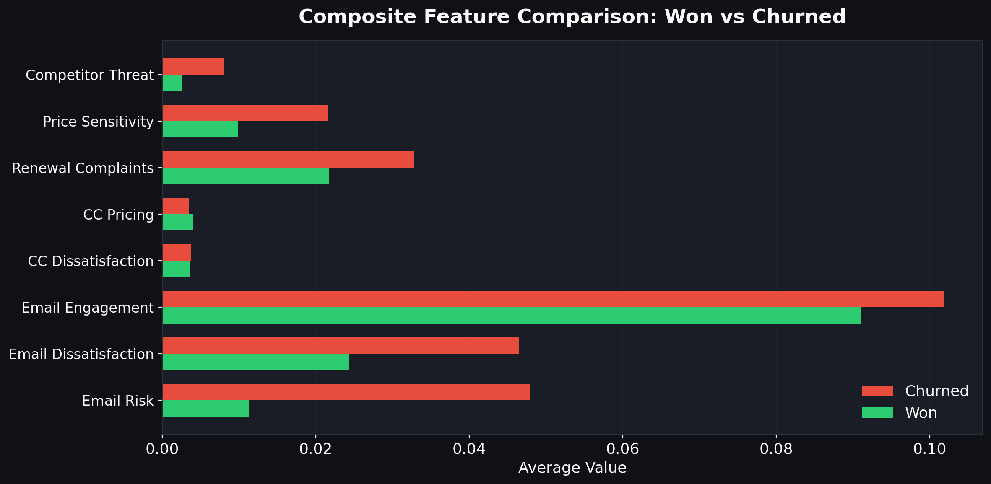
Composite Features: Won vs Churned
Engineered indices clearly separate the two groups

Slide 26
8. Model Training
10 Models Compared

Slide 27
Modelling Approach
Training setup, leakage handling, and evaluation
9 Leaky Features Removed Before Training:
Total_Net_Paid, price_change_pct/abs, net_paid_vs_last (financial outcome)
Payment_Method, Payment_Timeframe (post-outcome), Days_To_Close_Post_Renewal
Total_Renewal_Score_New (target-adjacent), Renewal_Year (temporal ID)
Training Setup:
Stratified train/test split | Baseline + Tuned runs for each model
F1 as primary metric | Class imbalance: SMOTE / SMOTENC / class weights
10 Models Trained: XGBoost, LightGBM, Gradient Boosting, Decision Tree, AdaBoost, Random Forest, Logistic Regression, KNN, Naive Bayes, SVM

Slide 28
Model Comparison
Best result per model, ranked by F1
Rank | Model | Variant | Accuracy | Precision | Recall | F1 | ROC AUC
1 | XGBoost | Tuned | 0.9565 | 0.8024 | 0.8074 | 0.8049 | 0.9806
2 | LightGBM | Tuned | 0.9549 | 0.7895 | 0.8110 | 0.8001 | 0.9808
3 | Grad. Boosting | Tuned | 0.9532 | 0.7754 | 0.8149 | 0.7947 | 0.9777
4 | Decision Tree | SMOTE | 0.9432 | 0.7106 | 0.8256 | 0.7638 | N/A
5 | AdaBoost | Tuned | 0.9353 | 0.6640 | 0.8477 | 0.7447 | 0.9711
6 | Random Forest | No SMOTE | 0.9421 | 0.9037 | 0.5371 | 0.6738 | N/A
7 | Logistic Reg. | Baseline | 0.8909 | 0.5056 | 0.8571 | 0.6360 | 0.9529
8 | KNN | Tuned | 0.9187 | 0.6740 | 0.5221 | 0.5884 | 0.8845
9 | Naive Bayes | Baseline | 0.8743 | 0.4595 | 0.7356 | 0.5656 | 0.9028
10 | SVM | Tuned | 0.8508 | 0.4132 | 0.8118 | 0.5477 | 0.9157

Slide 29
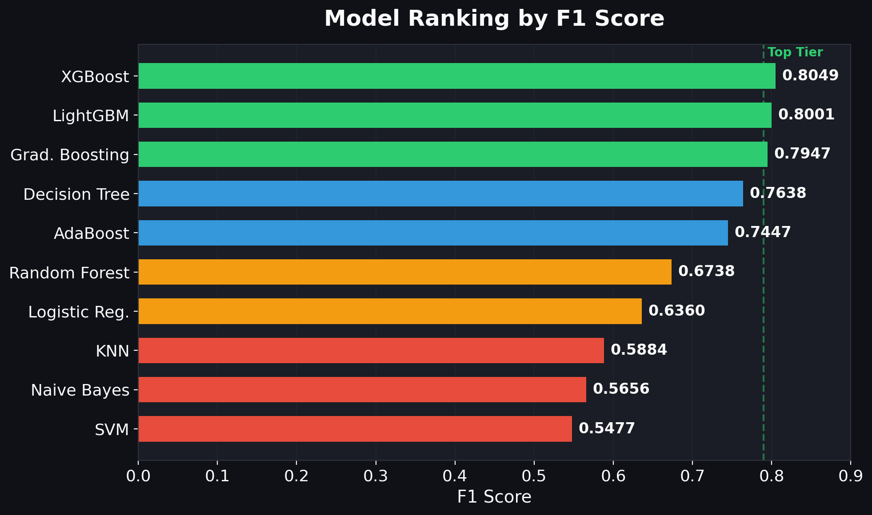
F1 Score Ranking
Clear top tier: XGBoost, LightGBM, Gradient Boosting

Slide 30
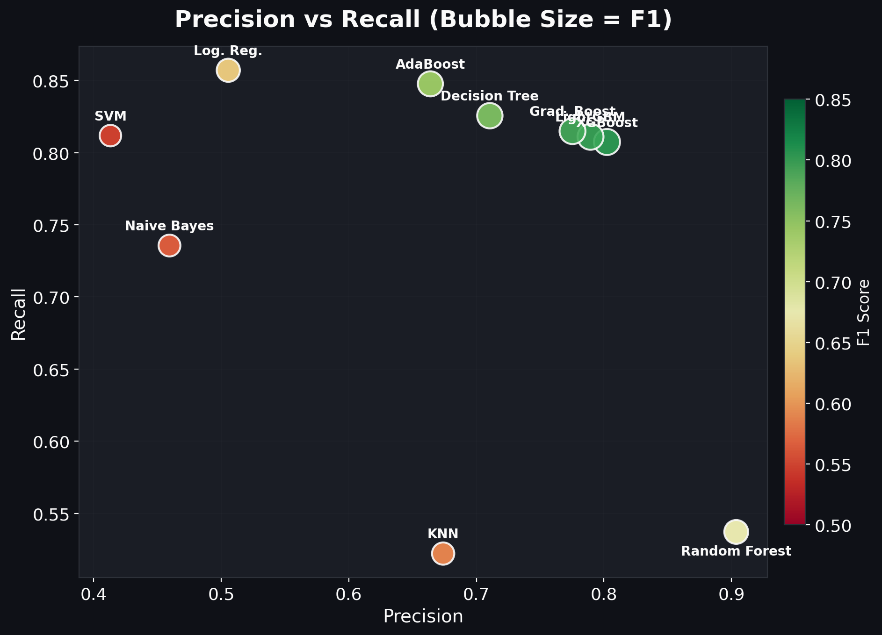
Precision vs Recall Tradeoff
Each model sits in a different spot on the precision-recall curve

Slide 31
9. Best Model
& Recommendation

Slide 32
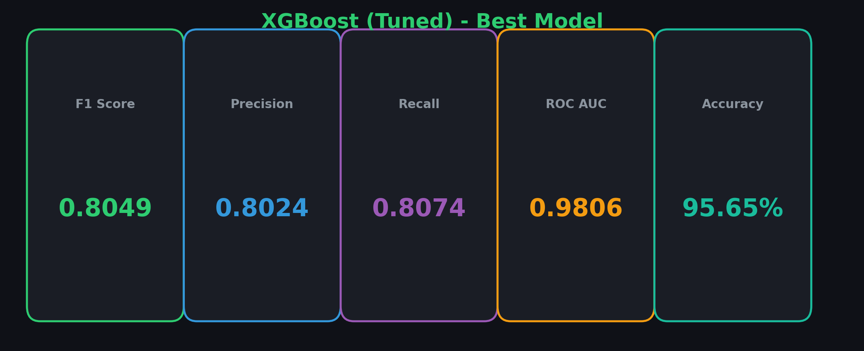
Best Model: XGBoost (Tuned)
Production-ready recommendation

Slide 33
Business Evaluation
Aligning model choice with retention strategy
Scenario 1: Balanced (RECOMMENDED) -> XGBoost
F1: 0.8049 | 80% of flagged churners are real | Catches 81% of actual churners
Best for: Targeted retention campaigns, personalized offers
Scenario 2: Maximum Detection -> AdaBoost / Logistic Regression
Recall: 0.85+ | Accept more false alarms to catch nearly all churners
Best for: High-value customers where missing a churner is very costly
Scenario 3: Precision-First -> Random Forest
Precision: 0.90+ | Only flag near-certain churners
Best for: Expensive interventions (account manager, large discounts)
Start with XGBoost. Adjust the probability threshold based on campaign results.

Slide 34
10. Dashboard
& Next Steps

Slide 35
Interactive Streamlit Dashboard
5-page dashboard for stakeholder exploration
Technology: Streamlit + Plotly | Command: python -m streamlit run dashboard/app.py
Page 1: Executive Summary - KPIs, donut chart, yearly trend, revenue
Page 2: Customer Profile - Churn by Band, Tenure, Payment, Connections
Page 3: Interaction Analysis - Email/CC/Renewal patterns, sentiment, scatter
Page 4: Model Performance - F1 ranking, P-R tradeoff, multi-metric comparison
Page 5: Risk Drilldown - Composite features, lift tables, radar chart
Features: Global filters (Year, Band, Tenure), dark theme, data caching, interactive charts

Slide 36
Next Steps
Moving from analysis to production impact
Immediate:
Deploy XGBoost to score 8,188 'Open' customers
Generate risk-ranked list for retention team
Set probability threshold based on campaign budget
Short-Term:
A/B test retention interventions on model-flagged vs random groups
Monitor model performance monthly
Share feature importance with operations for root cause action
Medium-Term:
Automate pipeline: raw data -> scoring -> alerts
Build customer lifetime value model for prioritization
Integrate real-time renewal call analysis for proactive prompts

Slide 37
Thank You
Customer Churn Prediction
Questions & Discussion

