Slide 1
Unveiling Narratives: Analyzing Character Roles & Themes in Novels
Thejesh Mallidi
Subramaniya Siva T S
Om Sai Krishna Madhav Lella
Jeeva Saravana Bhavanandam

Slide 2
Problem Description
Motivation:
This project aims to explore the potential of NLP methods in understanding the deeper dynamics of character roles, themes, and interactions in literature.
Objective:
To develop and implement diverse methods for analyzing character roles, themes, and interactions between characters in novels.
Dataset Used:
We used a collection of 3,036 English books, written by 142 authors from the Gutenberg Dataset, for our analysis in various steps of the project.

Slide 3
Problem Tasks
To achieve our objectives, we divided the problem into several tasks:
Name Entity Recognition
Entity Role Identification
Narrative Theme Identification
Narrative Explanation Generation
The first two tasks help us gain insight into the characters, while the last two tasks focus on how these characters are utilized in the literature.

Slide 4
Named Entity Recognition
Thejesh Mallidi

Slide 5
Task 1: Named Entity Recognition
Introduction
Goal: To develop a robust Named Entity Recognition (NER) system for literary texts.
Challenges:
High rate of false positives with standard models
Capturing the nuances of literary language
Differentiating between character names and other entities
Key Objectives:
Improve precision and recall
Model Fine-Tuning
Rule-based Enhancements

Slide 6
Approach
Initial Attempt:
Used SpaCy’s pre-trained models
Issues: High rate of false positives in literary contexts
Model Fine-Tuning:
Fine-tuned a RoBERTa model on the CoNLL-2003 dataset
Benefit: Leveraged reliable annotations for entities like persons, organizations, and locations.
Rule-Based Enhancements:
Entity Confidence Thresholding
Ignoring Irrelevant Entity Types
Merging Adjacent Entities

Slide 7
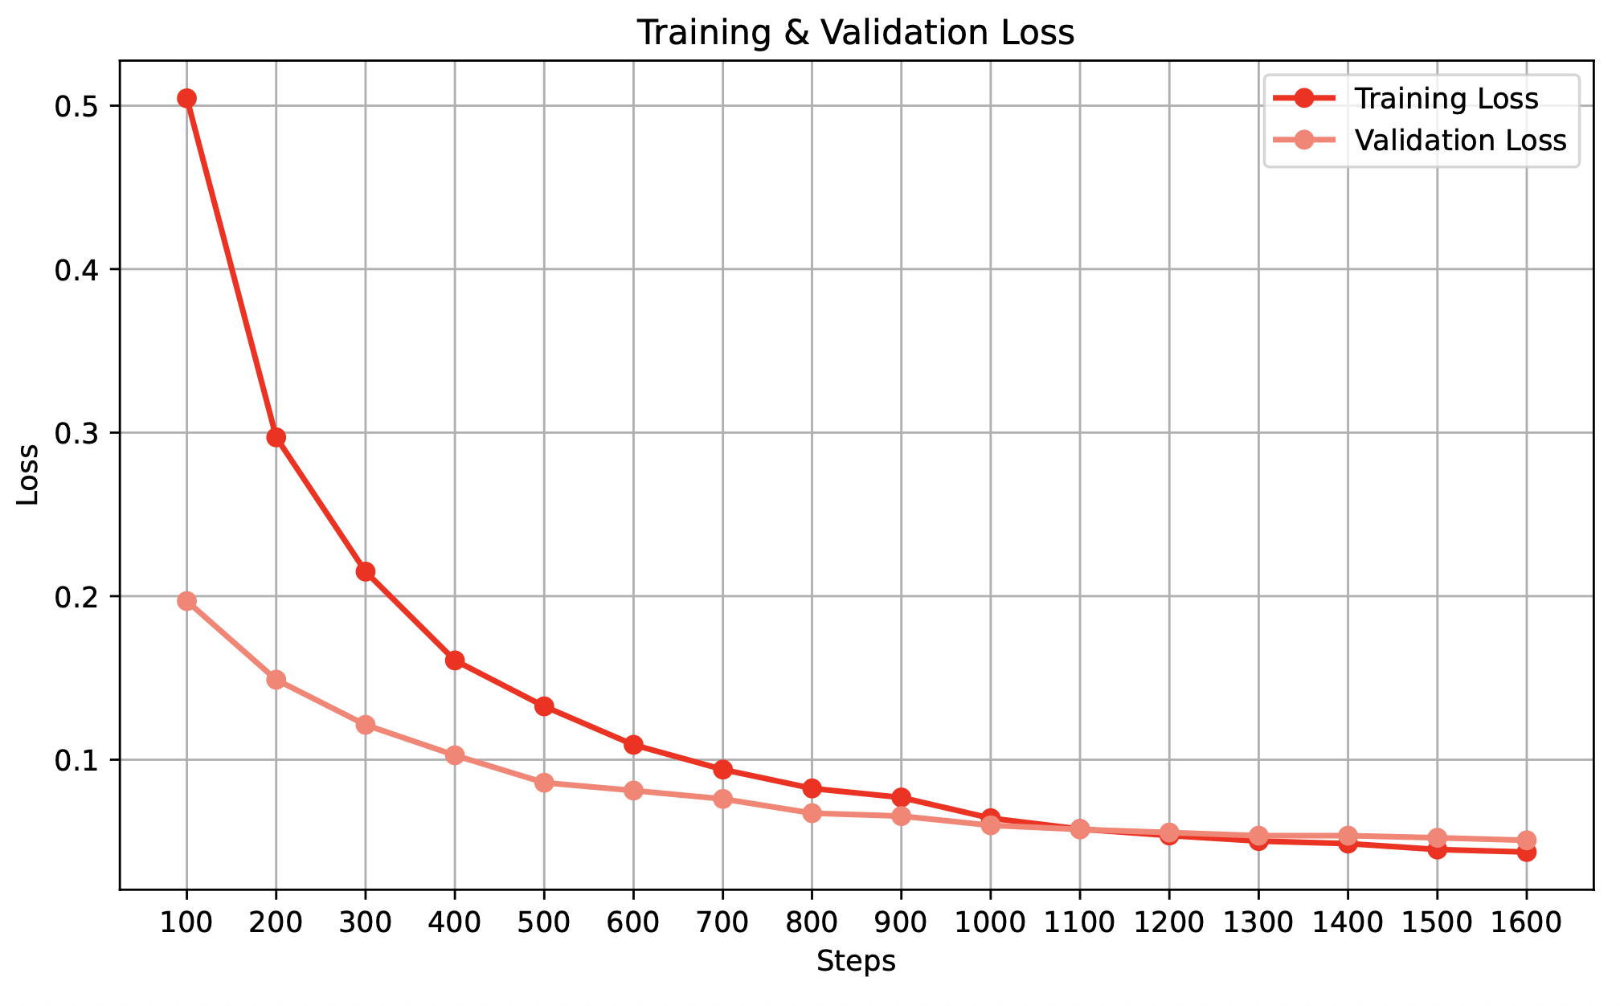
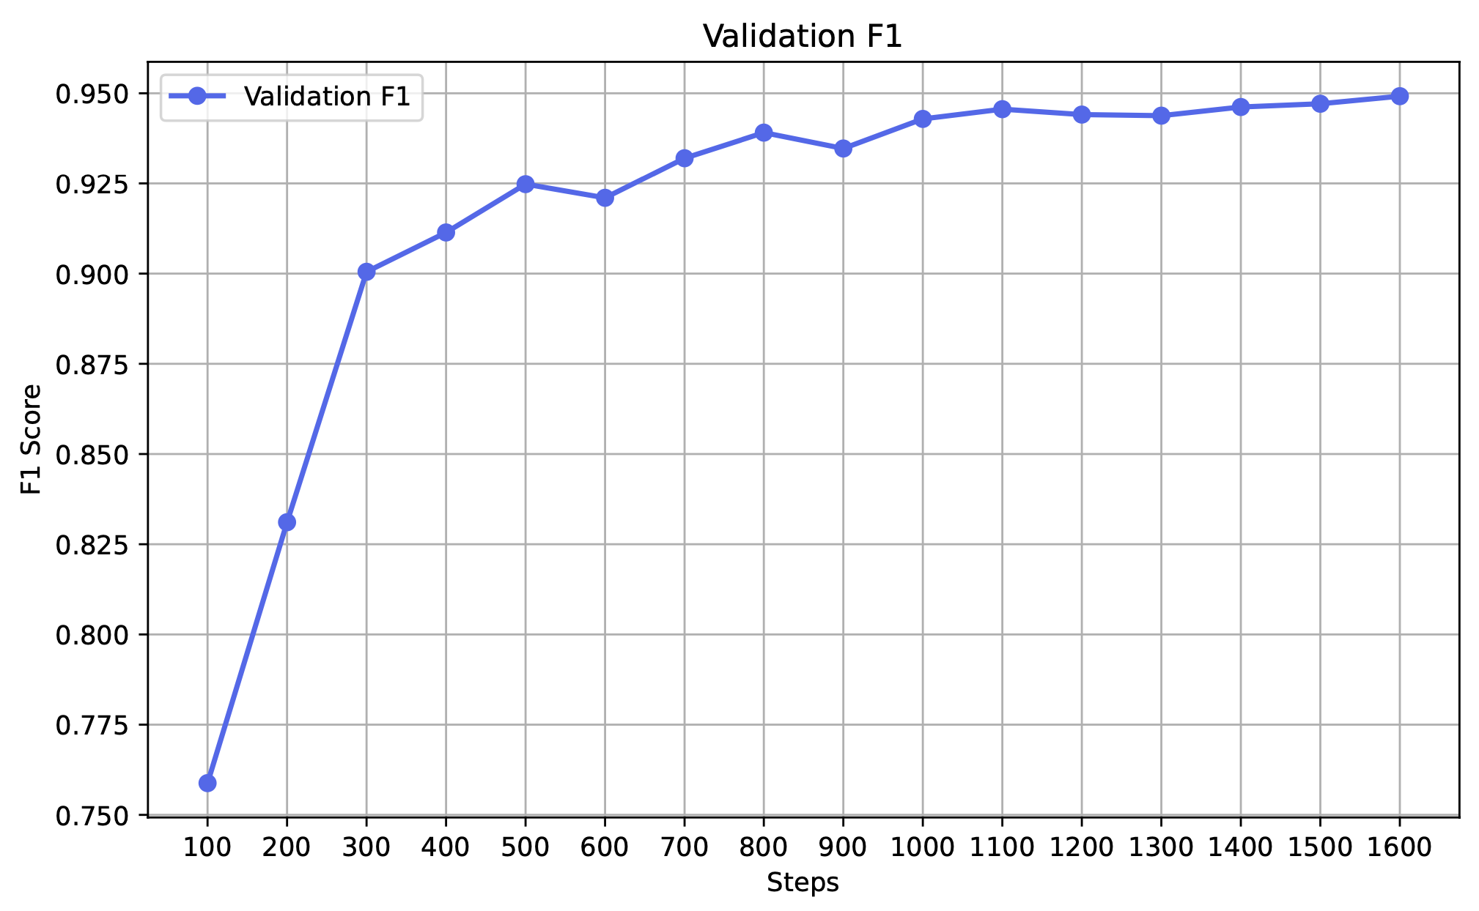
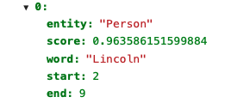
Evaluation & Results
Metrics Used:
Precision, Recall & F1-Score
Results:
BERT-base Model with rule based enhancements improved the F1-score to 0.89
RoBERTa-base Model further improved F1-Score to 0.91
Sample Output:

Slide 8
Named Entity Recognition
Subramaniya Siva T S

Slide 9
Task 2: Entity Role Identification
Introduction
Goal:
The aim is to systematically classify characters in books by identifying their:
Roles: For instance, Protagonist, Antagonist, or other supporting roles.
Traits: Descriptive characteristics such as Brave, Intelligent, or Cunning, which define their personality and influence in the story.
Key Objectives:
Accurately identify and extract character mentions while filtering irrelevant or ambiguous references.
Compile narrative context around characters for meaningful analysis.
Assign hierarchical roles and defining traits to enhance character profiling.
By achieving these objectives, the project aims to enable a structured and insightful examination of character dynamics in any book.

Slide 10
Roles and Traits
Roles
Traits
Roles represent the narrative functions or positions of characters within the story, defining their impact and contributions to the plot
Traits are characteristics that define a character's personality, emotions, and motivations, offering insight into their actions and decisions.
Protagonist
Antagonist
Support
Moral
Personality
Emotional
Hero
Anti-Hero
Mentor
Leader
Survivor
Everyman
Reluctant Hero
Tragic Hero
Villain
Rival
Betrayer
Oppressor
Manipulator
Sidekick
Confidant
Protector
Advisor
Companion
Honest
Dishonest
Generous
Greedy
Compassionate
Cruel
Just
Corrupt
Principled
Opportunistic
Kind
Arrogant
Brave
Cowardly
Intelligent
Foolish
Optimistic
Pessimistic
Charismatic
Friendly
Hostile
Calm
Angry
Joyful
Sad
Moody
Anxious
Stoic
Foil
Comic Relief
Neutral Character
Contrast Character
Mirror Character
Jester
Clown
Bystander
Mediator
Informant
Outsider
Opportunist
Social
Motivation
Behavior
Introverted
Extroverted
Outgoing
Reserved
Manipulative
Supportive
Ambitious
Lazy
Driven
Indifferent
Passionate
Apathetic
Aggressive
Passive
Assertive
Reckless
Cautious
Strategic

Slide 11
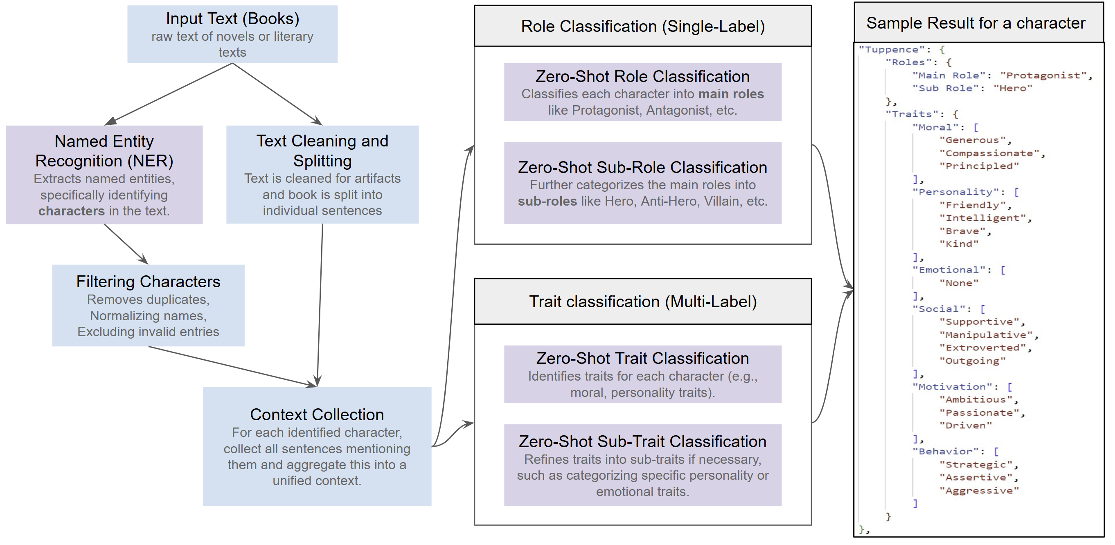
Methodology
Models Experimented: Facebook BART-Large MNLI, DistilBERT, RoBERTa-Large MNLI

Slide 12
Filtering Characters
Effective character filtering is a crucial step in text analysis, ensuring that only meaningful and unique character names are retained for further processing. This process eliminates noise, standardizes data, and enhances the accuracy of role and trait classification.
Data Loading
Initial Cleaning
Name Normalization
Input: JSON file containing character entities.
Extraction: Focus on entries labeled as "Person".
Whitespace Removal: Strip leading and trailing spaces from names.
Length Filtering: Exclude names with 2 or fewer characters.
Stopwords: Remove common stopwords (e.g., 'and', 'on', 'the') to avoid non-informative names.
Prefixes: Eliminate titles such as 'Mr.', 'Mrs.', 'Dr.', 'Sir', etc.
Validation Checks
Normalization and Uniqueness
Final Output
Alphabetic Characters: Ensure names contain alphabetic characters.
Case Sensitivity: Names must start with an uppercase letter.
Allowed Characters: Permit spaces, hyphens (-), and apostrophes (') only.
Case Normalization: Convert names to lowercase for consistency.
Deduplication: Ensure each character name is unique after normalization.
A clean, unique list of character names ready for further analysis.

Slide 13
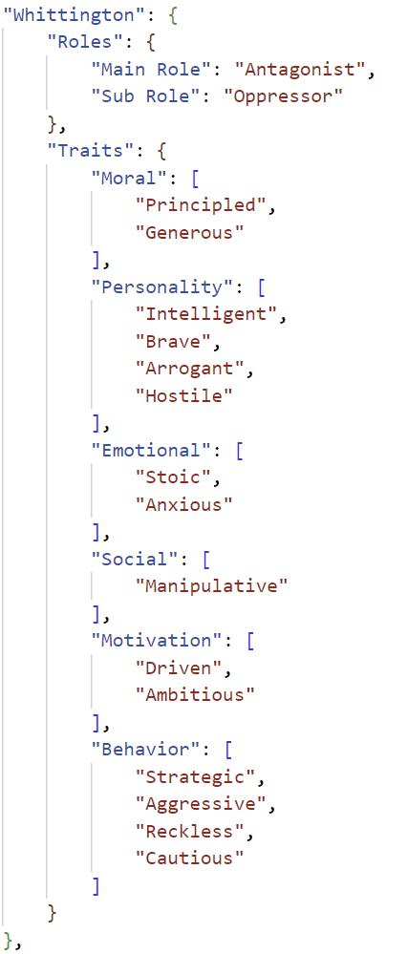
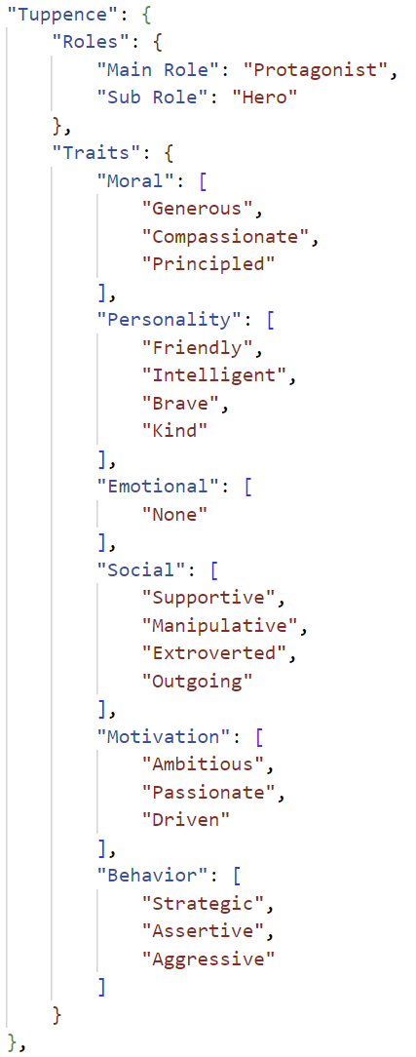
Results
Key Observations:
Roles:
Tuppence:
Predicted Role: Protagonist and Hero, showcasing bravery, intelligence, and moral principles.
In the Book: Accurately portrayed as the main driving force in solving the mystery, with cleverness and courage aligning with her role.
Whittington:
Predicted Role: Antagonist and Oppressor, representing corruption and selfishness.
In the Book: Matches his role as an early villain.
Traits:
Tuppence:
Predicted Traits: Strategic, assertive, supportive yet manipulative for good, morally principled.
In the Book: These predictions hold true. Tuppence is resourceful, bold, and willing to use manipulation tactically, such as impersonating "Jane Finn" to extract information.
Whittington:
Predicted Traits: Arrogant, hostile, reckless, manipulative, and anxious.
In the Book: Largely accurate. Whittington is manipulative and arrogant but reckless under pressure, leading to his eventual failure.
Model struggles with people who turn villain in the later half of the story or nuanced well written villains.
This is mostly due to the limited context length of the models.

Slide 14
Narrative Theme Identification
Om Sai Krishna Madhav Lella

Slide 15
Task 3: Narrative Theme Identification
Objectives:
Uncover latent narrative themes within an unsupervised dataset.
Computationally efficient on the large corpus of data by limiting the number of prompts made to LLM.

Slide 16
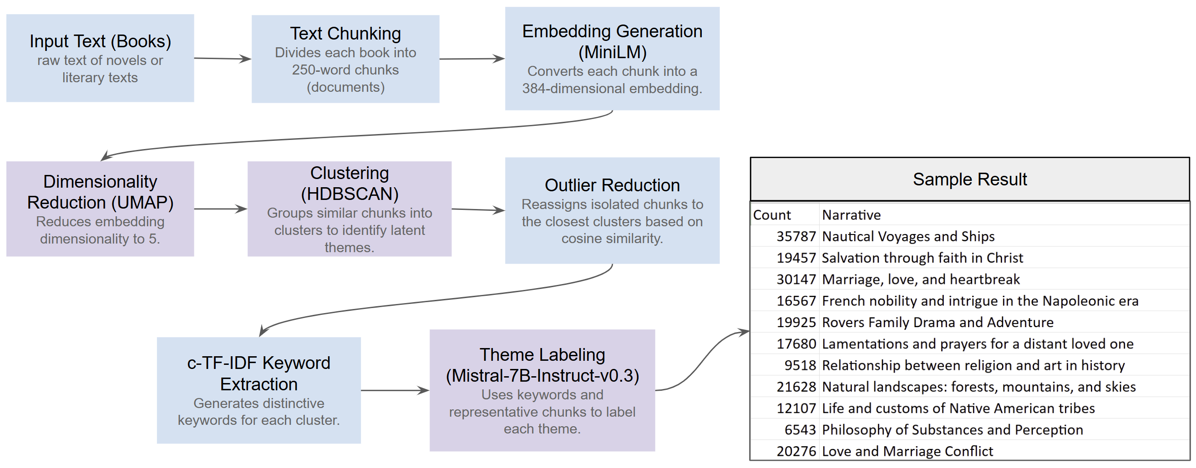
Methodology

Slide 17
Models and Algorithms Used
all-MiniLM-L6-v2: Used to convert chunks of text into dense vector embeddings for semantic representation.
UMAP: Applies dimensionality reduction to the embeddings, making them easier to visualize and process.
HDBSCAN: Utilized for clustering the reduced embeddings, helping identify patterns and groupings in the data.
c-TF-IDF and KeyBERTInspired: Extracts and refines key terms from each cluster by weighting terms based on their frequency and significance.
Mistral-7B-Instruct-v0.3: Leverages a language model to label and classify the narrative themes within each cluster based on their content.

Slide 18
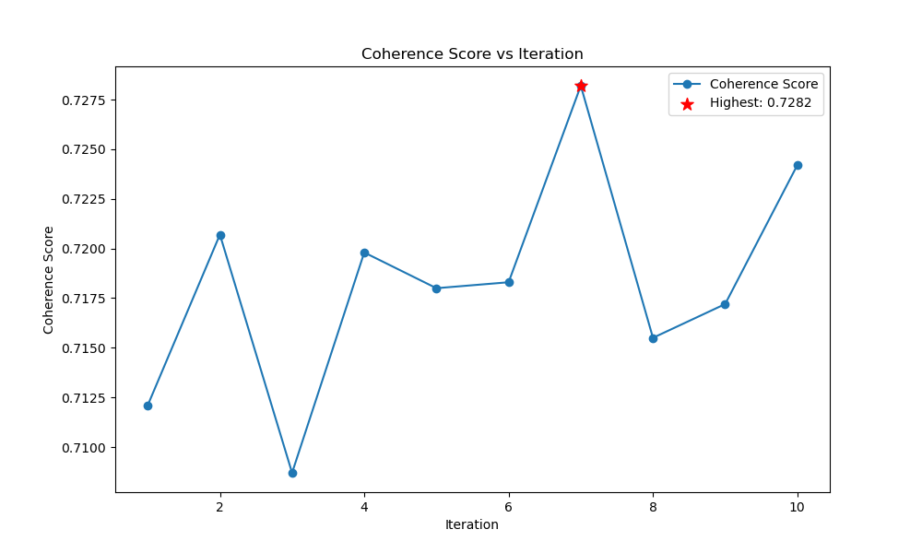
Performance Validation
We performed a total of ten iterations by varying the min cluster size from 50 to 500. After that, we evaluated the performance of each iteration by evaluating the coherence scores of top 25 clusters in each iteration.
Coherence Score (c_v):
The 'c_v' coherence score measures the semantic coherence of the words within a narrative cluster. It calculates the degree to which the top words of a cluster co-occur in the corpus. A higher 'c_v' score indicates more meaningful and interpretable narratives.

Slide 19
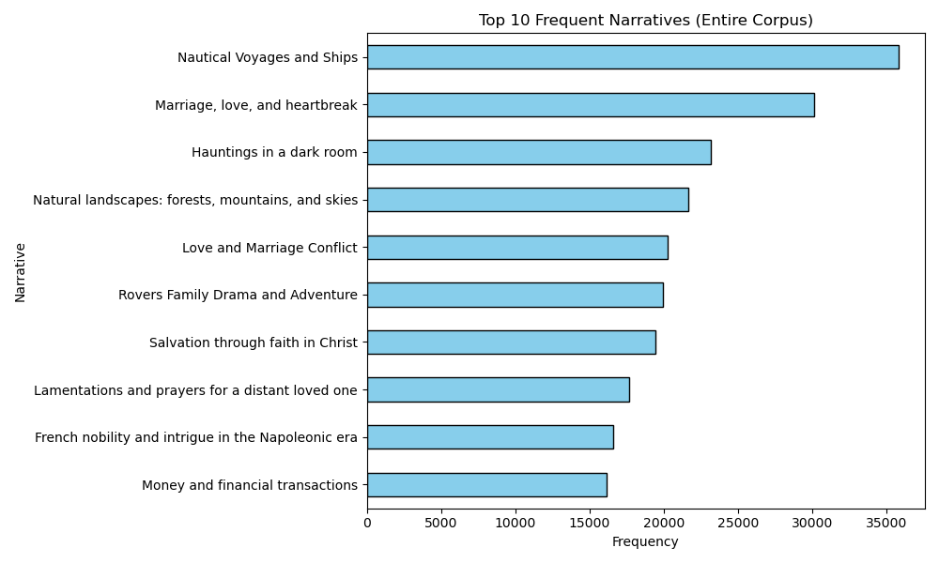
Discovered Narratives in the Entire Corpus

Slide 20
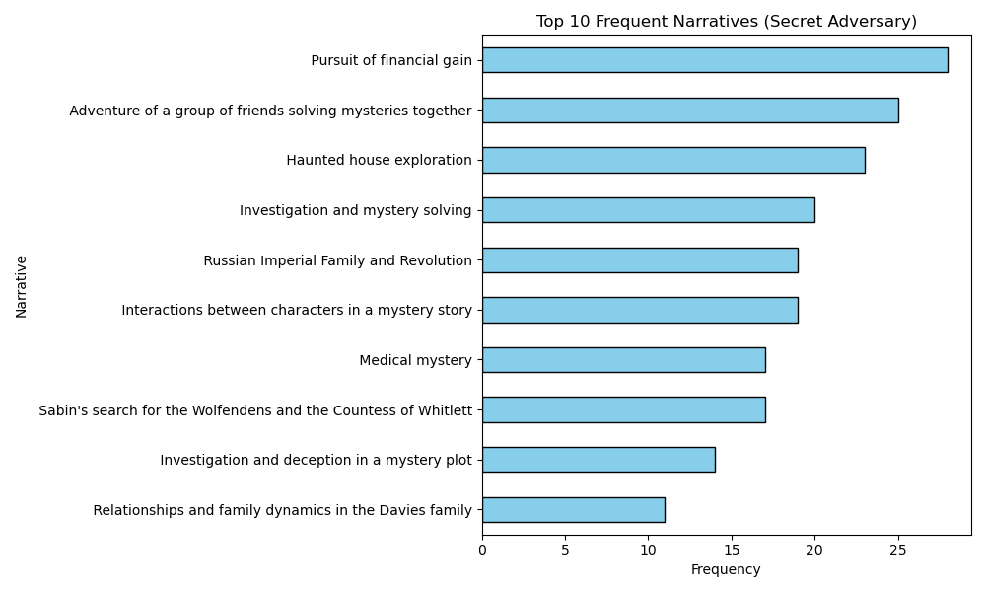
Discovered Narratives in The Secret Adversary

Slide 21
Narrative Explanation Generation
Jeeva Saravana Bhavanandam

Slide 22
Task 4: Narrative Explanation Generation
Introduction
Task: Generate narratives with contextual explanations from datasets.
Relevant Domains: Literary analysis, historical document analysis, thematic exploration.
Challenges: Semantic understanding + contextual relevance.
Objective
Build a hybrid retrieval system:
- Combine semantic embeddings and knowledge graphs.
Key goals:
- Vector-based retrieval for semantic similarity.
- Knowledge graph construction for relational insights.
- Hybrid integration for better narrative retrieval.

Slide 23
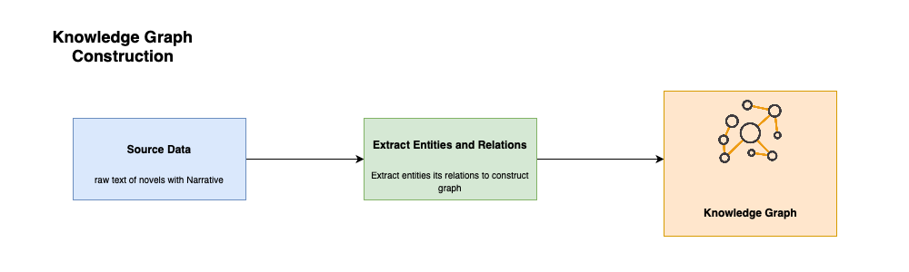
Knowledge Graph
Graph Schema Design
The schema of the knowledge graph was designed to represent key entities and relationships:
- Entities:
- Author: Represents the creator of literary works.
- Book: Represents a specific work of an author.
- Narrative: Captures thematic or event-driven descriptions.
- Explanation: Provides contextual insights for each narrative.
- Relationships:
- Author → WROTE → Book
- Book → HAS → Narrative
- Narrative → HAS → Explanation
Knowledge Graph Construction
- Parsed each row of the dataset.
- Created nodes for unique authors, books, narratives, and explanations.
- Established relationships based on the schema.
Graph-Based Retrieval
- Handles structured queries (e.g., narratives by authors, keyword-linked explanations).
- Neo4j: Efficient traversal of relationships for contextual relevance.

Slide 24
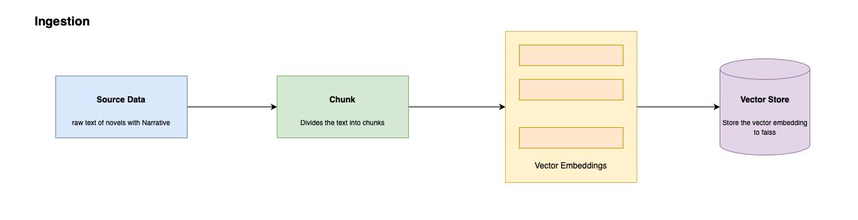
Vector Based Retrieval
Vector Based Retrieval
Tool: FAISS (Facebook AI Similarity Search) for efficient vector storage and retrieval.
Goals:
- Finds semantic similarity in high-dimensional space.
- Captures thematic and subtle textual nuances missed by graphs.
Steps:
- Compute embeddings for all dataset narratives.
- Initialize FAISS IndexFlatL2 (L2 distance for similarity).
- Add embeddings to the FAISS index for retrieval.
Benefit: Fast and accurate similarity search for narrative embeddings.

Slide 25
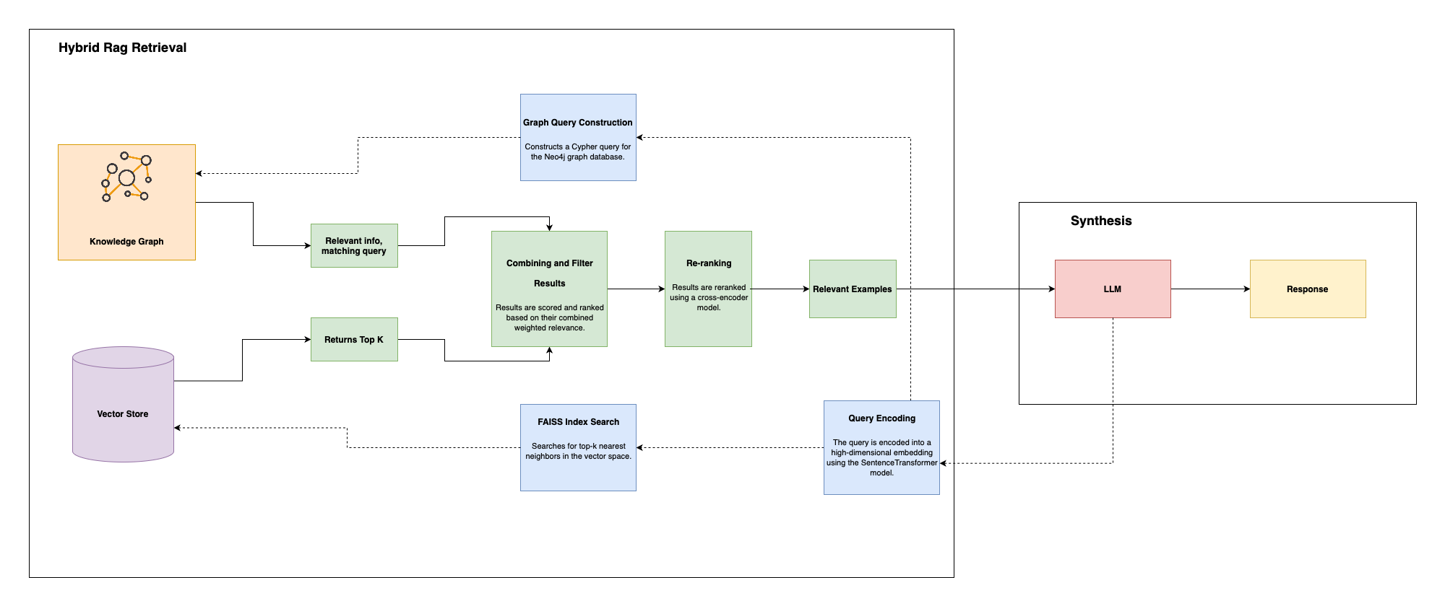
Hybrid Retrieval with Graph and Vector Store
Hybrid Approach
- Graph Querying: Retrieves narratives via explicit relational criteria.
- Vector Querying: Retrieves top-k semantically similar narratives using FAISS.
- Result Combination:
Scoring formula: Score = (Graph Weight × Graph Score) + (Vector Weight × Vector Score).
Reranking
- Purpose: Refine retrieved results for better accuracy.
- Model Used: Cross-encoder/ms-marco-MiniLM-L-6-v2.
- Process:
- Input: Query + retrieved narrative pairs.
- Compute: Relevance score for contextual fit.
- Sort: Results based on relevance scores.
Outcome
- Combines relational precision and semantic richness.
- Enhances retrieval accuracy and contextual relevance

Slide 26
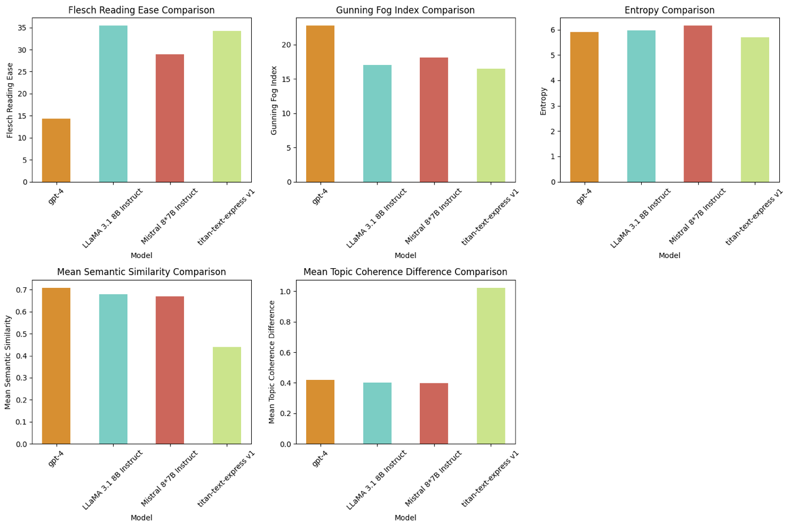
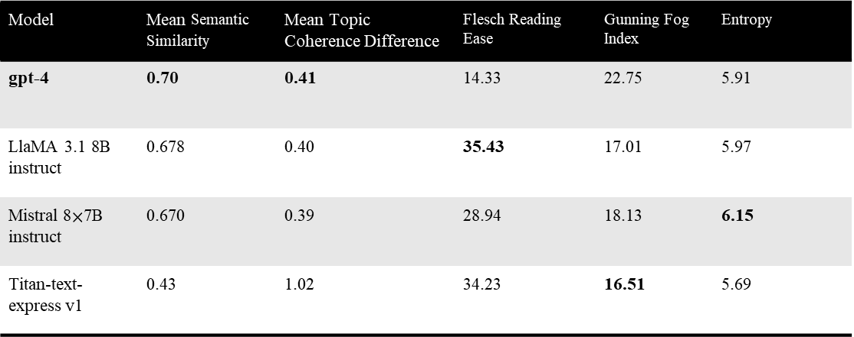
Performance
Model | Mean Semantic Similarity | Mean Topic Coherence Difference | Flesch Reading Ease | Gunning Fog Index | Entropy
gpt-4 | 0.70 | 0.41 | 14.33 | 22.75 | 5.91
LlaMA 3.1 8B instruct | 0.678 | 0.40 | 35.43 | 17.01 | 5.97
Mistral 8$×$7B instruct | 0.670 | 0.39 | 28.94 | 18.13 | 6.15
Titan-text-express v1 | 0.43 | 1.02 | 34.23 | 16.51 | 5.69
GPT-4
- Semantic Similarity: Highest (0.70).
- Topic Coherence: Best alignment (0.41).
- Readability: Low (Flesch 14.33, Fog 22.75).
LLaMA 3.1 8B Instruct
- Semantic Similarity: Moderate (0.678).
- Readability: High (Flesch 35.43, Fog 17.01).
Mistral 8×7B Instruct
- Coherence: Balanced (0.39).
- Semantic Similarity: Moderate (0.670).
- Readability: Medium (Flesch 28.94, Fog 18.13).
Titan-text-express v1
- Simplicity: Lowest entropy (5.69).
- Semantic Similarity: Lowest (0.43).
- Coherence: Weak (1.02).

Slide 27
Thank You!

