Slide 1
AHIR: from program to hardware
Sameer Sahasrabuddhe, K. Arya, M. P. Desai

Slide 2
Concept
Start with a program written in a “standard programming language” such as C.
  Use software compiler to optimize program to extract parallelism etc.
Transform the program into an intermediate representation (a virtual circuit)
  AHIR
Map the virtual circuit to an actual logic circuit
  Optimize hardware by sharing resources etc.

Slide 3
Potential Value
Replace use of embedded processors in SoCs
  Provided that generated circuits are 10X superior in energy-delay product and/or throughput/area metrics
Use as part of VLSI Design Flow
  Provided that generated circuits are competitive with conventionally designed circuits.
Simplify the verification process considerably
  verification/validation at the program (specification) level rather than the RTL level.

Slide 4
C to CDFG to AHIR
C program translated to CDFG by compiler tools
  LLVM tool-suite
CDFG transformed to AHIR
  Provably correct transformation
AHIR representation
  Orthogonal representation: CP X DP X Memory
  Each factor can be optimized without affecting the others.

Slide 5
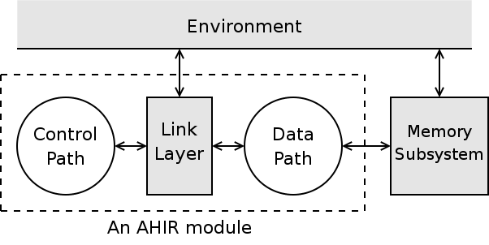
AHIR

Slide 6
AHIR
Orthogonal representation
  CP X DP X Memory
Amenable to static analysis
  e.g. Arbiterless sharing of operators in the datapath.
Information for memory optimizations
  Data placement
  Hazard-free scheduling.

Slide 7
Throughput/Area metrics
Ahir RTL mapped to FPGA vs. P-4 processor
  2X (Linpack) to 500X (A5/1-stream cipher) better in throughput/area metric. Typical improvement 10X over range of applications: FFT,Red-black-tree,AES, Linpack, A5/1.
Ahir RTL vs. handcrafted RTL
  360X worse for AES
  900X worse for A5/1
  Room for improvement

Slide 8
Looking ahead
Trying to quantify energy-delay benefits of using AHIR
Optimized memory subsystem to reduce run-times
  Using more exact dependency rules.
Exploiting compiler-level optimizations
Parallel-programming languages as starting points?
  e.g. Esterel?

Slide 9
Conclusion
A complete flow from C to hardware
  Scalable, applicable to complex software.
  Competitive with processor implementations in throughput/area
  Expected to be even more competitive if energy-delay metric is used for comparison
Use of parallel programming language as starting point will get us closer to hand-crafted RTL.

