Slide 1
Paper Evaluation Using Artificial Intelligence
REVIEW 2 · DESIGN, METHODOLOGY AND PROGRESS
Design, methodology and progress: a local pipeline from PDF to assessment and an auditable reviewer ranking
Presented by
Under the guidance of
Mula Sreebindu 23K91A05G3
Puramshetty Vishnu Vardhan 23K91A05K2
K Sampoorna 24K95A0512
Korsa Shivashankar 24K95A0515
M Anupama, [DESIGNATION]
Department of Computer Science and Engineering
TKR College of Engineering & Technology · Batch C8 (CSE-C) · [ACADEMIC YEAR]
Notes:
This review shows how PeerScope is designed and built: the data and models, what is implemented, the first measured results and the open items.

Slide 2
Contents
01
02
03
Recap and architecture
Methodology and dataset
Preprocessing and models
04
05
06
Training and decision logic
Data flow, database and UML
Technology stack
07
08
09
Implementation progress and results
Output screens and testing
Challenges and next steps
Notes:
Agenda for the design and progress review.

Slide 3
Recap: problem and proposed system
!
Problem
i
Proposed system
B
Base paper link
Submissions outgrow reviewer pools. Editors choose reviewers from memory or keywords, matches are hard to explain, and first-pass screening of papers is inconsistent.
PeerScope reads the PDF locally, adds a decision signal and a local AI critique, retrieves related work, and ranks reviewers with a score whose terms are all shown.
Bagheri et al. make reviewer matching auditable with LLM keyword induction. PeerScope keeps the audit idea, adds paper assessment, availability and conflict terms, and runs locally. Results are not comparable.
Notes:
One-minute recap of Review 1: the editorial bottleneck, our hybrid approach, and how the base paper relates (shared principle, different scope and data).

Slide 4
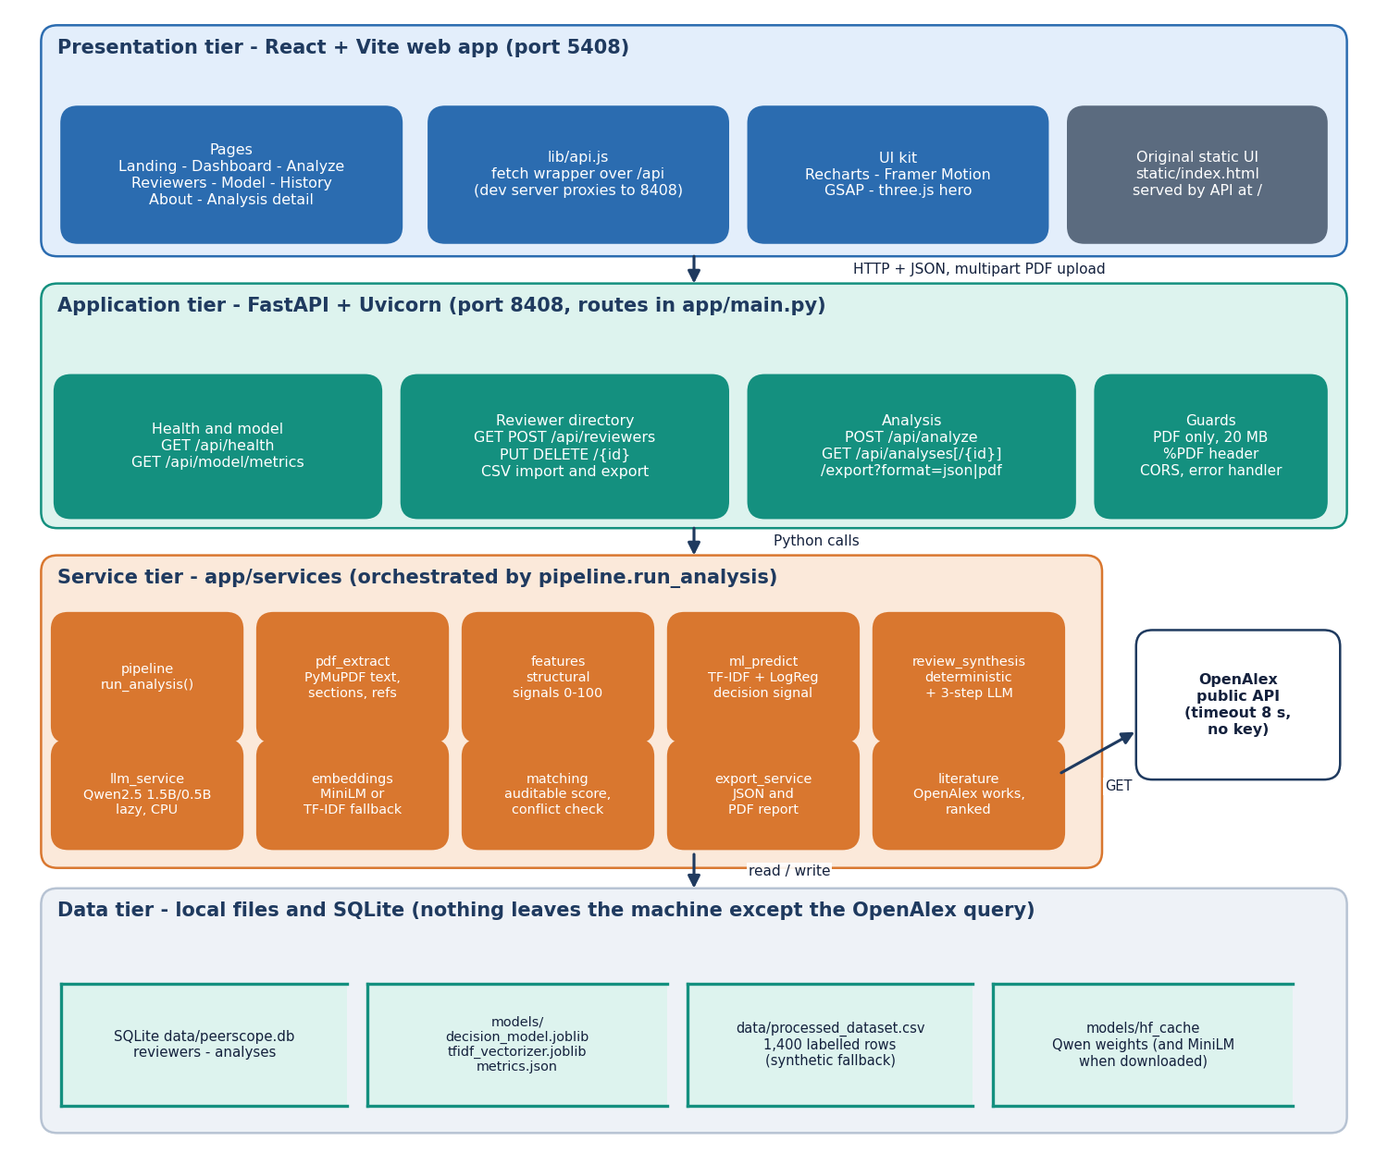
System architecture
Four tiers
Presentation: React and Vite web app (port 5408), 8 pages.
Application: FastAPI (port 8408), 12 routes under /api, PDF-only upload with a 20 MB limit and header check.
Services: plain function modules orchestrated by pipeline.run_analysis.
Data: SQLite (reviewers, analyses), joblib model files, cached language models. Only the OpenAlex query leaves the machine.
Notes:
All routes live in app/main.py; the services are separate modules so each stage can be tested alone. Storage is local.

Slide 5
Methodology: end-to-end workflow
PDF upload
Extract + sections
Features + signals
Decision signal
AI critique
Literature
Reviewer ranking
One pipeline
Graceful degradation
Measured, not typed
A single function, run_analysis, calls every stage in order and stores the result, so the web app, the tests and the scripts exercise the same code.
No language model: deterministic review with a visible notice. No internet: literature marked unavailable. No sentence-embedding model: TF-IDF fallback.
scripts/measure_metrics.py writes every reported number to docs/metrics/metrics.json; figures are regenerated from it.
Notes:
The three design principles: one pipeline, honest fallbacks, and numbers that come from a script. The same pipeline serves the live app and the measurements.

Slide 6
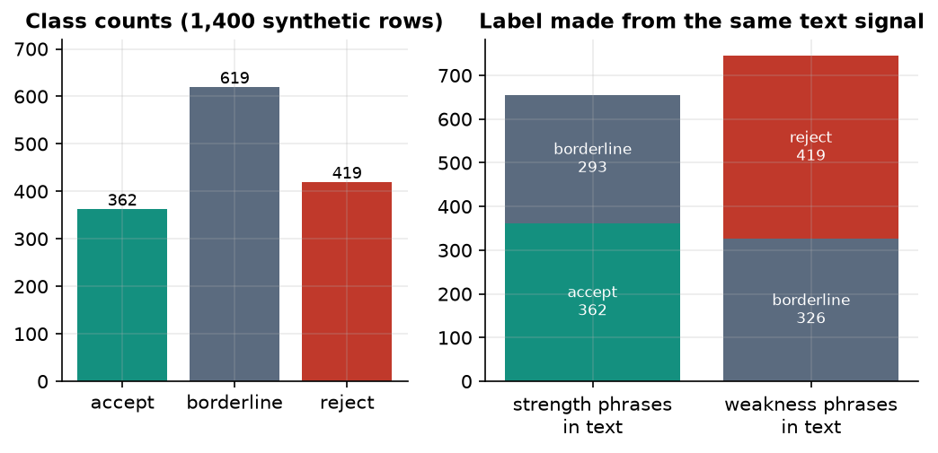
Datasets used
1,400
3
1,120 / 280
40 + 6
synthetic labelled papers (decision model)
classes: accept, borderline, reject
train / held-out test (stratified)
probe abstracts + demo reviewers
The public peer-review probe in prepare_dataset.py returned no data, so the project generated a labelled synthetic set (seed 42).
Labels come from the same strength and weakness phrases that appear in the text, and borderline is drawn from both: no text classifier can exceed about 56% accuracy.
Reviewer pool: six demo profiles. Matching probe: 40 abstracts written by the team, labelled by the team.
Class counts and how the label relates to the text phrases.
Notes:
Be frank: the dataset is synthetic, so the decision model demonstrates the pipeline and is not evidence of predicting real peer-review decisions. The matching probe is also team-made; independent expert labels were not available.

Slide 7
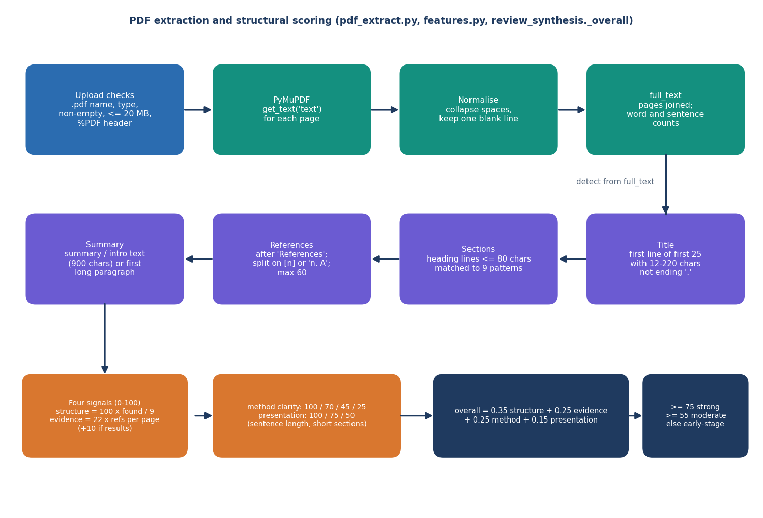
Data preprocessing: from PDF to features
1 PyMuPDF text of every page, whitespace normalised
2 Title: first plausible line (12-220 characters, no final full stop)
3 Nine sections found by heading patterns
4 References parsed (up to 60)
5 Frequency keywords, 21 method terms, 18 topic hints
6 Four structural signals combined 0.35 / 0.25 / 0.25 / 0.15
Known weakness: roman-numeral headings such as 'I. INTRODUCTION' are not detected.
Notes:
The extraction is rule based. On the IEEE base paper itself the introduction heading was not detected and the title came out as the DOI line; this is listed as a defect.

Slide 8
Models used
Component | Configuration | Role
Decision signal | TF-IDF words 1-2 (8,000) + characters 3-5 (4,000), logistic regression, balanced classes | accept / borderline / reject probabilities
Sentence embeddings | all-MiniLM-L6-v2 (TF-IDF fallback, 512 terms, when it cannot load) | expertise similarity paper vs reviewer
Local language model | Qwen2.5-1.5B-Instruct on CPU, 32-bit floats (0.5B fallback); analyse, critique, synthesise | reviewer-style critique, never a ranking
12,000
1.5 B
No GPU
TF-IDF features in the decision model
parameters in the local language model
everything runs on a CPU
Notes:
Three models with separate jobs. The language model only writes the critique text; ranking never depends on it, which keeps the score auditable.

Slide 9
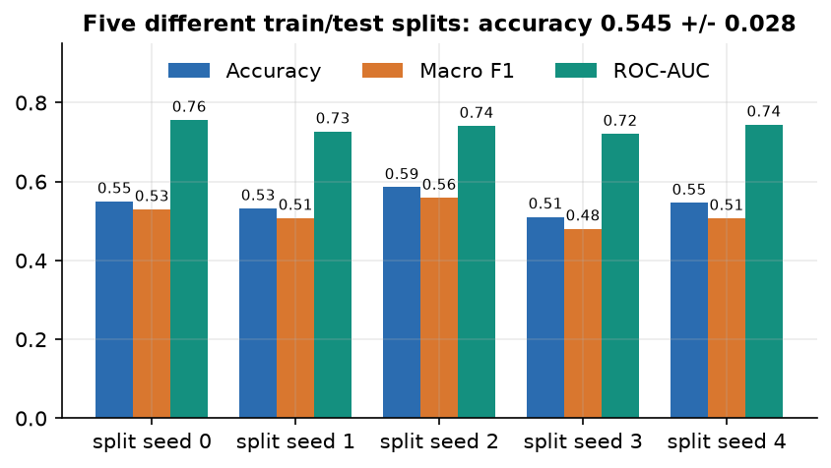
Training configuration (decision model)
Setting | Value
Data and split | 1,400 synthetic rows; 80 / 20 stratified, seed 42 (1,120 train / 280 test)
Classifier | LogisticRegression, C = 1.0, max_iter = 1000, class_weight = balanced
Features | TF-IDF word 1-2 grams (8,000, English stop words) + character 3-5 grams (4,000) over title + text
Robustness check | Five other splits: accuracy 0.545 +/- 0.028, macro F1 0.517 +/- 0.029
Hardware | 12th Gen Intel Core(TM) i5-12500, 15.7 GB RAM, CPU only; training takes seconds
Accuracy moves by about three points between splits, so one split's 0.55 is not a precise figure. Training and the five-split study both run in the measurement script; the shipped model files were not changed.
Notes:
Settings are from scripts/train_model.py. The five-split study re-trains in memory only. The spread shows the headline number is a noisy estimate.

Slide 10
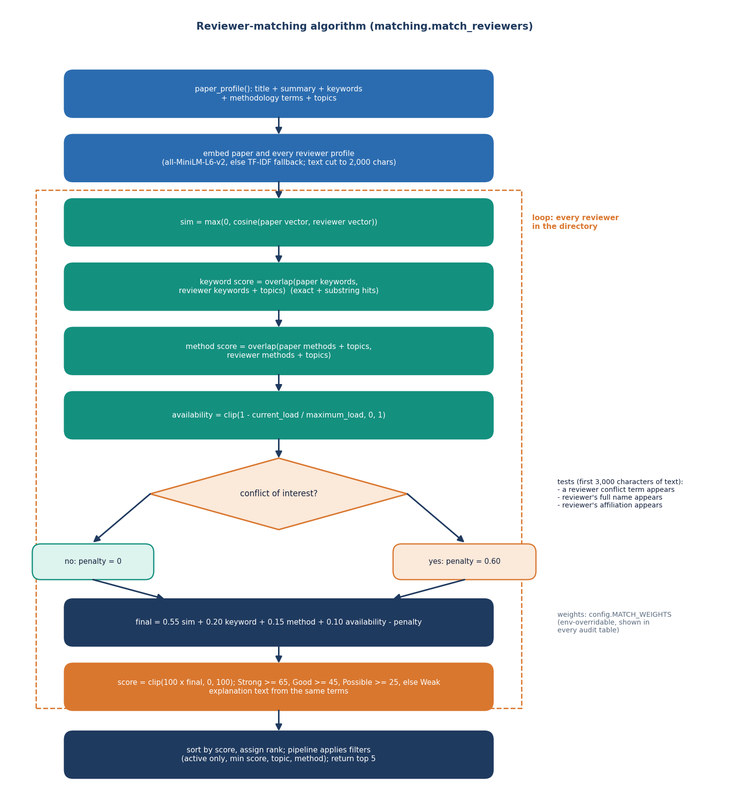
Decision logic: the auditable match score
Score. 0.55 x embedding similarity + 0.20 x keyword overlap + 0.15 x method / topic overlap + 0.10 x availability - 0.60 x conflict penalty, scaled to 0-100.
Bands. Strong from 65, Good from 45, Possible from 25, otherwise Weak.
Availability. 1 - current load / maximum load.
Conflict. A listed conflict term, the reviewer's full name or affiliation found in the paper text applies the penalty.
Audit. Every card shows each term, its weight, the matching words and a plain-language reason.
Notes:
The weights live in app/config.py. Conflict detection is literal string matching, a limitation measured later: 12 of 12 literal links found, paraphrased ones missed.

Slide 11
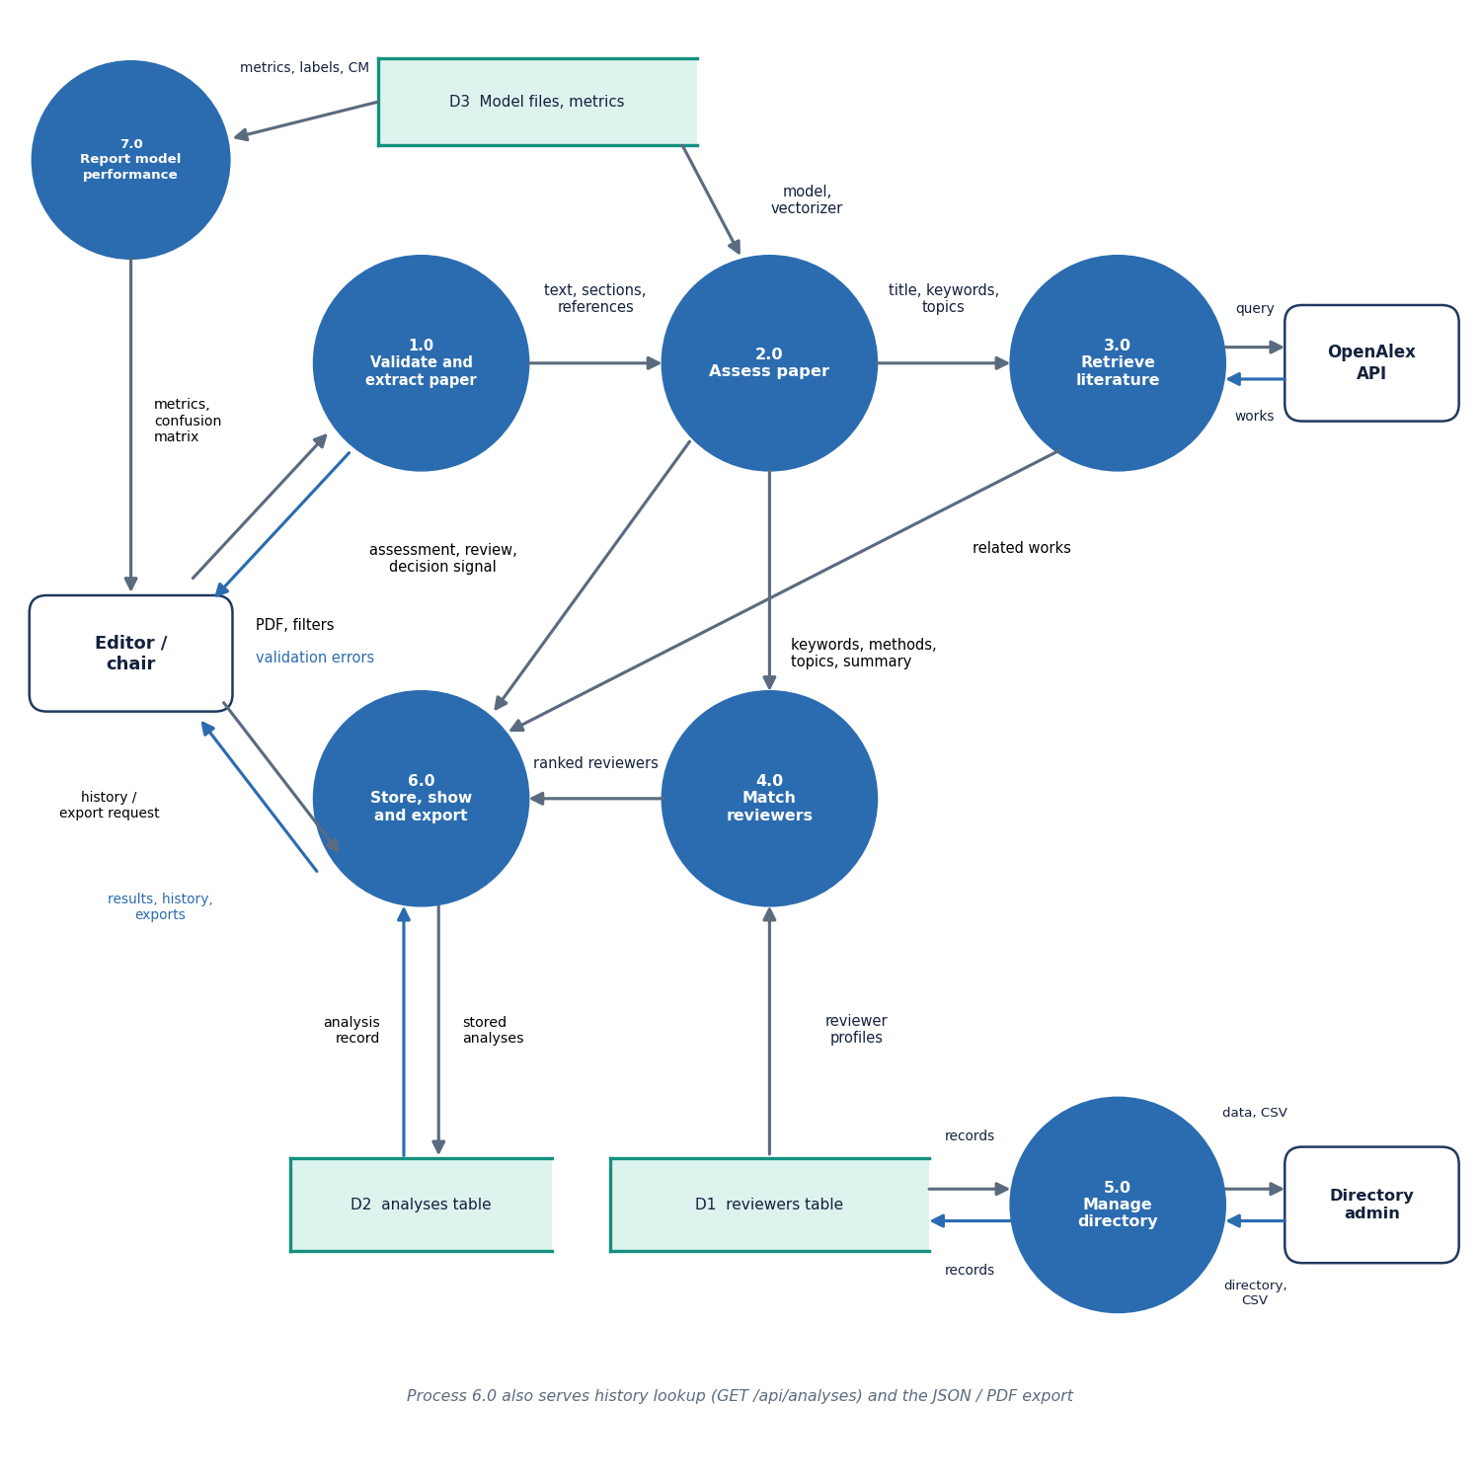
Data flow and modules
Module | Role
pdf_extract | text, sections, references
features | keywords, structural signals
ml_predict | decision signal
review_synthesis | rules + 3-step AI review
llm_service | lazy Qwen loading
literature | OpenAlex retrieval
embeddings | MiniLM / TF-IDF
matching | score, conflicts, ranking
export_service | JSON and PDF report
Notes:
Level-1 data flow: the upload becomes a paper profile, the profile is scored against the reviewer directory, and the result is stored and exported.

Slide 12
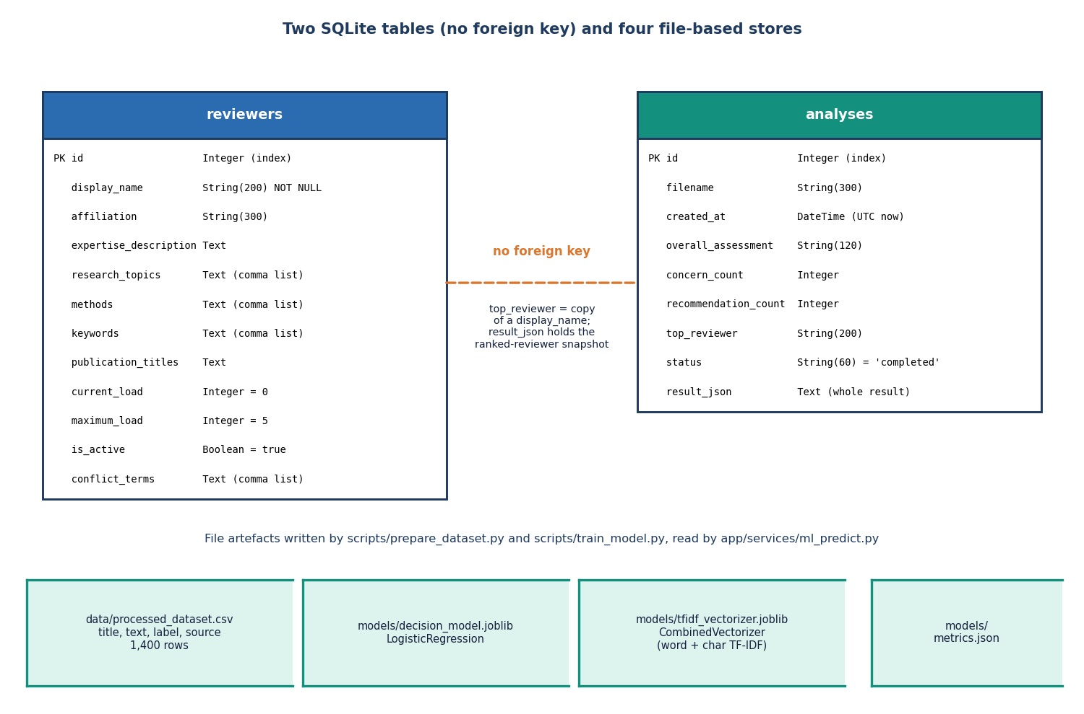
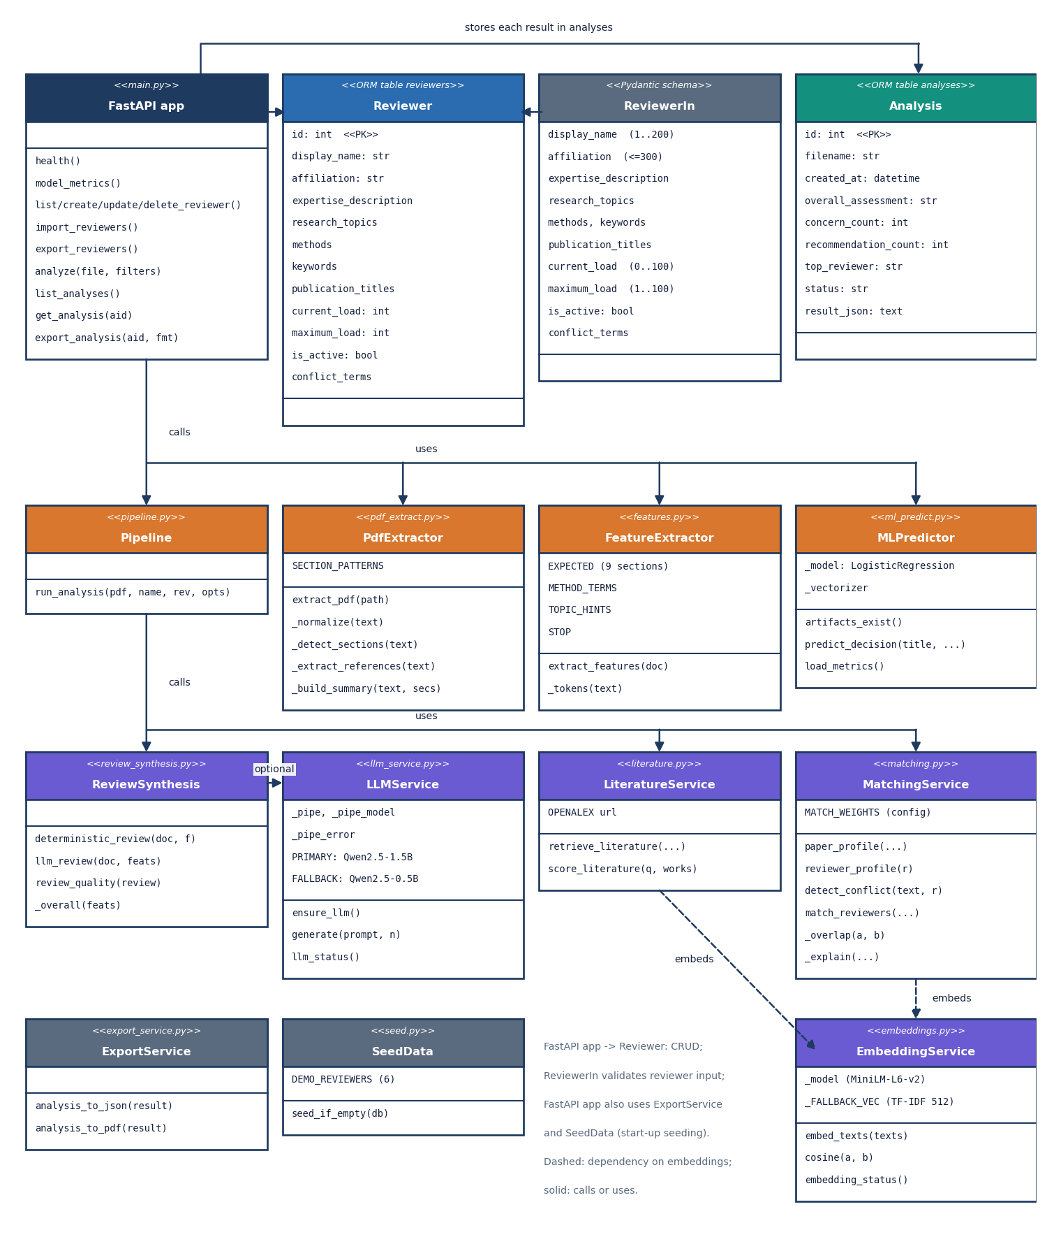
Database design and UML
Two SQLite tables, no foreign key: an analysis stores the whole ranked result as JSON and copies the top reviewer's name. Trained models and the dataset are files.
Notes:
Honest point: the services are plain function modules, drawn as classes in the UML for readability. The analyses table has no foreign key to reviewers.

Slide 13
Technology stack
Layer | Technology
Backend | Python 3.11.9, FastAPI 0.120.4, Uvicorn, Pydantic, SQLAlchemy 2.1.6, SQLite
PDF and reports | PyMuPDF (text extraction), reportlab 5.0.1 (PDF export)
Machine learning | scikit-learn 1.9.1, NumPy, pandas, joblib
Embeddings and language model | sentence-transformers 6.2.0 (all-MiniLM-L6-v2), PyTorch 2.14.1, Transformers 5.20.2, Qwen2.5-1.5B-Instruct
Literature | OpenAlex public REST API through requests (8 s timeout, no key)
Front end | React 19, Vite 8, Recharts, Framer Motion, GSAP, three.js (port 5408)
Testing | pytest, FastAPI TestClient, httpx, Playwright browser walk, smoke script
Notes:
Python 3.11.9 on Windows. Everything is open source; run.bat creates the environment, trains the decision model if needed and starts both servers.

Slide 14
Implementation progress
Component | Status | Evidence
PDF extraction, sections, features | Done | 4 real PDFs and a demo paper processed
Decision signal (TF-IDF + logistic regression) | Done | synthetic data; accuracy 0.55
Local AI review with deterministic fallback | Done | Qwen2.5-1.5B; 9-16 min per analysis on CPU
Literature grounding (OpenAlex) | Done, 1 defect | HTTP 400 when the title contains a question mark
Reviewer matching and conflict check | Done | 40-abstract probe; 12 of 12 literal conflicts found
API (12 routes) and web app (8 pages) | Done | 24 of 24 smoke checks; 17 screenshots
Real publication profiles, h-index | Not done | six demo reviewers only
Novelty assessment | Not done | coverage chart shows a fixed placeholder
Notes:
State of the code base. The honest gaps: real publication histories, novelty assessment, and independent expert evaluation.

Slide 15
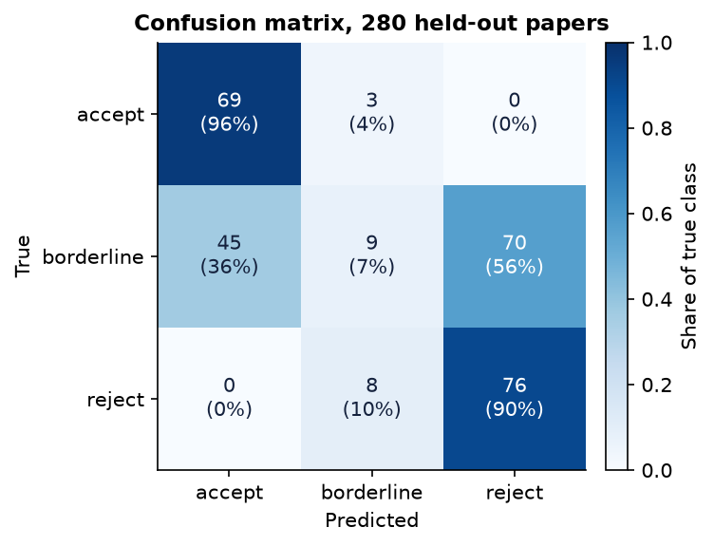
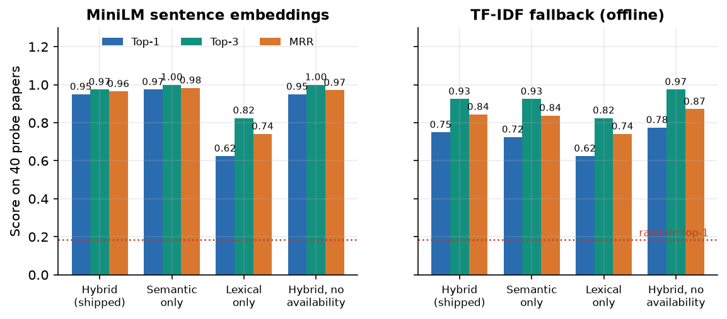
Preliminary results
55.0%
0.509
95% / 75%
12 / 12
decision accuracy, synthetic test (n = 280)
macro F1 (borderline recall 0.07)
matching top-1: MiniLM / TF-IDF fallback
literal conflicts found; 0 false flags
Decision model: synthetic labels, so accuracy cannot exceed about 0.56; accept vs reject is 93% right. Matching: 40 abstracts written by the team, 6 demo reviewers; not comparable with the base paper.
Notes:
Four headline numbers, each with its caveat. 55.0 percent accuracy on synthetic data near the 0.56 ceiling; macro F1 0.509; matching top-1 0.95 with MiniLM and 0.75 with the TF-IDF fallback on the team's 40-abstract probe; 12 of 12 literal conflicts detected, none of the paraphrased ones.

Slide 16
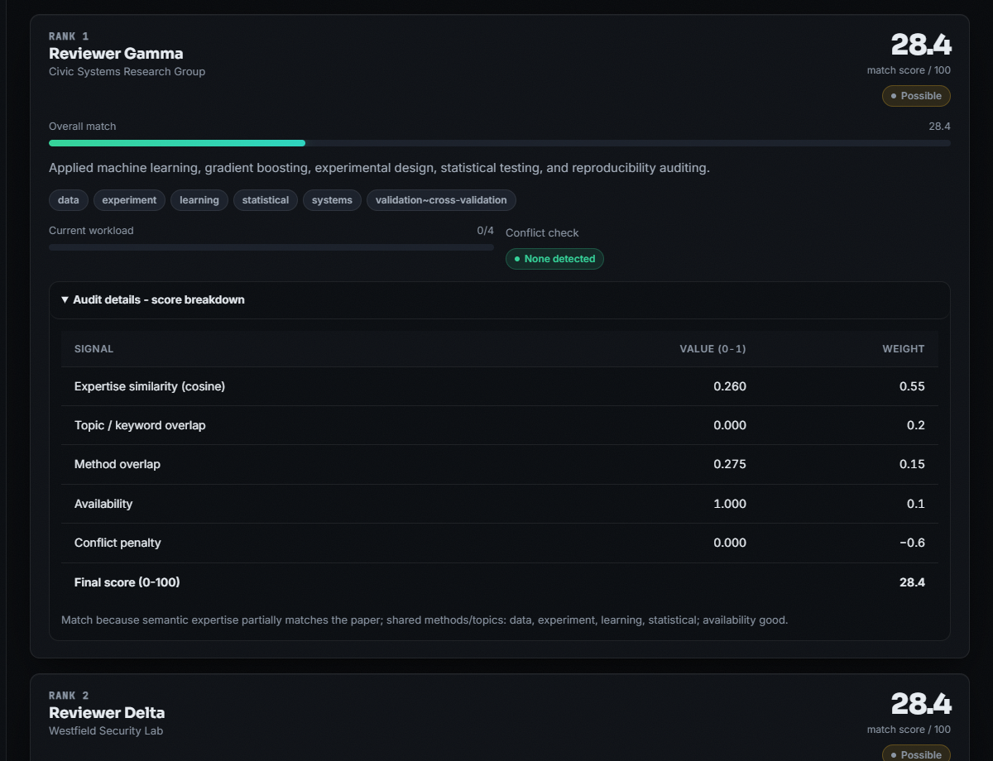
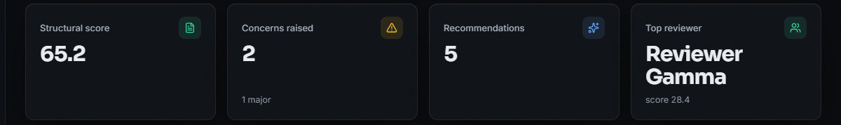
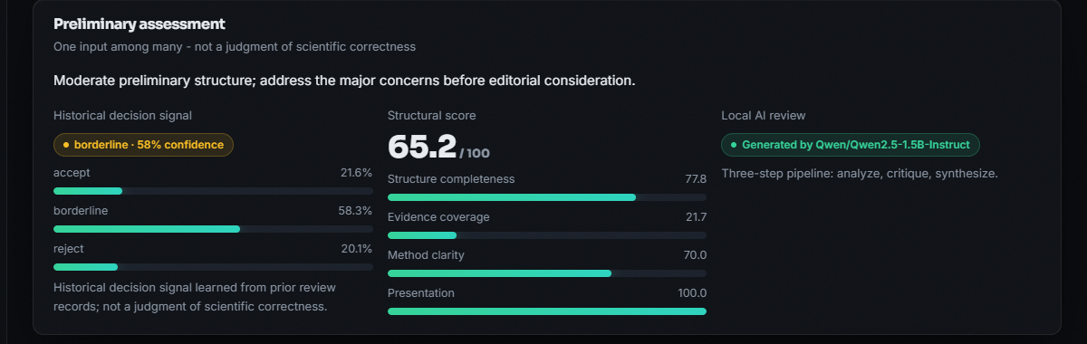

Output screens
Real paper (ReViewGraph PDF): rank 1 scores only 28.4 of 100 because the demo reviewers are far from its topic; the breakdown shows why. Right: assessment and literature.
Notes:
Real screenshots of the running application with the local language model loaded, from an analysis of a real 17-page paper. Low absolute scores are expected: the demo reviewers do not work on this topic.

Slide 17
Initial testing and observations
7 / 7
24 / 24
0
1.3 s
pytest tests passed
smoke-test checks passed
console errors in the browser walk
analysis without the AI review (3 pages)
Observation | Action
OpenAlex answers HTTP 400 when the extracted title has a question mark; the survey PDF got no literature | Shown as 'unavailable'; query clean-up listed as next step
IEEE-format PDF: introduction not detected, title came out as the DOI line | Recorded as a defect; heading patterns to be extended
Paraphrased affiliations and first names are not flagged as conflicts | Stated limitation; literal links 12 of 12, 0 false flags
Notes:
Tests ran with the language model disabled so they are fast and repeatable. The observations come from running real PDFs and injected conflict cases, and each is documented rather than hidden.

Slide 18
Challenges and corrective actions
Challenge | Corrective action
No open peer-review corpus could be fetched | Labelled synthetic set, stated everywhere; ceiling analysis shows what it can show
The local language model is slow on a CPU (534-946 s per analysis) | Lazy loading, rules-based review always shown, visible status badge
Offline or failing services (OpenAlex, embedding model) | Time-outs and fallbacks: literature 'unavailable', TF-IDF embeddings
TF-IDF fallback is fitted once and then frozen | Measured: top-1 75% against 95%; MiniLM preferred
Ranking re-embeds every reviewer per request | Measured: 86 ms for 6 reviewers, 5.2 s for 500; caching planned
Notes:
Each challenge was met by a concrete design choice or by measuring it and saying so in the report.

Slide 19
Next steps
1
Real data
2
Independent evaluation
3
Harden
4
Extend
Train and test the decision model on a real open review corpus, and build reviewer profiles from real publication histories.
Judge the ranking against assignments or labels made by people outside the team, and report MRR and precision at 3.
Clean the OpenAlex query, detect roman-numeral headings, cache reviewer embeddings, add authentication.
Estimate novelty against retrieved literature, support scanned PDFs, try a smaller or quantised language model.
Notes:
Plan to the final review and beyond. The first two items address the biggest honest gaps: synthetic training data and team-made labels.

Slide 20
Thank you
Questions and suggestions are welcome.
Notes:
Likely questions: why a classical classifier for the decision signal; how conflicts are detected (literal strings); what the language model is allowed to do (write a critique, never rank).

