Slide 1

Paper Evaluation Using Artificial Intelligence (Hybrid AI Framework for Research Paper Evaluation and Reviewer Recommendation)
Final Review · PeerScope
Team Details : Batch C8
Under the Esteemed Guidance of
M Anupama
[DESIGNATION], Department of CSE
23K91A05G3 Mula Sreebindu
23K91A05K2 Puramshetty Vishnu Vardhan
24K95A0512 K Sampoorna
24K95A0515 Korsa Shivashankar
DEPARTMENT OF COMPUTER SCIENCE AND ENGINEERING · TKR College of Engineering & Technology · Academic Year [ACADEMIC YEAR]
Notes:
Introduce the team and the project: PeerScope, a local application that assesses a research paper and ranks reviewers with an audit trail.

Slide 2
Table of Contents
Abstract
Base Paper & Literature Survey
Research Gap, Problem Statement & Objectives
Proposed System & Architecture
Methodology, Dataset & Models
Scoring Workflow, Interaction & Storage
Implementation Highlights
Results: Decision Model, Reviewer Matching
Performance & Testing
Comparison with Base Paper
Output Screens
Conclusion, Future Scope & References
Dept. of CSE | Batch C8 | Final Review
2
Notes:
The agenda follows the report: problem, design, method, results, comparison, screens, conclusion.

Slide 3
Abstract
Journals receive more submissions than their reviewer pools can absorb; assigning reviewers is manual, keyword matching favours shared vocabulary over expertise, and first-pass screening is inconsistent.
PeerScope reads a PDF locally, extracts sections and structural signals, adds a TF-IDF decision signal, a local Qwen2.5-1.5B critique and OpenAlex literature, then ranks reviewers with an auditable score: 0.55 embedding similarity + 0.20 keywords + 0.15 methods + 0.10 availability - 0.60 conflict.
Decision model: 55.0% accuracy on 280 synthetic test papers; the labels limit any text classifier to about 0.56, so this shows the pipeline, not real-world prediction.
Reviewer matching: first-choice reviewer acceptable in 95% (MiniLM) and 75% (TF-IDF fallback) on a team-written 40-abstract probe, 6 demo reviewers; 12 of 12 literal conflict links flagged.
Without the language model an analysis takes about 1.3 s; with it, about 9 minutes on a CPU. 7 of 7 tests and 24 of 24 smoke checks pass.
Not done: real peer-review data, independent expert labels, novelty scoring, a user study.
Dept. of CSE | Batch C8 | Final Review
3
Notes:
Read the problem, then the system in one breath. Give each number with its protocol and end on the honest limits.

Slide 4
Base Paper
F. Bagheri, D. Buscaldi and D. Reforgiato Recupero, "LLM-assisted reviewer assignment via auditable expertise matching," IEEE Access, vol. 14, pp. 127834-127863, 2026, doi: 10.1109/ACCESS.2026.3724622.
Aspect | Base paper: LLM-assisted reviewer assignment via auditable expertise matching
Method | Ensemble of producer LLMs, a judge LLM and deterministic normalisation induce keywords; LLMs never rank reviewers. Matchers: TF-IDF, Jaccard, SBERT (all-MiniLM-L6-v2), cross-encoder re-ranking, keyword graphs
Data | 663 papers from 85 conferences, 1,989 assignments, 524 reviewers (Semantic Scholar profiles); relevance = historical assignments
Reported results | Best MRR@3 0.7778 (titles, two-stage re-ranking) and 0.7843 (abstracts, KG edge-Jaccard); best P@3 0.4545 and MAP@3 0.3232 (summaries, keyword-aware SBERT)
Auditability | Every stage stores prompts, model ids, keywords, score matrices and top-3 lists as an audit trail
Stated limits | No expert judgements; conflict of interest and capacity not benchmarked; most text-encoder differences not significant; no assessment of the paper itself
Dept. of CSE | Batch C8 | Final Review
4
Notes:
Bagheri et al., IEEE Access 2026. We adopt the auditable principle and the MiniLM encoder, add paper assessment, availability and conflict handling, and do not use an LLM ensemble.

Slide 5
Literature Survey
Work | Year | Approach | Data / finding / limitation
Bagheri et al. [1] (base) | 2026 | LLM ensemble induces keywords; judge LLM picks; SBERT / KG matchers | 663 papers, 524 reviewers; best MRR@3 0.7843; no paper assessment
Charlin et al. [10] | 2012 | Learned paper-reviewer suitability scores + integer-program assignment | Learns from few provided scores; two conference datasets
Mimno & McCallum [11] | 2007 | Author-Persona-Topic expertise model vs language-model baselines | Judged on human relevance labels; APT beat the language-model baselines
Kang et al. PeerRead [22] | 2018 | Accept/reject prediction from 14.7K drafts and 10.7K reviews | Up to 21% error reduction over majority; decision only, no matching
Liang et al. [24] | 2024 | GPT-4 feedback on full PDFs vs human reviewers | Overlap 30.85% / 39.23% (humans 28.58% / 35.25%); no reviewer matching
Li et al. ReViewGraph [7] | 2025 | LLM reviewer-author debates + graph network for accept/reject | ICLR accuracy 66-72%; costly agents; decisions only
Torrielli et al. [2] | 2026 | Hidden instructions in manuscripts steer chatbot reviewers | Followed in 78% (ChatGPT) and 86% (Gemini) of cases
Reimers & Gurevych SBERT [19] | 2019 | Siamese BERT sentence embeddings compared by cosine | Pair search over 10,000 sentences: ~65 h (BERT) to ~5 s
Dept. of CSE | Batch C8 | Final Review
5
Notes:
Representative work in reviewer assignment, embeddings and automated review. Items whose text could not be read are marked in the report's reference list.

Slide 6
Research Gap
Base paper scores reviewer affinity only; it never assesses the paper itself
Automated-review work predicts decisions or writes reviews but does not match reviewers
Conflict of interest and workload were left out of the base paper's experiments
LLM reviewers can be steered by hidden text (78-86% compliance), so human oversight is needed
Embedding matchers are hard to audit; per-score breakdowns are rare
No student-deployable tool joins PDF intake, assessment and auditable matching
Dept. of CSE | Batch C8 | Final Review
6
Notes:
Six gaps drawn from the survey. We address the first, second, fifth and sixth directly; the third and fourth shape the design and the limits.

Slide 7
Problem Statement
Reviewer assignment is manual and depends on the editor's personal knowledge
Keyword matching picks reviewers who share vocabulary, not expertise
Slow reviews delay the publication of valid research
Review quality varies between reviewers with no consistency check
Need: assess submissions automatically and assign the most expert reviewer
Input
Output
Record
Research-paper PDF (up to 20 MB) and a directory of reviewer profiles
Preliminary assessment and ranked reviewers with a visible score breakdown
Stored analyses, JSON and PDF export, measured model metrics
Dept. of CSE | Batch C8 | Final Review
7
Notes:
The statement has three parts: assess the paper, rank the reviewers transparently, and keep an inspectable record.

Slide 8
Objectives
1. Build a corpus of submitted papers and reviewer publication profiles
2. Extract topics, methods and keywords from paper text with NLP
3. Represent reviewer expertise as comparable vectors
4. Rank candidate reviewers by semantic similarity for each paper
5. Give a preliminary assessment: structure, novelty signals, completeness
6. Evaluate assignment quality and conflict-of-interest handling
Dept. of CSE | Batch C8 | Final Review
8
Notes:
The six objectives of the proposal. The conclusion states the real status of each: 1 and 6 only partly met, 5 met except novelty.

Slide 9
Proposed System
PDF upload
Extract + signals
Decision + AI review
Literature
Rank reviewers
Read the PDF locally: text, sections, references, structural signals
Add a trained decision signal and a local AI critique with a visible fallback
Ground the paper with related works from OpenAlex
Rank reviewers: 0.55 similarity + 0.20 keyword + 0.15 method + 0.10 availability
Subtract a conflict penalty and show every term of the score
Final editorial judgement stays with a human: every screen carries the decision-support disclaimer.
Dept. of CSE | Batch C8 | Final Review
9
Notes:
The proposed system as one line of boxes and the five design rules behind it.

Slide 10
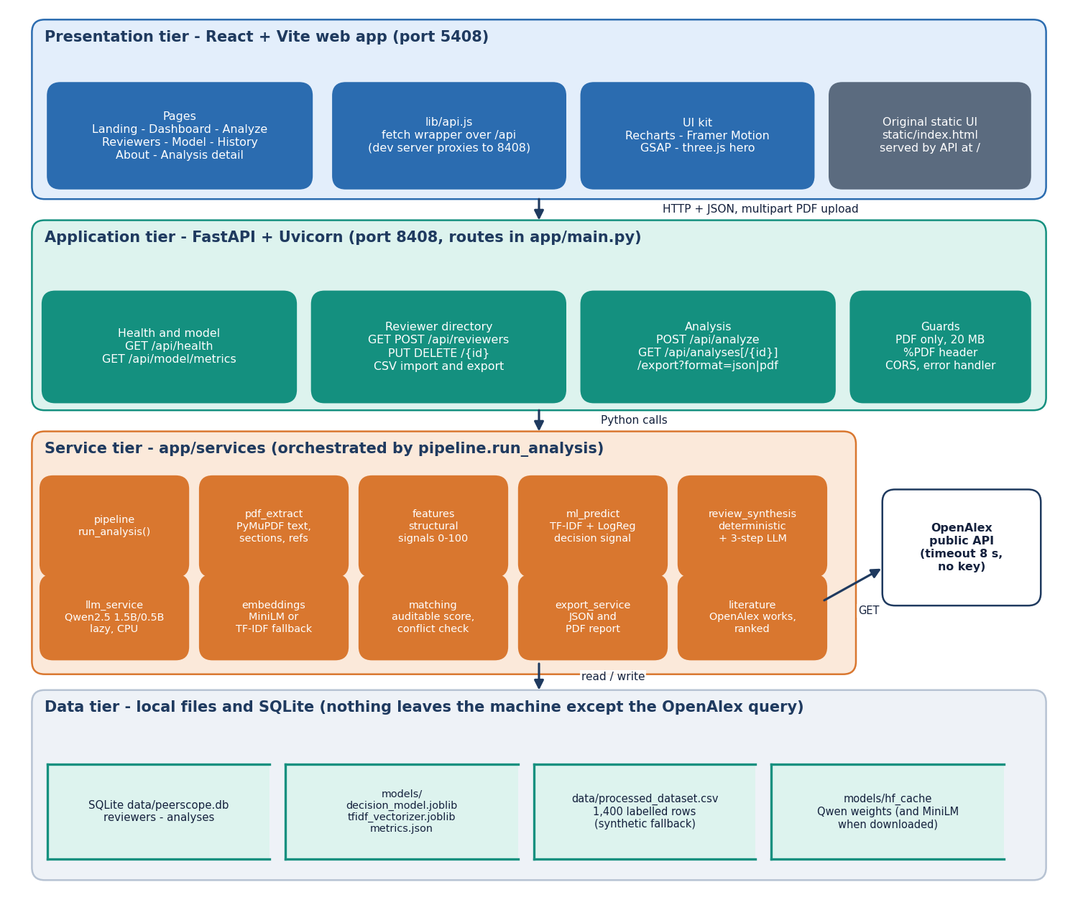
System Architecture
Web app: React + Vite on port 5408
API: FastAPI on port 8408, 12 routes
Services: extraction, features, decision, review, literature, matching
Storage: SQLite (reviewers, analyses) and model files
Local first: only a title query leaves the machine (OpenAlex)
Dept. of CSE | Batch C8 | Final Review
10
Notes:
Tiers and storage; all analysis runs on the local machine.

Slide 11
Methodology
Read PDF
Sections + features
Decision signal
AI review (3 steps)
OpenAlex
Match + conflict
Store + export
Deterministic rules always run; the local language model adds text only when it loads, and a visible notice replaces it otherwise: nothing is fabricated.
Decision model: stratified 80/20 split, seed 42; extra measurements: five other splits, baselines, confidence threshold sweep.
Matching evaluated on 40 held-out probe abstracts across six areas: top-1, top-3 and MRR for four score configurations and two embedders.
Conflict handling tested by injecting 15 links into papers; false flags counted on 240 clean paper-reviewer pairs.
Every number is written by scripts/measure_metrics.py to docs/metrics/metrics.json.
Dept. of CSE | Batch C8 | Final Review
11
Notes:
Workflow and the measurements added on top of the shipped model.

Slide 12
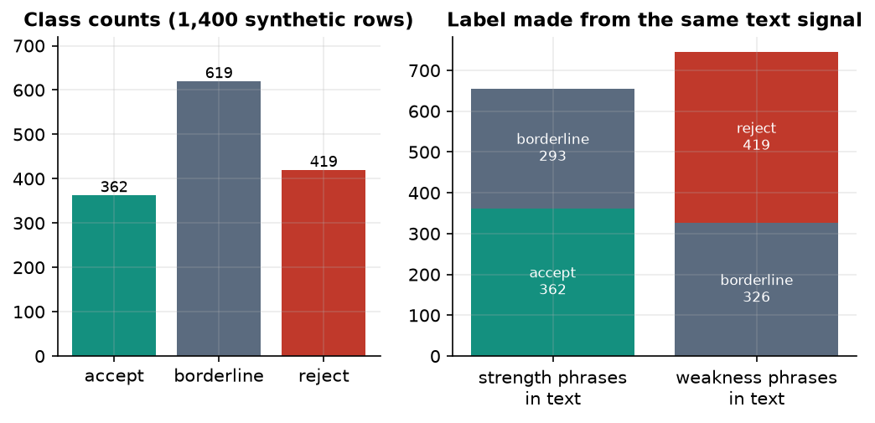
Dataset & Models
1,400
Component | Choice
Decision signal | LogisticRegression, balanced, C = 1
Embeddings | all-MiniLM-L6-v2 (TF-IDF fallback)
AI review | Qwen2.5-1.5B-Instruct, CPU
Literature | OpenAlex API, 6 works
synthetic labelled rows (fallback data)
12,000
TF-IDF features: 8k word + 4k char
Class counts: 362 accept, 619 borderline, 419 reject.
Each label comes from the same strength or weakness phrases that appear in the text; borderline is drawn from both groups, so accuracy cannot exceed about 0.56.
The public PeerRead probe returned no data, so this is the fallback.
1120 / 280
train / test papers (80/20, seed 42)
Reviewer data: 6 labelled demo profiles (Reviewer Alpha to Zeta).
Dept. of CSE | Batch C8 | Final Review
12
Notes:
Be frank about the data: synthetic, and the label construction caps accuracy near 0.56. The reviewer pool is six demo profiles.

Slide 13
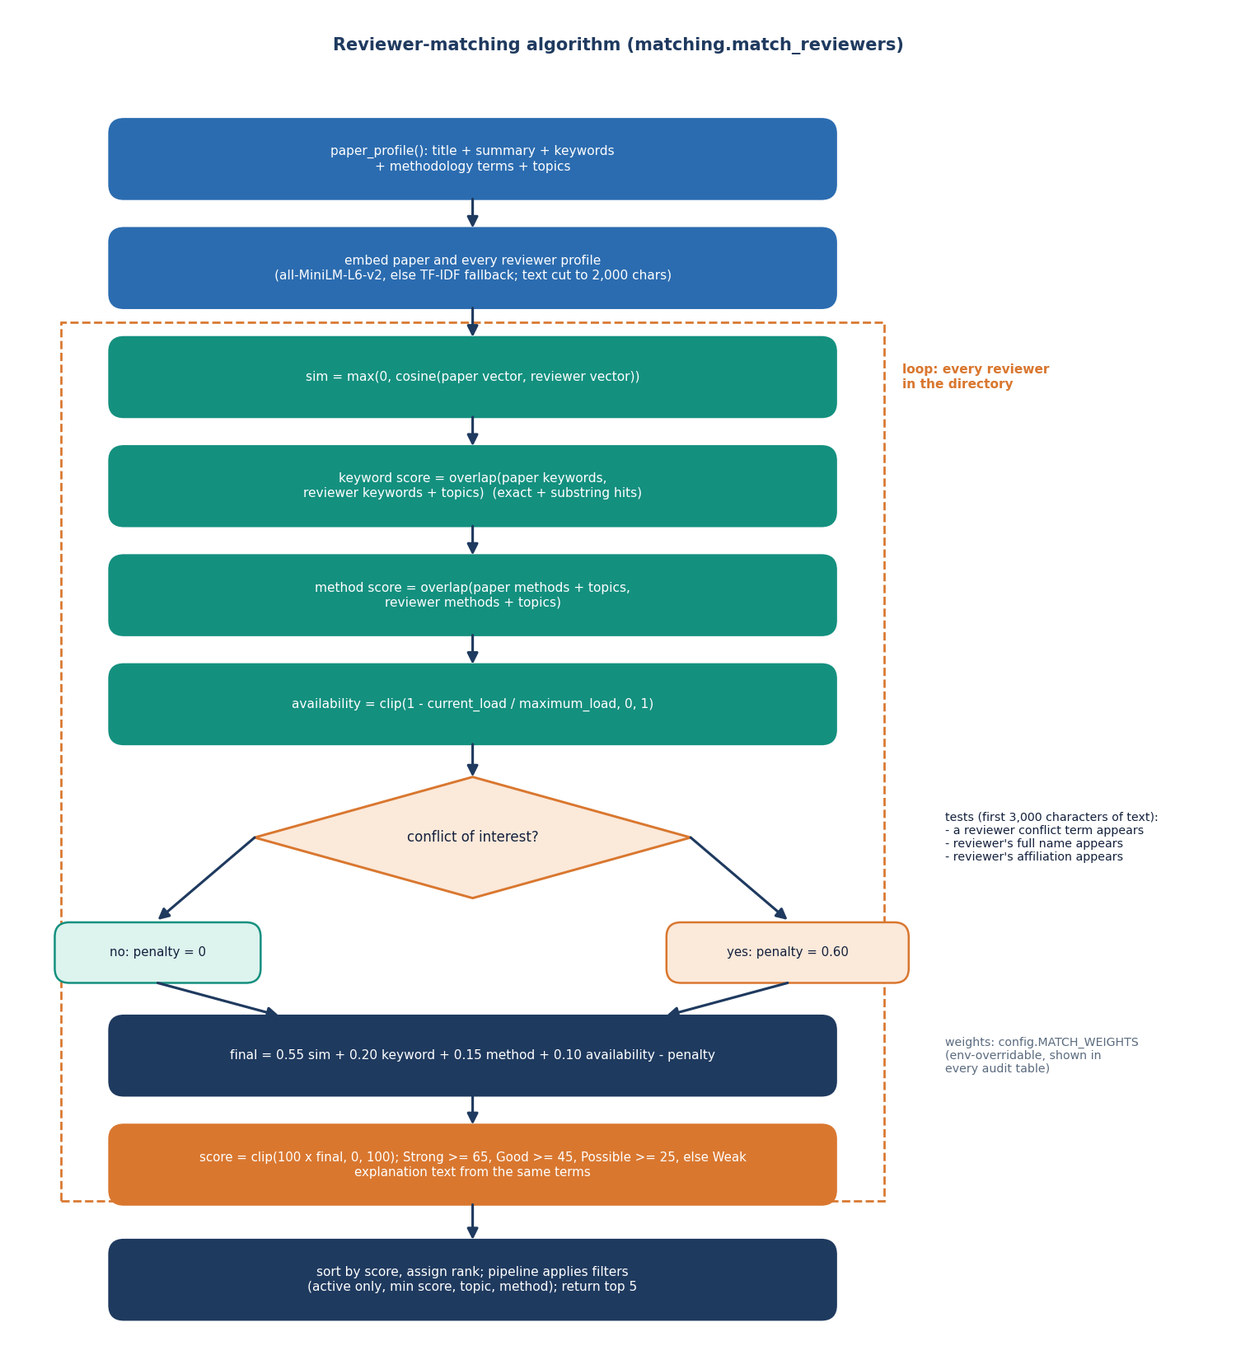
Reviewer Scoring Workflow
Embed paper profile and every reviewer profile; cosine = expertise similarity.
Keyword overlap, method / topic overlap, availability = 1 - load / maximum.
Conflict check: conflict terms, full name or affiliation found in the paper text: penalty 0.60.
Score x 100, clipped 0-100; Strong >= 65, Good >= 45, Possible >= 25, else Weak.
The UI shows each term, its weight and the matching terms for every recommendation.
Dept. of CSE | Batch C8 | Final Review
13
Notes:
The core algorithm of the matcher, in app/services/matching.py.

Slide 14
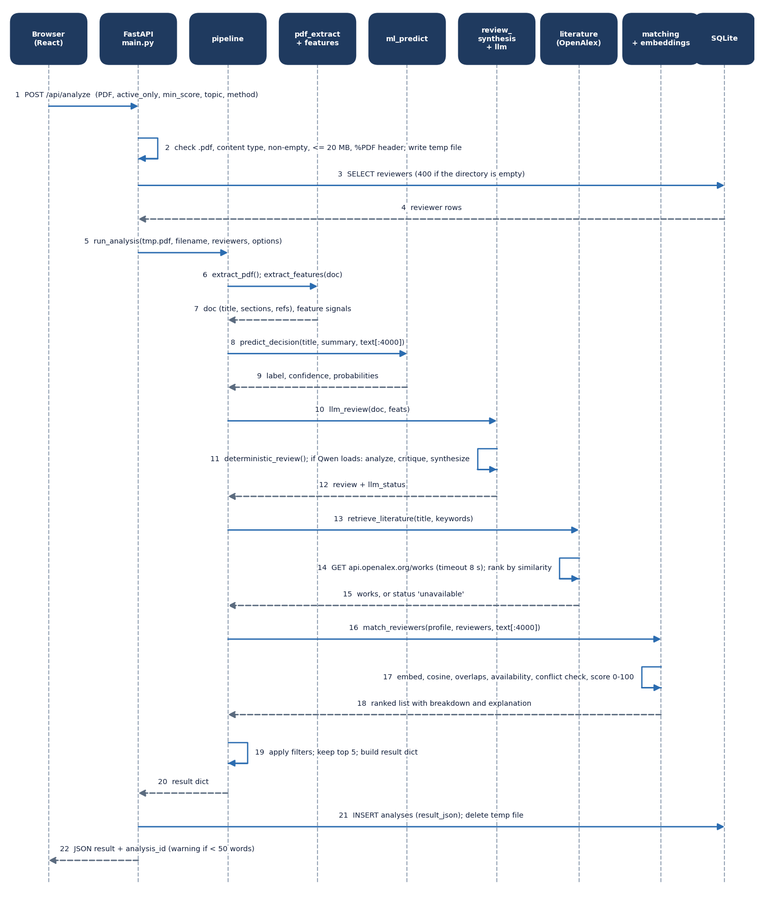
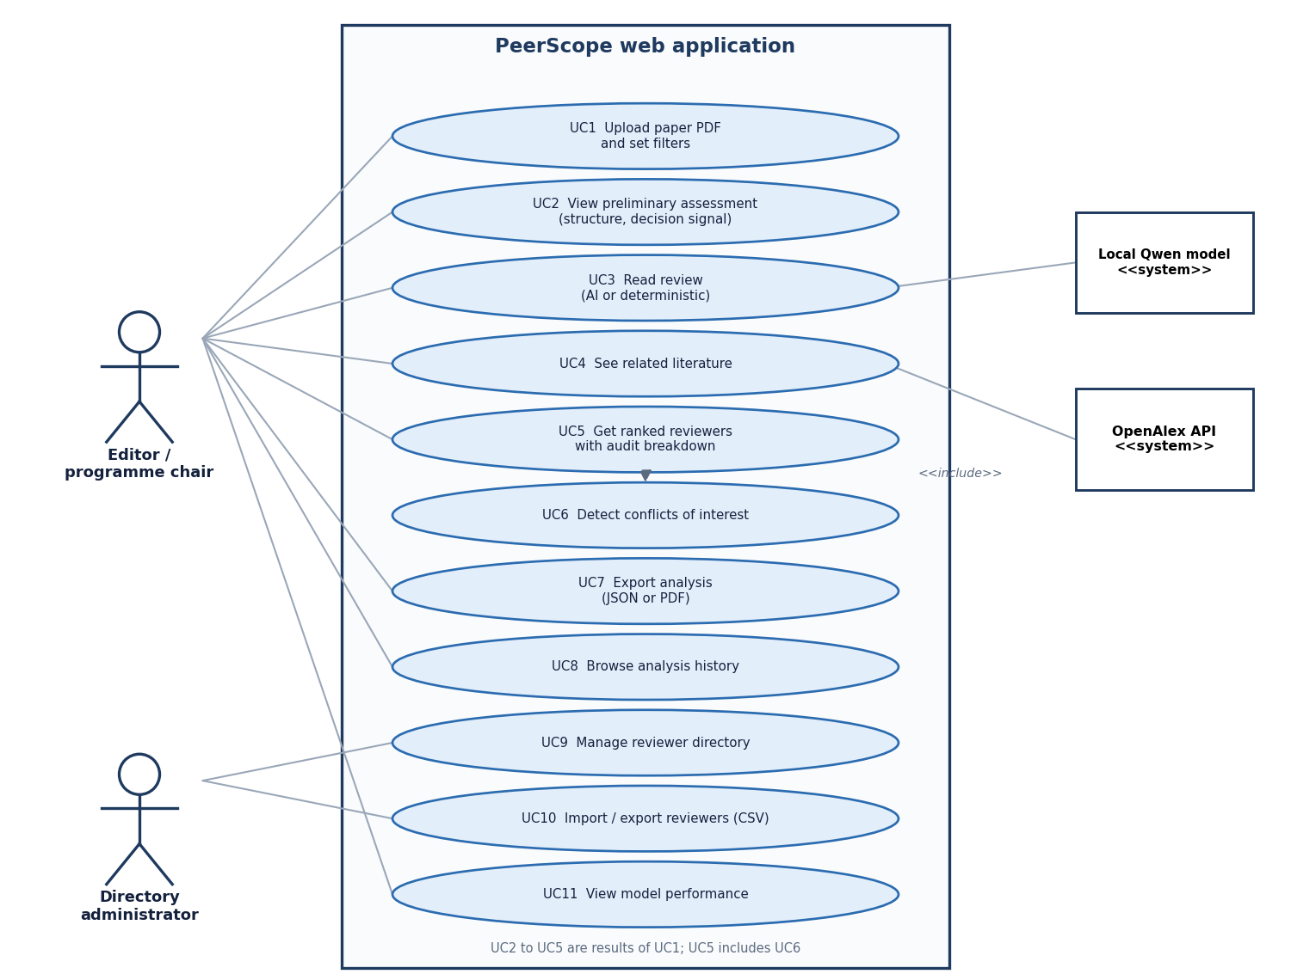
User – System Interaction
Dept. of CSE | Batch C8 | Final Review
14
Notes:
Sequence of one analysis request and the use cases of the editor and the directory administrator.

Slide 15
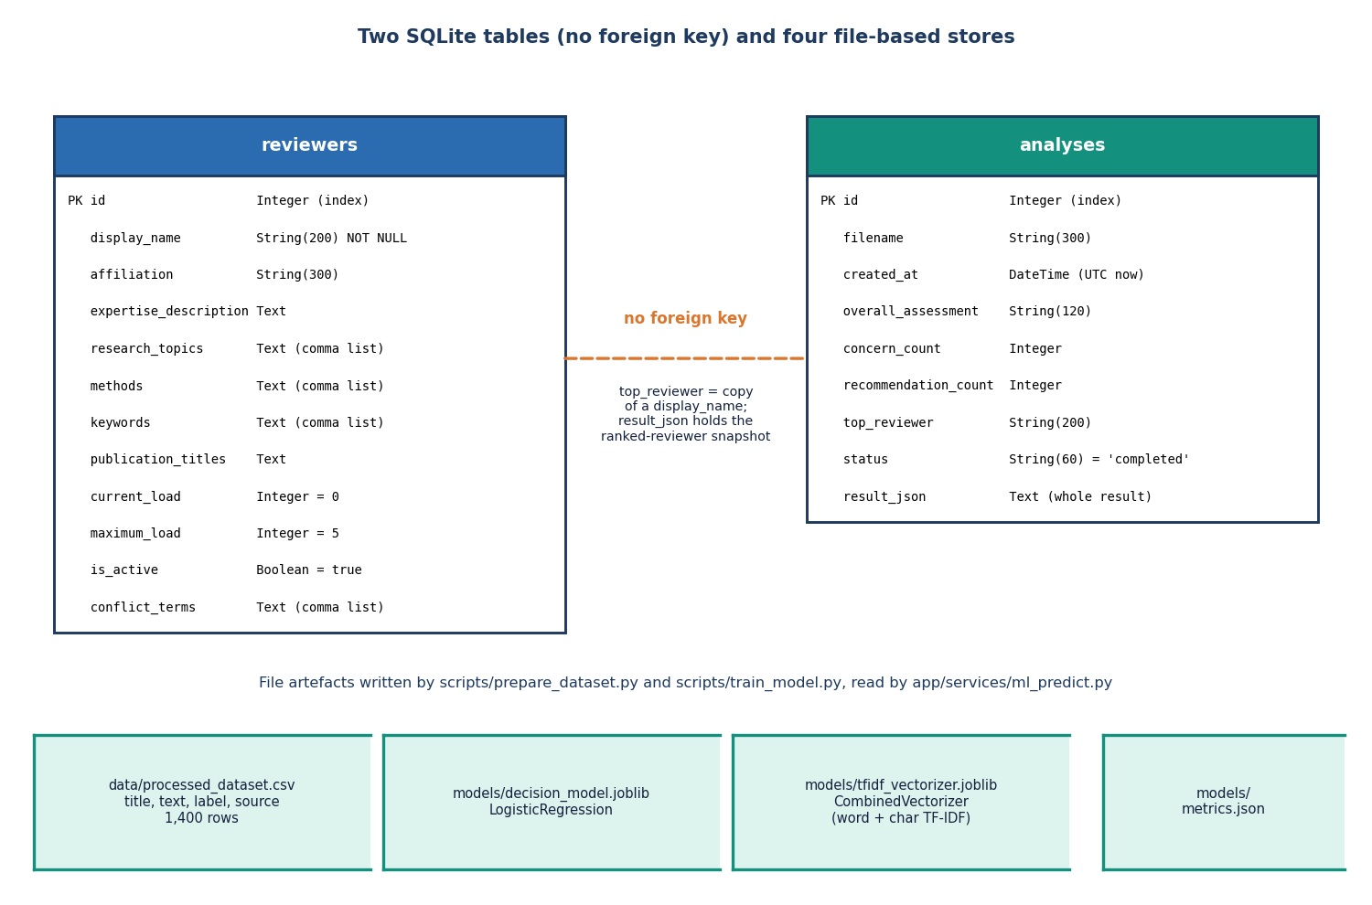
Database Design
Store | Content
table reviewers | 11 columns: profile, load, conflict terms
table analyses | 9 columns incl. result_json
processed_dataset.csv | 1,400 synthetic rows
decision_model.joblib | logistic regression
tfidf_vectorizer.joblib | word + char vectoriser
metrics.json | measured metrics
models/hf_cache | Qwen weights
No foreign key: an analysis stores the ranked reviewers inside its JSON, so later edits to the directory do not change past results.
Dept. of CSE | Batch C8 | Final Review
15
Notes:
Two SQLite tables plus file-based artefacts. The missing foreign key is deliberate: analyses are frozen snapshots.

Slide 16
Implementation Highlights
12
7 + 24
8
1,449
REST routes (+ /docs)
pytest tests + smoke checks
React pages
lines of backend code
Upload validation: .pdf extension, content type, empty file, %PDF header, 20 MB limit (HTTP 413), warning when fewer than 50 words are extracted.
Graceful degradation: local model missing -> visible notice and deterministic review; OpenAlex 8 s timeout -> literature 'unavailable'; MiniLM missing -> TF-IDF.
Reviewer directory with CRUD, activate / deactivate, CSV import and export; analysis history with JSON and PDF export (reportlab).
One command starts both servers (run.bat); a Docker image serves the API.
Dept. of CSE | Batch C8 | Final Review
16
Notes:
Highlights: validation, degradation paths, directory management and one-command start.

Slide 17
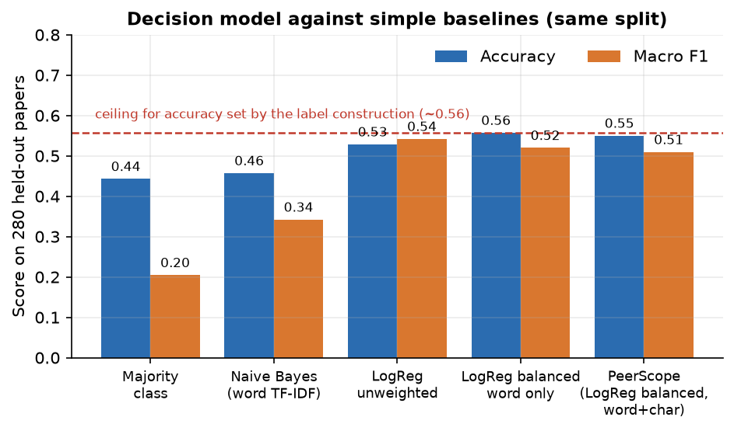
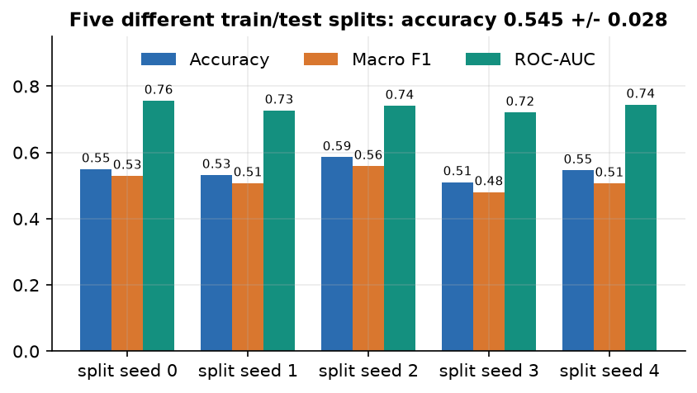
Results – Decision Model (synthetic data)
55.0%
0.509
0.771
93.0%
accuracy, n = 280
macro F1
macro ROC-AUC
accept vs reject only
Five splits: accuracy 0.545 +/- 0.028. Borderline recall 0.07: it cannot be told apart from text by construction.
Dashed line: best accuracy any text rule can reach on these labels (~0.56). Shows the pipeline works; not evidence of predicting real peer-review decisions.
Dept. of CSE | Batch C8 | Final Review
17
Notes:
Accuracy 0.55 sits next to the ceiling of about 0.56 set by the label construction; the model beats the majority baseline (0.44) and naive Bayes (0.46). On the four real papers it answered borderline every time.

Slide 18
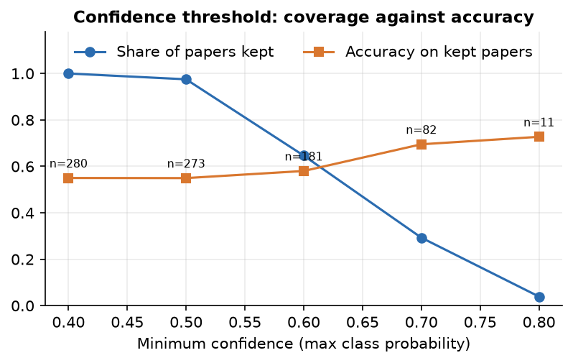
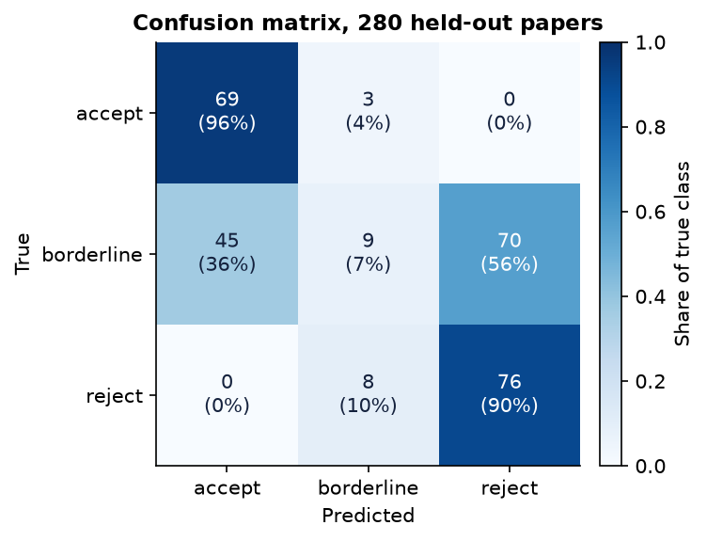
Confusion Matrix & Confidence Threshold
Of 124 borderline papers 45 are predicted accept and 70 reject; accept and reject are almost never confused.
Confidence >= 0.7 keeps 29% of papers at 70% accuracy (n = 82).
Rows: true class; columns: predicted.
Dept. of CSE | Batch C8 | Final Review
18
Notes:
Rows are the true class. The error is almost entirely borderline papers pushed to accept or reject. Raising the confidence threshold trades coverage for accuracy.

Slide 19
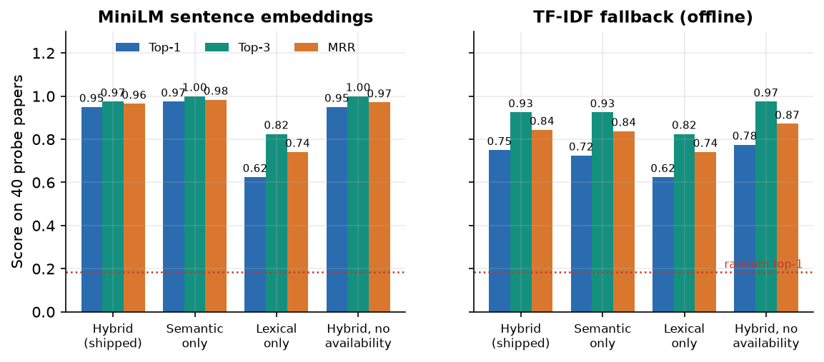
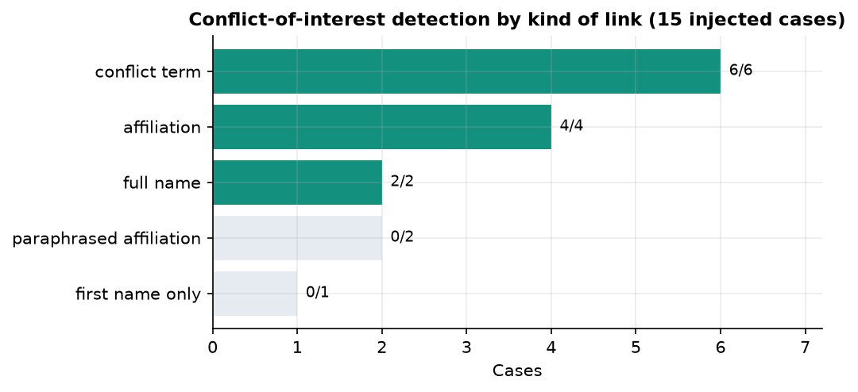
Results – Reviewer Matching & Conflict Handling
Semantic similarity alone scores 0.975 top-1; the hybrid 0.95; lexical overlap alone only 0.62.
Conflicts: 6/6 terms, 4/4 affiliations, 2/2 names flagged; paraphrased links 0/3 missed; false flags 0 of 240 clean pairs.
Ranking time: 86 ms for 6 reviewers, 5.2 s for 500 (embeds every profile each request).
Scope: team-written 40-abstract probe, 6 demo reviewers; labels are the team's own, so figures are optimistic.
Embedder | Top-1 | Top-3 | MRR
MiniLM (hybrid) | 0.95 | 0.97 | 0.96
TF-IDF fallback | 0.75 | 0.93 | 0.84
Lexical only | 0.62 | 0.82 | 0.74
Random | 0.18 | 0.53 | -
Dept. of CSE | Batch C8 | Final Review
19
Notes:
Top-1 0.95 with MiniLM, 0.75 with the offline fallback; both far above random (0.18). The probe is small and labelled by the team, so it is not comparable with the base paper.

Slide 20
Performance & Testing
2.4 s
31 ms
136 ms
8.5 min
PDF extraction (3 pages, first call)
decision signal
reviewer matching (6 reviewers)
local AI review, 3 steps, CPU
Test layer | What it covers | Result
Unit and API (pytest) | extraction, features, matching, conflicts, decision service, API, CRUD, pipeline | 7 of 7 passed in 34 s
Smoke test | running API and web app: CRUD, CSV, bad uploads, analysis, export, CORS | 24 of 24 checks
HTTP latency (LLM off) | analysis of 3 / 30 pages; list and health calls | 1.3 s / 1.2 s; 2.4 ms
HTTP latency (LLM on) | full analysis of 30 / 30 / 17 pages | 534 s / 621 s / 946 s
Real PDFs | four papers through the pipeline | found 2 defects (title '?', roman headings)
Intel Core i5-12500, 15.7 GB, CPU only. Tests ran with the language model disabled. Not tested: GPU, concurrent users, scanned PDFs, a user study.
Dept. of CSE | Batch C8 | Final Review
20
Notes:
The language model is about 97 percent of the time of a full analysis; everything else takes a few seconds.

Slide 21
Comparison with Base Paper (context only – different data and scope)
Aspect | Base paper [1] | This project (PeerScope)
Scope | Reviewer affinity scoring only | Paper assessment + reviewer ranking + directory, history, export
Keywords / model | LLM ensemble and judge induce keywords | Frequency and lexicon keywords; local LLM only writes the review text
Matcher | TF-IDF, Jaccard, SBERT (MiniLM), cross-encoder, keyword graphs | MiniLM cosine + keyword + method overlap + availability - conflict
Data | 663 papers, 524 reviewers, 1,989 assignments | team-written 40-abstract probe, 6 demo reviewers
Reported | Best MRR@3 0.7778 (titles) / 0.7843 (abstracts) | Top-1 0.95, MRR 0.96 (not comparable)
Conflict / load | Not benchmarked | In the score; 12/12 literal links flagged, paraphrases missed
Different data, labels and task scope: the numbers are context, not a ranking; no superiority over the base paper is claimed.
Dept. of CSE | Batch C8 | Final Review
21
Notes:
State plainly that 0.95 top-1 on 40 team-written abstracts and 6 demo reviewers cannot be compared with MRR@3 on 663 real papers.

Slide 22
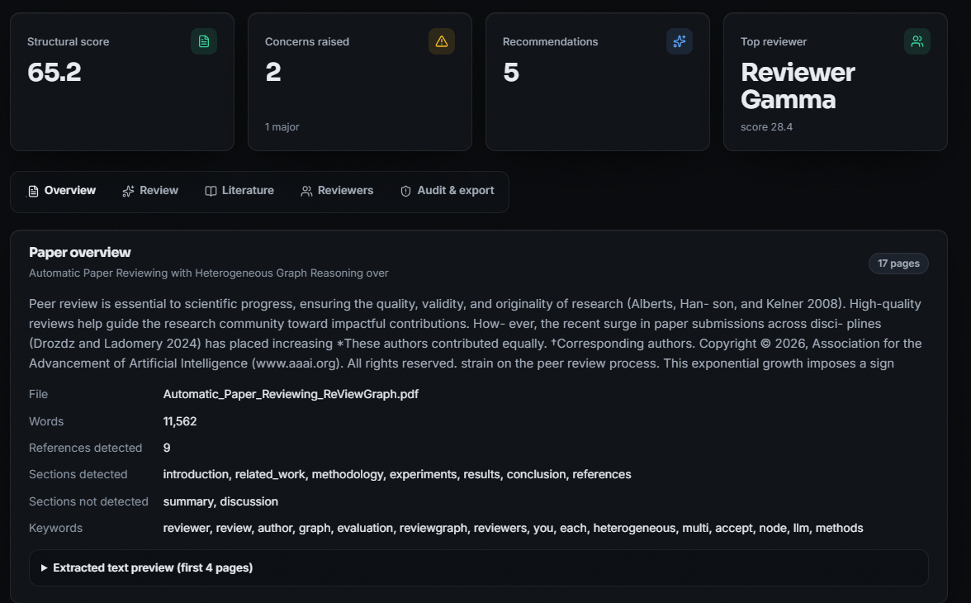
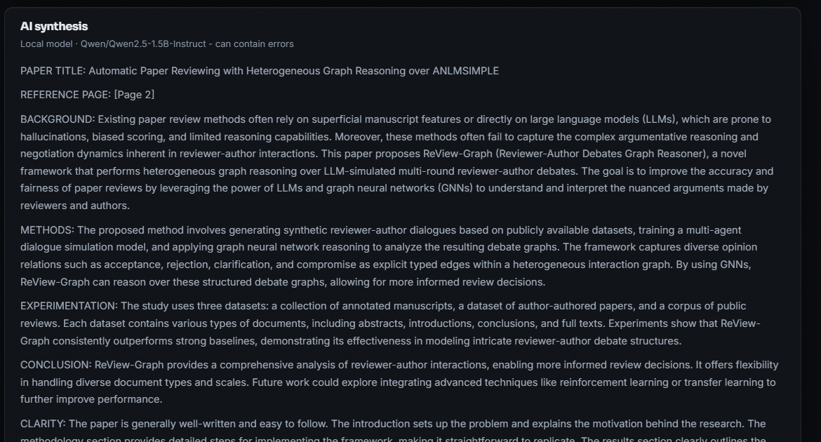
Output – Analysis Result and AI Review
Left: a 17-page paper analysed: structural score 65.2, decision signal 'borderline' (58%), review generated by Qwen2.5-1.5B. Right: the AI synthesis, which can contain errors (here it misdescribes the paper's datasets).
Dept. of CSE | Batch C8 | Final Review
22
Notes:
Real screenshots of a real analysis (ReViewGraph paper, arXiv 2511.08317). The AI text is shown unedited, including its mistakes.

Slide 23
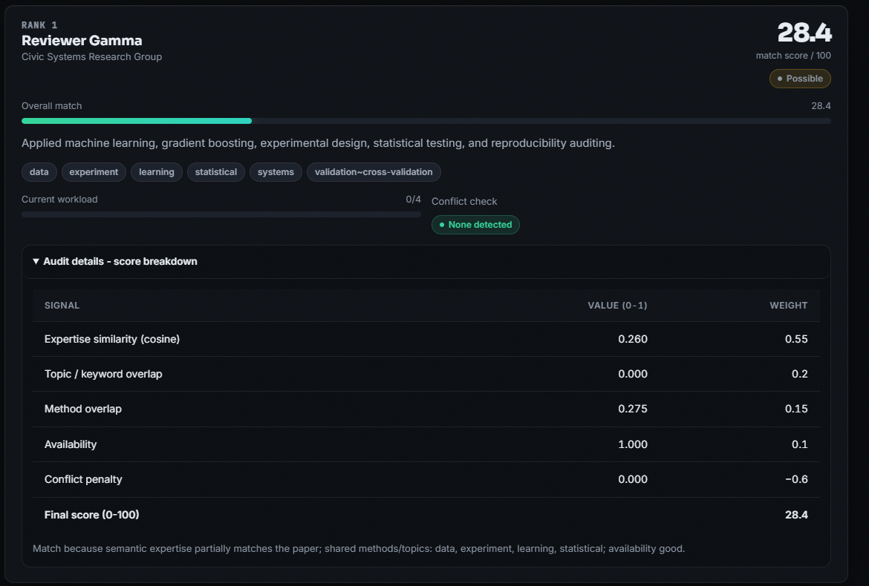
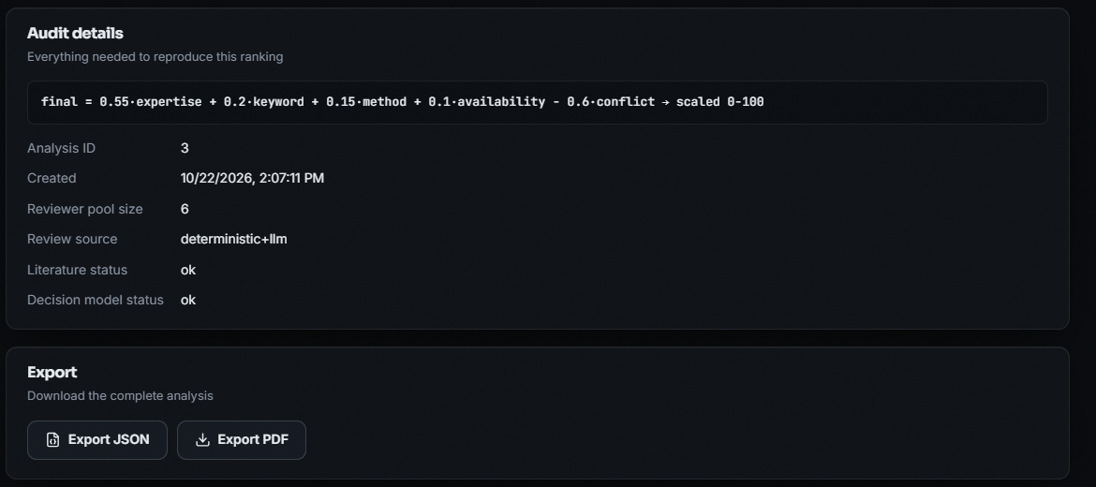
Output – Reviewer Ranking and Audit
Left: rank 1 reviewer with the score breakdown (0.55 x 0.260 + 0.15 x 0.275 + 0.10 x 1.0 = 28.4; low because no demo reviewer is close to this paper). Right: audit details and JSON / PDF export.
Dept. of CSE | Batch C8 | Final Review
23
Notes:
Every recommendation exposes its terms. The low absolute scores are honest: the six demo reviewers do not cover this paper's topic.

Slide 24
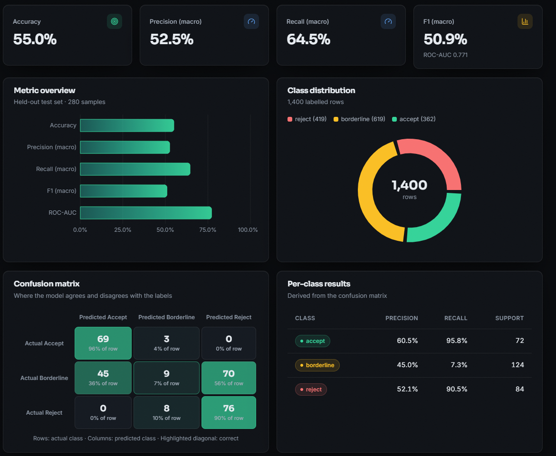
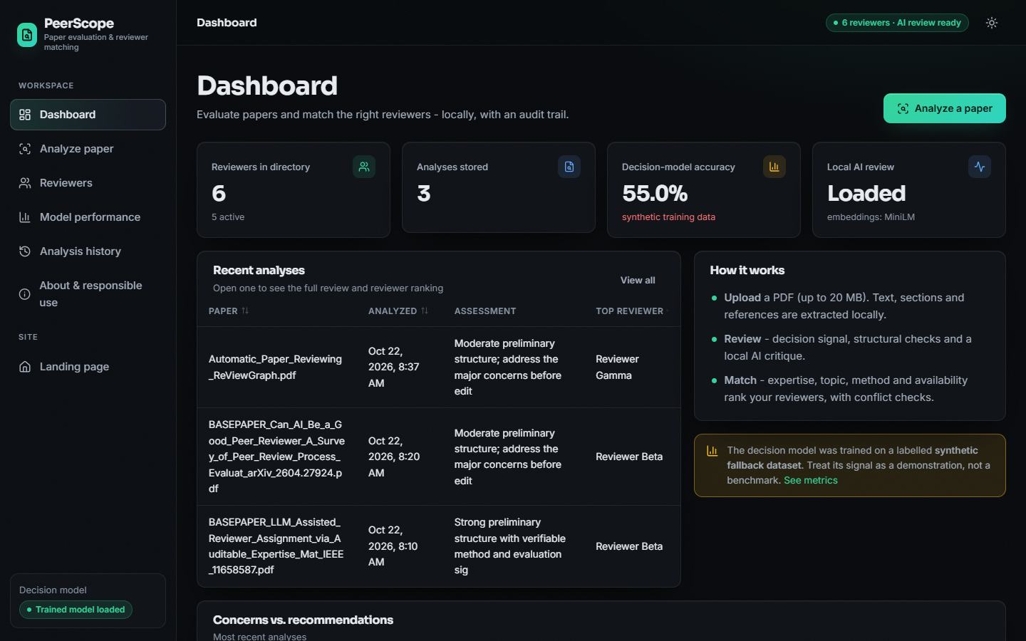
Output – Model Performance and Dashboard
Left: model page with the measured metrics and the synthetic-data warning. Right: dashboard with three stored analyses of real papers, the language model loaded and MiniLM embeddings.
Dept. of CSE | Batch C8 | Final Review
24
Notes:
The product itself says the accuracy comes from synthetic data. Dashboard shows real stored analyses.

Slide 25
Conclusion
Delivered: a working local application from PDF upload to assessment, literature context, auditable reviewer ranking, history and export, with 7 pytest tests and 24 smoke checks passing.
Measured: decision model 55.0% on synthetic data (ceiling ~0.56); reviewer matching top-1 0.95 / 0.75 on a team-written 40-abstract probe, 6 demo reviewers; conflict links 12/12 literal, 0/3 paraphrased.
Objectives: 2, 3, 4 met; 5 met except novelty; 1 and 6 partly (demo profiles, team-labelled probe, no real expert judgement).
Limits: synthetic training data; six demo reviewers; novelty not assessed; literal conflict matching; minutes per analysis with the language model on a CPU; no user study.
Position: decision support only; the editor decides.
Dept. of CSE | Batch C8 | Final Review
25
Notes:
Be explicit about which objectives were met and which were not, and what was never measured.

Slide 26
Future Scope
Train and test the decision model on real peer-review records (e.g. PeerRead / OpenReview) and report accuracy on real decisions.
Build reviewer profiles from real publication histories (OpenAlex, Semantic Scholar) and evaluate against expert or historical assignments.
Fix the defects found: sanitise OpenAlex queries, recognise roman-numeral headings, fit the TF-IDF fallback on a stable corpus.
Add a measured novelty signal from literature similarity; paraphrase-aware and co-authorship-aware conflict detection.
Cache reviewer embeddings or use an index for large pools; quantised or GPU model for faster reviews; sign-in and multi-user support.
Dept. of CSE | Batch C8 | Final Review
26
Notes:
Concrete next steps, ordered by value.

Slide 27
References
[1] F. Bagheri, D. Buscaldi and D. Reforgiato Recupero, "LLM-assisted reviewer assignment via auditable expertise matching," IEEE Access , vol. 14, pp. 127834-127863, 2026, doi: 10.1109/ACCESS.2026.3724622.
[2] F. Torrielli, S. Locci, A. Rapp and L. Di Caro, "How to get your paper accepted by an AI reviewer: indirect prompt injection in peer review," Research Square preprint, Jan. 2026, doi: 10.21203/rs.3.rs-8432945/v1. (Published as "Exploiting large language models in peer review: indirect prompt injection attacks and integrity probes," Scientometrics , vol. 131, no. 7, pp. 4889-4951, 2026, doi: 10.1007/s11192-026-05695-x.)
[6] S. Wu, O. Jiang, Y. Zhao, T. Hu, Y. Ma, K. Zhang, M. Patwardhan and A. Cohan, "Can AI be a good peer reviewer? A survey of peer review process, evaluation, and the future," arXiv:2604.27924, Apr. 2026.
[7] S. Li, L. Fan, Y. Lin, Z. Li, X. Wei, S. Ni, H. Alinejad-Rokny and M. Yang, "Automatic paper reviewing with heterogeneous graph reasoning over LLM-simulated reviewer-author debates," arXiv:2511.08317, Nov. 2025 (AAAI 2026 copyright notice on the PDF).
[10] L. Charlin, R. S. Zemel and C. Boutilier, "A framework for optimizing paper matching," arXiv:1202.3706, Feb. 2012.
[11] D. Mimno and A. McCallum, "Expertise modeling for matching papers with reviewers," in Proc. 13th ACM SIGKDD Int. Conf. Knowl. Discovery Data Mining , 2007, pp. 500-509, doi: 10.1145/1281192.1281247.
[13] A. Beygelzimer, Y. N. Dauphin, P. Liang and J. W. Vaughan, "Has the machine learning review process become more arbitrary as the field has grown? The NeurIPS 2021 consistency experiment," arXiv:2306.03262, Jun. 2023.
[19] N. Reimers and I. Gurevych, "Sentence-BERT: sentence embeddings using Siamese BERT-networks," in Proc. EMNLP-IJCNLP , 2019, pp. 3980-3990, doi: 10.18653/v1/D19-1410.
[20] W. Wang, F. Wei, L. Dong, H. Bao, N. Yang and M. Zhou, "MiniLM: deep self-attention distillation for task-agnostic compression of pre-trained transformers," arXiv:2002.10957, Feb. 2020.
[22] D. Kang, W. Ammar, B. Dalvi, M. van Zuylen, S. Kohlmeier, E. Hovy and R. Schwartz, "A dataset of peer reviews (PeerRead): collection, insights and NLP applications," in Proc. NAACL-HLT , 2018, pp. 1647-1661, doi: 10.18653/v1/N18-1149.
[24] W. Liang et al., "Can large language models provide useful feedback on research papers? A large-scale empirical analysis," NEJM AI , vol. 1, no. 8, Jul. 2024, doi: 10.1056/AIoa2400196.
[27] J. Keuper, "Prompt injection attacks on LLM generated reviews of scientific publications," arXiv:2509.10248, Sep. 2025.
[29] A. Yang et al. (Qwen Team), "Qwen2.5 technical report," arXiv:2412.15115, Dec. 2024.
[32] J. Priem, H. Piwowar and R. Orr, "OpenAlex: a fully-open index of scholarly works, authors, venues, institutions, and concepts," arXiv:2205.01833, 2022.
Dept. of CSE | Batch C8 | Final Review
27
Notes:
Selected references; the complete numbered list is in the report.

Slide 28
THANK YOU
Questions & Suggestions
Dept. of CSE | Batch C8 | Final Review
28
Notes:
Invite questions.

