Slide 1
Multi-Disease Prediction Using Machine Learning
REVIEW 2 · DESIGN, METHODOLOGY AND PROGRESS
Design, methodology and progress: four classifiers for each of four diseases, behind one web interface
Presented by
Under the guidance of
AJMEERA HARINI 23K91A0507
BANDI LIKITHA 23K91A0526
CHINTHAKINDI SWATHI 23K91A0555
BADROJU SRI HANSIKA 23K91A0524
B. SRUTHI, Faculty Project Guide, Department of CSE
Department of Computer Science and Engineering
TKR College of Engineering and Technology (Autonomous) · Batch A3 (CSE-A) · [ACADEMIC YEAR]
Notes:
This review shows how the Intelligent Health Assistant is designed and built: data, models, what is implemented, the first measured results, and the open items. The training data are synthetic and we say so on every relevant slide.

Slide 2
Contents
01
02
03
04
Recap
Architecture
Methodology
Dataset
05
06
07
08
Preprocessing
Models and training
Decision logic
Data flow, data model, UML
09
10
11
12
Technology stack
Progress and results
Output screens and testing
Challenges and next steps
Notes:
Agenda for the design and progress review.

Slide 3
Recap: problem and proposed system
!
Problem
i
Proposed system
B
Base paper link
Patients see several specialists for separate tests, tools cover one disease each, and rural centres cannot interpret routine reports early. Late diagnosis raises cost and mortality.
One web application that takes routine clinical values and returns a high / low risk class with the model's confidence for diabetes, heart, liver and kidney disease.
Alam et al. (IEEE Access 2026) classify thyroid status on 7,200 UCI records with five classifiers, nested cross-validation, SHAP and counterfactuals. We take the idea of comparing classifiers under held-out evaluation and widen it to four diseases; the explanation part is not yet built.
Notes:
One-minute recap of Review 1. Need: A single machine learning system that screens multiple diseases from routine clinical parameters and flags risk early. The base paper studies one disease with real data and explanations; this project covers four diseases on synthetic data and does not yet explain predictions.

Slide 4
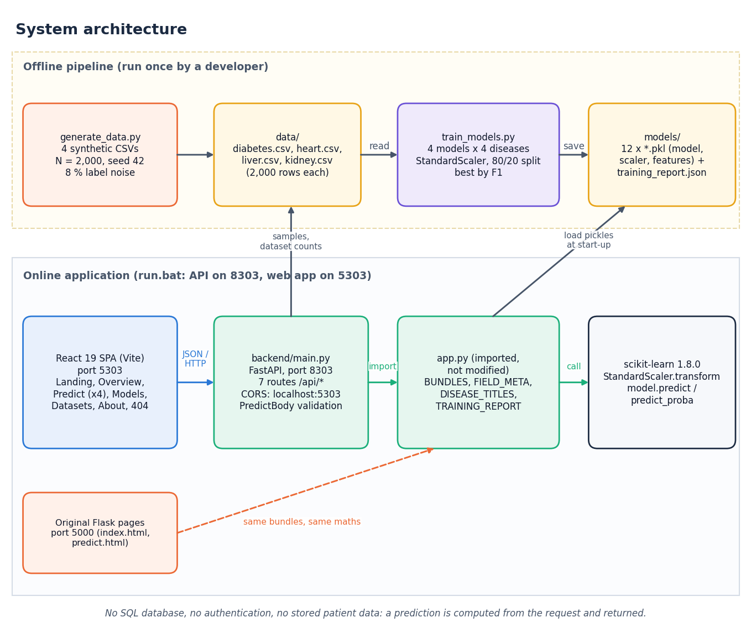
System architecture
Data: generate_data.py writes four synthetic CSVs; train_models.py trains and saves models/*.pkl and training_report.json.
Flask layer: app.py loads the model bundles (model, scaler, features) and field metadata; original server-side pages on port 5000.
API: FastAPI (port 8303) imports app.py, so predictions are identical; 7 routes.
UI: React + Vite (port 5303): prediction forms, model comparison, datasets.
No database, no accounts, no stored patient data.
Notes:
Four layers. The FastAPI layer imports the Flask module, so no model code was rewritten for the React interface. There is no database.

Slide 5
Methodology: end-to-end workflow
Generate / load CSV
Split 80/20
StandardScaler
Train 4 models
Metrics on test
Best by F1
Save + serve
Same recipe per disease
Selection on F1
Served unchanged
Four diseases, four algorithms, one split rule (stratified, seed 42) and the same settings: 16 models in total.
The model with the highest F1 on the 400-row test set is saved; this reuses the test set for selection, so the reported best is slightly optimistic.
The saved model, scaler and feature list are loaded by app.py and used by the API for every prediction.
Notes:
The workflow is exactly what train_models.py runs. The scaler is fitted on the training part only, so the test rows do not leak into scaling.

Slide 6
Dataset: four synthetic tables
8,000
43
8%
~92%
rows: 2,000 for each disease
input features: 8 + 13 + 10 + 12
of labels flipped at random
accuracy ceiling set by the noise
Disease | Features | High risk | Risk score is built from
Diabetes | 8 | 40.6% | glucose, BMI, age, pedigree, blood pressure
Heart disease | 13 | 73.1% | age, sex, chest pain, BP, cholesterol, angina, ST depression, vessels, max HR
Liver disease | 10 | 28.1% | bilirubin, ALP, ALT, AST, albumin, age
Kidney disease | 12 | 59.8% | albumin, sugar, creatinine, urea, haemoglobin, glucose, gravity, BP, age
Synthetic: generate_data.py (seed 42) draws feature values from clipped normal / exponential distributions, scores them with a hand-written linear rule, applies a sigmoid at 0.5 and flips 8% of labels.
Split: 1,600 training and 400 test rows per disease; 0 missing cells, 0 duplicates. Results show how well the pipeline recovers a known rule, not clinical performance.
Notes:
Be explicit: the build environment had no access to public data, so the CSVs are generated. Because labels are a linear rule plus 8% flips, no model can exceed about 92% accuracy. The README and the Datasets page of the app say the same. Feature counts per disease: 8, 13, 10 and 12.

Slide 7
Data preprocessing
Step | What the code does
Split | train_test_split, test size 20%, stratified on the label, random_state 42
Scale | StandardScaler fitted on the training rows only, applied to the test rows
Persist | scaler saved as models/<disease>_scaler.pkl and reused for every online prediction
Validate (online) | UI checks required / numeric; API rejects missing or non-finite values with HTTP 422
Range hint | UI warns when a value is outside the training range of that feature
!
Not implemented
No imputation, outlier handling, feature selection, SMOTE or class weights: the synthetic data has no missing cells or real outliers. Objective 2 is only partly met.
Notes:
Preprocessing is a single StandardScaler. The objective to handle missing values and outliers has nothing to act on in the synthetic data, and no imputation code was written; the supplementary real-data check imputes with the median.

Slide 8
Models compared
Model | Settings (train_models.py) | Test accuracy, 4 diseases
Logistic Regression | max_iter 1000, random_state 42 | 88.3% - 91.8% (served for 3 diseases)
Decision Tree | max_depth 6 | 74.5% - 86.0% (fits label noise)
Random Forest | 200 trees, max_depth 8 | 81.5% - 88.3% (train 93.6 - 95.9%)
SVM | RBF kernel, C = 1, probability = True | 85.3% - 89.5% (served for diabetes)
The four algorithms are the ones named in the abstract. No hyper-parameter search was run: the settings are fixed. The linear model is the right family here because the synthetic labels come from a linear rule.
Notes:
Four scikit-learn models per disease. Random Forest fits the training part to 93.6-95.9% but scores less on test, which shows over-fitting of the noisy labels.

Slide 9
Training configuration
Setting | Value
Split | 80/20 stratified, random_state 42 (1,600 train / 400 test per disease)
Features | scaled with StandardScaler (fit on train)
Metrics | accuracy, precision, recall, F1 (ROC-AUC added afterwards in run_experiments.py)
Selection rule | highest F1 on the test set; ties are not handled specially
Saved files | models/<disease>_model.pkl, _scaler.pkl, _features.pkl, training_report.json
Pinned versions | scikit-learn 1.8.0 (older versions fail on predict_proba), pandas 3.0.2, numpy 2.4.4
Hardware / time | Intel Core i5-12500, CPU only; all 16 models fit in about 2.8 s
Notes:
These are exactly the settings of train_models.py. The re-run in scripts/run_experiments.py reproduces all 16 stored results to four decimals.

Slide 10
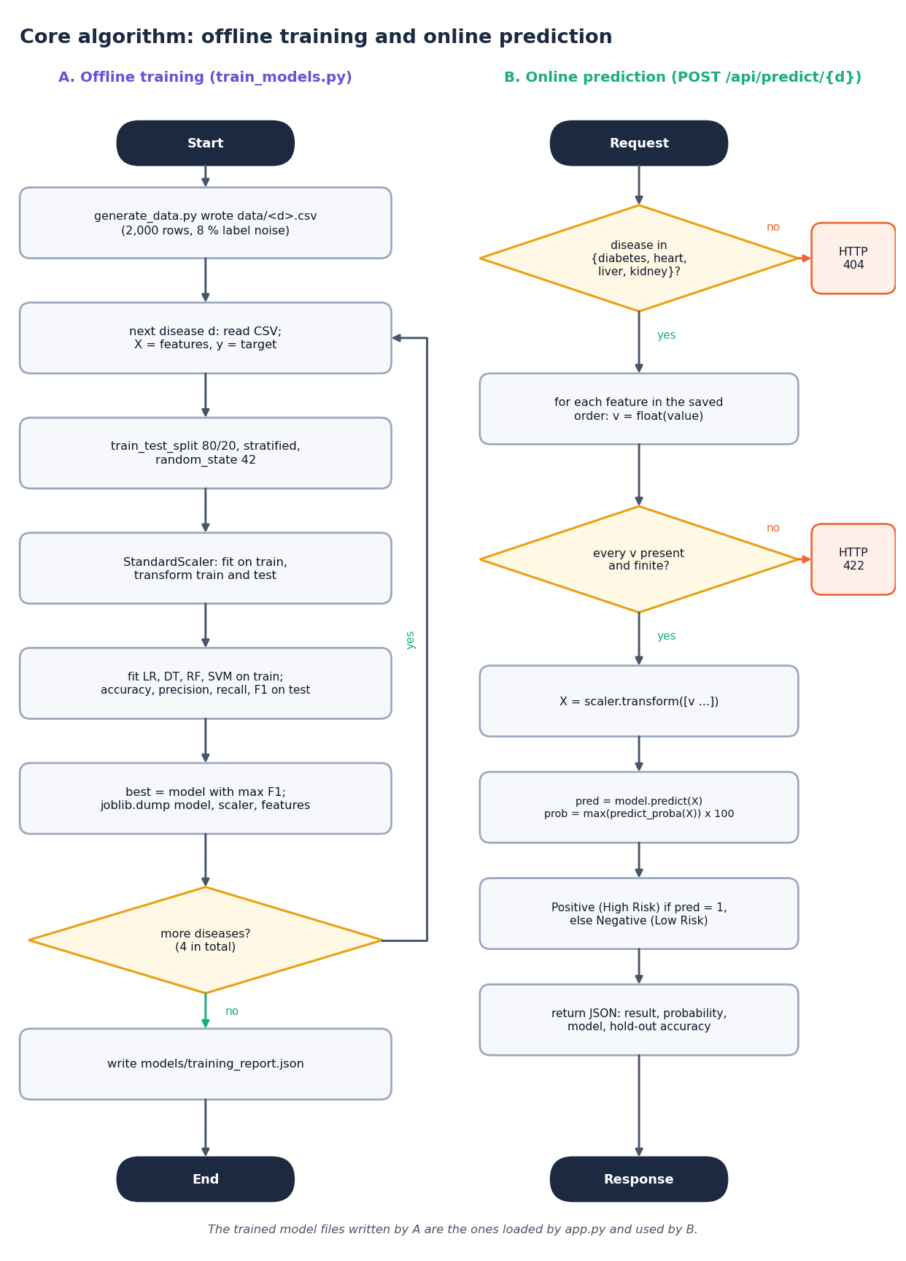
Decision logic
Choose the model. For each disease the algorithm with the highest F1 on the hold-out set is saved: SVM for diabetes, Logistic Regression for heart, liver and kidney.
Predict. Values are scaled, then model.predict gives the class; 1 = Positive (High Risk), 0 = Negative (Low Risk).
Confidence. The percentage shown is max(predict_proba) of the predicted class (50-100%), not a calibrated risk.
Threshold. The 0.5 rule is used as is; a sweep from 0.20 to 0.80 was run offline only.
Caution. On ten different splits Logistic Regression had the best F1 every time, so the diabetes choice of SVM is within noise.
Notes:
The decision rule is simple and fixed. The model selection is not robust for diabetes: SVM beat Logistic Regression by 0.004 F1 on one split, inside the split-to-split spread.

Slide 11
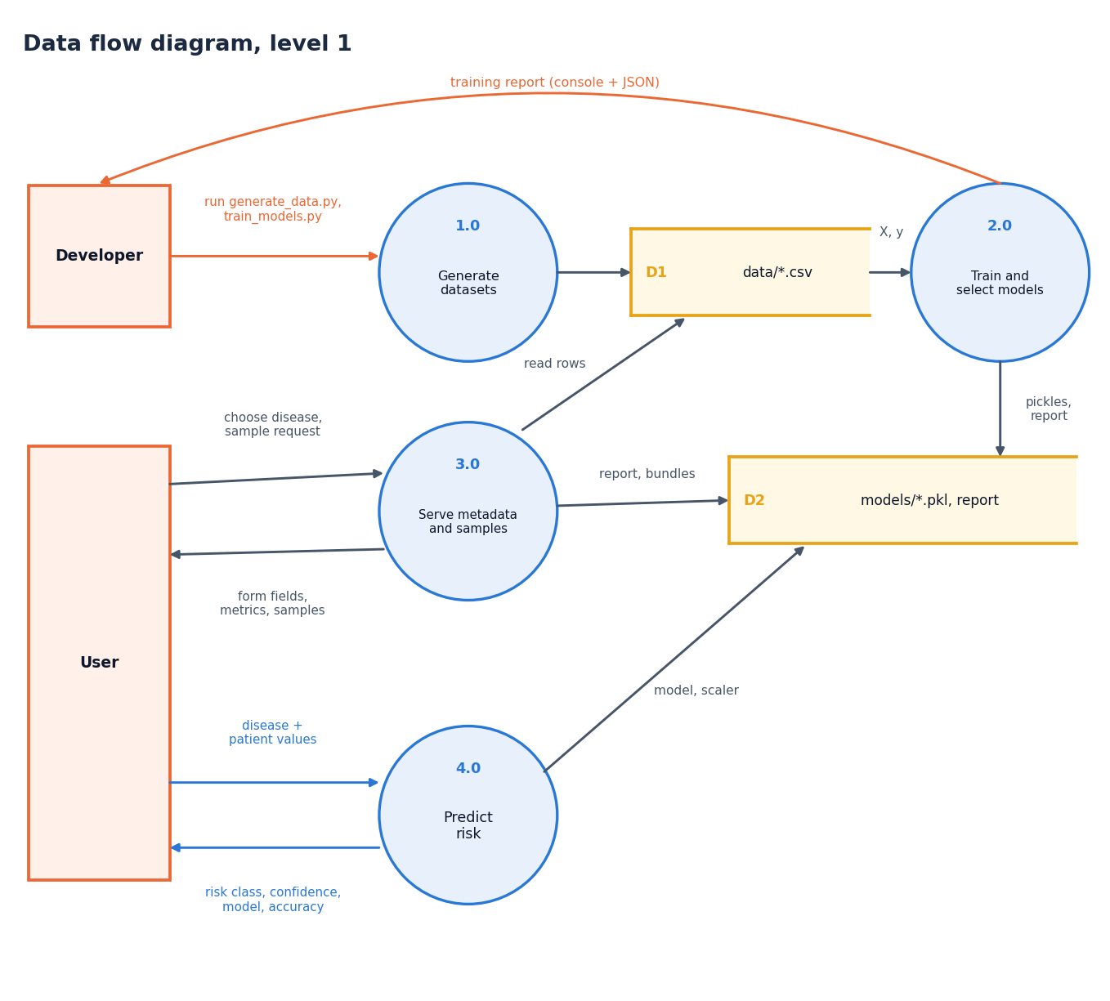
Data flow and modules
Module | Role
generate_data.py | writes the four synthetic CSVs
train_models.py | split, scale, train, evaluate, save
app.py | load bundles, field metadata, Flask pages
backend/main.py | 7 JSON routes over app.py
frontend/src/pages | Landing, Overview, Predict, Models, Datasets, About
scripts/ | smoke, API, experiment and screenshot scripts
Notes:
Level-1 data flow. Level 0 and level 2 are in the report. The module table lists where each step of the flow lives.

Slide 12
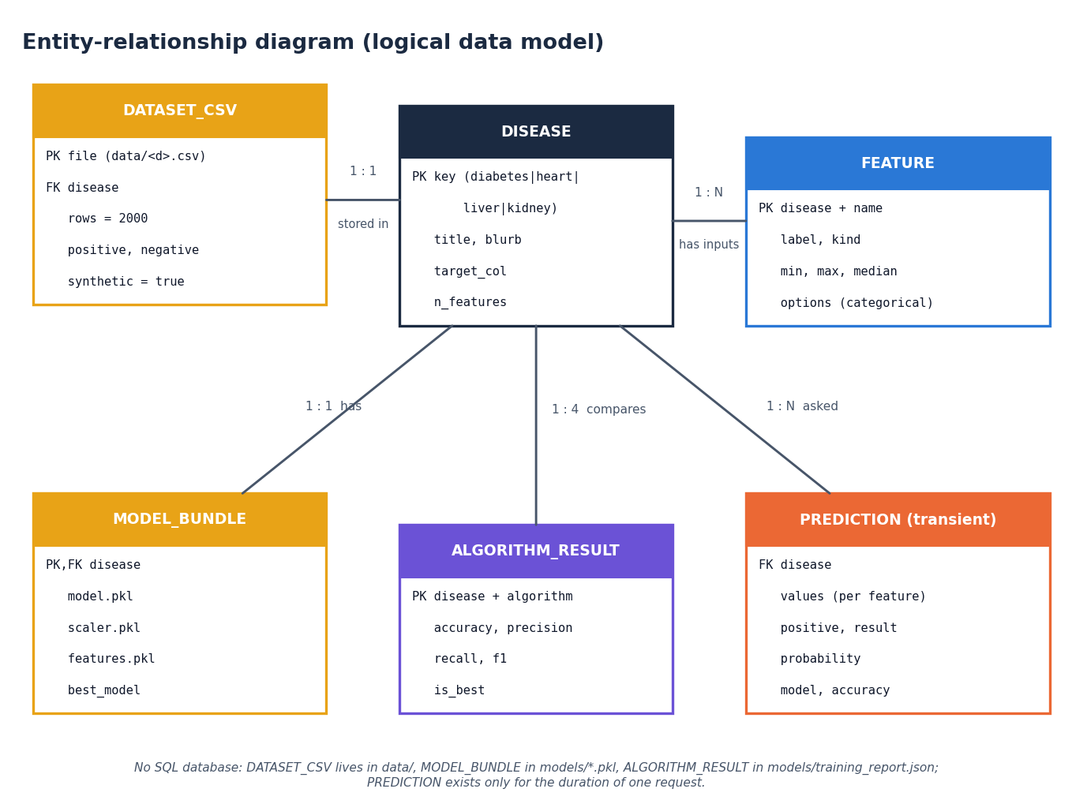
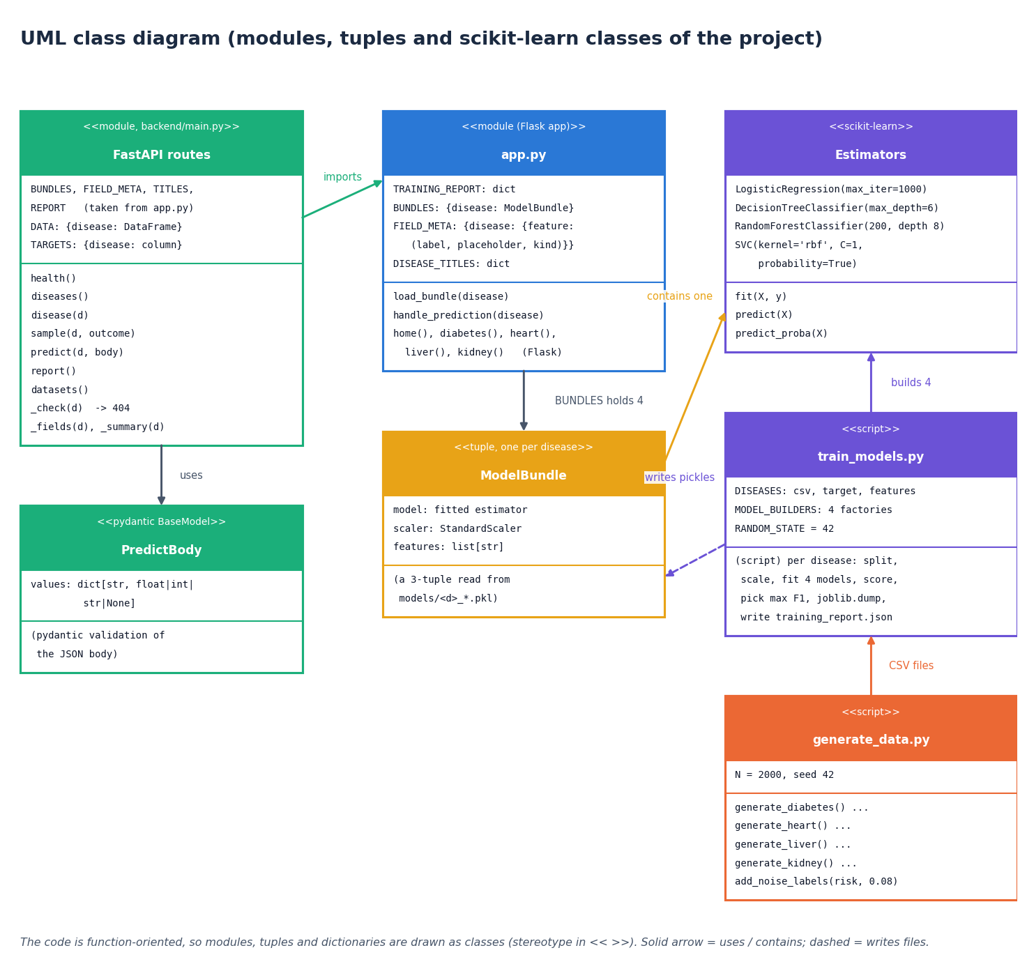
Database and UML
There is no database: data live in CSV files, model bundles in pickle files and the report in JSON. The ER diagram is the logical data model; the code is function-oriented, so the UML shows modules and data holders rather than many classes.
Notes:
State plainly that there is no database and no stored patient data. Predictions are computed and returned; nothing is kept.

Slide 13
Technology stack
Layer | Technology
Machine learning | scikit-learn 1.8.0 (LR, DT, RF, SVC, StandardScaler), pandas 3.0.2, numpy 2.4.4, joblib 1.5.3
Original pages | Flask 3.1.3 with HTML / CSS templates (port 5000)
API | FastAPI 0.110.0, uvicorn 0.29.0, pydantic request model, CORS for localhost:5303
Front end | React 19, Vite 8, React Router 7, Recharts 3, framer-motion, three.js hero scene
Testing and capture | scripts/smoke_test.py, scripts/api_tests.py, Playwright for screenshots
Run | run.bat builds the venv and starts ports 8303 / 5303 (Python 3.11.9, Node 24, Windows 11)
Notes:
Everything is open source and runs on one machine; run.bat starts the stack. scikit-learn is pinned because the saved models need it.

Slide 14
Implementation progress
Component | Status | Evidence
Synthetic data generation, four CSVs | Done | generate_data.py, 8,000 rows
Training and selection, 16 models | Done | train_models.py; reproduced to 4 d.p.
Flask pages and FastAPI layer (7 routes) | Done | smoke test 27 checks, API tests 41 / 41
React interface, four forms, models, datasets | Done | 20 real screenshots
ROC-AUC, cross-validation, threshold analysis | Offline only | scripts/run_experiments.py
Imputation, outlier handling, feature selection | Not implemented | no missing values in the synthetic data
Per-prediction explanations, recommendations | Not implemented | objective 6 only partly met
Notes:
State of the code base. The gaps are imputation / outlier handling, explanations and recommendations; ROC-AUC and cross-validation exist only as offline scripts.

Slide 15
Preliminary results: 400-row test sets
89.5%
88.5%
91.8%
88.3%
accuracy: diabetes, SVM
accuracy: heart, Logistic Regression
accuracy: liver, Logistic Regression
accuracy: kidney, Logistic Regression
i
Reading
F1 by algorithm. Logistic Regression has the best F1 on 10 of 10 random splits for all four diseases. Synthetic data: ceiling about 92%. On real public data the best algorithm scores 72-99% and the shipped models transfer only partly.
Notes:
Hold-out accuracy of the served models: diabetes SVM 0.8950, heart LR 0.8850, liver LR 0.9175, kidney LR 0.8825. F1 values: Diabetes: SVM F1 0.864; Heart disease: Logistic Regression F1 0.924; Liver disease: Logistic Regression F1 0.841; Kidney disease: Logistic Regression F1 0.903. These are results on synthetic data. The supplementary real-data check gives 76.5% (Pima), 84.3% (Cleveland), 71.8% (ILPD), 98.8% (CKD) for the best algorithm.

Slide 16
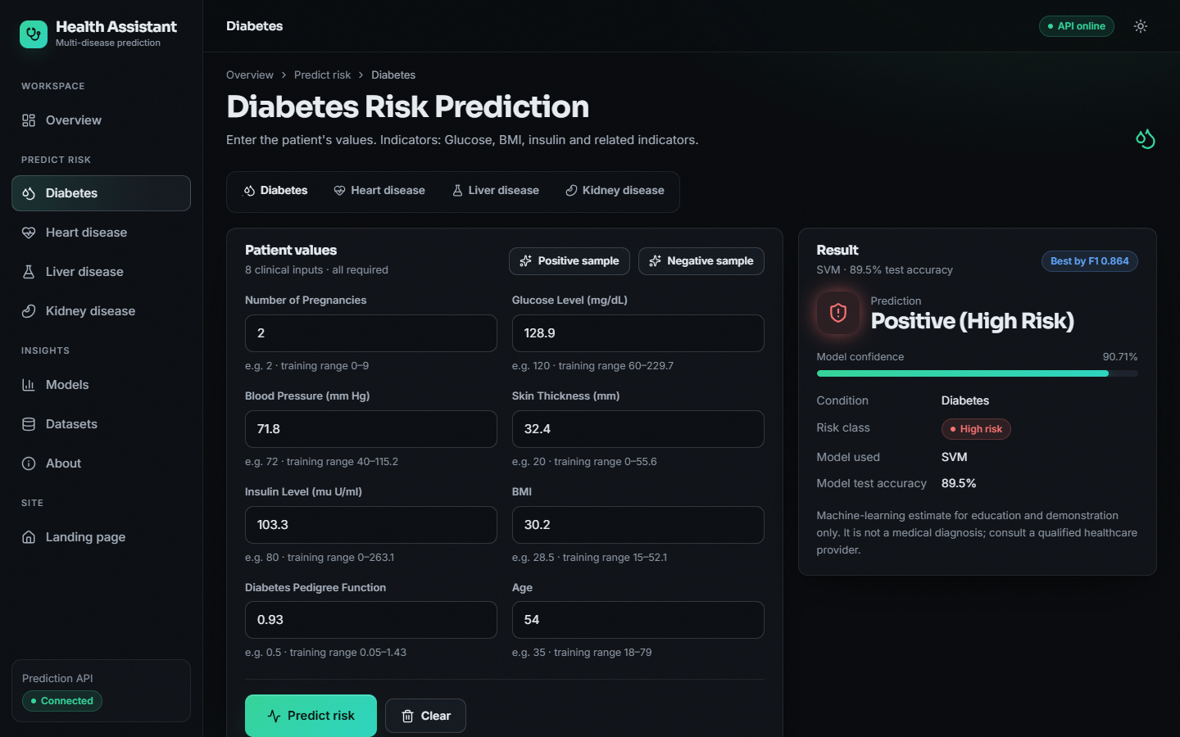
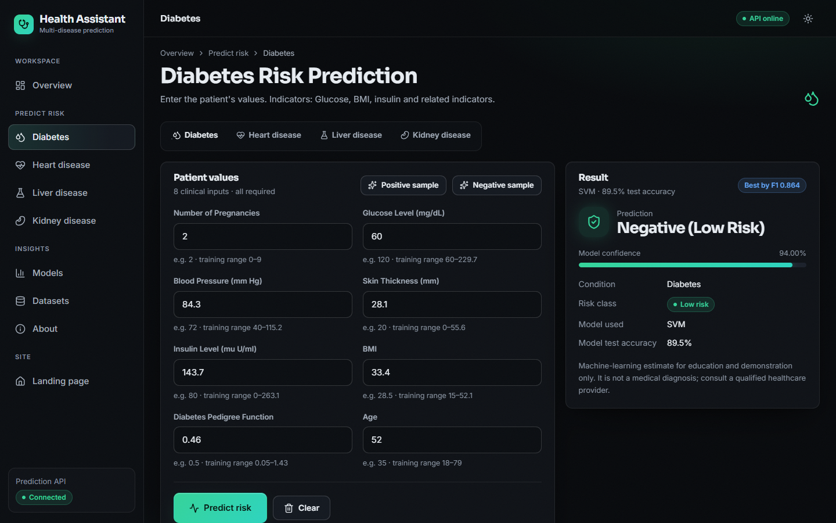
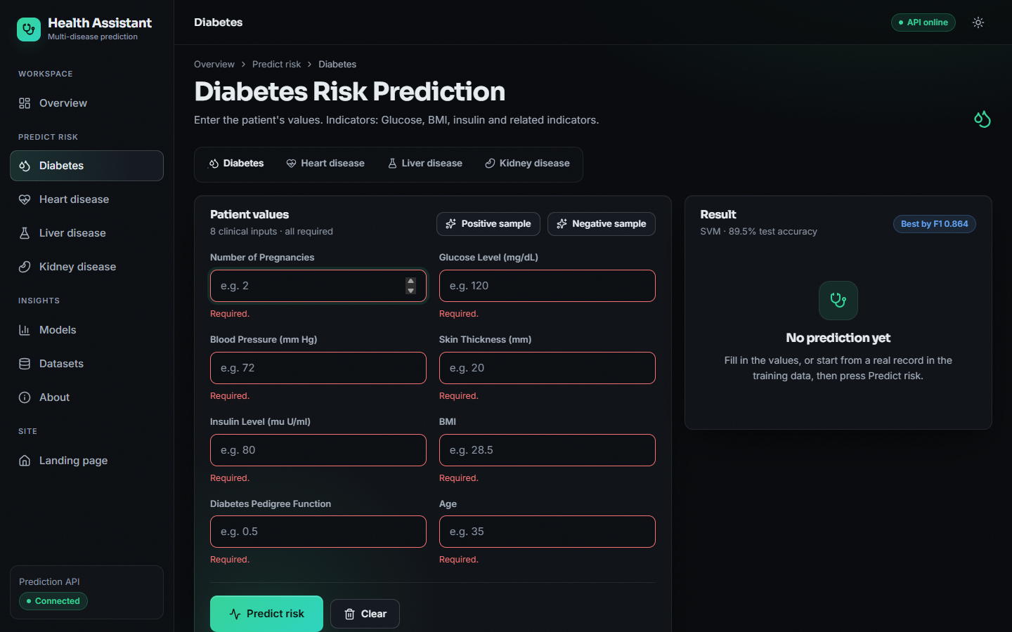
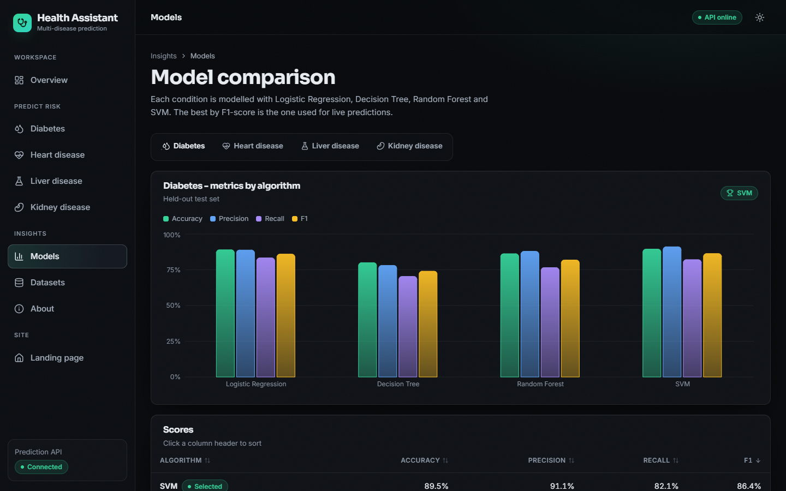
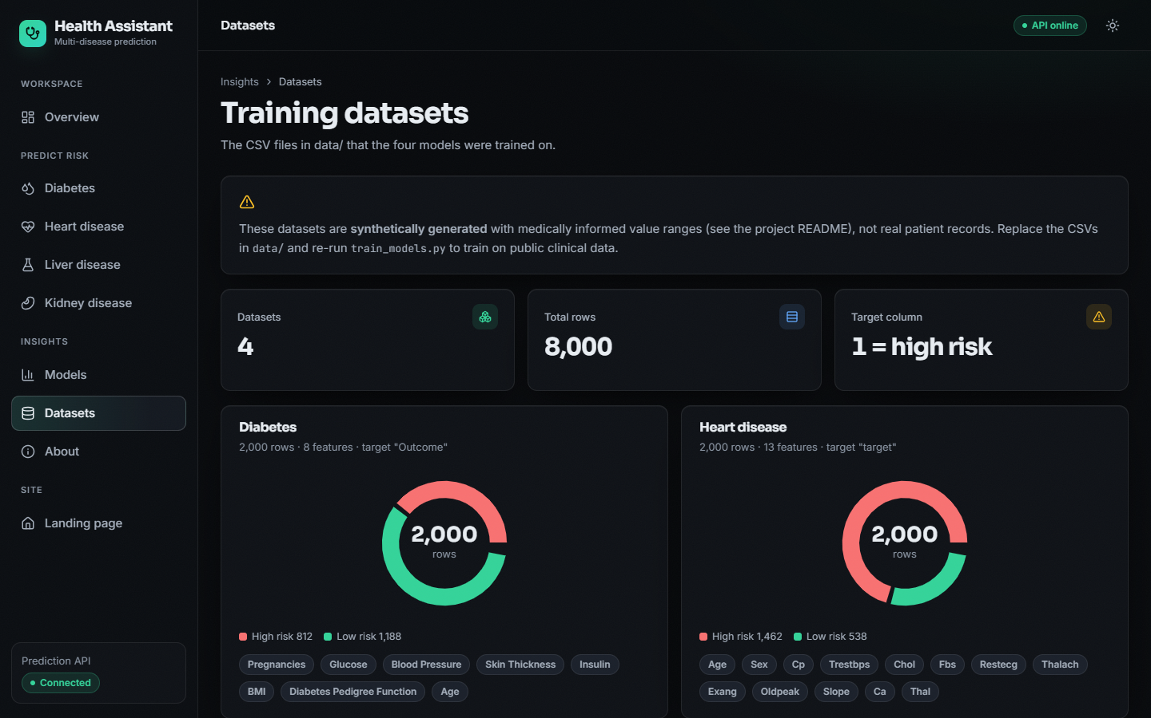
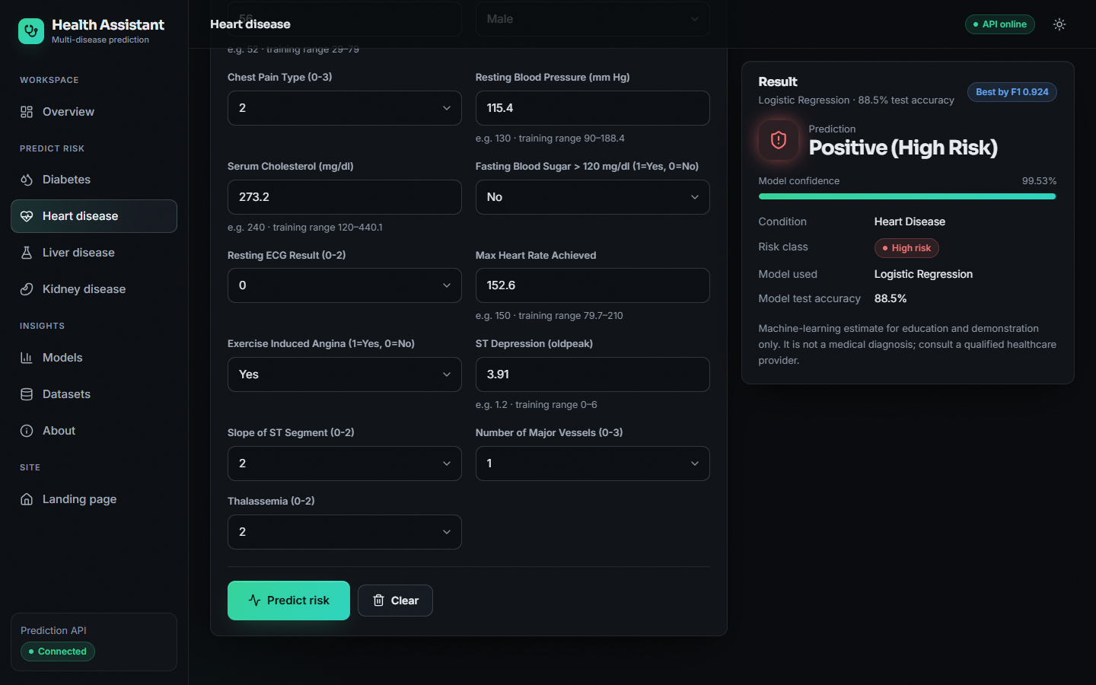
Output screens
Diabetes: High Risk, SVM
Diabetes: Low Risk
Empty form: required fields
Model comparison
Datasets and synthetic warning
Failure case: label 0, model says High Risk
Notes:
Real screenshots of the running application with records drawn from the training CSVs. The last one is a genuine false positive: a label-0 heart record the model calls High Risk with 99.53% confidence.

Slide 17
Initial testing and observations
27
41 / 41
14 ms
416 / s
smoke-test checks passed
API checks: functional, consistency, validation
median predict latency, 127.0.0.1
requests per second, 4 clients
Observation | Action
API accepts impossible values (glucose 100,000 mg/dL gives High Risk 60.94%; age -5 is accepted) | Only a UI warning exists; server range validation is a next step
Missing, NaN, infinite, text and null inputs, unknown disease, malformed JSON | Rejected with 422 / 404 / 405 as designed
API prediction equals direct model.predict on 40 sampled rows | Consistency with the Flask pages confirmed
No pytest suite, load test beyond 200 calls, security test or user study has been done. Timings were taken on a busy PC.
Notes:
Tests run against the live API. Latency: p50 about 13 ms, p95 about 25 ms; Windows timer resolution (about 15.6 ms) quantises single calls, so treat the numbers as upper bounds.

Slide 18
Challenges and corrective actions
Challenge | Corrective action
No public clinical data in the build environment | Synthetic generator; a separate real-data check (Pima, UCI Cleveland, ILPD, CKD) was added for the documents
Random Forest over-fits the noisy labels (train 93.6-95.9%, test 81.5-88.3%) | Depth limited to 8; stated as a finding; cross-validation reported
Model chosen on the test set with one split | 5-fold CV and 10 splits show Logistic Regression best; the shipped diabetes SVM is not changed
Shipped models transfer partly to real records (liver 54.0% vs 71.4% majority baseline) | Documented as a limitation; retraining on real data is future work
Saved models need the same scikit-learn version | requirements.txt pins scikit-learn 1.8.0
Notes:
Each challenge was met either with a change in how results are reported or, where the code was not changed, with a clear statement of the limit.

Slide 19
Next steps
1
Evaluate
2
Explain
3
Harden
4
Document
Report ROC curves, confusion matrices, cross-validation and threshold analysis in the final results.
Show the driving parameters per prediction (objective 6); compare with SHAP and counterfactuals of the base paper.
Range validation on the server, imputation and outlier handling, retraining on real public data.
Final report, IEEE paper and final deck with every figure regenerated from the JSON files.
Notes:
Plan to the final review. Real-data retraining and explanations are the two items that would most change the project's value.

Slide 20
Thank you
Questions and suggestions are welcome.
Notes:
Likely questions: why synthetic data; why Logistic Regression is best here; why SVM is shipped for diabetes; why there are no explanations yet.

