Slide 1

Multi-Disease Prediction Using Machine Learning
Final Review
Team Details : Batch A3 (CSE-A)
Under the Esteemed Guidance of
B. Sruthi
Faculty Project Guide, Department of CSE
23K91A0507 Ajmeera Harini
23K91A0526 Bandi Likitha
23K91A0555 Chinthakindi Swathi
23K91A0524 Badroju Sri Hansika
DEPARTMENT OF COMPUTER SCIENCE AND ENGINEERING · TKR College of Engineering and Technology (Autonomous) · Academic Year [ACADEMIC YEAR]
Notes:
Introduce the team and the project: a web application that screens four chronic conditions from routine clinical values with machine learning.

Slide 2
Table of Contents
Abstract
Base Paper & Literature Survey
Research Gap & Problem Statement
Objectives
Proposed System & Architecture
Methodology, Dataset & Drivers
Decision Workflow, Use Cases & Data Model
Implementation Highlights
Results: Metrics, Confusion, Stability, Threshold & Parameters
Real-Data Check, Testing & Comparison with Base Paper
Output Screens
Conclusion, Future Scope & References
Dept. of CSE | Batch A3 | Final Review
2
Notes:
The agenda follows the report: problem, design, method, results, honest limits, screens, conclusion.

Slide 3
Abstract
Chronic diseases are found late, and screening tools usually cover one condition at a time. We built an Intelligent Health Assistant that screens four conditions - diabetes, heart, liver and kidney disease - from routine clinical values in one web interface.
Per disease, Logistic Regression, Decision Tree, Random Forest and an RBF SVM are trained on standardised inputs and compared on a stratified 80/20 split; the best model by F1 is saved and served by a FastAPI service and a React interface.
The data are synthetic (2,000 rows per disease, linear risk rule, 8% flipped labels, so about 92% is the ceiling). Selected models reach 89.5%, 88.5%, 91.8% and 88.3% accuracy: a check on the pipeline, not clinical performance.
On real public data the same algorithms reach 72-99%, and the shipped models transfer only partly. API checks: 41/41 passed.
Not implemented: per-prediction explanations, recommendations, imputation, range validation. A teaching demonstration, not a diagnostic tool.
Dept. of CSE | Batch A3 | Final Review
3
Notes:
Read the first two bullets, then the headline numbers with their protocol, and end on the honest limits: synthetic data, no explanations.

Slide 4
Base Paper
M. Z. Alam, R. Rahman, H. M. Sozib, H. Ahmed, A. Hossain, A. A. Sabeena, A. F. Tasnim, F. Ahmed, M. I. Sarkar and T. I. Erdei, "Enhancing Thyroid Disease Diagnosis With Machine Learning and Counterfactual Explainable AI," IEEE Access, vol. 14, pp. 80346-80370, 2026, doi: 10.1109/ACCESS.2026.3663497.
Aspect | Base paper (thyroid disease, IEEE Access 2026)
Method | Five classifiers (SVC, Random Forest, Extra Trees, AdaBoost, CatBoost), nested cross-validation (5 outer, 3 inner folds), SHAP and counterfactual explanations
Data | Real UCI thyroid data, 7,200 samples, 21 features, three classes; full feature set and a TOP-10 consensus set
Reported results | Random Forest and CatBoost 0.996-0.997 accuracy / F1, AUC 0.999-1.000; SVC 0.965-0.967 accuracy; SMOTE tried and rejected
Stated limits | Class imbalance, no external validation, one disease; explanations aligned with TSH / FTI physiology
Dept. of CSE | Batch A3 | Final Review
4
Notes:
A rigorous single-disease study on real data. We take its idea of comparing classical classifiers under held-out evaluation and widen it to four diseases behind one interface; we do not reproduce its nested CV or explanations.

Slide 5
Literature Survey
Work | Approach | Data | Reported result | Limitation
Alam et al., 2026 (base paper) [1] | Five classifiers, nested cross-validation, full and TOP-10 feature sets, SHAP and counterfactual explanations | UCI thyroid, 7,200 samples, 21 features, 3 classes | Random Forest / CatBoost accuracy 0.996-0.997, AUC 0.999-1.000; SVC 0.965-0.967 | One disease; class imbalance; no external validation
Zannat et al., 2025 [2] | Eight classifiers plus soft and hard voting ensembles; PCA; 5-fold CV tuning | Bangla symptoms-disease set: 758 relations, 85 diseases, 172 symptoms; 607 train / 151 test | Ensembles accuracy 0.98; Random Forest 0.97; Decision Tree 0.78 | Symptom flags only, no laboratory values; small data; single 80/20 split
Al Nahian et al., 2022 [3] | Several classifiers on survey-based symptom data | Survey data for 11 common diseases (e.g. flu, migraine, heart disease, diabetes) | Abstract names a best classifier but gives no numbers | No quantitative result in the abstract; symptom survey, not clinical measurements
Kamakshamma et al., 2025 [4] | Django web app with one model per disease; recall prioritised; threshold lowered to 0.2 for diabetes | Kaggle: stroke 5,110, student depression 27,901, diabetes 100,000 records | Recall 94.73% (stroke), 88.39% (depression), 91.02% (diabetes) | Different diseases; public Kaggle data; no liver or kidney module
Sun and Sun, 2024 [5] | Six supervised classifiers compared with accuracy, precision, recall and F1 | Pima Indians Diabetes dataset | Gradient boosting best, 81.8% accuracy | Authors state results may apply only to this sub-population
Islam et al., 2023 [6] | 12 supervised classifiers after reducing 25 variables to about 30% of them | Chronic kidney disease data, 25 variables including the class | XGBoost best: accuracy 0.983, precision, recall and F1 0.98 | Single disease; one data set; no external test
Salekin and Stankovic, 2016 [8] | Classifier over 24 predictive parameters; attribute ranking; cost-accuracy trade-off | 400 individuals, 250 with CKD | F1 0.993, RMSE 0.1084; error 56% lower than CKD-EPI equation | Small cohort; kidney only
Straw and Wu, 2022 [7] | Re-created published liver-disease models; sex-stratified error analysis, 100 repeats | Indian Liver Patient Dataset | Accuracy about 71% (logistic regression) to about 79% (SVM); higher false-negative rate in women | Shows bias, does not propose a deployable fix
Details as read from each source; datasets and protocols differ, so the reported numbers are not comparable with each other or with ours.
Dept. of CSE | Batch A3 | Final Review
5
Notes:
Results are quoted as the authors report them. Survey items that could not be verified are listed in the report and not cited.

Slide 6
Research Gap
One disease at a time: the surveyed papers each target a single condition; a separate tool and workflow is needed per disease.
Screening plus explanation: the gap is a single pipeline that screens several conditions from routine values and explains which parameters drove each prediction - the base paper does the explaining (SHAP, counterfactuals) for thyroid only.
Evidence quality: many small demonstrations report one split on one dataset; model choice on a single split is fragile and synthetic data is rarely audited against real data.
Usability: few works deliver a running interface that a non-programmer can use.
Dept. of CSE | Batch A3 | Final Review
6
Notes:
This project covers the first and the last gap; explanation is only partly addressed (offline permutation importance, not in the app).

Slide 7
Problem Statement
Given the routine clinical values of one patient (for example glucose, blood pressure, cholesterol, bilirubin, creatinine, haemoglobin), estimate for each of four chronic conditions - diabetes, heart disease, liver disease and kidney disease - whether the patient falls in the high-risk or the low-risk class, report how confident the model is, and do so through one interface that a non-programmer can use. The classifier for every condition must be chosen by comparing several algorithms on held-out data with metrics that are not fooled by class imbalance.
Input
Output
Record
One patient's routine clinical values (8-13 fields per disease)
High-risk / low-risk class and the model's confidence, per disease
Metrics per algorithm, saved model, model-comparison page
Dept. of CSE | Batch A3 | Final Review
7
Notes:
Three parts: predict the class, say how confident the model is, and do it in one interface.

Slide 8
Objectives
1. Collect and clean benchmark datasets covering diabetes, heart disease, liver and kidney disorders.
2. Handle missing values, outliers and feature scaling through a common preprocessing pipeline.
3. Train and compare Logistic Regression, Decision Tree, Random Forest and Support Vector Machine for each disease.
4. Select the best model per disease using accuracy, precision, recall and ROC-AUC.
5. Serve the selected models behind a single interface that accepts one patient record.
6. Present a per-disease risk indication together with the parameters that drove it.
Dept. of CSE | Batch A3 | Final Review
8
Notes:
Six objectives from the proposal. The conclusion slide states how each was met: three achieved or partly, honestly marked.

Slide 9
Proposed System
Enter values
Check + scale
Predict (4 models)
Best-by-F1 model
Risk class + confidence
Four scikit-learn classifiers per disease (LR, Decision Tree, Random Forest, RBF SVM); the best on F1 is saved with joblib and loaded at start-up.
FastAPI service with seven routes imports the original Flask module, so predictions match the earlier pages exactly.
React interface: landing page, overview, one prediction form per disease with real-record samples, model comparison, dataset page; dark and light themes, phone layout.
Every result carries a not-a-diagnosis notice; no data are stored.
Dept. of CSE | Batch A3 | Final Review
9
Notes:
The proposed system in one line of boxes, then the four properties that matter.

Slide 10
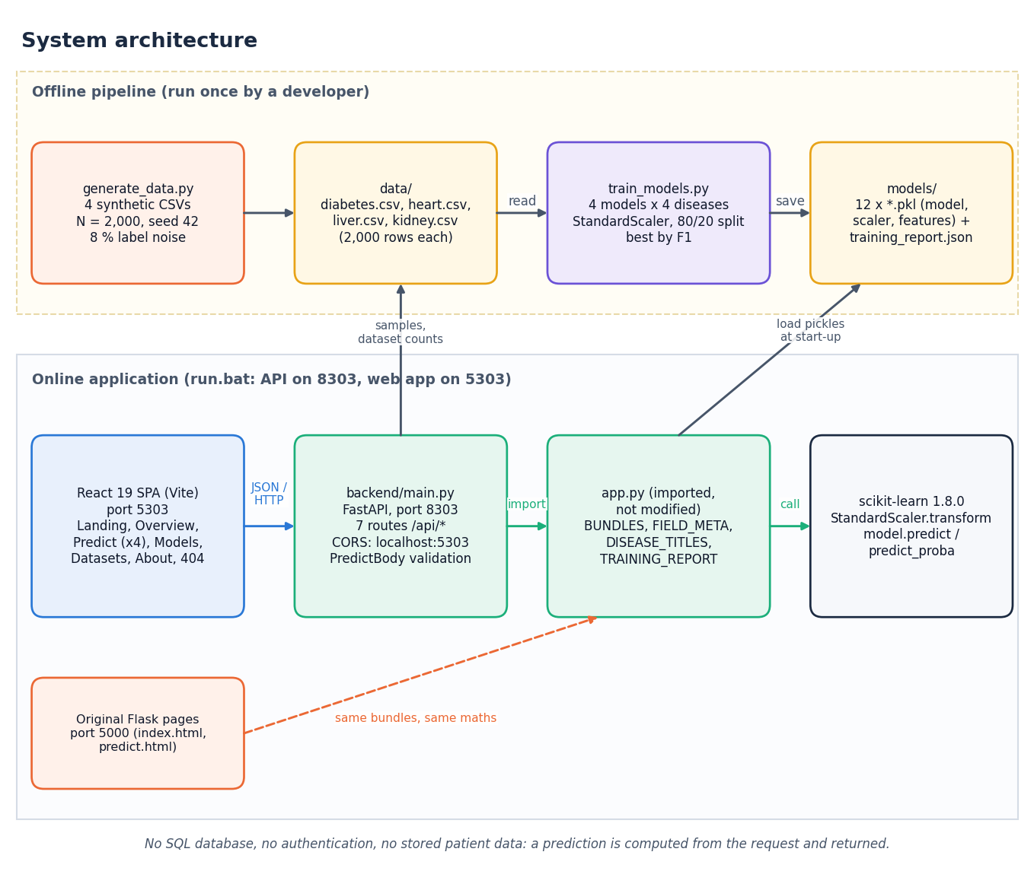
System Architecture
Presentation: React 19 + Vite (port 5303); original Flask pages (5000)
Application: FastAPI (8303), 7 routes, CORS limited to the local front end
Core: app.py model bundles (model, scaler, features) and field metadata
Data and models: four CSV files, joblib pickles, training_report.json; no database, no login
Dept. of CSE | Batch A3 | Final Review
10
Notes:
Four tiers. The API wraps the Flask module; nothing is persisted.

Slide 11
Methodology
Generate CSVs
Split 80/20
StandardScaler
Train 4 models
Evaluate
Pick max F1
Save + serve
80/20 stratified, random_state 42 (1,600 train / 400 test per disease). Scaler fitted on the training part only; nothing else (no imputation, feature selection, tuning or class weights).
Settings: LR max_iter 1000; Decision Tree depth 6; Random Forest 200 trees, depth 8; SVM RBF, C = 1, probability on.
Beyond the shipped script we added ROC-AUC, confusion matrices, 5-fold CV, ten random splits, threshold and parameter sweeps, permutation importance, and a real-data check.
All numbers are written to JSON by scripts/run_experiments.py and read into the documents.
Dept. of CSE | Batch A3 | Final Review
11
Notes:
The shipped pipeline is deliberately simple. The extra protocols exist because selecting on one 400-row split is fragile.

Slide 12
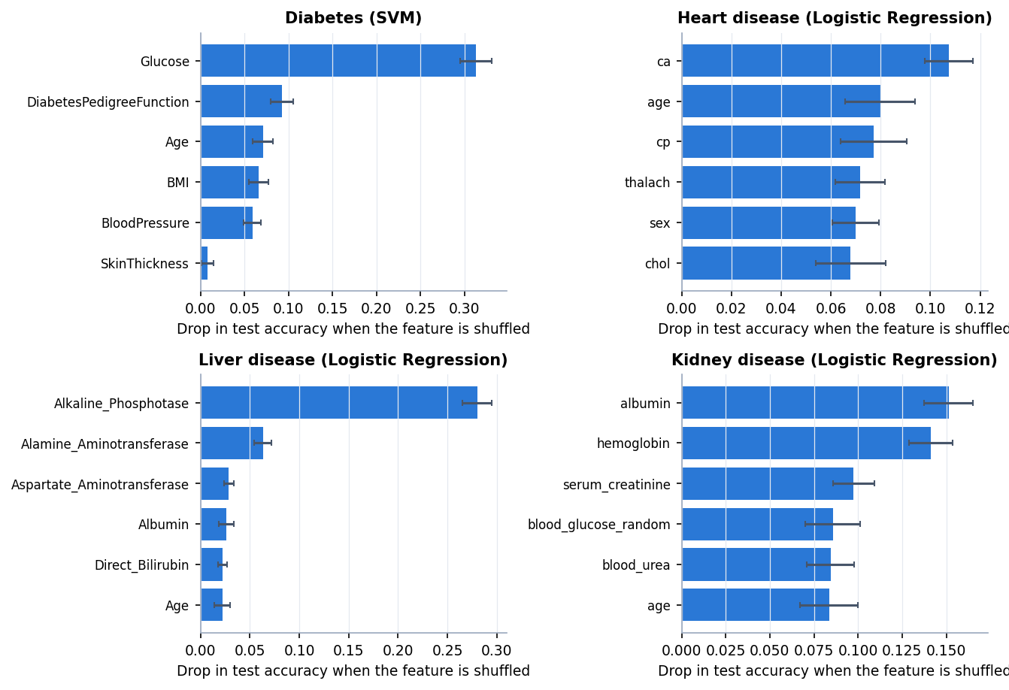
Dataset, Features & Drivers
4 x 2,000
Positive rate: diabetes 40.6%, heart 73.1%, liver 28.1%, kidney 59.8%.
Top drivers (permutation): glucose; ca, age; alkaline phosphatase; albumin, haemoglobin.
rows, synthetic, no missing / duplicates
8 % flipped
label noise: ceiling about 92% accuracy
8 - 13
features per disease (4 sets)
Labels come from a hand-written linear risk rule, so recovering these drivers checks the pipeline: it is not evidence about real patients.
Permutation importance was run offline; the application does not show it.
Dept. of CSE | Batch A3 | Final Review
12
Notes:
Be explicit: the rows are generated. The four training datasets are synthetic: generate_data.py draws 2,000 rows per disease from clipped normal, exponential and uniform distributions, computes a hand-written linear risk score, converts it to a label with a sigmoid and a 0.5 threshold, and then flips 8% of the labels at random. No classifier can therefore exceed about 92% accuracy on this data, and the reported accuracies describe how well the pipeline recovers a known rule, not how well it detects disease in patients.

Slide 13
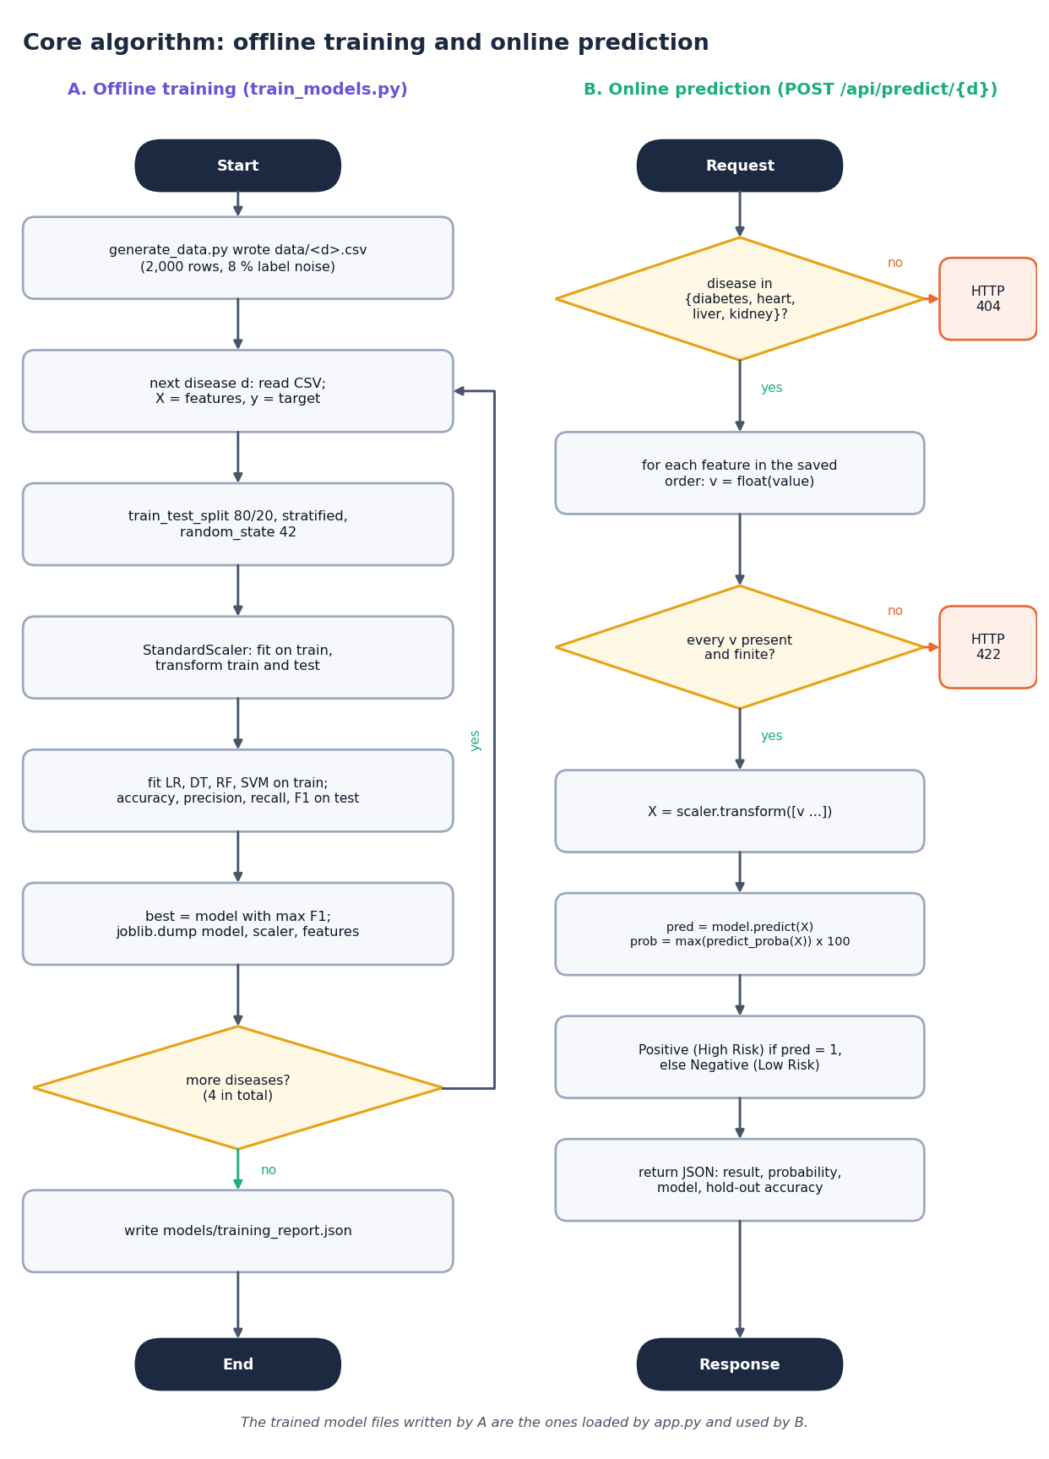
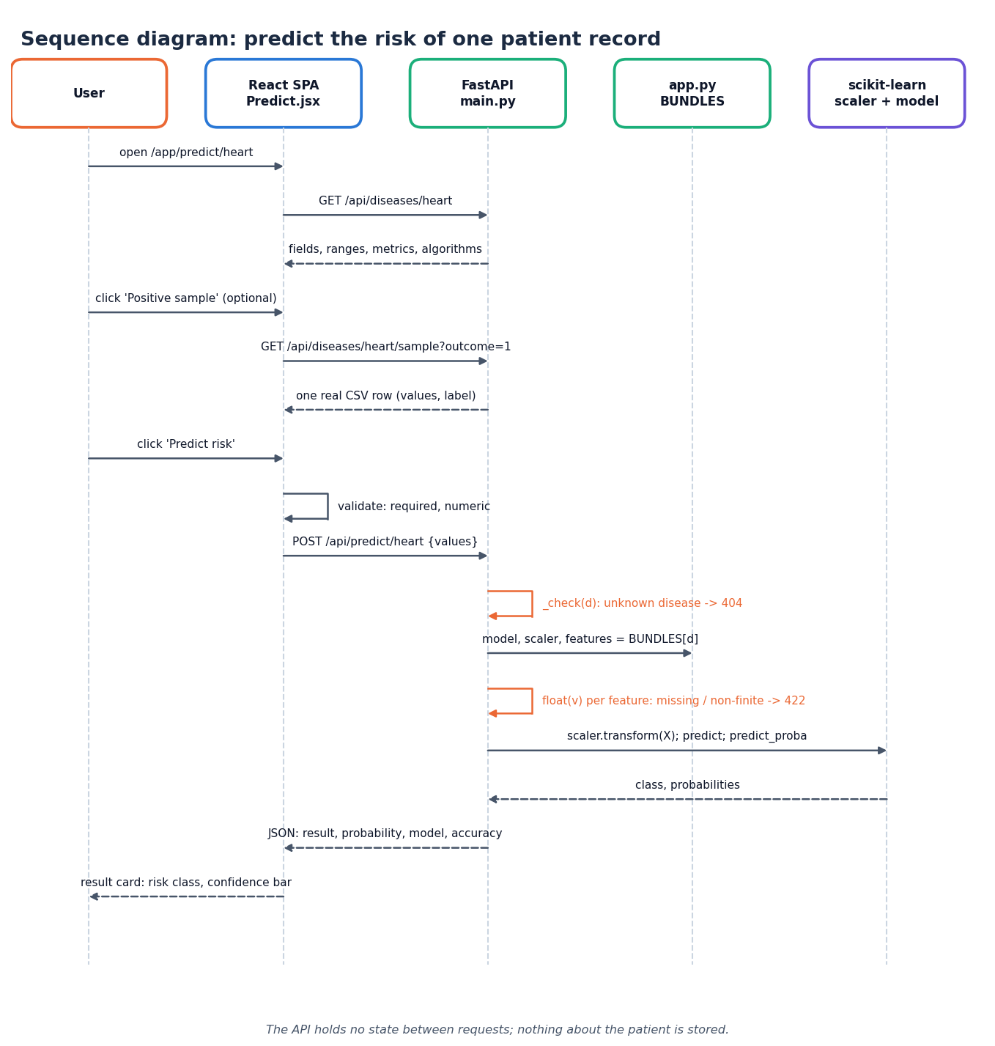
Decision Workflow & Interaction
Validate: required and numeric in the form; missing or non-finite values give HTTP 422.
Scale with the stored scaler, predict, and take max(predict_proba) as the confidence.
Class 1 = Positive (High Risk); class 0 = Negative (Low Risk).
No range check: glucose 100,000 mg/dL is accepted by the API (UI shows a warning only).
Dept. of CSE | Batch A3 | Final Review
13
Notes:
Left: training and serving path. Middle: one prediction as a sequence. Right: what the decision rule does and does not check.

Slide 14
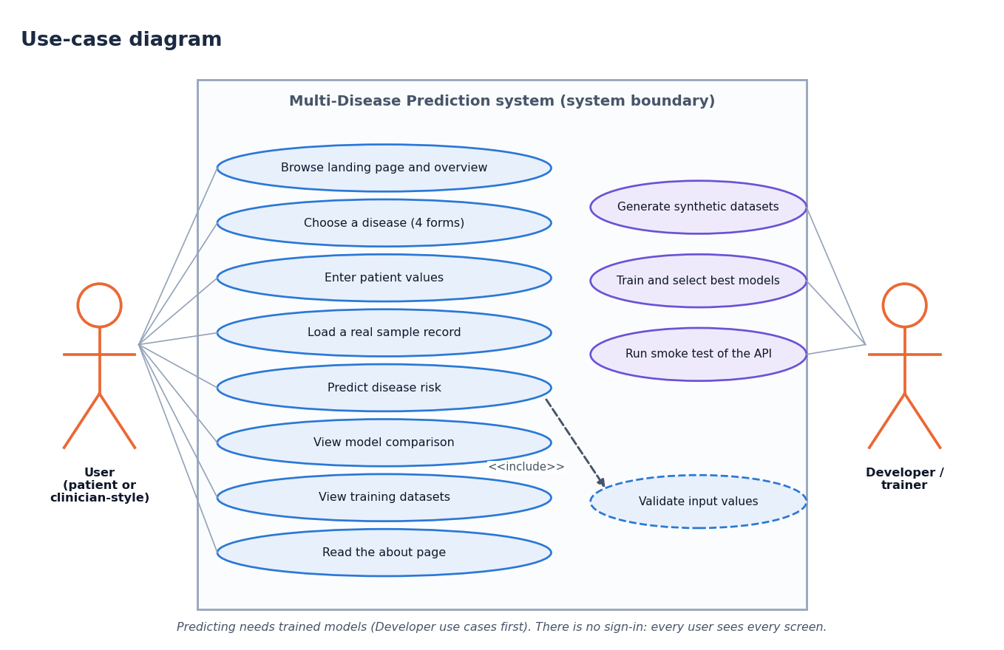
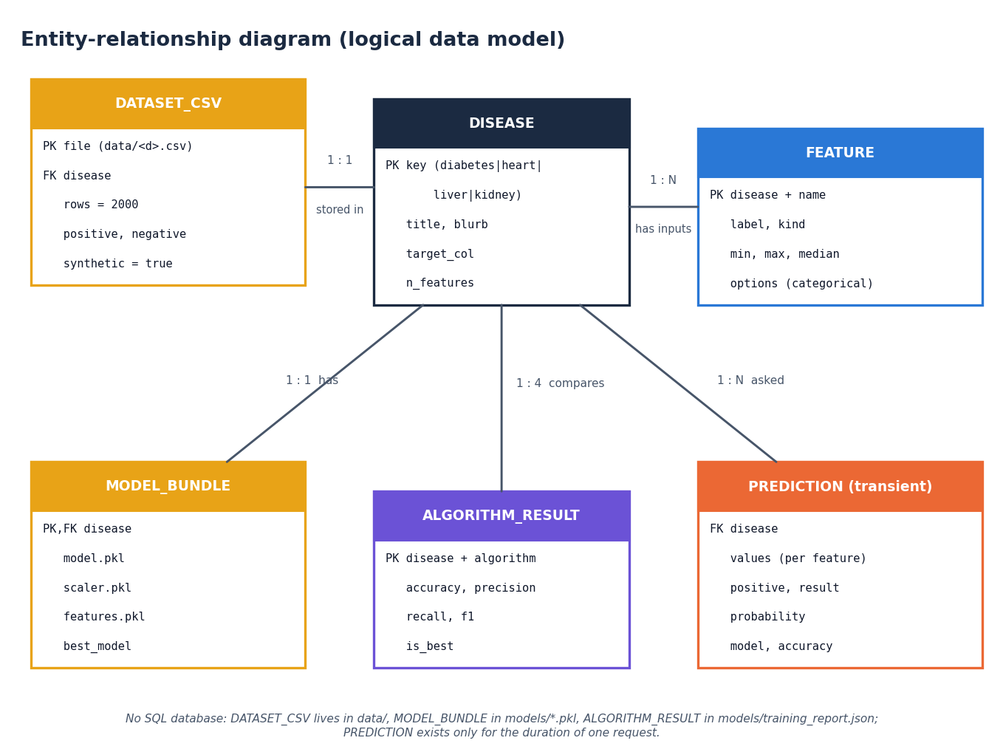
Use Cases & Data Model (logical)
There is no SQL database and no user accounts: the data model describes CSV files, pickled model bundles and the JSON training report. Predictions are transient and never stored.
Dept. of CSE | Batch A3 | Final Review
14
Notes:
Use cases of the user and the developer; the ER diagram is a logical model of files and in-memory objects, not a database.

Slide 15
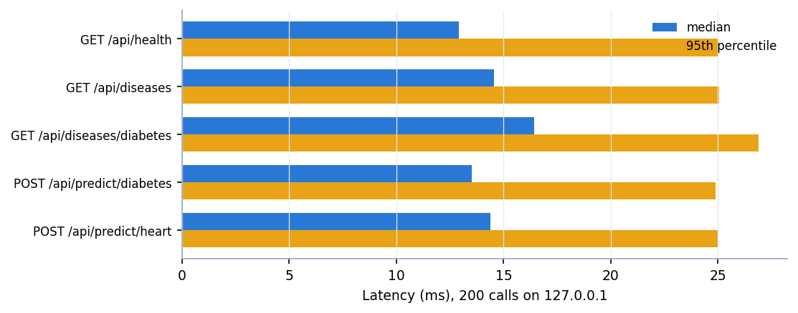
Implementation Highlights
7
41/41
7
1
API routes (FastAPI)
API checks passed
front-end page components
command to start (run.bat)
API imports app.py, so Flask and React give identical predictions (40 of 40 sampled rows agree).
Form fields (label, min, max, median, options) are generated from FIELD_META and the CSV ranges.
'Positive / Negative sample' buttons pre-fill a real CSV row.
Out-of-training-range values trigger a warning; the server rejects missing or non-finite input.
Latency on 127.0.0.1, 200 calls per route. No authentication, persistence or audit log (honest limits).
Dept. of CSE | Batch A3 | Final Review
15
Notes:
Highlights: shared model module, generated forms, samples, validation. Latency measured while the PC was under memory pressure; Windows timer resolution is about 15 ms, so treat as upper bounds.

Slide 16
Results – Model Performance (400-row test sets)
Disease | Selected model | Accuracy | Precision | Recall | F1 | ROC-AUC
Diabetes | SVM | 0.8950 | 0.9110 | 0.8210 | 0.8636 | 0.9077
Heart disease | Logistic Regression | 0.8850 | 0.8917 | 0.9589 | 0.9241 | 0.8455
Liver disease | Logistic Regression | 0.9175 | 0.9158 | 0.7768 | 0.8406 | 0.8881
Kidney disease | Logistic Regression | 0.8825 | 0.8934 | 0.9121 | 0.9027 | 0.9076
Logistic Regression is selected for heart, liver and kidney; SVM for diabetes (F1 0.8636 vs 0.8599, a gap well inside split noise).
The Decision Tree is weakest everywhere (accuracy 74.5-86.0%); Random Forest over-fits the noisy labels (train 93.6-95.9%, test 81.5-88.3%).
Accuracy 88.3-91.8% sits close to the 92% noise ceiling: the models recover the rule, they do not detect disease.
Selection used the same test set that reports the scores, so the best-model figures are slightly optimistic.
Dept. of CSE | Batch A3 | Final Review
16
Notes:
Protocol: 1,600 train, 400 test rows per disease, seed 42, fixed settings. Numbers match models/training_report.json exactly; ROC-AUC was measured afterwards by run_experiments.py.

Slide 17
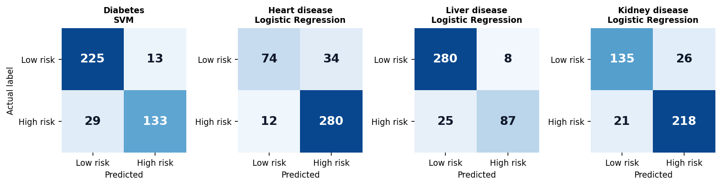
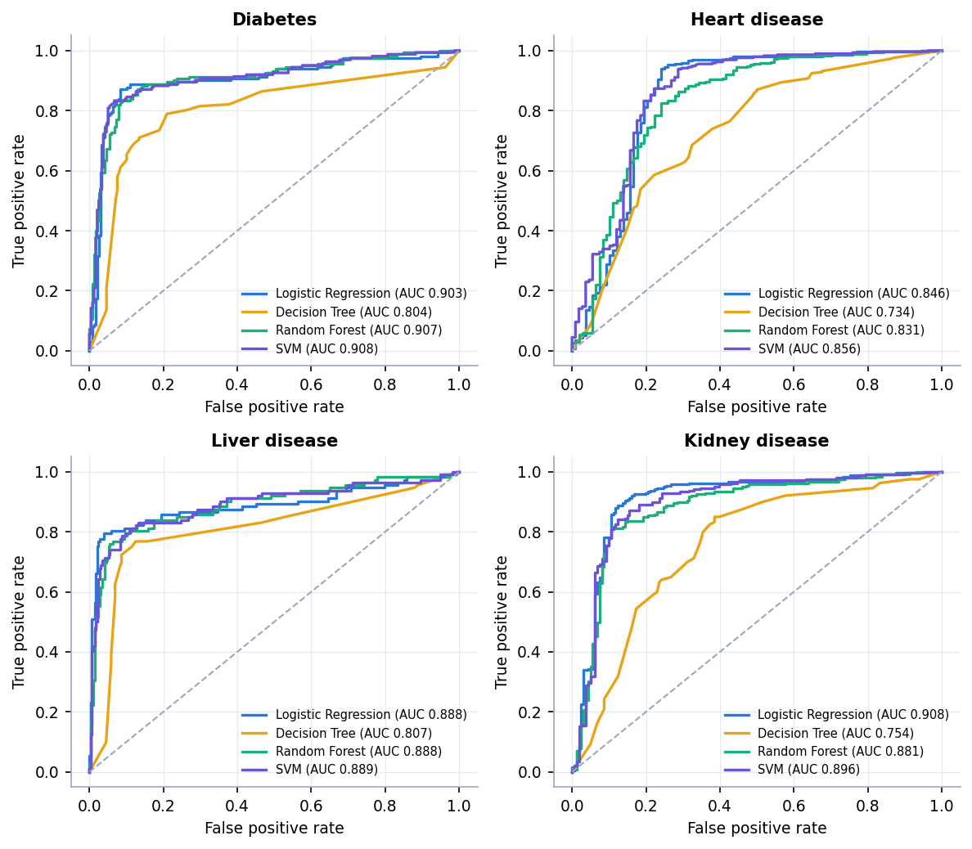
Confusion Matrices & ROC Curves
Diabetes (SVM): 29 of 162 diabetic test cases missed, only 13 false alarms. Heart (LR): 34 of 108 low-risk rows flagged (the model favours recall, 0.9589).
Liver (LR): 25 of 112 positives missed, 8 false alarms. Kidney (LR): 21 missed, 26 false alarms.
ROC-AUC of the selected models 0.85-0.91; Random Forest and SVM curves are close to LR, the tree is lower.
ROC curves of all four algorithms for each disease (test set); AUC in the legends.
Dept. of CSE | Batch A3 | Final Review
17
Notes:
Rows are the true label, columns the prediction. For a screening aid a miss is costlier than a false alarm; the costs were not measured.

Slide 18
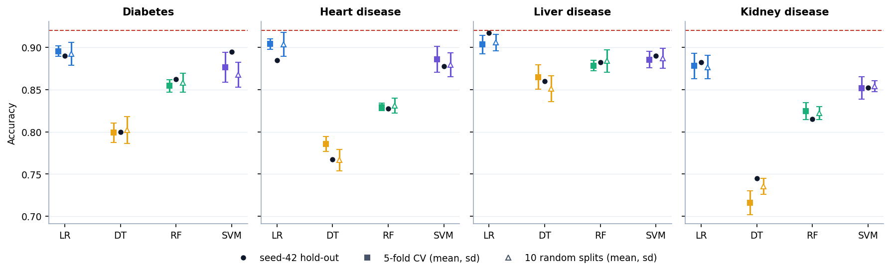
Stability: 5-Fold CV and Ten Random Splits
Logistic Regression has the best F1 on 10 of 10 splits for every disease.
For diabetes SVM was shipped from one split; CV and the other nine splits favour LR (0.8955 vs 0.8765 accuracy in CV).
Disease | Served model | Served: hold-out acc. | LR: 5-fold CV acc. | LR: 10 splits acc. | LR best F1 (of 10)
Diabetes | SVM | 0.895 | 0.895 ± 0.006 | 0.893 ± 0.013 | 10
Heart disease | Logistic Regression | 0.885 | 0.904 ± 0.006 | 0.904 ± 0.014 | 10
Liver disease | Logistic Regression | 0.917 | 0.903 ± 0.011 | 0.906 ± 0.010 | 10
Kidney disease | Logistic Regression | 0.882 | 0.878 ± 0.015 | 0.877 ± 0.014 | 10
Dept. of CSE | Batch A3 | Final Review
18
Notes:
Cross-validation re-fits the scaler inside each fold. Error bars are one standard deviation. The shipped diabetes model is within noise of LR but is not the best by CV.

Slide 19
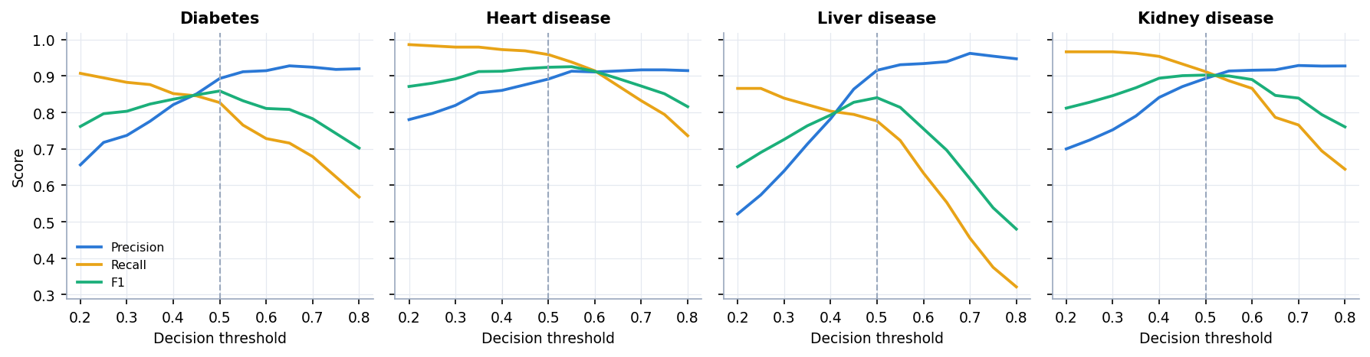
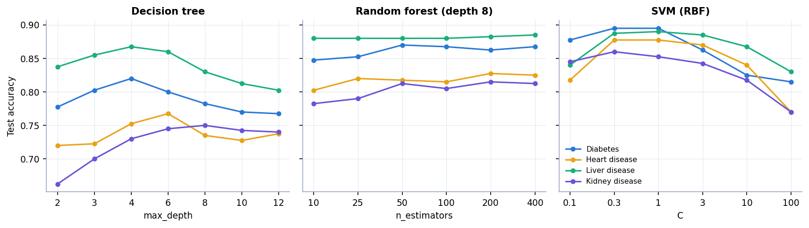
Threshold & Parameter Analysis
Best-F1 threshold (0.20-0.80): diabetes 0.50; heart 0.55; liver 0.50; kidney 0.50. The app always uses 0.50.
Trees peak at depth 4-8 and drop when deeper (they fit label noise); RF is flat beyond 50 trees.
SVM is best at C 0.3-1 and falls to 77-83% accuracy at C = 100.
No grid search was run: shipped settings are reasonable but untuned.
Dept. of CSE | Batch A3 | Final Review
19
Notes:
Threshold sweep is on the test predictions of the served model (precision, recall, F1). Sensitivity: test accuracy, seed-42 split, one parameter varied at a time.

Slide 20
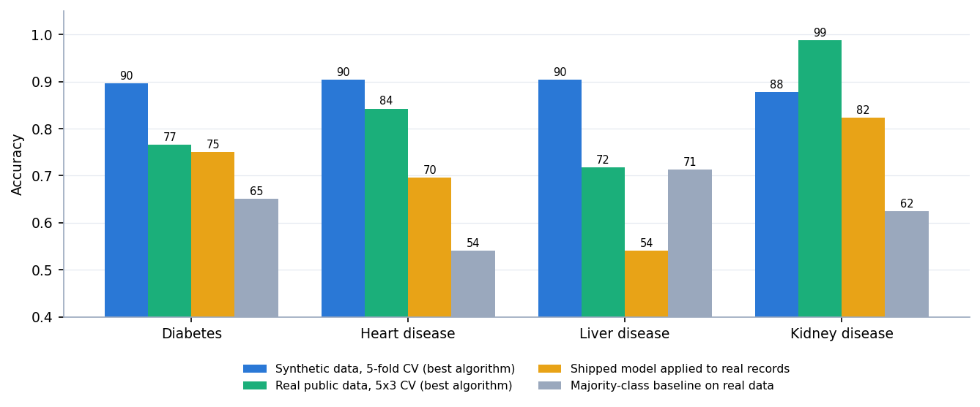
Supplementary Check on Real Public Data
Disease | Real data | Shipped acc. | AUC | Majority
Diabetes | Pima, 768 | 75.0% | 0.796 | 65.1%
Heart | Cleveland, 303 | 69.6% | 0.884 | 54.1%
Liver | ILPD, 583 | 54.0% | 0.745 | 71.4%
Kidney | UCI CKD, 400 | 82.3% | 0.992 | 62.5%
Same four algorithms, 5-fold CV x 3 on real data: best accuracy 76.5% (diabetes), 84.3% (heart), 71.8% (liver), 98.8% (kidney) - far below 88-92% on synthetic data except for kidney.
Shipped synthetic-trained models keep some ranking power (AUC 0.75-0.99) but the 0.5 rule transfers badly: liver accuracy 54.0% is below the 71.4% majority baseline.
Not used by the application; it shows why synthetic scores must not be read as clinical performance.
Dept. of CSE | Batch A3 | Final Review
20
Notes:
Scripts/real_data_check.py. Heart codes (cp, slope, thal) had to be mapped; the thal mapping is arbitrary. Sources: Pima (NIDDK), UCI Cleveland, UCI ILPD, UCI CKD.

Slide 21
Performance & Testing
41/41
27
13.5 ms
416 /s
API checks passed (api_tests.py)
smoke-test checks passed
median predict call (127.0.0.1)
requests per second, 4 clients
Test layer | What it covers | Result
Model reproduction | all 16 model / disease cells re-computed; shipped pickles re-scored | 16 of 16 match training_report.json
API tests (api_tests.py) | every route, both classes, invalid input (abc, nan, inf, null), 404/405/422, API = direct model on 40 rows | 41/41 passed
Browser walk (Playwright, Chrome) | 20 screens at 1440 x 900 plus a 390 px phone view, real CSV rows | all screens captured
Not done | pytest suite, load / security test, user study, clinical validation | stated as limits
Measured on an i5-12500 CPU while the PC was under memory pressure; timer resolution about 15 ms. A prediction takes well under 25 ms end to end.
Dept. of CSE | Batch A3 | Final Review
21
Notes:
Observations, not failures: the API accepts impossible values such as glucose 100,000 or age -5, because there is no clinical range validation.

Slide 22
Comparison with Base Paper (context only – different data)
Aspect | Base paper [1] | This project
Disease and data | Thyroid; real UCI data, 7,200 samples, 21 features | Four diseases; synthetic, 4 x 2,000 rows, 8-13 features
Task | Three classes (normal / hypo / hyperthyroid) | Binary high-risk / low-risk per disease
Protocol | Nested CV: 5 outer, 3 inner folds with grid search | One stratified 80/20 split, fixed settings; CV and 10 splits added by us
Models | SVC, RF, Extra Trees, AdaBoost, CatBoost | LR, Decision Tree, RF, SVM
Reported | RF / CatBoost accuracy 0.996-0.997, AUC 0.999-1.000 | Accuracy 88.3%-91.8%; real-data CV 72-99%
Explanation | SHAP and counterfactual 'what-if' analysis | None in the app (offline permutation importance only)
Beyond the paper | - | One interface for four diseases; synthetic-vs-real audit; selection-robustness study
Not comparable: different disease, data, class count and protocol. The numbers are context, not a ranking; we do not claim to match the paper.
Dept. of CSE | Batch A3 | Final Review
22
Notes:
State plainly that the base paper uses real thyroid data with nested cross-validation. Our data are synthetic, so no like-for-like comparison is possible.

Slide 23
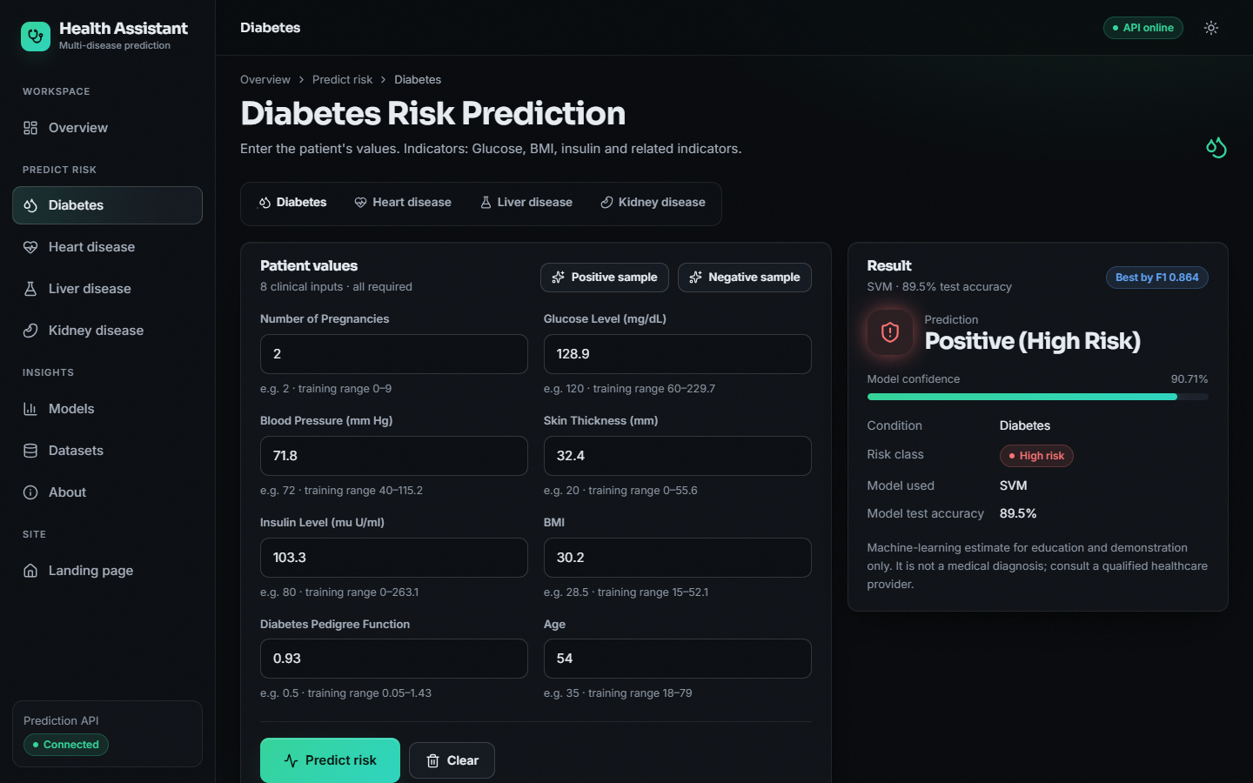
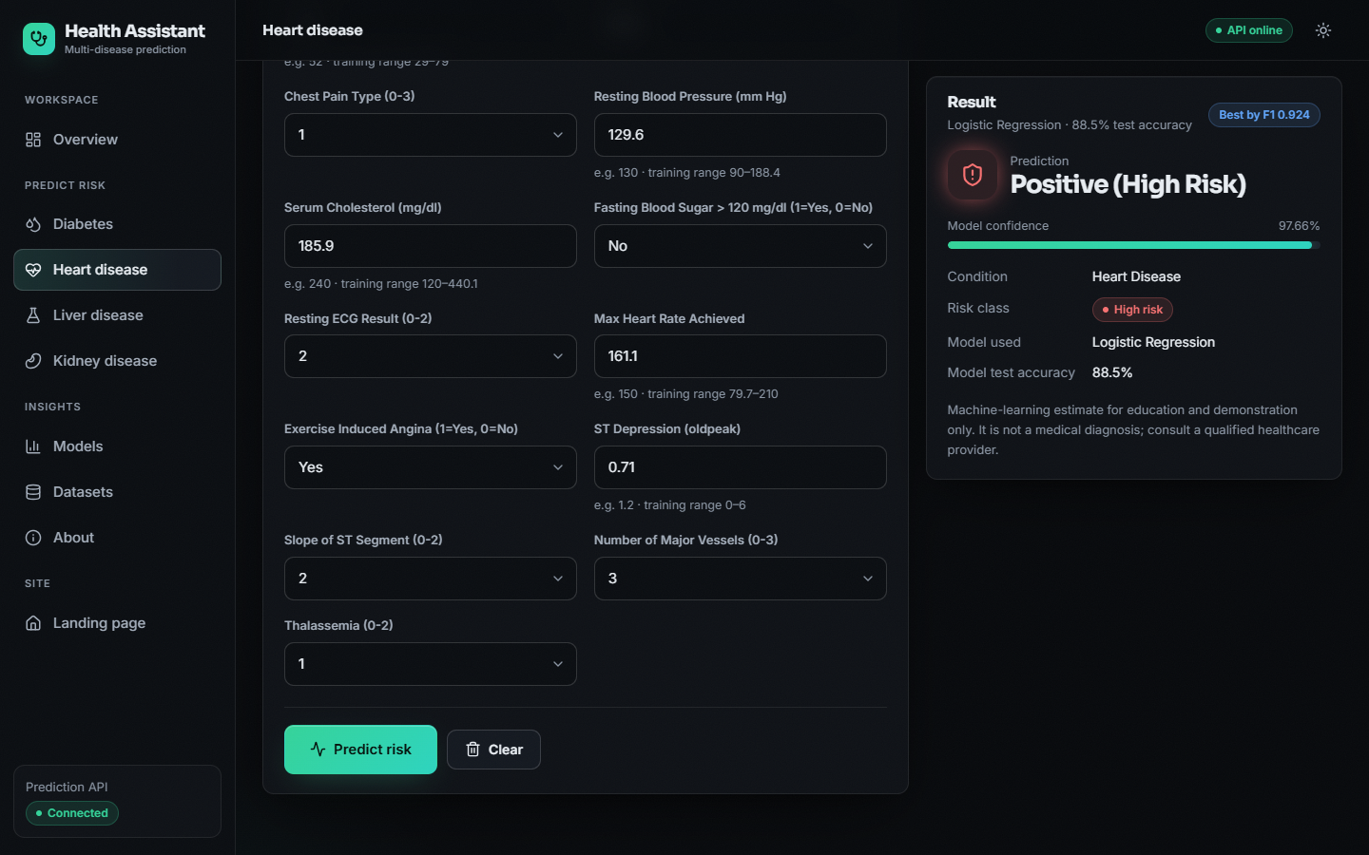
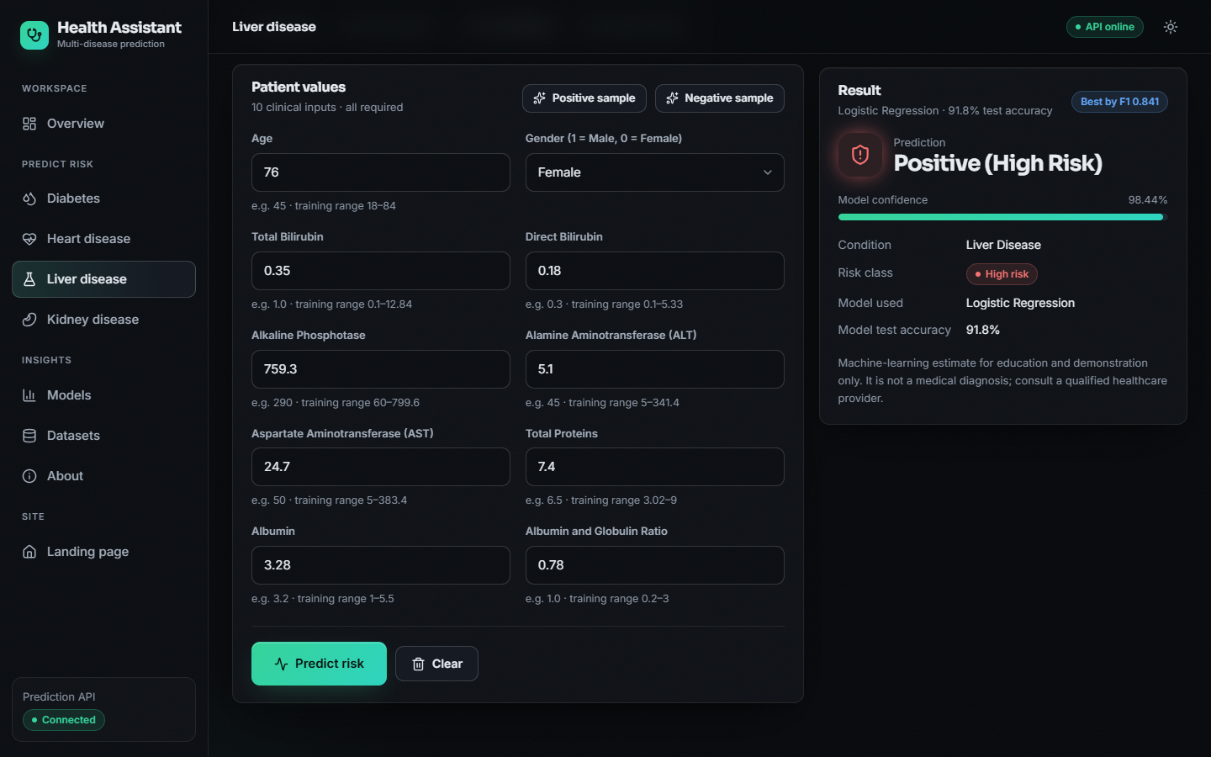
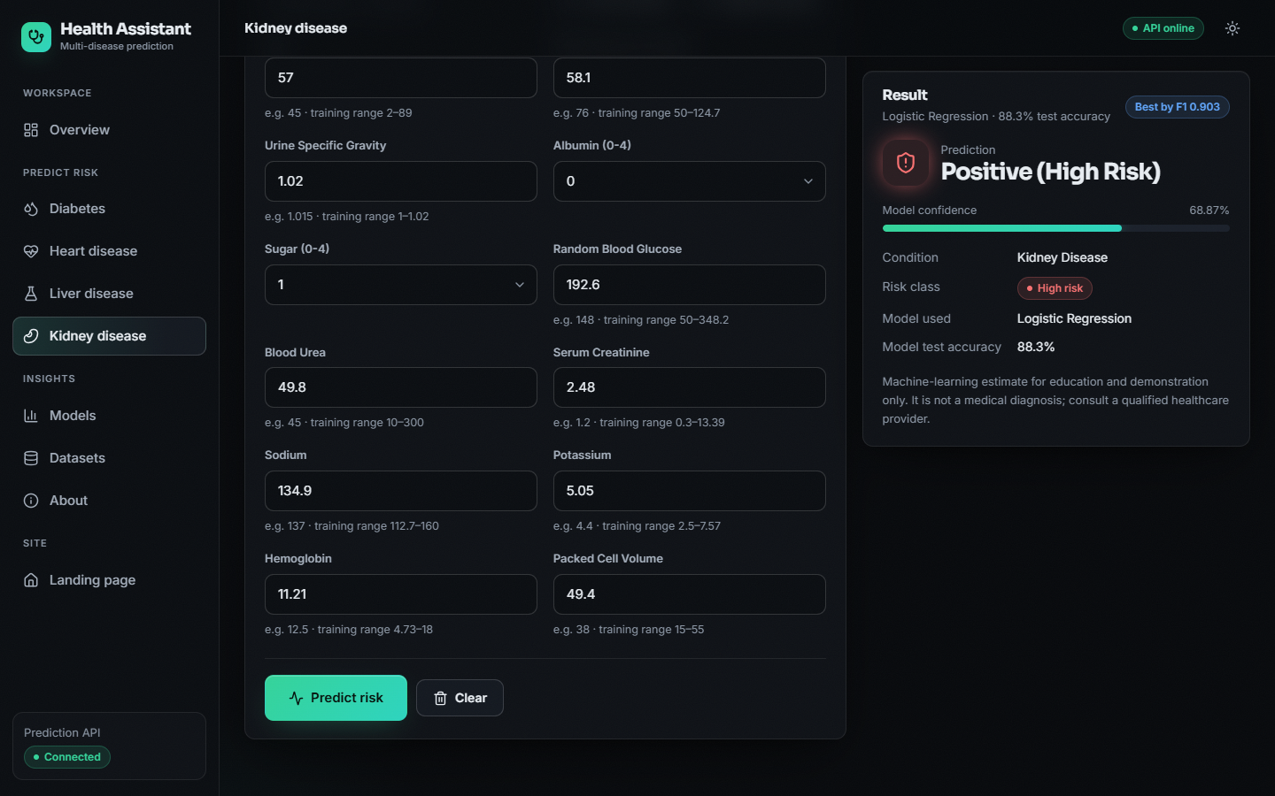
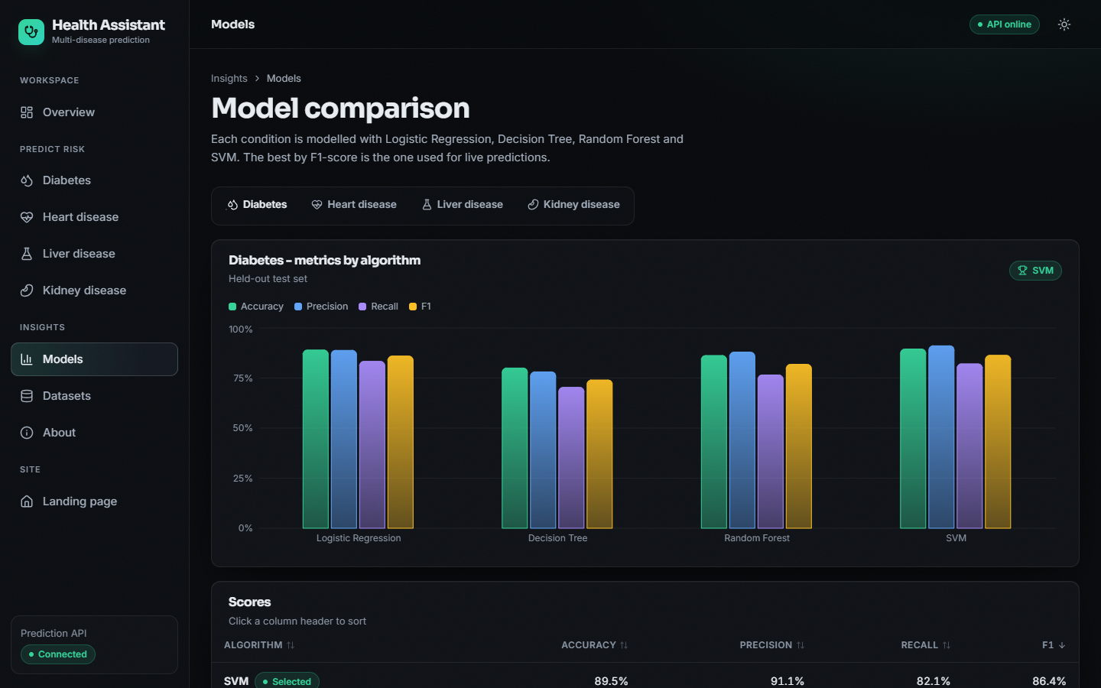
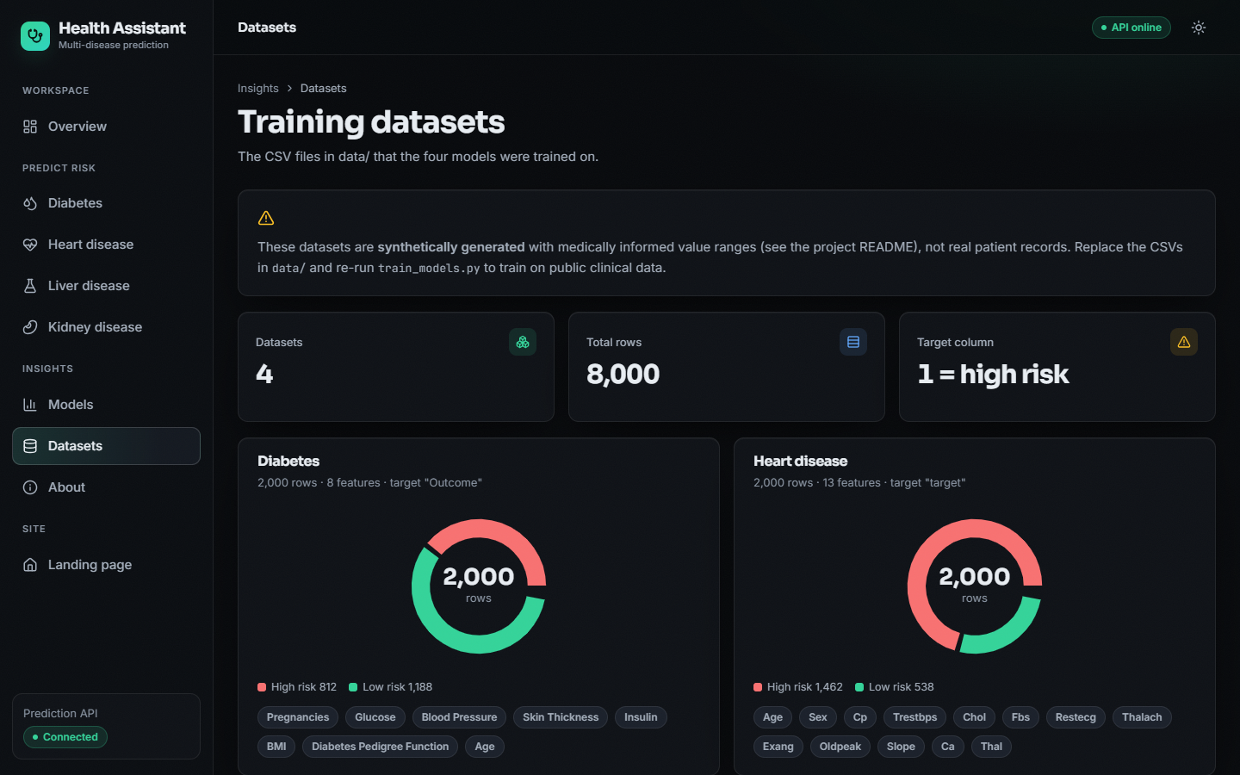
Output Screens – Predictions (high risk) & Analysis
Diabetes: High Risk 90.71% (SVM)
Heart disease prediction
Liver disease prediction
Kidney disease prediction
Model comparison
Datasets, with synthetic-data warning
Dept. of CSE | Batch A3 | Final Review
23
Notes:
Real screenshots: each prediction page filled from a real CSV row ('Positive sample'), the model-comparison page and the dataset page that states the data are synthetic.

Slide 24
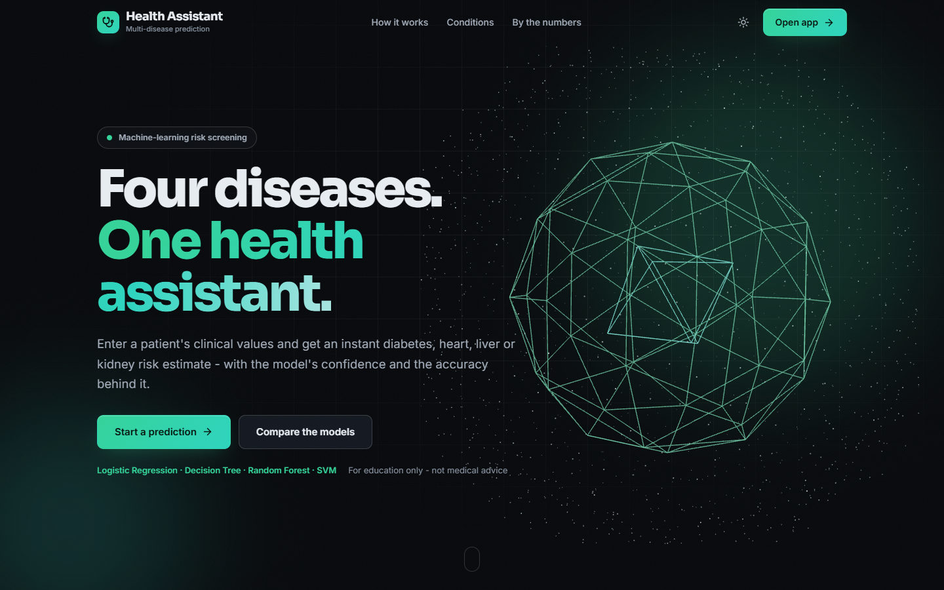
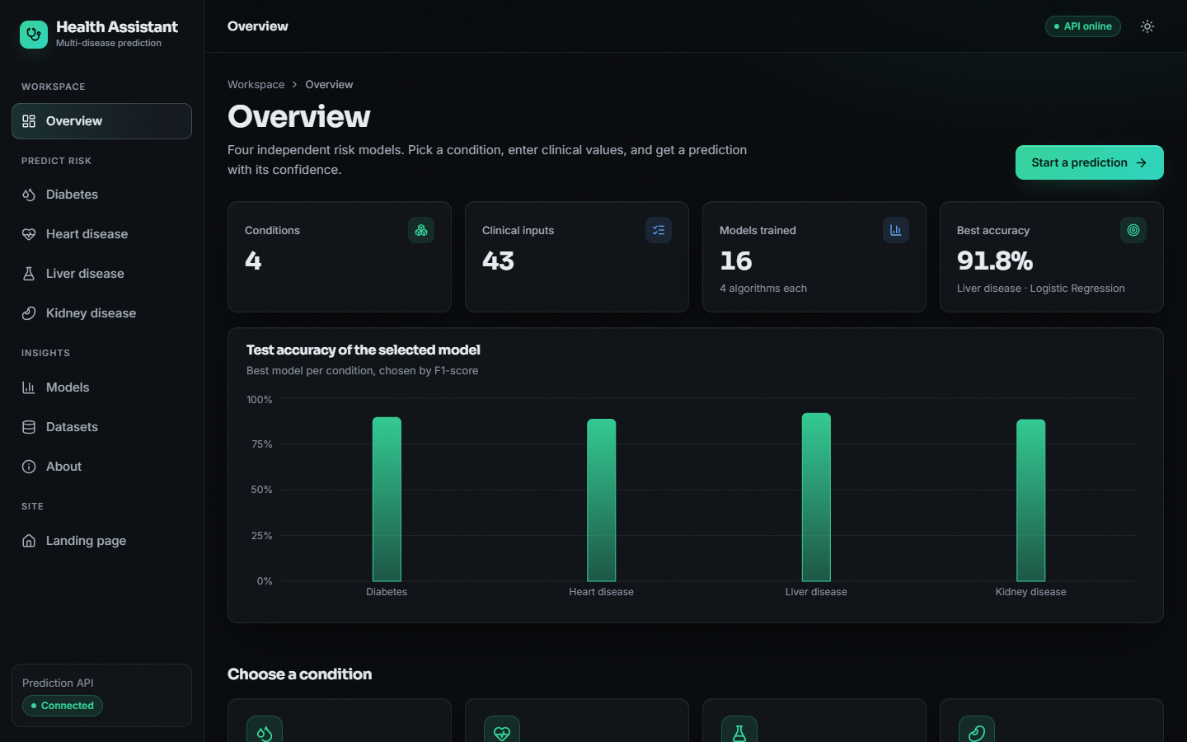
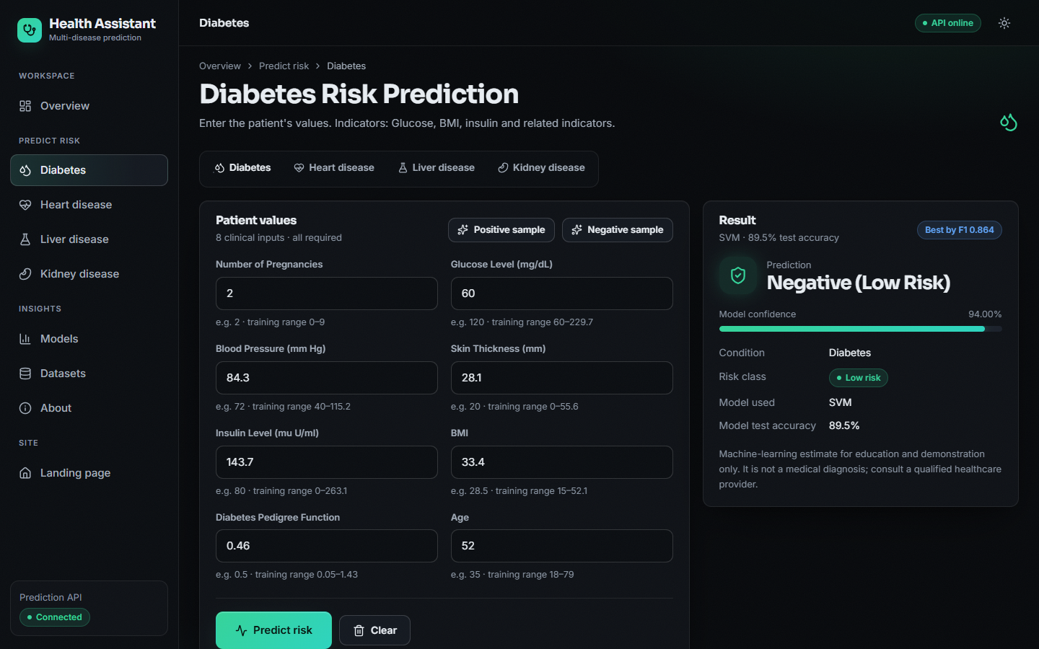
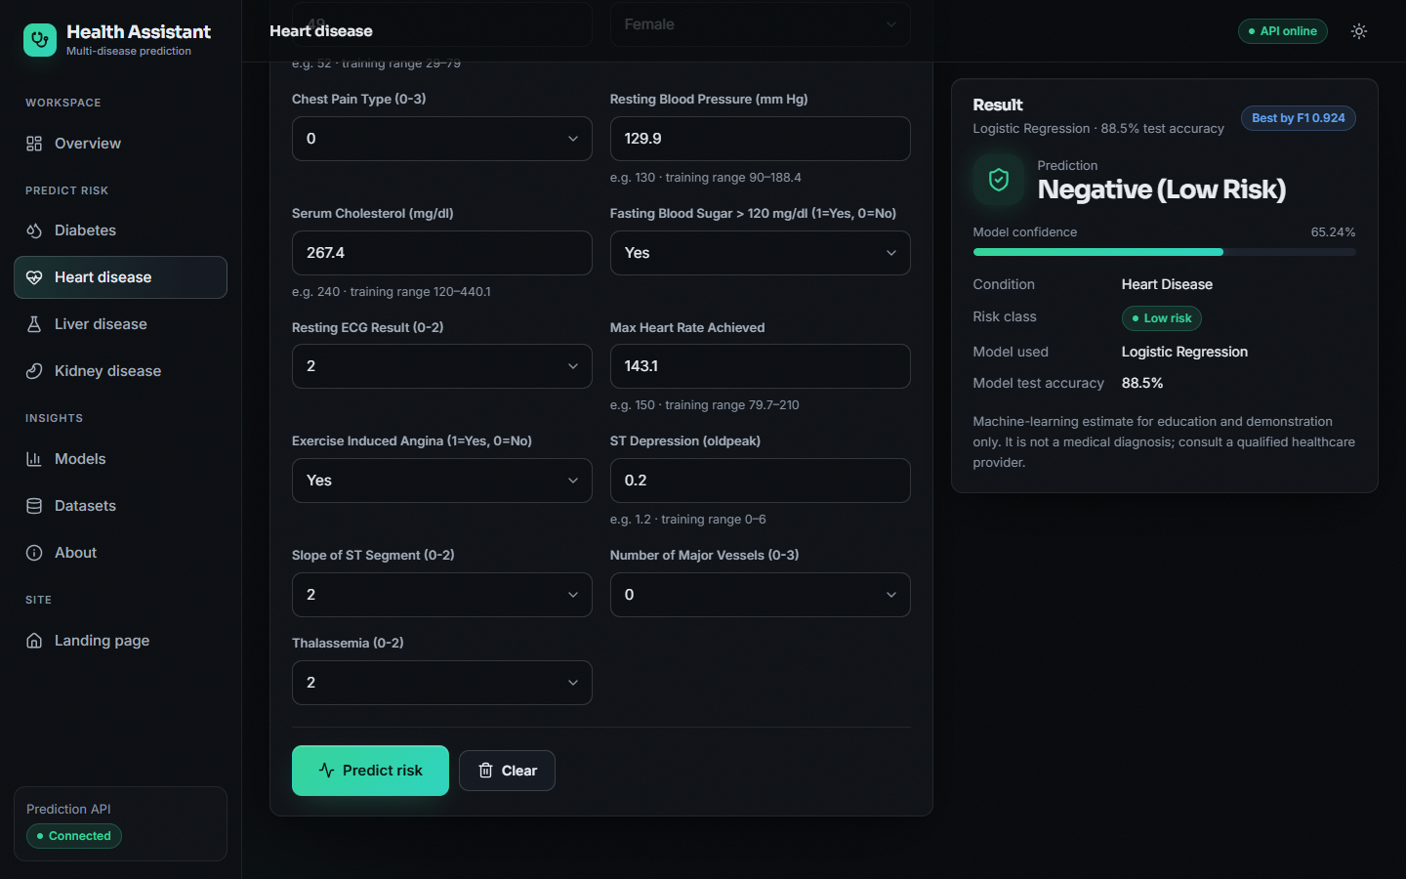

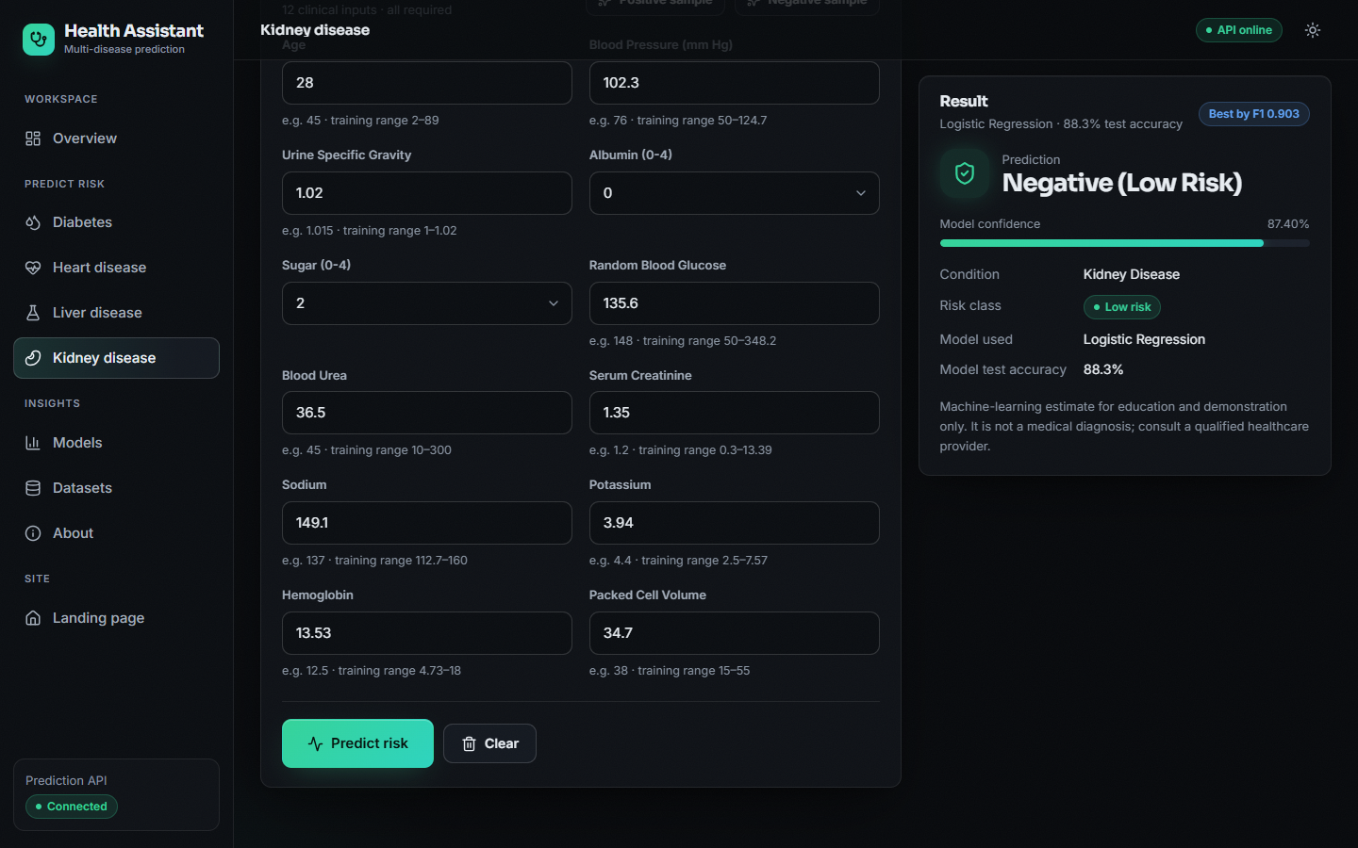
Output Screens – Low-Risk Results & Navigation
Landing page (dark)
Overview
Diabetes: Low Risk 88.18%
Heart disease: Low Risk
Liver: Low Risk 87.07%
Kidney: Low Risk
Dept. of CSE | Batch A3 | Final Review
24
Notes:
Landing and overview pages, then label-0 samples scored by the models.

Slide 25

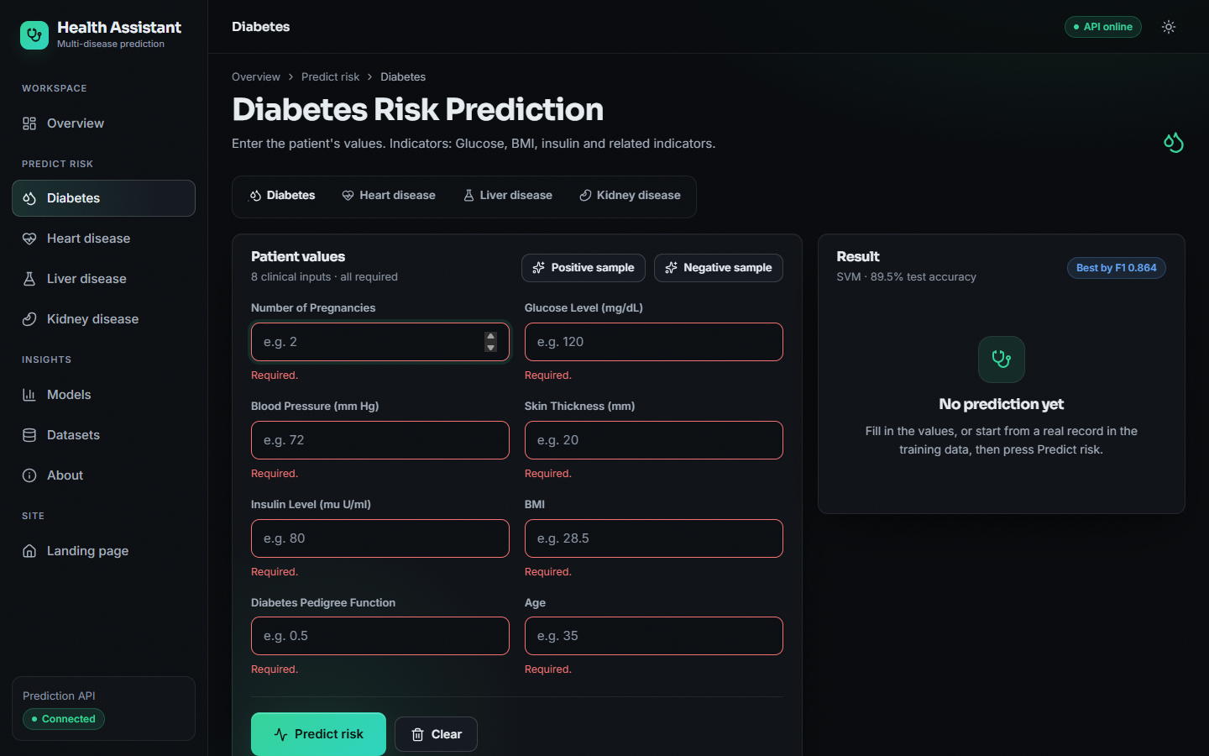
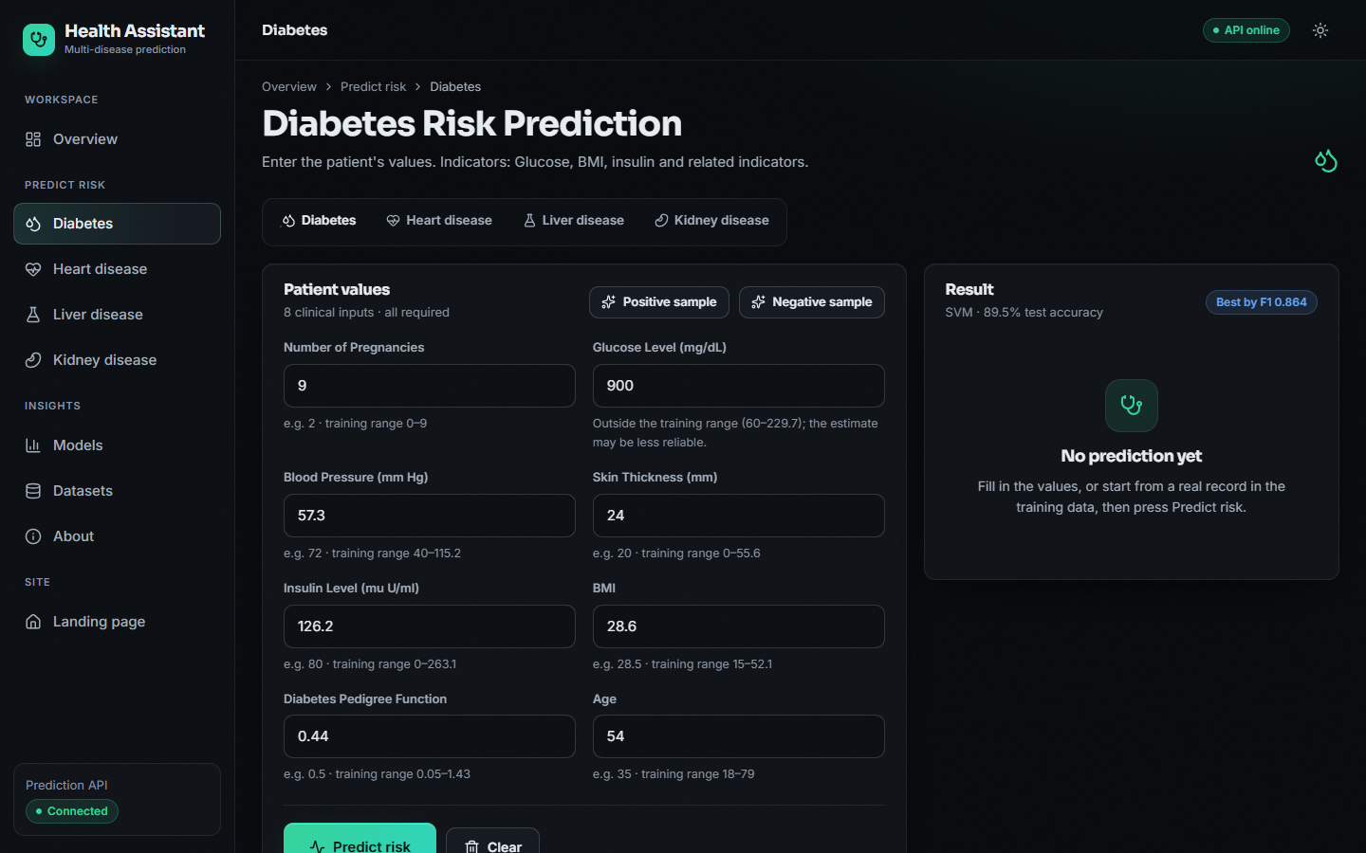
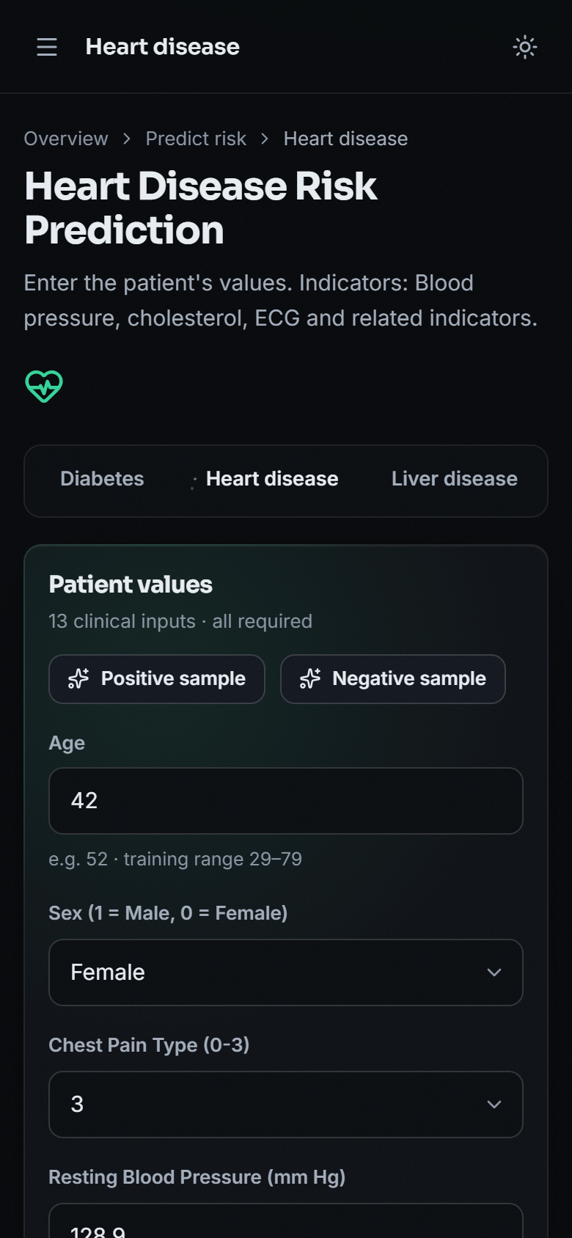
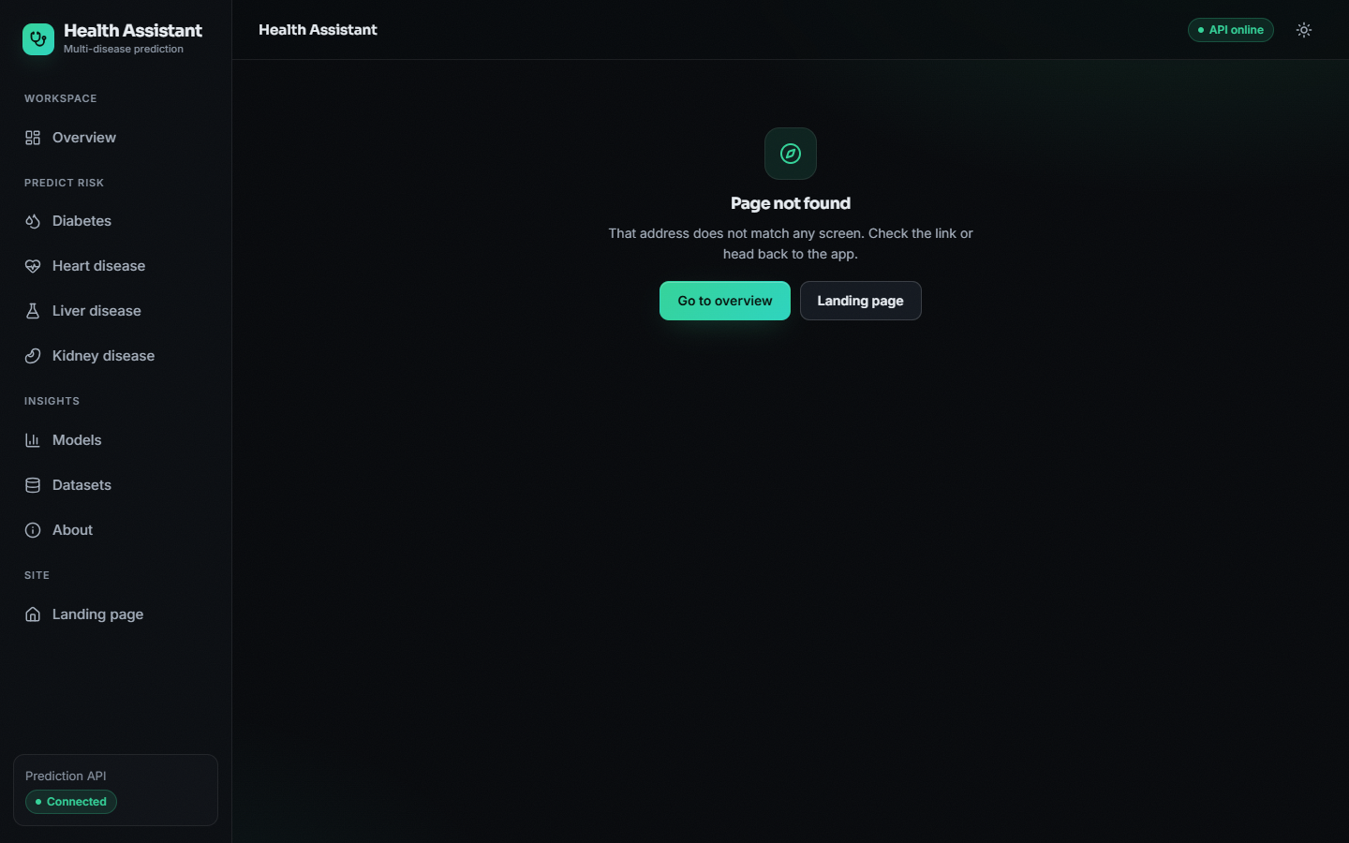
Output Screens – Failure Case, Validation & Phone Layout
Failure: label-0 heart row scored High Risk 99.53%
Empty form: 'Required.' on every field
Glucose 900: outside-training-range warning
Phone layout (390 px): the form stacks in one column.
Honest note: the false positive is a genuine miss of the model on a label-0 record; the app warns that the model may disagree with the label.
Dept. of CSE | Batch A3 | Final Review
25
Notes:
The third output slide shows failure and edge cases: a real false positive, validation errors, out-of-range warning, the phone layout and the 404 page.

Slide 26
Conclusion & Future Scope
Conclusion
Delivered: a four-disease risk-screening app: 16 models, FastAPI + React, 7 routes, 41/41 API checks.
Measured (synthetic): accuracy 89.5% / 88.5% / 91.8% / 88.3%; near the 92% ceiling.
Finding: Logistic Regression is the best model for all four diseases on CV and 10 splits; RF over-fits noisy labels.
Objectives: model comparison and one interface achieved; benchmark data, preprocessing, ROC-AUC selection and explanations only partly.
Not done: real clinical data, calibration, range validation, recommendations, clinical validation.
Future scope
Train on real data (UCI / Pima) with imputation, outlier handling and nested CV.
Add explanations: SHAP, counterfactuals as in the base paper.
Calibrate probabilities; choose thresholds by clinical cost.
Add range validation, authentication and persistence.
Score one record against all four diseases at once; add more conditions.
Clinical validation with clinicians before any use.
Dept. of CSE | Batch A3 | Final Review
26
Notes:
Status of each objective: 1: PARTLY | 2: PARTLY | 3: ACHIEVED | 4: PARTLY | 5: ACHIEVED | 6: PARTLY. Evaluation is on synthetic data and says so.

Slide 27
References
[1] M. Z. Alam, R. Rahman, H. M. Sozib, H. Ahmed, A. Hossain, A. A. Sabeena, A. F. Tasnim, F. Ahmed, M. I. Sarkar, and T. I. Erdei, "Enhancing thyroid disease diagnosis with machine learning and counterfactual explainable AI," IEEE Access, vol. 14, pp. 80346-80370, 2026, doi: 10.1109/ACCESS.2026.3663497.
[2] R. Zannat, A. Al Shafi, and A. Muntakim, "Bridging the gap in Bangla healthcare: Machine learning based disease prediction using a symptoms-disease dataset," in Proc. Int. Conf. Elect., Comput. Commun. Eng. (ECCE), Chattogram, Bangladesh, Feb. 2025, doi: 10.1109/ECCE64574.2025.11012950 (arXiv:2601.12068).
[12] J. W. Smith, J. E. Everhart, W. C. Dickson, W. C. Knowler, and R. S. Johannes, "Using the ADAP learning algorithm to forecast the onset of diabetes mellitus," in Proc. Annu. Symp. Comput. Appl. Med. Care, 1988, pp. 261-265.
[14] A. Janosi, W. Steinbrunn, M. Pfisterer, and R. Detrano, "Heart Disease," UCI Machine Learning Repository, 1989 (303 instances, 13 features), doi: 10.24432/C52P4X.
[15] L. Rubini, P. Soundarapandian, and P. Eswaran, "Chronic Kidney Disease," UCI Machine Learning Repository, 2015 (400 instances, 24 features), doi: 10.24432/C5G020.
[16] B. Ramana and N. Venkateswarlu, "ILPD (Indian Liver Patient Dataset)," UCI Machine Learning Repository, 2012 (583 instances, 10 features), doi: 10.24432/C5D02C.
[17] F. Pedregosa et al., "Scikit-learn: Machine learning in Python," J. Mach. Learn. Res., vol. 12, pp. 2825-2830, 2011.
[18] L. Breiman, "Random forests," Mach. Learn., vol. 45, no. 1, pp. 5-32, 2001, doi: 10.1023/A:1010933404324.
[19] C. Cortes and V. Vapnik, "Support-vector networks," Mach. Learn., vol. 20, no. 3, pp. 273-297, 1995, doi: 10.1007/BF00994018.
[21] S. M. Lundberg and S.-I. Lee, "A unified approach to interpreting model predictions," in Proc. Adv. Neural Inf. Process. Syst. (NIPS), vol. 30, 2017, arXiv:1705.07874.
[23] N. V. Chawla, K. W. Bowyer, L. O. Hall, and W. P. Kegelmeyer, "SMOTE: Synthetic minority over-sampling technique," J. Artif. Intell. Res., vol. 16, pp. 321-357, 2002, doi: 10.1613/jair.953.
[24] S. Varma and R. Simon, "Bias in error estimation when using cross-validation for model selection," BMC Bioinformatics, vol. 7, Art. no. 91, 2006, doi: 10.1186/1471-2105-7-91.
Selected references; the complete list is in the project report.
Dept. of CSE | Batch A3 | Final Review
27
Notes:
Selected references; the complete list is in the report.

Slide 28
THANK YOU
Questions & Suggestions
Dept. of CSE | Batch A3 | Final Review
28
Notes:
Invite questions.

