Slide 1
AI-Powered Medical Lab Report Analysis and Health Insights Platform
REVIEW 2 · DESIGN, METHODOLOGY AND PROGRESS
Design, methodology and progress: a working pipeline from uploaded report to flagged results, explanations and trends
Presented by
Under the guidance of
BANOTH SWAPNA 23K91A0528
BEKKAM VARSHITHA 23K91A0535
A NAVADEEP REDDY 23K91A0502
BUDIGAM MANOJ 23K91A0546
L.G REDDY, [DESIGNATION]
Department of Computer Science and Engineering
TKR College of Engineering and Technology (Autonomous) · Batch A8 (CSE-A) · 2026-2027
Notes:
This review shows how the system is designed and built, what was implemented against the abstract, the first measured results and the open items.

Slide 2
Contents
01
02
03
Recap and architecture
Methodology and dataset
Preprocessing and extraction model
04
05
06
Configuration and decision logic
Data flow, database and UML
Technology stack
07
08
09
Implementation progress and results
Output screens and testing
Challenges and next steps
Notes:
Agenda for the design and progress review.

Slide 3
Recap: problem and proposed system
!
Problem
i
Proposed system
B
Link to the base paper
Lab reports are written for clinicians. Patients cannot interpret them, manual reading is slow and error-prone, digitising tools do not explain, and no history is kept.
Read the report, extract test, value, unit and range, flag Low, Normal or High, explain abnormal values in plain language and track every parameter across reports.
Keeps its idea of patient-friendly explanation from curated knowledge, but covers any lab parameter, measures extraction, and adds trends. Its LLaMA-3 retrieval pipeline is not reproduced.
Notes:
One-minute recap of Review 1. The base paper handles one condition with RAG; this project is a general platform whose extraction is measured.

Slide 4
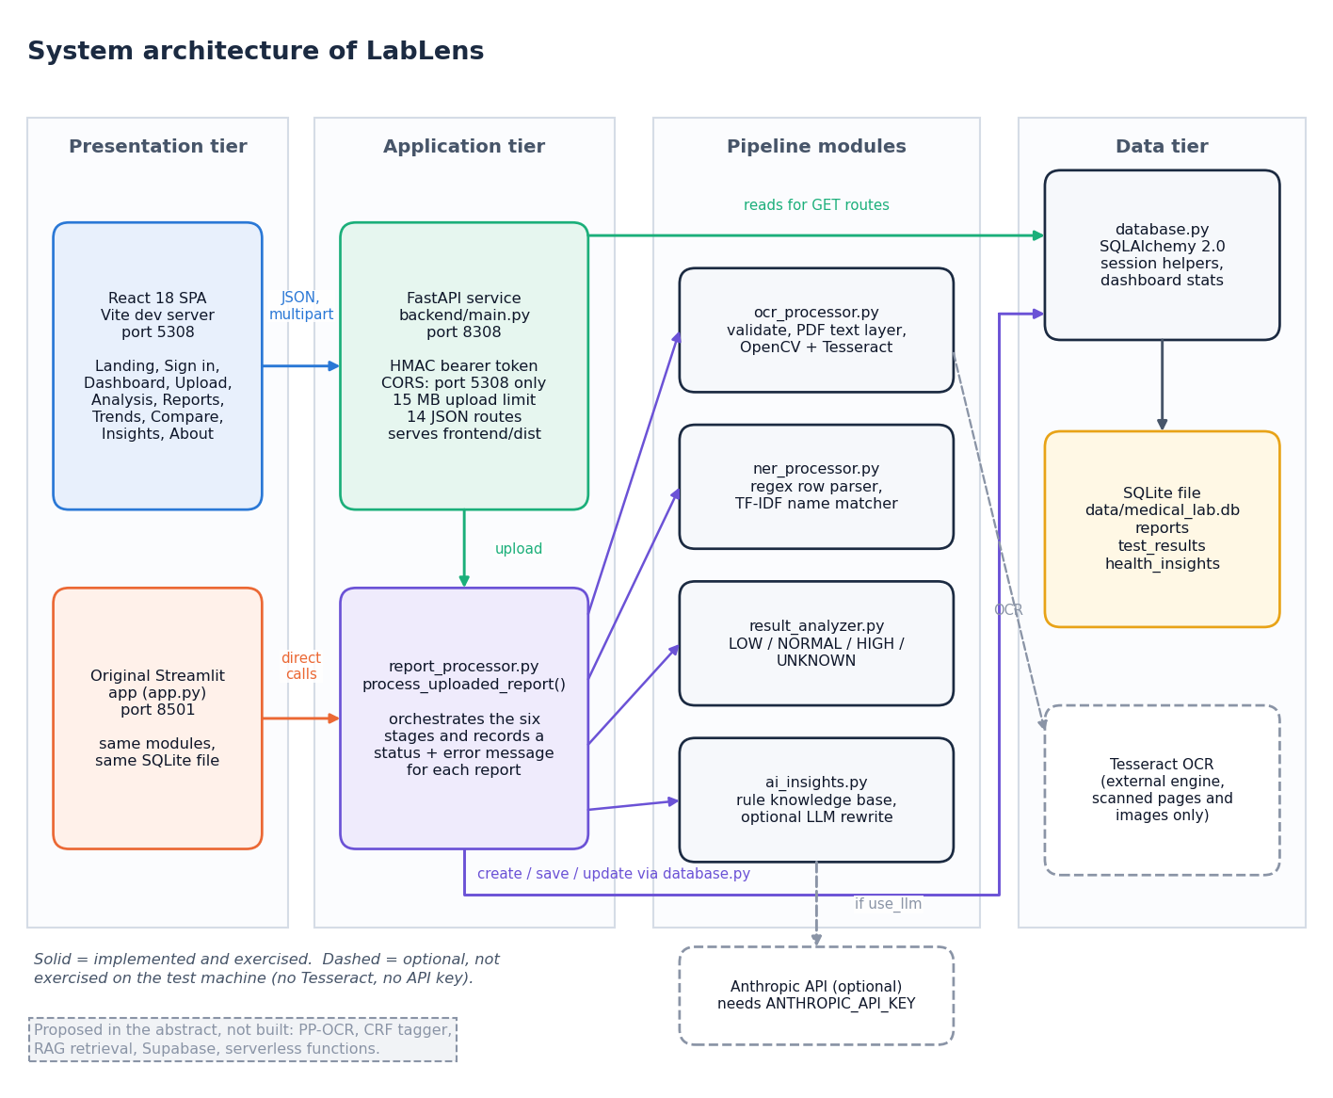
System architecture
Tiers
React single-page app, port 5308.
FastAPI service, port 8308, signed-token login, upload validation.
Pipeline modules: ocr_processor, ner_processor, result_analyzer, ai_insights, report_processor.
SQLite through SQLAlchemy: reports, test results, insights.
The original Streamlit app runs on the same modules and database.
Notes:
The API layer imports the same pipeline modules as the original Streamlit app, so both interfaces give identical results on the same file.

Slide 5
Methodology: end-to-end workflow
Upload and validate
Text: PDF layer or OCR
Parse test rows
Classify against range
Explain abnormal values
Store in SQLite
Dashboard, trends, compare
Fail-safe stages
One pipeline
Measured, not assumed
Any stage failure marks the report Failed with a readable message and keeps the raw text when there is any; nothing partial is shown as a result.
Web upload, the Streamlit app and the demo-data seeder all call the same process_uploaded_report function.
A generated corpus of labelled PDFs (seed 42) scores each stage: row recall, field accuracy, name matching, latency.
Notes:
Seven steps from upload to dashboard. The same function runs for every entry point, so the evaluation of the pipeline applies to all of them.

Slide 6
Dataset: a generated, labelled evaluation corpus
120
1,680
8
55
synthetic lab-report PDFs
ground-truth test rows
report layouts, 15 reports each
names in the test dictionary
Layout | Example line
plain | Hemoglobin 10.8 g/dL 12 - 16
paren | ... g/dL (12 - 16)
flag | Sodium 134 L mEq/L 135 - 145
colon | Hemoglobin: 10.8 g/dL Ref: 12 - 16
unit_last | Hemoglobin 10.8 12 - 16 g/dL
mixed_sep | range written 12 - 16, 12 to 16 or 12-16
tabular | name, value, unit, range on separate lines
ocr_noise | 10 % character noise on test names
Each report has 12 dictionary tests and 2 tests outside it, plus header decoys and a date line.
Values: about 55 % in range, 25 % low, 20 % high; ground truth is generated with the PDF.
Five 14-test demo reports (April to October 2026) feed the screenshots.
Limit: no manually labelled real reports were available, so these numbers describe the parser on clean digital PDFs, not on real scans.
Notes:
All data is invented and reproducible from scripts/run_experiments.py. It is the only labelled data the project has; real scanned reports are not measured.

Slide 7
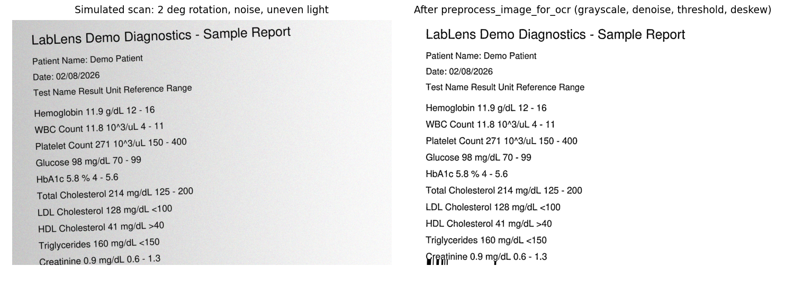
Preprocessing: text layer, then image clean-up
PDF page
30+ characters in text layer?
Yes: use text
No: render 300 dpi
Clean up + Tesseract
1 Grayscale
2 Denoise (non-local means, h = 10)
3 Gaussian adaptive threshold, block 31, C = 15
4 Deskew with minAreaRect (if skew is 0.5 degrees or more)
5 Tesseract, page-segmentation mode 6
The left image is a clean rendered page with a simulated scan defect (2 degree rotation, noise, uneven light); the right image is the real output of preprocess_image_for_ocr. Tesseract is not installed on the build machine, so OCR accuracy on scans is not measured.
Notes:
Digital PDFs skip the image path completely. The image path exists and its first stage works as shown, but scan accuracy is a stated gap.

Slide 8
Extraction model: parser and name matcher
Component | Technique | Setting
Row parser, stage 1 | Regular expression: name, value, optional unit | line starts with a letter; header lines skipped
Row parser, stage 2 | Range: a-b, a to b, a – b, <x, >x; trailing unit | rows with neither range nor unit dropped
Name matcher | TF-IDF on character n-grams, cosine similarity | n-grams 2-4, 55 names, threshold 0.55
Confidence score | 0.9 with two-sided range, 0.6 otherwise | minus 0.1 when no unit is found
Classifier | Low / Normal / High / Unknown by reference range | limits inclusive
Explanation | Rule-based text, optional LLM rewrite | 17 test entries plus generic wording
55
17
0
dictionary names
tests with specific explanation text
learned weights: nothing is trained
Notes:
A hybrid of rules and a small similarity model. The abstract planned a CRF tagger; none was built, and the module comment says a CRF can be swapped in later. The only fitted component is the TF-IDF vocabulary over the 55 dictionary names.

Slide 9
Configuration: parameters, not training
Setting | Value
Scanned-page resolution | 300 dpi; a page is OCR'd when its text layer has fewer than 30 characters
Image clean-up | denoise h = 10; Gaussian adaptive threshold, block 31, C = 15; deskew from 0.5 degrees
Name matcher | character n-grams 2 to 4, cosine similarity at least 0.55, 55 dictionary names
Upload limits | PDF, JPG, JPEG or PNG; at most 15 MB; empty and corrupt files rejected
Critical alert | Low below 0.5 x lower limit or High above 1.5 x upper limit
Evaluation | seed 42, 120 generated reports, 1,680 rows, one CPU (Intel Core i5-12500), no GPU
Notes:
There is no training stage, so this slide lists the tunable values instead. The threshold 0.55 is analysed on the results slide.

Slide 10
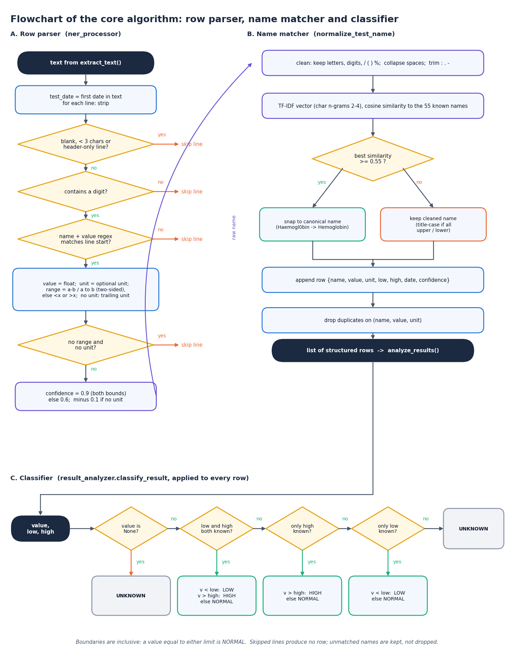
Decision logic
Validate. Extension, size and readability are checked; each failure gives a clear message and the report is marked Failed.
Classify. Below the lower limit is LOW, above the upper limit is HIGH, otherwise NORMAL; a one-sided range such as <100 uses only its bound; no range gives UNKNOWN.
Explain. LOW and HIGH rows get a knowledge-base entry or generic wording; the text states it is educational and never names a disease.
Check. The rule agreed with an independent reference on 20,000 random cases with 0 differences.
Notes:
The decision rule is deliberately simple and deterministic. The explanation text is the only part that can optionally use a language model.

Slide 11
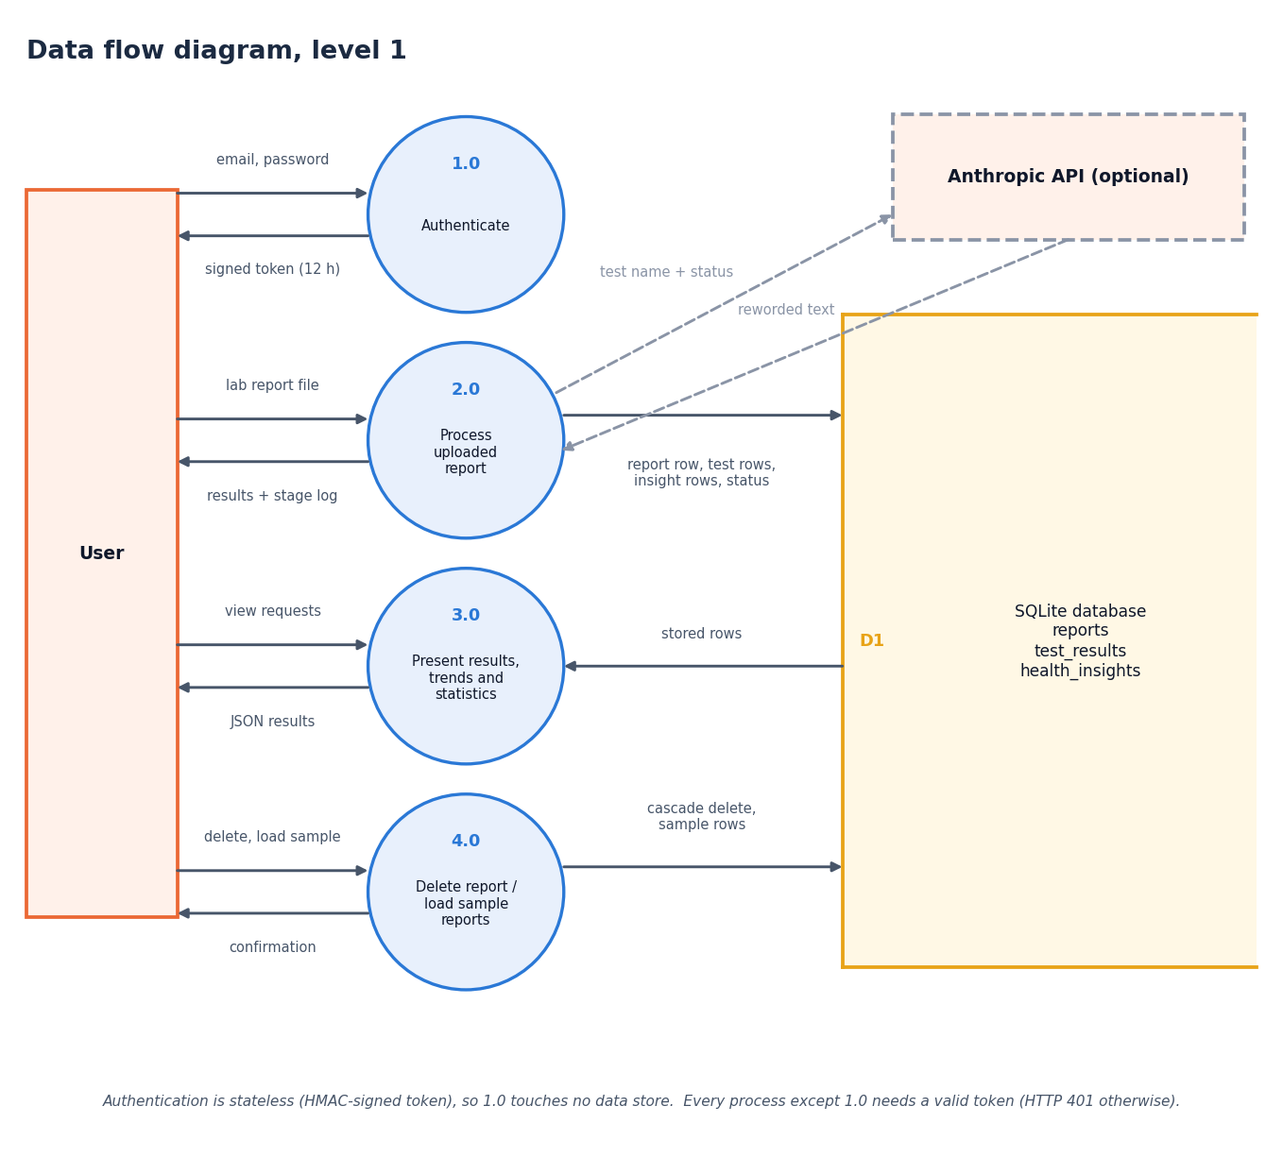
Data flow and modules
Module | Role
ocr_processor.py | validate, PDF text, OCR
ner_processor.py | rows, units, ranges, names
result_analyzer.py | Low / Normal / High
ai_insights.py | explanations
report_processor.py | stage orchestration
database.py | SQLAlchemy storage
backend/main.py | API and login
Notes:
Level-1 data flow. Levels 0 and 2 are in the report. The module table lists where each process lives.

Slide 12
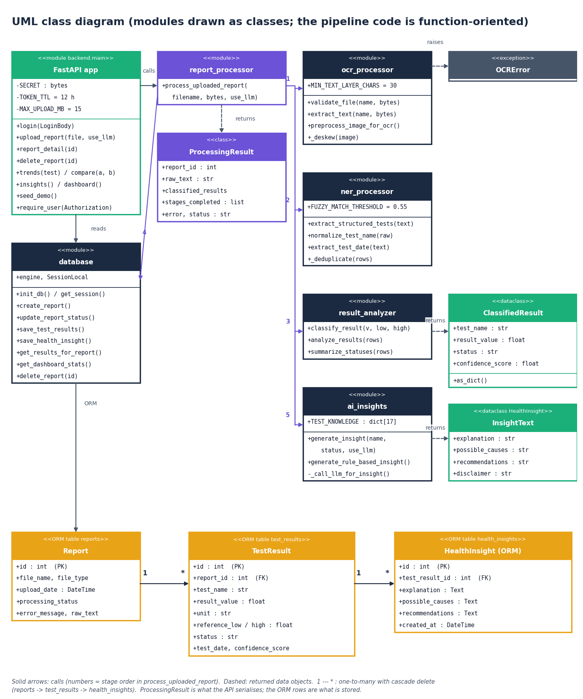
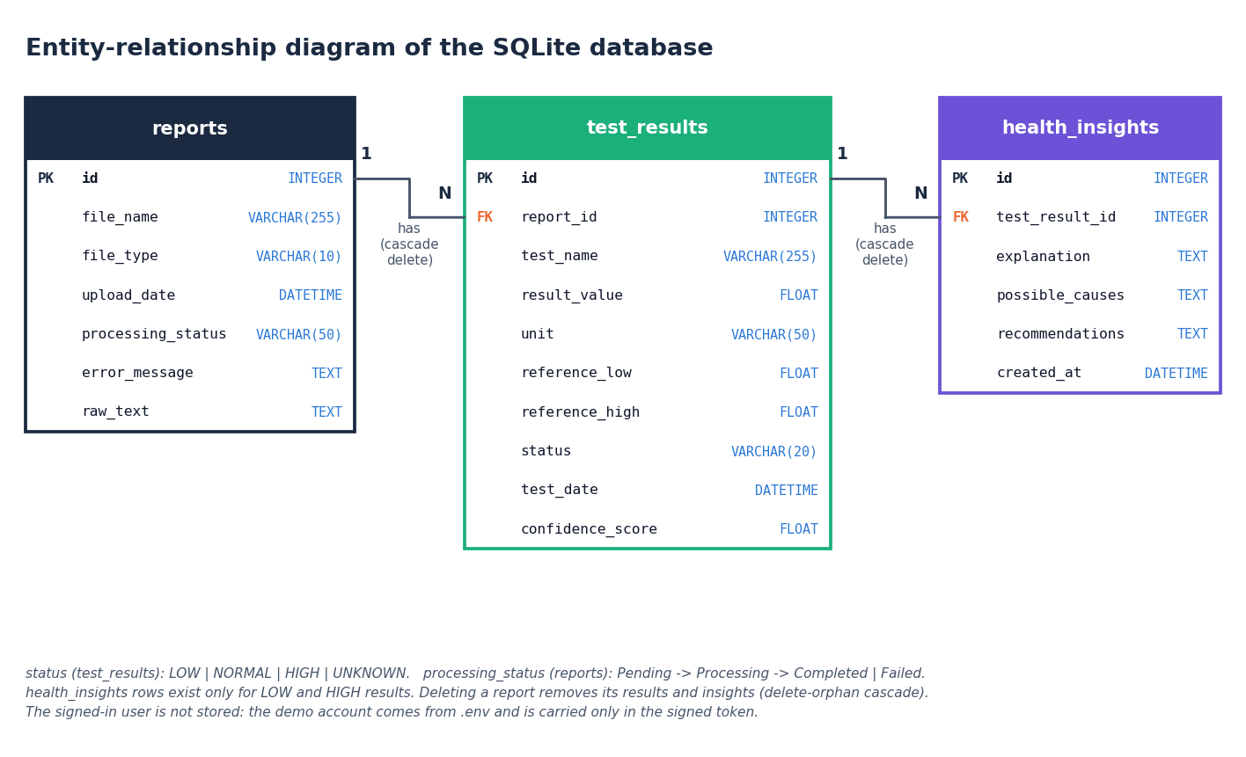
Database design and UML
Three tables: reports, test_results, health_insights; deleting a report cascades to its results and insights.
Notes:
Each report owns many test results; each abnormal result owns one insight. The class diagram shows the code-level structure.

Slide 13
Technology stack
Layer | Technology
PDF and images | PyMuPDF 1.28.2, OpenCV 4.11.0, pytesseract with Tesseract (optional)
Parsing and matching | regular expressions, scikit-learn 1.5.0 TF-IDF; spaCy optional (patient name only)
API | FastAPI 0.143.3, Uvicorn, python-multipart
Database | SQLite with SQLAlchemy 2.0.30
Front end | React 18.3.1, Vite 5.4.21, React Router, Recharts 2.15.4
Optional LLM | Anthropic API for rewriting explanations; falls back silently without a key
Testing and run | pytest, Playwright browser smoke test; run.bat starts both servers
Notes:
Open-source stack. The abstract named Supabase, Tailwind and cloud functions; the implementation uses SQLite, hand-written styles and a local FastAPI service.

Slide 14
Implementation progress against the abstract
Component | Abstract | Built | Status
Text extraction | PP-OCR | PyMuPDF text layer, Tesseract fallback | Built; scans unmeasured
Field extraction | CRF NER | regex parser + TF-IDF name matcher | Built; no CRF
Flagging | range comparison | classify_result rule | Done, 0 / 20,000 differ
Explanations | RAG + LLM | 17-entry rule base, optional LLM | Partial: no retrieval
Storage | Supabase | SQLite + SQLAlchemy | Done; no row-level security
Interface | React, Tailwind | React, Vite, Recharts, 11 pages | Done; no Tailwind
Deployment | Cloud Functions | local FastAPI via run.bat | Not serverless
Speed | under 10 s | 53 ms pipeline, 210 ms upload | Met for text PDFs
Notes:
The honest comparison with the abstract. Timings are medians on the build machine for a 14-row digital PDF.

Slide 15
Preliminary results: field extraction on 120 reports
0.916
0.963
0.874
72.9%
row F1
row precision
row recall
rows fully correct
i
Reading
Single-line layouts: recall 1.00. The tabular layout, with one cell per line, yields 0 rows. Units are the weak field (87.1%); range and status are 99.9% and 99.9%. Clean digital PDFs only.
Notes:
1,680 ground-truth rows, 1,525 predicted. Precision is limited by 57 false rows (55 of them a date line read as a test). The grouped chart shows the tabular layout failing completely and the flag layout losing units because the L/H letter sits between value and unit.

Slide 16
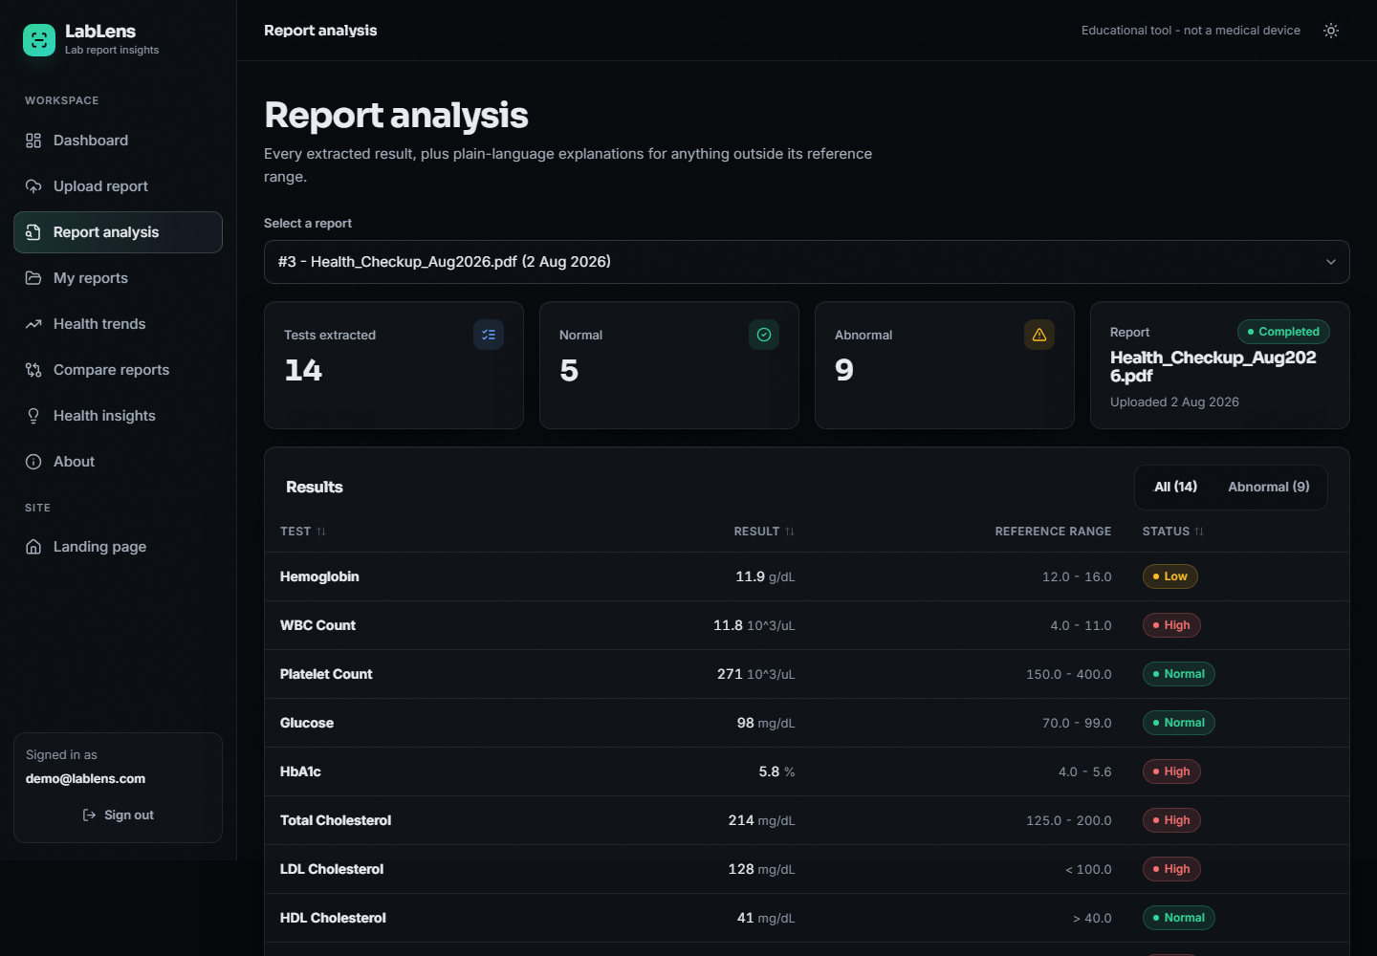
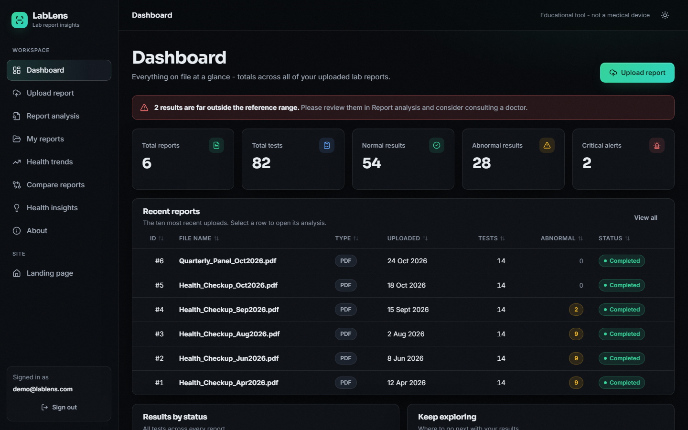
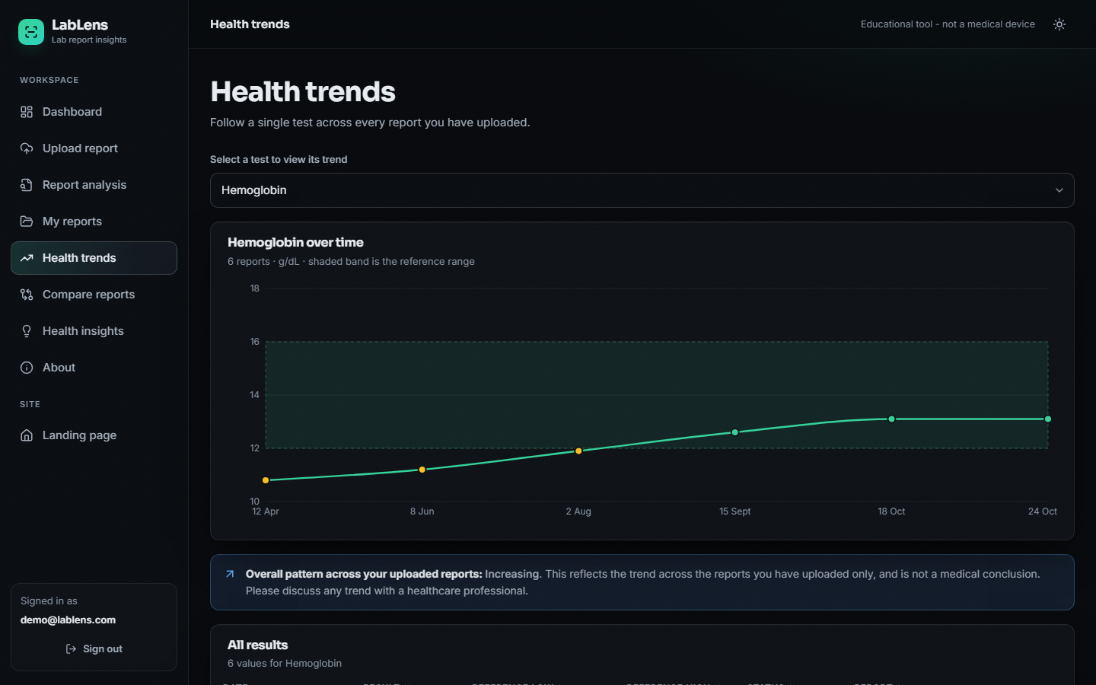
Output screens
Report analysis: the extracted table with Low / High flags (cropped from the full page)
Notes:
Real screenshots of the running application with the five sample reports plus one uploaded report: report analysis, dashboard and a trend chart. The data is synthetic.

Slide 17
Testing
36
24 + 7
20,000
0
pytest tests passed
API + browser smoke checks passed
random classification cases, 0 differences
failures in the final runs
Layer | What the tests check
Classification and parsing | range boundaries, one-sided ranges, header lines, duplicates, test dates, noisy names
Input handling | unsupported type, empty file, oversize file, corrupt PDF
Pipeline and database | stored rows and statuses, failed report, cascade delete, critical-alert count
API | login, tampered token, upload to trend to compare to insights, demo seeding
Browser | login redirect, charts render, wrong file type rejected, Escape closes dialog, no console errors
Notes:
All tests run offline against a temporary database. The browser checks need a built frontend. Scanned-image OCR is not covered because Tesseract is not installed on the build machine.

Slide 18
Challenges found and responses
Challenge | Measured evidence | Response
Table PDFs with one cell per line | 0 of 210 rows read | documented; joining cells by position planned
Date line parsed as a test row | 55 of 57 false rows | documented; date filter planned
Units missing from the list | unit accuracy 87.1% | list extension planned (mg/L, ng/dL, uIU/mL ...)
Unseen names snapped to a dictionary entry | Sodium Bicarbonate read as Sodium | threshold trade-off analysed (0.55 shipped)
Only 17 of 55 tests have explanations | 35.8% of abnormal rows specific | generic wording used; base to be expanded
No real labelled or scanned reports | corpus is generated; OCR unmeasured | stated as a limit
Notes:
These came out of the measurements, not from guesswork. The first three are bugs or gaps in the parser; the last two are limits of the data and the explanation base.

Slide 19
Next steps
1
Fix the parser
2
Measure scans
3
Better matching
4
Final documents
Handle cell-per-line tables, skip date lines, extend the unit list, then re-run the same 120-report corpus.
Install Tesseract and build a small set of labelled scanned reports to measure OCR accuracy and latency.
Compare the TF-IDF matcher with an edit-distance matcher, which scored higher under noise in our test.
Final report, paper and deck with every number regenerated from the experiment files.
Notes:
The plan to the final review. Real-report labelling and the retrieval-based explanation of the base paper remain future work.

Slide 20
Thank you
Questions and suggestions are welcome.
Notes:
Likely questions: why no CRF; why TF-IDF for names; why SQLite; how the explanations avoid diagnosis; what is not measured.

