Slide 1

AI-Powered Medical Lab Report Analysis and Health Insights Platform
Final Review
Team Details : Batch A8
Under the Esteemed Guidance of
L.G REDDY
[DESIGNATION], Department of CSE
23K91A0528 Banoth Swapna
23K91A0535 Bekkam Varshitha
23K91A0502 A Navadeep Reddy
23K91A0546 Budigam Manoj
DEPARTMENT OF COMPUTER SCIENCE AND ENGINEERING · TKR College of Engineering and Technology (Autonomous) · Academic Year 2026 – 2027
Notes:
Introduce the team and the project: LabLens reads a lab report, flags abnormal values, explains them in plain language and tracks them over time.

Slide 2
Table of Contents
Abstract
Base Paper & Literature Survey
Research Gap & Problem Statement
Objectives
Proposed System & Architecture
Methodology, Data & Matching
Decision Workflow, Interaction & Database
Implementation Highlights
Results, Error Analysis, Threshold Analysis, Performance & Testing
Comparison with Base Paper
Output Screens
Conclusion, Future Scope & References
Dept. of CSE | Batch A8 | Final Review
2
Notes:
The agenda follows the report: problem, design, method, results, comparison, screens, conclusion.

Slide 3
Abstract
Patients receive lab reports full of parameters and reference ranges they cannot interpret; understanding one normally needs a follow-up visit.
LabLens reads a PDF or scanned report (PDF text layer; OpenCV + Tesseract for scans), extracts test name, value, unit and reference range, and flags each result Low, Normal or High.
Abnormal results get plain-language explanations: curated rule-based text for 17 of 55 known tests, generic text otherwise, optional LLM rewrite. Results are stored in SQLite and shown in a React dashboard with trends and report comparison.
On 120 generated reports (1,680 labelled rows): row F1 0.916, range accuracy 0.999, status accuracy 0.999, unit accuracy 0.871; 53 ms per report; 36 automated tests pass.
Not built or not measured: PP-OCR, CRF, retrieval-augmented generation and Supabase named in the proposal; scanned-image accuracy (no Tesseract on the test machine); real manually labelled reports.
Dept. of CSE | Batch A8 | Final Review
3
Notes:
Read the first two bullets, then the headline numbers with their protocol (generated labelled corpus, text-layer PDFs). End on what was not built or measured.

Slide 4
Base Paper
A. Karhade, I. Verma, V. Gadaokar and J. Mahajan, "RAG-Based Blood Test Report Analysis to Reverse Metabolic Syndrome," Communications on Applied Nonlinear Analysis, vol. 32, no. 10s, pp. 2771-2779, 2025, doi: 10.52783/cana.v32.5718.
Aspect | Base paper [1]
Method | Retrieval-augmented generation on LLaMA-3 8B; LangChain splitter (1,024 characters, overlap 100), ChromaDB vectors, top-3 chunks with a relevance threshold
Knowledge base | 20 medical books, 383 YouTube transcripts (Whisper) and a 33-parameter range document; text extracted with PyMuPDF
Scope | Metabolic syndrome only: 33 blood parameters; personalised diet and lifestyle advice, source citations, login and encrypted storage
Evaluation | 20 responses scored 1 to 100 by GPT-4 on correctness, clarity, helpfulness, completeness; no extraction accuracy or latency reported
Stated future scope | Multilingual support, personalisation from repeated tests over time, speech input
Dept. of CSE | Batch A8 | Final Review
4
Notes:
The base paper interprets blood reports with RAG for one condition. LabLens takes the goal of plain-language report explanation, but generalises the report parsing and adds the trend tracking the paper lists as future scope.

Slide 5
Literature Survey
Author / Year | Methodology | Data | Key result | Limitation
Karhade et al., 2025 [1] | RAG on LLaMA-3 8B over books and transcripts | 33 metabolic-syndrome parameters | GPT-4 scores 80 to 100 on 20 responses | One condition; LLM-judged; no extraction metrics
Ren et al., 2025 [2] | Serialising phone-photographed lab report images into structured records | Image-based lab reports | Structured storage of report content | Method details not reviewed beyond its abstract
Xiang et al., 2026 [3] | Constrained workflow turning check-up reports into action cards | 2,000 de-identified real reports | Experts: 84% of outputs fully reasonable | No model best on every dimension; safety limits recall
Bakhsheshi & Beigy, 2025 [4] | General vision-language models read report images; Sentence-BERT compares answers | 100 blood report images | Practical for preliminary analysis | Small dataset; answers compared to each other
Nguyen et al., 2025 [5] | Three fine-tuned FLAN-T5-Large models; web and mobile app | Medical reports and conversations | Lightweight report summarisation | Summarises text; no value extraction or trends described
Lewis et al., 2020 [6] | Retrieval-augmented generation | Knowledge-intensive NLP tasks | Grounds generation in retrieved text | Needs a curated corpus (not built here)
Three further sources named in the batch survey (laboratory safety, RT-PCR statistics, device extraction testing) concern laboratory practice, not report analysis; they are listed in the report but not used as evidence.
Dept. of CSE | Batch A8 | Final Review
5
Notes:
Representative work on lab and check-up report understanding. Entries are summarised from their abstracts; limitations are those stated by the authors or visible in the setup.

Slide 6
Research Gap
Scope: the base paper explains blood reports for a single condition; a general platform for arbitrary lab parameters is missing.
Extraction: it is evaluated on the quality of generated advice, not on whether test names, values, units and ranges were read correctly.
History: no longitudinal view; the base paper itself lists tracking tests over time as future work.
Digitising versus explaining: report-digitising work stores values but does not say what an abnormal value means; explanation work does not parse reports.
Evidence: generated explanations are rarely tied to a stated source or checked against a fixed rule for what is abnormal.
Dept. of CSE | Batch A8 | Final Review
6
Notes:
Five gaps drawn from the survey. LabLens addresses scope, extraction measurement, history and the digitise-plus-explain split; grounded retrieval is only partly addressed (curated text, no retrieval).

Slide 7
Problem Statement
Laboratory reports are written for clinicians. Given a PDF or scanned report, extract every test with its value, unit and reference range, flag the abnormal ones, explain them in plain language, and keep the history so a patient can see whether a parameter is improving or worsening.
Input
Output
Record
PDF, JPG, JPEG or PNG report, up to 15 MB
Structured results, Low / Normal / High status, explanation for each abnormal value
Report library, dashboard, trends, side-by-side comparison
Manual reading is slow and error-prone; existing tools digitise reports but do not explain them and keep no history.
Dept. of CSE | Batch A8 | Final Review
7
Notes:
The statement has three parts: extract and flag, explain, record over time.

Slide 8
Objectives
1. Accept lab reports in PDF or scanned image form and extract text using high-speed OCR.
2. Apply named entity recognition to identify test parameters, values, units and reference ranges.
3. Compare each extracted value against its reference range and flag abnormal results.
4. Generate plain-language explanations for abnormal findings, grounded in trusted medical sources.
5. Track parameters across successive reports to display health trends over time.
6. Present results through a dashboard and evaluate extraction accuracy against manually labelled reports.
Dept. of CSE | Batch A8 | Final Review
8
Notes:
The six objectives of the proposal. The conclusion reports for each whether it was met; objectives 1, 2, 4 and 6 were met only in part.

Slide 9
Proposed System
Upload report
Extract text
Parse test rows
Classify vs range
Explain
Store + trend
Text comes from the PDF text layer when there is one; scanned pages and photos go through OpenCV preprocessing and Tesseract.
A line parser reads name, value, unit and range; a TF-IDF matcher snaps noisy names to a 55-name dictionary.
Each value is compared with its range (inclusive limits); abnormal rows receive an explanation, with an optional LLM rewrite that falls back silently.
FastAPI service over the same Python pipeline and SQLite database as the original Streamlit app; React interface with trends and comparison; a not-a-medical-device notice on every screen.
Dept. of CSE | Batch A8 | Final Review
9
Notes:
The proposed system in one line of boxes, then the four properties that matter.

Slide 10
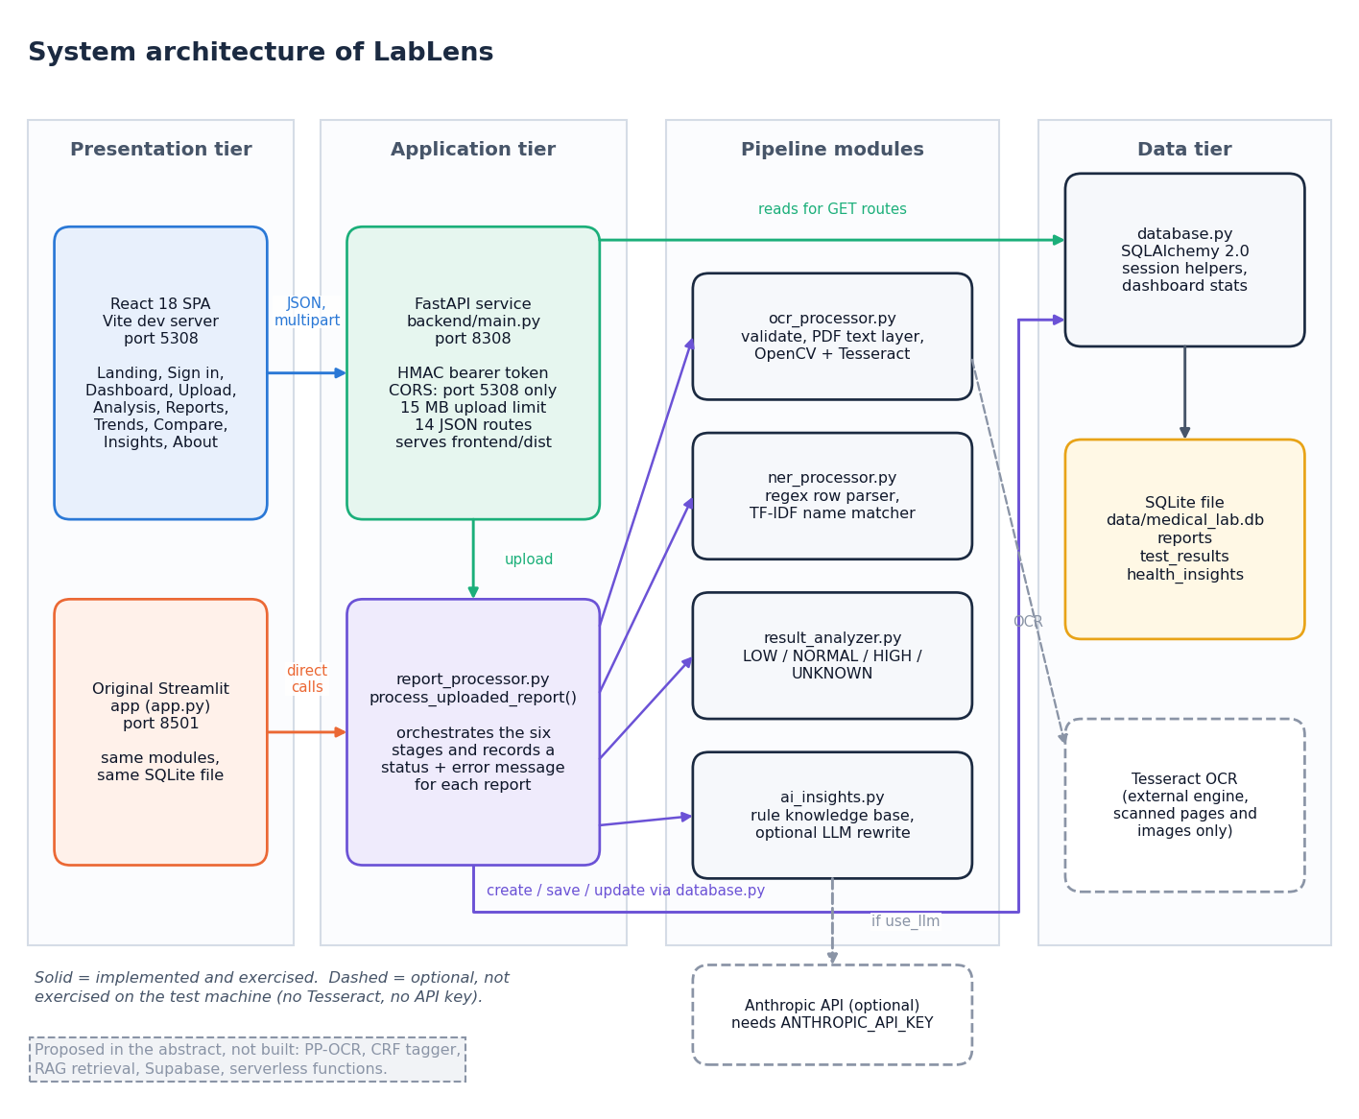
System Architecture
Presentation: React 18 + Vite + Recharts; original Streamlit app
API: FastAPI, signed bearer token, upload validation
Pipeline: ocr_processor, ner_processor, result_analyzer, ai_insights, report_processor
Data: SQLite through SQLAlchemy, three tables
Dept. of CSE | Batch A8 | Final Review
10
Notes:
Four tiers. The pipeline modules are shared by the React interface (through FastAPI) and the original Streamlit interface.

Slide 11
Methodology
Validate (type, size)
PDF text / OCR
Parse rows
Snap names
Classify
Explain
Store
Scans: a page with fewer than 30 characters of text is rendered at 300 dpi, converted to grey, denoised, adaptively thresholded (Gaussian, block 31) and deskewed before Tesseract (page-segmentation mode 6).
Rows: regular expressions read name, value, optional unit, and a range written as a-b, a to b, <x or >x; rows with neither range nor unit are dropped, duplicates removed, confidence 0.9 or 0.6.
Names: character n-grams (2 to 4) with TF-IDF and cosine similarity against the dictionary; match accepted at 0.55 or above, otherwise the text is kept.
Evaluation: a seeded generator writes labelled report PDFs; the unchanged pipeline reads them and the output is compared with the known answers.
Dept. of CSE | Batch A8 | Final Review
11
Notes:
The workflow, step by step. The scanned-image branch is implemented but could not be measured because Tesseract is not installed on the test machine.

Slide 12
Evaluation Data, Parser & Name Matcher
1,680
Layout | Example line in the PDF
plain | Hemoglobin 10.8 g/dL 12 - 16
paren | Hemoglobin 10.8 g/dL (12 - 16)
flag | Hemoglobin 10.8 L g/dL 12 - 16
colon | Hemoglobin: 10.8 g/dL Ref: 12 - 16
unit_last | Hemoglobin 10.8 12 - 16 g/dL
mixed_sep | range written 12 - 16, 12 to 16 or 12-16
tabular | name, value, unit, range as separate text cells
ocr_noise | 10% character noise on the test name
Honest limit
Labels are generated, not hand-labelled from real reports; PDFs carry a text layer.
ground-truth rows in 120 generated PDFs
55
dictionary test names
17
tests with specific explanation text
0.55
name-match cosine threshold
Each report: 12 dictionary tests + 2 unseen tests, header decoys and a date line; 15 reports per layout; seed 42. Values: about 55% in range, 25% low, 20% high.
Dept. of CSE | Batch A8 | Final Review
12
Notes:
The evaluation corpus is synthetic with known answers, because no manually labelled real reports were available. Eight layouts probe the parser; the 'tabular' and 'ocr_noise' layouts are the hard ones.

Slide 13
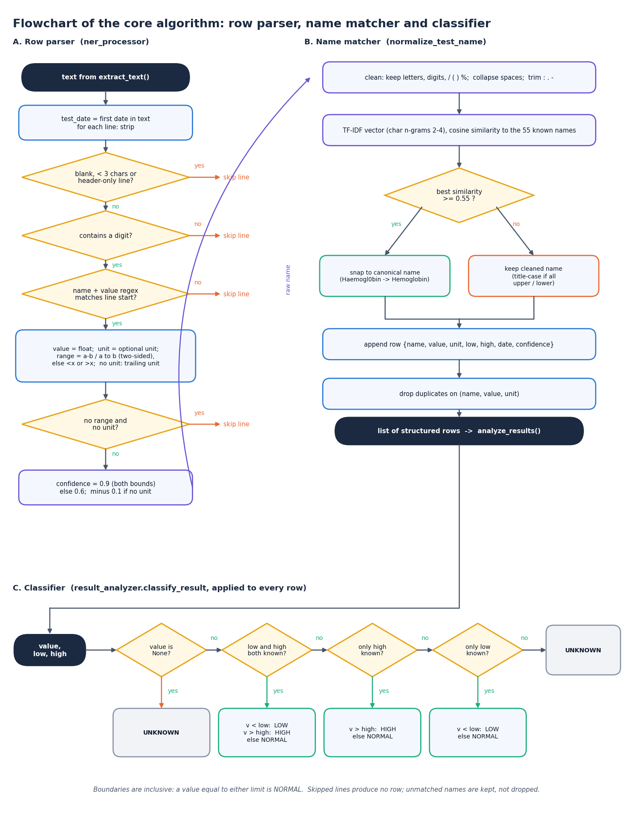
Decision Workflow
Classify: LOW if value < low; HIGH if value > high; limits are inclusive; UNKNOWN when there is no range. Checked against an independent rule on 20,000 random cases: 0 disagreements.
Explain: each LOW or HIGH row gets knowledge-base text or a generic non-specific text; an optional LLM call is used only when a key is configured.
Persist: a failure at any stage marks the report Failed with a readable message and keeps the raw text.
Alert: the dashboard calls a result critical if it is below half the lower limit or above 1.5 times the upper limit.
Dept. of CSE | Batch A8 | Final Review
13
Notes:
The core algorithm as a flowchart. The classification rule is deliberately simple and was verified against a separately written rule.

Slide 14
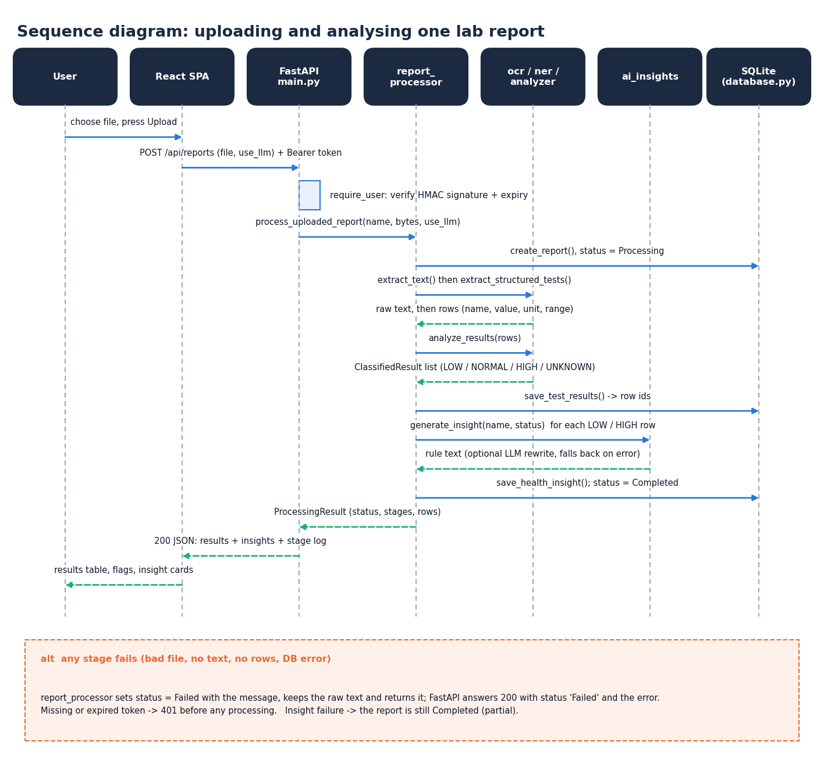
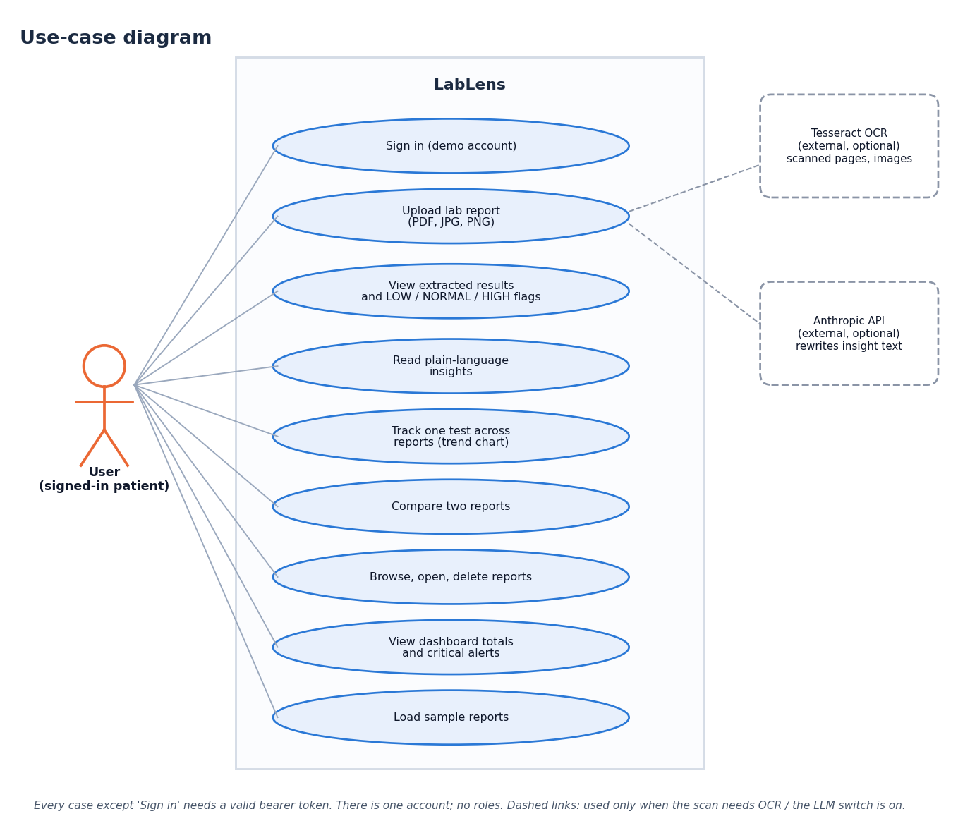
User – System Interaction
Dept. of CSE | Batch A8 | Final Review
14
Notes:
Left: the sequence of one report upload through the API and pipeline. Right: the use cases of the signed-in user.

Slide 15
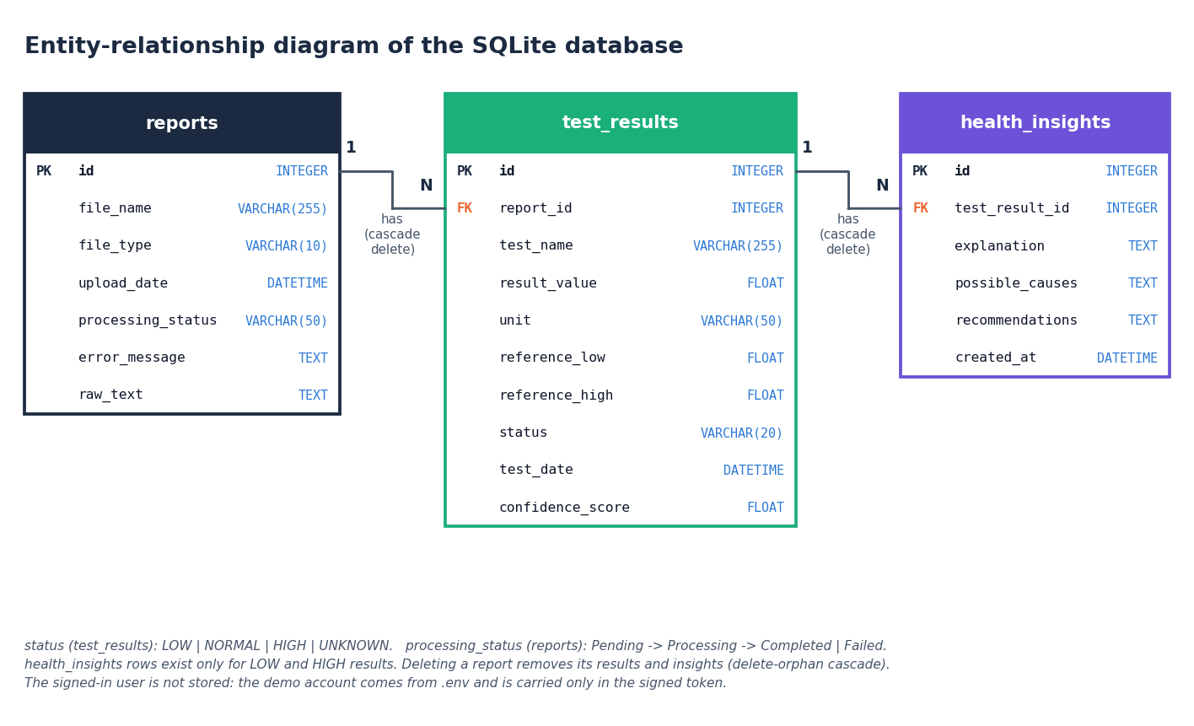
Database Design
test_results column | Type
id, report_id (FK) | INTEGER
test_name | TEXT
result_value | REAL
unit | TEXT
reference_low / reference_high | REAL (nullable)
status | LOW / NORMAL / HIGH / UNKNOWN
test_date | DATETIME
confidence_score | REAL 0 to 1
reports (1) to test_results (many) to health_insights (many); cascade delete removes a report with everything under it.
Dept. of CSE | Batch A8 | Final Review
15
Notes:
Three tables. Deleting a report removes its results and insights, which is covered by a test.

Slide 16
Implementation Highlights
14
36
10
3
REST endpoints
pytest tests passing
React screens
database tables
Bearer token signed with HMAC-SHA256 (12 h) and checked in constant time; CORS limited to the local front end; 15 MB limit and an extension whitelist on uploads.
Sample-report loader renders five synthetic PDFs and runs them through the same pipeline, so every screen can be shown with real extracted data.
Trend charts with the reference band, grouped comparison charts, sortable tables, light and dark themes, keyboard support.
Authentication is a single demo account and the library is shared: not suitable for real patient data. One-click start with run.bat.
Dept. of CSE | Batch A8 | Final Review
16
Notes:
Highlights of the implementation. The last bullet is a limitation: the sign-in is demo-grade.

Slide 17
Results – Extraction Performance
Metric (120 generated reports) | Value
Row precision | 0.963
Row recall | 0.874
Row F1 | 0.916
Name accuracy (found rows) | 0.956
Unit accuracy | 0.871
Reference-range accuracy | 0.999
Status accuracy | 0.999
Exact rows (all four fields right) | 0.729
Cell-per-line table layout: 0 of 210 rows read. Names of the 55 dictionary tests: 0.987; unseen tests: 0.771.
Text-layer PDFs only; ground truth is generated. Scanned images were not measured (Tesseract not installed).
Dept. of CSE | Batch A8 | Final Review
17
Notes:
Protocol: 120 generated reports, 8 layouts x 15, 1,680 labelled rows, seed 42. Row F1 is high on every single-line layout; the table layout, where each cell is its own text line, scores zero.

Slide 18
Error Analysis (Row-level Confusion)
1,468
212
57
rows found (true positives)
rows missed (false negatives)
rows invented (false positives)
Error | Rows | Cause found in the failure cases
Missed rows | 212 | All 210 rows of the cell-per-line table layout (each cell is a separate text line); 2 more in the noisy-name layout
Unit wrong or missing | 189 | Unit outside the regular-expression list (uIU/mL, mg/L, umol/L, ng/dL, ug/dL, pg/mL); a flag letter L or H between value and unit
Name wrong | 64 | Unseen tests snapped to a dictionary name (Sodium Bicarbonate read as Sodium); heavy character noise
False rows | 57 | 55 are the header date line (Sample Collected: 12-04-2026) read as a test with range -4 to 2026; 2 others (one mis-read name, one date row matched to a real RDW value of 12)
Status wrong | 1 | Range and status are almost always right once a row is found
Dept. of CSE | Batch A8 | Final Review
18
Notes:
A confusion-style breakdown: found, missed and invented rows, and the cause of each error class read from the failure cases saved in experiments/lablens/failure_cases.json. These are concrete defects, listed as future work.

Slide 19
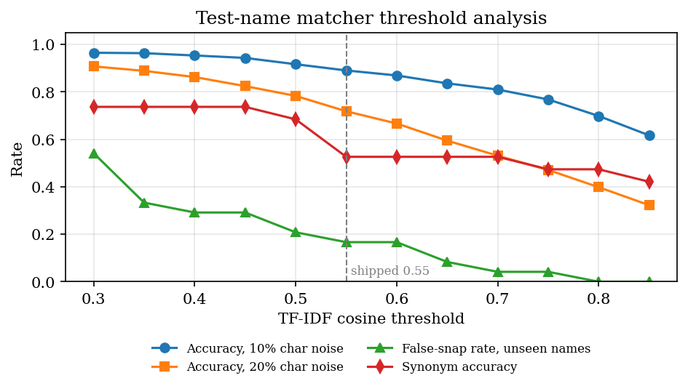
Threshold & Parameter Analysis (Name Matcher)
Name accuracy against simulated per-character noise (55 names x 30 trials)
Matcher / threshold | Accuracy at 10% noise | Accuracy at 20% noise | Unseen names wrongly snapped | Synonyms right
TF-IDF 0.30 | 0.965 | 0.907 | 54% | 74%
TF-IDF 0.55 (shipped) | 0.890 | 0.718 | 17% | 53%
TF-IDF 0.80 | 0.698 | 0.398 | 0% | 47%
difflib ratio 0.60 (baseline) | 0.981 | 0.946 | not measured | not measured
Sweep and noise bars use separate random trials, so the 20% TF-IDF figure differs slightly (0.718 vs 0.731).
Dept. of CSE | Batch A8 | Final Review
19
Notes:
The threshold is a trade-off: lower values rescue noisy names but wrongly rename unseen tests. 0.55 is a middle choice. A plain difflib matcher was more noise-tolerant on the dictionary names but was not adopted; its false-snap rate was not measured.

Slide 20
Performance & Testing
1.4 ms
7.2 ms
53 ms
210 ms
PDF text layer (1 page)
field extraction, 14 rows
whole pipeline incl. database
HTTP PDF upload, median
Test layer | What it covers | Result
pytest | classification boundaries, extraction, name matching, OCR input checks, insights, pipeline, cascade delete, dashboard, API auth, upload, trend, compare, seed | 36 passed, 0 failed
Live smoke test | running API in a temporary copy, plus browser flow on the built front end | 24 API + 7 browser checks passed
Classification rule | 20,000 random value and range cases against an independent rule | 0 disagreements
Not measured | scanned-image OCR speed and accuracy, LLM explanations, many users, real reports | stated as gaps
The proposal's target of under 10 seconds per report is met for text-layer PDFs (field extraction grows linearly: about 113 ms for 200 rows). Machine: i5-12500, 15.7 GB, no GPU.
Dept. of CSE | Batch A8 | Final Review
20
Notes:
All timings are medians on a CPU-only desktop, measured against 127.0.0.1. The test table shows what passed and, in the last row, what was never measured.

Slide 21
Comparison with Base Paper (context only – different task and data)
Aspect | Base paper [1] | LabLens
Task | Answer questions about a blood report for metabolic syndrome with RAG | Read any lab report, flag abnormal values, explain, track trends
Input | Blood test reports from users; 33 chosen parameters | PDF or image reports; 55 known test names, other tests kept as read
Language model | LLaMA-3 8B with retrieval over books and transcripts | No generative model needed; rule-based text, optional LLM rewrite (not exercised)
How quality was judged | GPT-4 scored 20 responses, 1 to 100; stated averages 92.4 / 89.7 / 91.1 / 88.9 (Table 4 recomputes to 94.0 / 94.9 / 90.1 / 88.65) | Extraction row F1 0.916, status accuracy 0.999 on 1,680 generated rows; explanation quality not scored
History over time | Listed as future scope | Trend chart, direction and report comparison implemented
Deliverable | RAG chatbot with login | Web application, 14 API endpoints, tests
Not like-for-like: the scores measure different things on different data, so neither set of numbers ranks one system above the other.
Dept. of CSE | Batch A8 | Final Review
21
Notes:
State plainly that tasks and data differ. The base paper's own stated averages differ from the averages recomputed from its Table 4; both are shown.

Slide 22
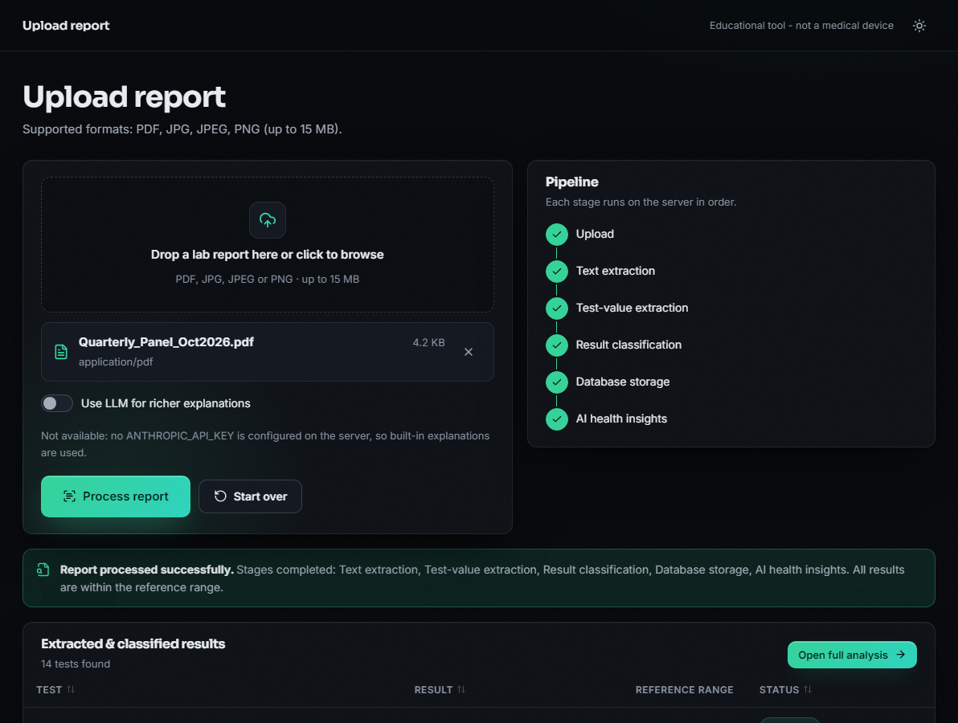
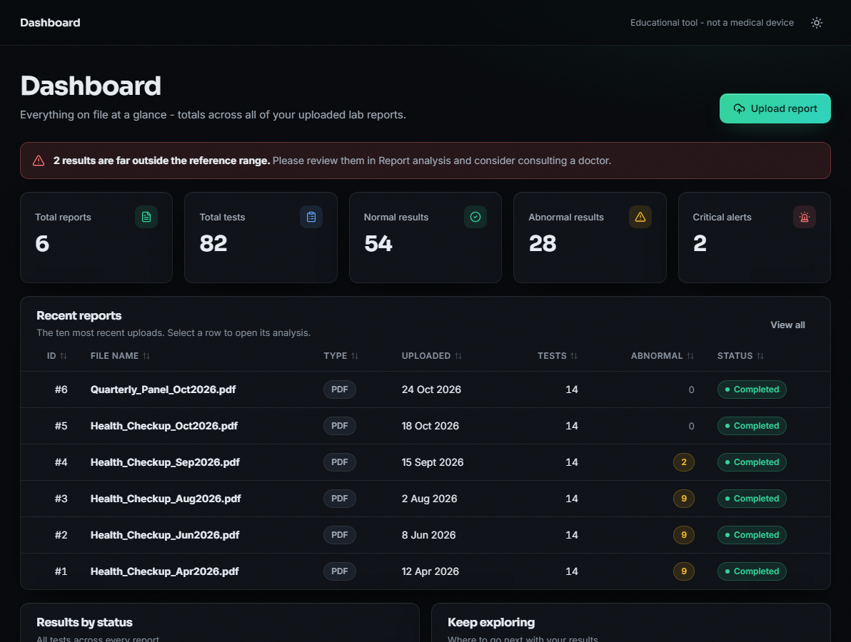
Output – Upload and Dashboard
Upload: pipeline stages completed, 14 tests extracted and classified.
Dashboard: totals, critical-result alert and recent reports.
Dept. of CSE | Batch A8 | Final Review
22
Notes:
Left: a report processed; the stage list ends with database storage and health insights. Right: dashboard across six reports (82 tests, 28 abnormal, 2 critical). All data is synthetic.

Slide 23
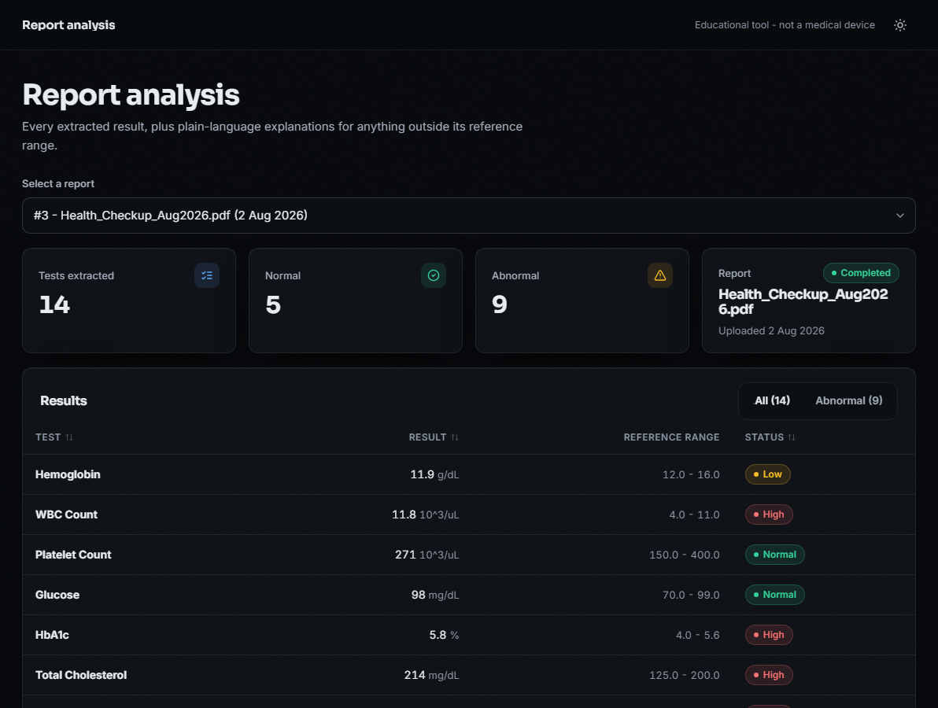
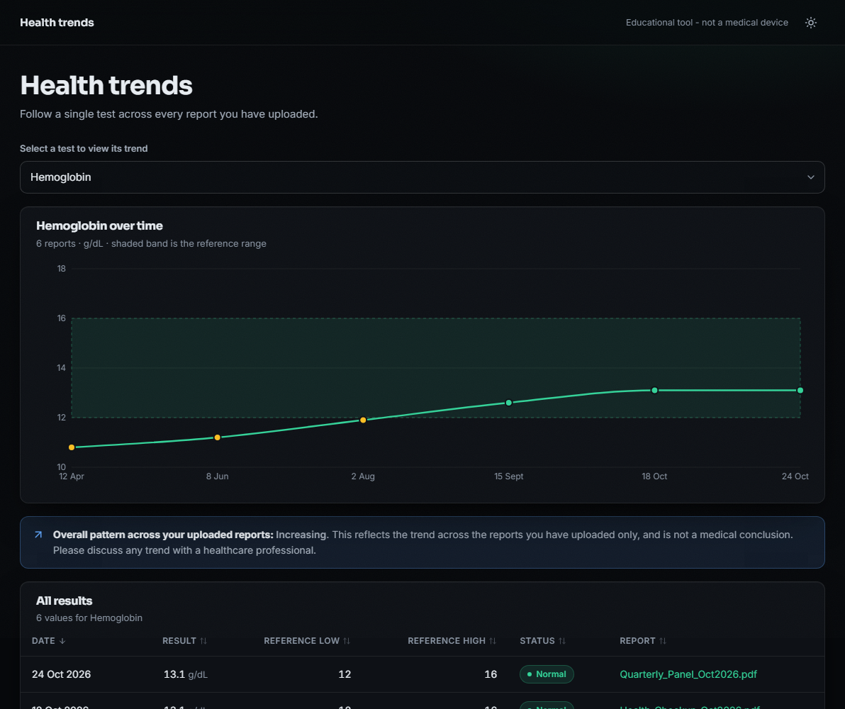
Output – Report Analysis and Health Trends
Report analysis: each result with range and Low / High status.
Trends: haemoglobin across six reports with the reference band.
Dept. of CSE | Batch A8 | Final Review
23
Notes:
Left: results table with explanations below for abnormal rows. Right: trend of one test over time, 10.8 to 13.1 g/dL.

Slide 24
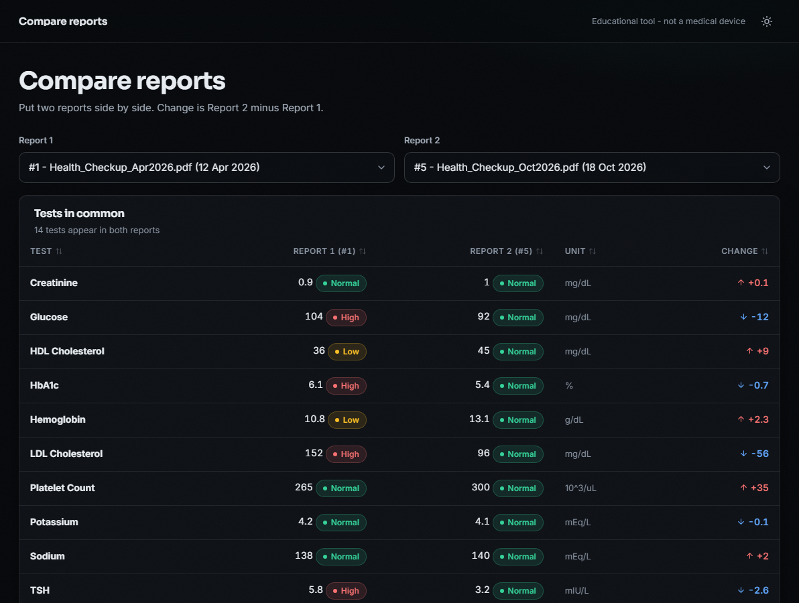
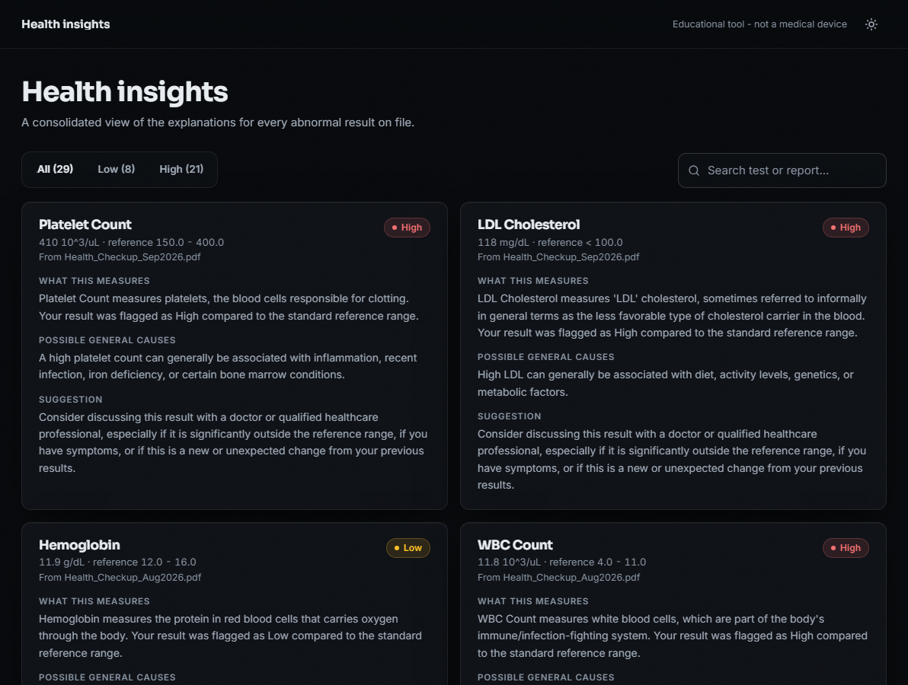
Output – Report Comparison and Health Insights
Compare: two reports side by side with change per test.
Insights: every abnormal result with its plain-language explanation.
Dept. of CSE | Batch A8 | Final Review
24
Notes:
Left: change between the first and the fifth report. Right: consolidated insight cards with causes stated in general terms and a suggestion to see a doctor.

Slide 25
Conclusion
Delivered: a working report-to-insight pipeline with a React and FastAPI application: extraction, Low / Normal / High flagging, explanations, history, trends, comparison and tests.
Measured: row F1 0.916, range accuracy 0.999, status accuracy 0.999, 53 ms per report, on generated labelled reports.
Met: objective 3 (flagging) and objective 5 (trends). Partly met: 1 (text-layer PDFs timed; scan OCR unmeasured), 2 (regex and TF-IDF, not CRF; tables fail), 4 (curated text for 17 of 55 tests, no retrieval), 6 (dashboard yes; evaluation on generated, not hand-labelled, reports).
Weak points found: cell-per-line tables, missing units, date lines read as tests, unseen tests renamed to a similar known test.
An educational tool, not a medical device; sign-in is demo-grade.
Dept. of CSE | Batch A8 | Final Review
25
Notes:
Objectives reported honestly: two met, four partly. The proposal named PP-OCR, CRF, RAG and Supabase; what was built instead is stated on the slide.

Slide 26
Future Scope
Read table layouts by header and column, widen the unit list, and ignore date and patient lines (fixes the main measured errors).
Measure scanned and photographed reports with Tesseract, and compare against PP-OCR or a vision-language model [4].
Add retrieval over a curated, cited medical corpus for explanations [1][6]; extend text from 17 tests to the full dictionary and add a synonym table.
Evaluate on consented, manually labelled real reports; fit the name-matcher threshold on them.
Per-user accounts with database-level isolation, a hosted database, test-date axis and slope-based trend direction.
Dept. of CSE | Batch A8 | Final Review
26
Notes:
Concrete next steps, ordered by the measured errors first.

Slide 27
References
[1] A. Karhade, I. Verma, V. Gadaokar, and J. Mahajan, "RAG-based blood test report analysis to reverse metabolic syndrome," Commun. Appl. Nonlinear Anal., vol. 32, no. 10s, pp. 2771-2779, 2025, doi: 10.52783/cana.v32.5718.
[2] X. Ren, D. Dou, X. He, F. Cui, and J. Zhao, "A serialization method for digitizing the image-based medical laboratory report," Digital Health, 2025, doi: 10.1177/20552076251334431.
[3] S. Xiang, S. Chen, K. Q. Lin, J. Yu, Y. Sun, P. Torr, and A. Atapour-Abarghouei, "Checkup2Action: A multimodal clinical check-up report dataset for patient-oriented action card generation," arXiv:2605.11533, 2026.
[4] N. Bakhsheshi and H. Beigy, "Analysis of blood report images using general-purpose vision-language models," arXiv:2509.06033, 2025.
[5] V.-T. Nguyen, H.-D. Pham, T.-H. To, C.-T. H. Do, T.-T.-T. Dong, V.-T. D. Le, and V.-P. Hoang, "Medalyze: Lightweight medical report summarization application using FLAN-T5-Large," arXiv:2505.17059, 2025.
[6] P. Lewis et al., "Retrieval-augmented generation for knowledge-intensive NLP tasks," in Advances in Neural Information Processing Systems, vol. 33, 2020, pp. 9459-9474.
[12] Y. Du, C. Li, R. Guo, X. Yin, W. Liu, J. Zhou, Y. Bai, Z. Yu, Y. Yang, Q. Dang, and H. Wang, "PP-OCR: A practical ultra lightweight OCR system," arXiv:2009.09941, 2020.
[13] R. Smith, "An overview of the Tesseract OCR engine," in Proc. 9th Int. Conf. Document Analysis and Recognition (ICDAR), 2007, pp. 629-633.
[14] J. Lafferty, A. McCallum, and F. Pereira, "Conditional random fields: Probabilistic models for segmenting and labeling sequence data," in Proc. 18th Int. Conf. Machine Learning (ICML), 2001, pp. 282-289.
[15] G. Salton and C. Buckley, "Term-weighting approaches in automatic text retrieval," Inf. Process. Manag., vol. 24, no. 5, pp. 513-523, 1988.
[16] F. Pedregosa et al., "Scikit-learn: Machine learning in Python," J. Mach. Learn. Res., vol. 12, pp. 2825-2830, 2011.
[17] G. Bradski, "The OpenCV library," Dr. Dobb's Journal of Software Tools, 2000.
[18] N. Reimers and I. Gurevych, "Sentence-BERT: Sentence embeddings using Siamese BERT-networks," in Proc. EMNLP-IJCNLP, 2019, pp. 3982-3992.
[20] Artifex Software, "PyMuPDF documentation." [Online]. Available: https://pymupdf.readthedocs.io
Dept. of CSE | Batch A8 | Final Review
27
Notes:
Selected references; the complete list is in the report.

Slide 28
THANK YOU
Questions & Suggestions
Dept. of CSE | Batch A8 | Final Review
28
Notes:
Invite questions.

