Slide 1
ATHENA - Autonomous Triage and Healthcare Electronic Neural Assistant
REVIEW 2 · DESIGN, METHODOLOGY AND PROGRESS
Design, methodology and progress: a scanned report and eight vitals fused into an explainable priority from 1 to 5
Presented by
Under the guidance of
Badaveni Srinath 23K91A0523
Basani Avinash 23K91A0532
Degala Praneeth 23K91A0561
Bontha Saisree 23K91A0545
K. Shalini, [DESIGNATION]
Department of Computer Science and Engineering
TKR College of Engineering & Technology · Batch A7 (CSE-A) · [ACADEMIC YEAR]
Notes:
This review shows how ATHENA is designed and built, what is implemented, the first measured results and the open items. All model results are on a seeded synthetic dataset, and we say so on every results slide. Introduce the four team members and the guide.

Slide 2
Contents
01
02
03
Recap and architecture
Methodology and dataset
Report reading and fusion
04
05
06
Model and training
Decision logic and data flow
Entities, UML, technology stack
07
08
09
Progress and preliminary results
Output screens and testing
Challenges and next steps
Notes:
Agenda for the design and progress review.

Slide 3
Recap: problem and proposed system
!
Problem
i
Proposed system
B
Base paper link [1]
Triage decides who is seen first, but it varies with the person on duty and under-identifies critical illness. Models built on structured fields cannot see a scanned report, and a bare prediction with no reasons is not accepted at the bedside.
ATHENA reads a PDF or scan, takes eight vitals, fuses them into 36 inputs, and gives a calibrated priority 1 to 5 with the strongest reasons (SHAP). The clinician accepts or changes it; the reason is stored.
Mlodawski et al. compare 19 classifiers on typed symptoms, rank diagnoses (TOP-1 / TOP-3) and explain with SHAP and LIME. We keep ranking, a confidence threshold and SHAP, and add scanned reports, vitals and a priority target. Results are not comparable.
Notes:
Recap of Review 1: the survey gap is that models are evaluated on single-modality structured data. ATHENA fuses a scanned report with the vitals and shows the reasoning. The base paper is a diagnostic comparison on typed data with a different target, so numbers are never put side by side without that caveat.

Slide 4
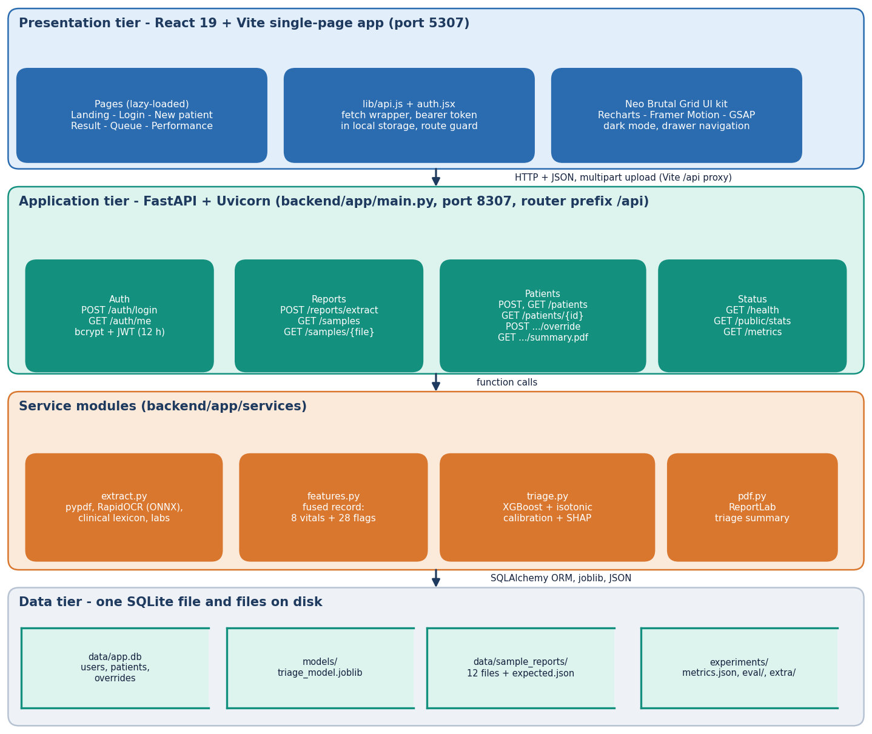
System architecture
Three tiers, one file database
Browser: React 19 single-page app (port 5307), six screens, dark mode, proxy to /api.
Server: FastAPI (port 8307), 13 endpoints, JWT bearer tokens, 15 MB upload cap, pydantic range checks.
Services: extract.py (report reading), features.py (fused record), triage.py (XGBoost, calibration, SHAP), pdf.py (summary).
Storage: SQLite via SQLAlchemy (users, patients, overrides); model, sample reports and metrics are files.
Notes:
All routes live in backend/app/routes/api.py. There is no external service: OCR, model and explainer run locally, so the product works offline.

Slide 5
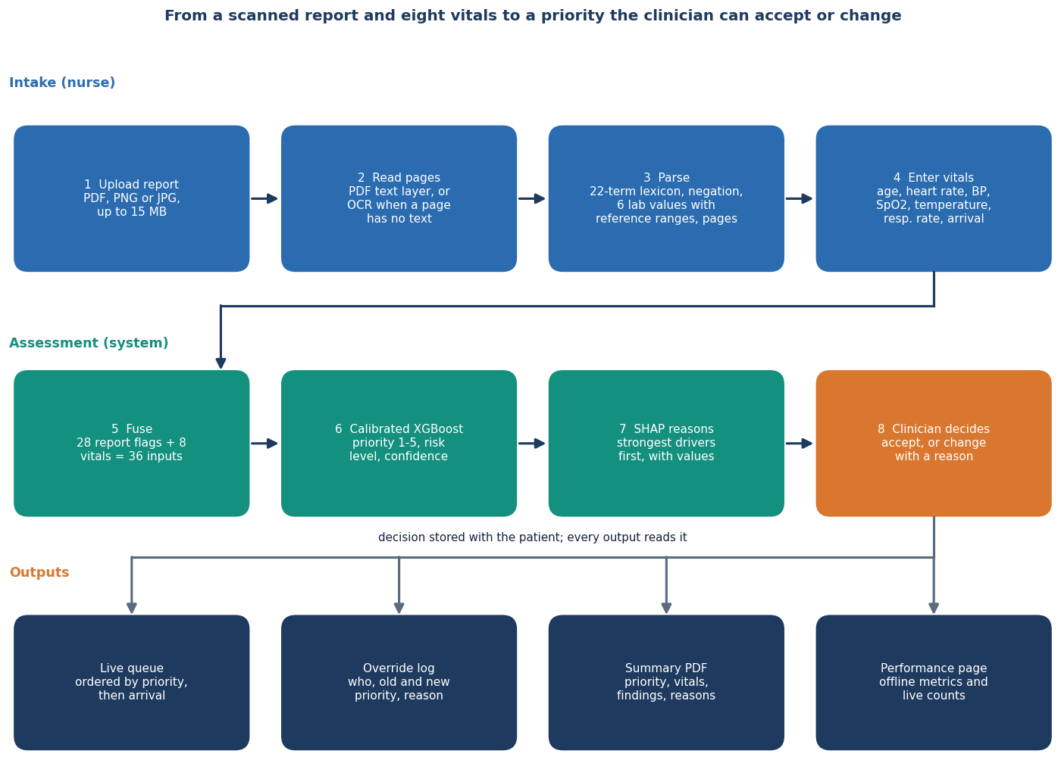
Methodology: from scan to decision
1. Read
PDF text layer, or local RapidOCR for images and image-only pages. A lexicon of 22 flags plus six lab rules turns text into report flags, each with its page.
2. Fuse and score
28 report flags and 8 vitals make 36 inputs. Calibrated XGBoost gives priority, risk level and confidence; SHAP lists the drivers.
3. Decide
The clinician accepts or changes the priority (reason required). The override is stored and the queue reorders.
Workflow of one patient, as implemented in the API.
Notes:
The model never replaces the clinician: the priority is a suggestion shown with its reasons, and every change is logged with who, when and why.

Slide 6
Dataset: seeded synthetic triage records
6,000
7
3,840 / 960 / 1,200
36
synthetic patients (seed 7307)
clinical archetypes simulated
fit / calibration / test split
inputs: 8 vitals + 28 report flags
 | How the data is made (ml/make_data.py)
Archetypes | minor 33.6%, cardiac 14.6%, respiratory 11.9%, trauma 11.7%, abdominal 10.3%, infection 9.4%, neuro 8.5%
Vitals and flags | vitals drawn from clipped normal distributions shifted per archetype; report flags drawn from per-archetype probabilities
Label | a hand-written severity score (vitals thresholds + flag weights + arrival bonus) plus noise (sd 0.4), cut into priorities 1 to 5
Class balance | P1 5.5%, P2 19.9%, P3 26.1%, P4 26.7%, P5 21.8%
Ceiling | knowing the clean score reproduces the label for 86.25% of rows: no model can exceed that exact accuracy
No real patient data was used. Accuracy measures recovery of a known rule, not agreement with clinicians. Real triage records are future work.
Notes:
Be frank: the dataset is simulated. A Kaggle triage dataset was identified as the real-data entry point, but its download script was never run, so no real record was used. The generator is seeded so every number is reproducible.

Slide 7
Report reading and fusion
Scanned report
PDF text or OCR
Unwrap, split sentences
Lexicon + negation
Lab values vs ranges
36-input record
22
6
45
lexicon flags: 11 symptoms, 5 findings, 6 history
lab values read with unit and reference range
characters of look-back for a negation word
Images are upscaled if small and read with RapidOCR (ONNX, offline); text boxes are sorted into reading order. A PDF page with no text layer falls back to OCR.
'Denies chest pain' or 'no fever' drops the flag; spaces in phrases tolerate OCR run-ons such as 'ofbreath'. Every item keeps the page it came from.
An abnormal lab (troponin, lactate, WBC, glucose, creatinine, haemoglobin) sets a lab flag; an unreported flag is 0, as in the base paper (no imputation).
Known limits: recall 84.3% and precision 95.2% on 40 hand-written fragments; paraphrases and split OCR words are missed.
Notes:
The reader is rule-based, not a medical language model. On the 12 generated sample reports it is 100 percent, but they were written with the lexicon in view; the 40-fragment stress set is the more honest figure.

Slide 8
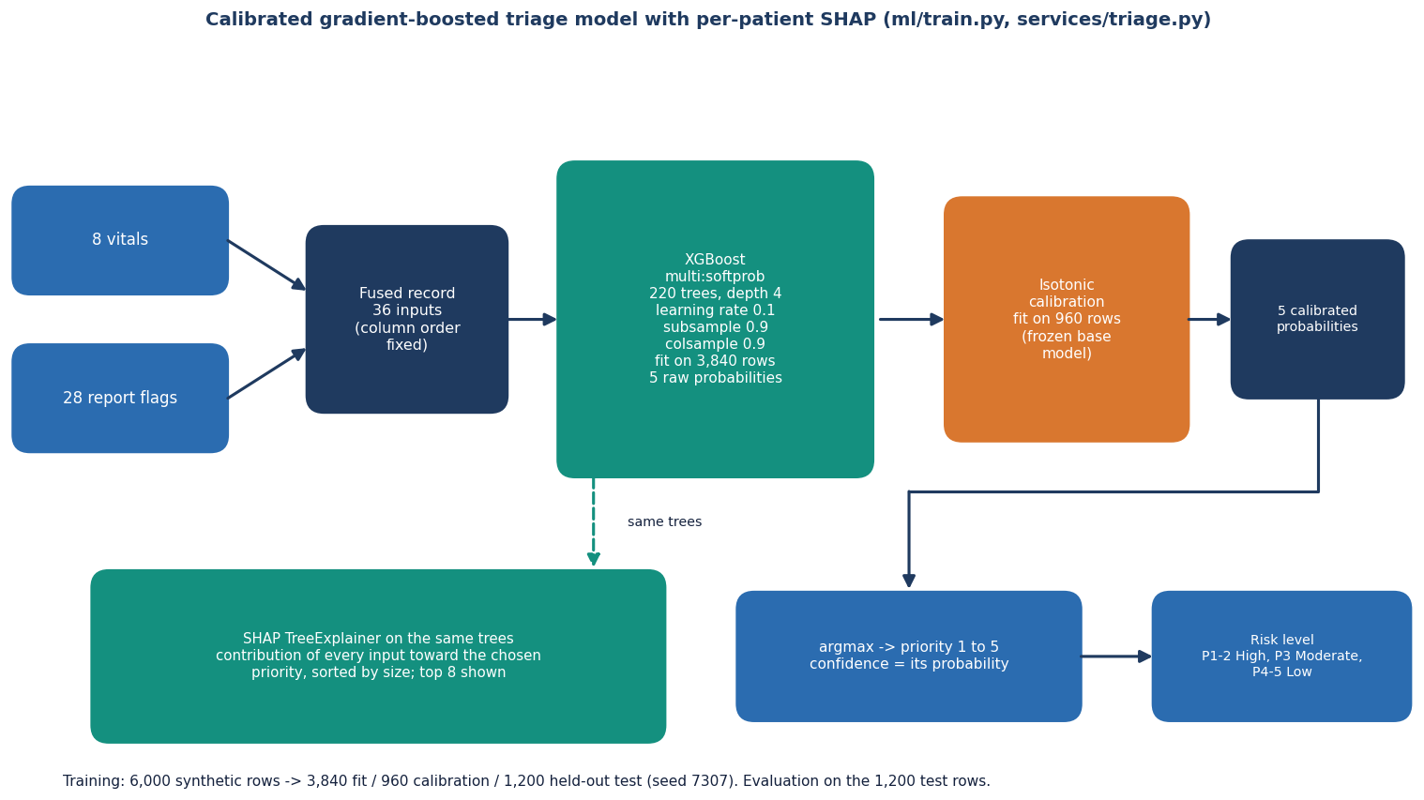
Model: calibrated XGBoost with SHAP
XGBoost: 220 trees, depth 4, learning rate 0.1, subsample and column sample 0.9, multi-class softmax over 5 priorities.
Isotonic calibration on a separate 960 rows, so the confidence is a probability, not a raw score.
SHAP TreeExplainer on the same trees: the push toward the chosen priority, strongest first, top 8.
A linear baseline scores higher on this data (72.4% vs 68.2% uncalibrated); trees were kept for SHAP and calibration.
Architecture of the triage model as built in ml/train.py and services/triage.py.
Notes:
XGBoost was chosen for SHAP's exact tree explainer and non-linearity headroom on real data, not because it won here: logistic regression is higher on the synthetic labels because they come from an additive score.

Slide 9
Training configuration
Setting | Value
Data and split | 6,000 synthetic rows; stratified 80/20 test split, then 80/20 of the training part for calibration; seed 7307
XGBoost | n_estimators 220, max_depth 4, learning_rate 0.1, subsample 0.9, colsample_bytree 0.9, objective multi:softprob
Calibration | scikit-learn CalibratedClassifierCV (isotonic) on a frozen base model, fitted on the 960 calibration rows
Explainer | shap.TreeExplainer(base); absent flags with |impact| < 0.15 hidden; warmed at server start (first call about 12 s in a fresh process)
Cost on this PC | Intel Core i5-12500 (12 threads), 15.7 GB RAM, Windows 11 Pro, no GPU, Python 3.11.9, Node 24.19.0: training 0.44 s; model inference 0.012 ms per patient in batch
Comparison runs | 8 model families, 5-fold CV, 5 split seeds, ablations: scripts/run_experiments.py; nothing tuned on the test set
Hyper-parameters are fixed in the code and were not searched; the test rows are used only for the reported metrics.
Notes:
The base paper tunes each of 19 algorithms with Optuna (100 trials). We did not tune: one fixed configuration, so our numbers carry no tuning advantage.

Slide 10
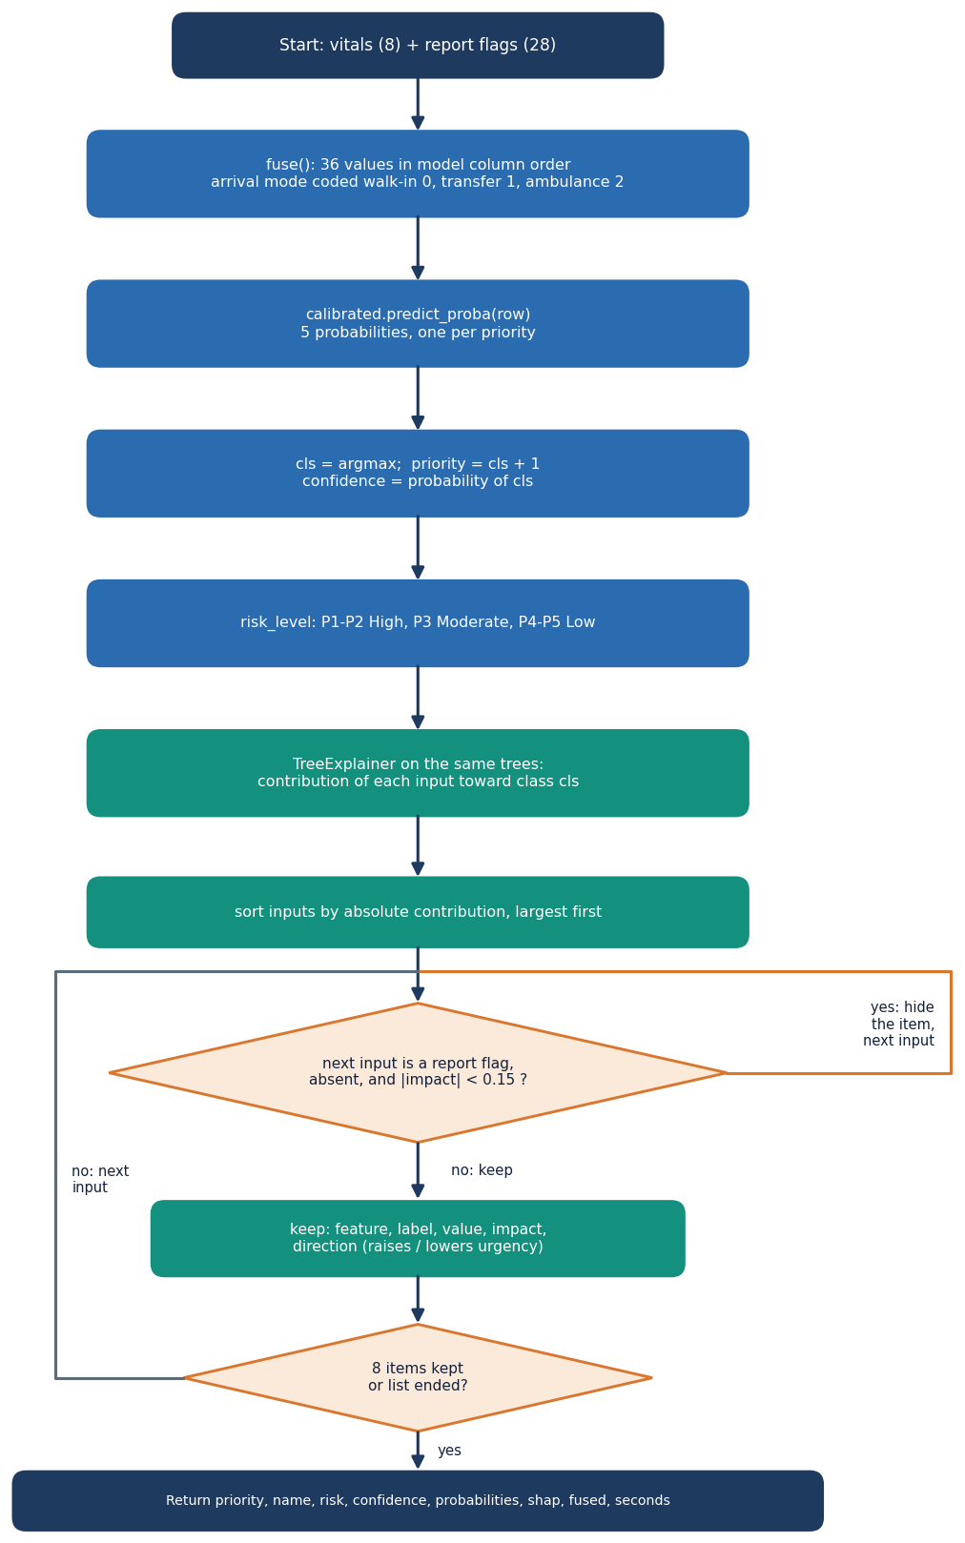
Decision logic: priority, risk and confidence
Priority. The arg-max of the calibrated probabilities: 1 Critical, 2 Emergent, 3 Urgent, 4 Less urgent, 5 Non-urgent.
Risk level. High for priorities 1 and 2, Moderate for 3, Low for 4 and 5.
Clinician. Accept, or change with a reason; the model's own suggestion is always kept.
Confidence >= | Coverage | Accuracy | Within 1
0.50 | 94.7% | 71.2% | 99.8%
0.70 | 58.8% | 78.2% | 99.7%
0.85 | 25.5% | 87.6% | 100.0%
Synthetic hold-out. Like the base paper's 0.85 threshold, a high-confidence cut keeps 25.5% of cases at 87.6% accuracy. No threshold is applied in the product: every priority goes to the clinician.
Notes:
The flowchart mirrors triage.predict. The threshold table is analysis only. A separate high-risk rule (flag when P1+P2 is at least 0.4) was measured but is not implemented.

Slide 11
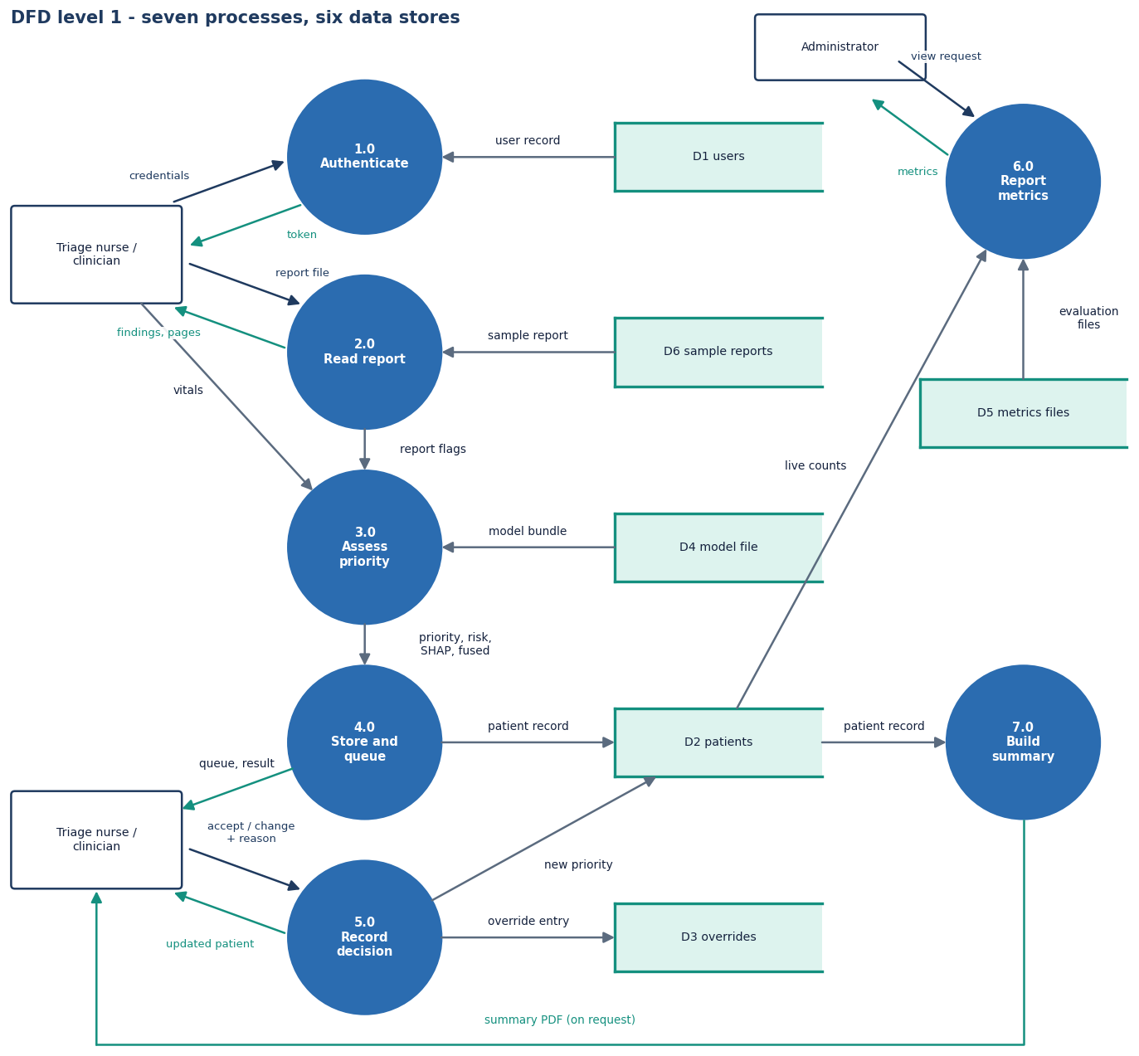
Data flow and modules
Module | Role
services/extract.py | PDF / OCR, lexicon, labs
services/features.py | 36-input fused record
services/triage.py | calibrated XGBoost + SHAP
services/pdf.py | triage summary PDF
routes/api.py | 13 endpoints, overrides
db.py, auth.py | SQLite models, bcrypt, JWT
ml/ (make_data, train, eval) | data, model, metrics
frontend/src | React pages and API client
Level-1 data-flow diagram of the platform.
Notes:
Level 1 splits the system into request validation, report reading, triage scoring, patient storage, override handling, metrics and offline training.

Slide 12
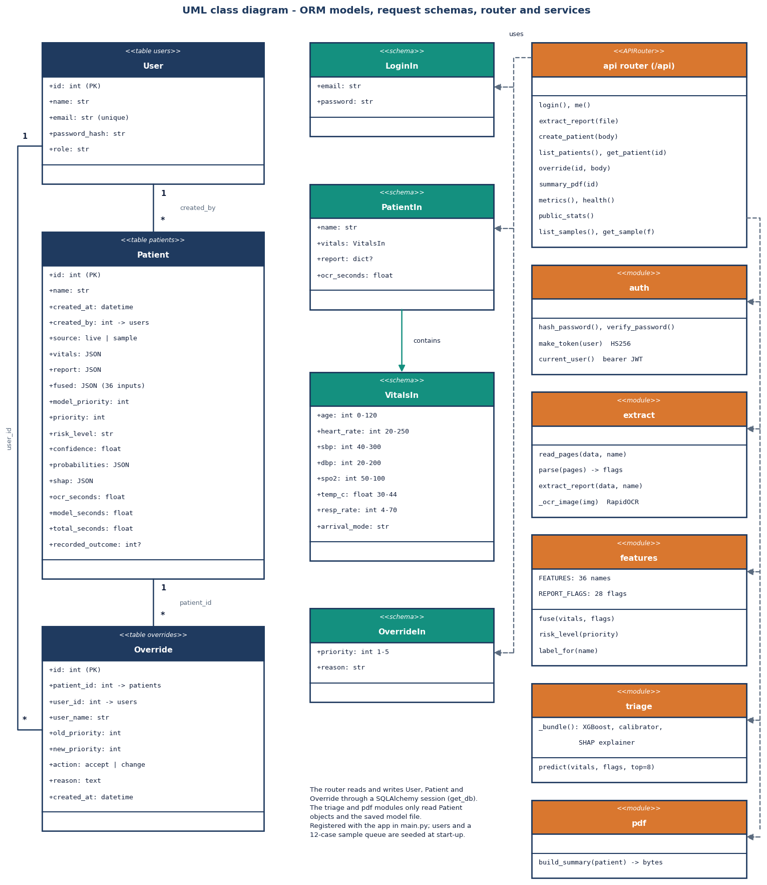
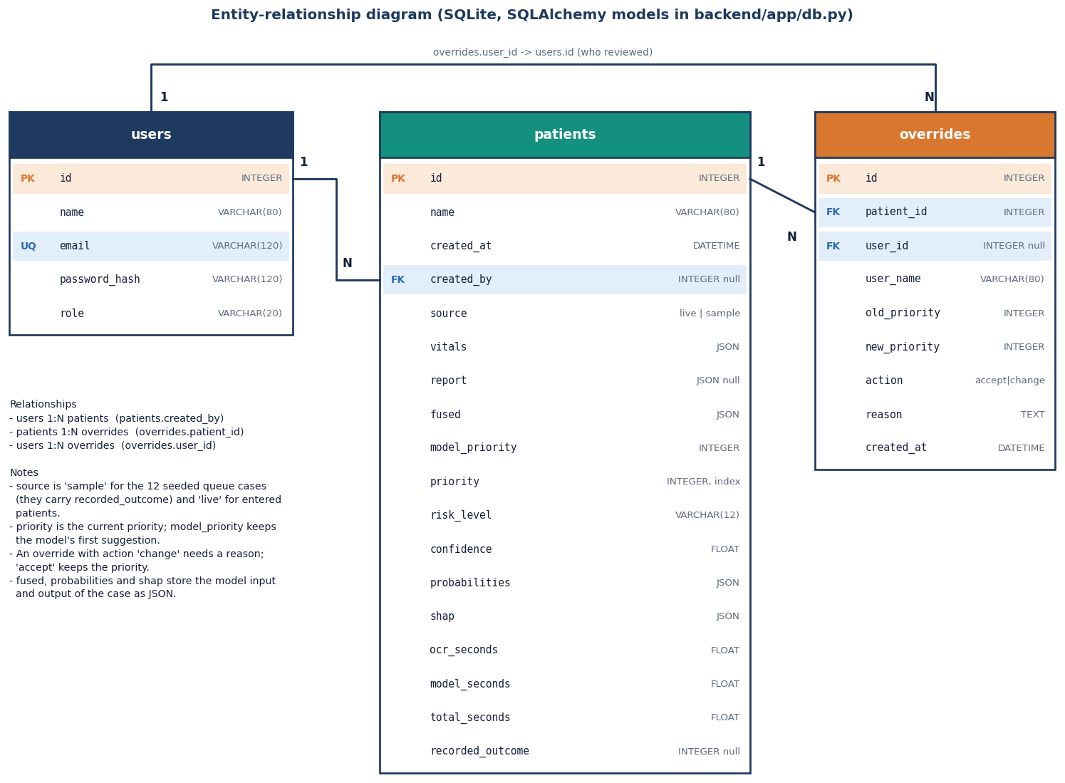
Database and UML
Three tables: users, patients (vitals, report, fused record, probabilities, SHAP as JSON) and overrides (old and new priority, action, reason, who, when).
Core classes: User, Patient, Override, request schemas, and the service modules.
Notes:
The patient row stores the model's own suggestion next to the current priority, so every clinician change can be audited against what the model said.

Slide 13
Technology stack
Layer | Technology
Server | Python 3.11, FastAPI, Uvicorn, SQLAlchemy 2 on SQLite, pydantic, PyJWT, bcrypt, python-multipart
Report reading | pypdf (text layer), RapidOCR on ONNX Runtime (PaddleOCR-family models, CPU), Pillow, a regex clinical lexicon
Machine learning | XGBoost, scikit-learn (calibration, baselines, metrics), SHAP, pandas, NumPy, joblib
Summary report | ReportLab for the downloadable triage-summary PDF
Front end | React 19, Vite 8, React Router 7, Recharts, Framer Motion, GSAP, lucide-react; 'Neo Brutal Grid' design kit
Testing and capture | pytest with FastAPI TestClient, requests smoke script, Playwright captures at 1440 x 900
Run | run.bat (virtual environment, training if needed, both servers); ports 8307 and 5307
Notes:
Versions are pinned in requirements.txt and package.json. The original plan named Node, Flask, MongoDB, BioBERT and PaddleOCR; FastAPI, SQLite, a lexicon and RapidOCR were used instead.

Slide 14
Implementation progress
Component | Status | Evidence
Report intake: PDF text, OCR for scans, lexicon, labs, pages | Done | 12/12 sample reports read exactly; 84.3% recall on 40 stress fragments
Fused record, calibrated XGBoost, per-patient SHAP | Done | accuracy 69.4%, within one level 99.7% (synthetic hold-out)
Clinician accept / change with reason, queue, summary PDF | Done | 17/17 smoke checks; 16 API tests
React app: landing, login, new patient, result, queue, performance | Done | 12 screenshots; 360 / 768 / 1440 px and dark mode checked
Experiments: 8 models, ablation, calibration, robustness | Done | scripts/run_experiments.py, experiments/extra/
Real triage data, medical language model (BioBERT), LIME | Not done | synthetic data and a lexicon used; no real records
RAG, multi-agent orchestration, six disease-risk models, MongoDB | Not done | outside the built scope; listed as future work
Notes:
State of the code base. The last two rows are the honest gaps against the original abstract: a lexicon replaces the medical language model, and the agent, RAG and disease-risk parts were not built.

Slide 15
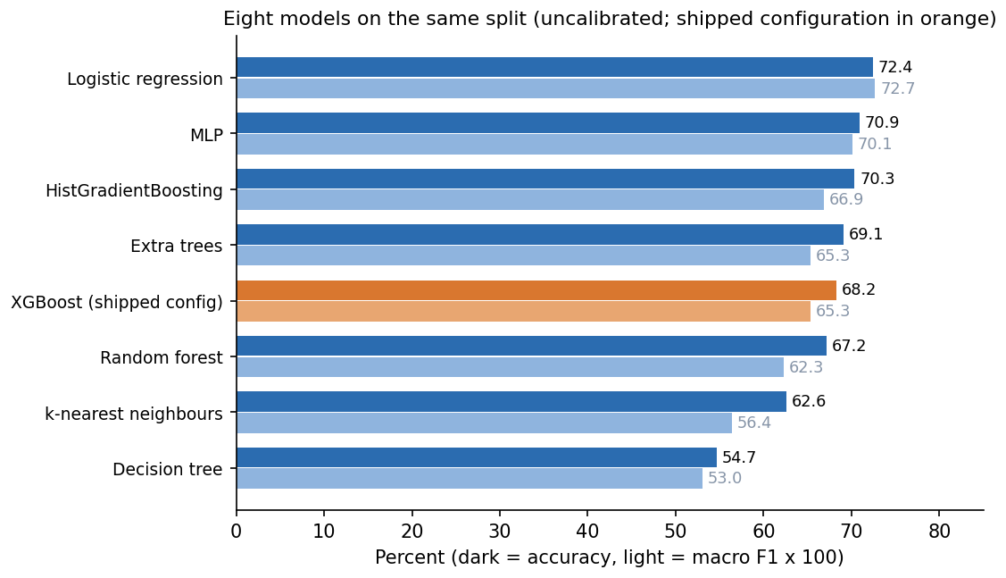
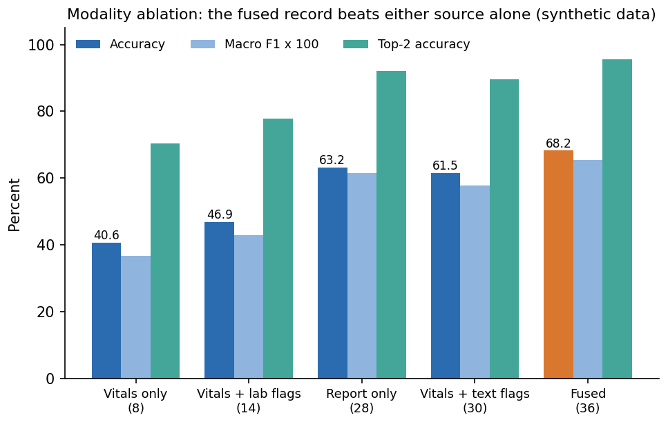
Preliminary results (synthetic hold-out)
69.4%
99.7%
0.670
0.880
exact priority, 1,200 held-out cases
within one priority level
macro F1 (P1 recall only 44%)
quadratic weighted kappa
Fusing report and vitals gives 68.2% against 40.6% for vitals alone and 63.2% for the report alone. A logistic baseline reaches 72.4%, and 86.2% is the ceiling set by label noise. High-risk (P1 or P2) recall is only 66.2%: the model under-triages the sickest patients most often. All on synthetic data.
Notes:
Headline findings. 1) 69.4% exact and 99.7% within one level on the held-out synthetic cases. 2) The report adds 27.7 points over vitals alone. 3) Linear baseline is higher, so the label rule is nearly linear. 4) P1 recall 43.9% and high-risk recall 66.2% are the weak points; flagging when P1+P2 is at least 0.4 would give 84.3% recall at 81.6% precision, not implemented yet.

Slide 16
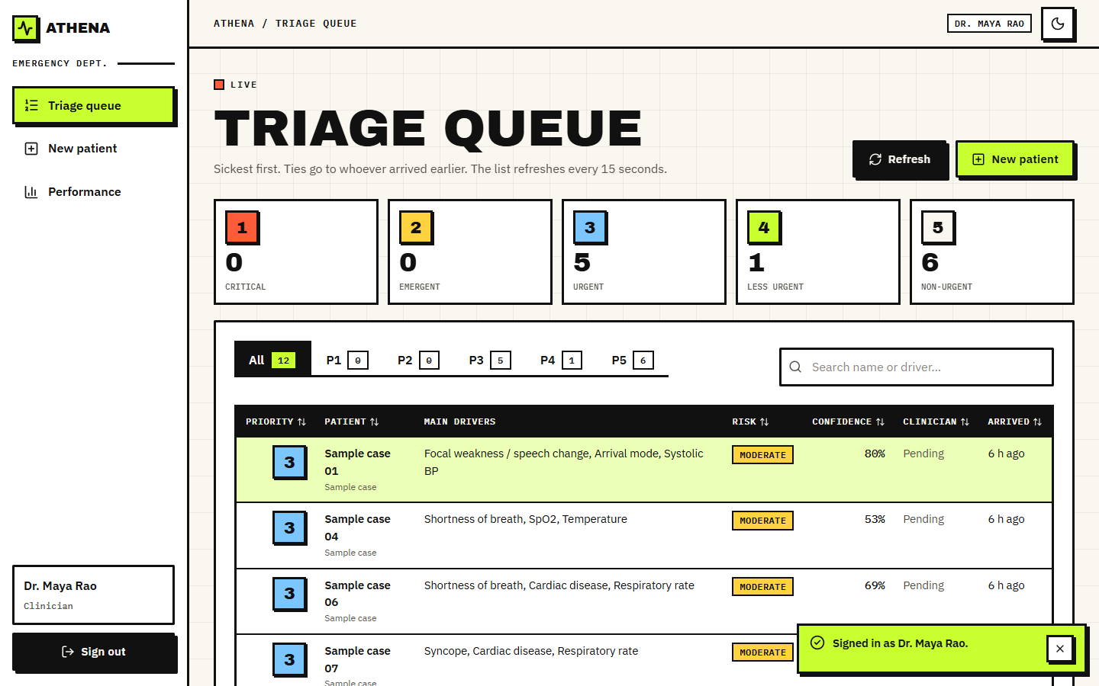
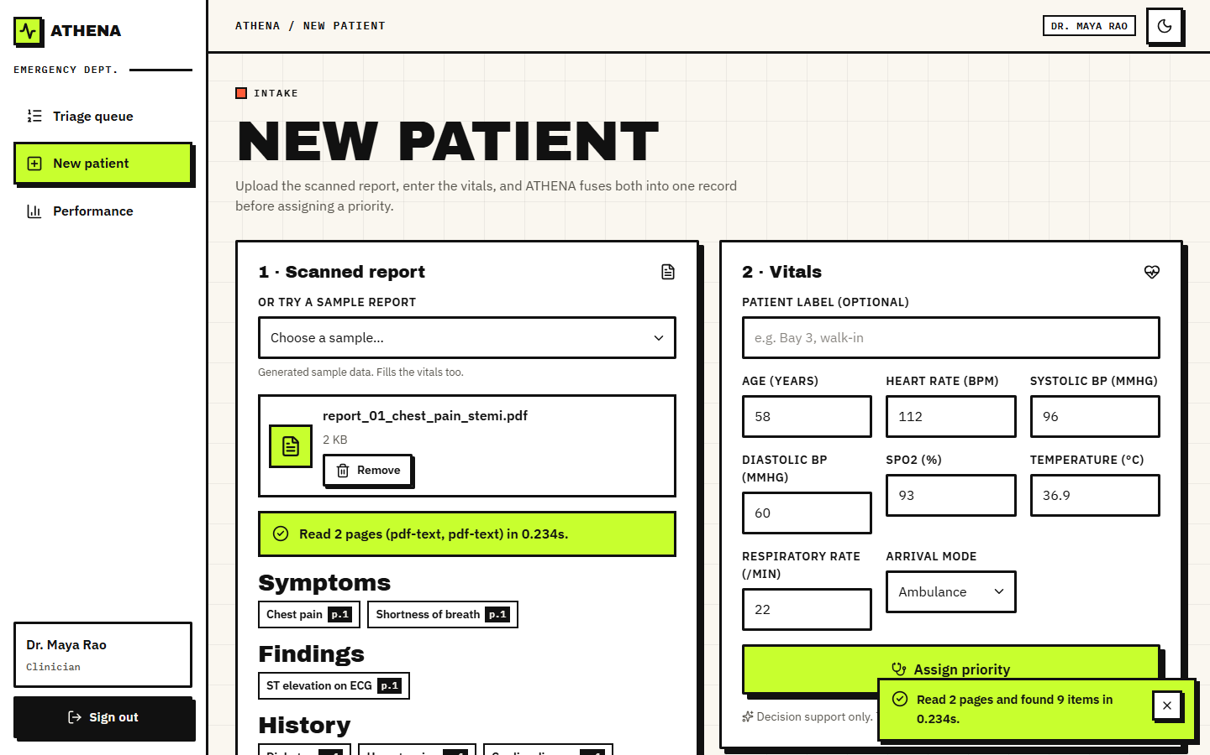
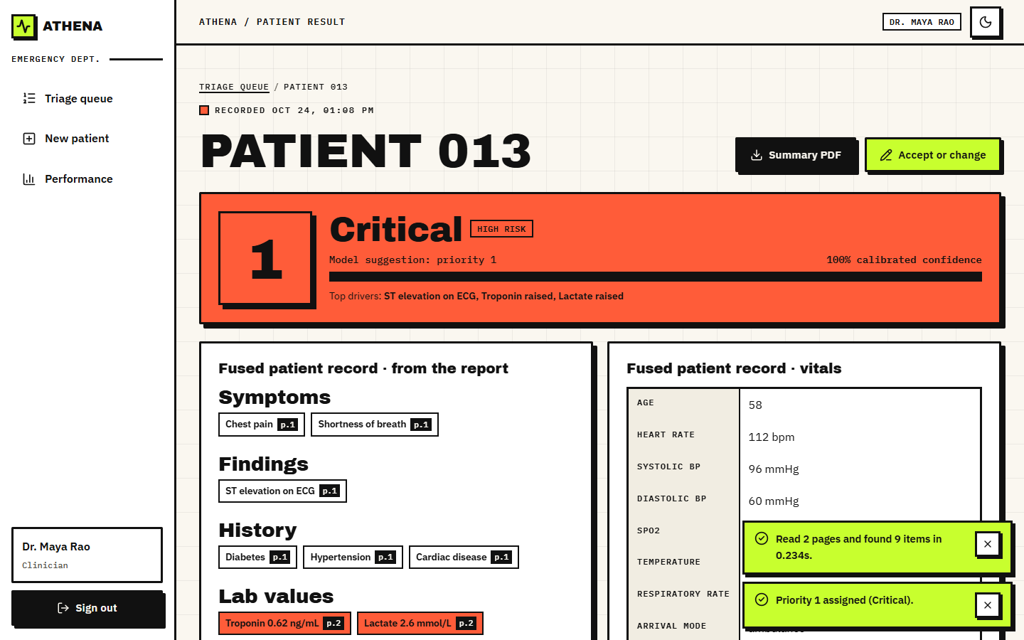
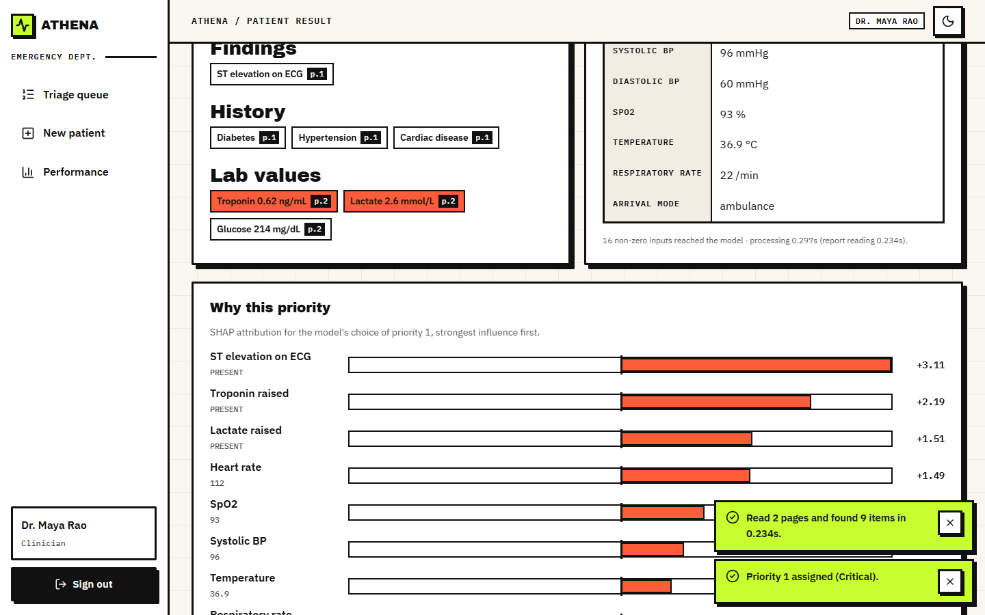
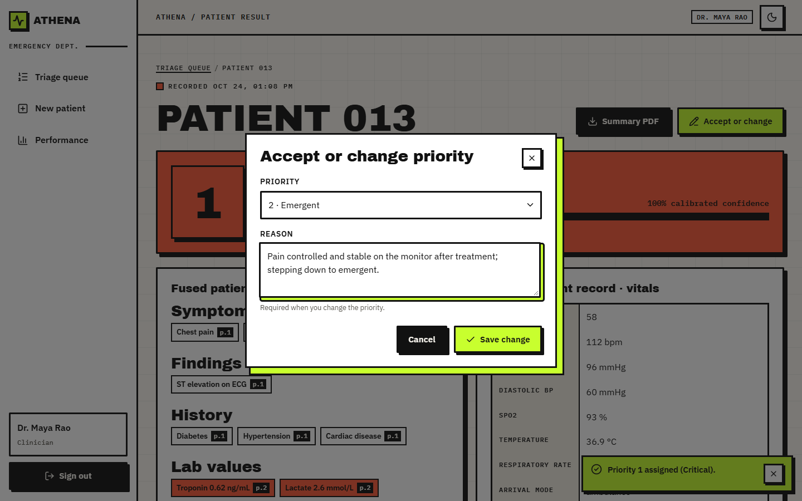
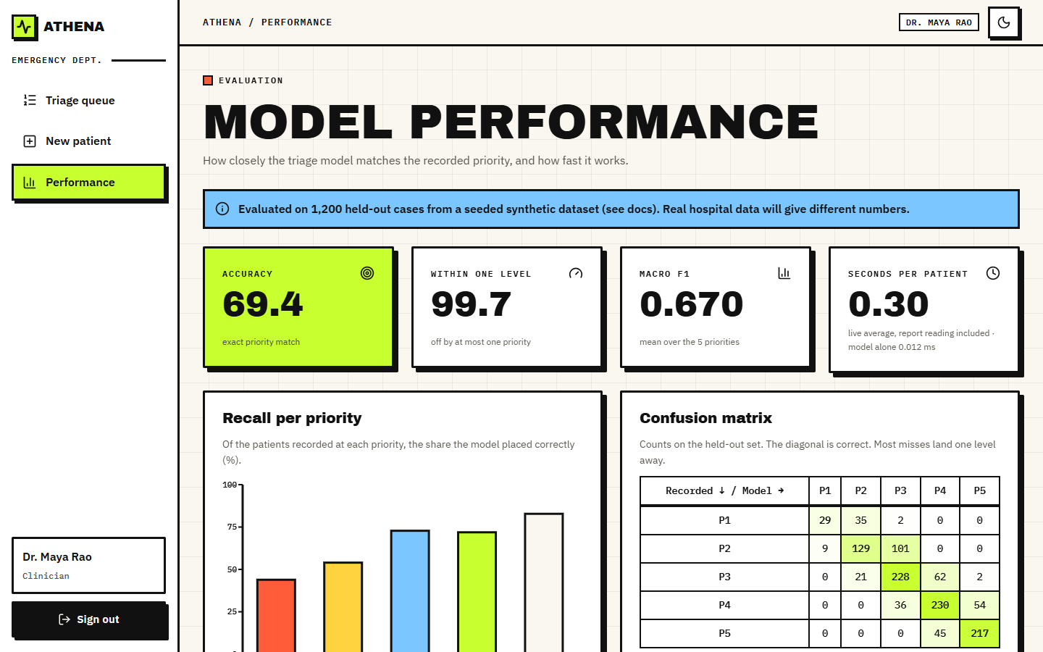
Output screens
Triage queue: ordered by priority, drivers and confidence
New patient: sample report read, vitals filled
Result: priority 1 Critical, risk and fused record
Why this priority: SHAP drivers, findings with pages
Clinician override: change needs a reason
Performance: metrics and confusion matrix
Real captures of the running application at 1440 x 900, with the seeded sample queue and one live patient entered.
Notes:
Real screenshots of the running app. The queue holds 12 labelled sample cases plus the patient entered during the capture; the performance page shows the synthetic hold-out numbers with a banner saying so.

Slide 17
Initial testing and observations
46 / 47
17 / 17
30 ms
2.2 s
pytest tests passed, 1 expected failure
smoke-test checks passed
median, PDF read + triage over HTTP
median OCR of one image scan on CPU
Observation | Action
'Afebrile' is read as fever; 'denies X but reports Y' also drops Y | Documented as reader defects; test marked expected failure
'Haematemesis' also raises the vomiting flag; split OCR words are missed | Listed with the stress-test results, not hidden
Logistic regression beats the shipped XGBoost on the synthetic labels | Stated in the results; the shipped model is unchanged
Default JWT secret and no rate limiting or HTTPS | Listed as demo-grade security in the limitations
Notes:
Tests cover the reader, the model wrapper and the API; the smoke script runs against the live server. Each observation came from running the code and is recorded rather than fixed silently.

Slide 18
Challenges and corrective actions
Challenge | Corrective action
No real triage records available; the product had to run offline | Seeded synthetic archetypes, with the label-noise ceiling and a 'synthetic' banner in the app
Gemini reading was dropped (no key, offline) | RapidOCR + lexicon; 84.3% stress recall, defects listed
P1 recall 43.9%; high-risk recall 66.2% | Reported plainly; P1+P2 >= 0.4 rule would give 84.3%, planned
SHAP explainer cold start of about 12 s on the first patient (measured in a fresh process) | Warmed in the server start-up; first request is no longer slow
OCR of an image scan takes about 2.2 s on a CPU | PDFs with a text layer take 9 ms; scans reported separately
Medical language model and agents in the abstract were out of reach | Stated as not built; lexicon used and future work listed
Notes:
Each challenge was met by a concrete design choice or by measuring it and saying so in the report.

Slide 19
Next steps
1
Real data
2
Better reading
3
Safer thresholds
4
Evaluate with users
Train and test on real triage records (credentialed or public sets), and compare against recorded nurse priorities.
Replace the lexicon by a medical language model, fix negation scope and the known defects, test on real scans.
Add the high-risk rule (P1+P2 at least 0.4), improve calibration, and always show the second-best priority.
A clinician usability study, security hardening (secrets, HTTPS, rate limits) and an audit log.
Priority: items 1 and 3 close the largest honest gaps, the synthetic training data and the weak recall for the most urgent patients.
Notes:
Plan to the final review. Real data is the largest gap; the high-risk rule is the cheapest safety gain because its effect was already measured.

Slide 20
Thank you
Questions and suggestions are welcome.
Notes:
Likely questions: why XGBoost when logistic regression scored higher; why synthetic data; why a lexicon instead of BioBERT; how the numbers relate to the base paper (they do not, different task and data).

