Slide 1

ATHENA - Autonomous Triage and Healthcare Electronic Neural Assistant
Final Review · ATHENA
Team Details : Batch A7
Under the Esteemed Guidance of
K. SHALINI
[DESIGNATION], Department of CSE
23K91A0523 BADAVENI SRINATH
23K91A0532 BASANI AVINASH
23K91A0561 DEGALA PRANEETH
23K91A0545 BONTHA SAISREE
DEPARTMENT OF COMPUTER SCIENCE AND ENGINEERING · TKR College of Engineering & Technology · Academic Year [ACADEMIC YEAR]
Notes:
Introduce the team and ATHENA: an emergency triage assistant that reads a scanned report, fuses it with vitals, and explains the priority it assigns.

Slide 2
Table of Contents
Abstract
Problem Statement & Objectives
Base Paper & Literature Survey
Research Gap & Proposed System
Architecture, Report Reading & Dataset
Fusion, Model & Data Design
Results: Accuracy, Safety, Models, Ablation
Calibration, Thresholds, Robustness & Reader
Explainability, Performance & Testing
Comparison with Base Paper & Output Screens
Objectives vs Outcomes, Limitations & Future Scope
References
Dept. of CSE | Batch A7 | Final Review
2
Notes:
The agenda follows the report: problem, design, method, results, comparison, screens, conclusion.

Slide 3
Abstract
Triage priority in the emergency department varies with the person on duty, and models built on structured fields cannot see what is written only in a scanned report.
ATHENA reads a PDF or scan (text layer or local OCR), fuses 28 report flags with 8 vitals into 36 inputs, and a calibrated XGBoost assigns priority 1 to 5 with a confidence and per-patient SHAP reasons; the clinician accepts or changes it.
All model numbers are on seeded SYNTHETIC data: accuracy 69.4%, within one level 99.7%, macro F1 0.670; P1 recall only 43.9%.
Fusing report and vitals gives 68.25% against 40.58% for vitals alone; a plain logistic regression scores 72.42%, and no model can pass about 86.25% because of label noise.
The report reader is exact on 12 generated samples but reaches 84.3% recall on 40 hand-written fragments. A PDF-to-priority request takes about 30 ms; an OCR scan about 2.1 s.
Dept. of CSE | Batch A7 | Final Review
3
Notes:
State at once that the data are synthetic; the accuracy measures recovery of a known rule, not agreement with clinicians.

Slide 4
Problem Statement & Objectives
Problem statement
Objectives (batch document)
Triage decisions are subjective and vary with the experience of the staff on duty
Existing systems analyse only structured fields and ignore scanned reports and clinical narrative
Predictions delivered without justification are not accepted into a clinical workflow
Delay in prioritising a critical patient directly worsens outcomes
Need: a multi-source triage assistant that reads scanned reports, assigns an explainable risk level and supports the clinician
1. Build an OCR stage that converts scanned medical reports into machine-readable clinical text
2. Apply a medical language model to extract symptoms, findings and history from that text
3. Combine text-derived features with tabular vitals in a single patient representation
4. Train a model that assigns a clinical risk level and a triage priority to each patient
5. Add an explainability layer that shows which findings drove the assigned priority
6. Evaluate triage accuracy against clinician-assigned priority and measure processing time per patient
Dept. of CSE | Batch A7 | Final Review
4
Notes:
Four problem points and the need, then the six objectives as written in the batch document. Their real status is on slide 25.

Slide 5
Base Paper
M. Mlodawski, S. Deniziak, M. Plaza, A. Kwiatkowska, D. Jaszczyk, A. Gajda and K. Twardowski, "Multidimensional analysis of the diagnostic performance of machine learning models in disease classification: implications for clinical decision support systems," IEEE Access, vol. 14, pp. 92149-92177, 2026, doi: 10.1109/ACCESS.2026.3703248.
Aspect | Base paper (IEEE Access 2026)
Task | Disease classification into ICD-10 codes (87 classes) from interview data of internal medicine and pediatrics; incomplete records, no imputation
Data | 1,655 real clinical cases (616 internal medicine, 1,039 pediatrics), 479 clinical parameters; 120 external cases
Method | 19 classifiers tuned with Optuna (TPE, 100 trials each); two-stage TOP-1 / TOP-3 ranking; 0.85 confidence threshold; SHAP + LIME
Reported | TOP-1: Gradient Boosting 84.7% (internal), Multi-Layer Perceptron 87.2% (pediatrics); TOP-3 up to 91.7% / 94.7%; external TOP-1 73.3% / 78.3%
Not covered (our reading) | Input is typed symptom indicators: no scanned reports, no vitals fusion, no five-level triage target, no processing time
Dept. of CSE | Batch A7 | Final Review
5
Notes:
Mlodawski et al., IEEE Access 2026. ATHENA borrows its probability-ranking and threshold ideas, SHAP, and the rule that an unreported symptom counts as absent; the task and data differ.

Slide 6
Literature Survey
Work | Year | Approach | Finding / limitation
Mlodawski et al. [1] (base paper) | 2026 | 19 classifiers, TOP-1 / TOP-3 ranking, SHAP + LIME, on incomplete real records | 1,655 cases, 87 ICD-10 classes; GB 84.74%, MLP 87.20%; text and tabular only
Fernandes et al. [8] | 2020 | Review of intelligent clinical decision support for ED triage | Many studies lacked an implementation phase; impact on care still to be shown
Hinson et al. [9] | 2019 | Systematic review of triage scale performance (CTAS, ESI, MTS) | 182 studies; sensitivity for critical illness below 80%; scales perform alike
Hong et al. [10] | 2018 | Logistic regression, XGBoost, deep nets for admission at triage | 560,486 visits; triage-only AUC about 0.87; adding history lifts to about 0.92
Levin et al. [11] | 2018 | Random-forest e-triage on vitals, complaint and history | 172,726 visits; AUC 0.73-0.92; matched or beat ESI; outcomes, not 5-level labels
Raita et al. [12] | 2019 | Lasso, forest, boosting, deep net on triage data | 135,470 visits; deep net AUC 0.86 vs 0.74 for an ESI model (critical care)
Cheng et al. [6] | 2025 | Multi-agent LLM dynamic matching for triage under uncertainty | Cited from title only; text-only agents, no scanned-report input
Also in the batch survey: Anatolian Curr. Med. J. [3] (ESI vs Manchester process study), Xie et al. [13] (MIMIC-IV-ED benchmark), a Nepal triage-knowledge study [5]; an obstetric-triage entry [2] could not be verified and a veterinary chapter [4] is out of domain.
Dept. of CSE | Batch A7 | Final Review
6
Notes:
Eight works shown; every figure is from the abstract or the paper itself. Two survey entries are unverified or out of domain and are not used as evidence.

Slide 7
Research Gap
The surveyed models are evaluated on single-modality structured data: no pipeline fuses a scanned report with the vitals
Triage priority (five levels) is rarely the target; most work predicts admission, critical care or ICD-10 diagnoses [10], [1]
Explanations are usually global or offline; a per-patient reason shown next to the decision is missing in deployed designs
Calibrated confidence and an accept-or-change record for the clinician are seldom reported together
Processing time per patient, including report reading, is almost never measured
Dept. of CSE | Batch A7 | Final Review
7
Notes:
Five gaps. ATHENA addresses the first, the second (target is the five-level priority), the third, the fourth and the fifth - on synthetic data.

Slide 8
Proposed System
Report intake
PDF / scan
Text layer or OCR
Lexicon + negation
6 lab ranges
28 flags + pages
Triage
8 vitals
Fused record: 36
XGBoost + isotonic
Priority 1-5, risk
SHAP reasons
Accept / change
Decision support only: the clinician accepts or changes every priority, and a change needs a written reason that is stored.
Priority 1 Critical to 5 Non-urgent; risk High for P1-2, Moderate for P3, Low for P4-5; the queue is ordered by priority, then arrival.
Runs offline on a laptop: local OCR, no API key, no GPU. Triage-summary PDF per patient.
Dept. of CSE | Batch A7 | Final Review
8
Notes:
Two chains: report intake and triage. The clinician loop closes it.

Slide 9
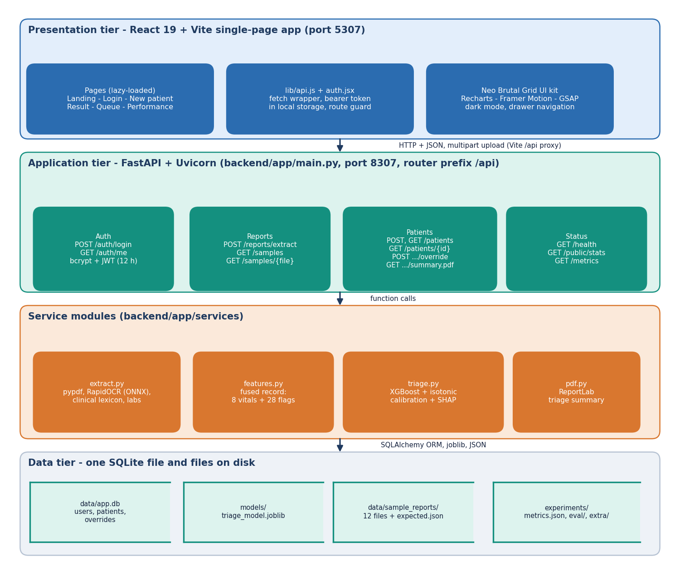
System Architecture
Web app: React 19 + Vite on port 5307, six screens
API: FastAPI on port 8307, 13 endpoints, JWT sign-in (clinician, admin)
Services: report reader, fused record, triage model + SHAP, summary PDF
Storage: SQLite with users, patients, overrides; model and sample files on disk
One command, run.bat, starts both servers
Dept. of CSE | Batch A7 | Final Review
9
Notes:
Browser, API, services, SQLite. The model is a joblib file loaded once; the SHAP explainer is warmed at start-up.

Slide 10
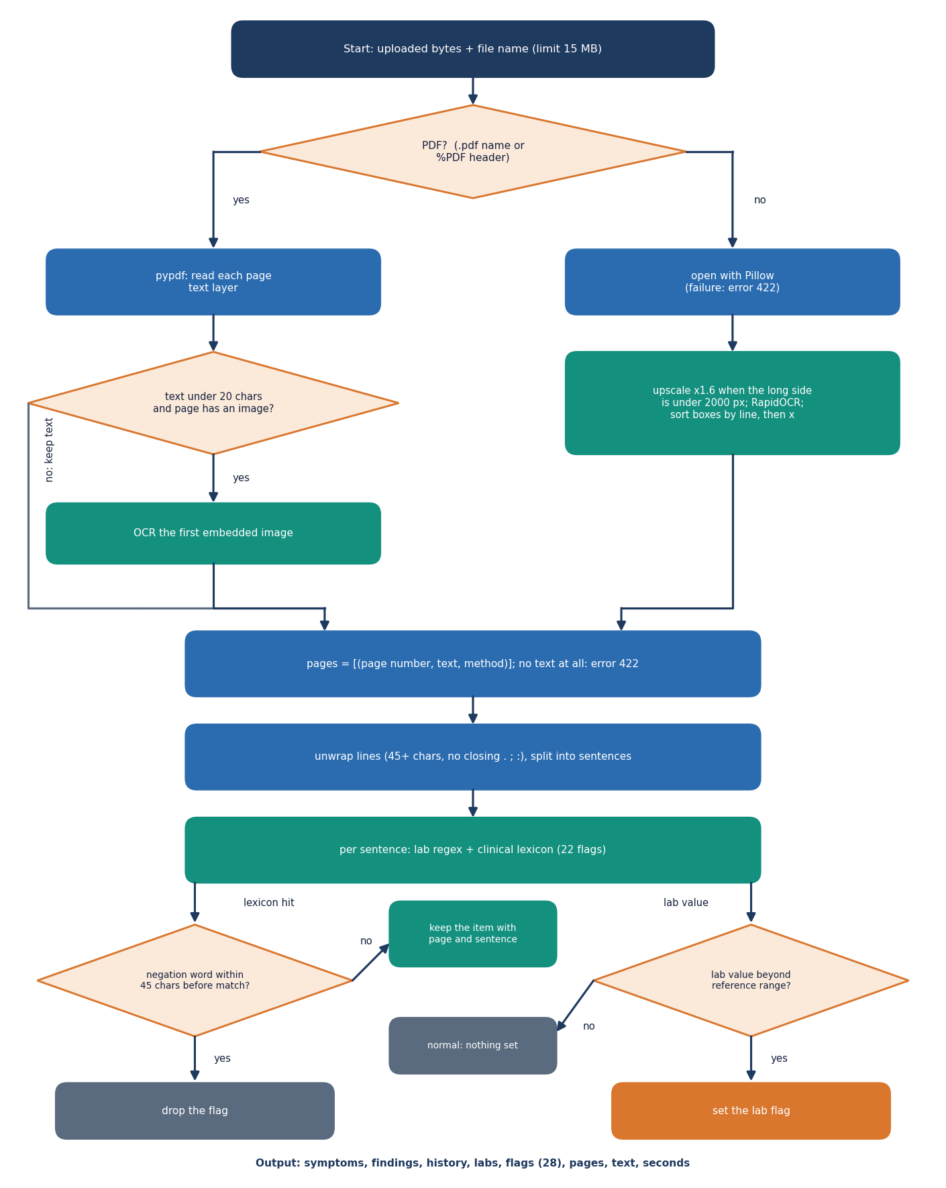
Report Reading
PDF: text layer by page; a page with under 20 characters falls back to OCR on its image.
Images: local RapidOCR (PaddleOCR-family models on ONNX Runtime), no network.
22 lexicon flags (11 symptoms, 5 findings, 6 history); negation within 45 characters drops a flag.
Six labs with units and reference ranges set a flag when abnormal; every item keeps its page.
Generated samples: precision 100%, recall 100% (12 of 12 exact). Hand-written stress set: precision 95.2%, recall 84.3%.
Dept. of CSE | Batch A7 | Final Review
10
Notes:
The reader is rule-based, not a medical language model. The generated samples were written with the lexicon in view, so 100% overstates it; 84% is the honest figure.

Slide 11
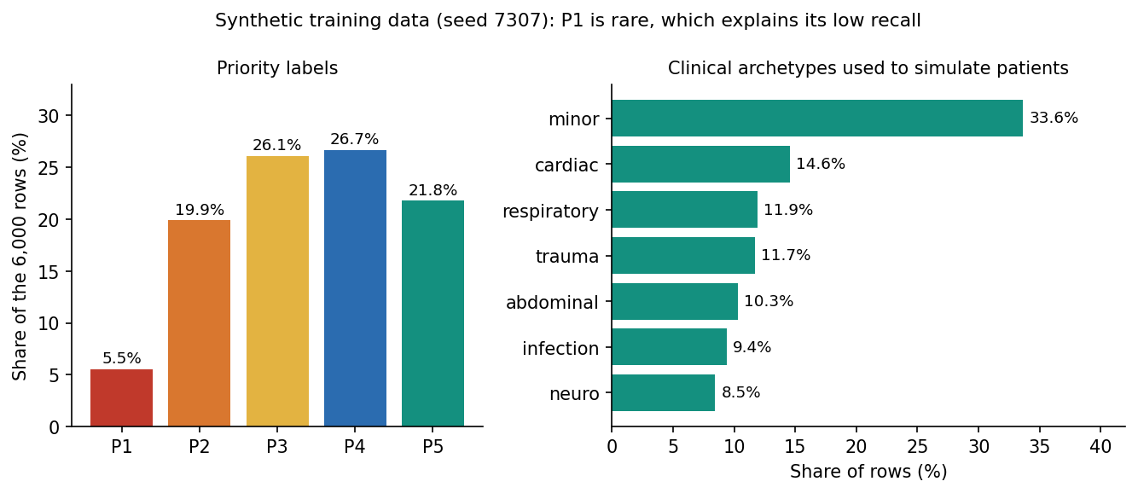
Dataset (Synthetic) & Split
6,000
seeded synthetic patients (seed 7307)
7
clinical archetypes (cardiac, trauma ...)
3,840 / 960 / 1,200
fit / calibration / test
Vitals and report flags are drawn per archetype; a hand-written severity score plus Gaussian noise (sd 0.4) is cut into priorities. P1 is only 5.5% of rows.
Noise ceiling: even knowing the clean score reproduces the label for 86.25% of rows, so exact accuracy cannot exceed about that.
No real patient data was used; the Kaggle triage dataset script was never run. Real triage records would give different numbers.
Dept. of CSE | Batch A7 | Final Review
11
Notes:
The label plays the clinician's recorded outcome. That is why every result slide says synthetic.

Slide 12
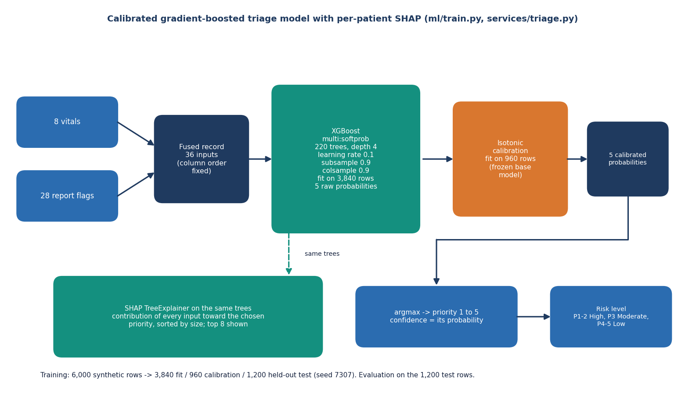
Fusion, Model & Calibration
Fused record: 8 vitals + 28 report flags = 36 inputs; an unreported flag counts as 0, as in the base paper.
XGBoost multi-class: 220 trees, depth 4, learning rate 0.1.
Isotonic calibration on a separate 960-row split so confidence is a probability.
Priority = argmax of the calibrated probabilities; risk from the priority.
Training takes 0.44 s; model inference about 0.012 ms per patient.
Dept. of CSE | Batch A7 | Final Review
12
Notes:
XGBoost was kept for the SHAP TreeExplainer and calibration; on this synthetic data a logistic regression actually scores higher (slide 16).

Slide 13
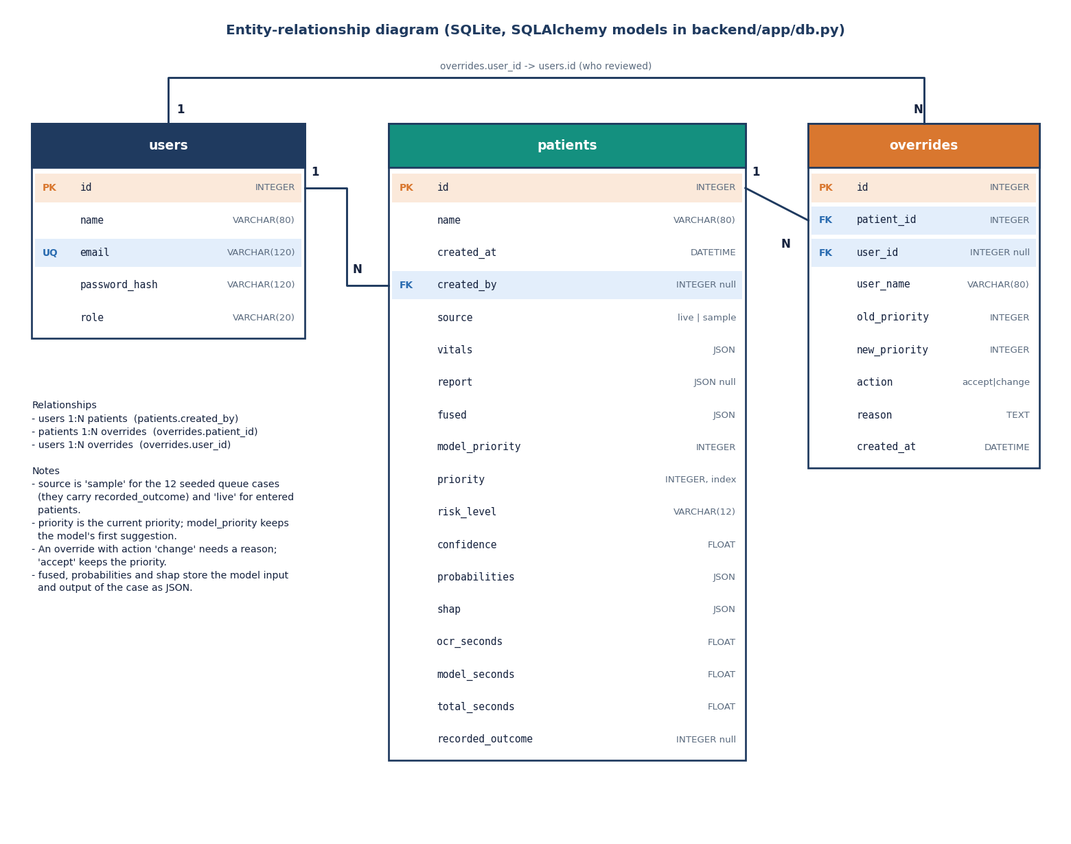
Data Design & Implementation
13
47 + 17
API endpoints
pytest tests + smoke checks
6
~4,100
screens, light and dark
lines of code and tests
Tables: users, patients (vitals, report, fused record, SHAP, timings as JSON) and overrides (old, new, action, reason).
bcrypt hashes, HS256 JWT valid 12 h, pydantic range checks, 15 MB upload limit.
Gaps: default JWT secret, no HTTPS, no rate limit.
A fresh database is seeded with 12 labelled sample cases so the queue and performance pages are never empty.
Dept. of CSE | Batch A7 | Final Review
13
Notes:
Three tables. Security is demo-grade and the slide says so.

Slide 14
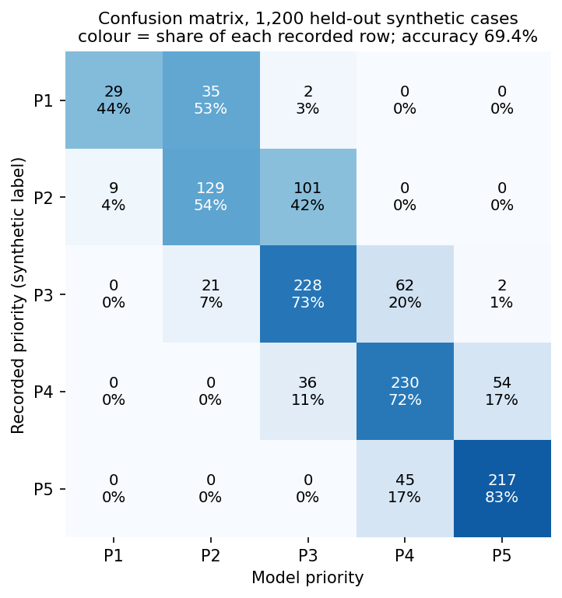
Results – Shipped Model (Synthetic Hold-out)
69.4%
99.7%
0.670
0.880
exact priority
within one level
macro F1
quadratic weighted kappa
Recall P1 to P5: 44 / 54 / 73 / 72 / 83 %. The sickest class is found least often.
Most errors are one level away: 99.7% within one, top-2 accuracy 95.3%.
35 of 66 recorded P1 cases land in P2; 101 of 239 P2 cases land in P3.
Five other splits of the same recipe give 71.6% (sd 0.9%); the shipped seed is a below-average split.
1,200 held-out synthetic cases; rows are the recorded priority. Accuracy measures recovery of a known rule, not agreement with clinicians.
Dept. of CSE | Batch A7 | Final Review
14
Notes:
Read the confusion matrix by row: recorded priority. P1 and P2 are the ones confused with their neighbours.

Slide 15
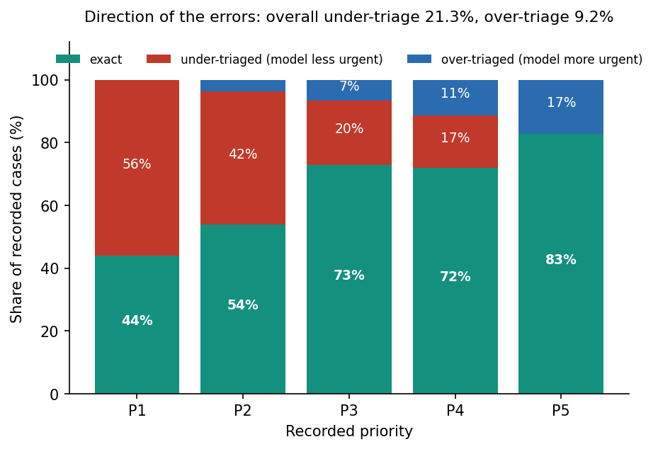
Safety View – Under- and Over-triage
Measure (1,200 synthetic cases) | Value
Under-triage (model less urgent) | 21.33%
Over-triage (model more urgent) | 9.25%
Two or more levels under | 0.33%
Recorded P1 placed at P3 or lower urgency | 2 of 66
High-risk (P1-P2) recall / precision, argmax | 66.2% / 90.6%
Flag when P(1)+P(2) ≥ 0.4 (not built) | 84.3% / 81.6%
The model errs toward the less urgent side more than the more urgent side, and misses a third of high-risk cases at argmax. A clinician must review every priority.
Dept. of CSE | Batch A7 | Final Review
15
Notes:
The honest safety message. A lower flag threshold for high risk would raise recall to 84% at 82% precision, but it is not implemented in the product.

Slide 16
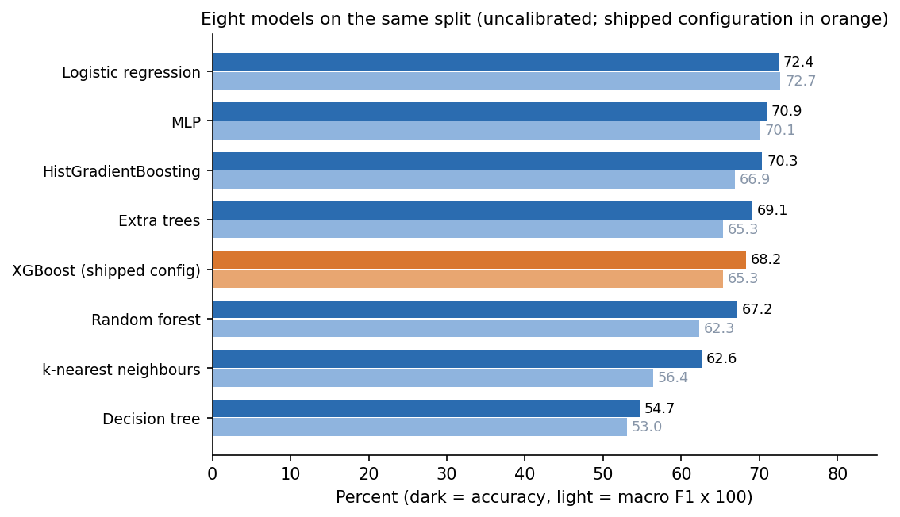
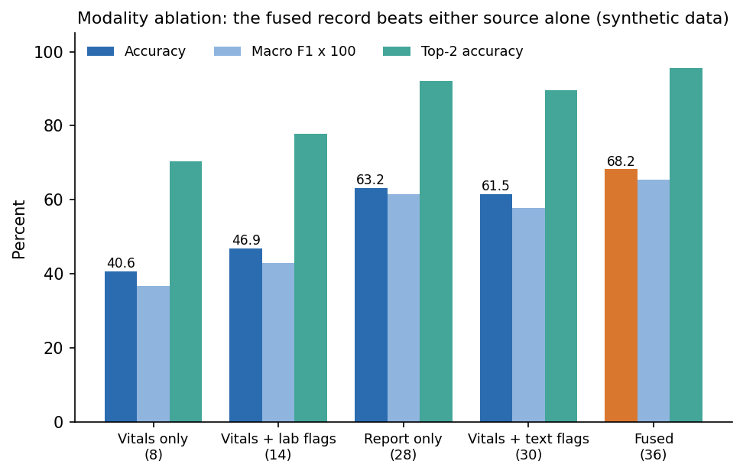
Model Comparison & Modality Ablation
Eight models, same split: logistic regression 72.42% beats the shipped XGBoost configuration (68.25%) because the synthetic labels come from an additive score. XGBoost was kept for SHAP and calibration.
Fusion: fused 68.25%, report only 63.17%, vitals only 40.58% - the single-modality gap named in the survey, measured on synthetic data.
5-fold CV accuracy: logistic 71.6%, random forest 71.1%, XGBoost 72.4%.
Dept. of CSE | Batch A7 | Final Review
16
Notes:
A linear model wins. We say so: the choice of XGBoost is about explanation and calibration, not about winning on this data.

Slide 17
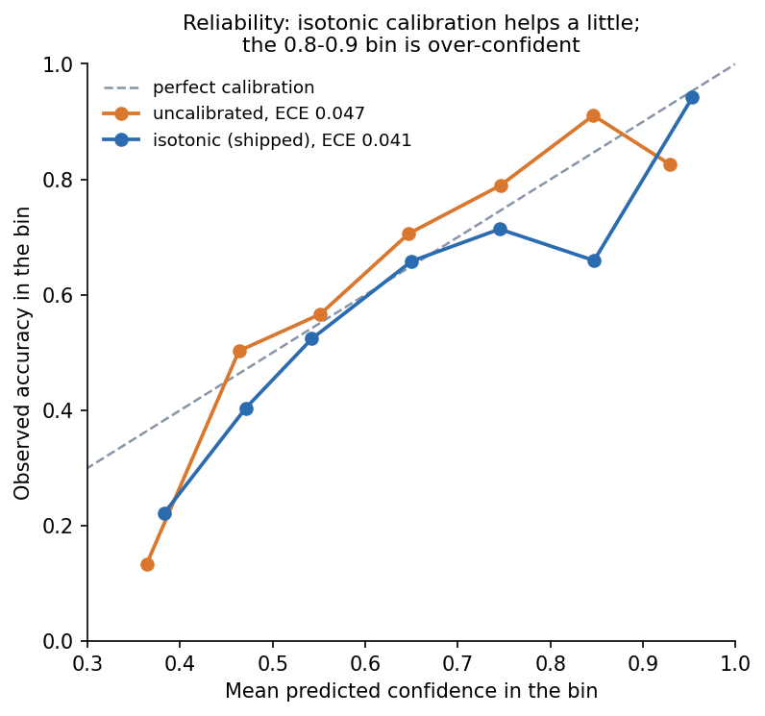
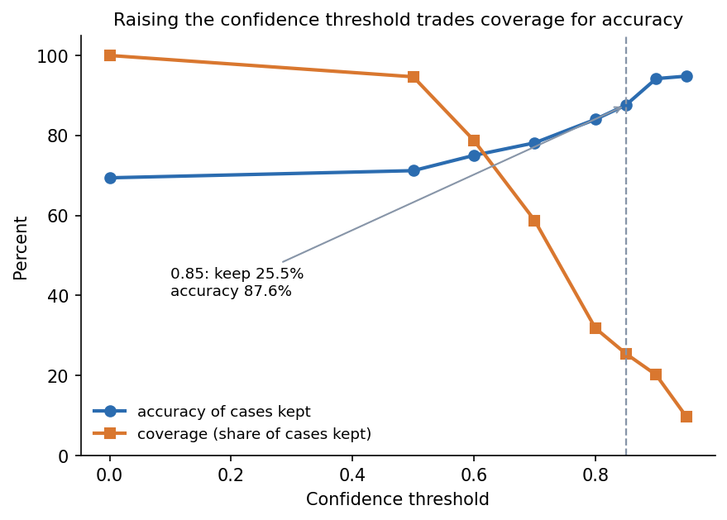
Calibration & Confidence Threshold
Isotonic calibration helps modestly: ECE 0.047 to 0.041; the 0.8-0.9 confidence bin is over-confident (66% observed).
Confidence threshold, as in the base paper's 0.85 rule: keeping only predictions at 0.85 or more covers 25.5% of cases at 87.6% accuracy (all cases: 69.4%).
The threshold is an analysis, not a gate in the product.
Dept. of CSE | Batch A7 | Final Review
17
Notes:
Parameter analysis: the confidence threshold trades coverage for accuracy. Analogous to the base paper's 0.85 threshold, on a different task and data.

Slide 18
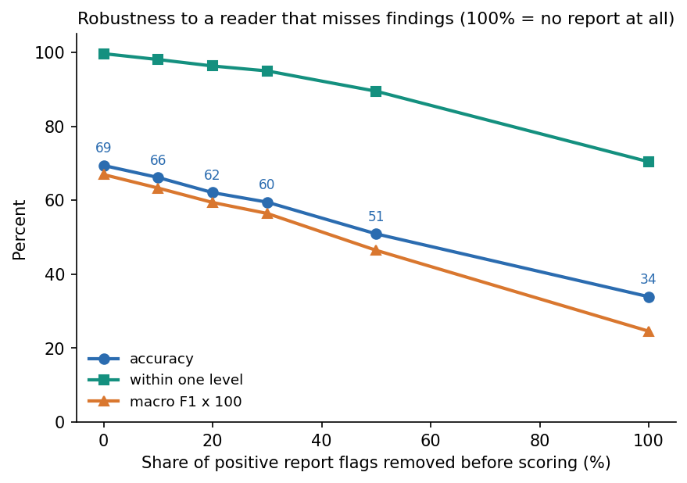
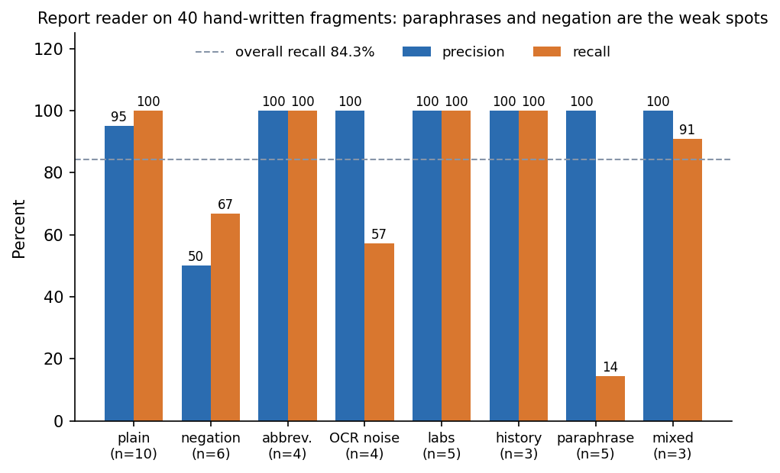
Robustness & Report-Reader Evaluation
Drop each positive report flag at random: accuracy 69.4% -> 66.2% (10%) -> 62.1% (20%); with no report at all 33.9%. A missed finding is costly.
Reader on 40 hand-written fragments: 95.2% precision, 84.3% recall, 27 of 40 read exactly; paraphrases are the weak spot (recall 0.14).
Found defects: "afebrile" read as fever, "chest pain: absent" flagged, "denies X but reports Y" negates Y, split OCR words missed.
Dept. of CSE | Batch A7 | Final Review
18
Notes:
Robustness to incomplete input is the base paper's theme. The reader defects were found by our own stress set and left unfixed in the product; they are documented.

Slide 19
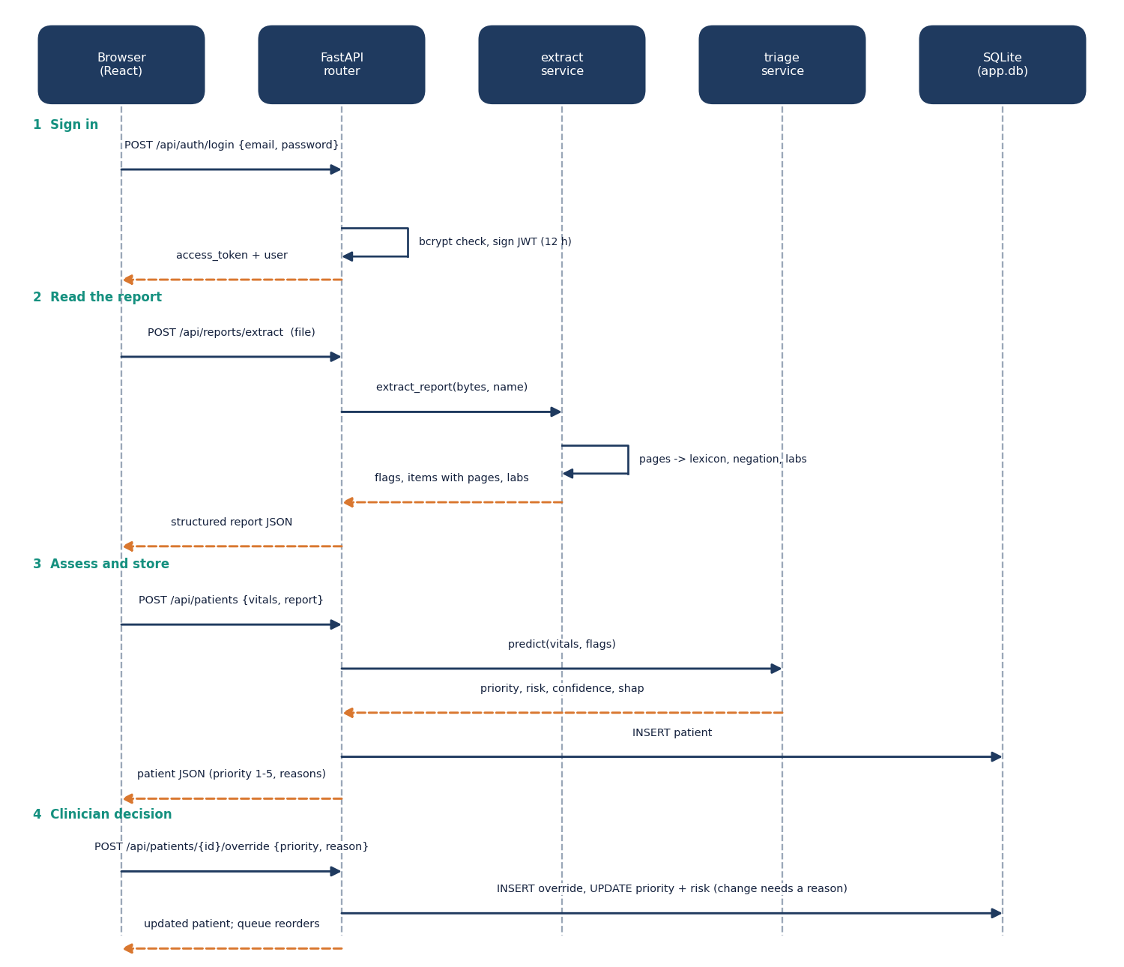
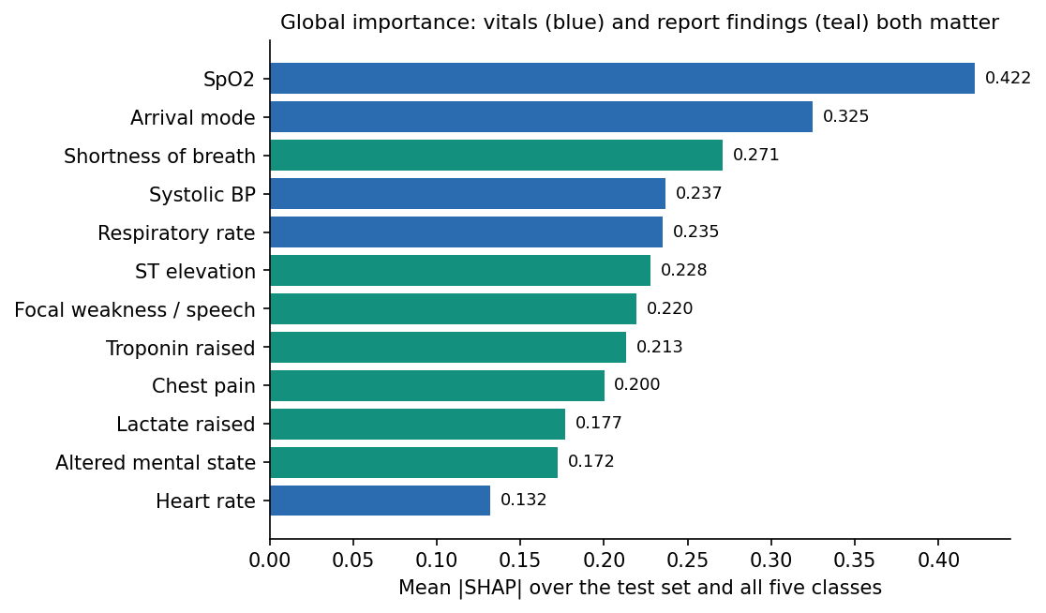
Explainability & Clinician Loop
Per patient: SHAP TreeExplainer lists the strongest drivers for the chosen priority (top 8, absent flags with tiny effect hidden). Globally SpO2, arrival mode, shortness of breath, blood pressure and ST elevation lead - matching the severity rule used to make the labels, which checks the explainer, not clinical validity.
A change of priority needs a reason; accept or change is stored with who, when, old and new priority, and the queue reorders.
Dept. of CSE | Batch A7 | Final Review
19
Notes:
Explanation beside the decision, and the override loop that makes it decision support.

Slide 20
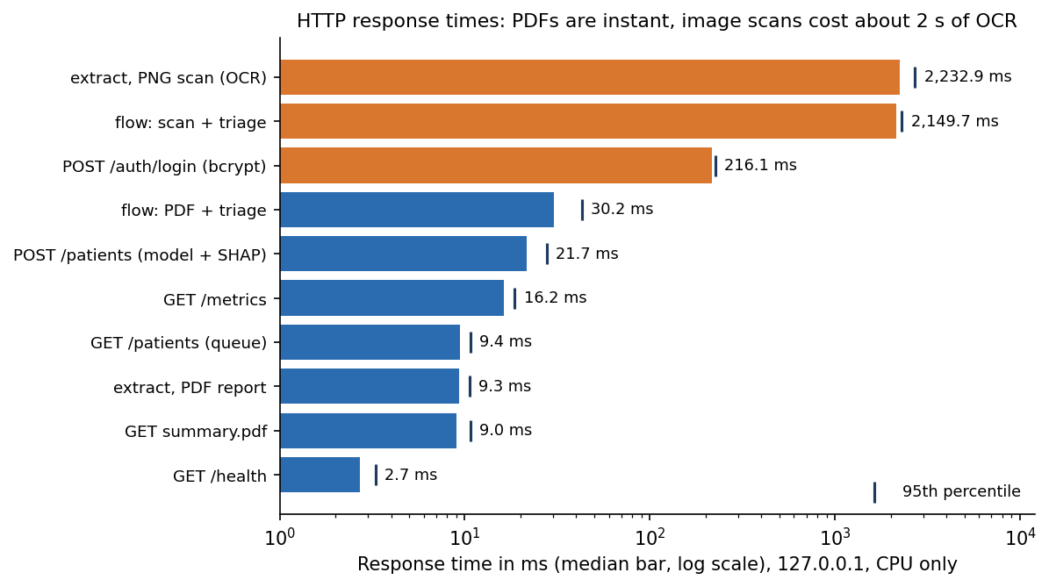
Performance & Testing
30 ms
2.15 s
22 ms
46 / 47
PDF extract + triage (HTTP median)
scan: OCR + triage
triage + SHAP request
pytest pass, 1 expected failure
Check | Result
pytest: reader 20, triage 11, API 16 | 46 pass, 1 documented failure, 0 fail (15 s)
Smoke test against running API | 17 of 17 checks pass
End to end, 12 samples (reader + model) | mean 1.26 s, median 0.017 s, max 4.32 s
Not tested | concurrency, real scans, fresh install, security audit, user study
Measured on Intel Core i5-12500 (12 threads), 15.7 GB RAM, Windows 11 Pro, no GPU, Python 3.11.9, Node 24.19.0, 127.0.0.1, medians of 10-50 calls.
Dept. of CSE | Batch A7 | Final Review
20
Notes:
Model time is negligible; OCR dominates for image scans, bcrypt dominates login. Nothing here is load testing.

Slide 21
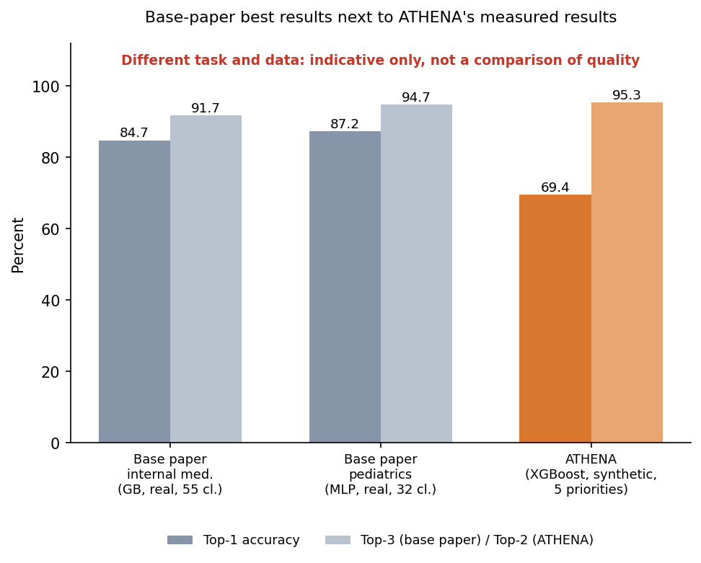
Comparison with Base Paper
Aspect | Base paper [1] | ATHENA
Task | ICD-10 diagnosis, 87 classes | Triage priority, 5 levels
Data | 1,655 real cases | 6,000 synthetic rows
Input | Typed symptom indicators | Scanned report + 8 vitals
Algorithms | 19 compared | 8 compared; XGBoost shipped
Ranking | TOP-3 up to 91.7% / 94.7% | Top-2 95.3%
Top-1 / exact | 84.7% / 87.2% | 69.4%
Confidence rule | 0.85 threshold | 0.85: 25.5% coverage, 87.6%
Explanation | SHAP + LIME, offline | Per-patient SHAP beside the decision
Different task, data and metrics: the numbers are indicative only and ATHENA is not claimed to beat the paper.
Shared ideas: probability ranking, confidence threshold, SHAP, absent = 0, comparison of several algorithms.
Dept. of CSE | Batch A7 | Final Review
21
Notes:
Plainly: they diagnose 87 ICD-10 classes on 1,655 real cases; we assign five priorities on synthetic data. We borrow ideas, not a score to beat.

Slide 22
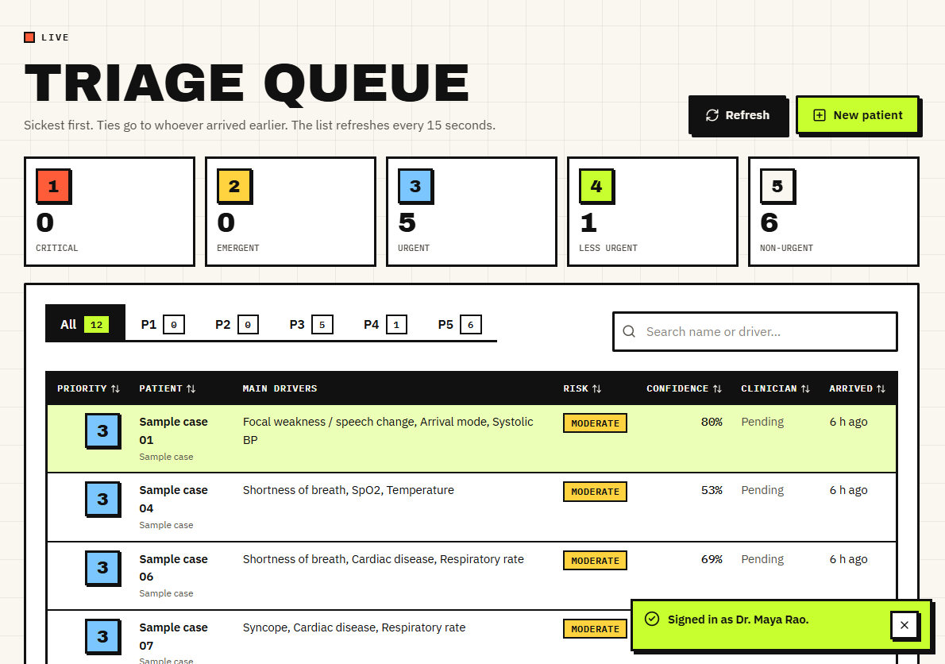
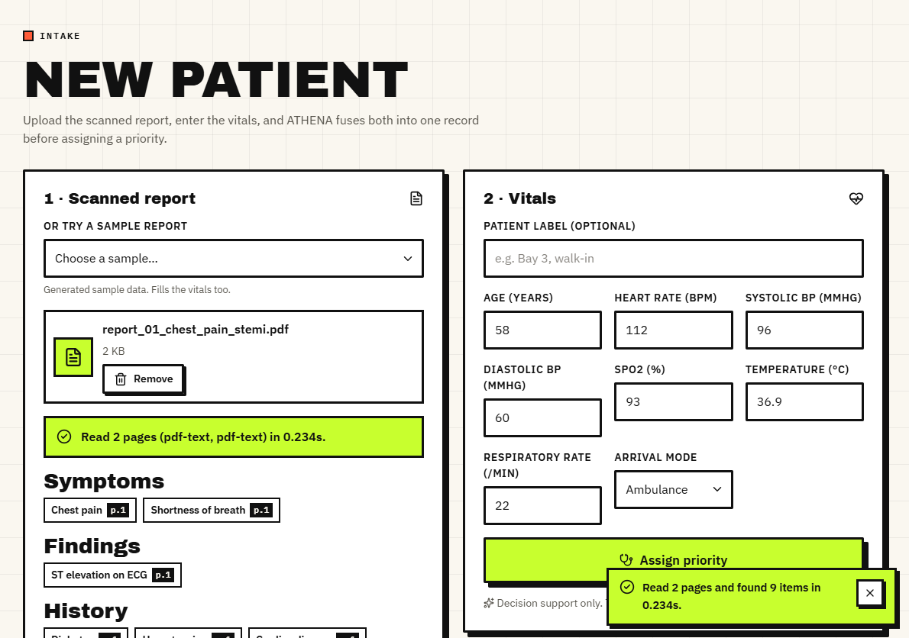
Output – Triage Queue and New Patient
Left: the queue of 12 labelled sample cases, ordered by priority then arrival, with main drivers, risk and confidence. Right: sample report 01 read in 0.234 s (2 pages); symptoms, findings, history and labs appear with their page numbers and the vitals are filled in.
Dept. of CSE | Batch A7 | Final Review
22
Notes:
Real captures of the running app with data in it.

Slide 23
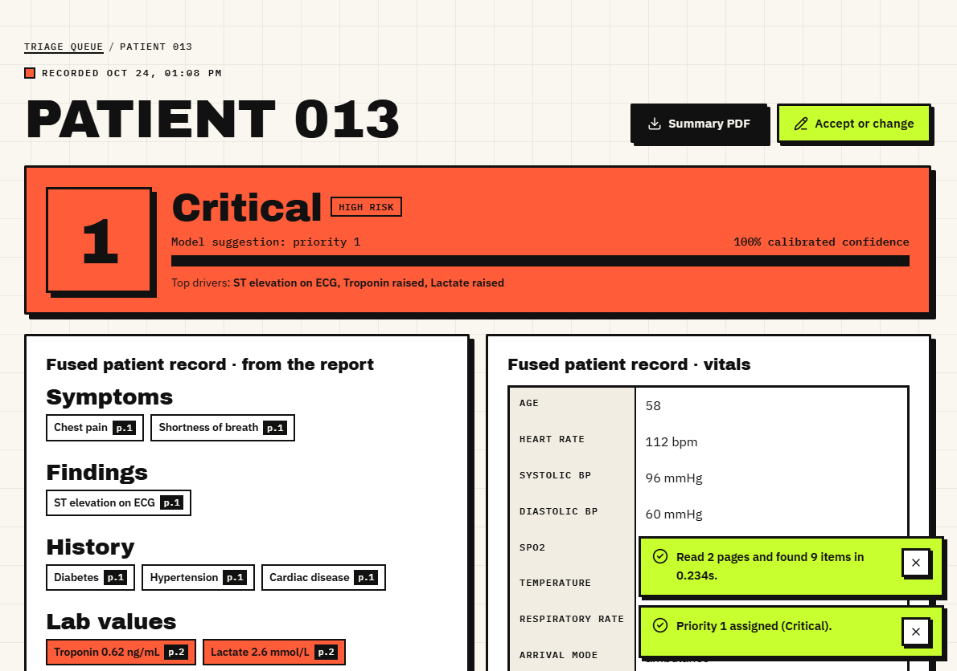
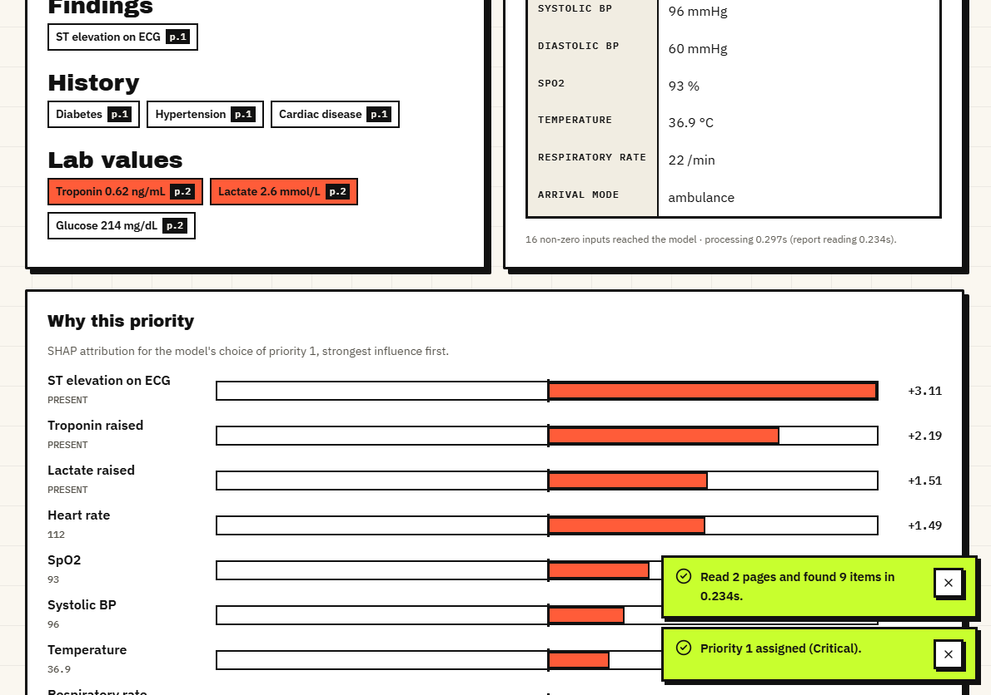
Output – Result and Why This Priority
Left: Patient 013 assigned priority 1 Critical, high risk; the fused record lists report findings and vitals. Right: the SHAP list - ST elevation, raised troponin and lactate, heart rate - strongest first. The 100% is the calibrated confidence for this textbook STEMI sample report.
Dept. of CSE | Batch A7 | Final Review
23
Notes:
The explanation sits next to the decision. Confidence near 100% on a textbook STEMI case does not mean the model is that sure in general (mean confidence is 0.73).

Slide 24
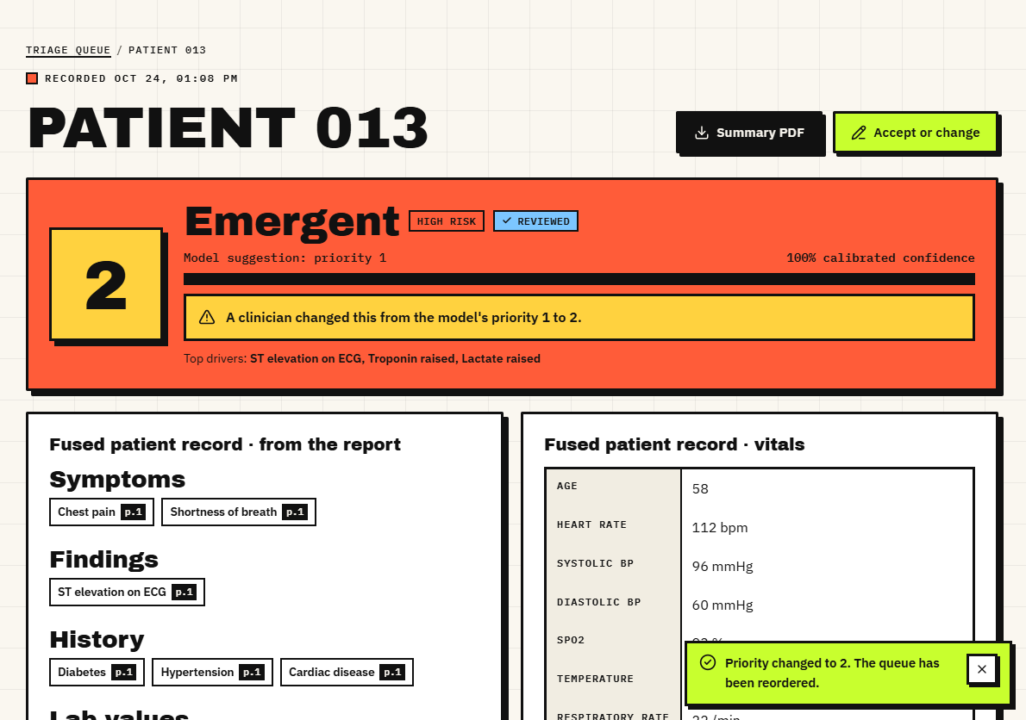
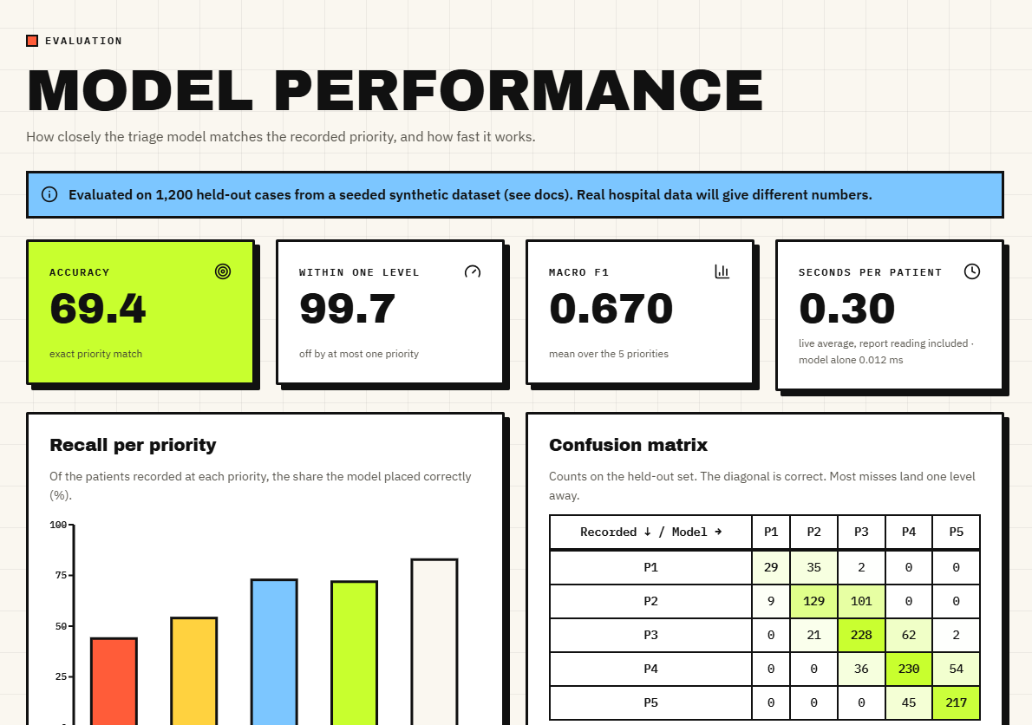
Output – Clinician Decision and Model Performance
Left: the clinician changed priority 1 to 2; the model's suggestion is kept and the case is marked reviewed. Right: the performance page - accuracy 69.4%, within one level 99.7%, macro F1 0.670, with a banner saying the data are synthetic.
Dept. of CSE | Batch A7 | Final Review
24
Notes:
The override loop and the performance page, which carries the synthetic-data warning in the product itself.

Slide 25
Conclusion & Objectives vs Outcomes
A working decision-support pipeline: report reading, fusion, calibrated priority, SHAP reasons and a stored clinician decision; 46 tests and 17 smoke checks pass.
Key finding: reports add 27.7 points over vitals alone, yet P1 recall is 43.9% and a linear baseline wins on synthetic data.
# | Objective | Status and evidence
1 | OCR stage for scanned reports | Met: PDF text layer + local RapidOCR; 4 generated scans read exactly
2 | Medical language model for extraction | Partly: rule-based lexicon (no BioBERT); recall 84.3% on stress set
3 | Fused text + vitals representation | Met: 36 inputs; fusion beats either part alone
4 | Model assigns risk level and priority | Met on synthetic labels only
5 | Explainability layer | Met: per-patient SHAP; no LIME
6 | Accuracy vs clinician priority; time per patient | Partly: accuracy vs synthetic label; time measured (30 ms PDF, 2.1 s scan)
Dept. of CSE | Batch A7 | Final Review
25
Notes:
Be explicit: two objectives are only partly met. BioBERT, RAG, multi-agent orchestration, MongoDB and the six disease models were not built.

Slide 26
Limitations & Future Scope
Known limitations
Future scope
Trained and tested on synthetic data; no clinician agreement measured
P1 recall 43.9%; high-risk recall 66.2%; under-triage 21.3%
Rule-based reader; negation and OCR defects; only 4 generated scans tried
Linear baseline beats XGBoost here; calibration only modest
No BioBERT, RAG, multi-agent, LIME, MongoDB or disease models
Demo-grade security; no user study
Retrain and validate on real triage records (credentialed access needed)
Medical language model for extraction; fix negation scope and OCR splits
Flag high risk when P(1)+P(2) is 0.4 or more; better calibration
Live vitals feed, multi-agent / RAG ideas, TOP-k style ranking
Prospective user study with triage nurses
Harden security: secrets, HTTPS, audit log, rate limits
Dept. of CSE | Batch A7 | Final Review
26
Notes:
Limitations first, then concrete next steps tied to measured weak points.

Slide 27
References
[1] M. Mlodawski, S. Deniziak, M. Plaza, A. Kwiatkowska, D. Jaszczyk, A. Gajda and K. Twardowski, "Multidimensional analysis of the diagnostic performance of machine learning models in disease classification: implications for clinical decision support systems," IEEE Access, vol. 14, pp. 92149-92177, 2026, doi: 10.1109/ACCESS.2026.3703248.
[6] H. Cheng, C. Yu, Y. Shi, C. Wang, C. Liu and Z. Jin, "Collaborative medical triage under uncertainty: a multi-agent dynamic matching approach," arXiv:2507.22504, Jul. 2025.
[8] M. Fernandes, S. M. Vieira, F. Leite, C. Palos, S. Finkelstein and J. M. C. Sousa, "Clinical decision support systems for triage in the emergency department using intelligent systems: a review," Artif. Intell. Med., vol. 102, Art. no. 101762, Jan. 2020, doi: 10.1016/j.artmed.2019.101762.
[9] J. S. Hinson, D. A. Martinez, S. Cabral et al., "Triage performance in emergency medicine: a systematic review," Ann. Emerg. Med., vol. 74, no. 1, pp. 140-152, Jul. 2019, doi: 10.1016/j.annemergmed.2018.09.022.
[10] W. S. Hong, A. D. Haimovich and R. A. Taylor, "Predicting hospital admission at emergency department triage using machine learning," PLoS ONE, vol. 13, no. 7, Art. no. e0201016, Jul. 2018, doi: 10.1371/journal.pone.0201016.
[11] S. Levin et al., "Machine-learning-based electronic triage more accurately differentiates patients with respect to clinical outcomes compared with the Emergency Severity Index," Ann. Emerg. Med., vol. 71, no. 5, pp. 565-574, May 2018, doi: 10.1016/j.annemergmed.2017.08.005.
[12] Y. Raita et al., "Emergency department triage prediction of clinical outcomes using machine learning models," Crit. Care, vol. 23, Art. no. 64, Feb. 2019, doi: 10.1186/s13054-019-2351-7.
[13] F. Xie et al., "Benchmarking emergency department prediction models with machine learning and public electronic health records," Sci. Data, vol. 9, Art. no. 658, Oct. 2022, doi: 10.1038/s41597-022-01782-9.
[14] N. Gilboy, P. Tanabe, D. Travers and A. M. Rosenau, Emergency Severity Index (ESI): A Triage Tool for Emergency Department Care, Version 4, Implementation Handbook 2012 Edition, AHRQ Pub. no. 12-0014. Rockville, MD, USA: Agency for Healthcare Research and Quality, 2011.
[15] T. Chen and C. Guestrin, "XGBoost: a scalable tree boosting system," in Proc. 22nd ACM SIGKDD Int. Conf. Knowl. Discovery Data Mining, San Francisco, CA, USA, 2016, pp. 785-794, doi: 10.1145/2939672.2939785.
[16] S. M. Lundberg and S.-I. Lee, "A unified approach to interpreting model predictions," in Proc. Adv. Neural Inf. Process. Syst. (NeurIPS), vol. 30, 2017, pp. 4765-4774, arXiv:1705.07874.
[17] S. M. Lundberg et al., "From local explanations to global understanding with explainable AI for trees," Nat. Mach. Intell., vol. 2, no. 1, pp. 56-67, Jan. 2020, doi: 10.1038/s42256-019-0138-9.
[18] B. Zadrozny and C. Elkan, "Transforming classifier scores into accurate multiclass probability estimates," in Proc. 8th ACM SIGKDD Int. Conf. Knowl. Discovery Data Mining, Edmonton, AB, Canada, 2002, pp. 694-699, doi: 10.1145/775047.775151.
[3] "The effects of patient triage management strategies on clinical outcomes and risk management in emergency departments: a prospective comparative study," Anatolian Curr. Med. J., vol. 7, no. 1, Jan. 2025.
Dept. of CSE | Batch A7 | Final Review
27
Notes:
Selected references; the complete numbered list is in the report.

Slide 28
THANK YOU
Questions & Suggestions
Dept. of CSE | Batch A7 | Final Review
28
Notes:
Invite questions.

