Slide 1
Data Protection Using Hybrid Encryption and Steganography
REVIEW 2 · DESIGN, METHODOLOGY AND PROGRESS
Design, methodology and progress: AES-256-GCM and RSA-OAEP encryption, hidden by LSB steganography in a PNG
Presented by
Under the guidance of
Allam Rakesh 23K91A0509
Bolleddu Shanker 23K91A0543
Agaram Sri Sarvagna 23K91A0506
B Akshay 24K915A0504
Rajalakshmi, [DESIGNATION]
Department of Computer Science and Engineering
TKR College of Engineering & Technology · Batch A15 (CSE-A) · [ACADEMIC YEAR]
Notes:
This review shows how CipherVeil is designed and built, what is implemented, the first measured results from our own evaluation, and the open items. Introduce the four team members and the guide.

Slide 2
Contents
01
02
03
Recap and architecture
Methodology, data and preprocessing
The pipeline and its configuration
04
05
06
Decision logic and data flow
Entities, UML and technology stack
Implementation progress
07
08
09
Preliminary results and output screens
Testing and challenges
Next steps
Notes:
Agenda for the design and progress review.

Slide 3
Recap: problem and proposed system
!
Problem
i
Proposed system
B
Base paper link [1]
Encryption alone shows that something secret is moving. Hiding alone protects nothing once found. Symmetric keys are fast but sharing them is the weak point, and naive LSB embedding can degrade the picture.
CipherVeil encrypts a file with a fresh AES-256-GCM key, wraps that key with the receiver's RSA public key, and hides the bundle in the least significant bits of a PNG. The receiver extracts, unwraps, verifies the tag and gets the file back byte for byte.
Ahmad and Rass (ProSt) hide secret bits among random decoy LSBs so an untrusted cloud can compute on them. We keep the LSB carrier and key-exchange framing, but move a whole file from sender to receiver and measure it. We do not implement homomorphic computation or its security proof.
Notes:
Recap of Review 1: the surveyed work advances steganography and encryption independently. The gap is a practical hybrid AES-RSA plus LSB pipeline evaluated end to end on capacity, imperceptibility and speed. ProSt reports no PSNR, SSIM or capacity, so we cannot compare numbers with it directly.

Slide 4
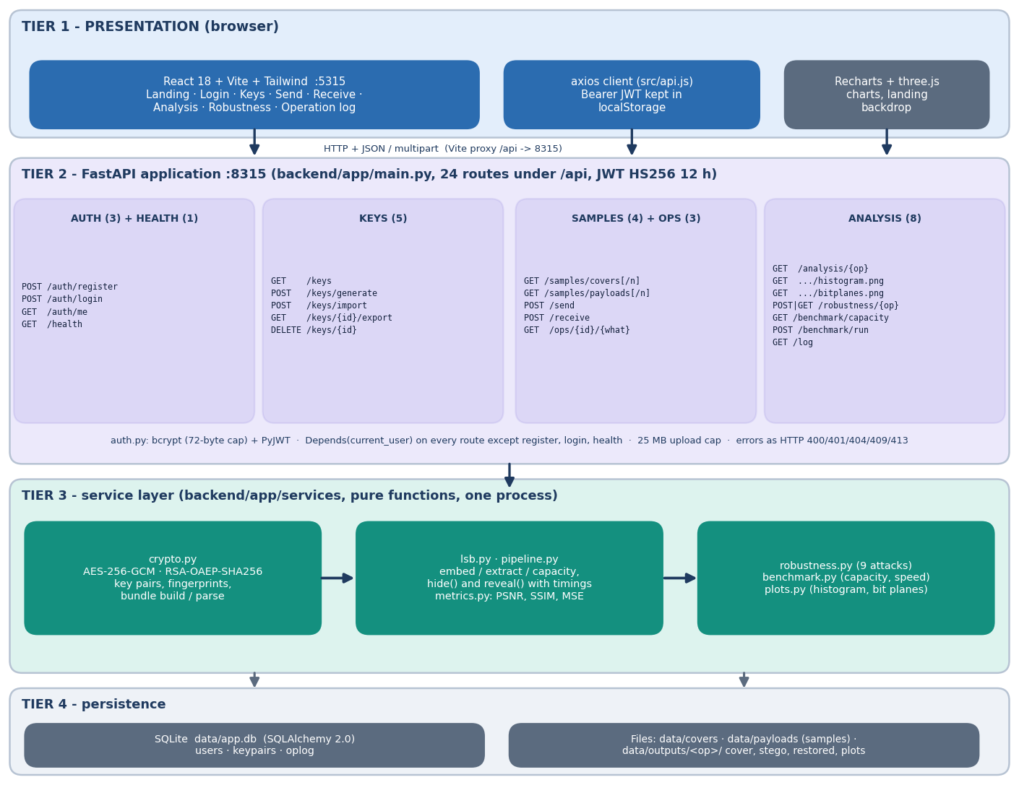
System architecture
Three tiers, one small database
Console: React 18 + Vite on port 5315, 8 pages: landing, sign-in, keys, send, receive, analysis, robustness, log.
API: FastAPI on port 8315, 24 endpoints under /api, JWT sign-in (12 h), bcrypt password hashes.
Services: crypto, lsb, metrics, pipeline, plots, robustness, benchmark (about 1,040 lines of backend Python).
Storage: SQLite with users, keypairs and oplog; cover, stego and restored files under data/outputs.
Notes:
Routes live in backend/app/routes; the services hold all cryptographic and image logic and are shared by the API, the benchmark and ml/eval.py, so the numbers in this deck come from the same code the user runs.

Slide 5
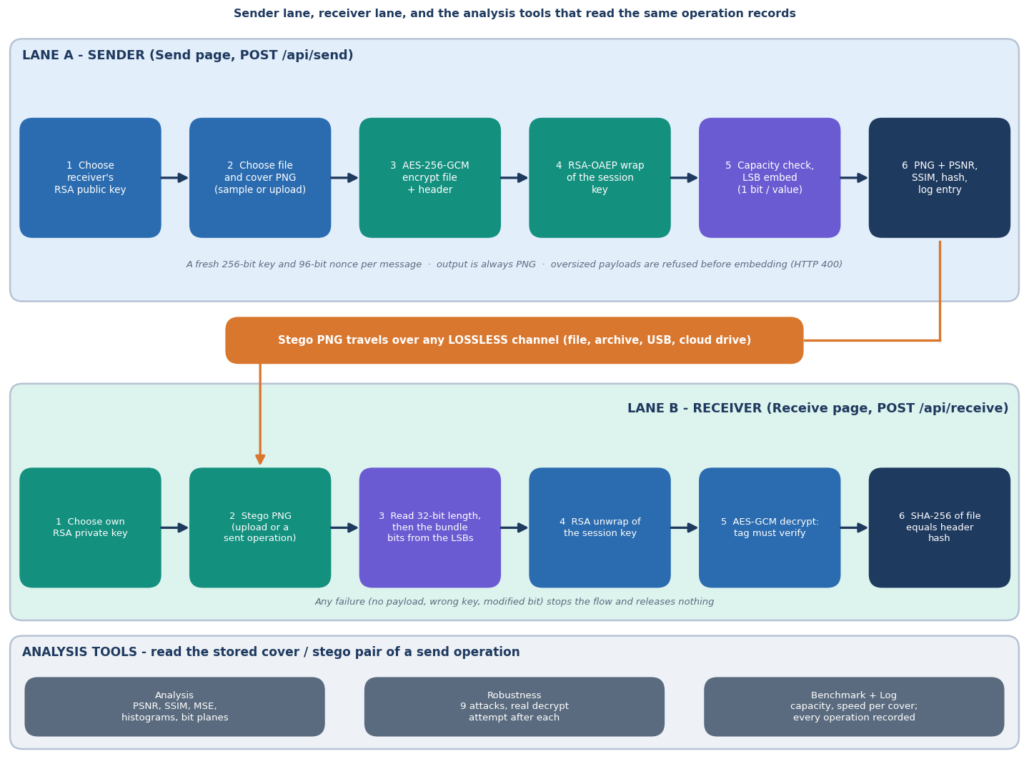
Methodology: encrypt, wrap, hide, recover
Send
Header {name, size, SHA-256} plus the file is encrypted with AES-256-GCM; the session key is wrapped with RSA-OAEP; a capacity check precedes embedding.
Hide
The 32-bit length and the bundle go into the lowest bit of each R, G, B value, row by row; the result is saved as a PNG and measured (PSNR, SSIM).
Recover
Extract, unwrap with the private key, verify the GCM tag, then compare the stored SHA-256 with the hash of the restored file.
High-level workflow as implemented in the backend services.
Notes:
A fresh AES key and nonce are generated for every message, so two messages to the same receiver share nothing except the RSA key.

Slide 6
Data: no dataset, six covers and four payloads
6
4
22 + 8
5
cover images, 200 x 200 to 1280 x 720
synthetic payloads, 99 B to 21.5 KiB
evaluation runs that fit + runs blocked by the capacity check
random payload seeds per fill level in the fill study
Cover | Pixels | Max hidden | Source and licence
astronaut_512x512.png | 512 x 512 | 96.0 KiB | scikit-image astronaut, NASA photo, public domain
cat_451x300.png | 451 x 300 | 49.5 KiB | scikit-image chelsea, CC0
coffee_600x400.png | 600 x 400 | 87.9 KiB | scikit-image coffee, CC0
coffee_small_200x200.png | 200 x 200 | 14.6 KiB | crop of coffee, resized, CC0
generated_landscape_1280x720.png | 1280 x 720 | 337.5 KiB | procedural, seed 11, generated here
rocket_640x427.png | 640 x 427 | 100.1 KiB | scikit-image rocket, public domain
Payloads: accounts.csv 2,774 B, confidential_memo.pdf 21,517 B, meeting_notes.txt 169 B, settings.json 99 B, all synthetic. Nothing is learned, so there is no train/test split; the committed files are regenerated by a seeded script. Any image up to 25 MB can be uploaded instead.
Notes:
CipherVeil needs no external dataset: it is a deterministic scheme, so we evaluate it on a fixed grid of covers and payload sizes. The limit is that these are only six images and four small files; camera photographs were not tested.

Slide 7
Preprocessing: preparing payload and cover
File bytes
Header: name, size, SHA-256
header_len + header + file
Cover to RGB uint8
Capacity check
Bit stream
3.0
32 bit
bits per pixel capacity: (W x H x 3 - 32) / 8 bytes per cover
big-endian length prefix written before the bundle
The stored file name is stripped to its base name; the header travels inside the encrypted layer, so name, size and hash are not visible.
Covers are converted to 8-bit RGB; an alpha channel is dropped; output is always PNG, the one common format that stores every pixel value exactly.
Uploads are capped at 25 MB; an empty file, a non-image cover or an oversized payload is rejected with a message before any bit is written.
Overhead added to the file: 401 B (RSA-2048), 529 B (RSA-3072), 657 B (RSA-4096).
Notes:
Overhead is the wrapped key, magic, lengths, nonce, header JSON and the 16-byte GCM tag. The cover keeps its geometry; only the lowest bit of the first bits-needed values changes.

Slide 8
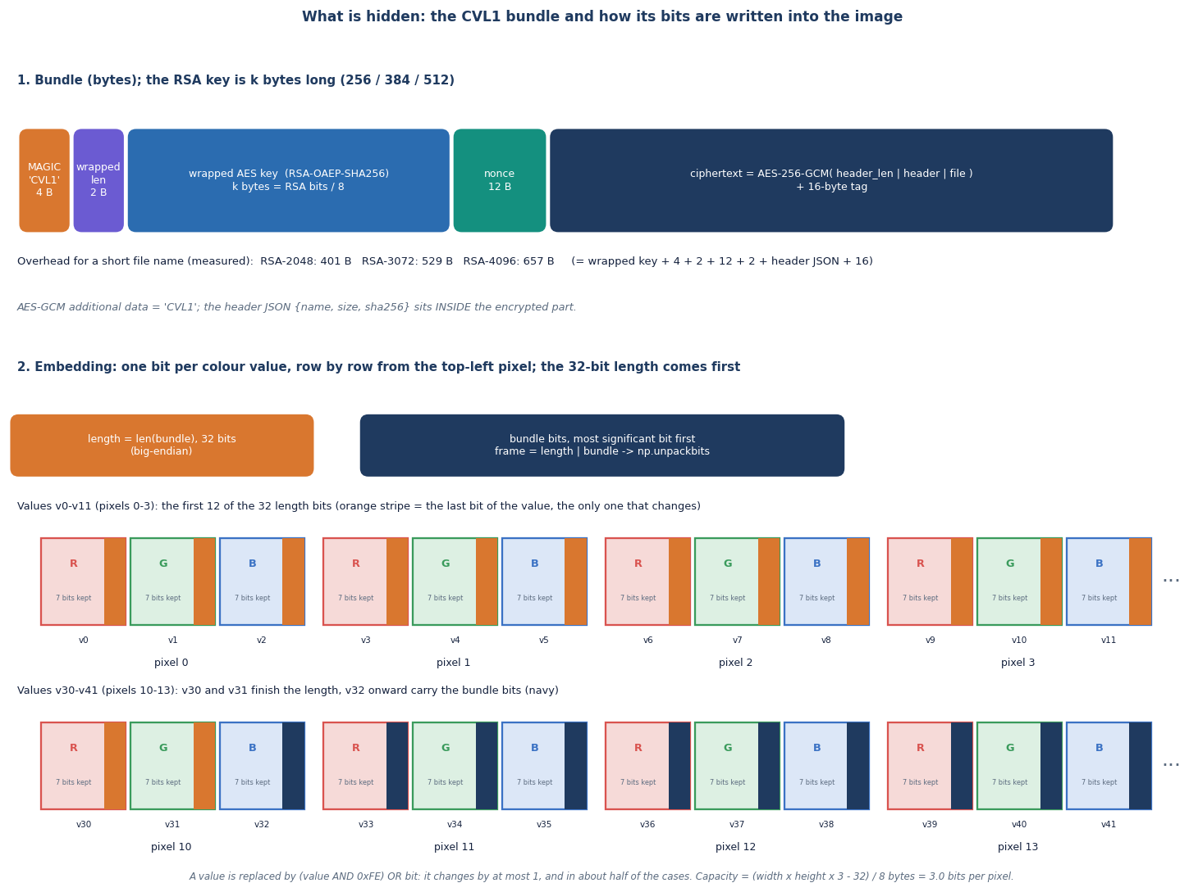
The pipeline: AES-256-GCM, RSA-OAEP and LSB
AES-256-GCM: fresh 256-bit key and 96-bit nonce per message; associated data is the magic CVL1; the 16-byte tag authenticates everything.
RSA-OAEP (SHA-256, MGF1-SHA-256) wraps the session key; RSA keys below 2048 bits are rejected.
LSB substitution: 1 bit per R, G, B value, sequential from the top-left pixel; no key-dependent permutation.
CVL1 bundle layout and the way its bits are laid into the image.
Notes:
All three primitives are standard; the contribution is the way they are combined, the bundle format and the measurement. Sequential embedding is a deliberate simplification and is the reason steganalysis can find the payload.

Slide 9
Configuration and evaluation set-up (no training)
Setting | Value
Cipher | AES-256-GCM, 96-bit random nonce, associated data CVL1, 128-bit tag; OAEP padding with SHA-256 and MGF1-SHA-256, public exponent 65537
Key sizes | RSA 2048 / 3072 (default) / 4096; key generation median 32 / 191 / 354 ms
Embedding | 1 LSB per colour value, row-major, 32-bit length prefix; stego saved as PNG compression level 6
Core evaluation | ml/eval.py: 6 covers x payloads 1, 4, 16, 64, 128 KiB, RSA-3072, 3 repeats, median; 22 runs fit, 8 blocked
Extra experiments | fill study (6 covers x 7 fill levels x 5 payload seeds), 9 extra attacks, chi-square and weighted-stego tests, 240 tamper flips
Reproducibility | fixed seeds (payloads 1000-1004, 2024, 77, 9); the covers are regenerated by scripts/make_samples.py
Machine | Core i5-12500 (6 cores), 15.7 GB RAM, Windows 11, Python 3.11.9, cryptography 44.0.0, scikit-image 0.24.0; CPU only
Parameters are those in the shipped code; the system has nothing to train or tune.
Notes:
There is no model to train, so configuration means the cryptographic parameters and the experiment grid. Timings vary by 10 to 30 percent between runs because other jobs share the PC; accuracy-type numbers such as PSNR do not.

Slide 10
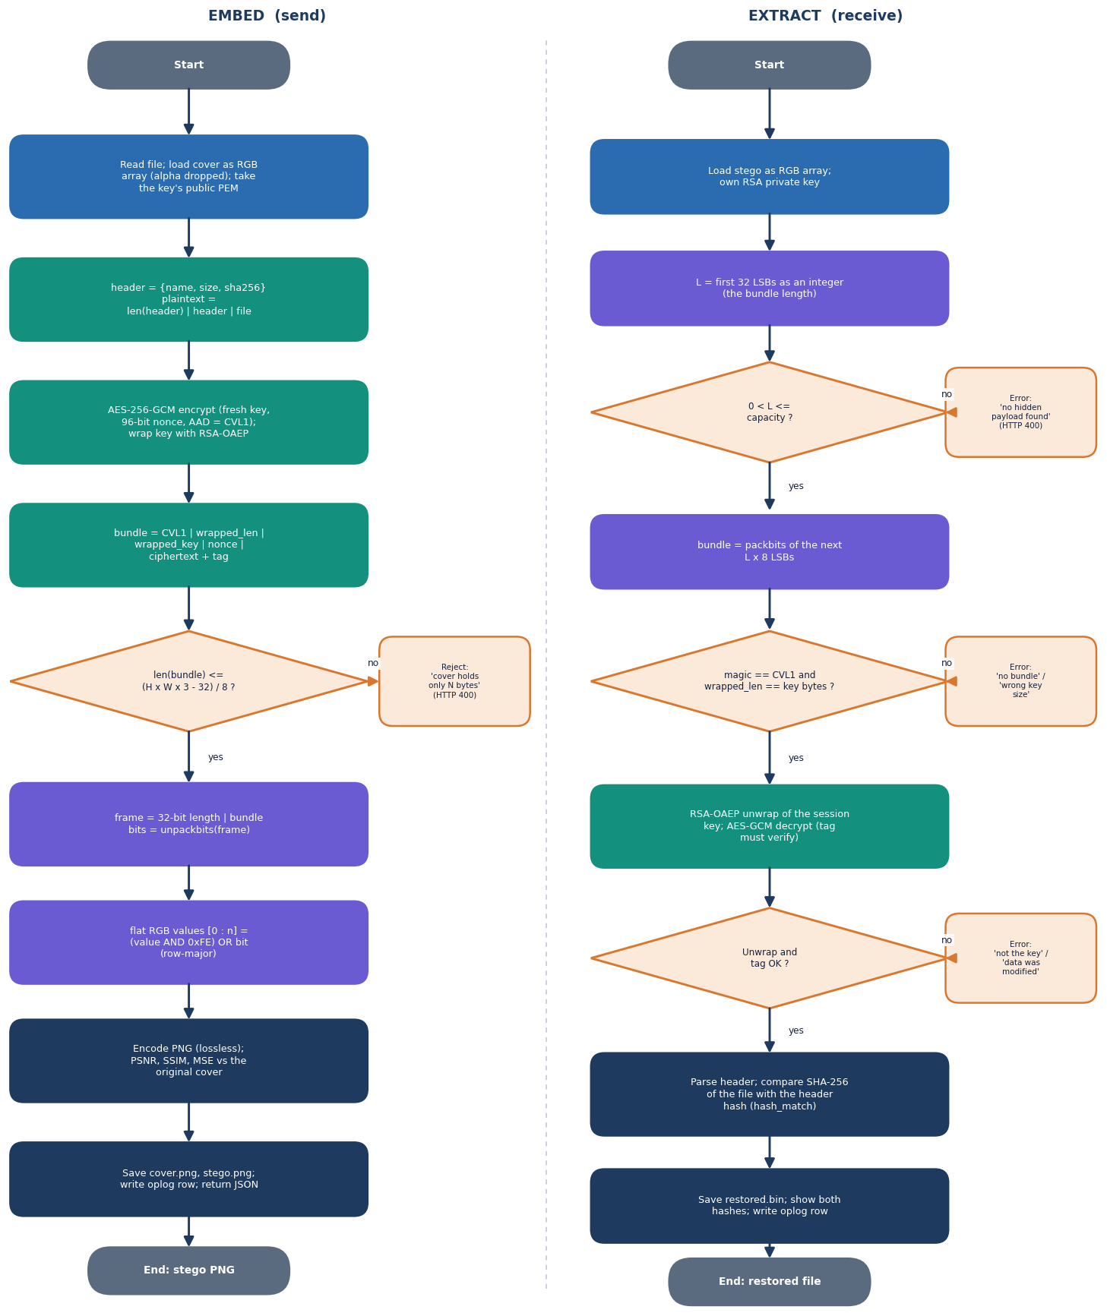
Decision logic: embedding, extraction and checks
Check | Outcome
Bundle larger than (W x H x 3 - 32) / 8 bytes | Send refused, nothing embedded
Length header zero or above capacity | Receive: no payload found
Magic is not CVL1 or bundle too short | Rejected before RSA is used
Wrapped-key length differs from key size | Wrong private key reported
RSA unwrap fails | Not the key the message was sent to
GCM tag check fails | Data modified; nothing released
SHA-256 in header differs from restored file | Hash mismatch flagged
Order matters: cheap structural checks run first, the RSA operation second, the authenticated decryption last; every failure ends in an explicit message and a log entry without secrets.
Notes:
This mirrors lsb.embed, lsb.extract, crypto.decrypt_bundle and the receive route. Failures are logged as failed operations with the error text only.

Slide 11
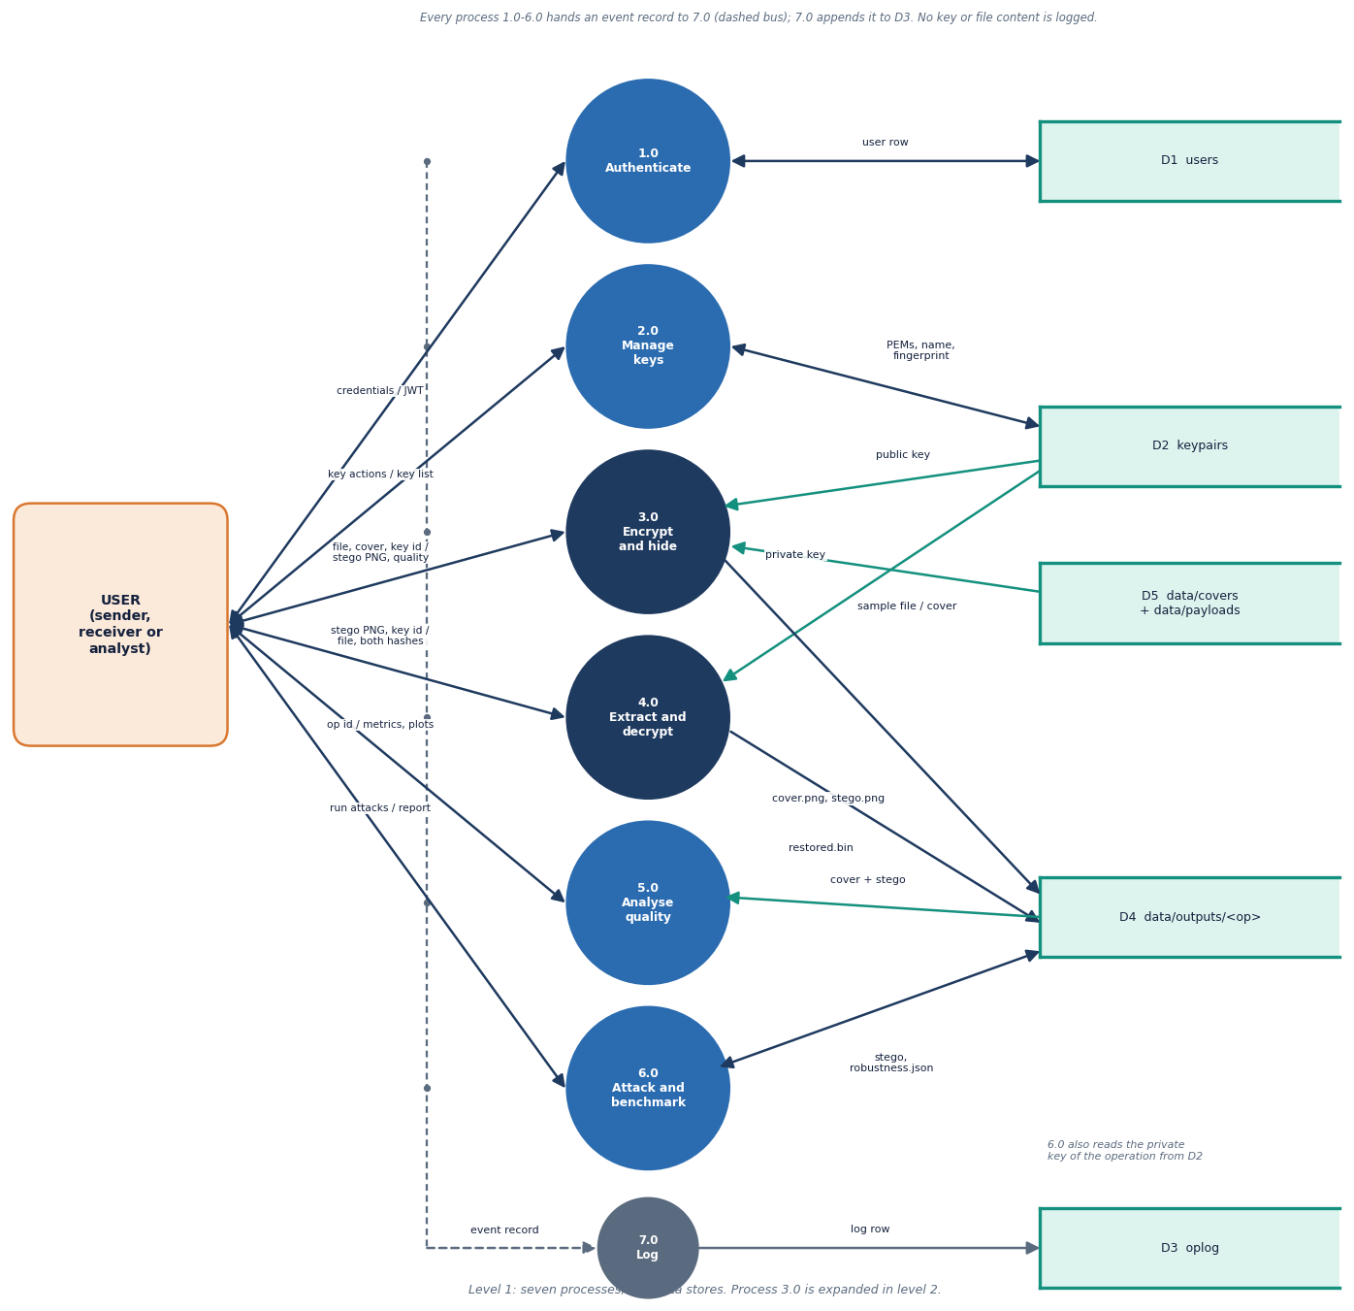
Data flow and modules
Module | Role
services/crypto.py | keys, bundle encrypt and decrypt
services/lsb.py | embed, extract, capacity
services/metrics.py | PSNR, SSIM, MSE
services/robustness.py | nine attacks, hash check
services/pipeline.py | hide and reveal with timings
routes/ (5 files) | 24 endpoints, ownership checks
db.py, auth.py | 3 tables, JWT, bcrypt
tests/, scripts/ | 39 tests, smoke, experiments
Level-1 data-flow diagram of the platform.
Notes:
Level 1 follows data from the user through authentication, key management, the send and receive pipelines, analysis and the log. The stores are the database and the output folder.

Slide 12
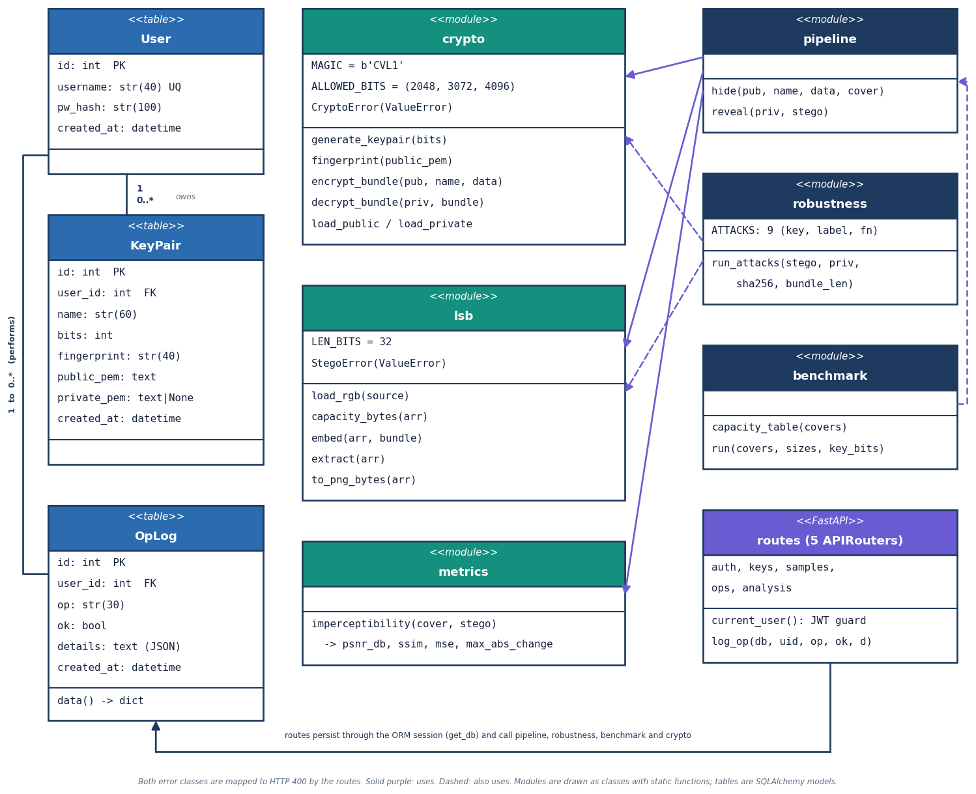
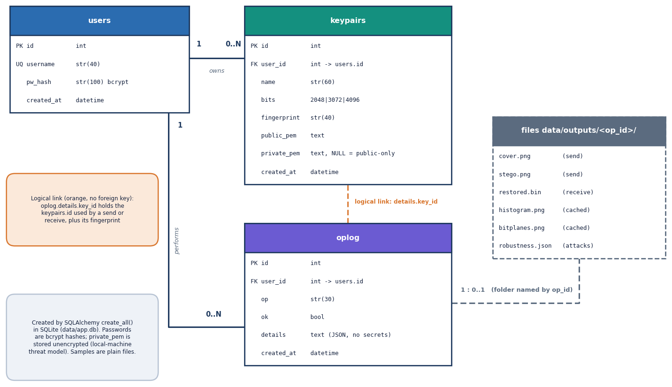
Database entities and UML
SQLite: users(id, username, pw_hash), keypairs(user_id, bits, fingerprint, public_pem, private_pem or NULL) and oplog(user_id, op, ok, details JSON).
Services and routes as classes and modules used by the API.
Notes:
Honest point: private keys are stored unencrypted in the local database, so data/app.db must be treated as sensitive. A public-only entry has a NULL private_pem. The log table never receives keys, passwords or file contents; a test checks this.

Slide 13
Technology stack
Layer | Technology
Language and API | Python 3.11.9, FastAPI 0.115.6, Uvicorn 0.34.0, SQLAlchemy 2.0.36 on SQLite, PyJWT 2.10.1 (HS256), bcrypt 4.2.1
Cryptography | cryptography 44.0.0: AESGCM, RSA key generation, OAEP; hashlib SHA-256; os.urandom for nonces
Image and metrics | Pillow 11.0.0, NumPy 2.1.3 (bit operations on uint8 arrays), scikit-image 0.24.0 (PSNR, SSIM), matplotlib 3.9.3 (histograms, bit planes)
Front end | React 18.3.1, Vite 6.0.3, Tailwind CSS 4, React Router 6, Axios, Recharts 3; three.js backdrop on the landing page
Testing and capture | pytest with FastAPI TestClient, urllib smoke script, Playwright with Chrome for 1440 x 900 captures
Run | setup.bat creates the virtual environment and installs packages; run.bat starts both servers on ports 8315 and 5315; runs offline, no API keys
Notes:
Versions are those installed on the measurement PC. The front end build succeeds in about 17 seconds; the landing page ships a 747 kB three.js chunk.

Slide 14
Implementation progress
Component | Status | Evidence
Crypto layer: AES-256-GCM, RSA-OAEP, CVL1 bundle, key import and export | Done | 13 crypto tests; 240/240 tampered bundles rejected
LSB embedder and extractor with capacity check | Done | 9 tests; 22/22 byte-exact round trips
Quality measures and plots: PSNR, SSIM, histograms, bit planes | Done | PSNR never below 51.14 dB at any fill (6 covers)
Robustness (9 attacks) and benchmark | Done | payload survives 2 of 9; lossy steps destroy it
API (24 endpoints), React console (8 pages), secret-free log | Done | 21/21 smoke checks; 10 API tests
Key-dependent embedding, error correction, steganalysis resistance | Not done | sequential LSB; chi-square flags 30 of 30 cases
Encrypted key store, sender signatures, login rate limit | Not done | private keys stored unencrypted; placeholder JWT secret
Defect: Send page crashes for an account with no keys | Open | KeyRound icon is used but not imported in Send.jsx
Notes:
State of the code base. The last three rows are the honest gaps. The KeyRound defect was found while capturing screens with a fresh account; the product code was not changed during documentation, and the fix is one import line.

Slide 15
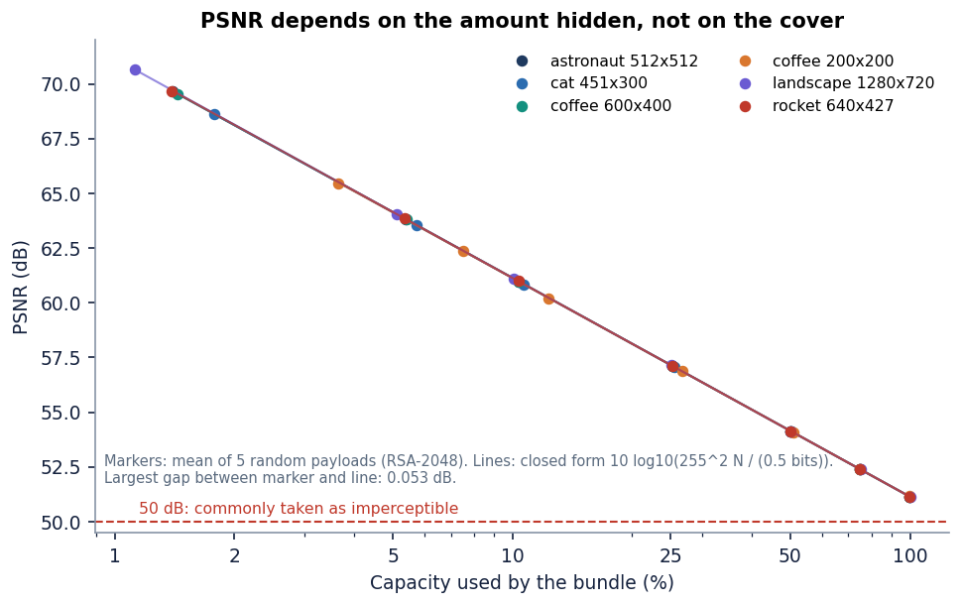
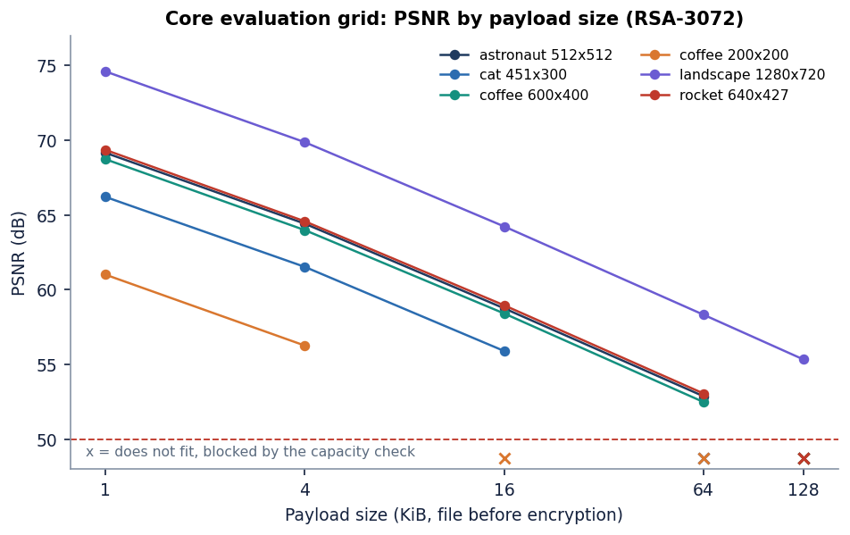
Preliminary results: imperceptibility and capacity
52.5 dB
0.9958
3.0 bpp
86 ms
minimum PSNR in 22 runs (mean 61.7 dB, up to 73% fill)
minimum SSIM (mean 0.9990)
capacity: 14.6 KiB (200 x 200) to 337.5 KiB (1280 x 720)
median RSA-3072 unwrap + decrypt; encrypt 0.15 ms, embed 0.25 ms
Measured PSNR follows the closed form 10 log10(255^2 N / (0.5 bits)) within 0.053 dB; at 100% fill the floor is 51.14 dB. Robustness: only lossless re-save and bottom crop survive (2 of 9); JPEG even at quality 100 and lossy WebP lose the payload (0 of 6). Chi-square on the embedded prefix flags the stego image in 30 of 30 cases: hidden from the eye, not from statistics.
Notes:
Headline: 22 of 22 round trips byte-exact, PSNR between 52.5 and 74.6 dB depending on how full the cover is, SSIM above 0.996. PSNR depends only on how many bits are embedded, because each embedded bit flips its value half the time. ProSt reports no PSNR or SSIM, so we compare only with the supporting SCReedSolo paper in the final review, and there the covers and payloads differ.

Slide 16
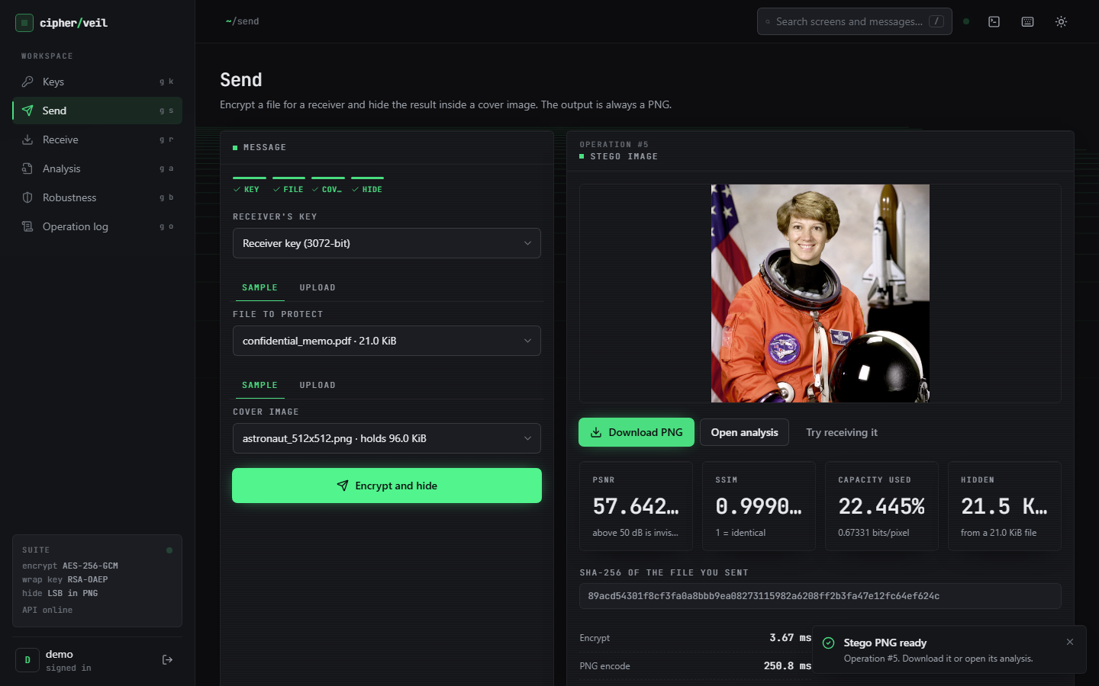
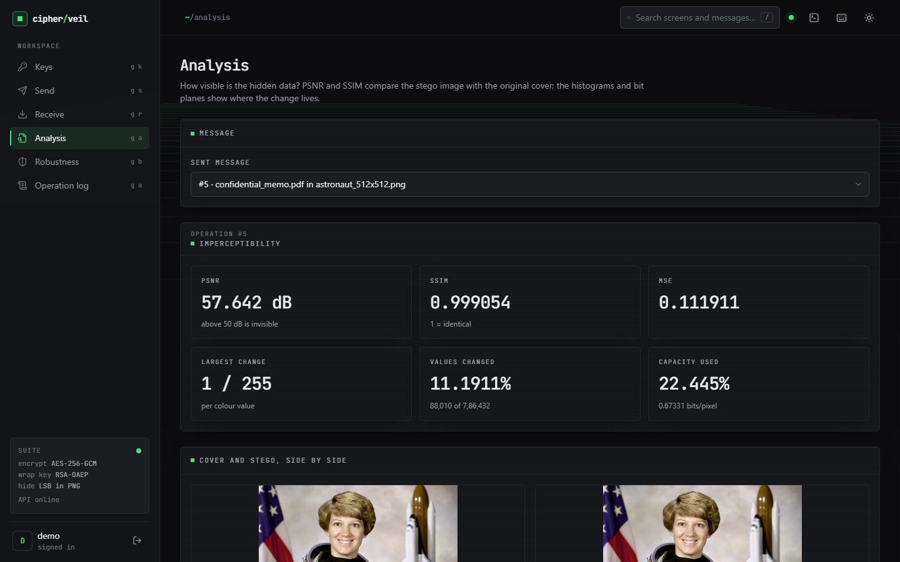
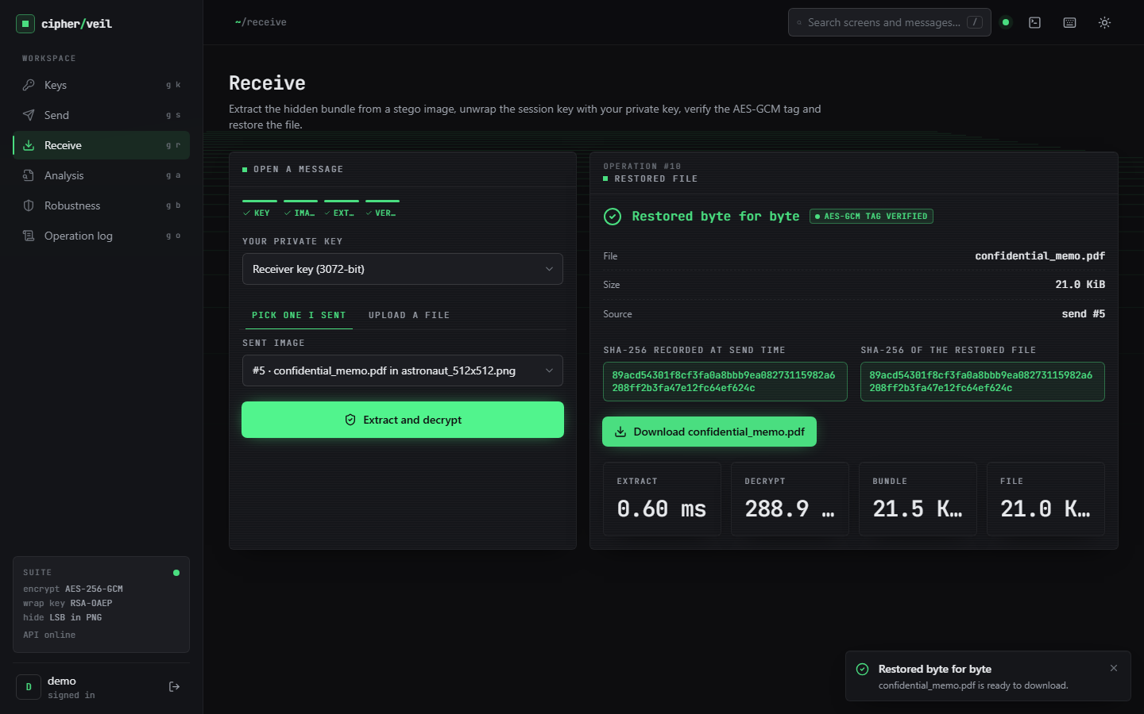
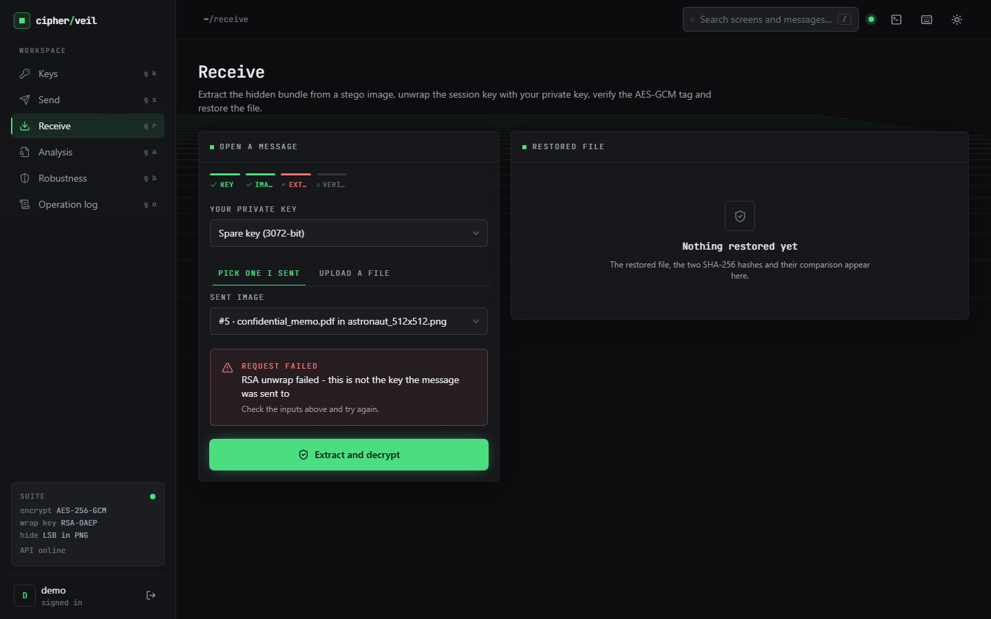
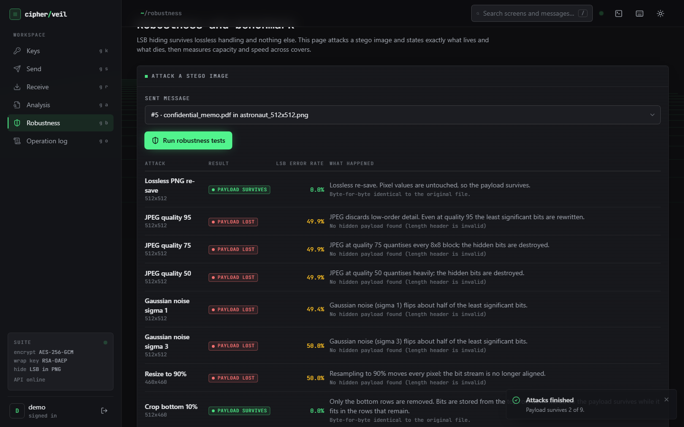
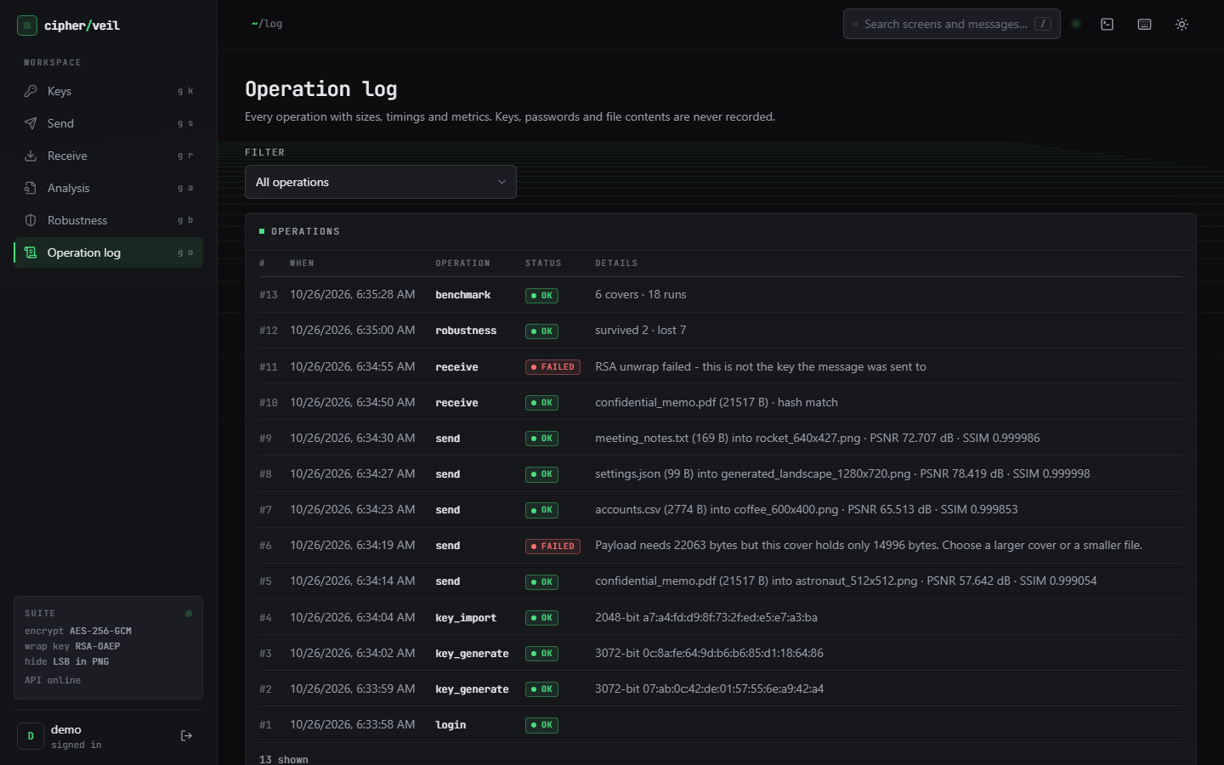
Output screens
Send: stego PNG, PSNR, SSIM, capacity, SHA-256
Analysis: PSNR, SSIM, MSE and side-by-side images
Receive: restored byte for byte, tag verified
Receive with the wrong key: RSA unwrap fails
Robustness: payload survives 2 of 9 attacks
Operation log: successes and failures, no secrets
Real captures of the running application at 1440 x 900 from one session on a fresh database: keys generated, files encrypted and recovered, attacks run.
Notes:
Real screenshots from one session. The memo is hidden in the astronaut photo (PSNR 57.64 dB, 22.4 percent of the capacity); the second receive uses a different 3072-bit key and is refused.

Slide 17
Initial testing and observations
39 / 39
21 / 21
240 / 240
438 ms
pytest tests passed (13 crypto, 9 LSB, 7 metrics, 10 API)
smoke-test checks passed against the live API
single-bit flips of the stego image rejected, 0 accepted with wrong data
median API send call (receive 198 ms), measured on 127.0.0.1
Observation | Action
Chi-square flags the embedded region in 30 of 30 cases; weighted-stego estimates the filled fraction | Stated in every result: invisible is not undetectable; low fill is safer, not safe
JPEG at quality 100, lossy WebP, noise, resize, rotate, flip and palette reduction all give 0 of 6 recovered | Send the stego image as a PNG file; no chat app or email client that re-encodes
Send dominated by PSNR/SSIM and PNG encoding, not by cryptography (AES-GCM 0.15 ms) | Timing split reported per stage; API latency measured separately
Send page crashes for an account with no keys (KeyRound not imported) | Recorded as an open defect; one-line fix proposed
Notes:
Tests cover the cryptography, the LSB layer, the metrics, the pipeline and the API through FastAPI's TestClient; the smoke script drives the live server. No browser assertion suite and no load test were run.

Slide 18
Challenges and corrective actions
Challenge | Corrective action
Base paper reports no PSNR, SSIM or capacity, and solves a different problem (computing on hidden bits) | Compared only with the supporting SCReedSolo figures and said plainly where covers and payloads differ
LSB data is destroyed by any lossy step; no error correction | Robustness tests state exactly what survives; output is PNG-only; Reed-Solomon coding listed as future work
Sequential embedding is statistically detectable (chi-square 30/30) | Reported honestly; key-dependent permutation and adaptive embedding are next steps
bcrypt reads only 72 bytes of a password | Password length capped at 72 characters in the API; the hash step also cuts at 72 bytes
Python clients to localhost add about 2 s per call on this PC (IPv6 fallback) | API latency measured on 127.0.0.1; timings otherwise vary 10 to 30% with other jobs
Notes:
Each challenge was met by a concrete design choice or by measuring it and saying so in the report.

Slide 19
Next steps
1
Harder to detect
2
Survive more
3
Harden the tool
4
Test wider
Key-dependent pixel permutation, LSB matching or adaptive embedding, and a test with stronger detectors (RS, sample-pair).
Add Reed-Solomon error correction so mild damage can be repaired; keep PNG-only guidance for lossy channels.
Encrypt stored private keys, sign messages (RSA-PSS or Ed25519), add login rate limiting, fix the Send page import.
Camera photographs, large covers, browser end-to-end tests, a load test and a small usability study.
Priority: items 1 and 3 close the largest honest gaps - statistical detectability and the unencrypted key store.
Notes:
Plan to the final review. Item 1 addresses the main weakness shown by the steganalysis results; item 3 addresses the security gaps listed on the progress slide.

Slide 20
Thank you
Questions and suggestions are welcome.
Notes:
Likely questions: why AES-GCM and not CBC; why RSA-OAEP; why PSNR does not depend on the cover; why the payload dies under JPEG; how ProSt differs; whether the scheme can be detected (yes, by chi-square and weighted-stego at medium and high fill).

