Slide 1

Data Protection Using Hybrid Encryption and Steganography
Final Review · CipherVeil
Team Details : Batch A15
Under the Esteemed Guidance of
Rajalakshmi
[DESIGNATION], Department of CSE
23K91A0509 ALLAM RAKESH
23K91A0543 BOLLEDDU SHANKER
23K91A0506 AGARAM SRI SARVAGNA
24K915A0504 B AKSHAY
DEPARTMENT OF COMPUTER SCIENCE AND ENGINEERING · TKR College of Engineering & Technology · Academic Year [ACADEMIC YEAR]
Notes:
Introduce the team and CipherVeil: a file is encrypted with AES-256-GCM, the AES key is wrapped with the receiver's RSA key, and the bundle is hidden in the least significant bits of a PNG.

Slide 2
Table of Contents
Abstract
Base Paper & Literature Survey
Research Gap, Problem Statement & Objectives
Proposed System, Architecture & Methodology
Bundle Format, Formulation & Design
Results: Quality, Robustness, Parameters
Steganalysis Finding & Performance
Comparison with Base Paper & Output Screens
Conclusion, Limitations & Future Scope
References
Dept. of CSE | Batch A15 | Final Review
2
Notes:
The agenda follows the report: problem, design, method, results, the steganalysis finding, comparison, screens, conclusion.

Slide 3
Abstract
Encryption alone shows that something secret is moving; hiding alone protects nothing once found. CipherVeil gives a file two layers: AES-256-GCM for the data, RSA-OAEP for the key, and LSB steganography to hide the result in an ordinary-looking PNG (FastAPI + React).
Measured on 6 covers and payloads of 1-128 KiB: 22 of 22 round trips byte-exact; PSNR 52.5-74.6 dB (mean 61.7); SSIM at least 0.9958; capacity 3.0 bits per pixel.
A closed-form PSNR model matches measurement within 0.053 dB; PSNR never drops below 51.1 dB, even with the cover full.
Tampering is detected: 240 of 240 single-bit flips were rejected, none released wrong data.
Honestly: the hidden data lives only in lossless PNGs (JPEG, noise, resize and rotation destroy it) and a chi-square test flags the embedded region in 30 of 30 cases, so it is hidden from the eye, not from statistics.
39 pytest tests and 21 smoke checks pass; no dataset is needed, and the six covers and four payloads are small.
Dept. of CSE | Batch A15 | Final Review
3
Notes:
Give the product, the headline numbers, then the honest limits: lossless only, and statistically detectable.

Slide 4
Base Paper
S. Ahmad and S. Rass, "ProSt: Provably secure homomorphic steganography," IEEE Access, vol. 14, pp. 14393-14409, 2026, doi: 10.1109/ACCESS.2026.3656995.
Aspect | ProSt: Provably Secure Homomorphic Steganography
Idea | Secret bits are hidden at a secret position among random decoy LSBs of cover images; an untrusted cloud then evaluates a Boolean circuit of Fredkin gates on every pixel without learning where the secrets are
Scheme | Four algorithms: LocGen (secret position), Emb (LSB substitution), Comp (gate evaluation on all pixels), Ext (extract the result at the secret position)
Security | Honest-but-curious adversary; advantage of order 1/n in the number n of LSB positions (Theorem 1); n of about 10^6 or more is recommended for advantage below 10^-6
Evaluation | Python/NumPy, 128x128x3 image, 17 gates, 61 wires: 8.38 s on an i5-1135G7 (the paper's own projection: about 33 s for 256x256). No PSNR, SSIM or capacity is reported
Stated limits | Circuit privacy not proven; one image per wire is costly; scalability and GPU acceleration left as future work
Dept. of CSE | Batch A15 | Final Review
4
Notes:
Ahmad and Rass, IEEE Access 2026. CipherVeil adopts the LSB carrier and the key-exchange framing. It does not implement homomorphic computation, decoy-bit location hiding or a provable-security argument; it moves a whole file instead.

Slide 5
Literature Survey
Work | Year | Approach | Relevance / limitation
Ahmad & Rass [1] (base) | 2026 | Homomorphic computation on LSB-hidden bits with Fredkin gates | No PSNR, SSIM or capacity; hides location, not existence
Raiyan & Kabir, SCReedSolo [3] | 2025 | Shuffle + Fernet + Reed-Solomon + LSB, 3 bpp | PSNR 51.8-57.7 dB; closest to our pipeline; adds error correction
Fatemieh et al. [2] | 2026 | Trivium / Grain-128a on memristive in-memory logic, steganography demo | Hardware-level; energy and steps down by up to 42 % / 44 %
Batch survey [4]-[7] | 2024-25 | Visual cryptography, image-object hiding, chaotic encryption + CNN, AES + DWT-DCT | Listed by title only; not verified, no result quoted
Chan & Cheng [11] | 2004 | Simple LSB substitution with pixel adjustment | Establishes LSB quality; no key protection
Westfeld & Pfitzmann [15]; Fridrich et al. [16] | 1999-2001 | Chi-square and RS attacks on LSB replacement | Show sequential LSB is statistically detectable
Fridrich & Goljan [18]; Ker & Bohme [19] | 2004-08 | Weighted-stego payload estimation | Used here as a blind check of our stego images
Dept. of CSE | Batch A15 | Final Review
5
Notes:
The four batch-survey papers could not be verified beyond title and year, so no result is quoted for them. Steganalysis work is why we test detectability.

Slide 6
Research Gap
The surveyed work advances steganography and encryption independently, including provably secure constructions (batch survey).
The base paper reports no PSNR, SSIM or capacity: it targets computation on hidden bits, not file transfer.
What is missing is a practical hybrid AES-RSA plus LSB pipeline, evaluated end to end on capacity, imperceptibility and speed.
Robustness and detectability of such a pipeline are rarely measured with real decryption and statistical tests, so claims of invisibility go untested.
Usable tooling (key handling, capacity checks, analysis views) is seldom provided with the algorithm.
Dept. of CSE | Batch A15 | Final Review
6
Notes:
The gap is the third bullet; the fourth and fifth explain why we measure robustness and detectability and ship a working tool.

Slide 7
Problem Statement
Encryption alone signals that sensitive data is being transmitted, inviting attack.
Steganography alone offers no protection once the hidden payload is discovered.
Symmetric encryption is fast, but its key exchange remains the weak point.
Naive LSB embedding degrades the cover image and is detectable by steganalysis.
Need: a two-layer scheme that encrypts data with hybrid AES-RSA and hides the result imperceptibly inside a cover image.
Input
Output
Record
A file up to 25 MB, a receiver's RSA public key and a PNG/image cover
A stego PNG, PSNR/SSIM/capacity measures, and on receipt the original file with a hash check
Operation log with sizes and timings (no keys), metrics JSON, screenshots
Dept. of CSE | Batch A15 | Final Review
7
Notes:
Four problem points from the batch statement, then the system's input, output and record.

Slide 8
Objectives
1. Implement AES encryption for the secret payload and RSA encryption for the AES key.
2. Build a secure key generation and exchange mechanism between sender and receiver.
3. Embed the encrypted payload into a cover image using LSB steganography.
4. Implement the extraction and decryption path to recover the original data.
5. Measure imperceptibility using PSNR and SSIM against the original cover image.
6. Evaluate embedding capacity, processing time and robustness of the combined scheme.
Dept. of CSE | Batch A15 | Final Review
8
Notes:
The six objectives from the batch document. The conclusion slide gives the status of each.

Slide 9
Proposed System
Send
File + SHA-256 header
AES-256-GCM (fresh key, nonce)
RSA-OAEP wraps the key
CVL1 bundle
Capacity check
LSB embed, save PNG
Receive
Stego PNG
Read length + bits
RSA unwrap with private key
AES-GCM decrypt, tag check
SHA-256 compare
Original file
A fresh 256-bit AES key and 96-bit nonce for every message; the magic CVL1 is bound in as associated data, so a modified bundle never decrypts.
Analysis, robustness and benchmark views measure how visible the hiding is and what survives: PSNR, SSIM, histograms, bit planes, nine attacks.
The operation log records sizes, timings and metrics, never keys or file contents.
Dept. of CSE | Batch A15 | Final Review
9
Notes:
Two chains: send and receive. The chain is standard; the contribution is the authenticated bundle format, the measurement and the honest evaluation.

Slide 10
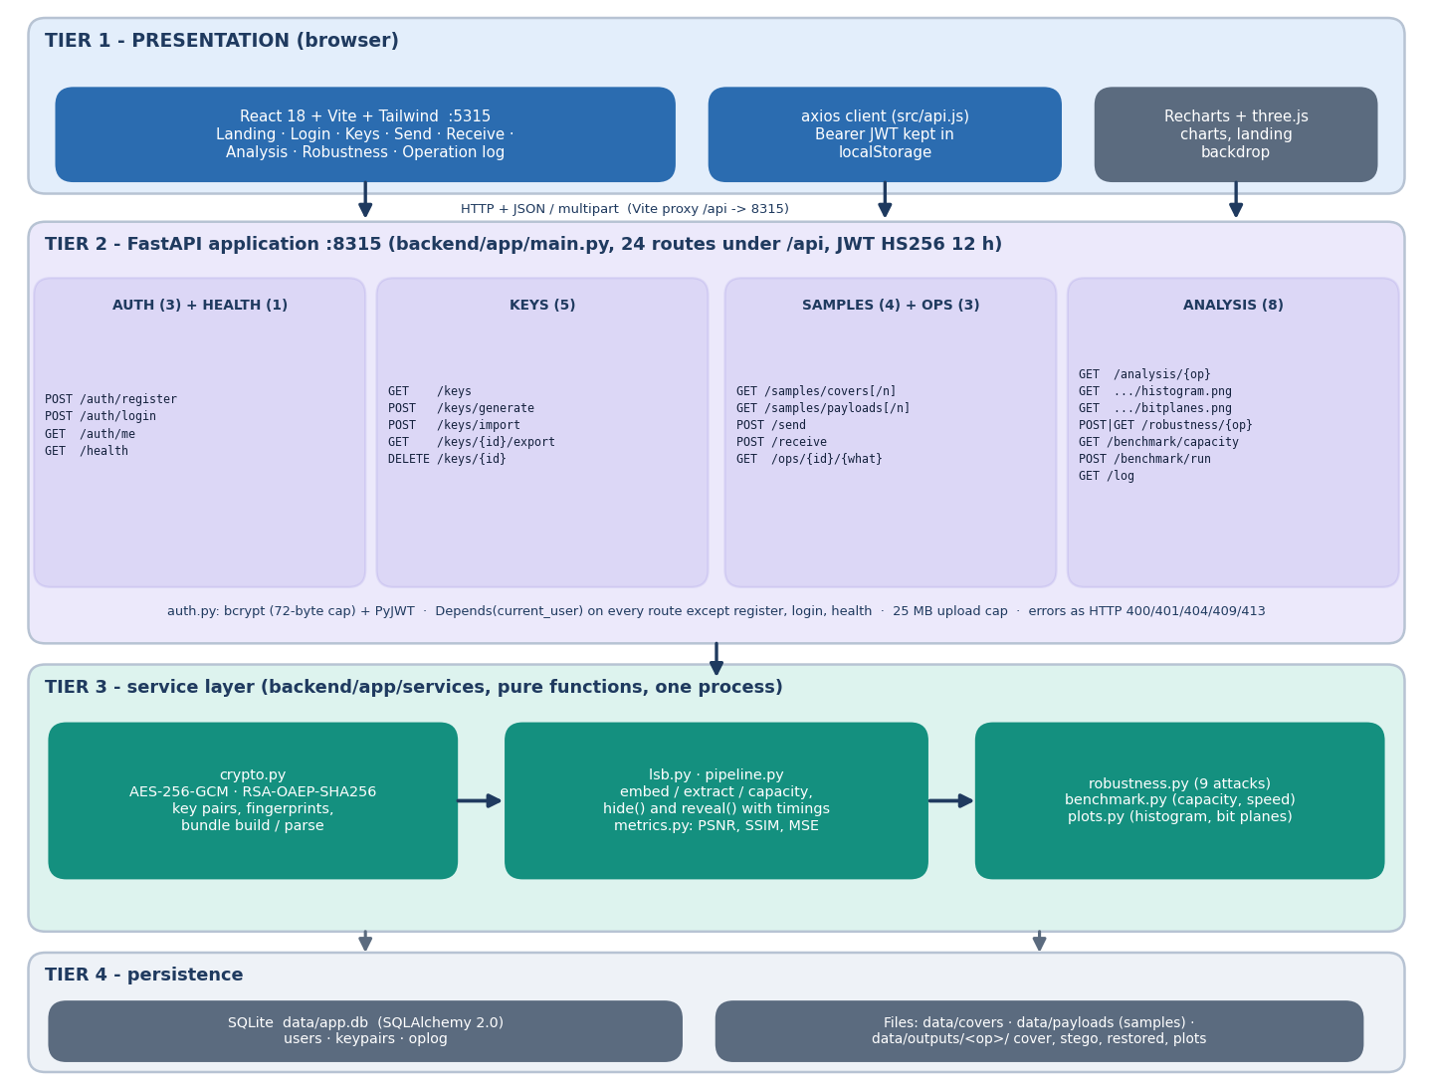
System Architecture
Console: React 18 + Vite + Tailwind, port 5315; 8 pages
API: FastAPI, port 8315; 24 endpoints, JWT (12 h), bcrypt
Services: crypto, lsb, metrics, pipeline, plots, robustness, benchmark - about 1,040 backend lines
Storage: SQLite with 3 tables (users, keypairs, oplog); covers, payloads and outputs as files
No external services; runs offline
Dept. of CSE | Batch A15 | Final Review
10
Notes:
Four tiers. The same pipeline module is used by the API, the benchmark and ml/eval.py, so measured numbers are the numbers of the product.

Slide 11
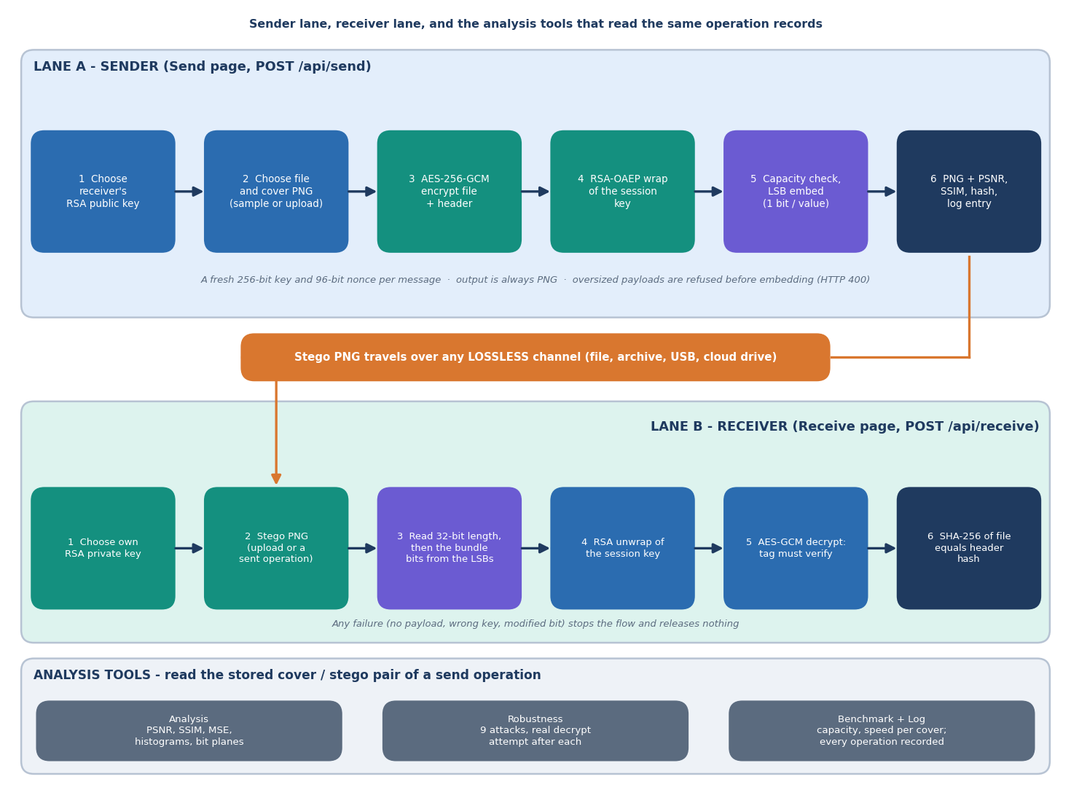
Methodology
No dataset: 6 committed cover images (200x200 to 1280x720) and 4 synthetic payloads (99 B to 21.5 KiB), regenerated by a seeded script.
Core evaluation: payloads of 1-128 KiB, RSA-3072, median of 3 repeats; 22 of 30 runs fit, 8 blocked by the capacity check.
Extra experiments: RSA key size, 6 covers x 7 fill levels x 5 seeds, plain vs encrypted, steganalysis, 240 tamper flips, extra attacks.
Robustness: every attack ends in a real decryption and a hash comparison.
Dept. of CSE | Batch A15 | Final Review
11
Notes:
Method in one picture, then the evaluation design. Everything is seeded and runs offline.

Slide 12
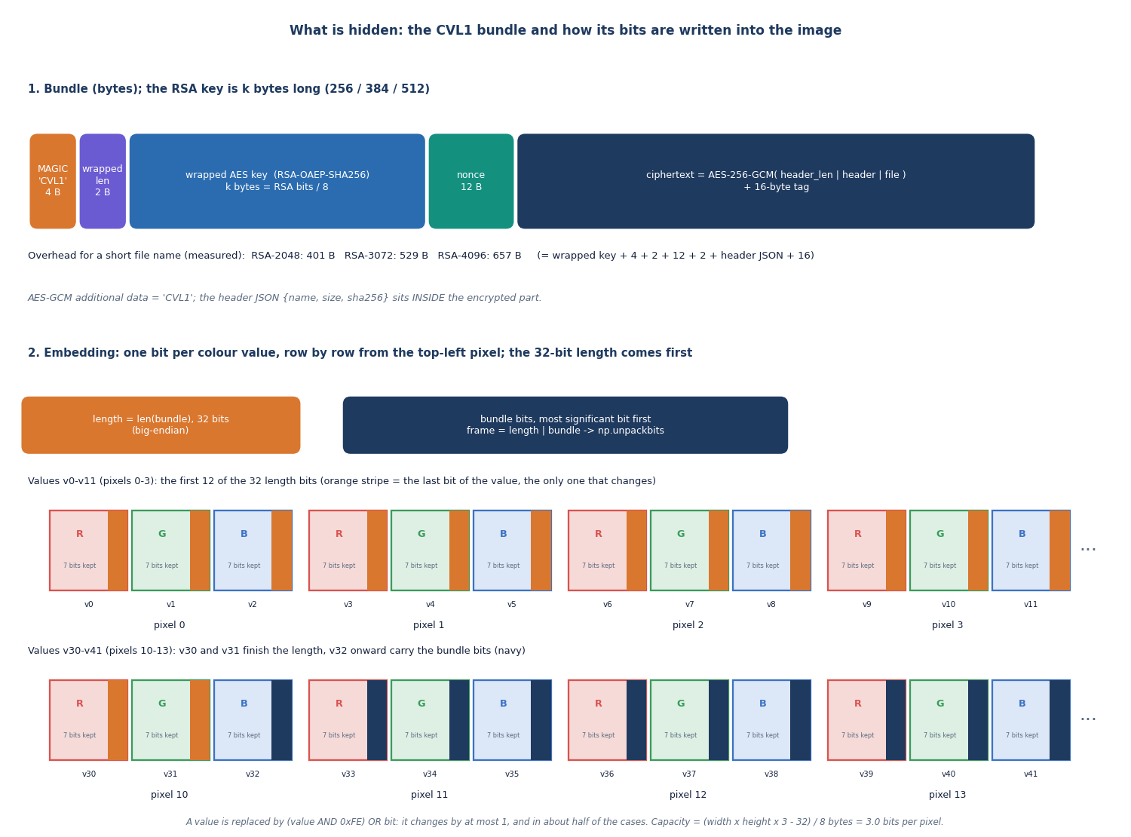
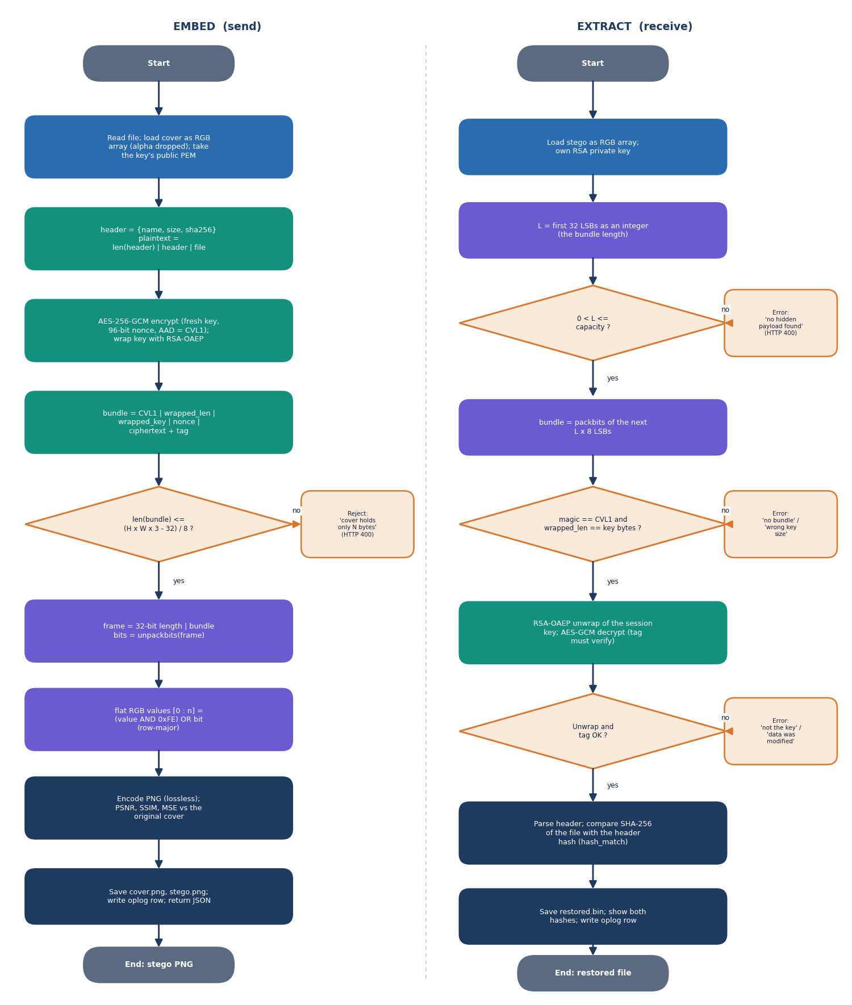
Bundle Format & Core Algorithm
Inside AES-GCM: header length | header JSON {name, size, sha256} | file. Hidden stream: 32-bit length, then the bundle, one bit per R, G, B value, row by row from the top-left pixel.
Dept. of CSE | Batch A15 | Final Review
12
Notes:
Left: byte layout. Right: the embed and extract flow with the capacity check and the GCM tag check. A wrong key, a flipped bit or a truncated bundle fails the tag and releases nothing.

Slide 13
Formulation & Test Material
Capacity of a W x H cover: C = (W*H*3 - 32) / 8 bytes (3.0 bits per pixel)
Imperceptibility: MSE = mean (x - x')^2, PSNR = 10 log10(255^2 / MSE), SSIM per colour channel, averaged
Random payload bits flip half of the touched values, so with b embedded bits in n values: E[MSE] = 0.5 b / n
Closed form: PSNR = 10 log10(255^2 n / (0.5 b)); with the cover full (b = n) the floor is 51.14 dB
Authenticity: GCM tag over header + file with CVL1 as associated data; RSA-OAEP with SHA-256 and MGF1-SHA-256 wraps the 256-bit key
0.053 dB
largest gap between measured PSNR and the closed form
6 covers
200x200 to 1280x720; public domain / CC0 / generated
4 payloads
memo PDF 21.5 KiB, CSV 2.7 KiB, notes, JSON (synthetic)
Why these choices: AES-GCM gives secrecy and integrity in one pass; OAEP is the standard randomised RSA padding; 1-bit sequential LSB is the simplest carrier and the one the base paper uses. LSB matching, adaptive embedding and error-correcting codes were left out of scope.
Dept. of CSE | Batch A15 | Final Review
13
Notes:
The formulation is short on purpose: capacity, PSNR and the random-bit model. The model was validated over 6 covers x 7 fill levels x 5 payload seeds.

Slide 14
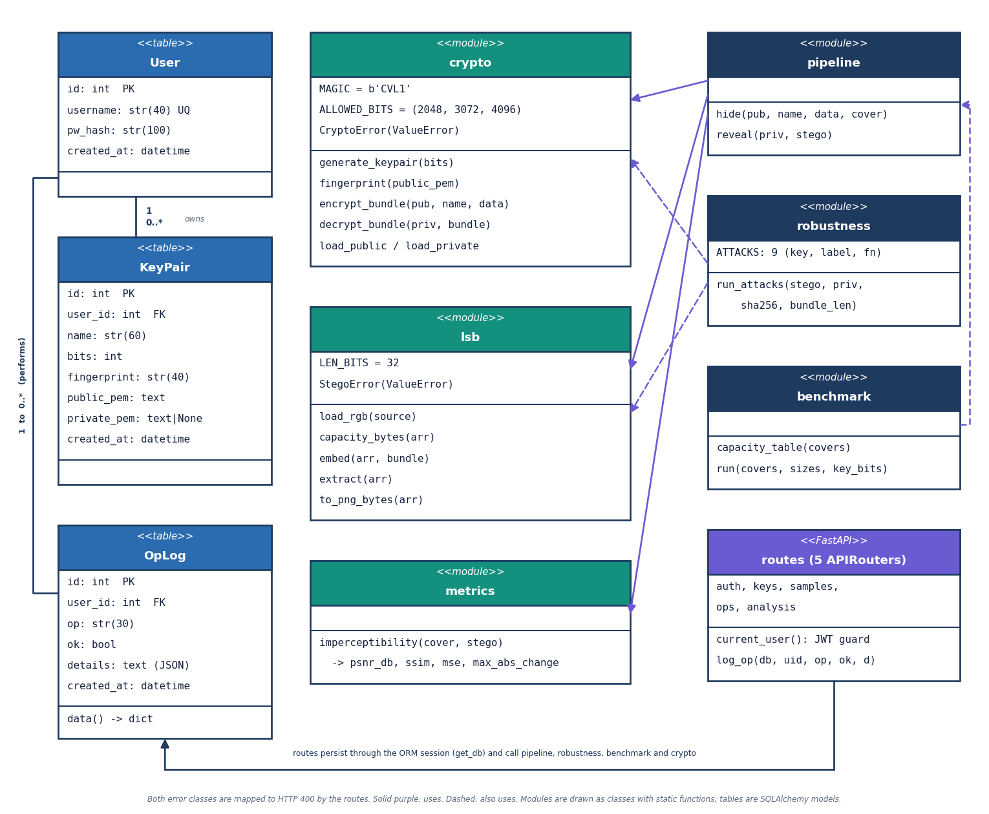
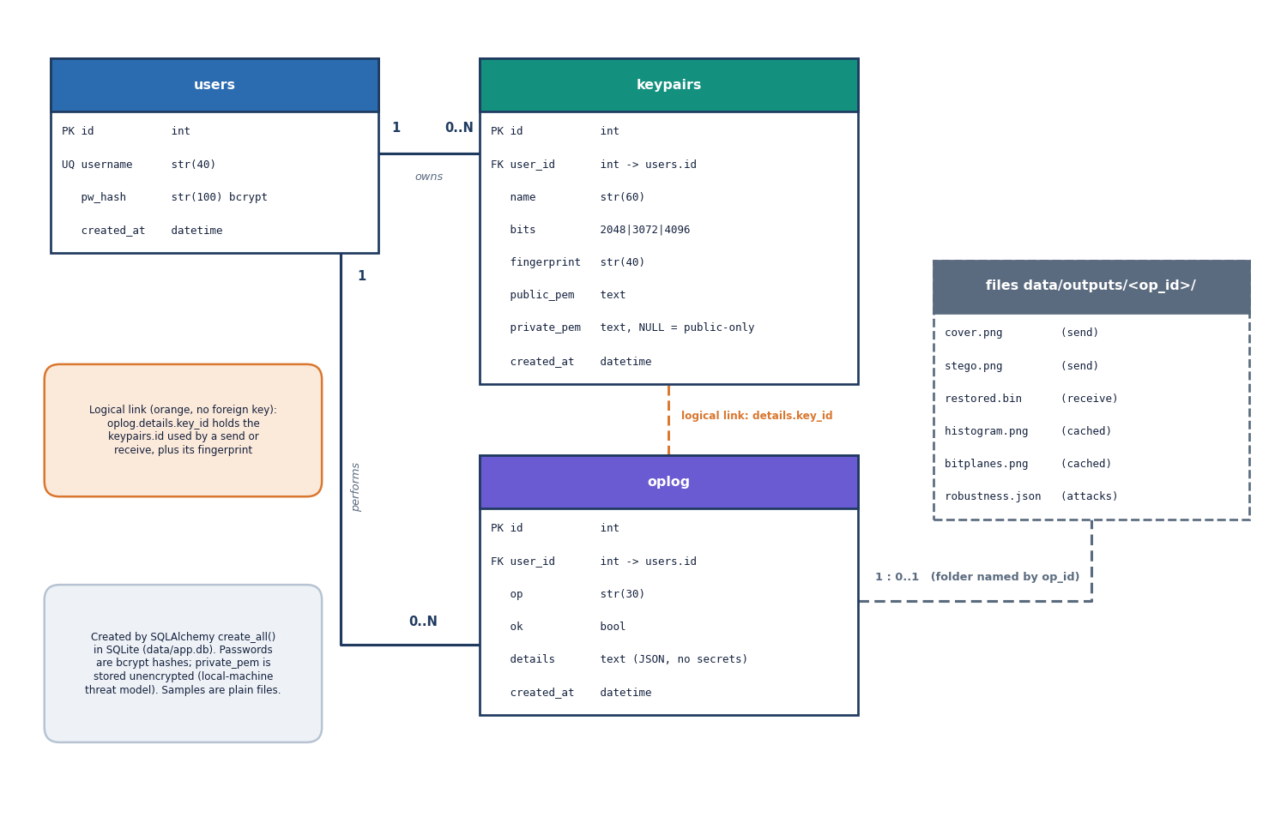
Design – Classes and Data
Table | Holds
users | username, bcrypt hash
keypairs | name, bits, fingerprint, public PEM, private PEM (empty = public only)
oplog | operation, status, JSON details (sizes, timings, metrics; no secrets)
Private keys are stored unencrypted in the local SQLite file: treat data/app.db as sensitive.
Dept. of CSE | Batch A15 | Final Review
14
Notes:
Class model of the services and routes, and the three tables. State the key-storage limitation here.

Slide 15
Implementation Highlights
24
39 + 21
3
8
API endpoints
pytest tests + smoke checks
database tables
React pages
Python 3.11, FastAPI, SQLAlchemy, cryptography 44, Pillow, NumPy, scikit-image (metrics), matplotlib (plots); React 18, Vite 6, Tailwind 4, Recharts.
One pipeline module (hide / reveal) serves the API, the benchmark and the evaluation script; samples are resolved from a directory listing, never joined from user input.
RSA keys below 2048 bits are rejected; uploads are capped at 25 MB; the oversize check runs before any embedding.
Known gaps: private keys unencrypted in the database, placeholder JWT secret in .env, no login rate limit, RSA only, no sender signatures.
Defect found while documenting: the Send page crashes for an account with no keys (a missing icon import); not fixed in the product code.
Dept. of CSE | Batch A15 | Final Review
15
Notes:
Highlights and honest gaps, including the Send-page defect found while documenting.

Slide 16
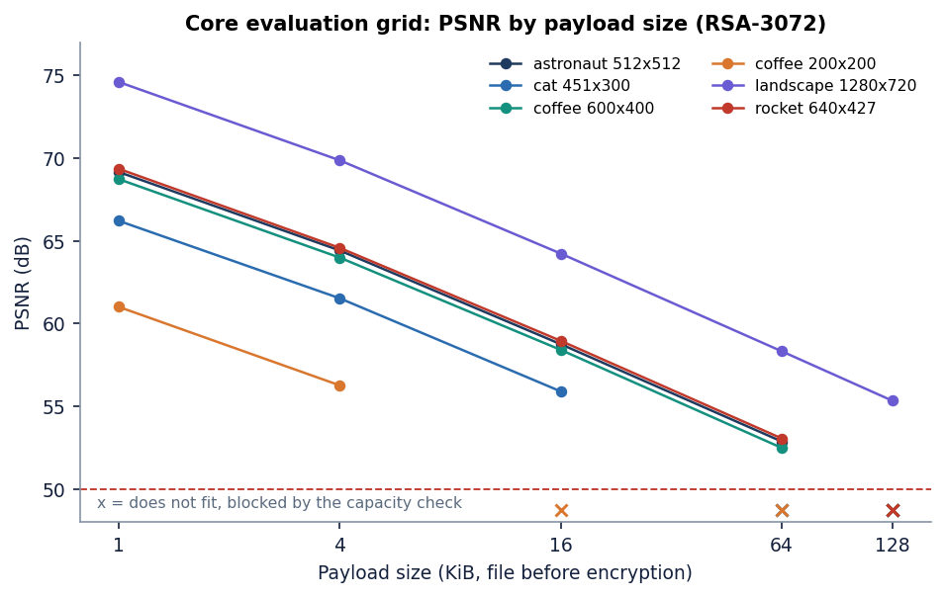
Results – Quality, Capacity and Speed
22 / 22
52.5 dB
0.9958
86 ms
round trips byte-exact (8 blocked by the capacity check)
minimum PSNR; mean 61.7 dB
minimum SSIM; mean 0.9990
RSA-3072 unwrap + decrypt; AES encrypt 0.15 ms
Cover | Pixels | Capacity (KiB) | PSNR in the grid (dB) | Min SSIM
astronaut_512x512.png | 512x512 | 96.0 | 52.9 - 69.2 | 0.9964
cat_451x300.png | 451x300 | 49.5 | 55.9 - 66.2 | 0.9991
coffee_600x400.png | 600x400 | 87.9 | 52.5 - 68.7 | 0.9972
coffee_small_200x200.png | 200x200 | 14.6 | 56.3 - 61.0 | 0.9992
generated_landscape_1280x720.png | 1280x720 | 337.5 | 55.3 - 74.6 | 0.9972
rocket_640x427.png | 640x427 | 100.1 | 53.0 - 69.4 | 0.9958
Grid: payloads of 1, 4, 16, 64, 128 KiB with RSA-3072. The lowest PSNR (52.5 dB) is the 600x400 cover filled to 73 %; PSNR depends on how much of the cover is used, not on which file is hidden. Median embed 0.25 ms, extract 0.05 ms.
Dept. of CSE | Batch A15 | Final Review
16
Notes:
Headline numbers from ml/eval.py. Capacity is 3.0 bits per pixel on every cover. The PSNR range reflects fill ratio.

Slide 17
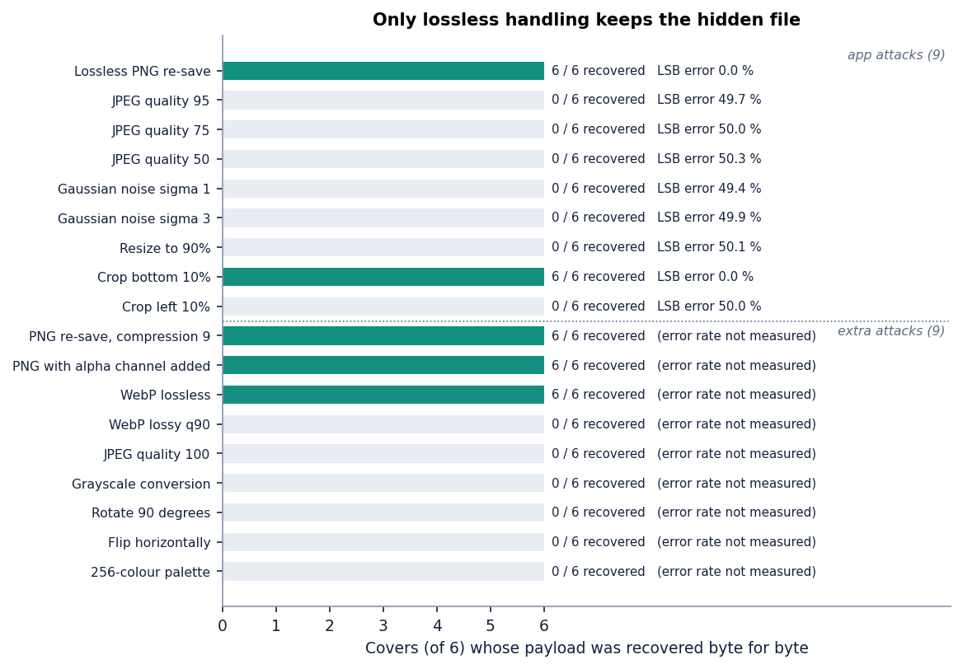
Robustness Matrix – What Survives
18 attacks on 6 covers (accounts.csv payload); each ends in a real decrypt and a hash check.
Survive (5 of 18, 6 of 6 covers): Lossless PNG re-save; Crop bottom 10%; PNG re-save, compression 9; PNG with alpha channel added; WebP lossless.
Lost: JPEG at q95, q75, q50 and even q100; lossy WebP; Gaussian noise sigma 1 and 3; resize 90 %; crop left 10 %; grayscale; rotate; flip; 256-colour palette. LSB error rate about 50 %.
Crop bottom 10 % survives only because bits run from the top row downwards and the payload still fits in the remaining rows.
Consequence: send the stego image as a PNG file; a chat app or social site that re-encodes it destroys the message.
Dept. of CSE | Batch A15 | Final Review
17
Notes:
This is the confusion-matrix equivalent: attack by outcome, counted over six covers. There is no error correction, so one flipped LSB region is fatal.

Slide 18
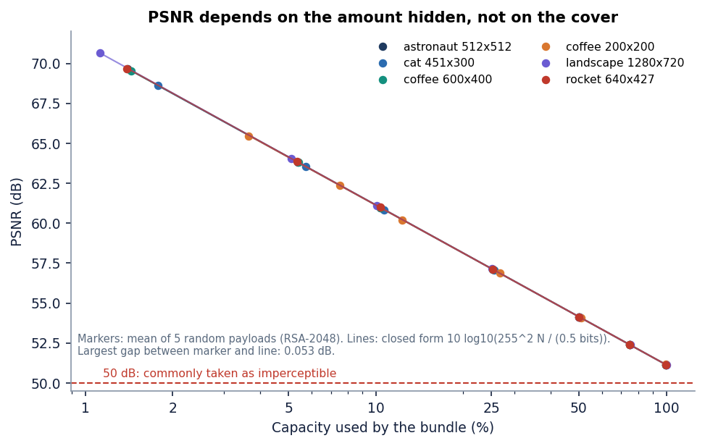
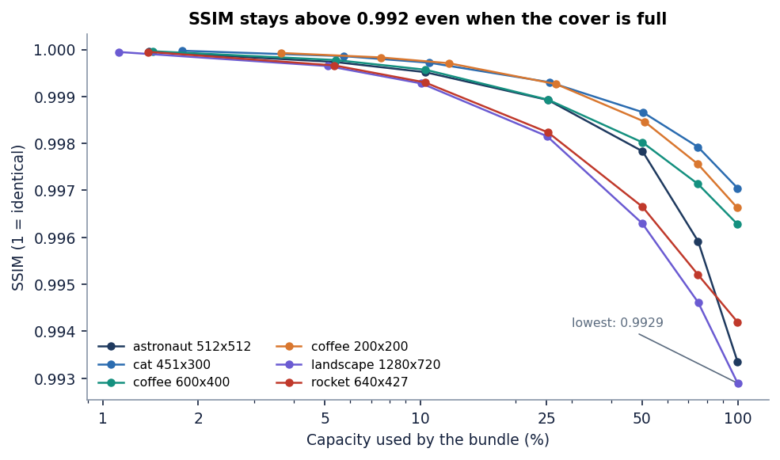
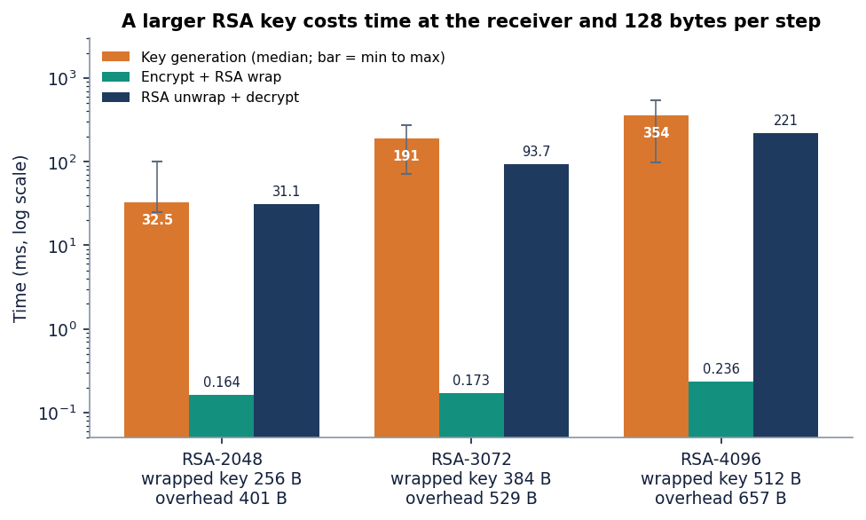
Parameter Analysis – Fill Ratio and RSA Key Size
RSA bits | Keygen (ms) | Wrap (ms) | Unwrap + decrypt (ms) | Wrapped key | Overhead
2048 | 32 | 0.16 | 31 | 256 B | 401 B
3072 | 191 | 0.17 | 94 | 384 B | 529 B
4096 | 354 | 0.24 | 221 | 512 B | 657 B
6 covers x 7 fill levels x 5 seeds: measured PSNR within 0.053 dB of the closed form; seed-to-seed std at most 0.10 dB.
Full cover: PSNR 51.14-51.17 dB, SSIM at least 0.9929.
Larger RSA keys add bytes and unwrap time, not image distortion beyond the bit count.
Dept. of CSE | Batch A15 | Final Review
18
Notes:
The parameters: how much of the cover is used (drives PSNR) and the RSA key size (drives time and overhead). Key generation times vary widely between runs.

Slide 19
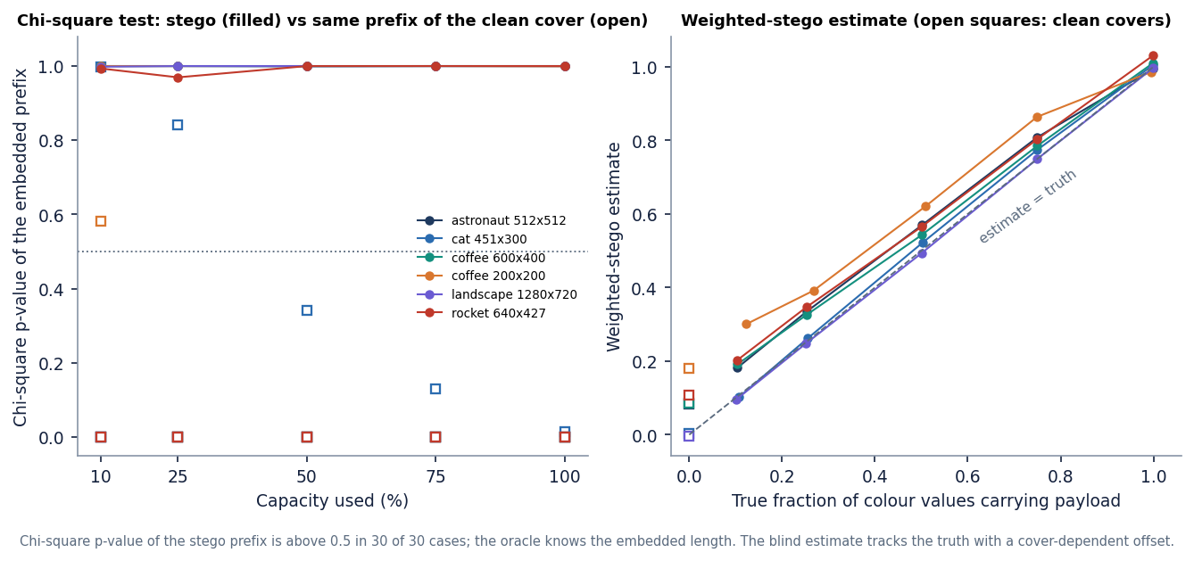
Steganalysis – Hidden from the Eye, Not from Statistics
Chi-square (Westfeld-Pfitzmann) on the embedded prefix: stego p-value above 0.5 in 30 of 30 cases (lowest 0.97); the clean cover prefix is below 0.5 in 27 of them.
In 3 cases (cat 10 % and 25 %, small coffee 10 %) the clean cover already looks equalised, so the test cannot separate them. It is an oracle test: it knows the used length.
Weighted-stego (blind) estimates the embedded fraction well: true 0.5 gave 0.49-0.62. Clean covers read -0.01 to 0.18 (natural-image bias).
Encryption does not cost quality (about 50 % of embedded bits flip a value either way) and makes the stream balanced, but sequential, key-independent embedding stays detectable at medium and high fill.
Dept. of CSE | Batch A15 | Final Review
19
Notes:
The key honest finding. PSNR above 50 dB means invisible to the eye; it does not mean undetectable. Low fill is safer, not safe. Stronger detectors were not run.

Slide 20
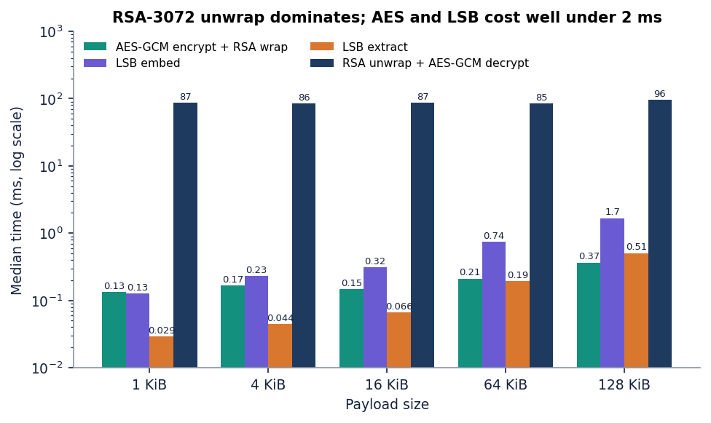
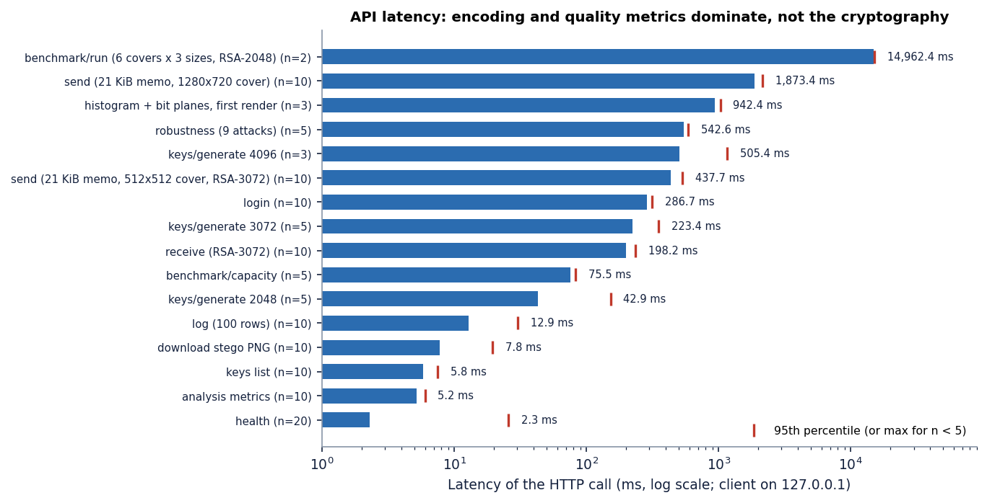
Performance & Testing
438 ms
1.9 s
198 ms
240 / 240
API send, 512x512 cover (median)
API send, 1280x720 cover
API receive, RSA-3072
tampered bundles rejected
Check | Result
pytest (crypto 13, LSB 9, metrics 7, API 10) | 39 of 39 passed; smoke test 21 of 21 checks
Cost split | AES encrypt 0.15 ms is negligible; PSNR/SSIM and PNG encoding dominate send time
Not tested | load or concurrent users, camera photographs, external security audit, other machines
Dept. of CSE | Batch A15 | Final Review
20
Notes:
Latencies measured on 127.0.0.1 on an i5-12500, CPU only, on the same PC that ran other jobs, so milliseconds vary by roughly 10-30 % between runs.

Slide 21
Comparison with Base Paper and Supporting Work
Aspect | ProSt [1] (base) | SCReedSolo [3] | CipherVeil
Goal | Compute on hidden bits at an untrusted cloud | Robust LSB hiding of text, audio, image | Send a file securely and invisibly
Crypto | None for the data; secret position as key | Fernet + Reed-Solomon, shuffling | AES-256-GCM + RSA-OAEP-SHA256
Reported quality | No PSNR, SSIM or capacity | PSNR 51.8 / 57.7 / 52.9 dB; SSIM 0.996 / 0.936 / 0.996; 3 bpp | PSNR 52.5-74.6 dB (up to 73 % fill), 51.1 dB full; SSIM >= 0.9929; 3.0 bpp
Reported time | 8.38 s: 17-gate circuit, 128x128x3 | not compared here | embed 0.25 ms, unwrap 86 ms (RSA-3072)
Robustness | Not evaluated | Reed-Solomon survives bit corruption | No error correction; 5 of 18 attacks survive (lossless only)
Different goals, covers and payloads: the figures are indicative, not a head-to-head. SCReedSolo hides far larger payloads in far larger covers. No superiority over either paper is claimed.
CipherVeil takes the LSB carrier and key-exchange framing from ProSt and adds authenticated hybrid encryption plus the quality, robustness and detectability measurements ProSt does not report.
Dept. of CSE | Batch A15 | Final Review
21
Notes:
State plainly that the datasets and goals differ. SCReedSolo's figures are for much larger covers and payloads. ProSt reports no PSNR or SSIM, so no quality comparison with it exists.

Slide 22
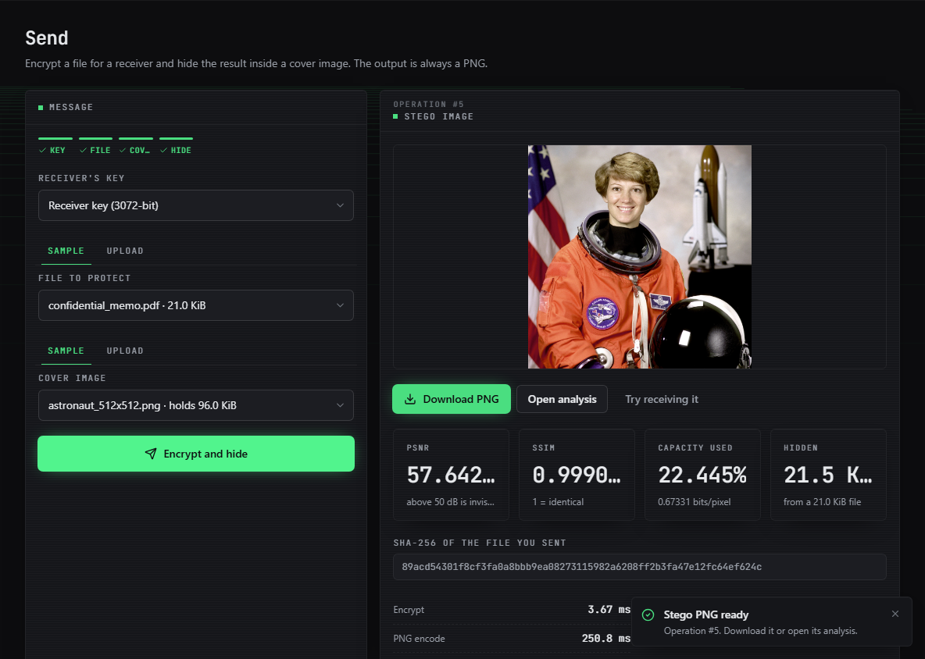
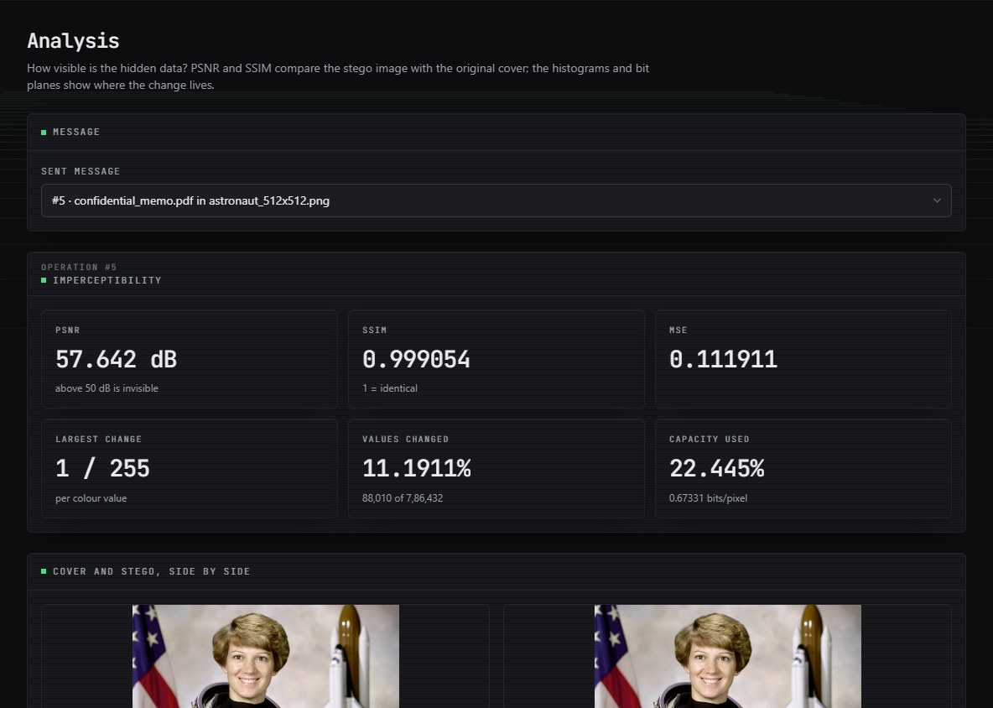
Output – Send and Analysis
Left: the 21 KiB memo hidden in the astronaut photo: PSNR 57.64 dB, SSIM 0.9991, 22.4 % of the cover used, SHA-256 of the file. Right: analysis of the same message: MSE 0.112, largest change 1 of 255, 11.2 % of values changed, cover and stego side by side.
Dept. of CSE | Batch A15 | Final Review
22
Notes:
Real captures of the running console. The change is invisible to the eye; the statistics tell the truth, as the steganalysis slide shows.

Slide 23
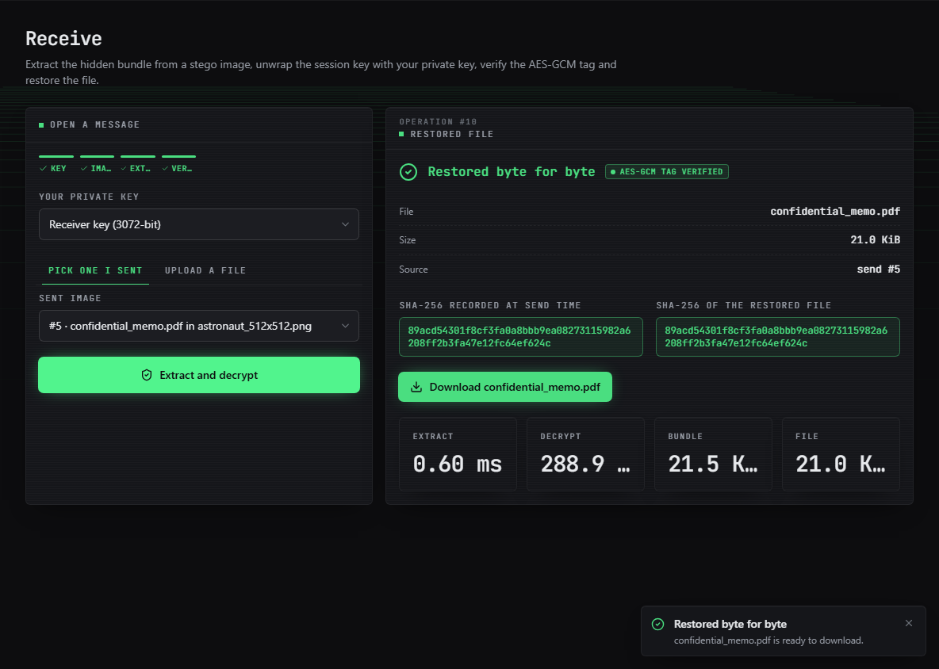
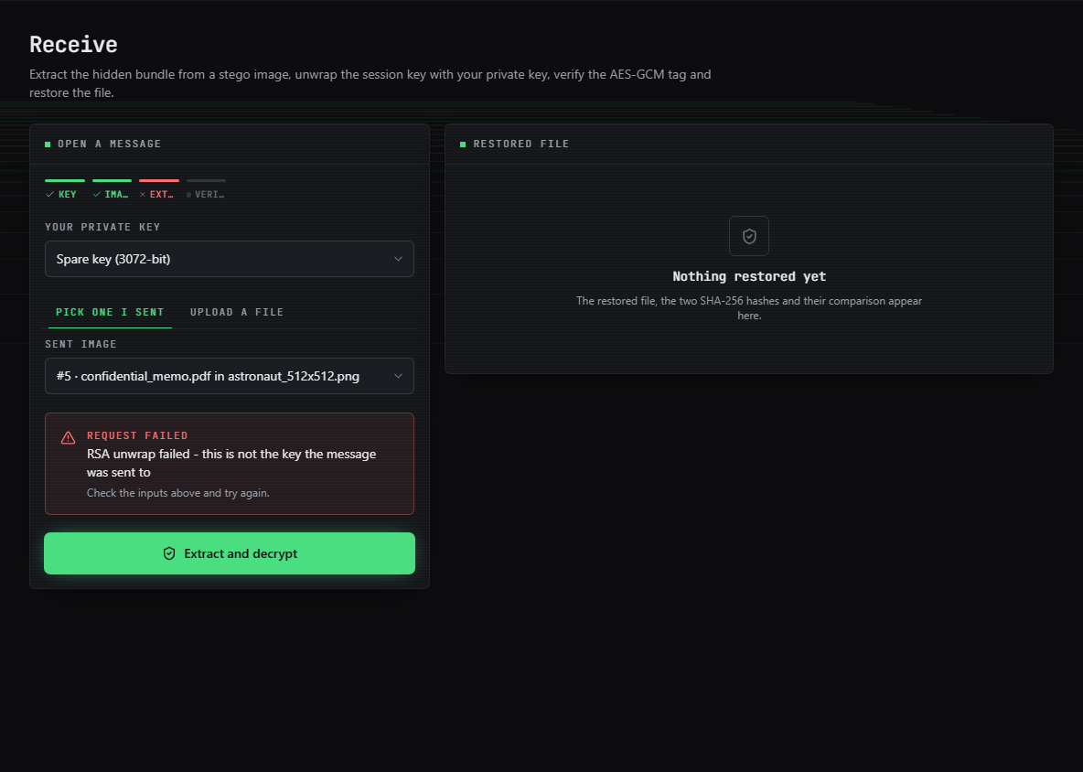
Output – Receive and Wrong Key
Left: the right key restores the memo byte for byte; the AES-GCM tag is verified and both SHA-256 values are identical. Right: another keypair of the same size fails at the RSA unwrap and nothing is released.
Dept. of CSE | Batch A15 | Final Review
23
Notes:
Success and failure of the receive path.

Slide 24
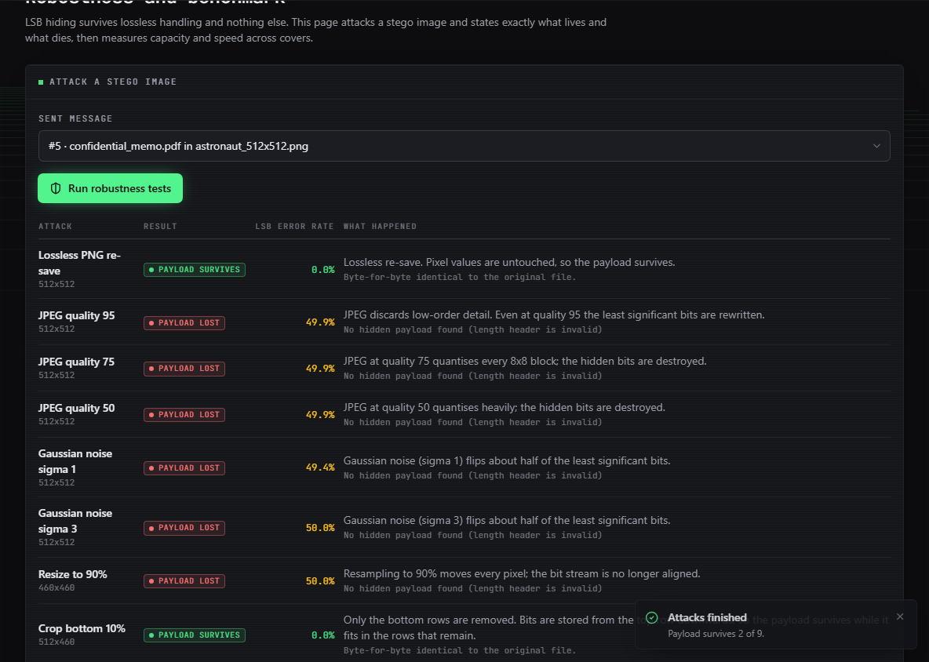
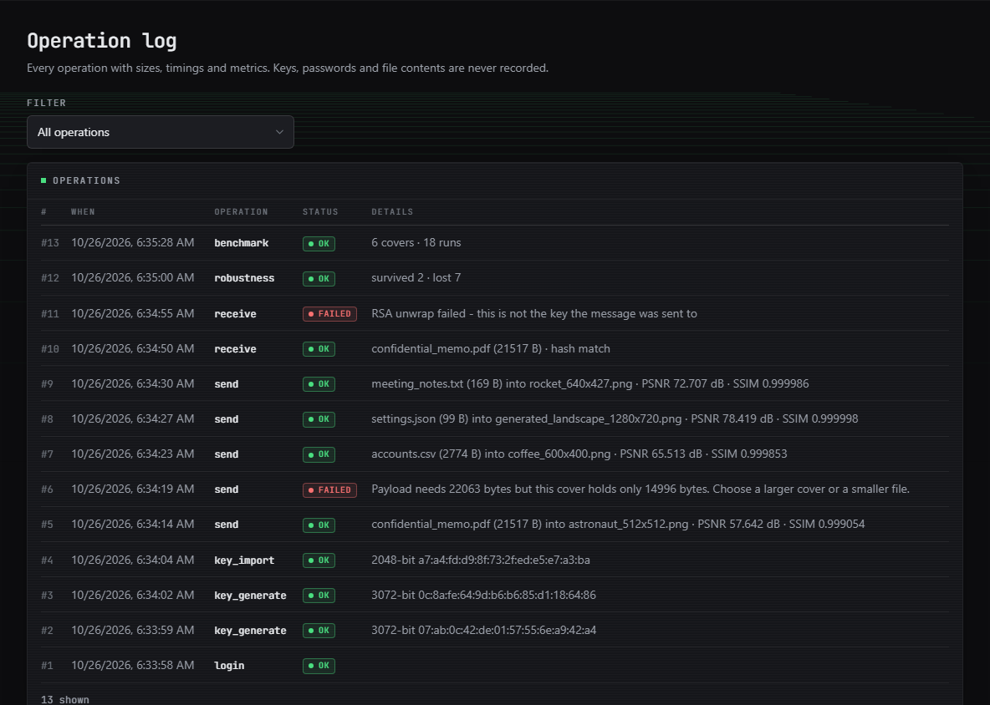
Output – Robustness and Operation Log
Left: nine attacks on one stego image: the payload survives 2 of 9, the rest give an LSB error rate near 50 %. Right: the operation log: keys, sends (one blocked by the capacity check), receives (one failed), robustness and benchmark, with no key material.
Dept. of CSE | Batch A15 | Final Review
24
Notes:
Robustness page and operation log from the same session.

Slide 25
Contributions, Conclusion & Objectives
Contributions
1. Authenticated CVL1 bundle: name, size and SHA-256 inside the AES-GCM layer, magic as associated data.
2. Hybrid AES-256-GCM + RSA-OAEP-SHA256 with a fresh key and nonce per message: byte-exact in 22/22 runs, 240/240 tampered bundles rejected.
3. Capacity-aware 1-bit LSB embedder, 3.0 bpp; PSNR model within 0.053 dB of measurement; PSNR >= 51.1 dB at any fill.
4. Honest evaluation: only lossless handling survives (5 of 18 attacks); chi-square flags 30/30; weighted-stego tracks the fill.
5. Full-stack tool (FastAPI + React) with key management, analysis, robustness and a secret-free log; 39 tests + 21 smoke checks.
Novelty is integration and evaluation, not new primitives: AES, RSA-OAEP and LSB are standard.
# | Objective | Outcome
1 | AES for data, RSA for key | Met: AES-256-GCM + RSA-OAEP
2 | Key generation and exchange | Met for RSA 2048-4096, PEM import/export; no identity check
3 | LSB embedding | Met: 3.0 bpp, capacity check
4 | Extract and decrypt | Met: byte-exact, tag and hash
5 | PSNR and SSIM | >= 51.1 dB at any fill; SSIM >= 0.993
6 | Capacity, time, robustness | Measured; lossless-only, detectable
Dept. of CSE | Batch A15 | Final Review
25
Notes:
Five contributions, then the six objectives against outcomes. Objectives 1-5 are met; objective 6 is met as a measurement, and the measurement is unflattering on robustness and detectability.

Slide 26
Limitations & Future Scope
Known limitations
Future scope
Data survives only lossless PNG handling; no error correction
Sequential, key-independent embedding: detected by chi-square and weighted-stego at medium and high fill
Private keys unencrypted in the database; placeholder JWT secret; no login rate limit
RSA only, no sender signature: the receiver cannot tell who sent it
Six covers, four small payloads, one machine; no camera photographs
ProSt's homomorphic computation and provable security are out of scope; Send page crashes for accounts with no keys
Key-dependent pixel permutation, LSB matching or adaptive (edge) embedding
Reed-Solomon coding for resilience to light corruption
Sender signatures (RSA-PSS or Ed25519) and an encrypted key store
Post-quantum key encapsulation in place of RSA
Test against stronger steganalysis (RS, sample-pair, learned detectors)
Audio and video carriers; rate limiting; a formal usability study
Dept. of CSE | Batch A15 | Final Review
26
Notes:
Limitations first, then concrete next steps. The first future item answers the steganalysis finding directly.

Slide 27
References
[1] S. Ahmad and S. Rass, "ProSt: Provably secure homomorphic steganography," IEEE Access, vol. 14, pp. 14393-14409, 2026, doi: 10.1109/ACCESS.2026.3656995.
[2] S. E. Fatemieh, R. Shahdi Alizadeh, and E. Zarezadeh, "Design of memristive lightweight encryption for in-memory image steganography," arXiv:2605.03494, May 2026.
[3] S. R. Raiyan and M. H. Kabir, "SCReedSolo: A secure and robust LSB image steganography framework with randomized symmetric encryption and Reed-Solomon coding," arXiv:2503.12368, 2025 (ACPR 2025).
[8] J. Fridrich, Steganography in Digital Media: Principles, Algorithms, and Applications. Cambridge, U.K.: Cambridge Univ. Press, 2009.
[11] C.-K. Chan and L. M. Cheng, "Hiding data in images by simple LSB substitution," Pattern Recognition, vol. 37, no. 3, pp. 469-474, Mar. 2004.
[15] A. Westfeld and A. Pfitzmann, "Attacks on steganographic systems," in Information Hiding (IH 1999), Lecture Notes in Computer Science, vol. 1768. Berlin, Germany: Springer, 2000, pp. 61-76.
[16] J. Fridrich, M. Goljan, and R. Du, "Detecting LSB steganography in color and gray-scale images," IEEE MultiMedia, vol. 8, no. 4, pp. 22-28, Oct.-Dec. 2001.
[18] J. Fridrich and M. Goljan, "On estimation of secret message length in LSB steganography in spatial domain," in Proc. SPIE, vol. 5306, Security, Steganography, and Watermarking of Multimedia Contents VI, 2004, pp. 23-34.
[20] Advanced Encryption Standard (AES), Federal Information Processing Standards Publication 197, NIST, Nov. 2001.
[21] M. Dworkin, "Recommendation for block cipher modes of operation: Galois/Counter Mode (GCM) and GMAC," NIST Special Publication 800-38D, Nov. 2007.
[23] K. Moriarty, B. Kaliski, J. Jonsson, and A. Rusch, "PKCS #1: RSA cryptography specifications version 2.2," IETF RFC 8017, Nov. 2016.
[26] Z. Wang, A. C. Bovik, H. R. Sheikh, and E. P. Simoncelli, "Image quality assessment: From error visibility to structural similarity," IEEE Trans. Image Processing, vol. 13, no. 4, pp. 600-612, Apr. 2004.
The full numbered list of 29 references, including the four batch survey items [4]-[7] (title level only), is in the report.
Dept. of CSE | Batch A15 | Final Review
27
Notes:
Selected references; the complete numbered list is in the project report.

Slide 28
THANK YOU
Questions & Suggestions
Dept. of CSE | Batch A15 | Final Review
28
Notes:
Invite questions. Likely ones: why LSB, how detectable it is, what survives, how this differs from the base paper.

