Slide 1
PhishGuard
REVIEW 2 · DESIGN, METHODOLOGY AND PROGRESS
A Dynamic Phishing URL Detection System Integrating Advanced Machine Learning and Crowdsourced Threat Intelligence
Presented by
Under the guidance of
D.ANISH MEGHAN 23K91A6750
B.AKSHAYA 23K91A6737
B.TANUJA 23K91A6736
CH.SAI CHETHAN 23K91A6742
Mr. G. Ravi, [DESIGNATION]
Department of Computer Science and Engineering (Data Science)
[COLLEGE NAME] · Batch A3 (CSE-DS, Section A) · [ACADEMIC YEAR]
Notes:
Review 2 covers the design, methodology and progress of PhishGuard.

Slide 2
Contents
01
02
03
04
Recap
Architecture
Methodology
Dataset
05
06
07
08
Preprocessing
Model and training
Decision logic
Data flow, modules, database
09
10
11
12
Technology stack
Progress
Preliminary results and screens
Testing, challenges, next steps
Notes:
Twelve parts, from a recap of Review 1 through design and methodology to progress, results, testing and next steps.

Slide 3


Recap: problem and proposed system
Problem
Proposed system
Blacklists miss zero-day phishing URLs, fixed rules are easy to evade, and models trained once go stale. Users cannot see why a link is flagged.
The base paper's three stages: URL features, ML classification, crowdsourced refinement, built as a Flask API with a React interface.
URL string
47 offline features
3 models, best F1 deployed
Community verdict first
Report, retrain, reload
Notes:
Recap of Review 1: the problem and the proposed system as a five-step pipeline.

Slide 4
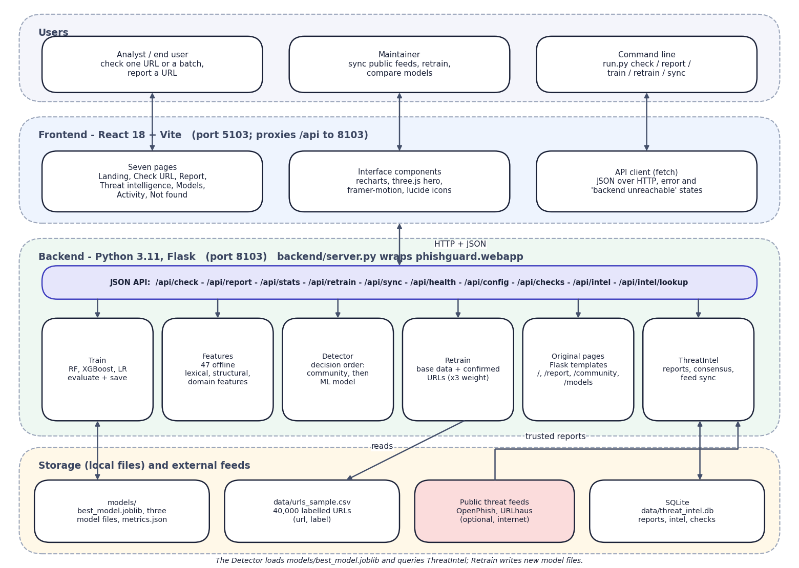

System architecture
Client: React 18 + Vite (port 5103), seven pages, recharts, three.js hero.
API: Flask (port 8103); backend/server.py wraps the original app and adds five read-only endpoints and CORS.
Detector: community verdict first, then the best model with reputation and vote adjustments.
ThreatIntel: SQLite store of reports, consensus, optional OpenPhish and URLhaus sync.
Retrain: base data plus confirmed URLs, hot reload of the best model.
Notes:
The browser talks only to the Vite server, which proxies /api to Flask. The detection modules are plain Python behind the API.

Slide 5
Methodology: end-to-end workflow
Load 40,000 URLs
Clean + normalise
Extract 47 features
Split 80 / 20
Train 3 models
Evaluate + select
Check, report, retrain
Same data for all
Community first
Closed loop
All three classifiers use the same features and the same stratified split, so the comparison is fair.
A confirmed community verdict, phishing or safe, overrides the model at check time.
Confirmed URLs are added to the training data (x3) and the retrained model is hot-reloaded.
Notes:
End-to-end workflow in seven steps. Features are computed offline from the URL string so training and checking use identical code.

Slide 6
Dataset and input sources
Source | Size | Use
Sample of a public labelled URL set | 40,000 URLs (20,000 + 20,000) | Train and test
Split (stratified, seed 42) | 32,000 train / 8,000 test | Evaluation
URL length | mean 51.5, median 40, max 1,383 | Feature design
Community reports | Created at run time (SQLite) | Zero-day verdicts
OpenPhish and URLhaus feeds | up to 500 URLs each, optional | Trusted reports
Notes:
The 40,000 URLs are a balanced sample of a public dataset of about 420,000 URLs. Its licence was not verified. Only 266 URLs contain a scheme, so the extractor adds http:// first.

Slide 7



Data preparation and features
Cleaning
Normalisation
47 features
Rows without a URL or label are dropped, labels mapped to 0/1, whitespace trimmed, URLs shorter than 4 characters removed and duplicates dropped.
Add a scheme when missing, lower-case the host, strip www., keep port, path and query. Malformed ports or brackets never raise an error.
23 lexical (lengths, counts, entropy, suspicious words), 9 structural (IP host, port, subdomains, shorteners, extensions) and 15 domain features (domain entropy, TLD, brand, reputation). No DNS or page download.
Notes:
Preprocessing is cleaning plus feature extraction. Everything is computed from the URL string, so training and real-time checking use the same code.

Slide 8
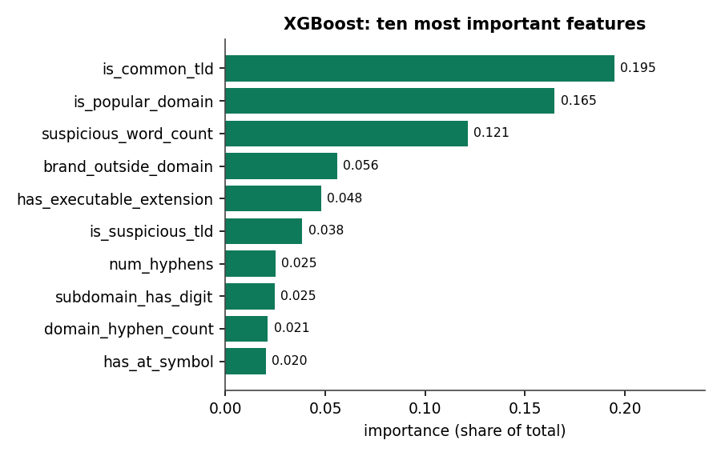

Models: three classifiers compared
Model | Setting
Logistic Regression | scaled, C 1.0, balanced
Random Forest | 300 trees, balanced
XGBoost | 400 trees, depth 8, lr 0.08
Top-10 features of the selected XGBoost model. Selection rule: highest F1, ROC-AUC breaks ties.
Notes:
The three models match the project objectives. The deployed model is the best by F1: XGBoost.

Slide 9
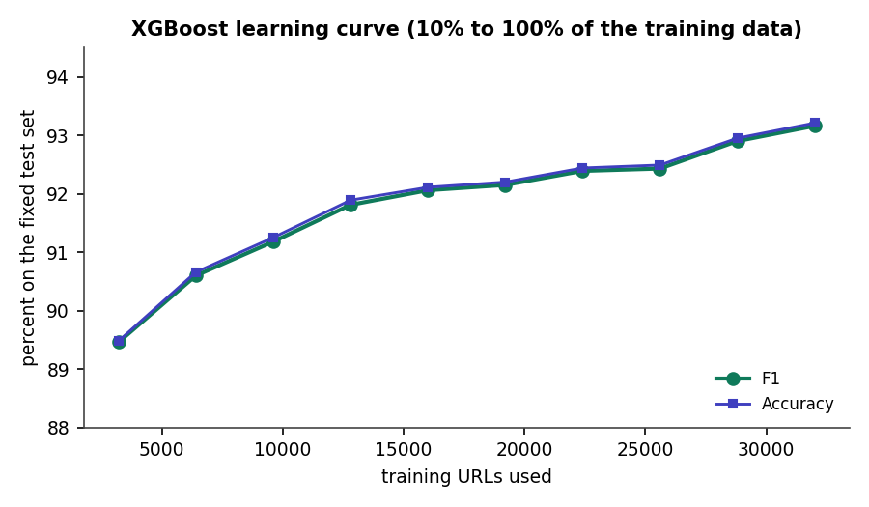

Training configuration
Setting | Value
Training / test rows | 32,000 / 8,000
Features | 47
Split | stratified, seed 42
Training time | RF 12.2 s, XGB 2.7 s, LR 0.2 s
Selection | best F1 (ROC-AUC tie-break)
Cross-validation | 5-fold, all 40,000 URLs
Retrain weight | confirmed URLs x3
Hardware | Intel Core i5-12500, 12 threads, no GPU
Learning curve: F1 rises from 89.5 % (3,200 URLs) to 93.2 % (32,000)
Notes:
Training is fast: all three models take about 15 seconds. The learning curve suggests more data would still help.

Slide 10
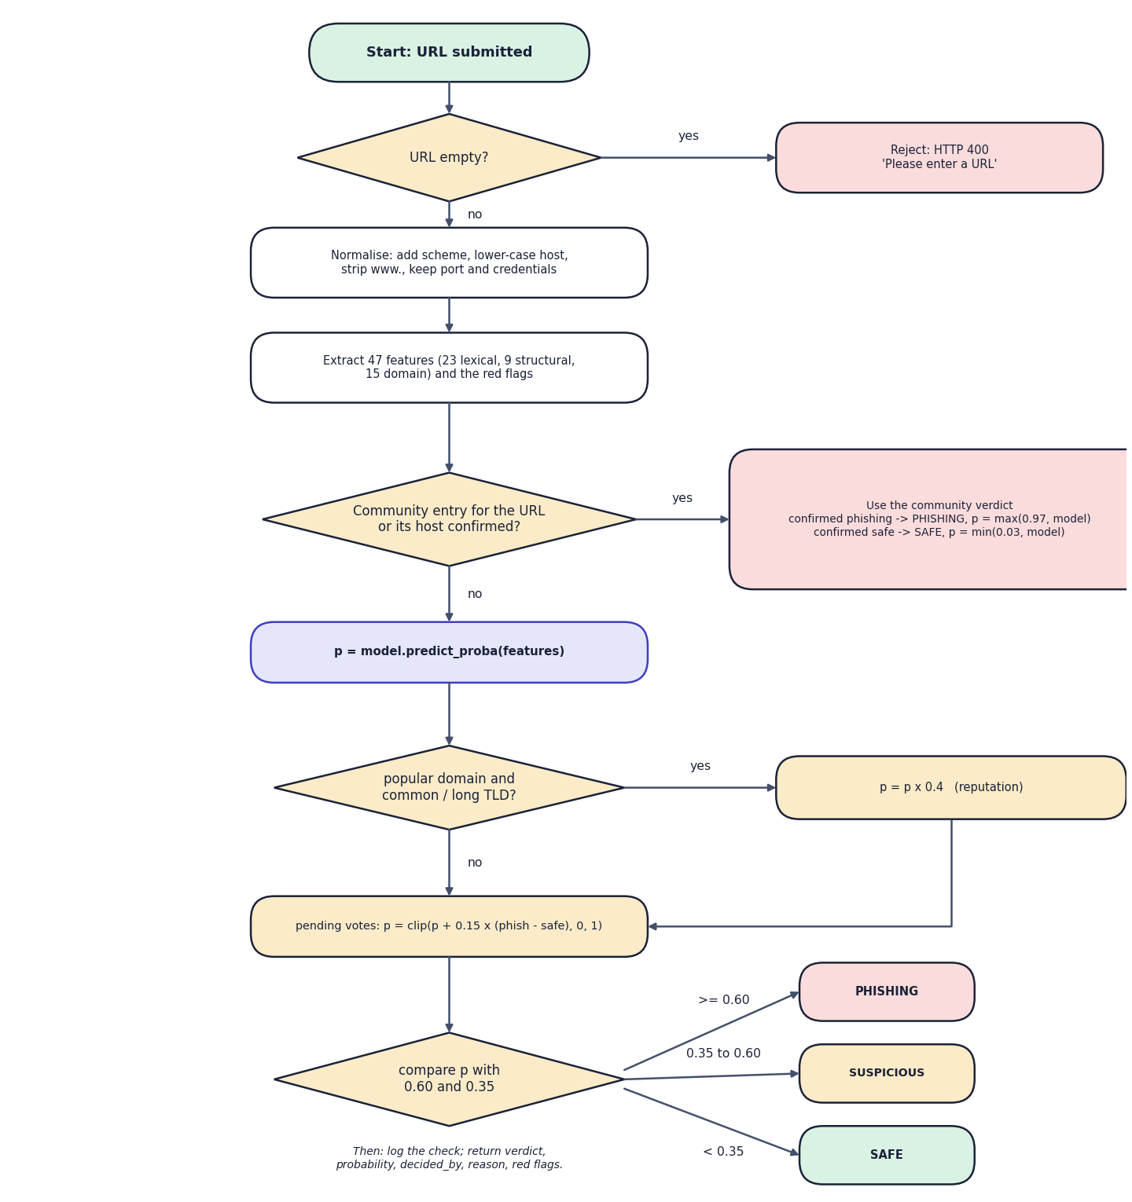

Decision logic
Community first
A confirmed entry for the URL or its host decides at once: phishing (probability at least 0.97) or safe (at most 0.03).
Model second
Otherwise p from the model; x0.4 for popular domains; +-0.15 per net pending vote.
Thresholds
p >= 0.60 phishing; p >= 0.35 suspicious; otherwise safe. Every check is logged with its reason.
Notes:
Decision logic: the community verdict wins, then the model with two small adjustments, then two thresholds.

Slide 11
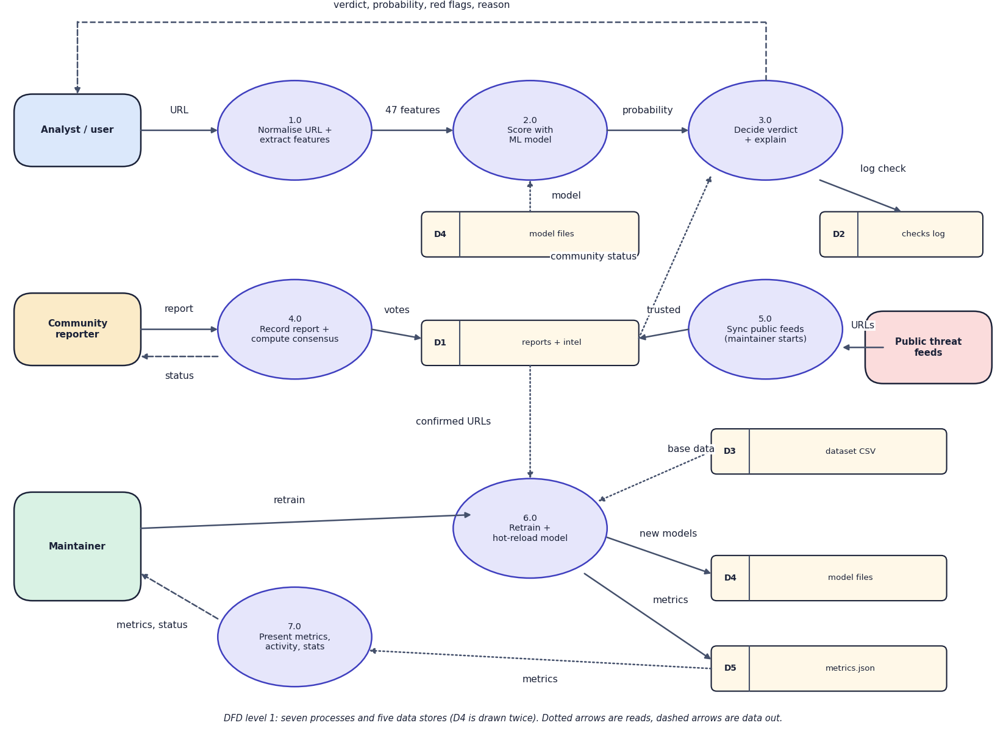
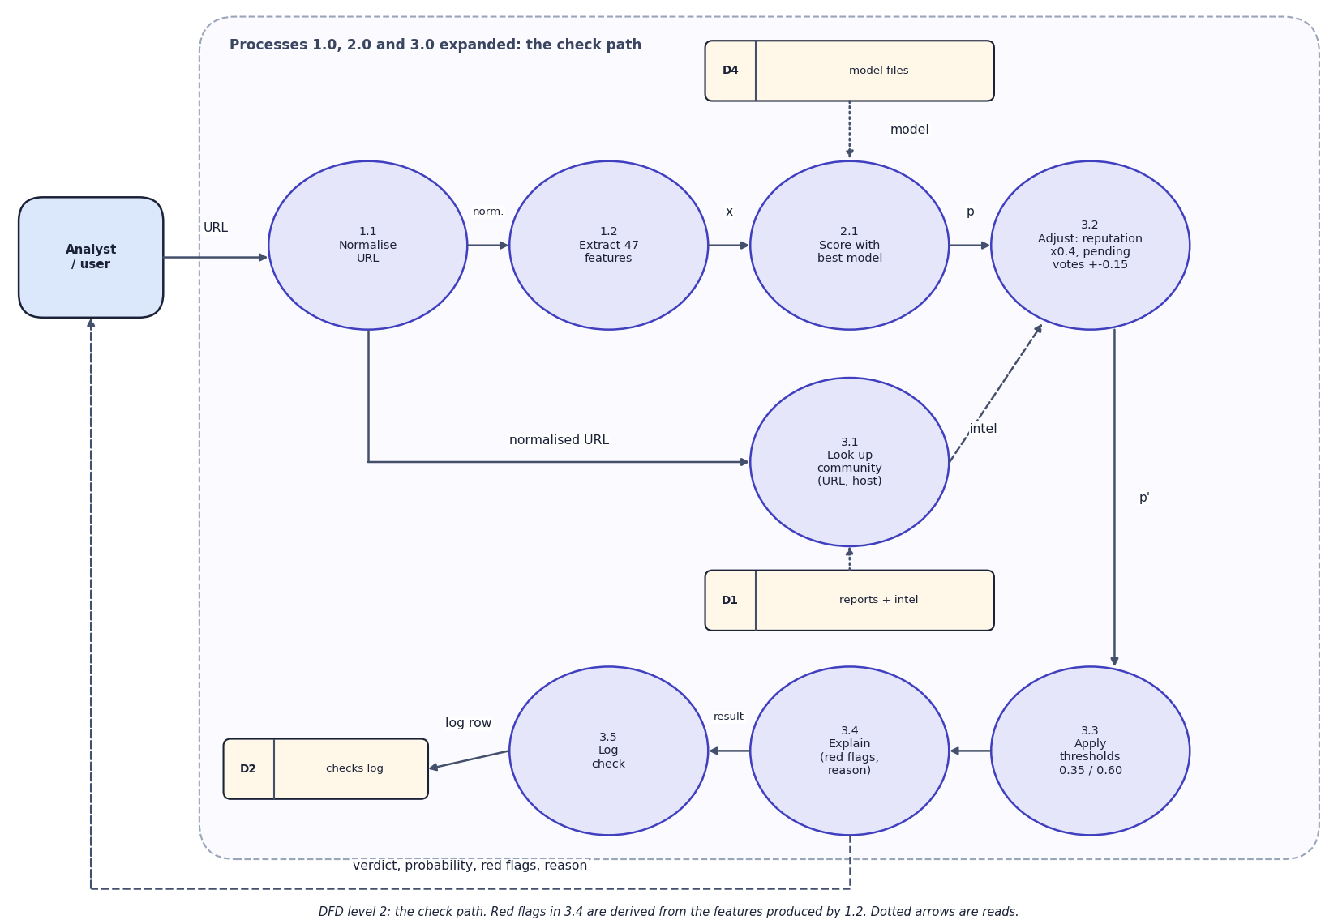

Data flow and modules
DFD level 1 (left) and level 2 expansion of the check path (right)
Module | Responsibility
features / data | normalise URLs, 47 features, dataset load and split
train / retrain | fit three models, evaluate, save metrics.json; merge confirmed URLs and retrain
detector / threat_intel | decision order, hot reload; reports, votes, consensus, feed sync, check log
Notes:
Level 1 shows seven processes and five data stores; level 2 opens the check path.

Slide 12
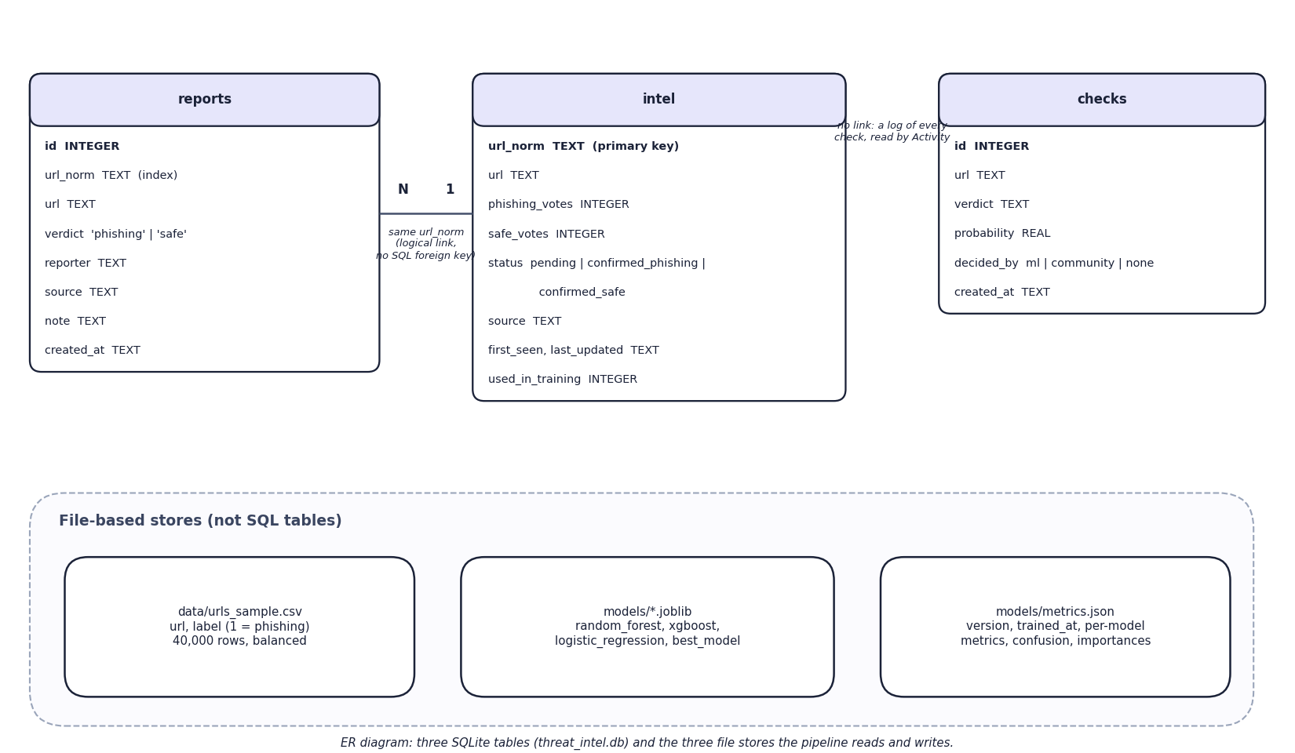
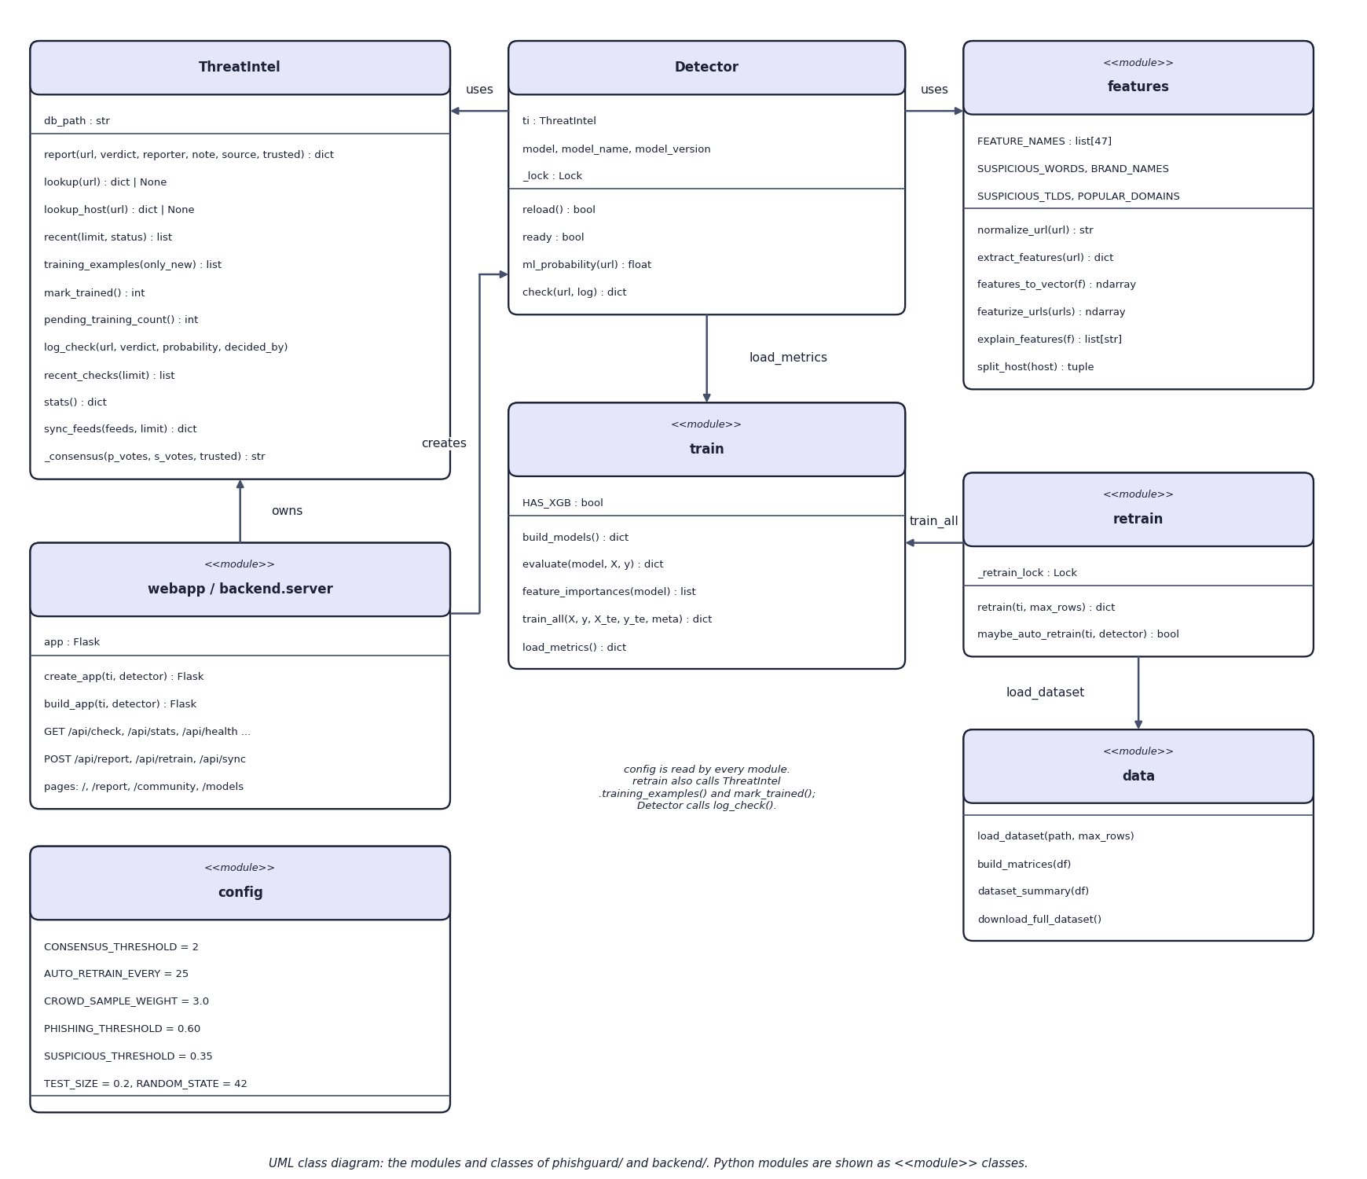

Database design and UML
ER diagram: 3 SQLite tables and 3 file stores (left); UML class diagram (right)
Table | Key fields | Relations
reports | url_norm, url, verdict, reporter, source, note, created_at | N per intel row (same url_norm)
intel | url_norm (PK), phishing_votes, safe_votes, status, used_in_training | 1 per URL
checks | url, verdict, probability, decided_by, created_at | append-only log
Notes:
Three SQLite tables in threat_intel.db. reports and intel are linked logically by the normalised URL; there is no SQL foreign key.

Slide 13






Technology stack
Language
Machine learning
Frontend
Python 3.11, JavaScript (JSX)
scikit-learn 1.4, XGBoost 2.0, pandas, NumPy, joblib
React 18, Vite 5, recharts, three.js, framer-motion, gsap, lucide
Backend
Data
Testing
Flask 3.1 JSON API, CORS, SQLite (sqlite3)
40,000-URL CSV, OpenPhish and URLhaus feeds (optional)
3 + 20 + 72 automated checks; Playwright captures
Notes:
Everything runs locally. The only external connections are the two optional feeds.

Slide 14
Implementation progress
Component | Status
Dataset, cleaning, 47-feature extractor | Completed
Three classifiers, comparison, metrics.json | Completed
Threat-intelligence store, consensus, feed sync | Completed
Decision pipeline with community override | Completed
Retraining loop with hot reload | Completed
Flask API, CLI and React interface (7 pages) | Completed
Automated tests (95 checks) and measurements | Completed
User acceptance, load tests, sign-in | Not done
3
classifiers trained
16
API and page routes
95/95
automated checks passing
Notes:
Every planned feature is implemented. Open items are user-acceptance testing, load testing and authentication.

Slide 15
Preliminary results: held-out test set (8,000 URLs)
92.9 %
XGBoost F1 (RF 92.5 %, LR 81.8 %)
0.981
XGBoost ROC-AUC (5-fold CV F1 92.6 %)
8.0 ms
mean time of a check through the API
Notes:
Held-out test results re-checked from the saved models. Cross-validation F1 is 92.56 % for XGBoost.

Slide 16
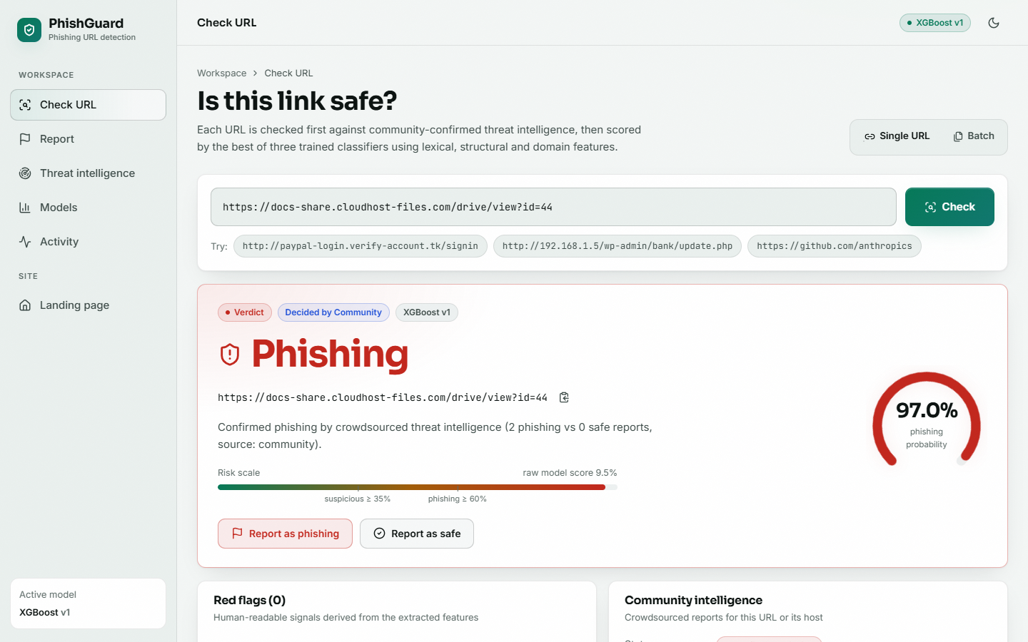
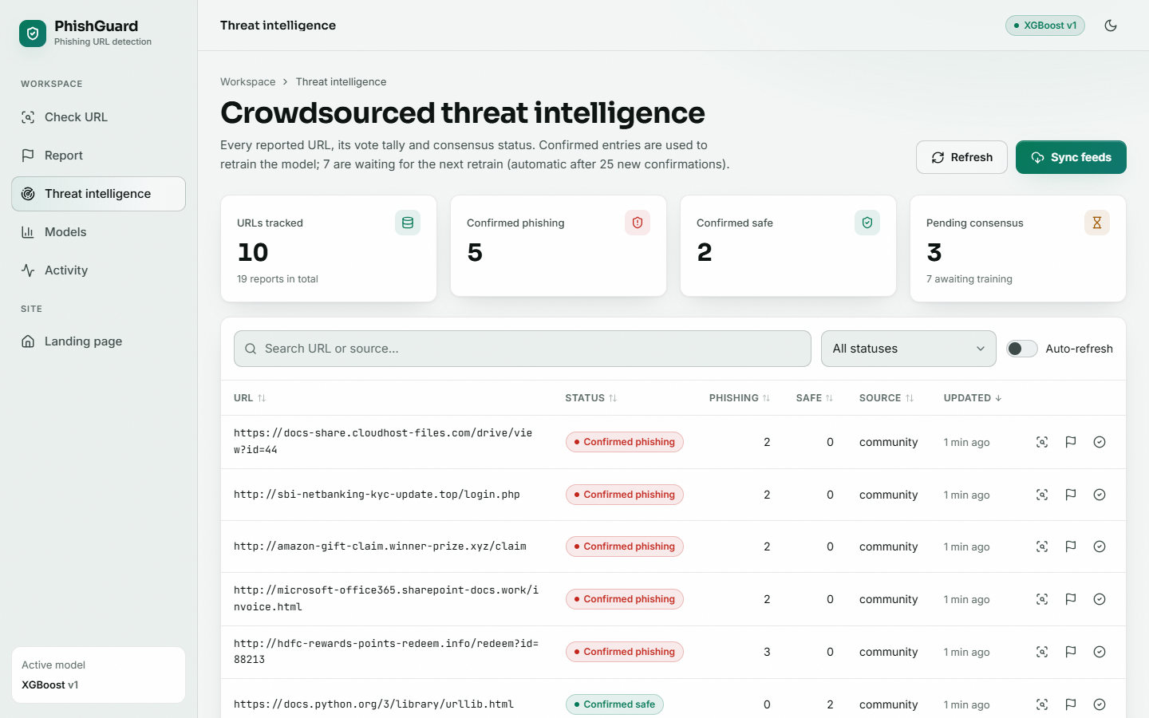


Output screens
Check URL: a lookalike page scored 9.5 % by the model becomes Phishing (97 %) after two reports
Threat intelligence: 10 URLs, 5 confirmed phishing, 2 confirmed safe, 3 pending
Notes:
Real captures of the running application with usage loaded: 19 reports, a feed sync and a retrain.

Slide 17
Testing and observations
Test group | Checks | Result
Original unit and web tests | 3 | Passed
End-to-end API smoke test | 20 | Passed
Extended: unit + integration | 31 | Passed
Extended: functional + validation | 31 | Passed
Extended: security + performance | 10 | Passed
Total | 95 | 95 passed
95 automated checks pass; malformed ports, 5,000-character URLs and javascript: URLs return normal responses.
SQL-injection text is stored as data; script tags are HTML-escaped on every page.
A check takes 8.0 ms on average through the API (p95 9.7 ms).
Retraining with 807 confirmed URLs produced model v2 end to end.
Not done: user-acceptance, load and authentication tests.
Notes:
The extended suite is scripts/extra_tests.py: 72 checks in six categories.

Slide 18



Challenges and corrective actions
Zero-day URLs
False positives
Clean-looking phishing
A community verdict overrides the model at once, in both directions.
docs.python.org and amazon.in are flagged; two safe reports clear them.
311 of 4,000 phishing URLs look ordinary; URL features alone cannot catch them.
Version drift
Does retraining help?
Noisy reports
The saved logistic-regression file cannot be loaded by the installed scikit-learn; it was refitted.
Random in-distribution URLs change F1 by under 0.1 point; value is the override.
Two net votes can be gamed; no sign-in or review yet. Recorded as a limitation.
Notes:
Six challenges found during the work and how each was handled or recorded.

Slide 19
Next steps
Real-user feedback
Fresher, larger data
Final report
Final presentation and demo
Ask analysts and reporters to try the interface (not yet done).
Evaluate on a larger, more recent dataset and URLs collected after training.
Add sign-in, rate limiting and an administrator review step for reports.
Document every diagram, test and result in the report.
Notes:
What remains: user feedback, stronger data and trust controls, then the report and the final demo.

Slide 20
Thank you
Questions and suggestions are welcome.
Notes:
Thank you. Questions are welcome.

