Slide 1

A Dynamic Phishing URL Detection System Integrating Advanced Machine Learning and Crowdsourced Threat Intelligence
Final Review
Team Details : Batch A3
Under the Esteemed Guidance of
Mr. G. Ravi
[DESIGNATION], Department of CSE (Data Science)
23K91A6750 D.ANISH MEGHAN
23K91A6737 B.AKSHAYA
23K91A6736 B.TANUJA
23K91A6742 CH.SAI CHETHAN
DEPARTMENT OF COMPUTER SCIENCE AND ENGINEERING (DATA SCIENCE) · Academic Year [ACADEMIC YEAR]
Notes:
Final review of PhishGuard: a dynamic phishing URL detection system with machine learning and crowdsourced threat intelligence.

Slide 2
Table of Contents
Abstract
Base Paper & Literature Survey
Research Gap & Problem Statement
Objectives
Proposed System & Architecture
Methodology & Decision Logic
Design & Implementation
Results, Testing & Comparison
Output Screens
Conclusion & Future Scope
References
Dept. of CSE (Data Science) | Batch A3 | Final Review
2

Slide 3
Abstract
Phishing sites steal credentials by imitating trusted pages; new domains appear daily and live only hours. Blacklists miss zero-day URLs, fixed rules are easy to evade and models trained once go stale.
PhishGuard implements the base paper's three stages: 47 offline URL features (23 lexical, 9 structural, 15 domain), classification with Random Forest, XGBoost and Logistic Regression, and refinement through crowdsourced threat intelligence.
A confirmed community verdict, phishing or safe, overrides the model at once; otherwise the best model scores the URL with thresholds 0.35 / 0.60. Two net votes or a trusted feed confirm a URL; confirmed URLs retrain the model, which is hot-reloaded.
XGBoost reaches accuracy 92.9 %, F1 92.9 % and ROC-AUC 0.981 on 8,000 held-out URLs (5-fold CV F1 92.6 %); a check takes 8.0 ms through the API.
Flask API, CLI and a seven-page React interface; 95 automated checks pass. Limits: one 40,000-URL dataset, URL-only features, anonymous votes.
Keywords: phishing detection, URL classification, crowdsourced threat intelligence, XGBoost, adaptive security.
Dept. of CSE (Data Science) | Batch A3 | Final Review
3
Notes:
Abstract: problem, approach, system and the headline results, with the limits stated.

Slide 4
Base Paper
L. Aldhuwayhi and A. Alromih, "A dynamic phishing URL detection system integrating advanced machine learning and crowdsourced threat intelligence," IEEE Access, vol. 14, pp. 88393-88404, 2026, doi: 10.1109/ACCESS.2026.3700833.
Design: Extractor, Detection, Updating by crowdsourcing. Novel URLs are verified by a human, added to the training set, and the model is retrained.
Data and model: PhiUSIIL, 235,804 URLs, 54 features (34 kept); LSTM with attention plus a dense branch.
Reported: accuracy 99.8 %, F1 0.9988, 5-fold cross-validation, learning-curve simulation of crowd data growth, about 0.20 ms per URL.
Limits: one dataset, crowd loop simulated, real-world validation, scalability, adversarial misuse and privacy left as future work.
Dept. of CSE (Data Science) | Batch A3 | Final Review
4
Notes:
The base paper is a framework paper with a strong benchmark number; its crowd loop is evaluated by simulation.

Slide 5
Literature Survey
Author / Year | Methodology | Dataset | Key Results | Limitations
Aldhuwayhi and Alromih, 2026 (base) [1] | LSTM-attention + dense; crowd feedback loop | PhiUSIIL, 235,804 URLs | Acc. 99.8 %, F1 0.9988 | Crowd loop simulated only
Vajrobol et al., 2024 [6] | Mutual information + logistic regression | PhiUSIIL | 99.97 % with 5 features | No real-time test
Etem and Teke, 2024 [7] | t-SNE reduction + decision tree | 51-feature set | 99.7 % | Single dataset
Alnemari and Alshammari, 2023 [8] | Classical classifiers | UCI phishing domains | 97.3 % (RF) | Static data
Priya et al., 2024 [11] | RF / LR browser extension | 11,055 URLs | 97 % | Latency not discussed
Assefa and Katarya, 2022 [14] | Autoencoder | Small URL set | 91.24 % | Below supervised models
Dept. of CSE (Data Science) | Batch A3 | Final Review
5
Notes:
Rows [6] to [14] are as summarised in the base paper. Works [2] to [5] from the batch survey were recorded by title only.

Slide 6
Research Gap
Author / Paper | Research Gap
Base paper [1] | Crowd loop only simulated; no live validation; no explanation of verdicts
Supervised detectors [6], [7], [8] | High accuracy on static datasets; no continuous retraining from new threat data
Deployed tools [11], [12] | Latency, load and retraining not discussed
Unsupervised detectors [14] | Suit novel sites but score lower and use small datasets
Blacklists and manual reports | Miss zero-day URLs; slow, manual updates
Dept. of CSE (Data Science) | Batch A3 | Final Review
6
Notes:
The gap: a live, explainable loop that joins ML with community verdicts and measured evidence.

Slide 7
Problem Statement
Phishing websites keep stealing credentials and financial data at scale.
Blacklists cannot detect newly created, zero-day phishing URLs.
Static rules and one-time-trained models fail as attack patterns evolve; false positives block legitimate sites.
Problem: given a URL, give a verdict (phishing, suspicious, safe) with probability and explanation, using a trained classifier and community-confirmed verdicts that override it and feed its retraining, in real time through a web interface.
Dept. of CSE (Data Science) | Batch A3 | Final Review
7

Slide 8
Objectives
Collect and preprocess a dataset of phishing and legitimate URLs.
Extract lexical, structural and domain-based URL features.
Train and compare Random Forest, XGBoost and Logistic Regression.
Integrate crowdsourced threat intelligence for newly reported phishing URLs.
Refine the model continuously as new threat data arrives.
Provide real-time URL classification through a simple web interface.
Dept. of CSE (Data Science) | Batch A3 | Final Review
8

Slide 9
Proposed System
1. Extract - 47 offline features from the URL string; red flags explain them.
2. Classify - Random Forest, XGBoost and Logistic Regression on one split; best F1 is deployed.
3. Decide - a confirmed community verdict wins; else model score, reputation x0.4, pending votes +-0.15, thresholds 0.35 / 0.60.
4. Report - users vote phishing or safe; net 2 confirms; OpenPhish and URLhaus confirm at once.
5. Refine - confirmed URLs join the training data (x3); retrain; the detector hot-reloads.
6. Use - Flask API, CLI and React interface with batch check, activity log and model comparison.
Dept. of CSE (Data Science) | Batch A3 | Final Review
9

Slide 10
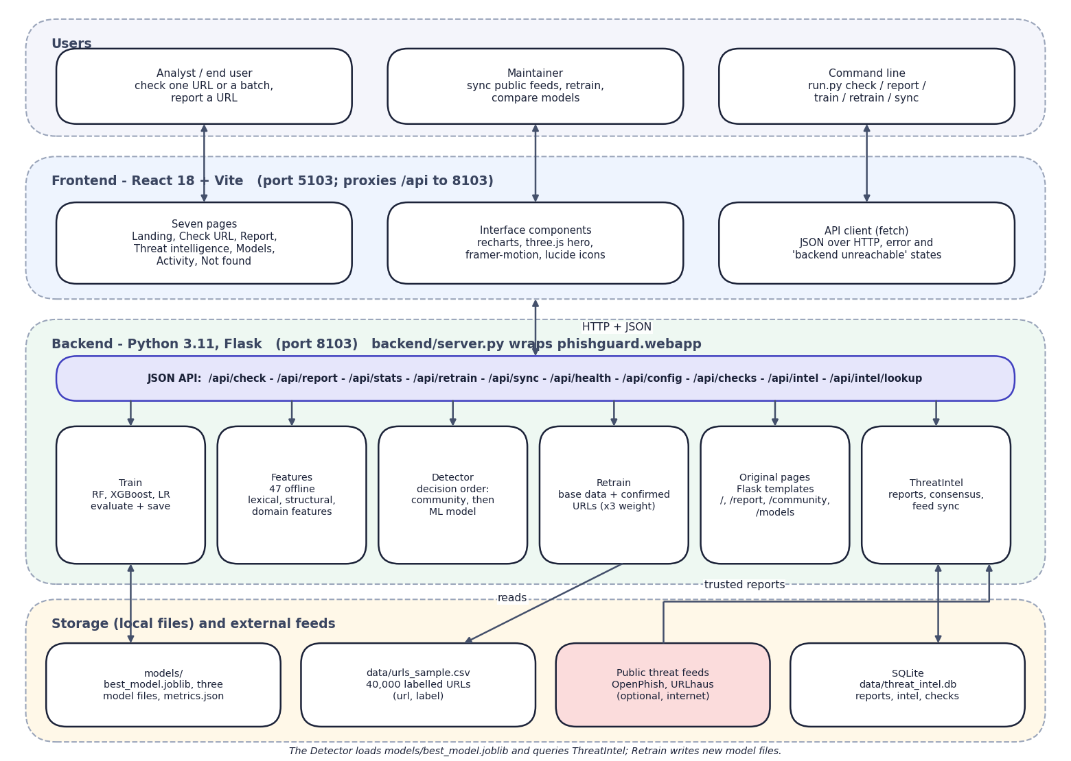

System Architecture
Layered architecture: users, React interface, Flask API with detection modules, local storage
Dept. of CSE (Data Science) | Batch A3 | Final Review
10

Slide 11
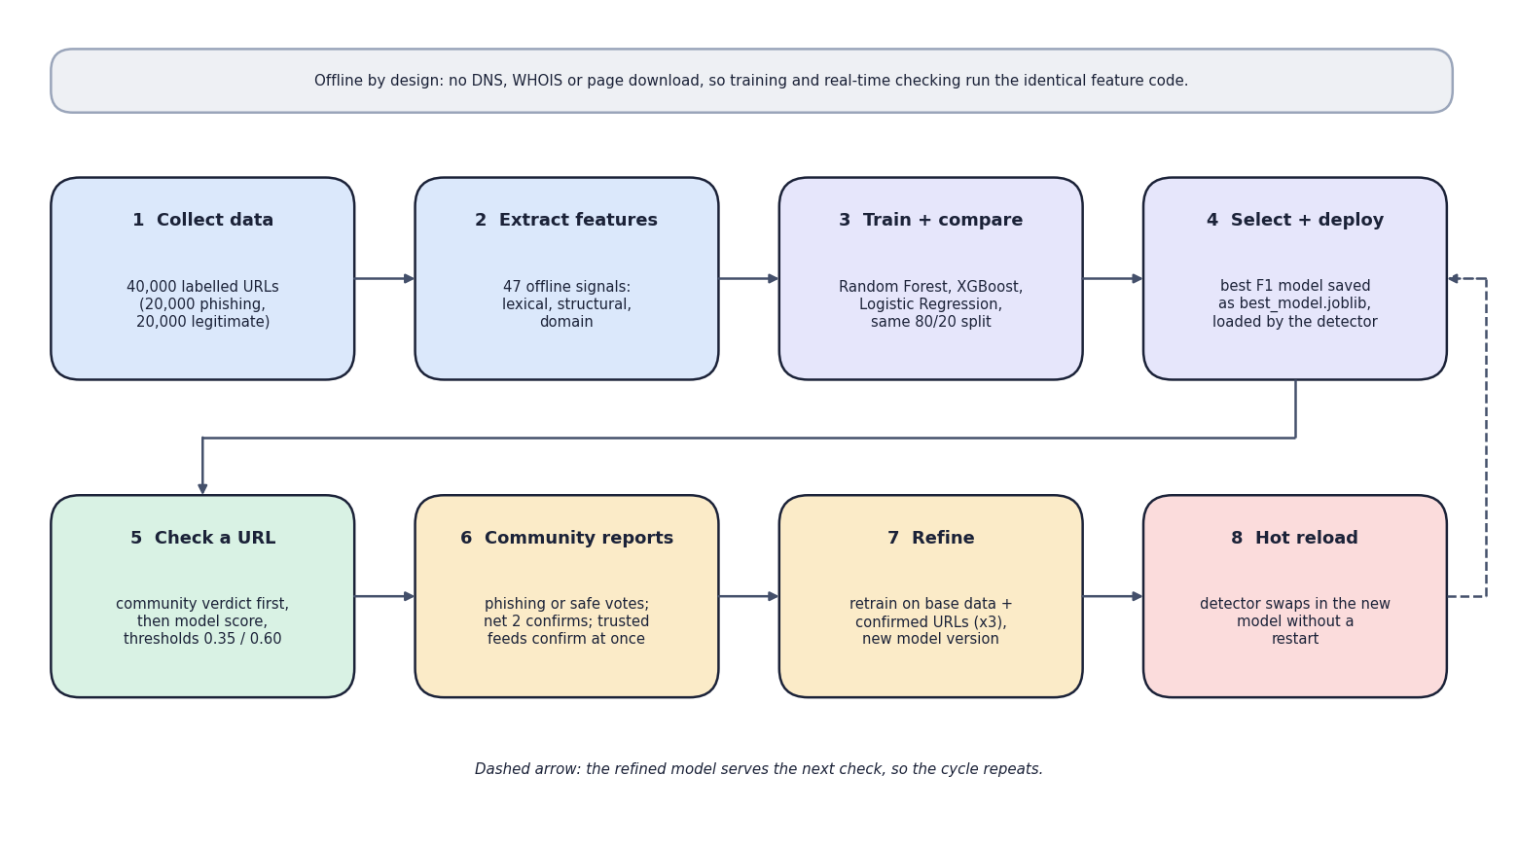

Methodology
End-to-end workflow: prepare the models once, then check, collect community reports, retrain and reload
Dept. of CSE (Data Science) | Batch A3 | Final Review
11

Slide 12
Dataset, Features & Models
Data: 40,000 URLs from a public set (20,000 phishing, 20,000 legitimate), cleaned and split 80/20 (32,000 / 8,000), stratified, seed 42.
47 offline features: 23 lexical, 9 structural, 15 domain; no DNS, WHOIS or page download.
Random Forest: 300 trees. XGBoost: 400 trees, depth 8, learning rate 0.08. Logistic Regression: scaled, C 1.0.
Selection: best F1 on the test set (ROC-AUC breaks ties) saved as best_model.joblib.
Community store: SQLite (reports, intel, checks); consensus = 2 net votes; trusted feeds confirm at once.
Retraining: base data + confirmed URLs x3, same split; training takes 15.1 s for the three models on this PC.
Dept. of CSE (Data Science) | Batch A3 | Final Review
12
Notes:
Everything is computed from the URL string, so training and real-time checking use identical code.

Slide 13
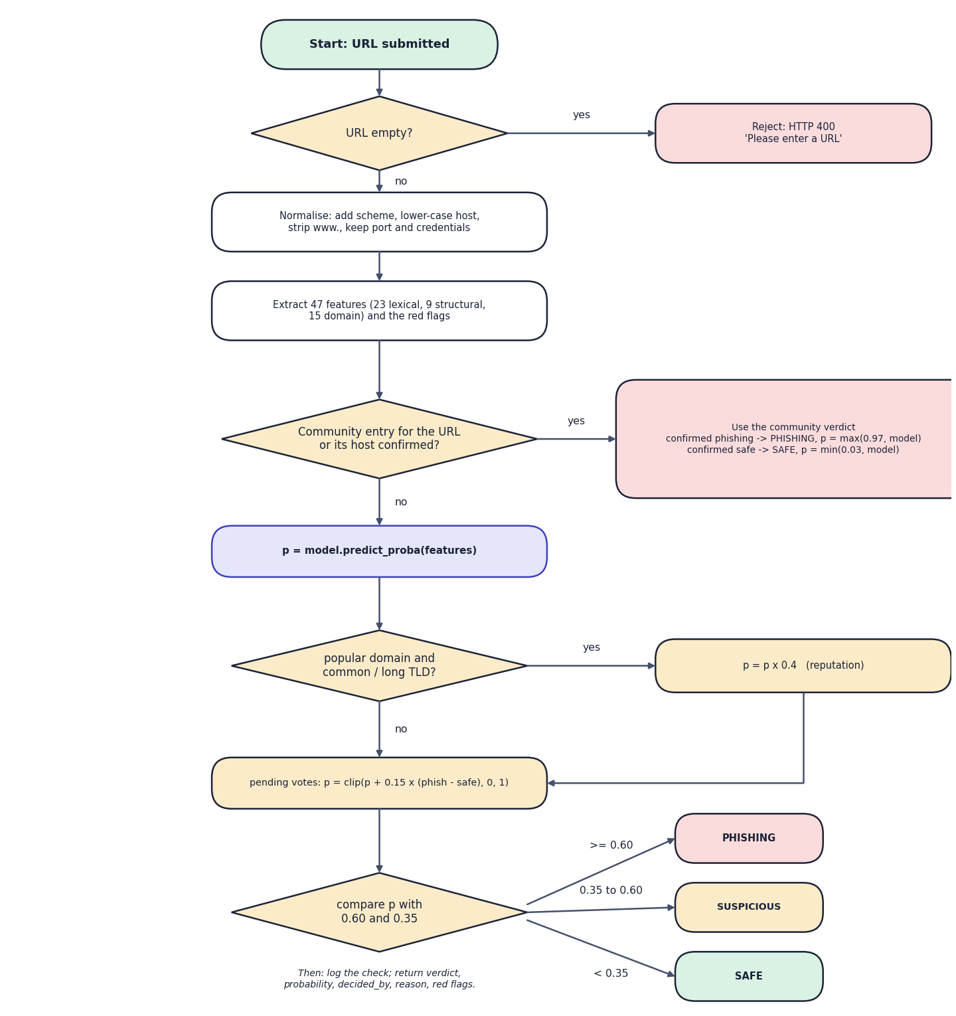

Decision Workflow
Decision order: community verdict first, then model score with adjustments and thresholds
Dept. of CSE (Data Science) | Batch A3 | Final Review
13

Slide 14
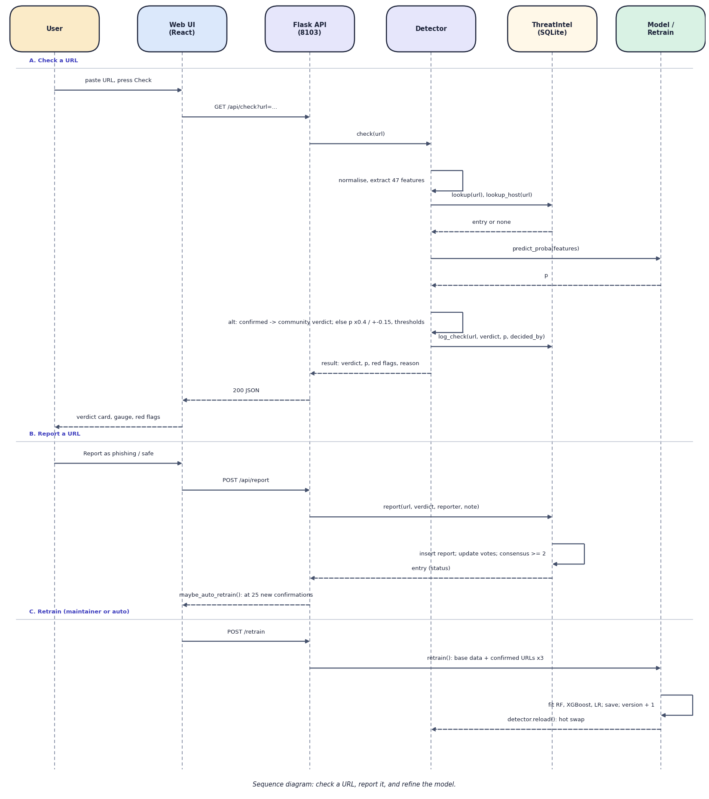

User–System Interaction
Sequence: check a URL, report it, and refine the model
Dept. of CSE (Data Science) | Batch A3 | Final Review
14

Slide 15
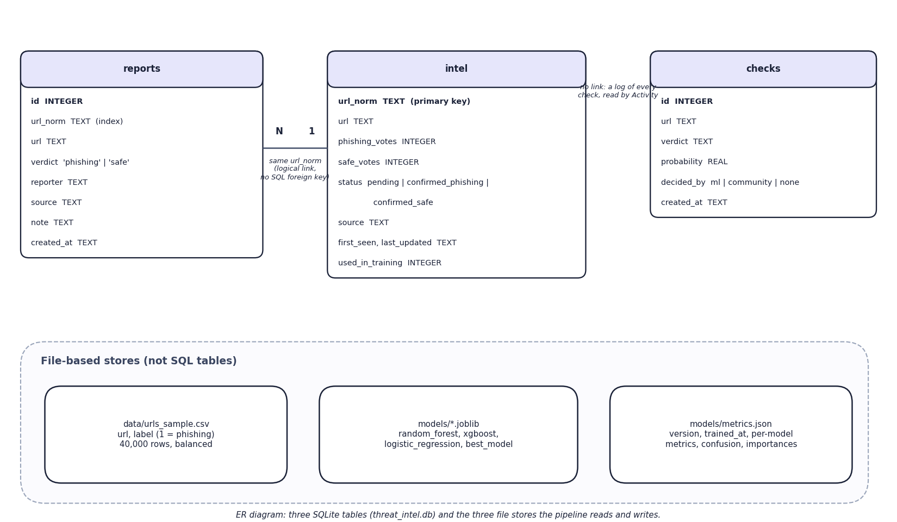

Database Design
Entity–relationship diagram: 3 SQLite tables and 3 file stores
Dept. of CSE (Data Science) | Batch A3 | Final Review
15

Slide 16
Implementation Highlights
Module | Implementation
Features | 47 offline features, red flags; robust to malformed ports and brackets
Training | Three models on one split; metrics, confusion matrix, importances in metrics.json
Threat intelligence | SQLite reports and intel; consensus 2; trusted feeds; host-level lookup; check log
Detector | Community first; model; reputation x0.4; pending votes; thresholds; hot reload under a lock
API and UI | Flask JSON API (16 routes), CLI, React interface with 7 pages
Tests | 3 + 20 + 72 = 95 automated checks; Playwright captures
Dept. of CSE (Data Science) | Batch A3 | Final Review
16

Slide 17
Results – Model Comparison (8,000 test URLs)
Model | Accuracy | Precision | Recall | F1 | ROC-AUC
XGBoost (selected) | 92.93 % | 93.53 % | 92.23 % | 92.88 % | 0.9809
Random Forest | 92.49 % | 92.69 % | 92.25 % | 92.47 % | 0.9776
Logistic Regression | 82.81 % | 86.94 % | 77.22 % | 81.80 % | 0.9218
XGBoost, 5-fold CV | 92.59 % | 92.91 % | 92.21 % | 92.56 % | 0.9792
Held-out 20 % of a 40,000-URL sample; the shipped numbers were re-checked from the saved models. Not comparable with the base paper's dataset.
Dept. of CSE (Data Science) | Batch A3 | Final Review
17
Notes:
XGBoost is best by F1. The 5-fold cross-validation result is slightly lower and very stable (std 0.18 points).

Slide 18
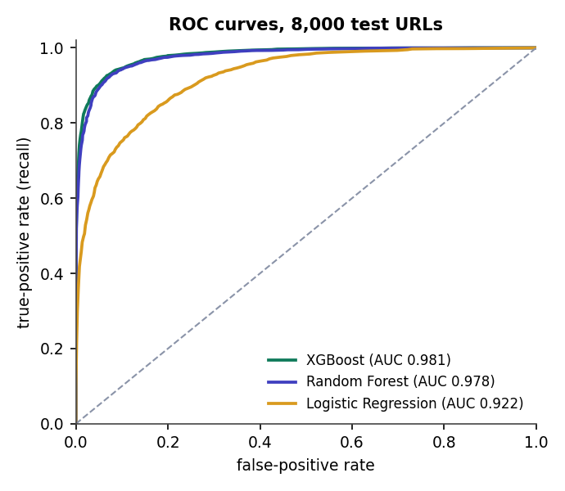
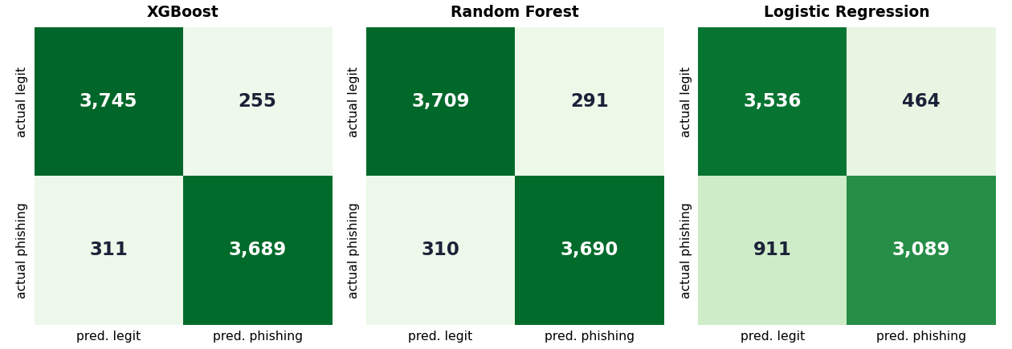


Confusion Matrices & ROC Curves
XGBoost: 3,745 TN, 255 FP, 311 FN, 3,689 TP
ROC-AUC: XGBoost 0.981, Random Forest 0.978, LR 0.922
Dept. of CSE (Data Science) | Batch A3 | Final Review
18
Notes:
The error is balanced: 6.4 % of legitimate URLs are flagged and 7.8 % of phishing URLs are missed.

Slide 19
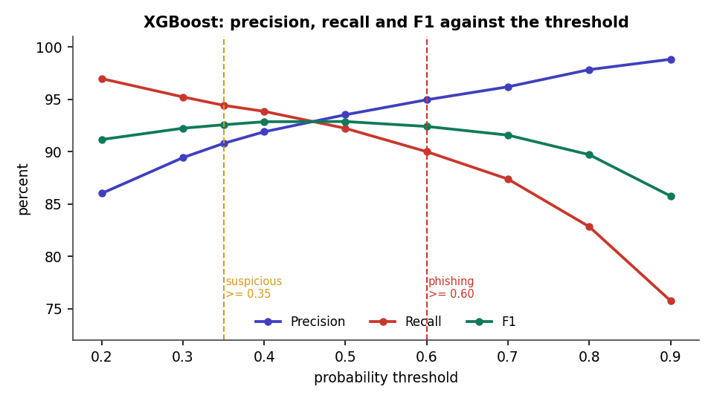
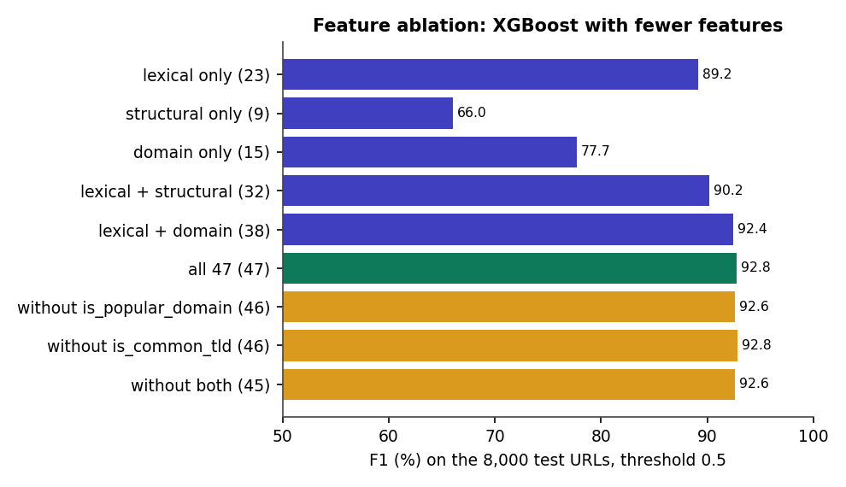


Threshold & Feature Analysis
F1 is flat between thresholds 0.40 and 0.60; 0.35 marks 'suspicious'
Lexical features give F1 89.2 %; all 47 give 92.8 %
Dept. of CSE (Data Science) | Batch A3 | Final Review
19
Notes:
The threshold sweep justifies 0.35 / 0.60; the ablation shows lexical features carry most of the signal and the model does not depend on its two strongest features alone.

Slide 20
Performance & Testing
Measurement | Result
Response time | /api/check mean 8.0 ms, p95 9.7 ms; feature extraction 0.077 ms per URL
Training time | RF 12.2 s, XGBoost 2.7 s, LR 0.2 s on 32,000 URLs
Automated tests | 95 passed, 0 failed (3 original, 20 smoke, 72 extended: unit 23, integration 8, functional 14, validation 17, security 8, performance 2)
Crowd loop (live run) | Zero-day page 9.5 % -> phishing 97 % after 2 reports; feed sync +800 URLs; retrain v1 -> v2
Retraining effect | Adding 250 to 2,000 confirmed URLs changes F1 by under 0.1 point on unseen URLs
Dept. of CSE (Data Science) | Batch A3 | Final Review
20
Notes:
Not measured: concurrent-user load, memory use, other hardware, user acceptance, authentication.

Slide 21
Comparison with Base Paper (context only – different datasets)
System | Data | Method | Crowd loop | Reported / measured | Extras
Base paper [1] | PhiUSIIL, 235,804 URLs | LSTM-attention + dense, 34 features | Human-verified, retrained periodically; simulated | Accuracy 99.8 %, F1 0.9988; 0.20 ms per URL | -
PhishGuard | 40,000-URL sample | XGBoost on 47 offline features (RF, LR compared) | Vote consensus + trusted feeds; applied at once; retrain + hot reload | Accuracy 92.9 %, F1 92.9 %; 8.0 ms per check | Red flags, React UI, CLI, activity log
Different data, features and models: the numbers are not a head-to-head benchmark. The gap of 6.9 points is not explained experimentally.
Dept. of CSE (Data Science) | Batch A3 | Final Review
21

Slide 22
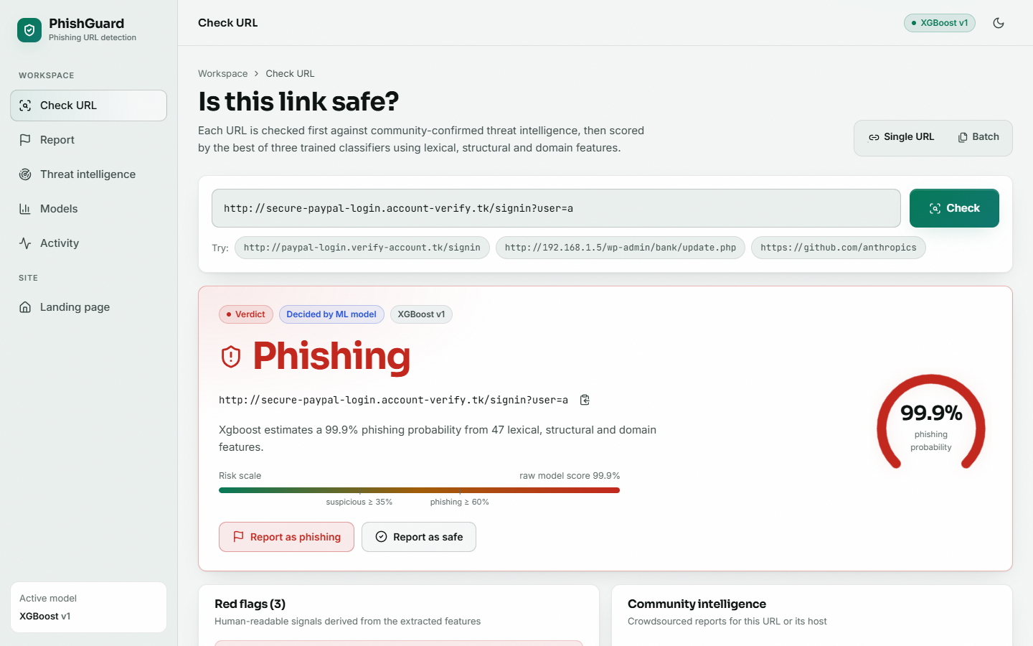
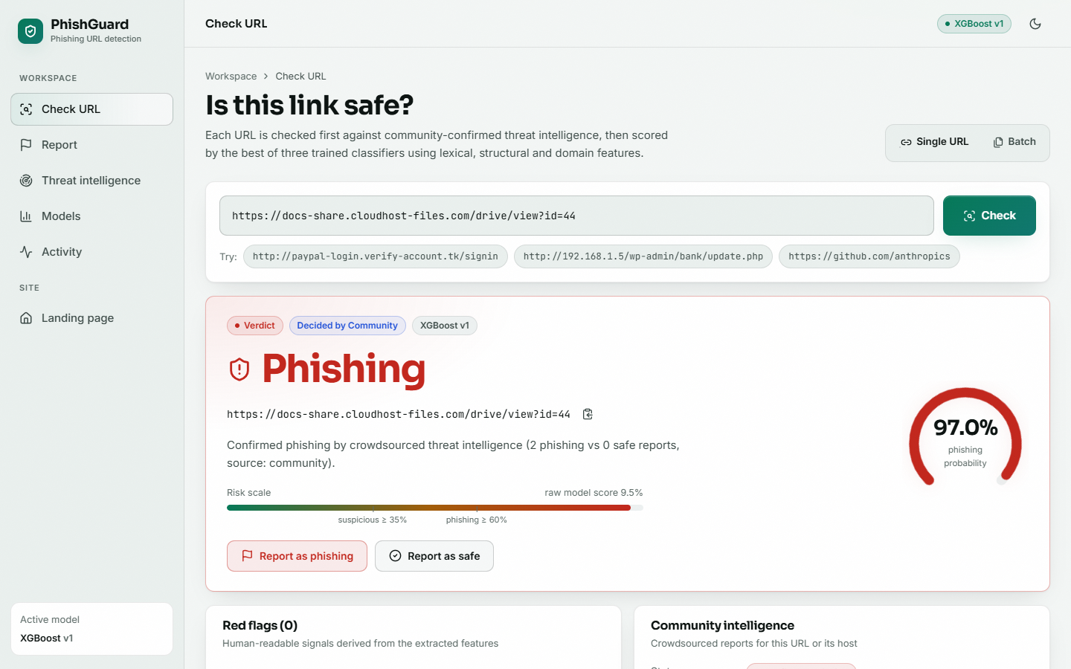


Output – Check URL
Phishing verdict with gauge and risk scale
Community overrides the model: 9.5 % -> 97.0 %
Dept. of CSE (Data Science) | Batch A3 | Final Review
22

Slide 23
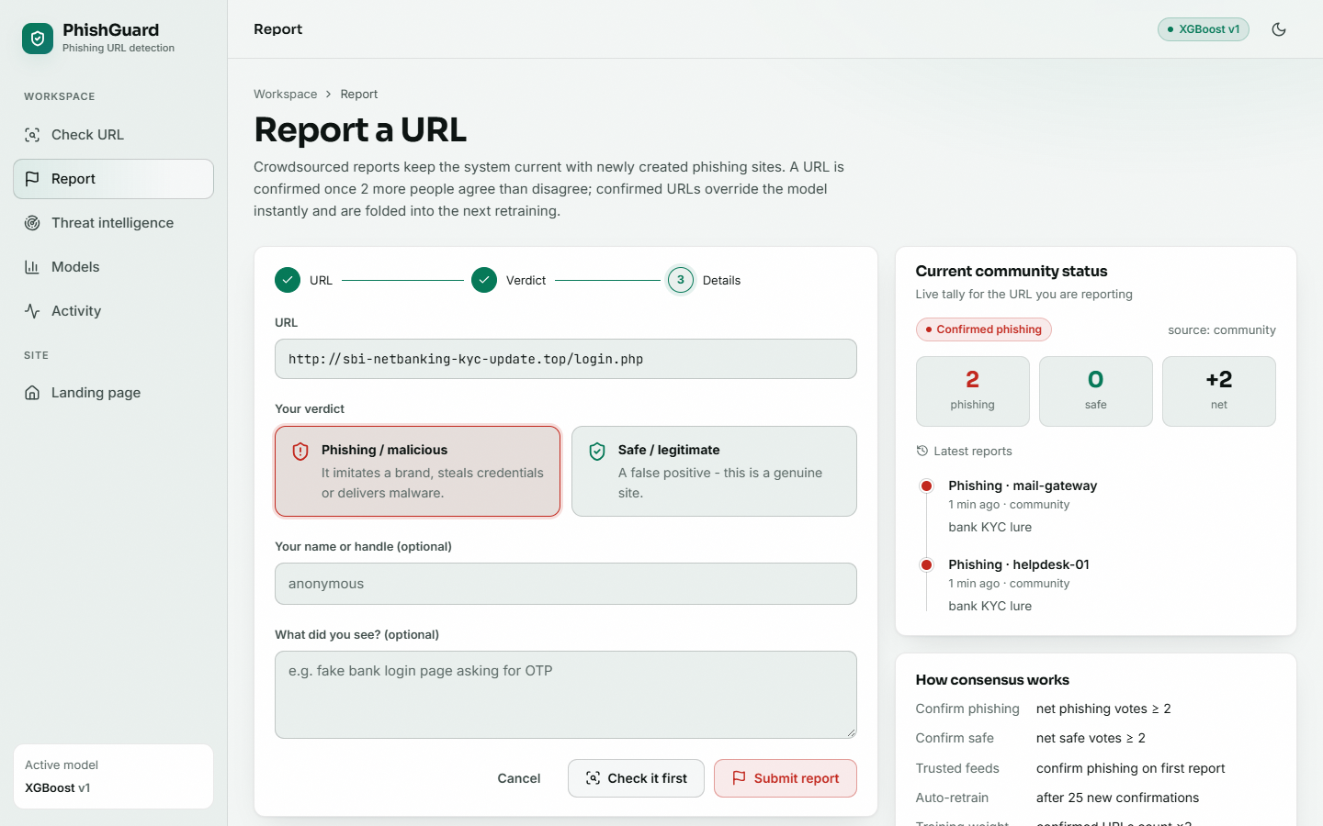
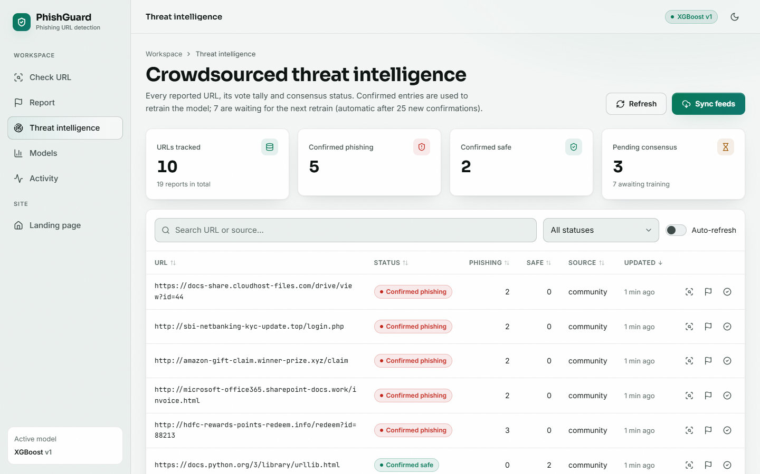


Output – Report and Threat Intelligence
Report form with live vote tally and consensus rules
Threat-intelligence board: statuses and votes
Dept. of CSE (Data Science) | Batch A3 | Final Review
23

Slide 24
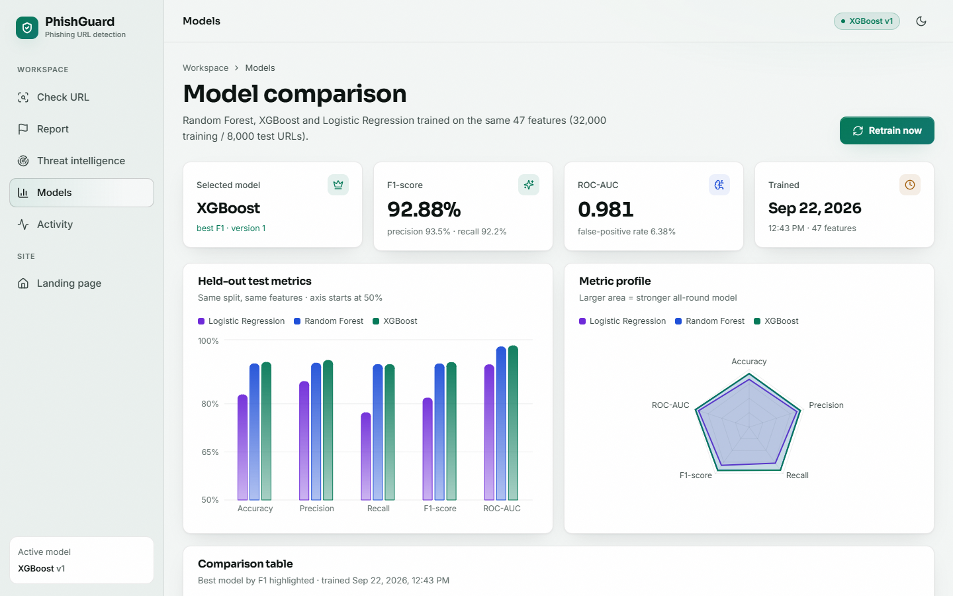



Output – Models and Retraining
Model comparison, version 1
After retraining on 807 confirmed URLs: version 2
Dept. of CSE (Data Science) | Batch A3 | Final Review
24

Slide 25
Conclusion
Built PhishGuard: a working, explainable implementation of the base paper's three-stage design.
XGBoost reaches F1 92.9 % and ROC-AUC 0.981 on held-out URLs; 5-fold CV F1 92.6 %; 8 ms per check.
A confirmed community verdict acts at once in both directions; the retraining loop with hot reload runs end to end on real feed data.
Retraining on random in-distribution URLs does not change the average F1; the loop's value is the override.
Limits: one 40,000-URL dataset (not comparable with 99.8 %), URL-only features, anonymous votes, no sign-in, no user-acceptance test.
Dept. of CSE (Data Science) | Batch A3 | Final Review
25

Slide 26
Future Scope
Evaluate on a larger, more recent dataset and on URLs collected after training.
Add sign-in, rate limiting, reporter reputation and an administrator review queue.
Better reputation data than a hand-written list; smarter host-level override.
Optional sandboxed page features for uncertain URLs; browser extension and mail plug-in.
Study the crowd loop under noisy reports and new campaigns; reproduce the base paper's network for a like-for-like comparison.
Dept. of CSE (Data Science) | Batch A3 | Final Review
26

Slide 27
References
[1] L. Aldhuwayhi and A. Alromih, "A dynamic phishing URL detection system integrating advanced machine learning and crowdsourced threat intelligence," IEEE Access, vol. 14, pp. 88393-88404, 2026, doi: 10.1109/ACCESS.2026.3700833.
[2] "Phishing URL detection using machine learning," Journal of Advanced Research in Production and Industrial Engineering, 2023.
[3] "Real-time phishing URL detection using reinforcement learning," International Journal of Science and Research (IJSR), 2025.
[4] "Phishing URL detection using machine learning and deep learning," in Proc. 2024 IEEE World AI IoT Congress (AIIoT), 2024.
[5] "Automated phishing detection through URL analysis and machine learning," Communications on Applied Nonlinear Analysis, 2025.
[6] V. Vajrobol, B. B. Gupta and A. Gaurav, "Mutual information based logistic regression for phishing URL detection," Cyber Security and Applications, vol. 2, p. 100044, Jan. 2024, doi: 10.1016/j.csa.2024.100044.
[7] T. Etem and M. Teke, "Advanced phishing detection: Leveraging t-SNE feature extraction and machine learning on a comprehensive URL dataset," Acta Infologica, vol. 231, no. 221, pp. 213-221, 2024, doi: 10.26650/acin.1521835.
[8] S. Alnemari and M. Alshammari, "Detecting phishing domains using machine learning," Applied Sciences, vol. 13, no. 8, p. 4649, Apr. 2023, doi: 10.3390/app13084649.
[9] U. A. Butt, R. Amin, H. Aldabbas, S. Mohan, B. Alouffi and A. Ahmadian, "Cloud-based email phishing attack using machine and deep learning algorithm," Complex & Intelligent Systems, vol. 9, no. 3, pp. 3043-3070, Jun. 2023, doi: 10.1007/s40747-022-00760-3.
[10] D. Rathee and S. Mann, "Detection of e-mail phishing attacks - using machine learning and deep learning," International Journal of Computer Applications, vol. 183, no. 47, pp. 1-7, Jan. 2022, doi: 10.5120/ijca2022921868.
[11] K. S. Priya, J. Chandrika and M. P. Lakshmi, "Machine learning-based phishing website detection: a comprehensive approach for cyber security," in Proc. 5th Int. Conf. Recent Trends in Computer Science and Technology (ICRTCST), Apr. 2024, pp. 344-349, doi: 10.1109/ICRTCST61793.2024.10578472.
[12] S. Sawant, R. Savakhande, O. Sankhe and S. Tamboli, "Phishing detection by integrating machine learning and deep learning," in Proc. 11th Int. Conf. Computing for Sustainable Global Development (INDIACom), Feb. 2024, pp. 1078-1083, doi: 10.23919/INDIACom61295.2024.10499100.
[13] Z. Fan, "Detecting and classifying phishing websites by machine learning," in Proc. 3rd Int. Conf. Applied Machine Learning (ICAML), Jul. 2021, pp. 48-51, doi: 10.1109/ICAML54311.2021.00018.
[14] A. Assefa and R. Katarya, "Intelligent phishing website detection using deep learning," in Proc. 8th Int. Conf. Advanced Computing and Communication Systems (ICACCS), vol. 1, Mar. 2022, pp. 1741-1745, doi: 10.1109/ICACCS54159.2022.9785003.
Dept. of CSE (Data Science) | Batch A3 | Final Review
27

Slide 28
THANK YOU
Questions & Suggestions
Dept. of CSE (Data Science) | Batch A3 | Final Review
28
Notes:
Thank you. Questions are welcome.

