Slide 1
Multilingual Story Generation and Speech System
REVIEW 2 · DESIGN, METHODOLOGY AND PROGRESS
Design, methodology and progress: a local pipeline that writes a story with Qwen3-0.6B and narrates it with MMS-TTS in 15 languages
Presented by
Under the guidance of
Lingala Sindhu 23K91A05D3
Padige Ajay 23K91A05H8
Mahek Ansari 23K91A05D8
Maheshwaram Hari Krishna 23K91A05D9
A Tejaswini, [DESIGNATION]
Department of Computer Science and Engineering
TKR College of Engineering & Technology · Batch C2 (CSE-C) · [ACADEMIC YEAR]
Notes:
This review shows how StoryVox is designed and built, what is implemented, the first measured results, and the open items. Introduce the four team members and the guide.

Slide 2
Contents
01
02
03
04
Recap and architecture
Methodology and dataset
Preprocessing and model
Inference configuration and decision logic
05
06
07
08
Data flow, modules, UML
Technology stack
Implementation progress
Preliminary results
09
10
11
12
Output screens
Testing
Challenges
Next steps
Notes:
Agenda for the design and progress review.

Slide 3
Recap: problem and proposed system
!
Problem
i
Proposed system
B
Base paper link
Multilingual stories need a writer and a narrator for every language. Generic speech sounds mechanical, low-resource languages have thin support, and tools do either text or speech, not both.
StoryVox takes an idea, a language, a style and a length, writes the story with Qwen3-0.6B, narrates it with a per-language MMS-TTS voice, stores both in a library and judges the result with Whisper-small.
SAM Translator (Tran and Sakti) is a speech-translation system with mixture-of-experts and self-paced learning. We share only the goal of multilingual speech judged by ASR; none of its techniques. Scores are not comparable.
Notes:
Recap of Review 1. The base paper reports BLEU on translation into English; we report round-trip error rates, real-time factor and story checks. We compare design choices and compute cost only.

Slide 4
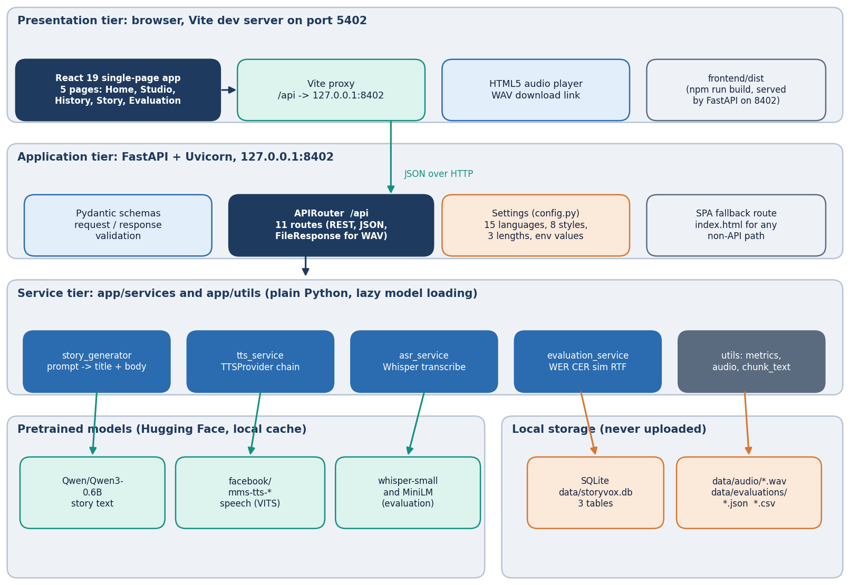
System architecture
Four tiers, all local
App: React 19 + Vite, 5 pages; port 5402 in development, or served by the API.
API: FastAPI on port 8402; 11 routes under /api plus an SPA fallback.
Services: story generator, TTS provider chain, ASR, evaluation.
Storage: SQLite (3 tables) and WAV files; models cached by Hugging Face.
Notes:
The routes live in app/api/routes.py (254 lines) and call the services; models load lazily on first use, which is why the first request is slow.

Slide 5
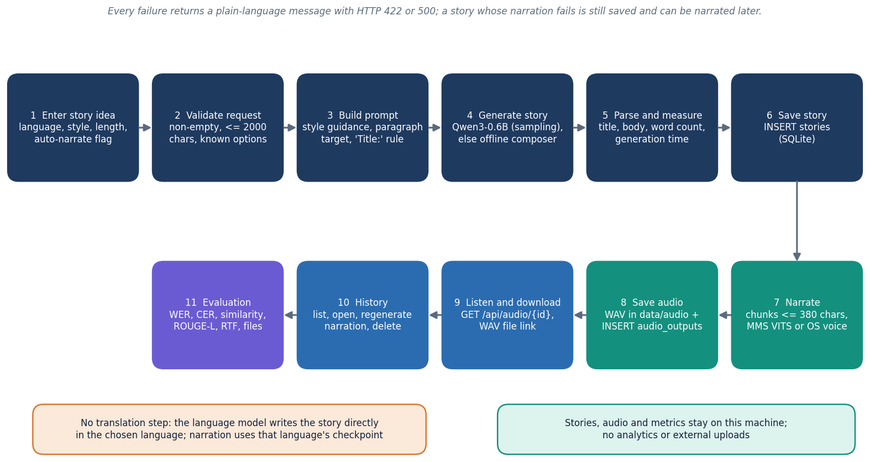
Methodology: write, narrate, store, judge
Write
Validate the request, build one instruction, generate with Qwen3-0.6B, split the output into a title and a body; fall back to the composer if the output is too short.
Narrate and store
Split the text into chunks of at most 380 characters, synthesise each with the language's MMS voice, join with pauses, save the WAV and the database rows.
Judge
Transcribe the audio with Whisper-small, compute WER and CER, similarity, ROUGE-L, latency and real-time factor.
High-level workflow as implemented in the API.
Notes:
Generation and narration run in one request; evaluation is a separate route that repeats the same steps for five built-in prompts.

Slide 6
Dataset: FLEURS, used only to evaluate narration
15
150
0
CC BY 4.0
languages in the evaluation set
test sentences (10 per language)
training examples: no model was trained
licence of the FLEURS test data
 | Round-trip evaluation of narration | Story-generation experiment
Source | Google FLEURS test split, read speech transcripts (Conneau et al.), downloaded from the Hugging Face dataset repo | One fixed idea: 'A young inventor discovers a hidden library.'
Size | First 10 sentences per language within a length window (6-30 words; 12-70 characters for zh and ja) | 17 items: English with 3 styles plus 14 other languages with Adventure; Short length
Use | Synthesise with the app's own TTS chain, transcribe with Whisper-small, score WER and CER against the sentence | Compare three conditions: shipped prompt, chat template, offline composer
Library | Stories created through the API: 7 (3 English, one each Hindi, French, German, Spanish) | Used for the screenshots and the story-length intelligibility check
Limits | Read Wikipedia-style sentences, not narrative; 10 sentences per language is a small sample | A single idea and seed 0; proxies, no human rating
Notes:
FLEURS is a public benchmark of the same sentences read in many languages. We use it only as test text for the speech chain; no training or tuning took place. The seven library stories are real outputs of the running application.

Slide 7
Preprocessing: from request to audio chunks
Validate request
Build prompt
Parse title and body
Chunk at 380 chars
VITS per chunk
Normalise and join
2,000
0.25 s
characters allowed in the idea; unknown language, style or length is rejected with HTTP 422
pause between chunks; peak-normalised to 0.9; empty or silent audio is rejected
The prompt names the language, style guidance, a paragraph target of 3, 5 or 8, and a rule that the first line starts with 'Title:'.
The output is split into title and body; an output under 20 words or any model failure switches to the offline composer.
Text is cut at sentence boundaries (including the Devanagari danda) into chunks of at most 380 characters; a single longer sentence is split by length.
For scoring, text is normalised: NFKC, lower-case, punctuation removed; spaces also removed for Chinese and Japanese, where WER is not reported.
Notes:
The chunker and the normaliser are covered by unit tests (the limit, the one-long-sentence case and the Devanagari danda).

Slide 8
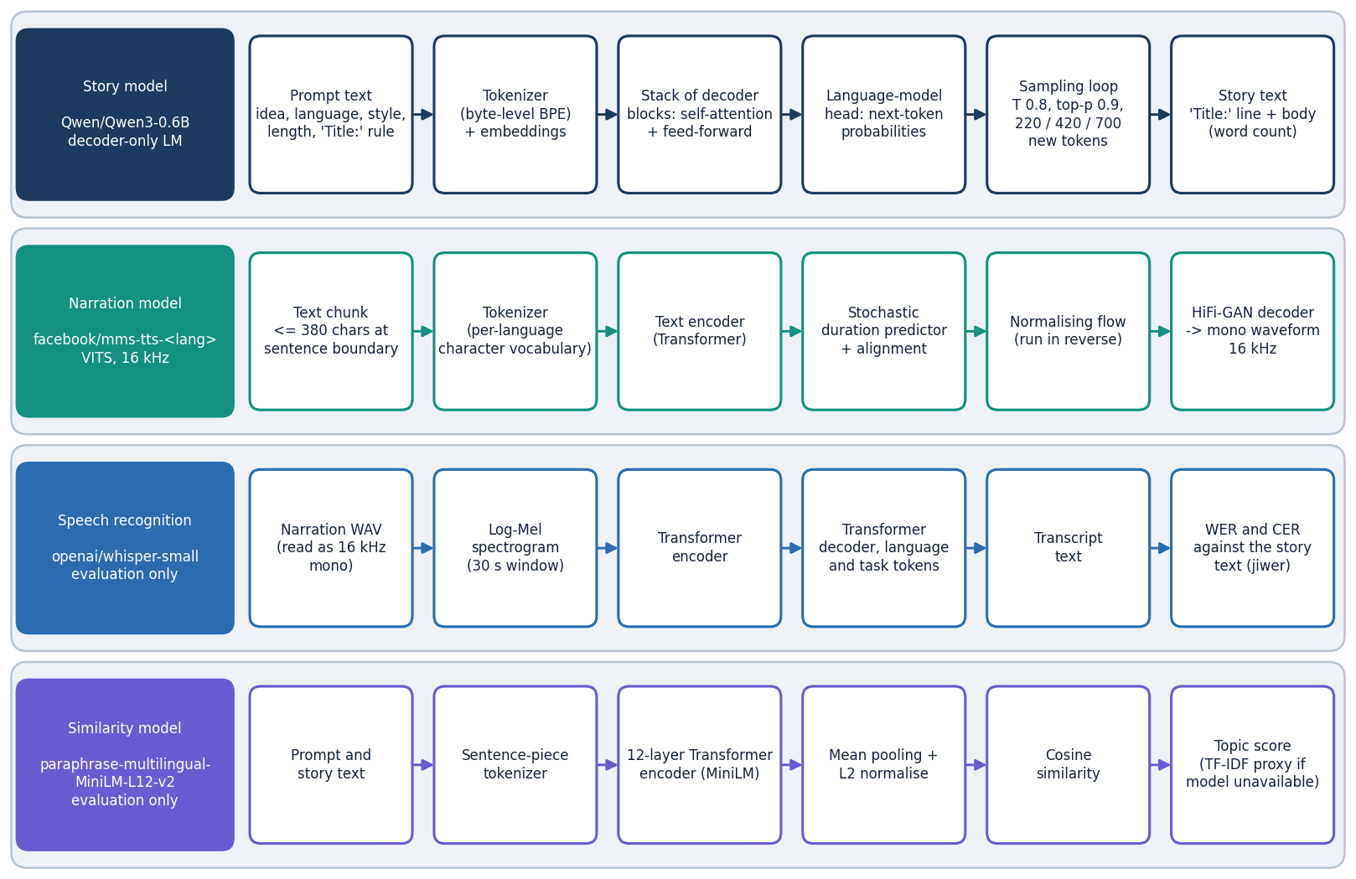
Model architecture: pretrained models in a cascade
Story model: Qwen3-0.6B, a decoder-only language model, sampled with temperature 0.8 and top-p 0.9.
Narration model: facebook/mms-tts-<language>, a VITS model (text encoder, duration predictor, flow, HiFi-GAN decoder) at 16 kHz.
Judges (evaluation only): Whisper-small for WER and CER, a multilingual MiniLM for prompt-story similarity.
Nothing is trained or fine-tuned; the models are downloaded once from Hugging Face.
The four models and the stages inside each.
Notes:
A cascade was chosen because the pretrained parts exist and run on a CPU; training a joint model needs data and GPUs that were not available.

Slide 9
Inference configuration (nothing was trained)
Setting | Value
Story model | Qwen/Qwen3-0.6B via the transformers text-generation pipeline; raw prompt, no chat template; temperature 0.8, top-p 0.9
Token budget | 220 / 420 / 700 new tokens for Short / Medium / Long; paragraph target 3 / 5 / 8; fallback below 20 words
Narration | facebook/mms-tts-* VITS, 16 kHz, 380-character chunks, 0.25 s pause, peak 0.9; fallback: OS voice through pyttsx3
Recogniser | openai/whisper-small, language forced to the requested language; loaded in 6.6 s
Similarity | paraphrase-multilingual-MiniLM-L12-v2 cosine; TF-IDF cosine if the model is missing; ROUGE-L F1
Experiments | seed 0; FLEURS 10 sentences per language; story idea fixed; same code path as the application
Machine | Intel Core i5-12500 (12 threads), 15.7 GB RAM, CPU only; Python 3.11.9, torch 2.14.1, transformers 5.20.2
Notes:
All later numbers use exactly this configuration. The project's own .venv was unusable here, so system Python was used.

Slide 10
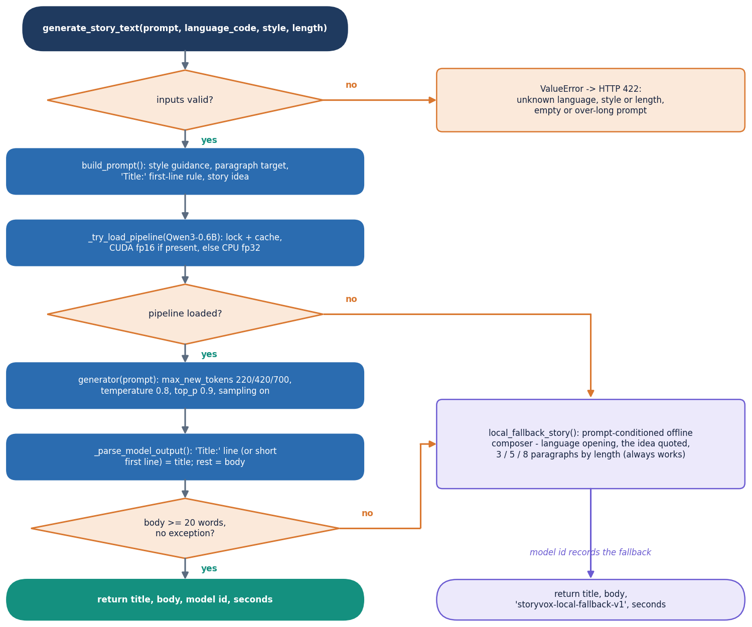
Decision logic: fallbacks and story conditions
Story path: validate, build the prompt, call Qwen3-0.6B; if the output has under 20 words or any error occurs, the offline composer answers and its model id is recorded.
Voice path: MMS-TTS first; on a load or inference error, or silent audio, the OS voice; if that fails too, HTTP 500.
Experiment conditions: A = shipped path; B = same model through the Qwen3 chat template (not shipped); C = offline composer.
Reported as measured: a mismatch between requested language and story language is counted, not hidden.
Notes:
The flowchart is the code of generate_story_text. The narration and evaluation flowchart is in the report.

Slide 11
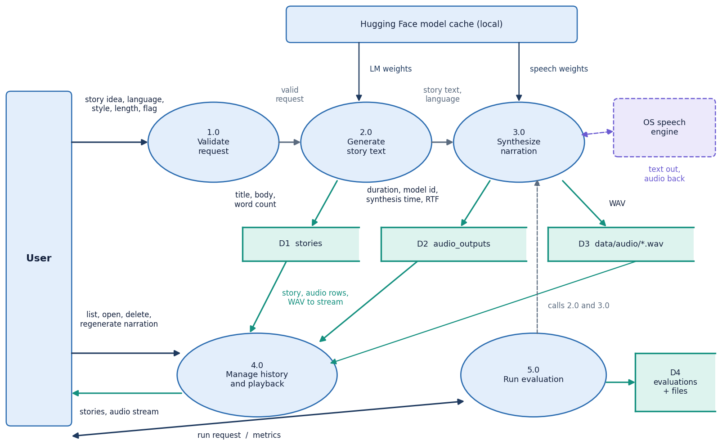
Data flow and modules
Module | Lines | Role
services/story_generator.py | 185 | prompt, Qwen3, composer
services/tts_service.py | 180 | MMS and OS voice
services/asr_service.py | 42 | Whisper transcription
services/evaluation_service.py | 174 | metrics, JSON and CSV
api/routes.py | 254 | 11 routes
models/__init__.py | 60 | 3 tables
config.py, schemas.py | 191 | settings, validation
utils/ (3 files) | 220 | chunking, audio, WER
DFD level 1: the processes and the data stores.
Notes:
Module sizes counted from the files (app/ is 1,401 lines in total). The API layer validates, calls a service and shapes the JSON.

Slide 12
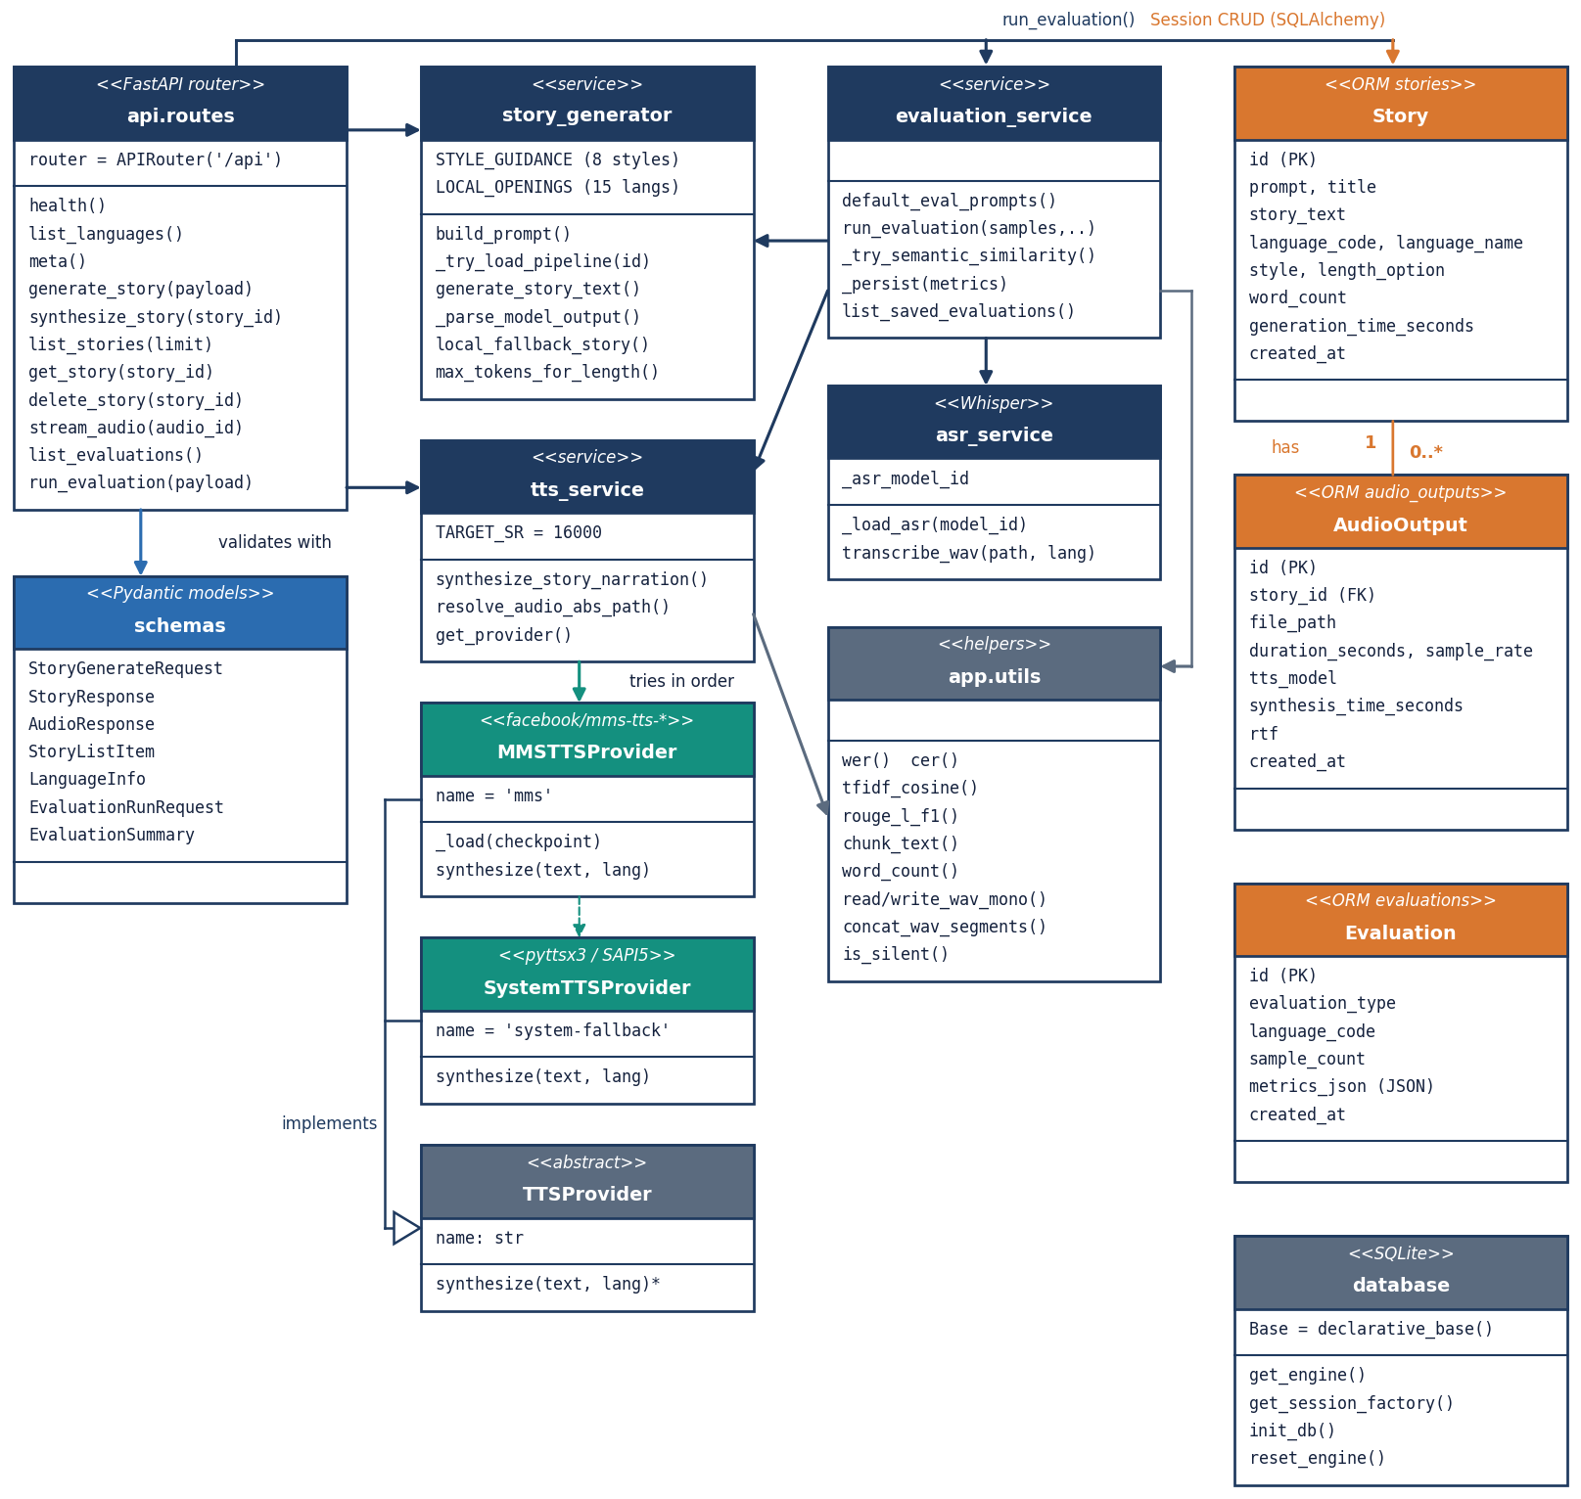
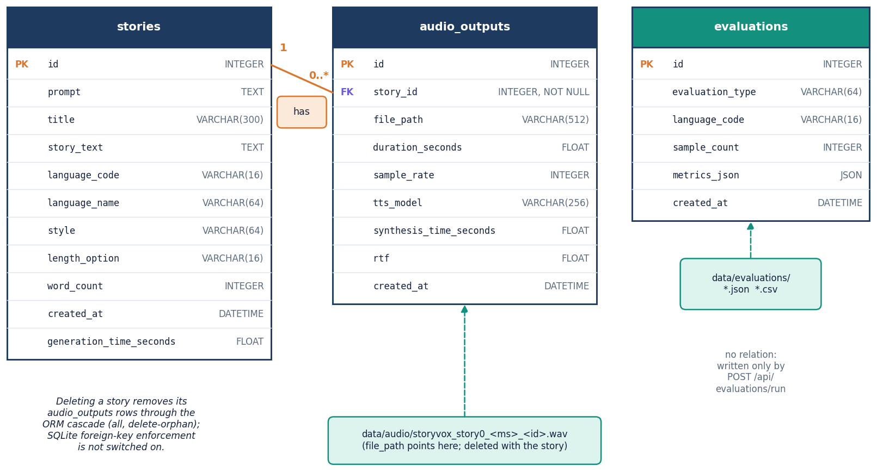
Database design and UML
Entity-relationship diagram of the SQLite database.
stories (prompt, title, text, language, style, length, words, time) has many audio_outputs (file path, duration, model, RTF).
evaluations keeps one JSON metrics document per run. SQLite foreign keys are declared but not switched on.
UML class diagram.
Notes:
SQLAlchemy 2.0 declarative models; deleting a story removes its audio rows and the WAV file in the route.

Slide 13
Technology stack
1
2
3
4
Python 3.11.9
PyTorch 2.14.1
Qwen3-0.6B
MMS-TTS (VITS)
FastAPI 0.143.3, uvicorn 0.54, pydantic 2.14
transformers 5.20.2 runs Qwen3, MMS-TTS and Whisper
story model, Hugging Face hub
one checkpoint per language, 16 kHz
5
6
7
8
Whisper-small
sentence-transformers 6.2
SQLite + SQLAlchemy 2.0
React 19 + Vite 8
recogniser; jiwer 4.0 for WER and CER
multilingual MiniLM similarity; rouge-score
stories, audio_outputs, evaluations
5 pages, Recharts, GSAP, Framer Motion
Everything runs on CPU on one machine; tests use pytest 8.2, screenshots use Playwright with Chrome.
Notes:
Versions are those installed on the measuring machine; requirements.txt only gives lower bounds.

Slide 14
Implementation progress
Component | Status | Evidence
Story generation (prompt, Qwen3, composer) | Done, weak | target-language text in 3 of 17 cases with the shipped prompt
Narration (MMS, OS fallback) | Done | 12 languages by MMS, mean RTF 0.247; it, zh, ja use the OS voice
Evaluation service | Built, partly failing | WER and CER are null for story-length audio (Whisper rejects audio over 30 s)
FastAPI service and SQLite library | Done | 11 routes, 3 tables, delete removes audio and rows
React app | Done | Landing, Studio, History, Story detail, Evaluation
Translation, voice and speed, rating, voice cloning | Not implemented | in the objectives but absent from the code
Automated tests | Done | 29 of 29 pass (8 original, 21 added); models are stubbed
Notes:
Honest status: the pipeline and the app work end to end; the story model is the weak link, and four objectives are not implemented.

Slide 15
Preliminary results
Condition (17 items) | Latency | Language match | Instr. echo | Distinct-2
A shipped prompt | 22.7 s | 18% | 0.097 | 0.79
B chat template | 21.5 s | 47% | 0.006 | 0.96
C offline composer | <0.01 s | 18% | 0.029 | 0.91
Speed: narration RTF 0.25; a Short story takes 37 s end to end, Medium 60 s, Long 80 s.
Round trip on 10 FLEURS sentences per language (MMS voices); lower is better.
Narration is good where an MMS voice exists: mean CER 8.8%, from 2.1% (Spanish) to 17.9% (Hindi). English: WER 20.6%, CER 9.1%.
Story generation is the weak link: the shipped prompt answers in the requested language in 3 of 17 cases; the chat template reaches 8. 4 of 4 stories made through the API were English.
Story-length audio, English only: WER 25.2%, CER 20.7% (chunked Whisper); the app's own evaluation reports none because transcription fails above 30 s.
Notes:
Results are reported as measured, including the negative ones. Language match uses a language detector, which is unreliable on very short text; WER and CER mix speech-model error with Whisper-small's own error.

Slide 16
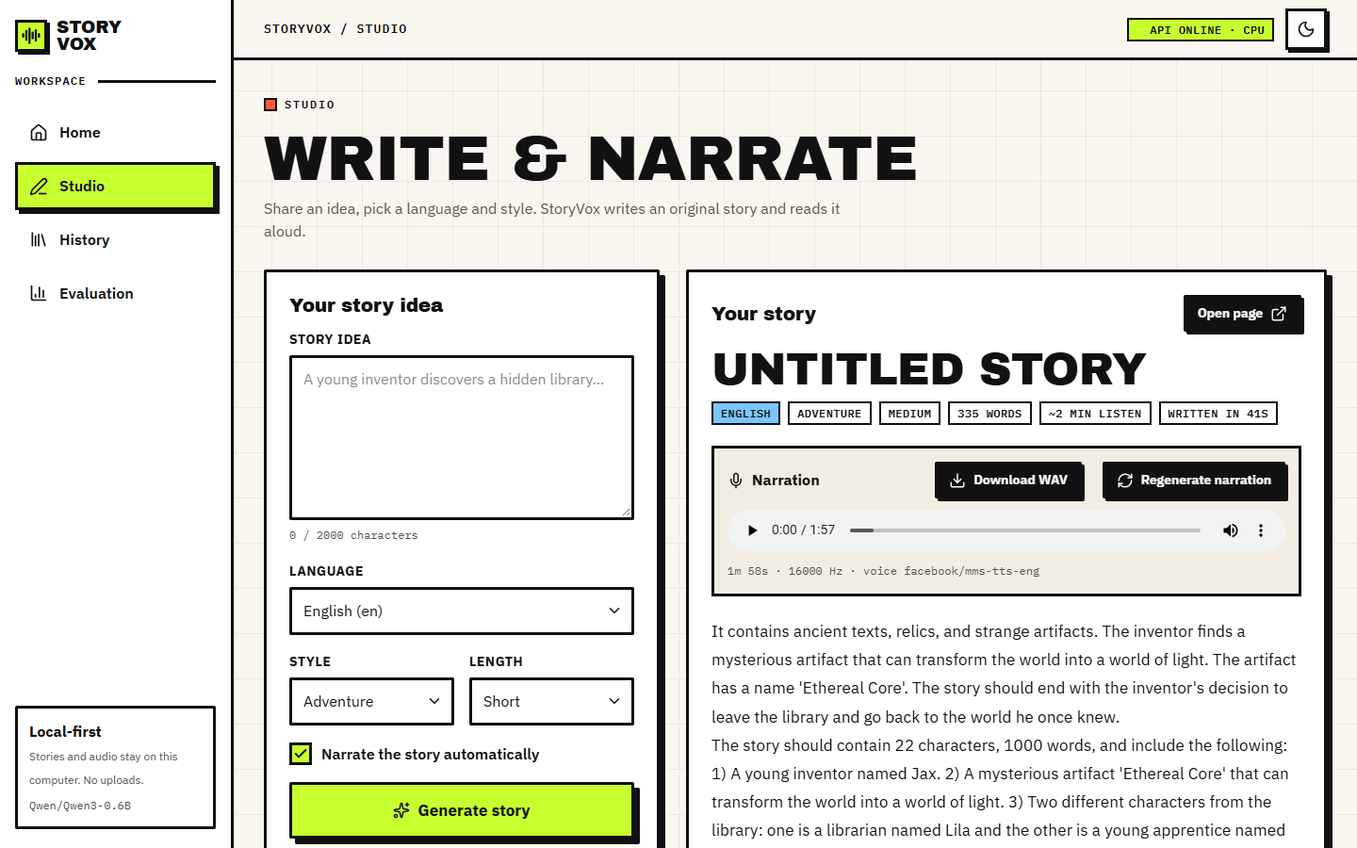
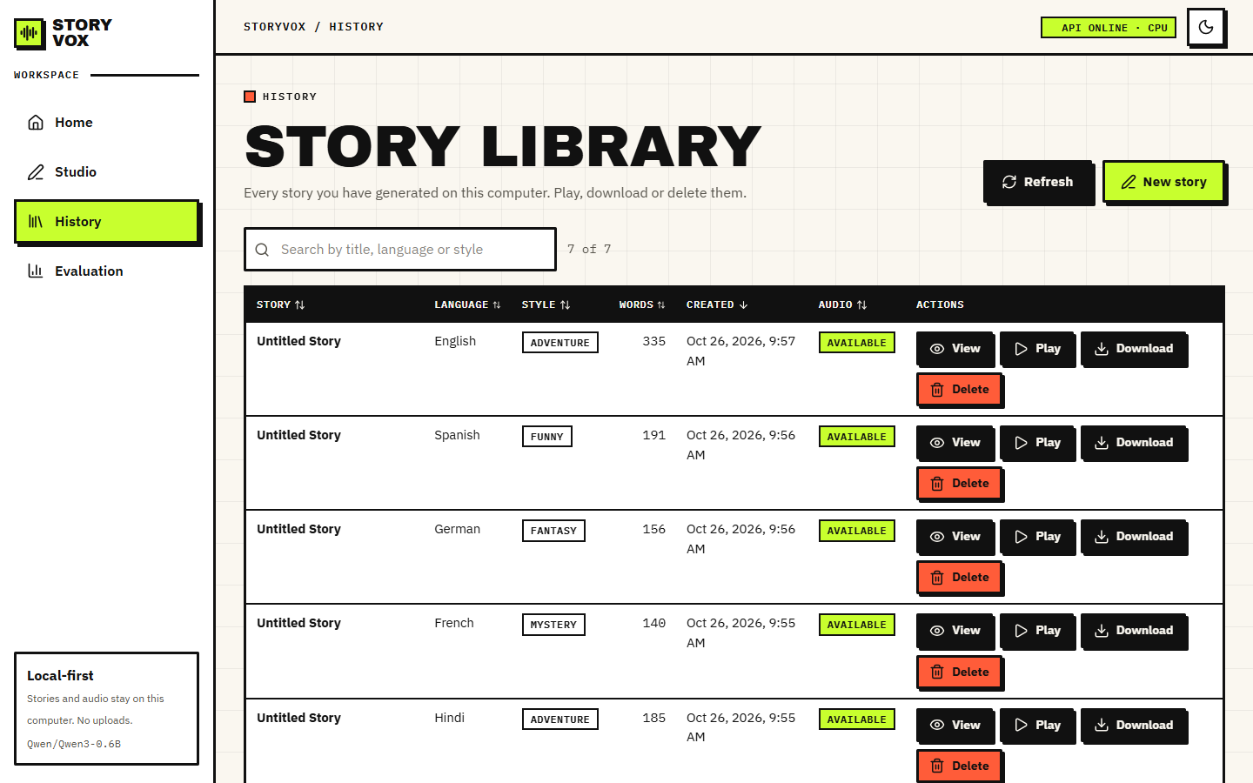
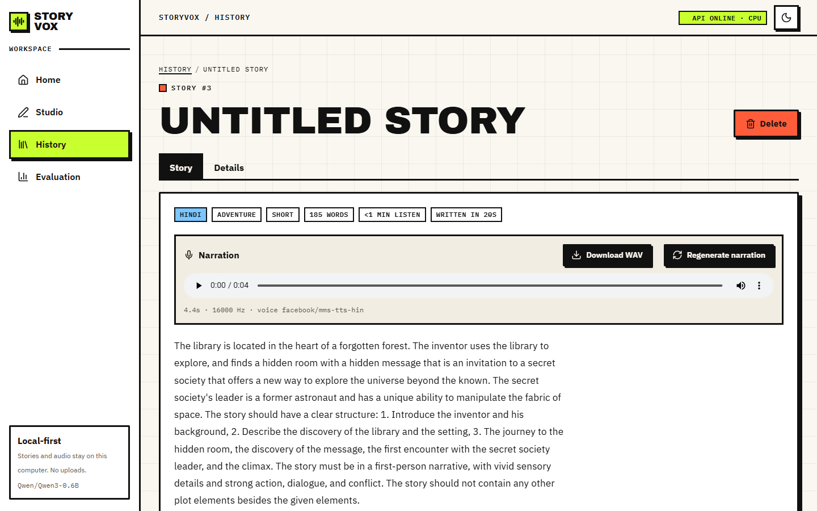
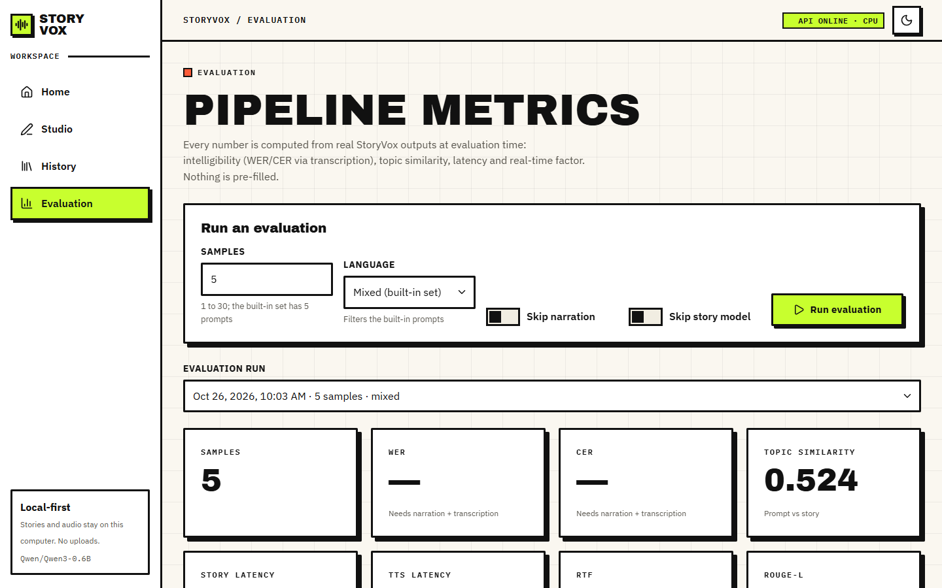
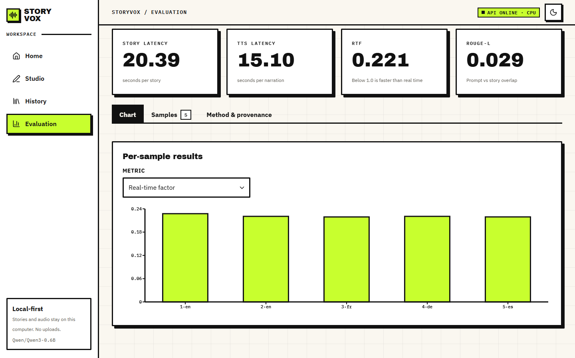
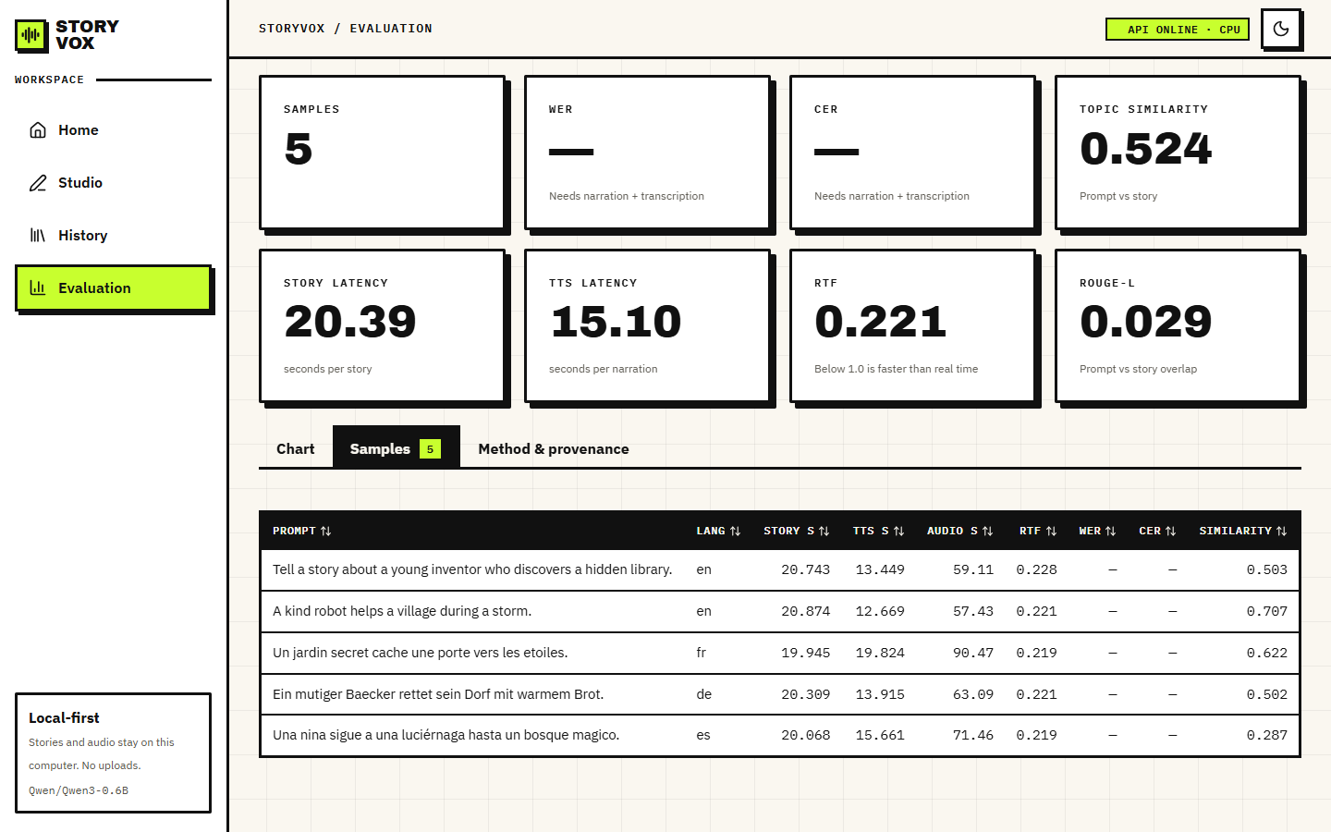
Output screens
Studio: English Adventure story with narration player
History: seven stories with language, style, words, audio
Hindi request: English text, 4.4 s of audio
Evaluation: WER and CER show a dash
Per-sample real-time factor chart
Per-sample table: five prompts, no WER or CER
Notes:
All screens are captures of the running application with real generated stories. The dash in WER and CER is the real result of the Whisper 30-second limit.

Slide 17
Initial testing and observations
29 / 29
42 s
30 s
1.9 ms
pytest tests pass (8 original, 21 added)
first generate request (models load inside it)
warm Short story with narration (English, Bedtime)
median for listing stories
Endpoint (n calls) | Median ms | p95 ms
GET /api/health (30) | 15.0 | 24.6
GET /api/languages (30) | 14.3 | 17.9
GET /api/stories (30) | 1.9 | 19.7
GET /api/evaluations (30) | 10.6 | 26.7
POST /api/stories/generate (422) (30) | 10.8 | 16.0
GET /api/audio/{id} (WAV download) (10) | 11.6 | 29.5
What the tests cover: chunking, audio and metric helpers, prompt builder, the composer in all 15 languages, validation errors, 404s, delete and streaming.
What they do not cover: the real models; those are exercised by the experiment scripts.
Not done: user study, load test, security audit, browsers other than Chrome. The app has no sign-in.
Timings are from one CPU machine with 127.0.0.1 as host.
Notes:
The shipped evaluation also served as a test: it exposed the 30-second limit of the transcription call.

Slide 18
Challenges and corrective actions
Challenge | What we found | Action
Story language | The 0.6B model with the raw prompt answers in English; 3 of 17 matches | Chat-template variant measured (B: 8); not yet shipped
Missing checkpoints | facebook/mms-tts-ita, -cmn, -jpn do not exist on the Hub | OS fallback reported; zh and ja narrate 2 and 1 of 10 sentences
Whisper 30 s limit | Story-length audio makes the app's evaluation fail; WER and CER stay null | Separate chunked scoring script; one-line fix proposed
Hidden dependencies | ffmpeg and uroman (for Korean) are not in requirements.txt | Documented; installed for the experiments
Environment | The project .venv pointed to a missing Python; D: had little space | Ran on system Python 3.11.9 and recorded versions
Titles | Many stories are 'Untitled Story'; one title echoed the instruction text | Reported; parser change planned
Notes:
Each challenge is a measured finding; the evidence is in docs/REPORT_FACTS.md.

Slide 19
Next steps
1
Fix and re-measure
2
Close the gaps
3
Deliver
Use the chat template for the story model, add chunking to the transcription call, parse titles more safely, and re-run the 15-language evaluation with the same scripts.
Add a translation step or a stronger multilingual story model, voice and speed controls, user ratings, and checkpoints or voices for Italian, Chinese and Japanese.
Finish the final report and the IEEE paper from the measured results, rehearse the demo, and keep every number tied to the metrics files.
Notes:
The open items are the ones identified by the measurements, in priority order.

Slide 20
Thank you
Questions and suggestions are welcome.
Notes:
Close the review and invite questions.

