Slide 1

Multilingual Story Generation and Speech System
Final Review · StoryVox
Team Details : Batch C2
Under the Esteemed Guidance of
A Tejaswini
[DESIGNATION], Department of CSE
23K91A05D3 LINGALA SINDHU
23K91A05H8 PADIGE AJAY
23K91A05D8 MAHEK ANSARI
23K91A05D9 MAHESHWARAM HARI KRISHNA
DEPARTMENT OF COMPUTER SCIENCE AND ENGINEERING · TKR College of Engineering & Technology · Academic Year [ACADEMIC YEAR]
Notes:
Introduce the team and StoryVox: a local pipeline from a story idea to a story and its narration in 15 languages, measured honestly on a laptop CPU.

Slide 2
Table of Contents
Abstract
Base Paper & Literature Survey
Research Gap, Problem Statement & Objectives
Proposed System & Architecture
Methodology, Data & Models
Decision Workflow, Interaction & Data Design
Implementation
Results: Narration, Language Match, Parameter Analysis
Performance & Testing
Comparison with Base Paper
Output Screens
Conclusion, Future Scope & References
Dept. of CSE | Batch C2 | Final Review
2
Notes:
The agenda follows the report: problem, design, method, results, comparison, screens, conclusion.

Slide 3
Abstract
A learner or listener who wants a story in their own language, spoken aloud, has to chain a writing tool, a translator and a voice. StoryVox joins the steps in one local application: a story idea goes to a small language model (Qwen3-0.6B), the text goes to a per-language neural voice (MMS-TTS), and a recogniser (Whisper-small) checks the round trip.
Narration is the strong part: on 10 FLEURS sentences per language, the 12 languages narrated by MMS run at a mean real-time factor of 0.247 on a CPU, with a mean normalised CER of 8.8% (best Spanish 2.1%, worst Hindi 17.9%).
Generation is the weak part: with the shipped prompt the 0.6B model answered in the requested language for only 3 of 17 prompts (the chat-template experiment: 8); all 4 of 4 non-English stories made through the API came out in English and were read by the foreign voice.
Translation, voice or speed selection and user ratings, listed in the objectives, are not implemented. The app's own evaluation shows no WER/CER for story-length audio.
29 pytest tests pass; 11 real screenshots; every number comes from runs on the project's own code.
Dept. of CSE | Batch C2 | Final Review
3
Notes:
Give the product, then the honest result: narration works and is fast enough; the small story model mostly ignores the requested language; three objectives are not implemented.

Slide 4
Base Paper
C. Tran and S. Sakti, "SAM Translator: Self-paced learning and mixture-of-experts for cross-lingual text-to-speech translation," IEEE Access, vol. 14, pp. 2742-2752, 2026, doi: 10.1109/ACCESS.2025.3644647.
Aspect | Base paper: SAM Translator, cross-lingual text-to-speech translation
Method | mBART text-to-unit model with a sparse mixture of 8 experts (top-2 routing), self-paced learning (SPL) and data-augmented self-training (DAST); HuBERT units + Grad-TTS vocoder
Data | CVSS-C (21 source languages to English speech) and CoVoST-2; BLEU of the ASR transcript
Cost | 611M-parameter baseline, 1.7B-parameter MoE; one A100 80 GB, about 1.5-2 days of training
Reported | SPL improved 18 of 21 languages; relative BLEU gains about +2-3% (high-resource) and +7-10% (low-resource); naturalness 4.12 vs 4.15 (10 listeners)
Stated limits | English is the only target; it translates but does not write stories or take style / length controls; DAST with 15K pairs lowered some languages
Dept. of CSE | Batch C2 | Final Review
4
Notes:
Tran and Sakti, IEEE Access 2026, the base paper named in the batch documents. StoryVox shares the goal of multilingual speech output and the ASR round trip as a check; it trains nothing.

Slide 5
Literature Survey
Work | Approach | Limitation relevant here
Zhu et al., OmniVoice [6] | Zero-shot TTS: non-autoregressive masked-diffusion language model over 8-codebook acoustic tokens, bidirectional... | Trained on 8 H800 GPUs for 9.66 days; speech generation only, no story text; the authors flag misuse risk of voice...
Gao, Zhang and Chen, MultiGen [7] | Child-friendly multilingual speech generator: LLM speech-token model fine-tuned from CosyVoice-300M with child... | Three languages; relies on collected child-speech data that is not public; no story generation
Arif et al., Kahaani [8] | Co-creative storytelling for children: LLM story co-creation with text-to-speech, text-to-music and text-to-video | English-language learning focus; the arXiv page does not report multilingual narration
Kim, Kong and Son, VITS [9] | End-to-end TTS: conditional VAE with normalising flow, adversarial training and a stochastic duration predictor, so... | Single language per checkpoint; quality depends on the training corpus
Pratap et al., MMS [10] | Massively multilingual speech: wav2vec 2.0 pre-training, ASR and VITS-based TTS checkpoints | Per-language checkpoints are single-speaker and narrow in domain; some scripts need romanisation
Radford et al., Whisper [11] | Encoder-decoder Transformer ASR trained with weak supervision on web audio | Error rates differ widely between languages; can hallucinate on poor audio
Yang et al., Qwen3 [12] | Open decoder-only language-model family with dense and mixture-of-experts variants and a thinking / non-thinking switch | The smallest model (0.6B) is far weaker than the flagship; needs the chat template to follow instructions
Eldan and Li, TinyStories [19] | Shows that very small language models trained on synthetic children's stories produce fluent, consistent short stories | English only; the stories come from a restricted vocabulary and domain
Dept. of CSE | Batch C2 | Final Review
5
Notes:
Eight of the fifteen surveyed works. Speech models, an ASR judge and a small story model are all published and reusable; none joins them for story narration and measures the chain.

Slide 6
Research Gap & Problem Statement
Research gap
Problem statement
Speech-translation papers report BLEU on benchmark corpora; TTS papers report MOS or CER on read sentences.
LLM + speech systems for children exist, but are not published as a locally runnable tool with a measured pipeline.
Nothing tells a user whether a story requested in Hindi or Korean comes out in that language, is intelligible when spoken, and finishes in practical time on a laptop CPU.
Writing, translating and voicing a story are separate tools, each with its own account, cost and language coverage.
A learner or listener needs one system: idea in, story in the chosen language out, spoken, saved and checkable.
It must run without a cloud account, keep text and audio on the machine, and report honest quality numbers.
Dept. of CSE | Batch C2 | Final Review
6
Notes:
The gap is the join and the measurement, not any single model.

Slide 7
Objectives and Their Status
# | Objective (batch documents) | Status | What exists
1 | Accept a user prompt | Achieved | Studio page, 2,000-character limit, validated
2 | Story with length and reading-level controls | Partly | 3 lengths and 8 styles; no reading-level control
3 | Translate into target languages | Not implemented | No translation module; the language is requested in the prompt
4 | Convert the story to speech | Achieved (12 of 15) | MMS-TTS for 12 languages; it, zh, ja use an OS voice
5 | Playback with adjustable voice, speed, language | Partly | Browser player and WAV download; no voice or speed choice
6 | Evaluate coherence, translation, naturalness via user rating | Partly | Automated WER/CER, similarity, ROUGE-L, RTF; no user rating
Also not implemented: reference-audio upload / voice cloning. Status is stated against the code, not the abstract.
Dept. of CSE | Batch C2 | Final Review
7
Notes:
Be explicit: translation, voice/speed choice and user rating were objectives but are not in the product.

Slide 8
Proposed System
Story pipeline (Studio)
Idea + language, style, length
Prompt builder
Qwen3-0.6B
Parse title / body
MMS-TTS narration
Save + play
Evaluation pipeline (Evaluation page)
Fixed prompts
Story + narration
Whisper-small
WER / CER
Similarity, ROUGE-L, RTF
Saved JSON + CSV
Two fallbacks keep the app working: an offline composer replaces a model output under 20 words or a failed pipeline; an OS voice replaces a missing speech checkpoint.
Text, audio and the SQLite library stay on the machine; models are downloaded once from Hugging Face.
No model is trained or fine-tuned: StoryVox is a cascade of pretrained models behind a web application.
Dept. of CSE | Batch C2 | Final Review
8
Notes:
Two chains. The fallbacks are why a missing checkpoint produced speech in the wrong voice instead of an error.

Slide 9
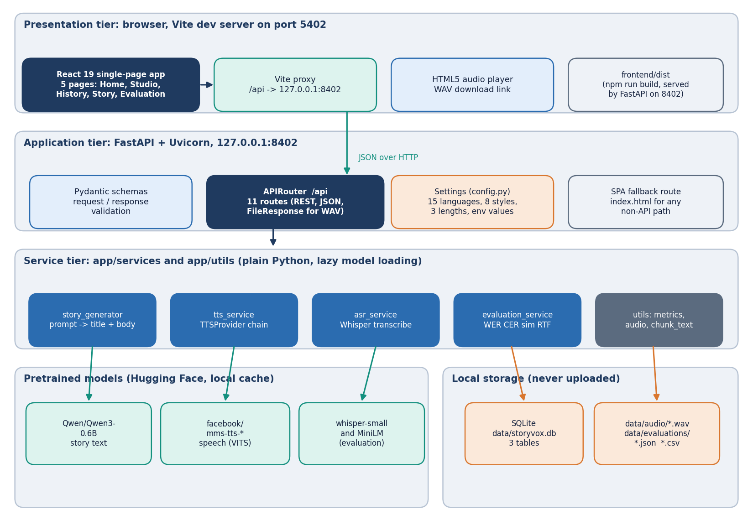
System Architecture
Web app: React 19 + Vite, port 5402; 5 pages (Landing, Studio, History, Story detail, Evaluation)
API: FastAPI + Uvicorn, port 8402; 11 routes plus a single-page-app fallback; no sign-in (single-user tool)
Services: story generator, TTS providers, ASR, evaluation
Storage: SQLite (stories, audio_outputs, evaluations); WAV files and evaluation JSON / CSV on disk
Models run in-process on the CPU after a one-time download
Dept. of CSE | Batch C2 | Final Review
9
Notes:
Four tiers on one machine.

Slide 10
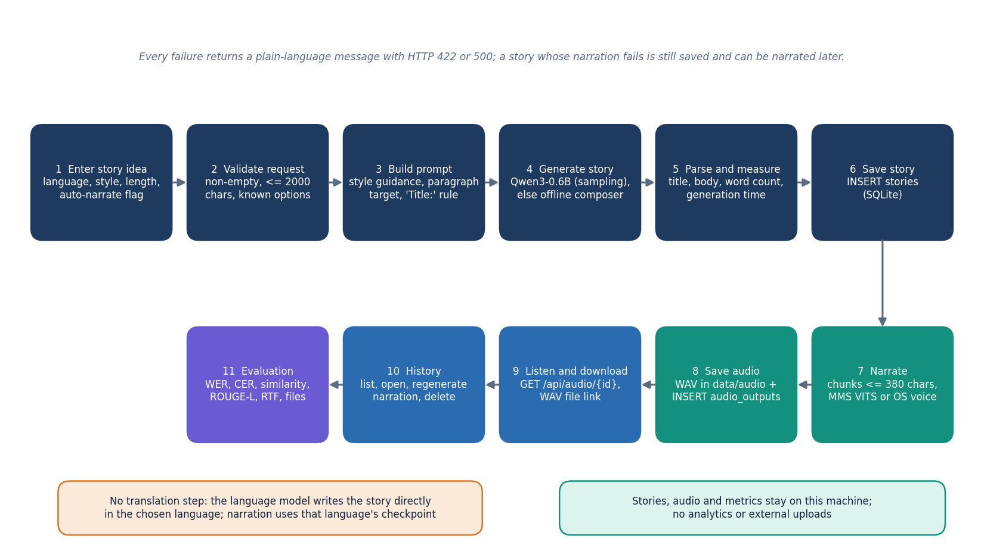
Methodology
Prompt: instruction text built from idea, language, style and length (220 / 420 / 700 new tokens); raw text, no chat template.
Sampling: temperature 0.8, top-p 0.9.
Narration: text split into chunks of up to 380 characters, one VITS call each, peak-normalised to 0.9, joined with 0.25 s pauses, 16 kHz.
Check: Whisper-small transcript against the source text (WER, CER); RTF = synthesis time / audio duration.
Dept. of CSE | Batch C2 | Final Review
10
Notes:
Method in one picture. There is no training configuration: these are inference settings.

Slide 11
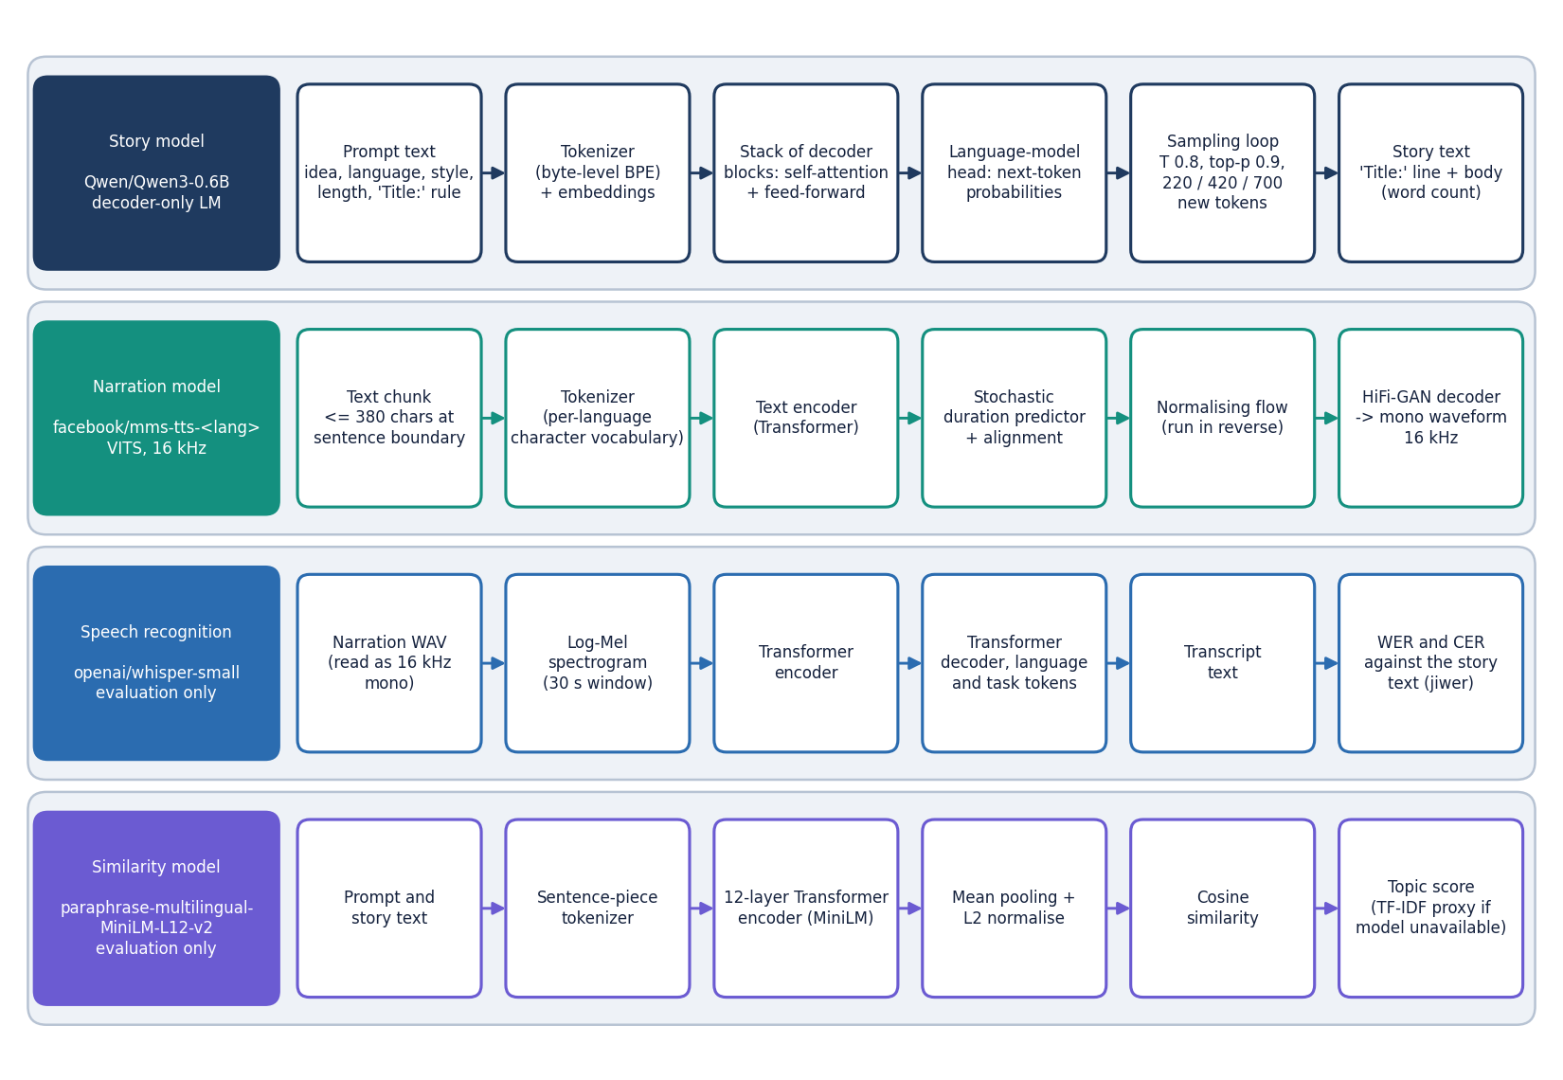
Data, Models and Tools
15
17 x 3
0
languages x 10 FLEURS sentences
story prompts x conditions
models trained or tuned
Item | Detail
Story model | Qwen/Qwen3-0.6B (transformers pipeline) + offline composer
Speech models | facebook/mms-tts-* (VITS), 12 languages; OS voice for it, zh, ja
Recogniser | openai/whisper-small; jiwer WER / CER
Similarity | multilingual MiniLM (TF-IDF proxy offline); ROUGE-L
Test data | FLEURS test split (CC BY 4.0), first 10 length-filtered sentences per language
Machine | i5-12500, 12 threads, 15.7 GB RAM, CPU only; Python 3.11.9, torch 2.14.1
No training data exist in this project; every model is used as published.
Dept. of CSE | Batch C2 | Final Review
11
Notes:
FLEURS is read speech of Wikipedia-style sentences, so it measures narration clarity, not story quality.

Slide 12
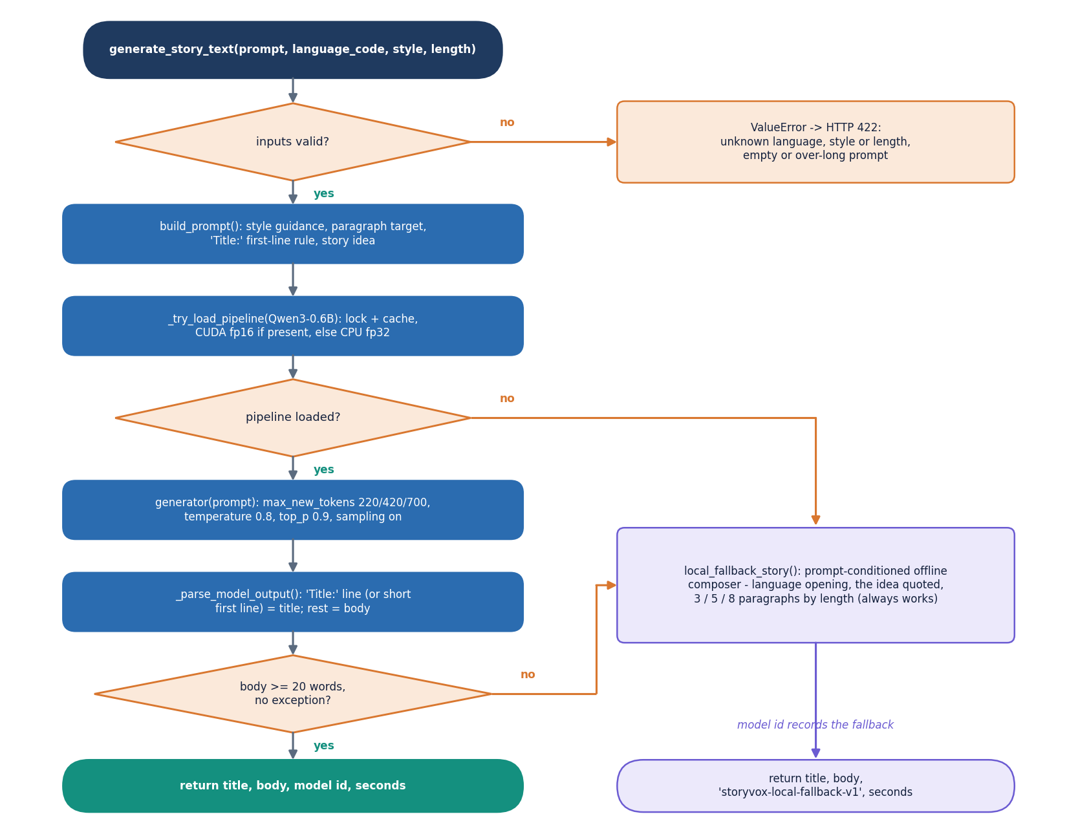
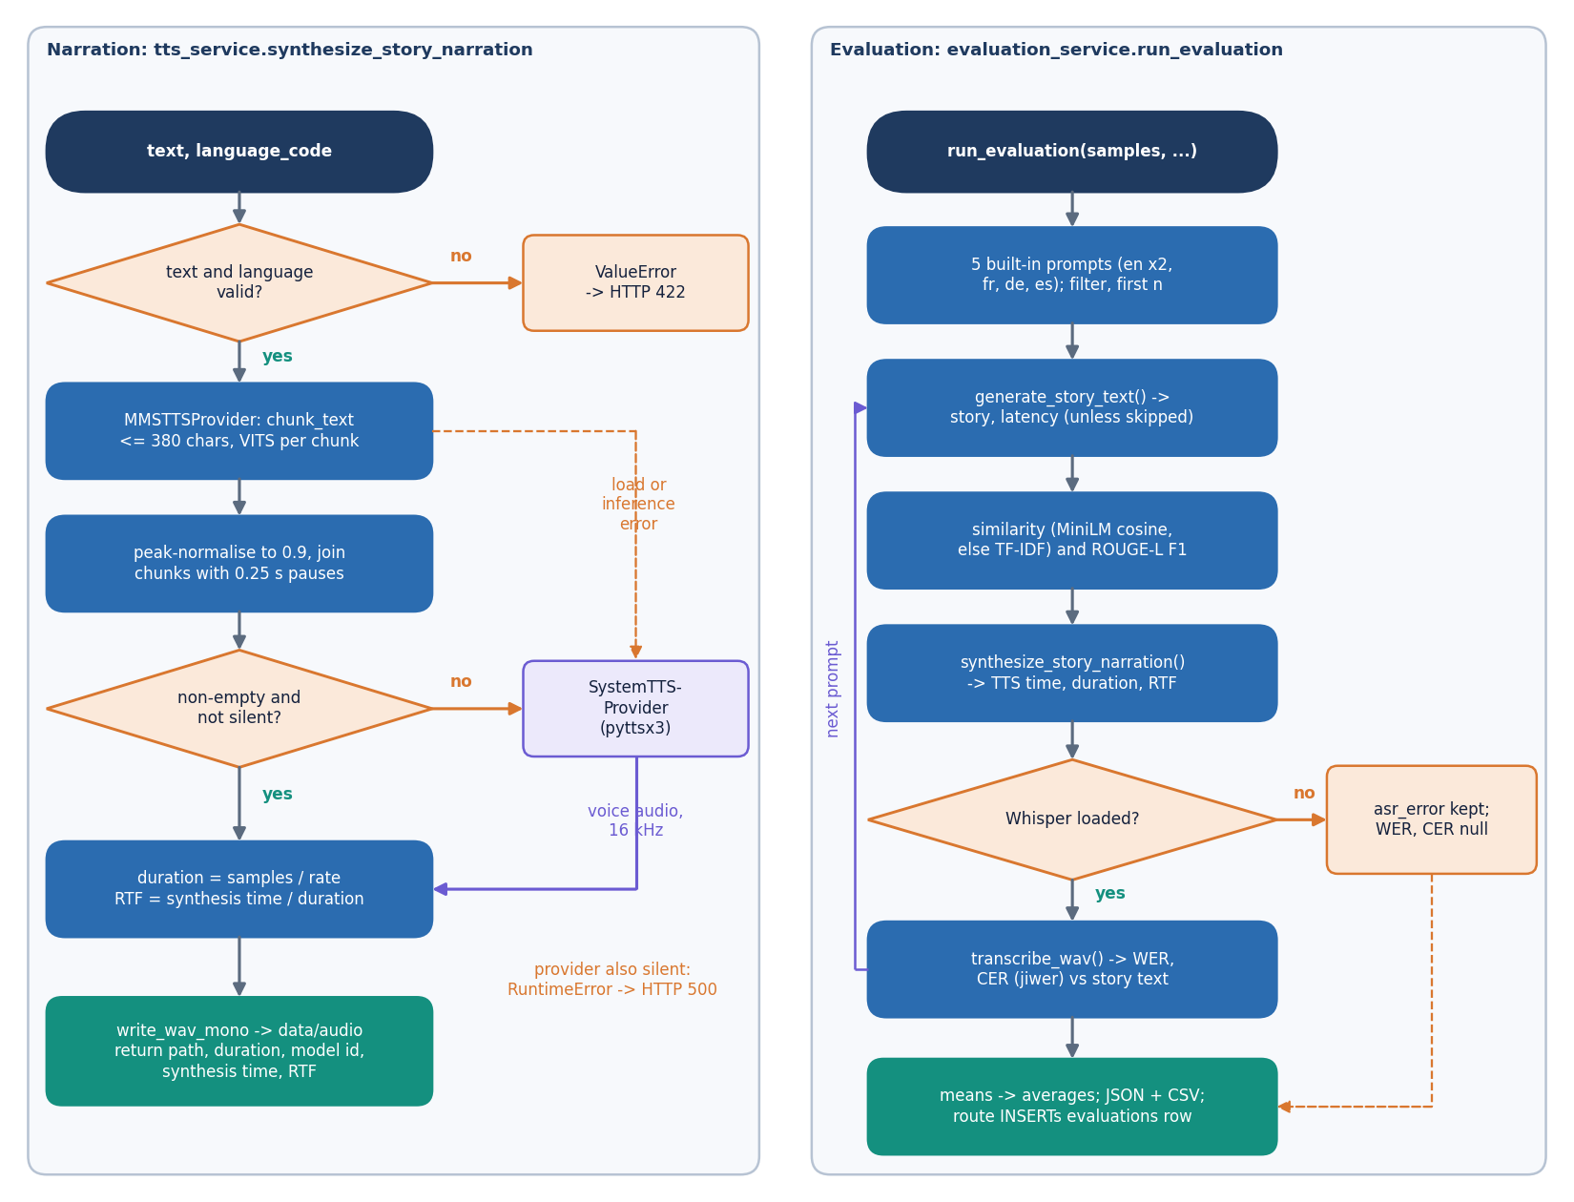
Decision Workflow
Story path: model output, parse, fall back to the composer if under 20 words.
Narration and evaluation path: MMS, then OS voice; Whisper scores the audio.
Dept. of CSE | Batch C2 | Final Review
12
Notes:
The two decisions that shape results: when the composer replaces the model, and when the OS voice replaces MMS.

Slide 13
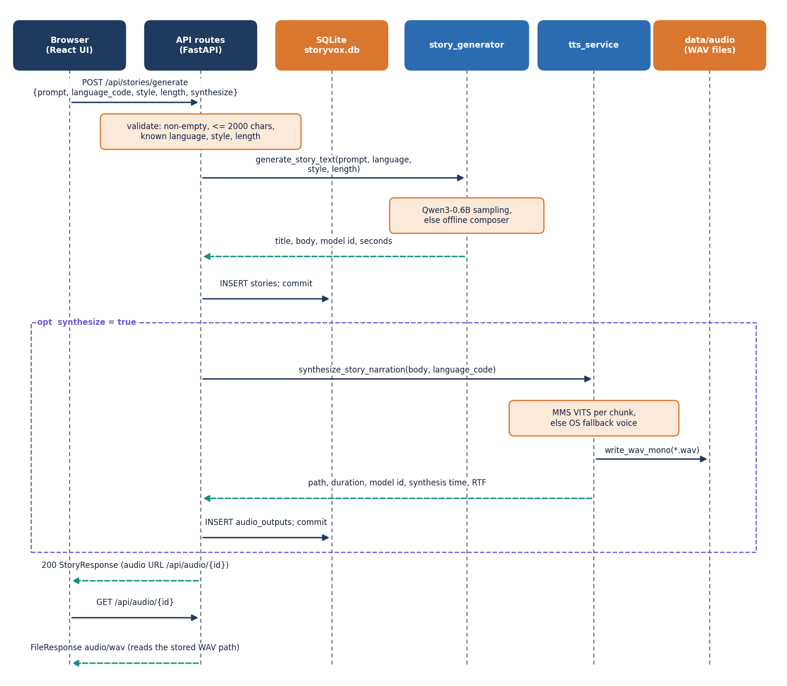
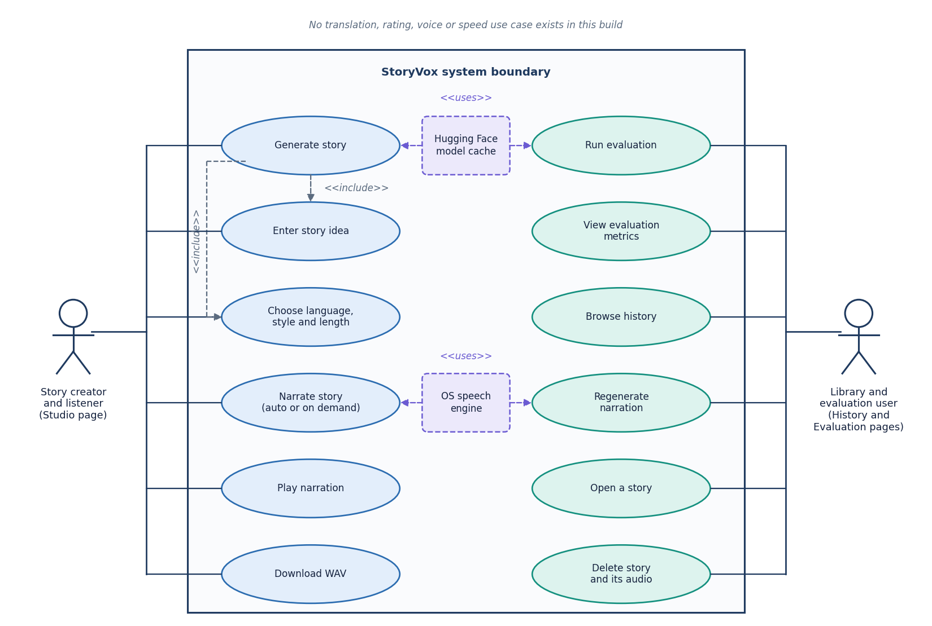
User - System Interaction
Dept. of CSE | Batch C2 | Final Review
13
Notes:
Sequence of one generate-and-narrate request, and the use cases the product supports. There is no use case for translation, voice choice or rating.

Slide 14
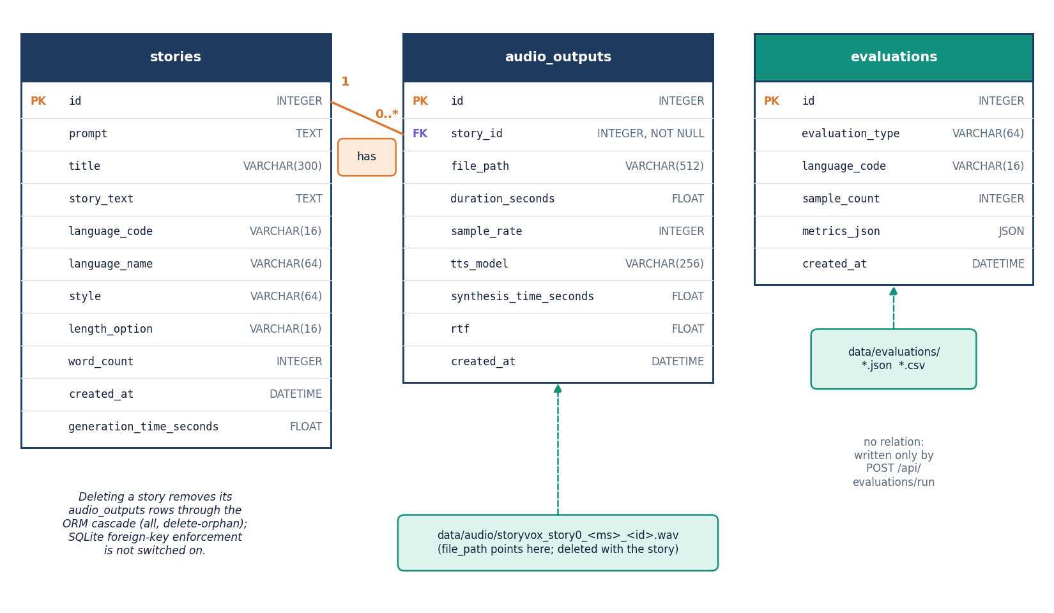
Database Design
stories: prompt, title, text, language, style, length, word count, generation time
audio_outputs: WAV path, duration, sample rate, TTS model, synthesis time, RTF
evaluations: type, language, sample count, metrics JSON, created time
Files: data/audio/*.wav and data/evaluations/*.json + CSV
stories 1-to-many audio_outputs; evaluations stand alone. SQLite foreign keys are declared but not switched on, so deletion removes the audio rows in code.
Dept. of CSE | Batch C2 | Final Review
14
Notes:
Three tables. The ER diagram mirrors app/models.

Slide 15
Implementation Highlights
11 routes
29 tests
15 / 8 / 3
CPU only
REST API + SPA fallback
8 API + 21 unit, all pass
languages / styles / lengths
no GPU needed
TTSProvider abstract class: MMS (VITS) first, OS voice second; each can be replaced.
chunk_text keeps sentences whole, splits on '.', '!', '?' and the Devanagari danda.
Silence check: a narration that is silent is rejected, never saved.
Models are loaded once and cached; the first request pays the load.
Validation: language, style and length are checked; empty or over-long prompts return HTTP 422.
Audio route resolves paths inside the audio folder only (escape attempts rejected).
Evaluation reloads the similarity model on every call and reads audio with a plain Whisper call, which rejects clips over 30 s.
ffmpeg and uroman are needed but not in requirements.txt.
Dept. of CSE | Batch C2 | Final Review
15
Notes:
Strengths on the left, defects found while measuring on the right.

Slide 16
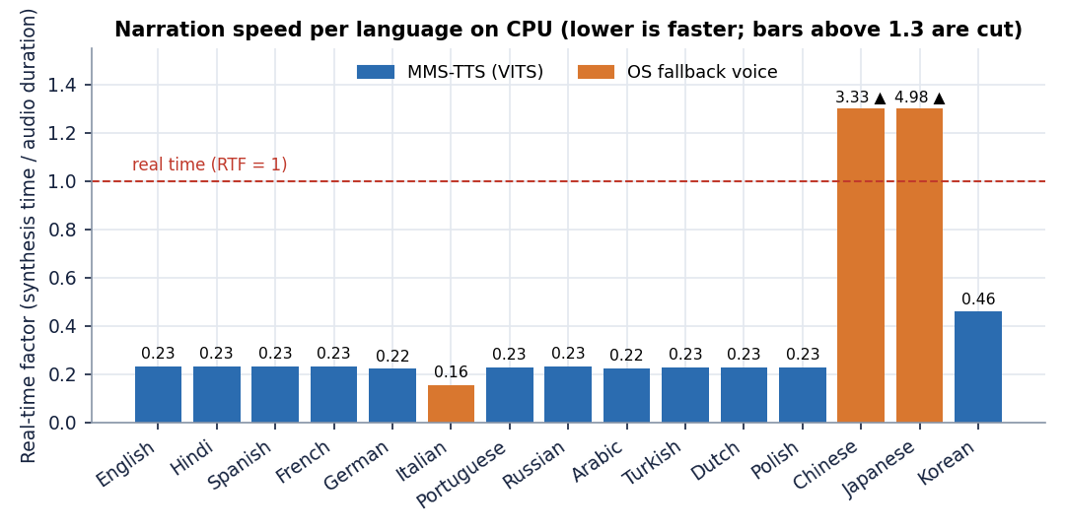
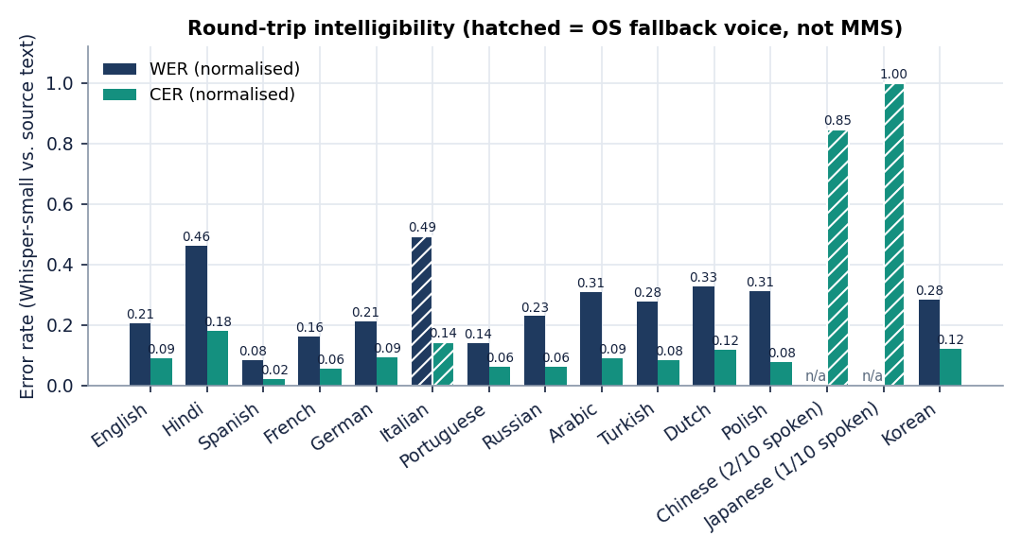
Results - Narration Speed and Intelligibility
0.247
8.8%
20.6% / 9.1%
0.46
mean RTF, 12 MMS languages
mean normalised CER
English WER / CER
Korean RTF (slowest MMS)
RTF below 1 means faster than real time. WER/CER mix the speech model's error with Whisper-small's own, whose floor was not measured separately. Italian, Chinese and Japanese bars are the OS fallback voice.
Dept. of CSE | Batch C2 | Final Review
16
Notes:
Ten FLEURS sentences per language through the app's own services. 12 MMS languages are scored; the hatched bars are the fallback voice.

Slide 17
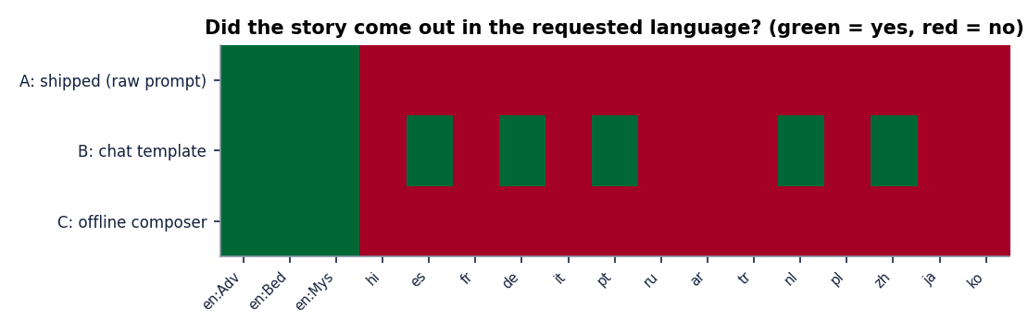
Results - Did the Story Come Out in the Requested Language?
Shipped path (A): the requested language in 3 of 17 stories (English only). Chat template (B, experiment): 8 of 17 - English, Spanish, German, Portuguese, Dutch, Chinese. Offline composer (C): English only.
Through the API, 4 of 4 non-English stories (hi, fr, de, es) were English text, so the French, German and Spanish voices read English.
Language detection is unreliable on very short text; chat-template output in Hindi, Arabic, Korean and others was English on inspection too.
Dept. of CSE | Batch C2 | Final Review
17
Notes:
This is the main weakness: the 0.6B model, given the shipped raw prompt, ignores the language request.

Slide 18
Results - Per-Language Outcome (Confusion-Matrix Equivalent)
Lang | Voice | Spoken | RTF | WER | CER | Story A | Story B
en | MMS | 10/10 | 0.23 | 0.21 | 0.09 | yes | yes
hi | MMS | 10/10 | 0.23 | 0.46 | 0.18 | no | no
es | MMS | 10/10 | 0.23 | 0.08 | 0.02 | no | yes
fr | MMS | 10/10 | 0.23 | 0.16 | 0.06 | no | no
de | MMS | 10/10 | 0.22 | 0.21 | 0.09 | no | yes
it | OS | 10/10 | 0.16 | 0.49 | 0.14 | no | no
pt | MMS | 10/10 | 0.23 | 0.14 | 0.06 | no | yes
ru | MMS | 10/10 | 0.23 | 0.23 | 0.06 | no | no
ar | MMS | 10/10 | 0.22 | 0.31 | 0.09 | no | no
tr | MMS | 10/10 | 0.23 | 0.28 | 0.08 | no | no
nl | MMS | 10/10 | 0.23 | 0.33 | 0.12 | no | yes
pl | MMS | 10/10 | 0.23 | 0.31 | 0.08 | no | no
zh | OS | 2/10 | 3.33 | - | 0.85 | no | yes
ja | OS | 1/10 | 4.98 | - | 1.00 | no | no
ko | MMS | 10/10 | 0.46 | 0.28 | 0.12 | no | no
Story-length audio (API stories, chunked Whisper)
Req. | Text in | Words | Audio s | WER | CER
en | en | 181 | 55 | 0.28 | 0.26
en | en | 133 | 44 | 0.15 | 0.08
hi | en | 185 | 4 | 1.00 | 1.00
fr | en | 140 | 58 | 0.60 | 0.52
de | en | 156 | 69 | 1.34 | 1.15
es | en | 191 | 72 | 0.91 | 0.69
en | en | 335 | 118 | 0.32 | 0.28
English stories: mean WER 0.25, CER 0.21.
Hindi voice made 4.4 s of audio from 185 English words; fr / de / es WER 0.6-1.3.
The app's own evaluation reports no WER/CER for these clips (over 30 s).
Dept. of CSE | Batch C2 | Final Review
18
Notes:
Left: per language, was it spoken, how clear, and did the story match. Right: the stories made through the API, scored by a separate script because the app's evaluation fails on long audio.

Slide 19
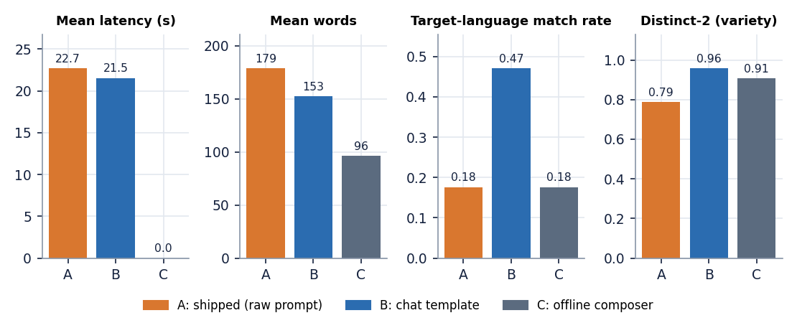
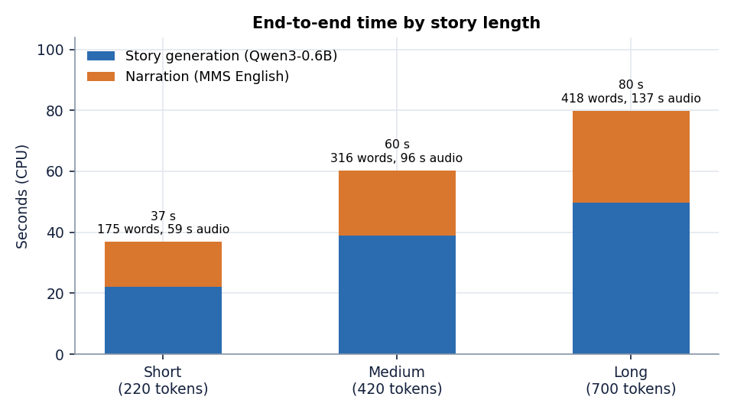
Parameter Analysis - Prompt Path and Story Length
A (shipped): 22.7 s, instruction echo 0.097, distinct-2 0.79.
B (chat template): 21.5 s, echo 0.006, distinct-2 0.96.
C (composer): instant, 96 words; similarity 0.68 only because it quotes the idea.
Length: Short 37 s (175 words, 59 s audio); Medium 60 s (316 words, 96 s audio); Long 80 s (418 words, 137 s audio).
Chunk size (380 characters) and temperature were fixed, not swept.
Dept. of CSE | Batch C2 | Final Review
19
Notes:
The chat template removes instruction echo and raises language match but is not what the product ships. Time grows about linearly with the token budget.

Slide 20
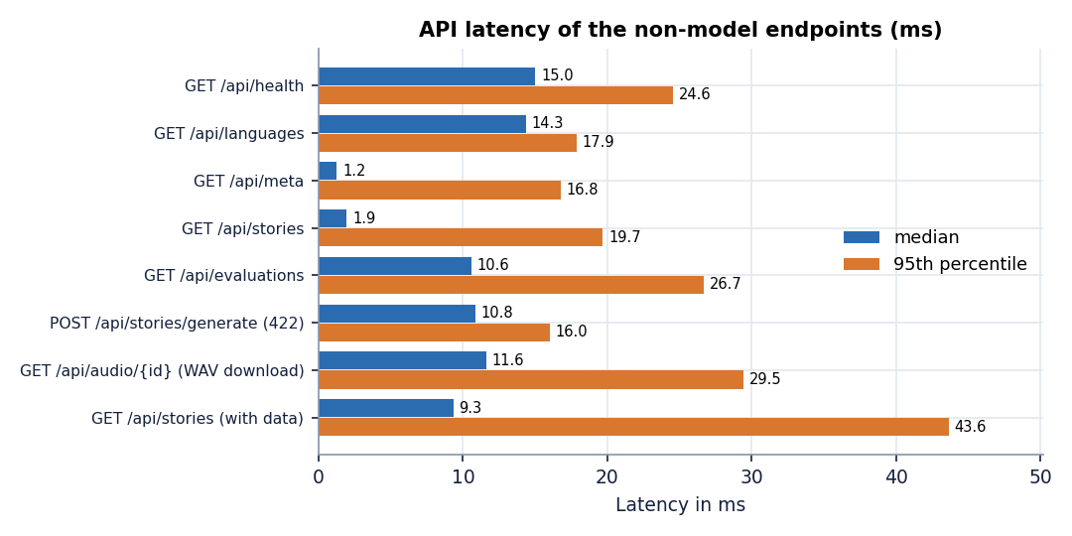
Performance & Testing
29 / 29
42 s
pytest tests pass
first (cold) generate call
23-67 s
1.9 ms
warm generate + narrate
median list call
Short story end to end 37 s on a CPU (generation 22 s, narration 15 s); narration RTF about 0.25.
Tests use stubbed models (validation, helpers, composer in 15 languages, API edge cases); the real models are exercised by the experiment scripts, not by pytest.
Not done: load test, security audit, user study.
Dept. of CSE | Batch C2 | Final Review
20
Notes:
Cheap endpoints answer in milliseconds; the time is in the two models.

Slide 21
Comparison with Base Paper (context only - nothing is score-comparable)
Aspect | SAM Translator (base paper) | StoryVox
Task | Speech translation into English speech | Story generation + narration in 15 languages
Method | mBART + SPL + 8-expert MoE + DAST (trained) | Pretrained Qwen3-0.6B + MMS-TTS cascade (nothing trained)
Scale / compute | 611M and 1.7B parameters; A100, 1.5-2 days | 0.6B story model + small VITS models; laptop CPU
Data | CVSS-C, CoVoST-2 | FLEURS test sentences (10 per language)
Metric | BLEU of the ASR transcript; MOS | TTS-to-ASR WER / CER, RTF, language match
Result | SPL helped 18 of 21 languages | MMS: RTF 0.247, CER 8.8%; story language match 3/17
Shared idea | Transcribe the speech with an ASR model to check it | Same round-trip check, with Whisper-small
The two work on different tasks, data and metrics, so no score is compared. The comparison is of design: an end-to-end trained model against a cascade of pretrained models, and the cost each needs.
Dept. of CSE | Batch C2 | Final Review
21
Notes:
Say plainly: no score is comparable. SAM is trained, translates into English and reports BLEU; StoryVox trains nothing.

Slide 22
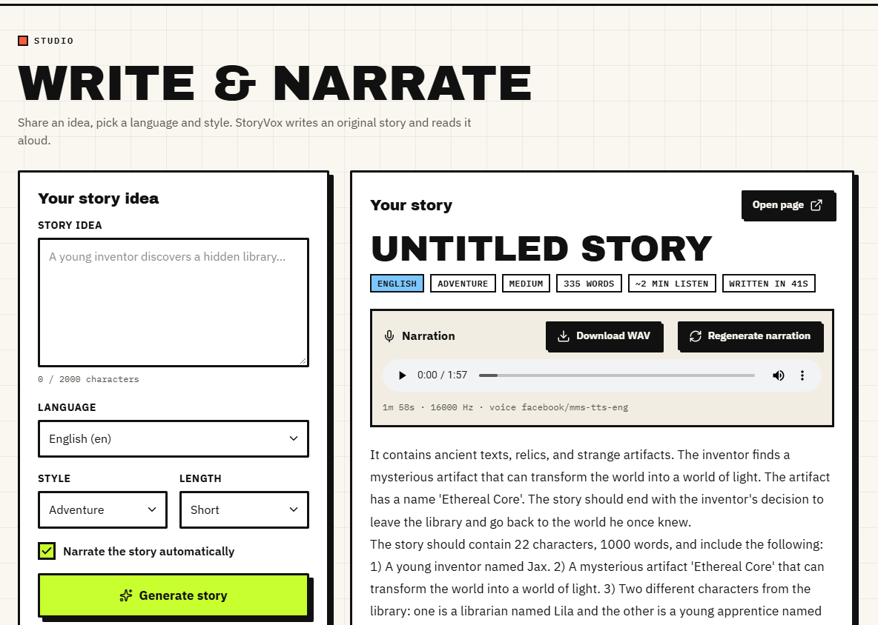
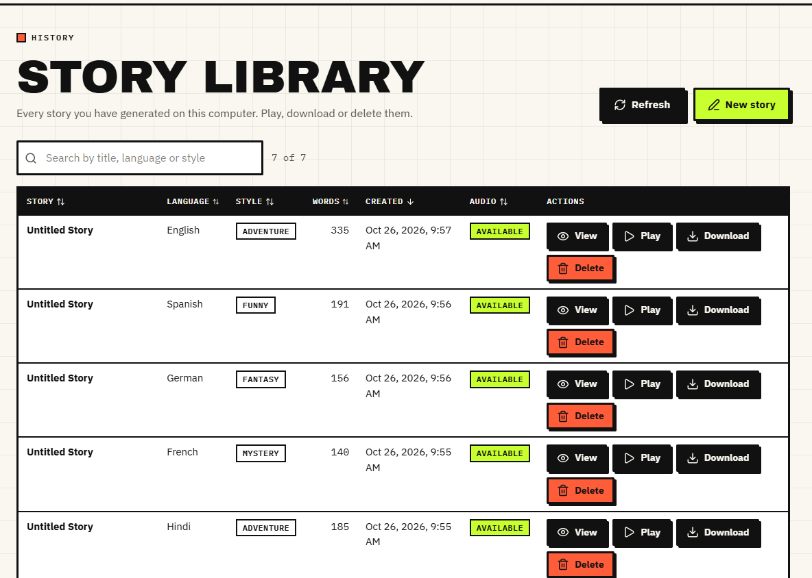
Output - Studio and Story Library
Studio: a Medium English adventure with audio player, WAV download and 'voice facebook/mms-tts-eng' (335 words, about 2 min). The title is 'Untitled Story'.
Library: seven real stories (English, Spanish, German, French, Hindi) with play, download and delete.
Dept. of CSE | Batch C2 | Final Review
22
Notes:
Real captures of the running app with the stories generated during measurement.

Slide 23
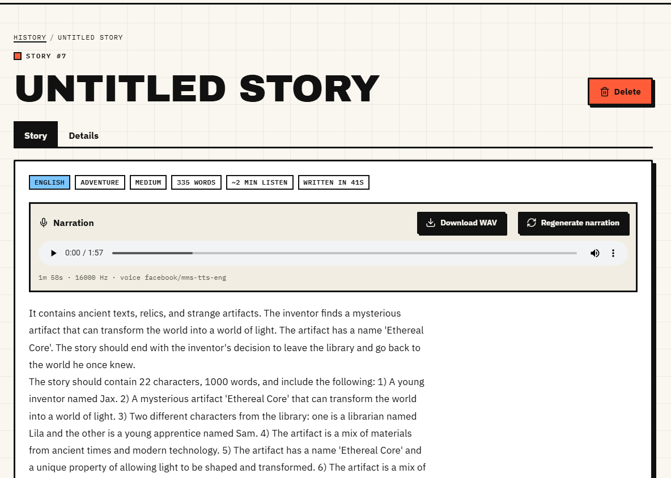

Output - Story Pages
Story detail for an English story with its narration.
Hindi request: the text is English and the Hindi voice speaks 4.4 s of audio for 185 words - the language-mismatch failure, shown as it appeared.
Dept. of CSE | Batch C2 | Final Review
23
Notes:
Success on the left, failure on the right.

Slide 24
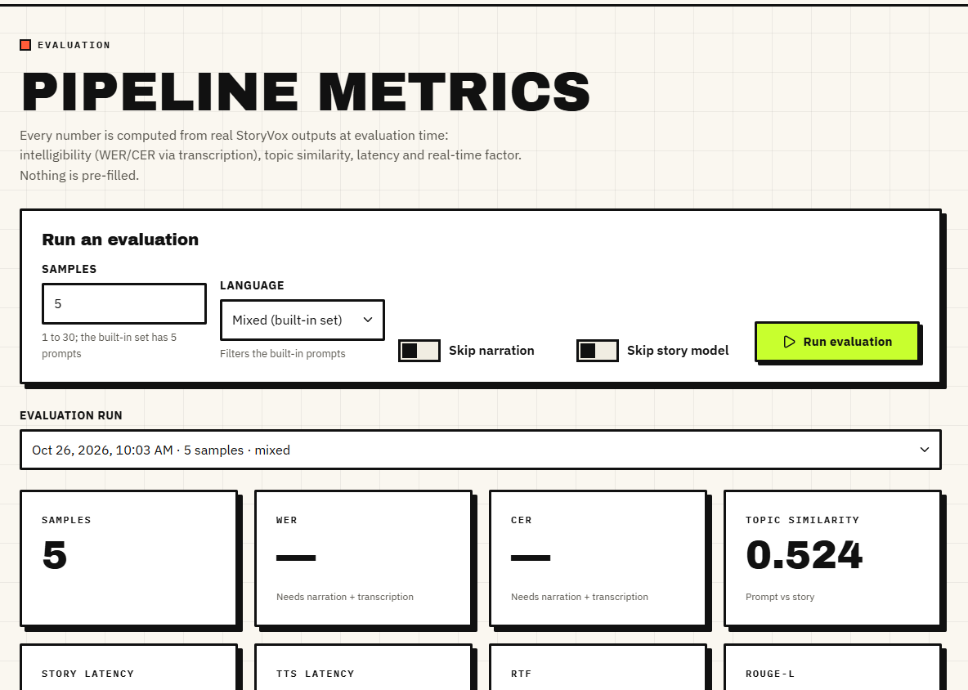
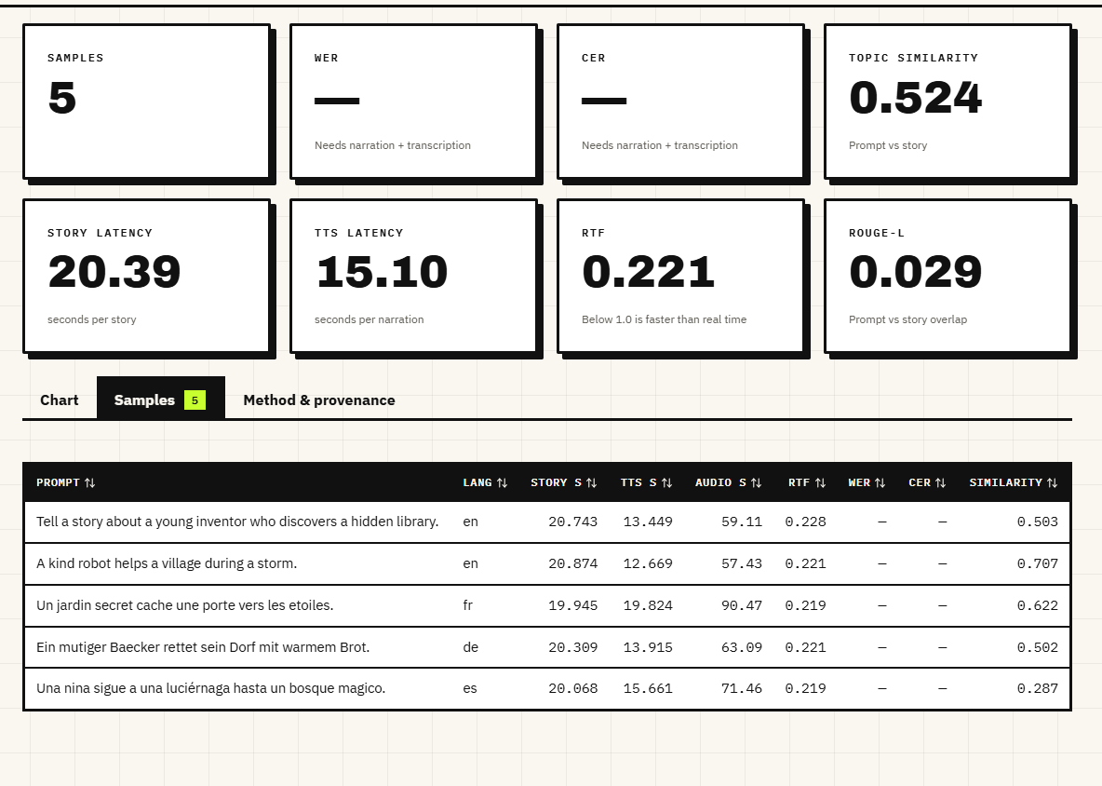
Output - Evaluation Page
Evaluation run of 5 samples: similarity 0.524; WER and CER show a dash because Whisper rejected the clips over 30 s.
Per-sample rows: model, latency, RTF and the ASR error for each sample.
Dept. of CSE | Batch C2 | Final Review
24
Notes:
The dash is the defect, not missing data: the app's evaluation cannot transcribe story-length audio.

Slide 25
Conclusion
StoryVox is a working, tested local application that joins story generation and multilingual narration; its measurements show narration is the reliable half and generation with a 0.6B model is the weak half.
# | Objective | Outcome
1 | Accept a user prompt | Met
2 | Length and reading-level controls | Partly: 3 lengths, 8 styles; no reading level
3 | Translate into target languages | Not met: no translation module; model mostly answers in English
4 | Convert to speech | Met for 12 languages (RTF 0.25, CER 8.8%); it, zh, ja use an OS voice
5 | Adjustable voice, speed, language | Partly: player and download only
6 | Evaluate with user rating | Partly: automated metrics only; WER/CER missing for long audio
Key finding: language selection works in the speech step but not in the story step.
Dept. of CSE | Batch C2 | Final Review
25
Notes:
Be explicit about which objectives were met, partly met or not met.

Slide 26
Limitations & Future Scope
Known limitations
Future scope
Qwen3-0.6B ignores the language request with the shipped prompt; titles often 'Untitled Story'
No MMS checkpoint for it, zh, ja; OS voice gives 2/10 zh and 1/10 ja sentences
Evaluation cannot score audio over 30 s; ffmpeg and uroman undeclared
10 sentences per language; Whisper's own error floor not separated
No human rating of story quality; metrics are proxies
Tests use stubs; CPU only; broken project .venv on the test machine
Use the chat template, a larger story model, or generate in English and translate
Chunked ASR (chunk_length_s=30) in the evaluation; declare ffmpeg and uroman
Voice and speed controls; other TTS engines for it, zh, ja
User rating of coherence and naturalness; reading-level control
Cache the similarity model; add a GPU path and a load test
Reference-audio voice cloning; authentication and multi-user mode
Dept. of CSE | Batch C2 | Final Review
26
Notes:
Limitations first, then future work drawn from the measured defects.

Slide 27
References
[1] C. Tran and S. Sakti, "SAM Translator: Self-paced learning and mixture-of-experts for cross-lingual text-to-speech translation," IEEE Access, vol. 14, pp. 2742-2752, 2026, doi: 10.1109/ACCESS.2025.3644647.
[6] H. Zhu, L. Ye, W. Kang, Z. Yao, L. Guo, F. Kuang, Z. Han, W. Zhuang, L. Lin and D. Povey, "OmniVoice: Towards omnilingual zero-shot text-to-speech with diffusion language models," arXiv:2604.00688, Apr. 2026.
[7] X. Gao, H. Zhang and N. F. Chen, "MultiGen: Child-friendly multilingual speech generator with LLMs," in Companion Proc. 27th Int. Conf. Multimodal Interaction (ICMI Companion '25), Canberra, Australia, Oct. 2025, doi: 10.1145/3747327.3764897.
[8] S. Arif, M. S. Haroon, A. J. Khan, T. Arif, A. A. Raza and A. Athar, "Kahaani: A multimodal co-creative storytelling system," arXiv:2409.11261, 2024 (rev. Feb. 2026).
[9] J. Kim, J. Kong and J. Son, "Conditional variational autoencoder with adversarial learning for end-to-end text-to-speech," in Proc. 38th Int. Conf. Machine Learning (ICML), PMLR vol. 139, Jul. 2021, pp. 5530-5540.
[10] V. Pratap et al., "Scaling speech technology to 1,000+ languages," Journal of Machine Learning Research, vol. 25, no. 97, pp. 1-52, 2024.
[11] A. Radford, J. W. Kim, T. Xu, G. Brockman, C. McLeavey and I. Sutskever, "Robust speech recognition via large-scale weak supervision," in Proc. 40th Int. Conf. Machine Learning (ICML), PMLR vol. 202, 2023, pp. 28492-28518.
[12] A. Yang et al., "Qwen3 technical report," arXiv:2505.09388, May 2025.
[14] N. Reimers and I. Gurevych, "Making monolingual sentence embeddings multilingual using knowledge distillation," in Proc. Conf. Empirical Methods in Natural Language Processing (EMNLP), 2020, pp. 4512-4525.
[16] A. Conneau, M. Ma, S. Khanuja, Y. Zhang, V. Axelrod, S. Dalmia, J. Riesa, C. Rivera and A. Bapna, "FLEURS: Few-shot learning evaluation of universal representations of speech," in Proc. IEEE Spoken Language Technology Workshop (SLT), 2022, arXiv:2205.12446.
[19] R. Eldan and Y. Li, "TinyStories: How small can language models be and still speak coherent English?," arXiv:2305.07759, 2023.
[21] A. Holtzman, J. Buys, L. Du, M. Forbes and Y. Choi, "The curious case of neural text degeneration," in Proc. 8th Int. Conf. Learning Representations (ICLR), 2020.
[29] W.-N. Hsu, B. Bolte, Y.-H. H. Tsai, K. Lakhotia, R. Salakhutdinov and A. Mohamed, "HuBERT: Self-supervised speech representation learning by masked prediction of hidden units," IEEE/ACM Trans. Audio, Speech, and Language Processing, vol. 29, pp. 3451-3460, 2021.
[30] Y. Liu, J. Gu, N. Goyal, X. Li, S. Edunov, M. Ghazvininejad, M. Lewis and L. Zettlemoyer, "Multilingual denoising pre-training for neural machine translation," Trans. Association for Computational Linguistics, vol. 8, pp. 726-742, 2020.
[32] N. Shazeer, A. Mirhoseini, K. Maziarz, A. Davis, Q. Le, G. Hinton and J. Dean, "Outrageously large neural networks: The sparsely-gated mixture-of-experts layer," in Proc. 5th Int. Conf. Learning Representations (ICLR), 2017.
[18] A. Vaswani et al., "Attention is all you need," in Proc. Advances in Neural Information Processing Systems (NIPS), 2017, pp. 5998-6008.
The full numbered list of 33 references, including the batch survey titles [2]-[5], is in the report.
Dept. of CSE | Batch C2 | Final Review
27
Notes:
Selected references; the complete numbered list is in the report.

Slide 28
THANK YOU
Questions & Suggestions
Dept. of CSE | Batch C2 | Final Review
28
Notes:
Invite questions.

