Slide 1
An Efficient Novel Approach for Predicting Startup Company Success Rates Using Advanced Machine Learning Paradigms
REVIEW 2 · DESIGN, METHODOLOGY AND PROGRESS
Design, methodology and progress: classifiers, comparable-startup retrieval and feature drivers behind a FastAPI service and a React interface
Presented by
Under the guidance of
Orchu Shirisha 23K91A05H6
Mudavath Raghavendar 23K91A05G1
Majgi Vaishnavi 23K91A05E0
Polishetty Poojitha 23K91A05J4
P Prasanna, [DESIGNATION]
Department of Computer Science and Engineering
[COLLEGE NAME] · Batch C10 (CSE-C) · [ACADEMIC YEAR]
Notes:
This review shows how the system is designed and built, what is implemented, the first measured results on real data, and the open items.

Slide 2
Contents
01
02
03
Recap and architecture
Methodology and dataset
Preprocessing and model
04
05
06
Training and decision logic
Data flow, database and UML
Technology stack
07
08
09
Implementation progress and results
Output screens and testing
Challenges and next steps
Notes:
Agenda for the design and progress review.

Slide 3
Recap: problem and proposed system
!
Problem
i
Proposed system
B
Base paper link
Startup success is judged subjectively; failure causes show up only after capital is committed; success is rare or imbalanced in data; and a bare prediction names no drivers.
37 structured features plus a MiniLM text embedding are fused. Four classifiers are compared; the best serves a prediction, and a balanced retrieval returns comparable historical startups with the top feature drivers.
Panjwani et al. (2026) report that ensembles predict best (85-92 % accuracy, dataset not stated). We keep the model family and add retrieval, explanations and a measured, leakage-aware evaluation; their numbers are not reproducible from the paper.
Notes:
One-minute recap of Review 1: the gap in feature engineering and rare-class handling, and how the base paper relates (model family and motivation only).

Slide 4
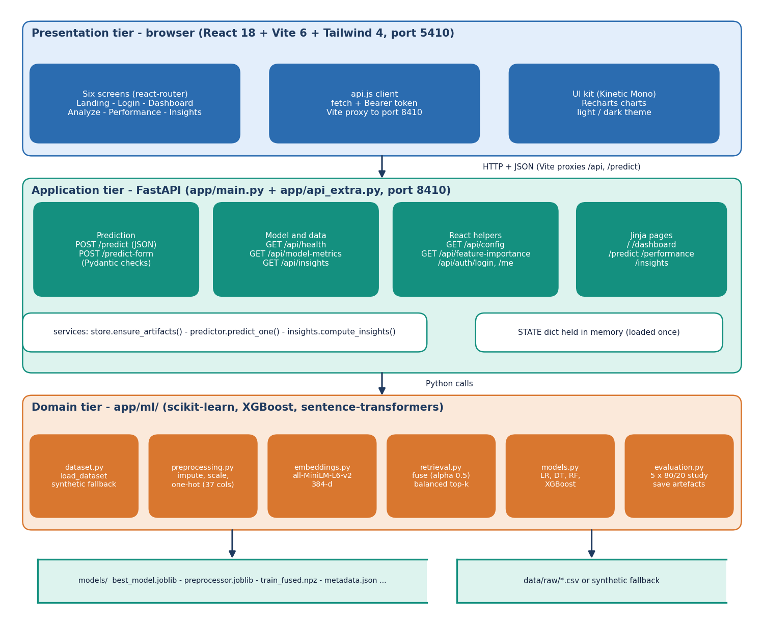
System architecture
Three tiers
Presentation: React 18 app (VenturePulse, port 5410) with landing, sign-in, dashboard, analyse, performance and insights screens.
Application: FastAPI (port 8410), JSON endpoints plus the original Jinja pages; one model held in memory.
Domain: app/ml (dataset, preprocessing, embeddings, retrieval, models, evaluation) and app/services (store, predictor, insights).
Storage: artefact files in models/; no SQL database.
Notes:
The FastAPI layer calls the same predictor service for the JSON API and the original server-rendered pages, so both use one model and one retrieval index.

Slide 5
Methodology: end-to-end workflow
Startup data
Clean + encode
Embed text
Fuse + index
Train 4 models
Select + save
Predict + explain
Leakage-safe
Class weighting
Reproducible
Preprocessing is fitted on the training part of each split, and retrieval searches training rows only, so a test startup never retrieves itself.
Balanced class weights in Logistic Regression, Decision Tree and Random Forest; imbalance strategies are compared on the real table.
scripts/run_experiments.py and extra_experiments.py write JSON; every number in the documents is read from it.
Notes:
The same preprocessing objects are used for training and serving. The experiment scripts reuse the product's own preprocessing and model definitions.

Slide 6
Dataset: two tables, kept apart
1,400
922
596 / 326
595 / 805
synthetic fallback rows (shipped app)
real public rows after de-duplication
real: success / failure
synthetic: success / failure
 | Shipped synthetic table | Real public table
Source | Generated with the same schema (public CSV was not available) | Kaggle 'Startup Success Prediction' (public domain), US startups
Outcome | acquired = SUCCESS (42.5 %), closed = FAILURE | acquired = SUCCESS (64.6%), closed = FAILURE
Text | Template descriptions that differ by class (they leak the label) | No description column
Used for | Serving the app, screenshots | All real measurements
In the real table SUCCESS is the majority class, the reverse of what the objectives assumed. Features that are recorded around or after the outcome (relationships, milestones) are flagged as leakage-like and tested later.
Notes:
The shipped app runs on a synthetic table of 1,400 rows because the public CSV needs a login; the identical 923-row public table was obtained separately and, after the app's own de-duplication, has 922 rows. All real results come from that table. Its lack of descriptions means the text half of the fusion cannot be tested on it.

Slide 7
Data preprocessing and feature extraction
Step | What the code does | Result
Clean rows | Drop duplicates; map acquired/IPO to SUCCESS (1) and closed to FAILURE (0); coerce numbers | Valid labelled rows
Missing values | Median imputation (numeric), most-frequent (flags), constant 'Unknown' (categorical) | No NaN reaches a model
Scale and encode | StandardScaler on 9 numeric fields + log1p funding; one-hot state (10) and industry (10) | 37 structured features
Text | Clean description, mask company name, MiniLM embedding (384-d), L2-normalised | Text vector
Fuse | x = [0.5 s, 0.5 t], then L2-normalise so cosine similarity is a dot product | 421-d fused vector
Seven flags and nine numeric fields: has_VC, has_angel, has_roundA-D, is_top500; funding total and rounds, ages at first and last funding and milestone, relationships, milestones, average participants. Funding velocity is only approximated by the ages and the number of rounds; no team-experience field exists in either table.
Notes:
All steps live in app/ml/preprocessing.py, dataset.py and retrieval.py. The preprocessor is saved with the model so serving uses the same transforms.

Slide 8
Model: four classifiers on fused features
4 + 1
37
384
k = 50
classifiers (+ HistGradientBoosting in the study)
structured features
text embedding dimensions
default comparable startups (10/20/30/50)
Model | Configuration (app/ml/models.py)
Logistic Regression | lbfgs, class_weight balanced, C = 1, max_iter 1000. Serves predictions in the app (best balanced accuracy on the shipped data)
Decision Tree | max_depth 8, min_samples_split 10, min_samples_leaf 5, balanced
Random Forest | 300 trees, min_samples_leaf 2, balanced
XGBoost | 400 trees, depth 6, learning rate 0.05, subsample 0.8, colsample 0.8
Selection rule: highest mean balanced accuracy over five stratified 80/20 splits (seed 42).
Notes:
The best model on the shipped synthetic table is Logistic Regression; on the real table the tree ensembles are ahead, which is reported in the results slide.

Slide 9
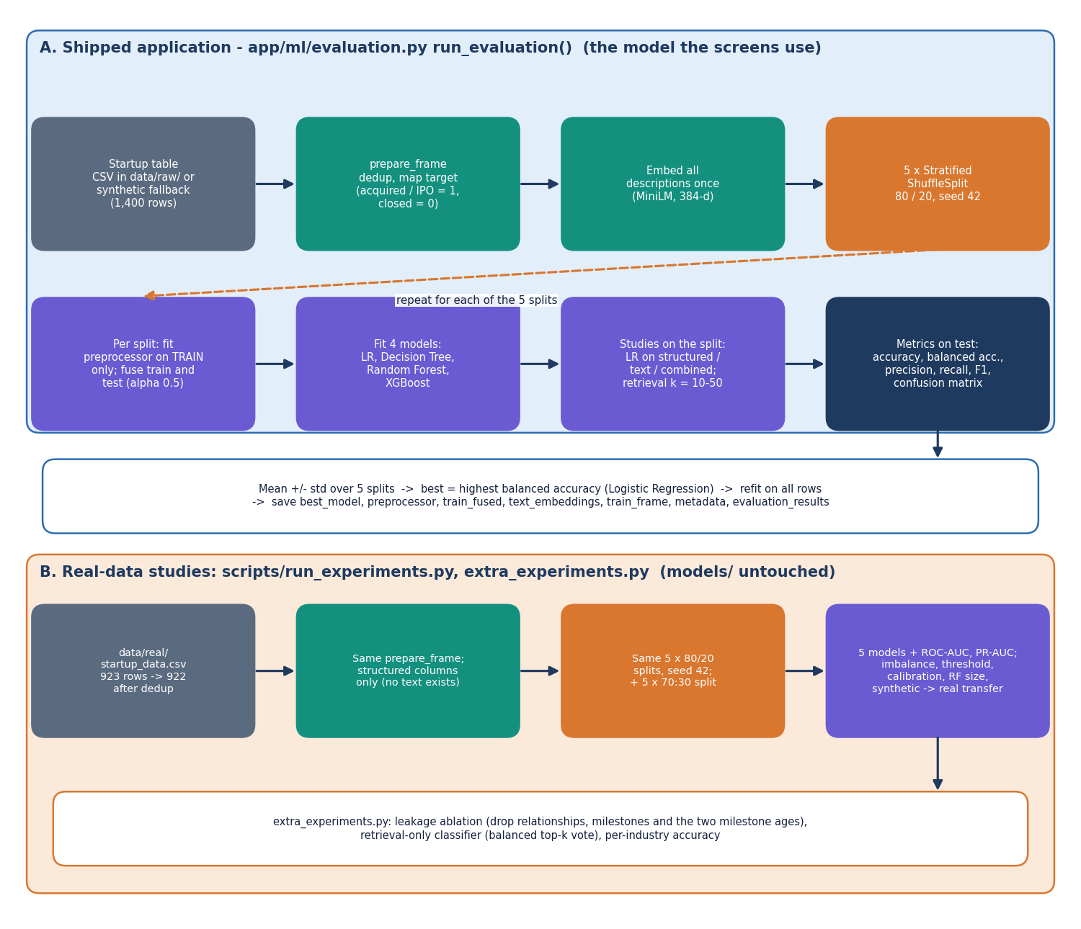
Training and evaluation configuration
Setting | Value
Protocol | 5 x StratifiedShuffleSplit, 80 % train / 20 % test, seed 42; preprocessing fitted on train only; mean ± std
Metrics | Accuracy, balanced accuracy (primary), precision, recall, F1, ROC-AUC, confusion matrix
Studies | Representation (structured / text / combined), retrieval k, imbalance, threshold, calibration, forest size, 70:30, leakage ablation
Real-data run | 922 rows, structured features, 139 s on CPU for the full study
Hardware | Intel Core i5-12500 (6 cores, 12 threads), 15.7 GB RAM, Windows 11 Pro, CPU only (no GPU)
The protocol follows the 2026 retrieval paper [2] (five repeated stratified 80/20 splits, balanced accuracy) and also runs the base paper's 70:30 split with five seeds, so both can be compared with the same data.
Notes:
Training is seconds, not hours: the whole real-data study of five models and all ablations takes about two minutes on the CPU.

Slide 10
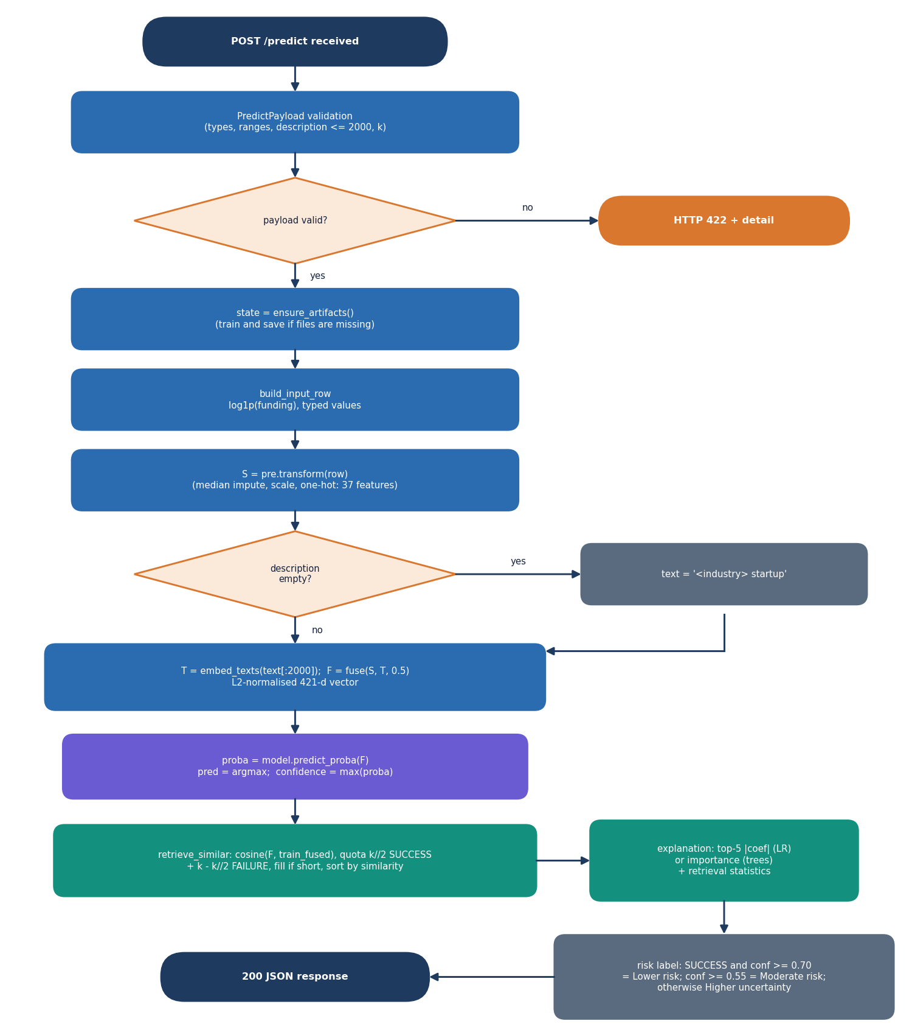
Decision logic: prediction, retrieval and risk label
Predict. The model returns P(success); the outcome is the larger of P(success) and P(failure), and the confidence is that maximum.
Retrieve. Cosine similarity to training rows only; half the k slots go to successful and half to failed startups, so rare cases are not crowded out.
Explain. Top five signed coefficient or importance terms, plus counts and average similarity of the retrieved cases.
Risk label. 'Lower risk' if SUCCESS with confidence at least 0.70; 'Moderate risk' if confidence at least 0.55; else 'Higher uncertainty'.
Caveat. Logistic Regression with balanced class weights under-states P(success) on the real table (calibration slide of the final review).
Notes:
Left: the core algorithm flowchart. The risk labels are rules on the displayed confidence; they are not validated probabilities.

Slide 11
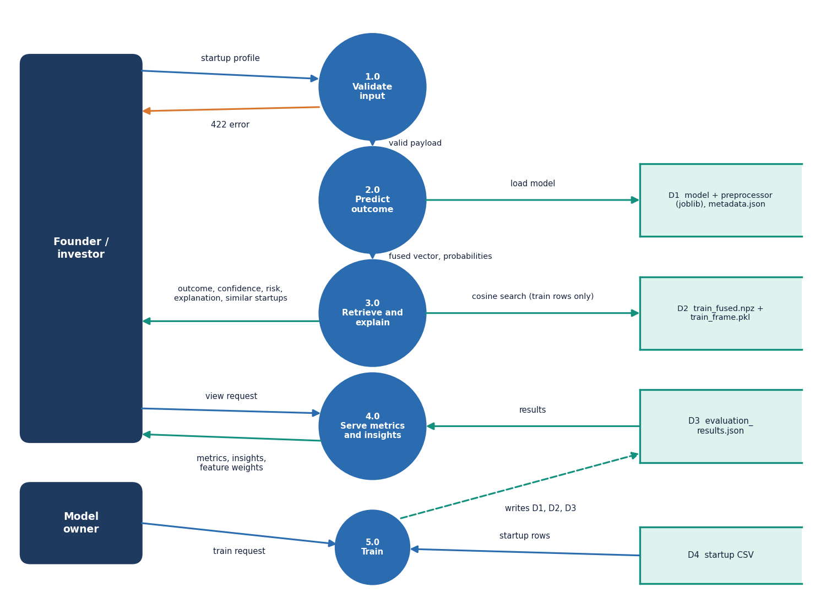
Data flow and modules
Module | Role
ml/dataset.py | load CSV or synthetic fallback
ml/preprocessing.py | clean, impute, scale, encode
ml/embeddings.py | MiniLM text vectors
ml/retrieval.py | fusion, balanced top-k search
ml/models.py | four classifiers
ml/evaluation.py | 5 x 80/20 study, charts
services/predictor.py | predict, explain, risk label
main.py, api_extra.py | routes, validation, demo sign-in
Notes:
Level-1 data flow: predict, model statistics and insights, evaluation/training, with the artefact files as the store.

Slide 12
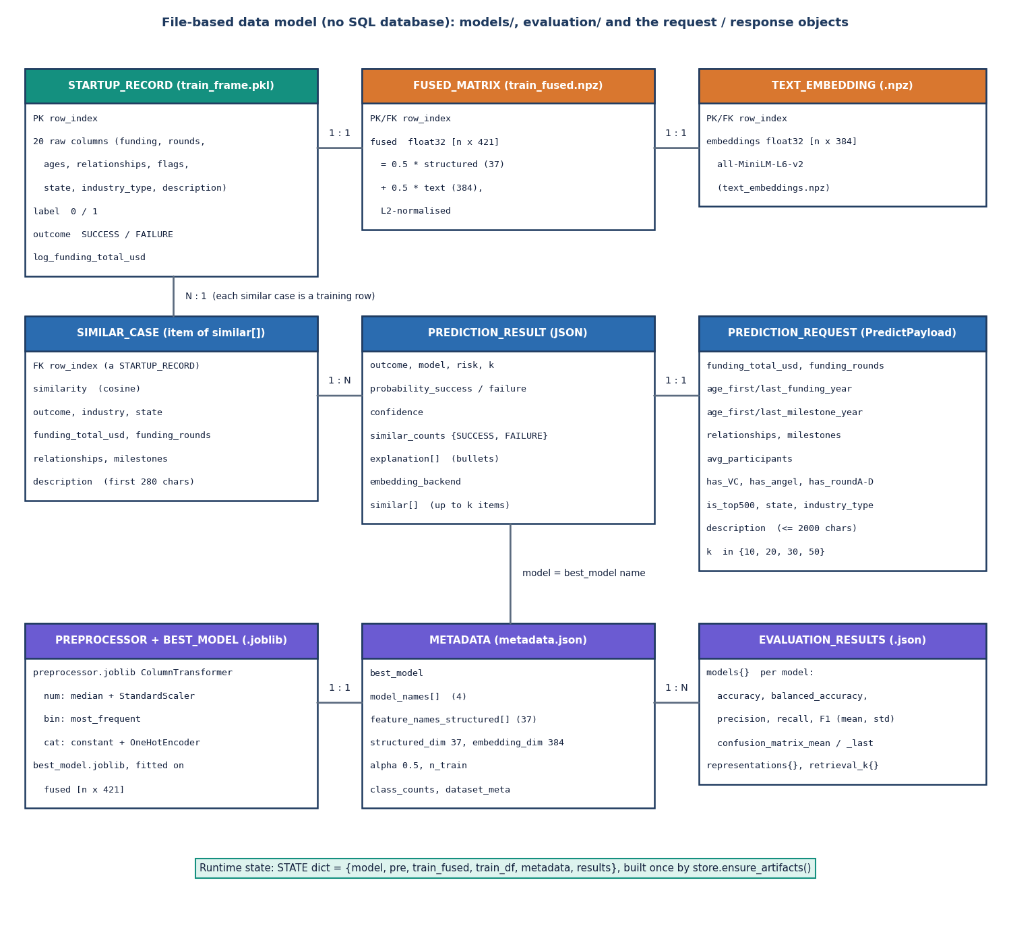
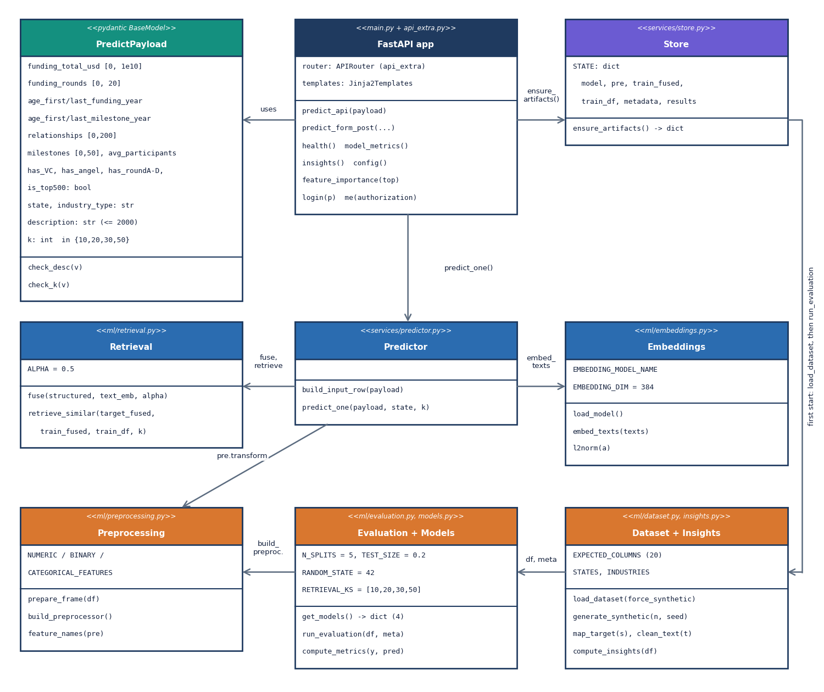
Database design and UML
There is no SQL database: models and the training frame are files in models/, state is held in memory. The ER diagram models these artefacts.
Notes:
The project stores files, not rows. The class diagram shows the real modules and the request model.

Slide 13
Technology stack
Layer | Technology
Machine learning | Python 3.11, scikit-learn 1.5.2, XGBoost 2.1.3, pandas 2.2.3, NumPy, joblib
Text embeddings | sentence-transformers 3.3.1 (all-MiniLM-L6-v2), torch 2.5.1 CPU
API | FastAPI 0.115.6, uvicorn 0.34.0, Pydantic validation (port 8410)
Front end | React 18, Vite 6, Tailwind CSS 4, Recharts (port 5410); original Jinja pages kept
Testing | pytest, API smoke and edge scripts, Playwright for screenshots
Hardware | Intel Core i5-12500 (6 cores, 12 threads), 15.7 GB RAM, Windows 11 Pro, CPU only (no GPU)
Notes:
Everything is open source and starts with run.bat. No external prediction service or API key is used.

Slide 14
Implementation progress
Component | Status | Evidence
Preprocessing, embeddings, fusion, retrieval | Done | app/ml, 7 pytest tests pass
Four classifiers + evaluation study | Done | 5 x 80/20, metrics JSON, charts
Real-data experiments (922 rows) | Done | run_experiments.py, extra_experiments.py
FastAPI service and React interface | Done | 15 smoke + 29 API edge checks pass
Founder / team-experience features | Not done | no such field in either table
Temporal split, SHAP, calibration fix | Not done | table has no dates; listed as future work
Text channel on real data, user study, load test | Not done | stated as limits
Notes:
State of the code base. The honest gaps are founder data, temporal validation and anything involving real descriptions.

Slide 15
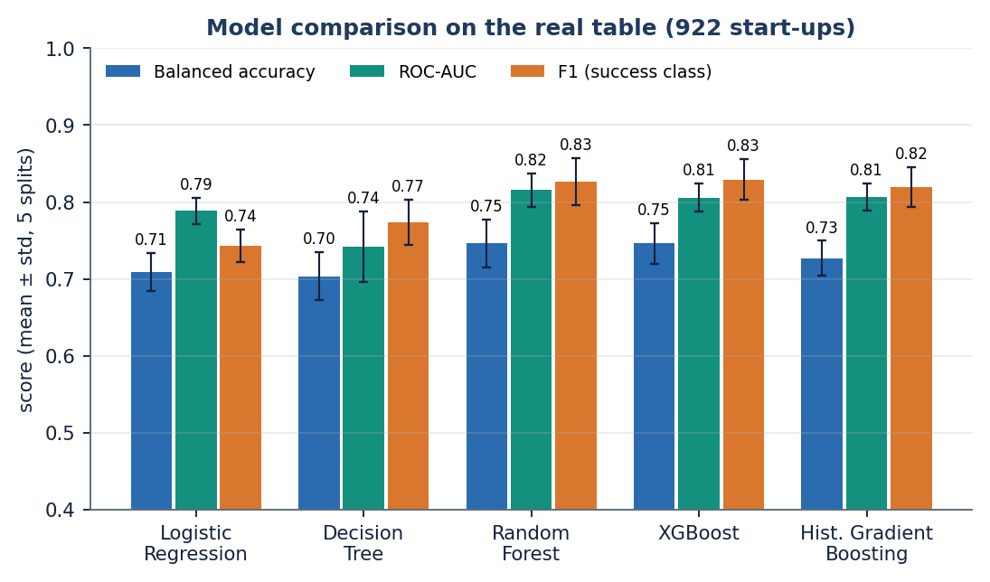
Preliminary results: real table, 5 x 80/20 splits
0.746
0.816
0.826
0.709
XGBoost balanced accuracy
Random Forest ROC-AUC
Random Forest F1
Logistic Regression balanced accuracy
i
Reading
Random Forest 0.746 ± 0.031, XGBoost 0.746 ± 0.026, Logistic Regression 0.709 ± 0.025 (balanced accuracy). Ensembles lead, within one std of each other. Accuracy 0.775 is below the base paper's 85-92 %. Without relationships and milestones, ROC-AUC drops to about 0.719.
Notes:
Real 922-row table: ensembles reproduce the base paper's ranking but not its accuracy level. Dropping the four post-outcome-style fields lowers ROC-AUC from 0.82 to 0.72 (Random Forest), so these numbers are an upper bound for early-stage prediction. The shipped app's own 0.749 is on synthetic data and is not a real-world figure.

Slide 16
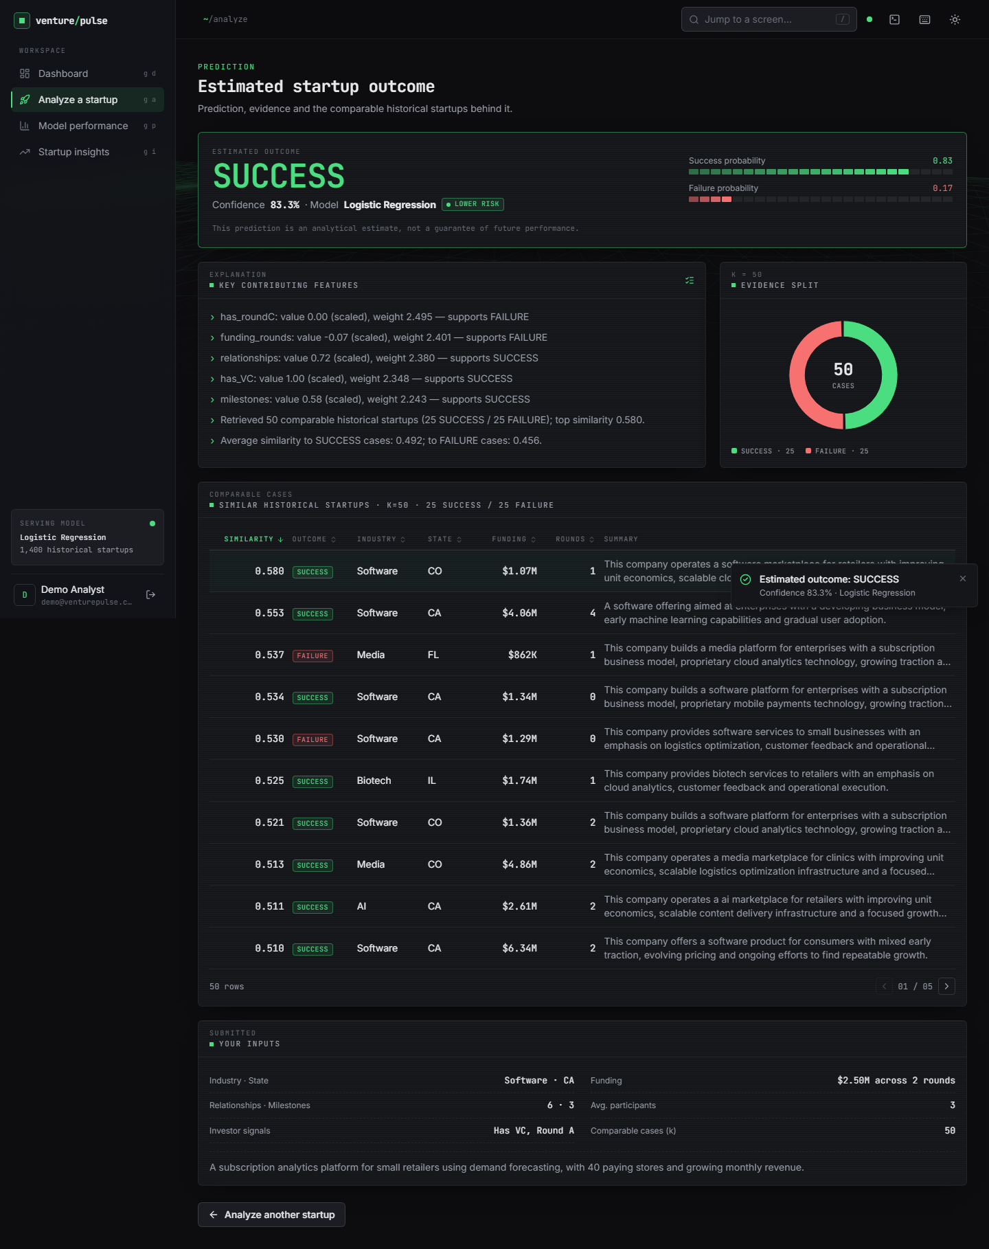
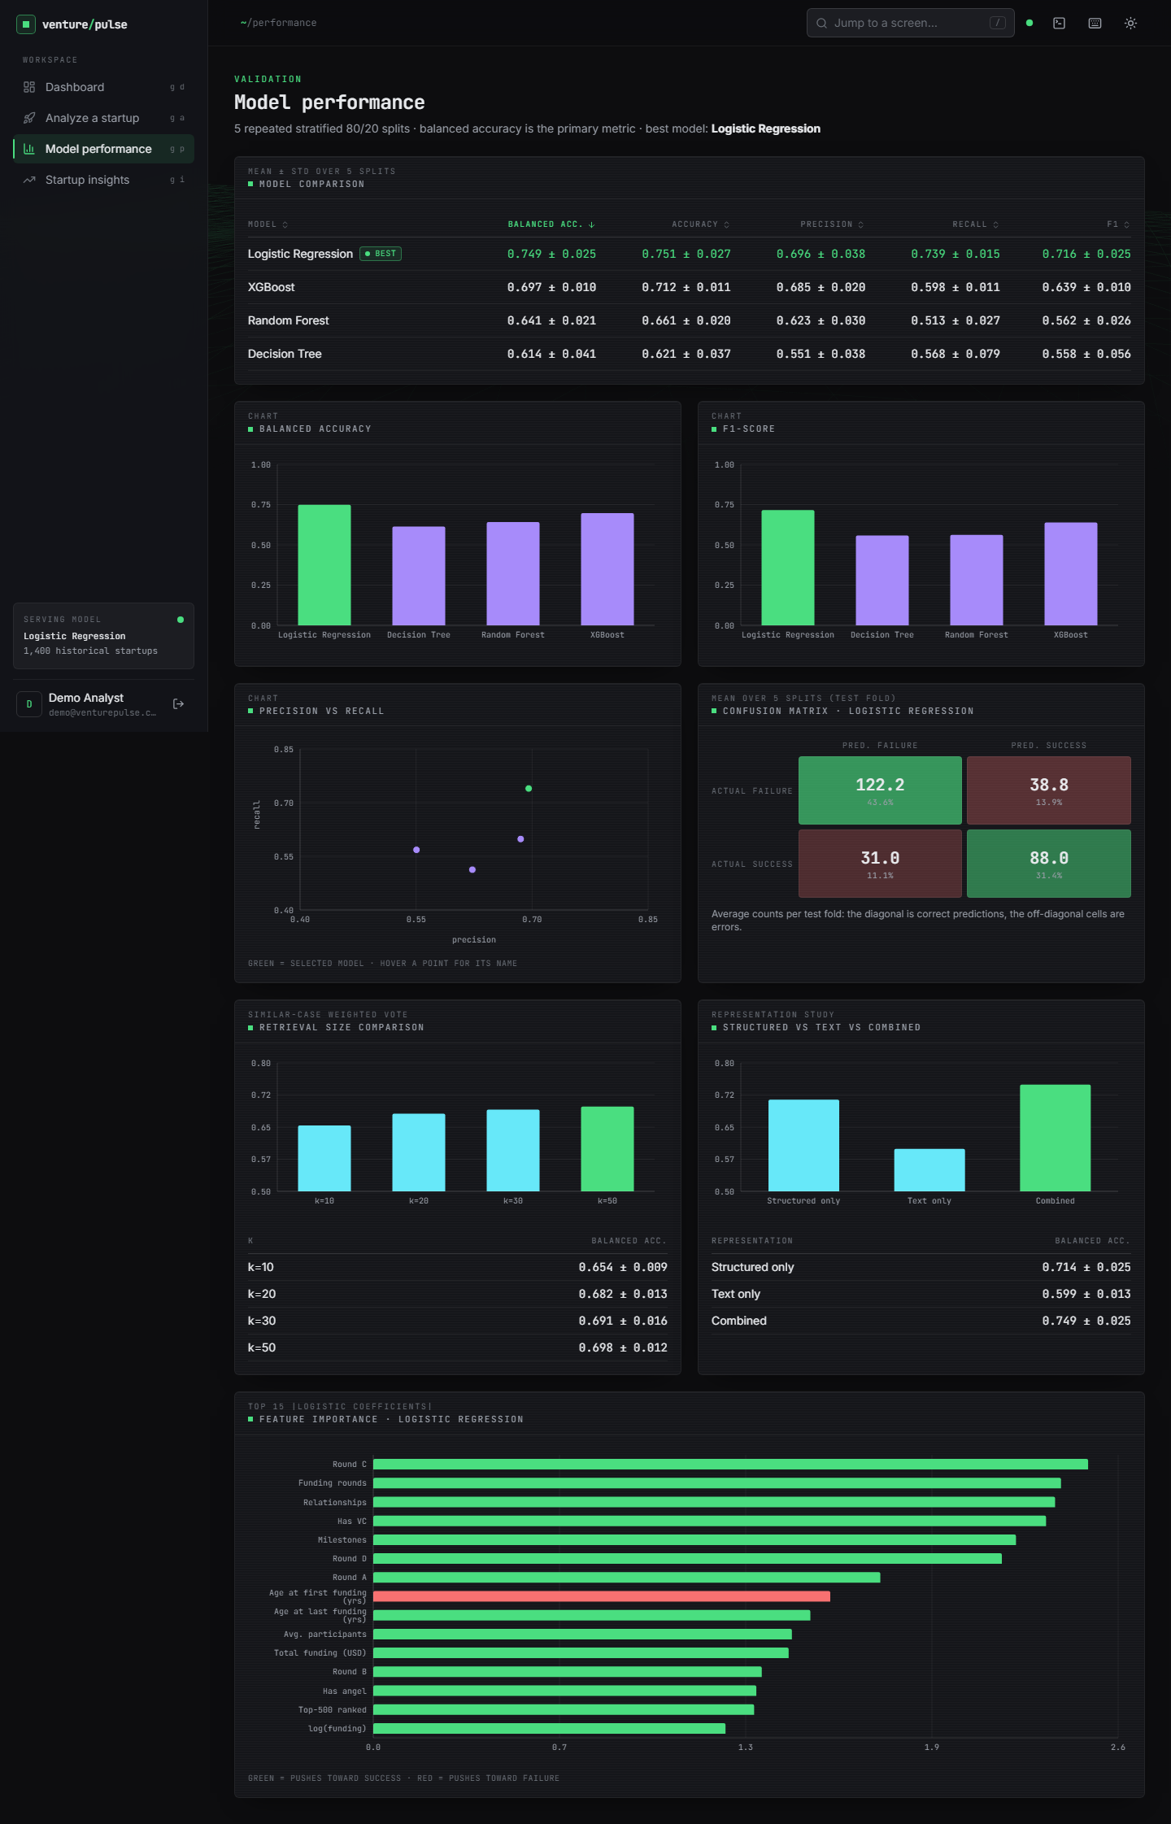
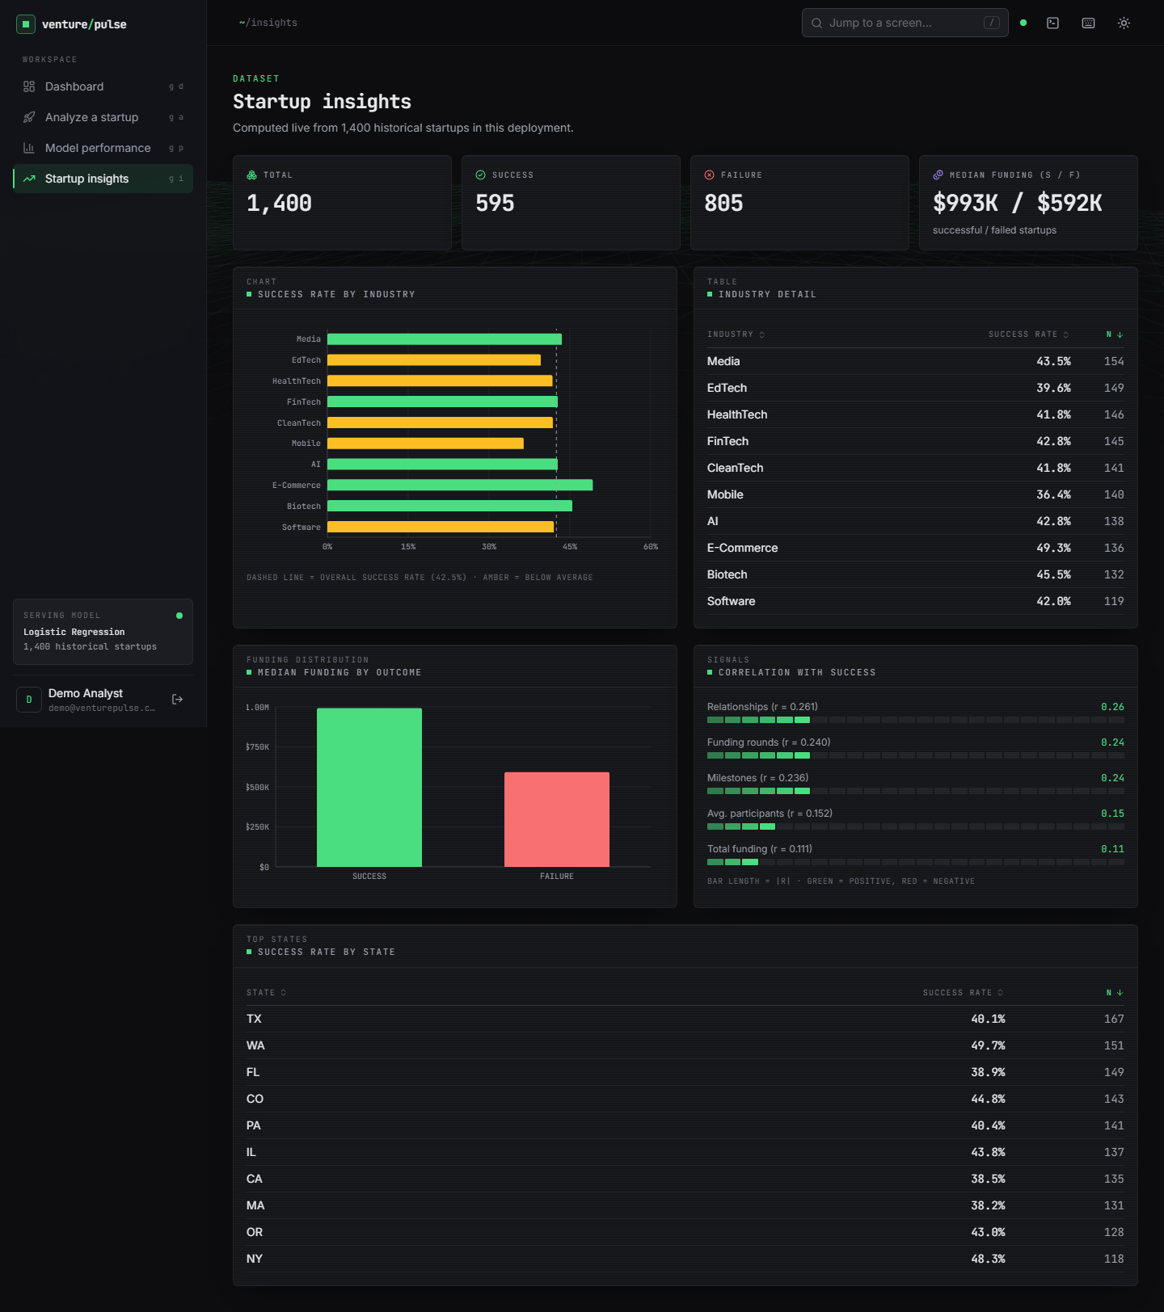
Output screens
Result for a real submission: SUCCESS 83.3 %, Lower risk, 50 comparable startups
Model performance screen
Startup insights screen
Notes:
Real screenshots of the running app. The submission is a software startup in California with USD 2.50 M over two rounds; the screens are served by the model trained on the synthetic fallback table, so the statistics shown on the performance screen are the synthetic ones.

Slide 17
Initial testing and observations
51
15
29
7
automated checks passed
API smoke checks
API edge and validation cases
pytest unit tests
Observation | Action
POST /predict median 148 ms (k = 10) and 198 ms (k = 50); GET endpoints 3.0-14.5 ms | Measured on 127.0.0.1, CPU only
Out-of-range funding, rounds, k outside {10,20,30,50} and over-long descriptions return 422 | Pydantic limits; 29 cases pass
A demo token with one signature character changed is rejected (401) | A first check that only appended text was corrected
Notes:
7 pytest tests, 15 smoke checks and 29 API edge cases. No load, stress or penetration test was run.

Slide 18
Challenges and corrective actions
Challenge | Corrective action
Public CSV needs a login; the shipped model trained on synthetic data | Obtained the identical public table, ran all real experiments on it, labelled app screens as synthetic-trained
Synthetic text leaks the label, so text looks useful | Reported text results as synthetic only; text untested on real data
SUCCESS is the majority class, not the rare class assumed | Compared weights, oversampling and thresholds; reported recall trade-offs
Some fields look recorded after the outcome | Ran a leakage ablation (ROC-AUC 0.82 to 0.72) and stated the limit
Saved models failed to load with the pinned library versions | Re-trained with the pinned versions; Logistic Regression unchanged
Notes:
Each challenge changed either the experiment design or how results are reported.

Slide 19
Next steps
1
Calibrate
2
Richer data
3
Explain better
4
Finish and document
Correct the probability bias of the class-weighted model and re-check the risk label thresholds.
Find a table with dates, descriptions and founder fields to test text and a temporal split.
Add SHAP-style attributions and significance tests over more splits.
Final deck, report and paper from the same measured numbers.
Notes:
Plan to the final review. None of these items is claimed as done.

Slide 20
Thank you
Questions and suggestions are welcome.
Notes:
Likely questions: why the shipped model is not the best on real data; why text is untested on real data; how leakage was checked; what the base paper's numbers mean for us.

