Slide 1

An Efficient Novel Approach for Predicting Startup Company Success Rates Using Advanced Machine Learning Paradigms
Final Review · VenturePulse
Team Details : Batch C10
Under the Esteemed Guidance of
P Prasanna
[DESIGNATION], Department of CSE
23K91A05H6 Orchu Shirisha
23K91A05G1 Mudavath Raghavendar
23K91A05E0 Majgi Vaishnavi
23K91A05J4 Polishetty Poojitha
DEPARTMENT OF COMPUTER SCIENCE AND ENGINEERING · [COLLEGE NAME] · Academic Year [ACADEMIC YEAR]
Notes:
Introduce the team and the project: VenturePulse, a startup outcome predictor that returns a prediction, the comparable historical startups and the feature drivers.

Slide 2
Table of Contents
Abstract
Base Paper & Literature Survey
Research Gap, Problem Statement & Objectives
Proposed System & Architecture
Methodology, Datasets & Model
Decision Logic, Interaction & Data Design
Implementation Highlights
Results, Confusion Matrix & Threshold Analysis
Performance & Testing
Comparison with the Base Papers
Output Screens
Conclusion, Future Scope & References
Dept. of CSE | Batch C10 | Final Review
2
Notes:
The agenda follows the report: problem, design, method, results, comparison, screens, conclusion.

Slide 3
Abstract
Most startups fail and investors judge prospects largely by experience and intuition; a data-driven early signal that names its drivers is missing.
VenturePulse scales funding, rounds, milestones, relationships, investor flags, state and industry, embeds an optional business description (MiniLM, 384-d) and fuses both. It returns SUCCESS or FAILURE with a confidence, the comparable historical startups and the top feature drivers.
On the real public table (922 start-ups, structured columns only, 5 x 80/20 splits) Random Forest and XGBoost reach balanced accuracy 0.746 and ROC-AUC 0.816 / 0.806; the base paper's 85-92 % accuracy is not reproduced (best 77.5 %).
The shipped app runs on a synthetic fallback table (1,400 rows), whose scores (LR balanced accuracy 0.749) are a pipeline check, not evidence.
A FastAPI service and a React web app complete the system; 51 automated checks pass.
Dept. of CSE | Batch C10 | Final Review
3
Notes:
Read the pipeline bullet, then the real-data headline with its protocol, then say plainly that the shipped app uses synthetic data and that the 85-92 % level was not reproduced.

Slide 4
Base Paper
M. Panjwani, P. Shrivastava, P. Hande, G. Meshram, N. Verma and D. Gotmare, "Startup success prediction using machine learning and ensemble techniques," IJRASET, vol. 14, no. IV, Apr. 2026, doi: 10.22214/ijraset.2026.80226.
Aspect | Base paper (Panjwani et al., IJRASET, 2026)
Method | Logistic Regression, Random Forest, SVM and Gradient Boosting on funding, team size, industry and location features; mean/mode imputation, one-hot or label encoding, standard scaling, ADASYN oversampling
Data and protocol | Public Crunchbase and Kaggle startup data (size not stated); 70:30 train / test split; hyper-parameter tuning; Flask back end with an HTML / CSS / JavaScript front end
Reported results | Ensembles (Random Forest, Gradient Boosting) best, accuracy 85-92 %; SVM slower; Logistic Regression the weaker baseline; no per-model table, no ROC-AUC values
Stated limits | Data quality and imbalance, no real-time data, external market conditions not modelled; future work: deep learning, real-time data, text and social media
Dept. of CSE | Batch C10 | Final Review
4
Notes:
A structured-data ensemble comparison with a Flask interface. We adopt its model set and its metrics; we add retrieved evidence, a React application and a measured, honest evaluation.

Slide 5
Literature Survey
Author / Year | Methodology | Dataset | Key Results | Limitations
Panjwani et al. 2026 [1] | LR, RF, SVM, GB; ADASYN; 70:30 | Crunchbase / Kaggle, size not stated | Ensembles 85-92 % accuracy | No table, no ROC-AUC
Maarouf et al. 2026 [2] | kNN in-context learning with an LLM vs LR, RF, XGBoost | 4,034 Crunchbase startups, 35.15 % success | Balanced acc. 0.713 vs LR 0.631, RF 0.634, XGB 0.618 | Needs an LLM and text
Mashhadi et al. 2026 [3] | Interpretable ML, inverse weights, SMOTE-NC, SHAP, temporal splits | Crunchbase firm-quarter panel 2010-2023 + USPTO | AUROC 0.921 / 0.817 / 0.872 | Panel data not available here
Bidgoli et al. 2024 [7] (via [1]) | RF, GB, SVM, LR compared | As summarised by [1] | Ensembles above 80 % accuracy | Not re-read
Zbikowski, Antosiuk 2021 [9] (via [1]) | Bias-free prediction from Crunchbase | As summarised by [1] | Look-ahead bias inflates accuracy | Not re-read
Gius 2025 [16] | Judge disagreement as predictor | 67 venture competitions | Disagreement predicts success | Not a classifier
Bhandari 2025 [17] | Survey, correlation, regression | 120 respondents, Nepal | Venture capital positively associated | Small survey, association only
Dept. of CSE | Batch C10 | Final Review
5
Notes:
Representative work; figures for [1]-[3], [16], [17] come from the papers or confirmed pages, entries marked via [1] are known only through the base paper's reference list.

Slide 6
Research Gap
Stated gap: The surveyed work applies ensemble methods to startup success prediction. The gap is systematic feature engineering around funding velocity and team composition, with explicit handling of the rare-success class.
Evidence, not just a label: most systems output a probability only; founders and investors need the comparable cases and the drivers behind it.
Leakage and imbalance are rarely tested: fields recorded after the outcome window and class prevalence both change what a score means.
Fair baselines: a trained-free retrieval baseline and a simple linear model are seldom reported next to the ensembles.
Usability: few works package the predictor so that a non-expert can enter a startup profile and read the result.
Dept. of CSE | Batch C10 | Final Review
6
Notes:
Five gaps. We build for the second and fifth and test the third and fourth honestly; the stated gap about team data is only partly addressed because no team-experience field exists.

Slide 7
Problem Statement
Given the funding history, team and ecosystem indicators, sector, location and (optionally) a short business description of an early-stage startup, estimate whether it is more likely to reach SUCCESS (acquisition or IPO) or FAILURE (closure), report a confidence score, name the features and the comparable historical startups that drive the estimate, and state plainly how reliable such an estimate is.
Input
Output
Evidence
Funding, rounds, milestones, relationships, investor flags, state, industry, optional description
SUCCESS / FAILURE, confidence, risk label, comparable startups, top feature drivers
Held-out metrics on real and synthetic data, ablations, latency, tests
Need: Startup success is judged subjectively, leading to inconsistent investment decisions; the project needs a machine learning model that predicts startup success early and names the factors behind each prediction.
Dept. of CSE | Batch C10 | Final Review
7
Notes:
The statement has three parts: predict, show the evidence and drivers, and report honestly how reliable the estimate is.

Slide 8
Objectives
1. Collect a startup dataset covering funding history, team background, sector, location and outcome.
2. Clean the data and engineer features capturing funding velocity, team experience and market context.
3. Address class imbalance between successful and failed startups.
4. Train and compare Logistic Regression, Decision Tree, Random Forest and boosting ensembles.
5. Identify the features that most strongly separate successful from failed startups.
6. Evaluate using accuracy, precision, recall, F1-score and ROC-AUC.
Dept. of CSE | Batch C10 | Final Review
8
Notes:
The six objectives of the proposal. The conclusion reports which were met: objectives 1 and 2 only partly (no founder or team-experience data exist in either dataset).

Slide 9
Proposed System
Startup profile
Scale + one-hot (37)
MiniLM text (384)
Fuse, alpha 0.5
Classifier + retrieval
Structured block: median / most-frequent imputation, StandardScaler, one-hot state and industry, log funding; text block: description cleaned, company name masked, embedded with all-MiniLM-L6-v2.
Fused vector [0.5 s, 0.5 t], L2-normalised; cosine retrieval of k comparable startups from the TRAINING rows only, half SUCCESS and half FAILURE.
Logistic Regression, Decision Tree, Random Forest and XGBoost are compared; the best by balanced accuracy serves predictions with a risk label.
FastAPI service over the library; React app with Dashboard, Analyze, Model performance and Startup insights screens.
Dept. of CSE | Batch C10 | Final Review
9
Notes:
The pipeline as a row of boxes, then four properties that matter.

Slide 10
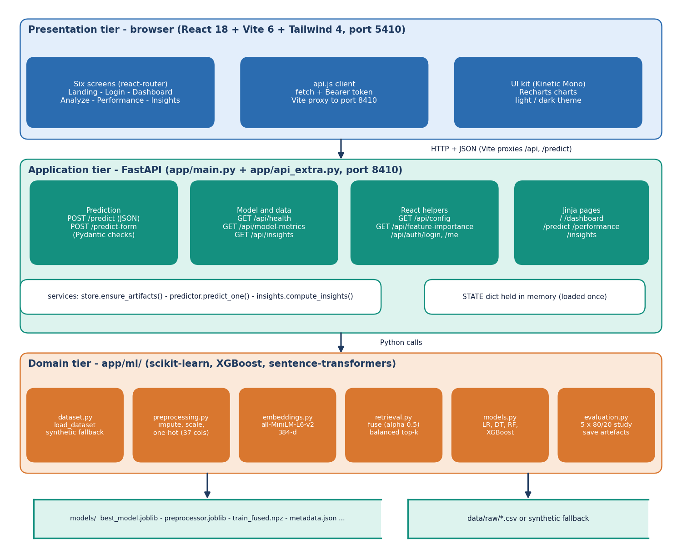
System Architecture
Presentation: React app (port 5410) plus the original Jinja pages
Application: FastAPI (port 8410), 8 JSON endpoints, artefacts loaded once
ML layer: dataset, preprocessing, embeddings, retrieval, models, evaluation
Storage: joblib / npz / pkl files in models/; no database
Dept. of CSE | Batch C10 | Final Review
10
Notes:
Three tiers plus file storage; the services layer loads the artefacts into an in-memory state on first use and trains if they are missing.

Slide 11
Methodology
Load table
Dedup + target map
Preprocess
5 x 80/20 splits
Train 4-5 models
Metrics
Best model
Target: acquired / IPO = SUCCESS, closed = FAILURE; duplicates removed; preprocessing is fitted on the training part only.
Protocol: 5 repeated StratifiedShuffleSplit (80 / 20, seed 42); mean ± std; balanced accuracy is the primary metric, with accuracy, precision, recall, F1 and (real-data study) ROC-AUC.
Two tables: the 1,400-row synthetic fallback that the app serves, and the real public table (922 rows) used for all real measurements.
Extra studies on the real table: class-imbalance strategies, threshold sweep, calibration, forest size, 70:30 protocol, synthetic-to-real transfer, leakage ablation, retrieval-only classifier.
Dept. of CSE | Batch C10 | Final Review
11
Notes:
The method and, as important, the studies that test whether the headline numbers can be trusted.

Slide 12
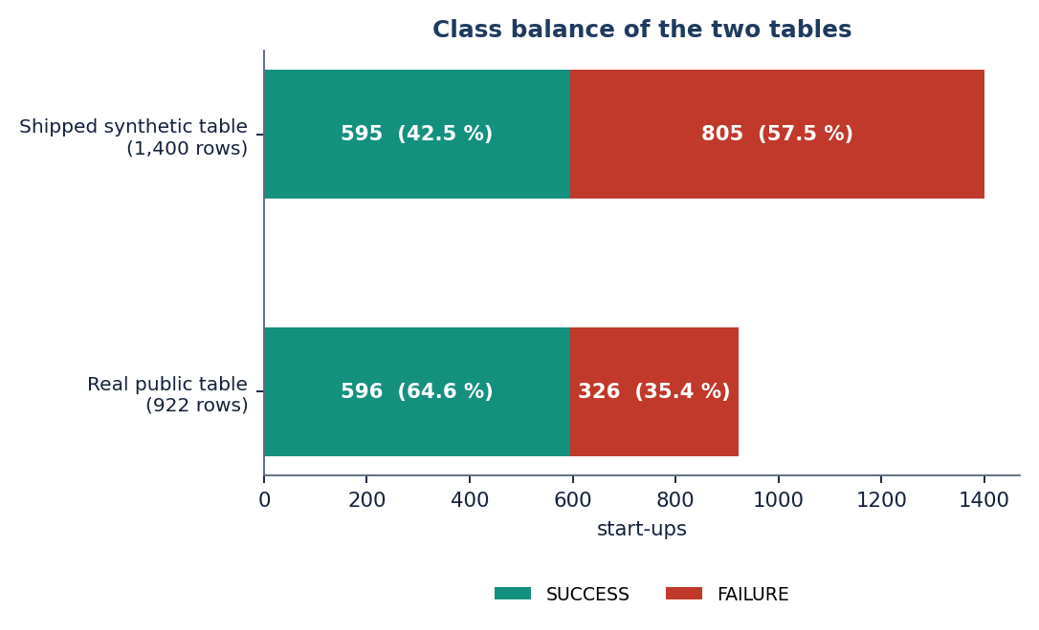
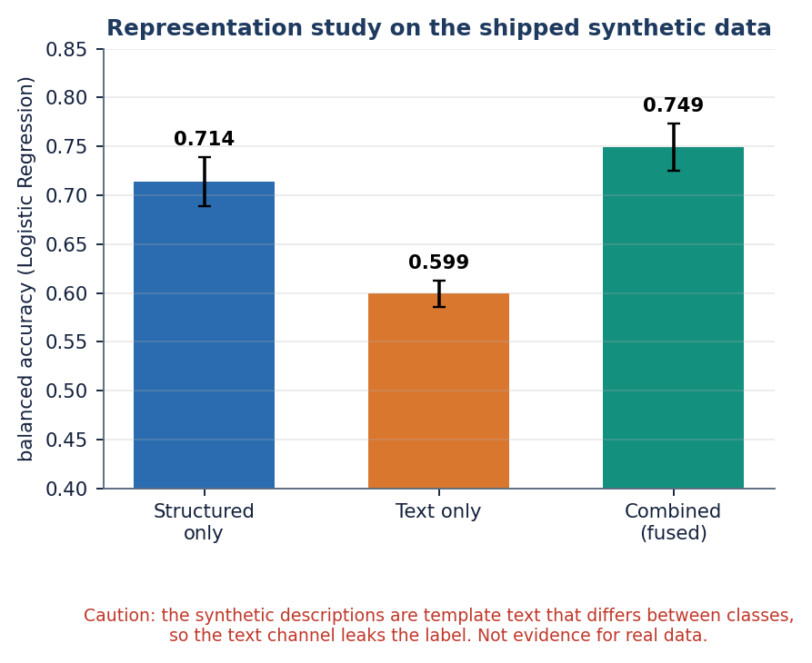
Dataset, Features & Model
922
real table: 596 success / 326 failure (64.6 % success)
1,400
synthetic fallback: 595 / 805
37 + 384
Real table: US start-ups, structured columns only, no description text; success (acquired) is the MAJORITY class. Synthetic table: same schema plus template descriptions that differ by class, so the text channel leaks the label.
Models: Logistic Regression (balanced, C=1), Decision Tree (depth 8), Random Forest (300 trees), XGBoost (400 trees, depth 6, lr 0.05); HistGradientBoosting in the study.
Kaggle needs a login, so the identical 923-row CSV came from a public GitHub copy.
structured features + MiniLM text dimensions
Means over 5 splits; real test folds hold 185 rows.
Dept. of CSE | Batch C10 | Final Review
12
Notes:
Two datasets, never mixed up. The representation chart is from the synthetic table, where text carries the label by construction.

Slide 13
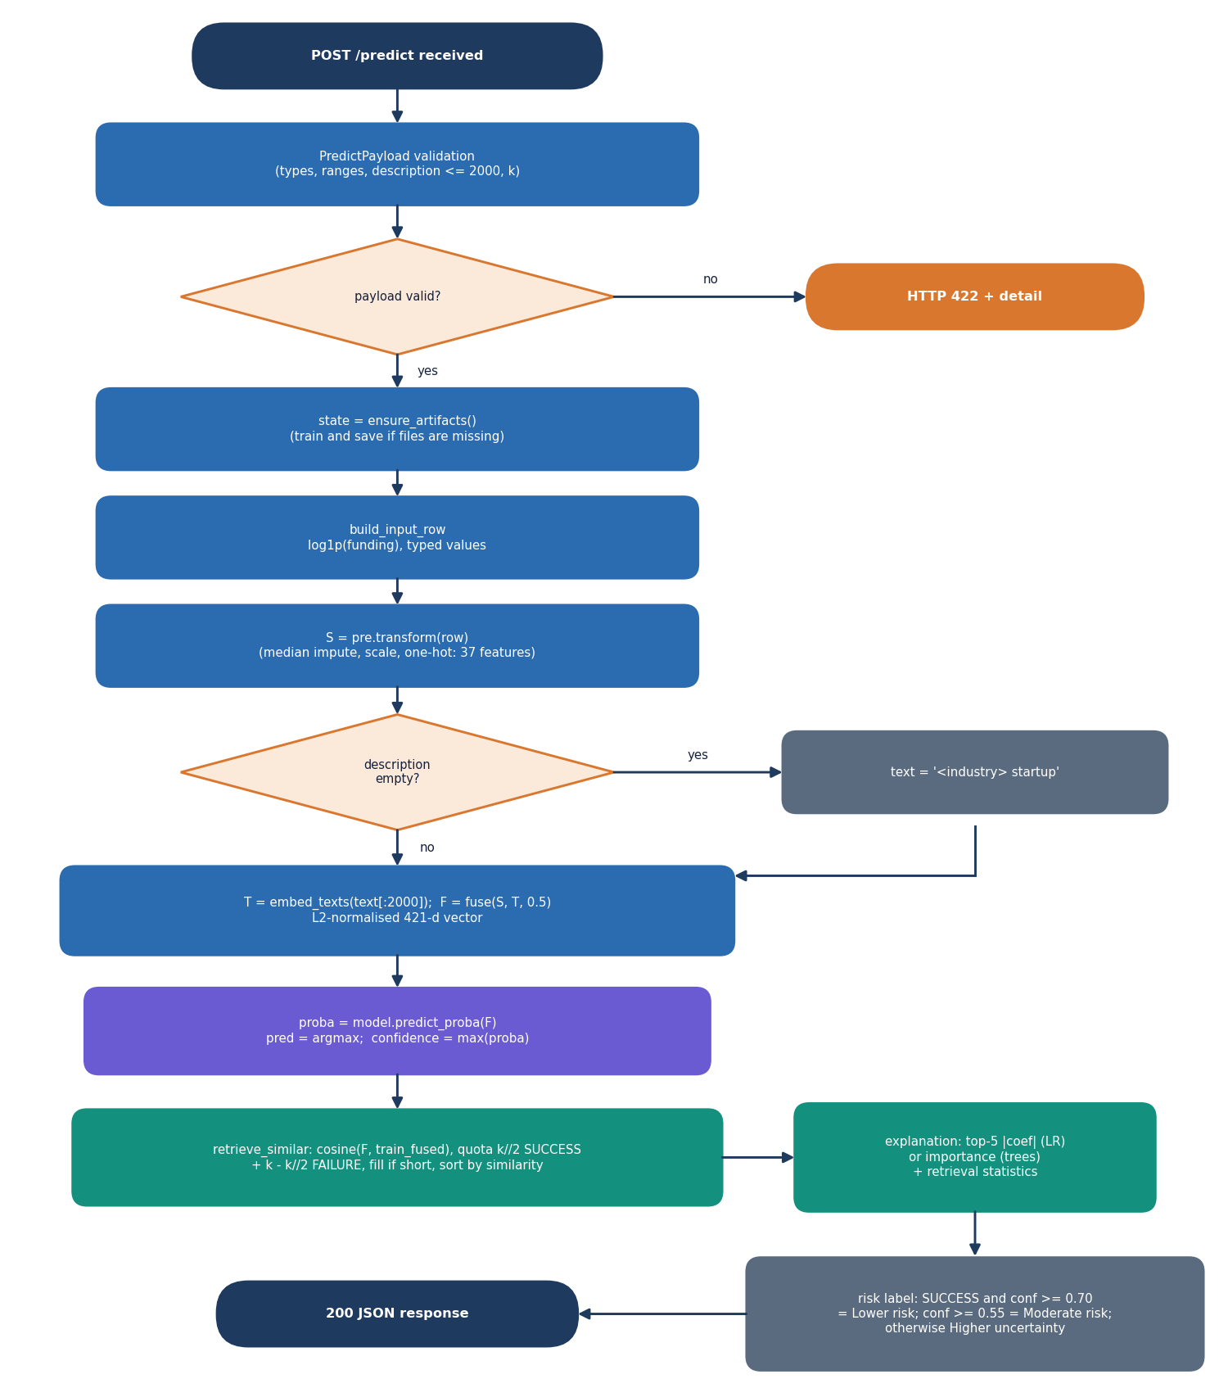
Decision Workflow
The profile is validated (ranges, k in {10, 20, 30, 50}, description up to 2,000 characters), scaled and embedded, then fused.
The served classifier returns P(success); outcome = the larger probability, confidence = max(P).
Retrieval returns k training startups by cosine similarity with a half / half class quota; the weighted vote is sum(sim x label) / sum(sim).
Risk label: Lower risk if SUCCESS with confidence at least 0.70, Moderate risk from 0.55, otherwise Higher uncertainty.
On the real table, retrieval alone (no trained model) scores balanced accuracy 0.700-0.714 and ROC-AUC 0.769-0.789: equal to Logistic Regression, below Random Forest.
Dept. of CSE | Batch C10 | Final Review
13
Notes:
The core algorithm. The last bullet is a result from the extra studies: retrieval is competitive with the linear model without any training.

Slide 14
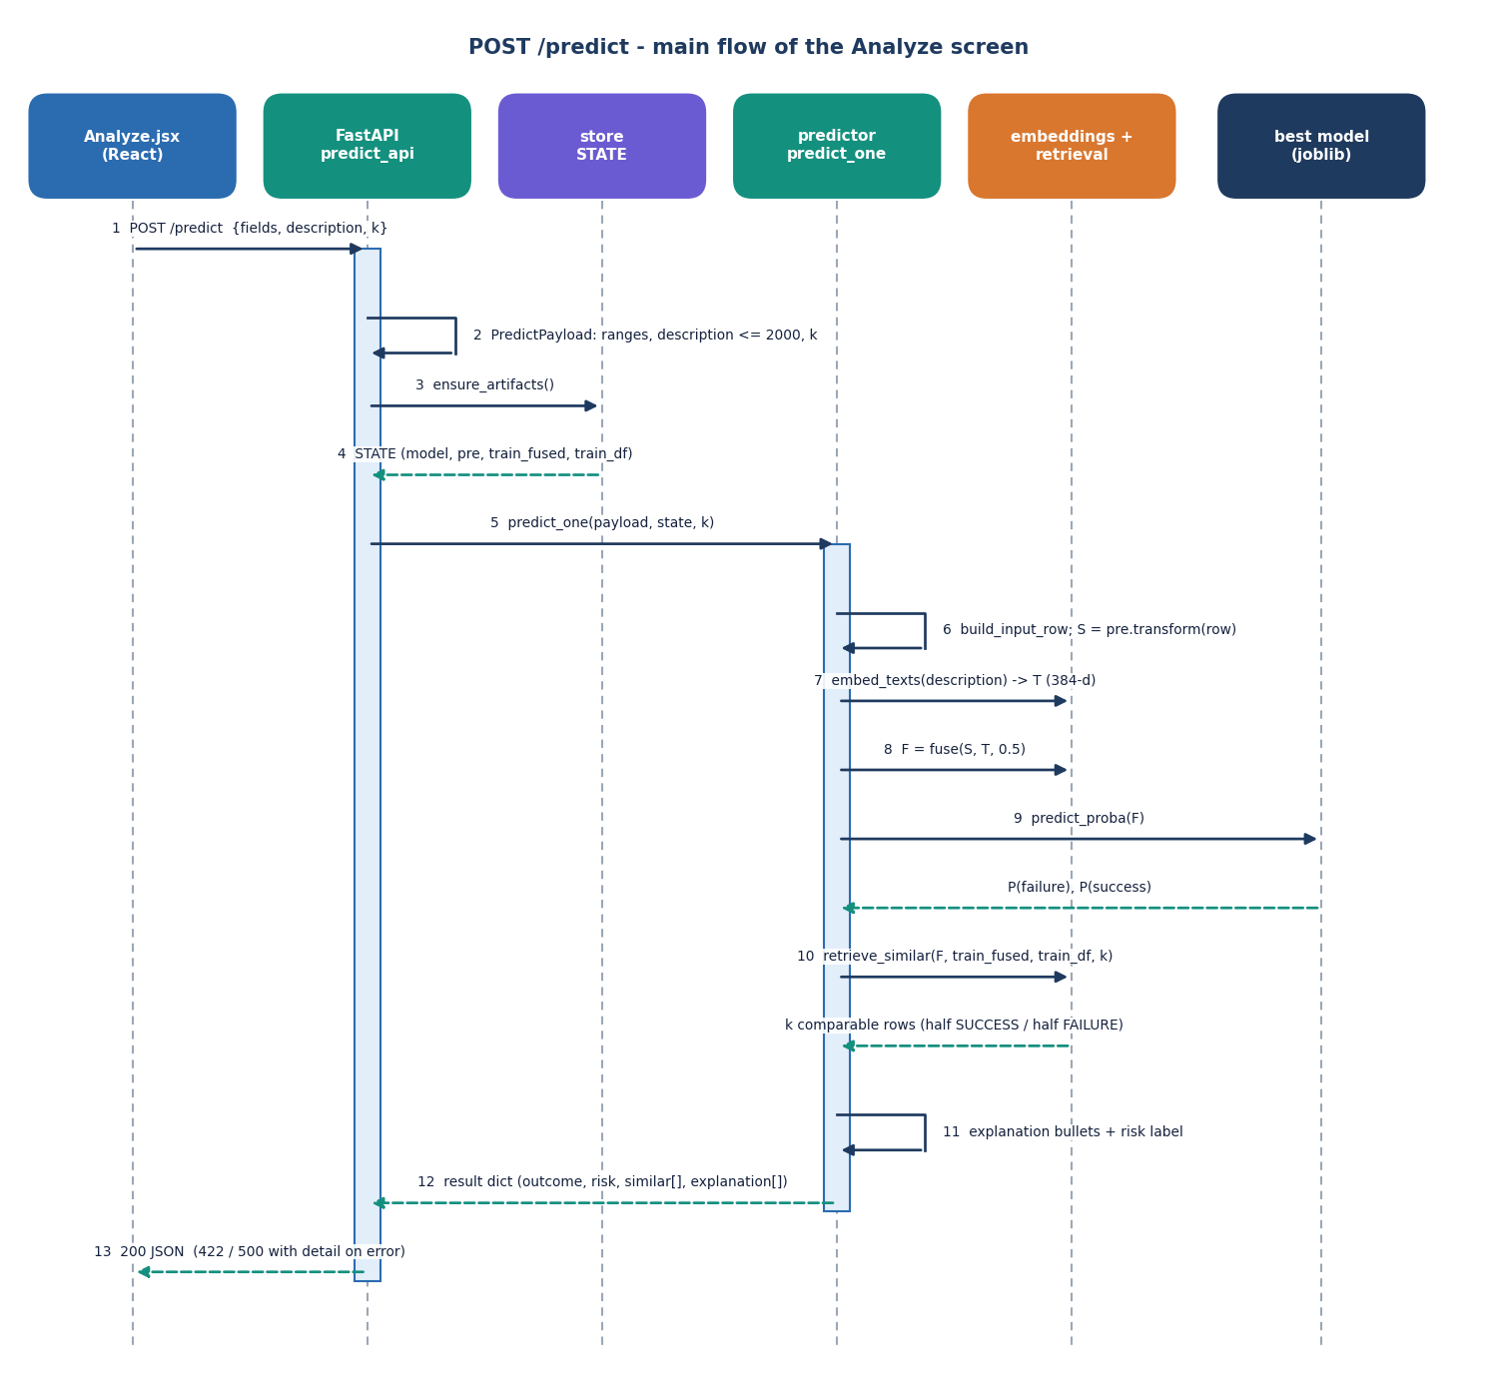
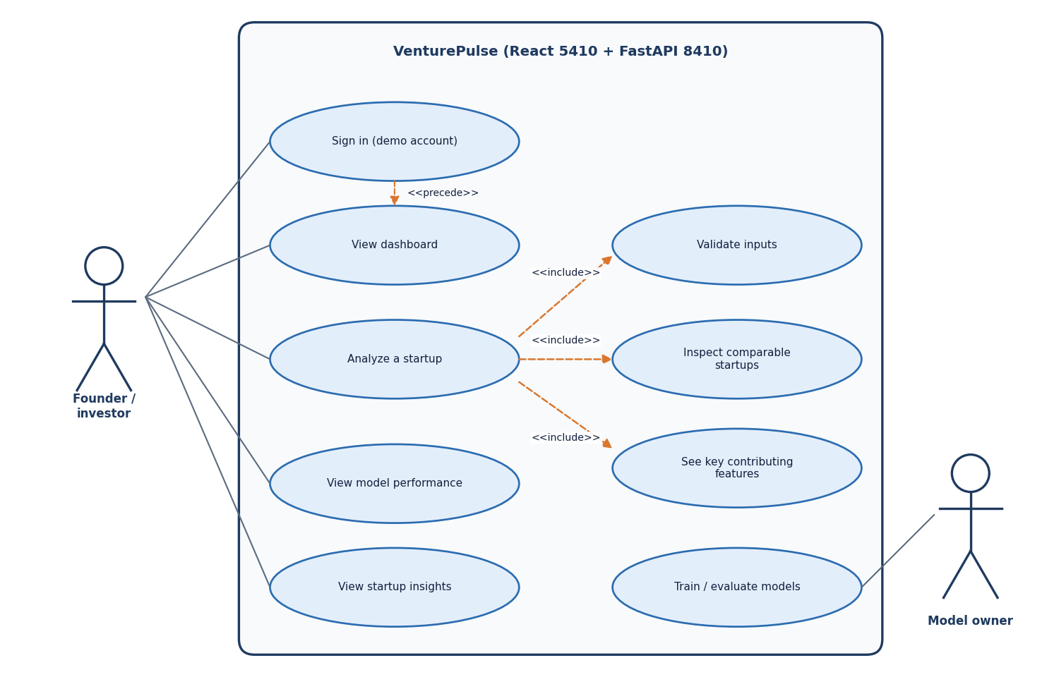
User – System Interaction
Dept. of CSE | Batch C10 | Final Review
14
Notes:
Sequence of one prediction request and the use cases. Sign-in is a demo account that only gates the React screens.

Slide 15
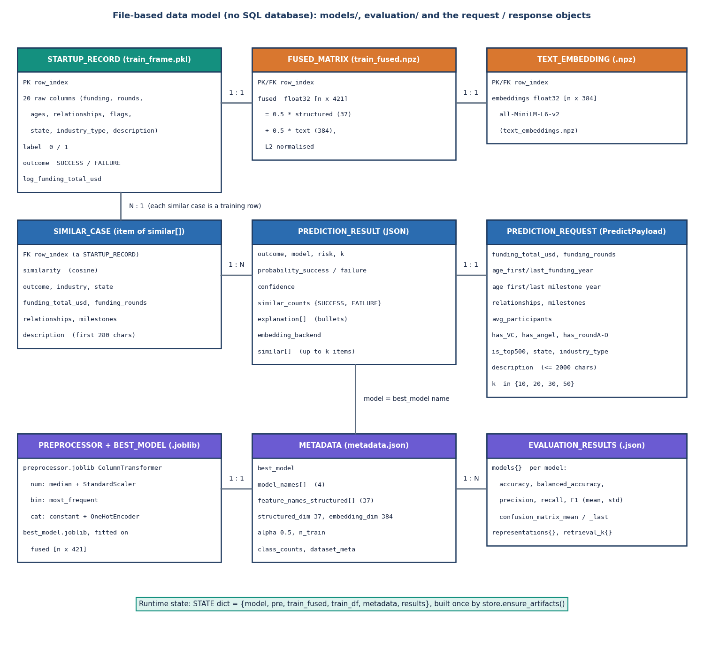
Data Design (file based)
Store | Content
best_model.joblib | served classifier
preprocessor.joblib | fitted scaler / encoder
train_fused.npz | fused vectors for retrieval
text_embeddings.npz | cached MiniLM vectors
train_frame.pkl | training records
metadata.json, evaluation_results.json | dataset flags, metrics
There is no SQL database: the diagram models the artefact files and the in-memory state. Predictions are not stored.
Dept. of CSE | Batch C10 | Final Review
15
Notes:
Honest point: the product stores files, not rows.

Slide 16
Implementation Highlights
8
51
6
1
JSON endpoints (+ 5 original pages)
automated checks
React screens
command to start (run.bat)
Models, preprocessor and training frame are loaded once into an in-memory state; if an artefact is missing the training pipeline runs on first start.
Validation: Pydantic ranges on every numeric field (for example funding 0 to 1e10, rounds 0 to 20), k whitelist, description length cap; invalid input returns 422.
Demo sign-in issues an HMAC-signed token valid for 12 hours; a changed signature character is rejected (401).
Each result shows outcome, probabilities, risk label, the top-5 signed feature terms and up to k comparable startups with similarity, funding and summary.
Dept. of CSE | Batch C10 | Final Review
16
Notes:
Highlights: lazy artefact loading, strict input validation, demo token and explained results.

Slide 17
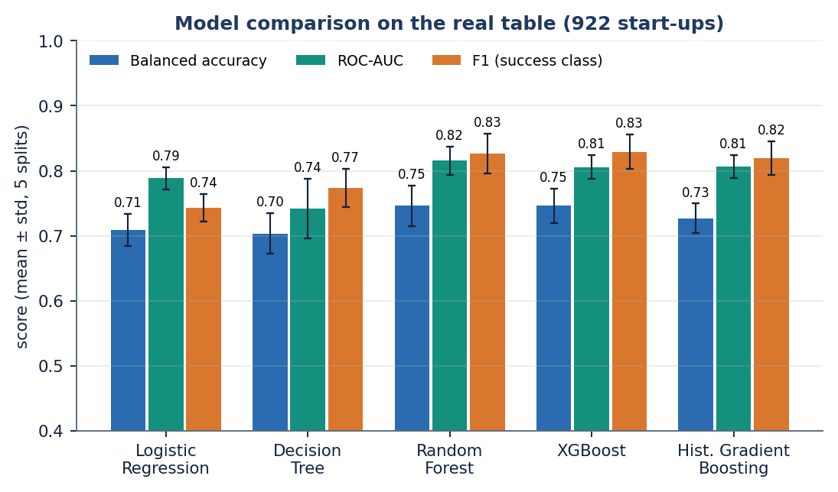
Results – Model Performance (real table, 5 x 80/20)
0.746
0.816
0.775
0.709
balanced accuracy, RF and XGBoost (0.746)
ROC-AUC, Random Forest (XGBoost 0.806)
best accuracy, XGBoost (RF 0.773)
balanced accuracy, Logistic Regression (AUC 0.789)
RF, XGBoost and HistGradientBoosting are within one standard deviation of each other; all beat Logistic Regression and the Decision Tree.
Without the four post-hoc fields (relationships, milestones, milestone ages) ROC-AUC falls from 0.82 to 0.72 (RF) and 0.70 (XGBoost).
Shipped app on synthetic data: LR 0.749; not real-world evidence.
Dept. of CSE | Batch C10 | Final Review
17
Notes:
Headline: ensembles beat the linear model, balanced accuracy 0.746, ROC-AUC about 0.81. The leakage ablation says the real numbers are an upper bound for early-stage prediction.

Slide 18
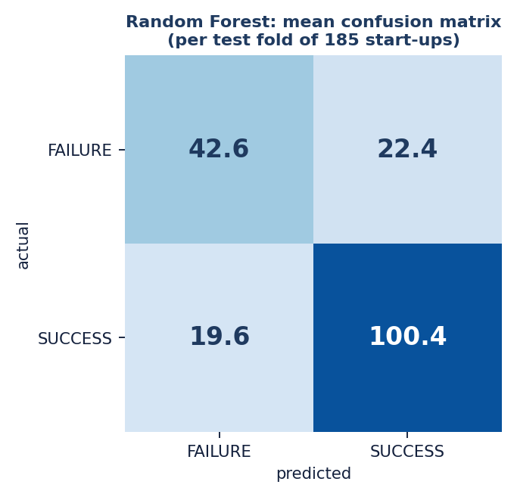
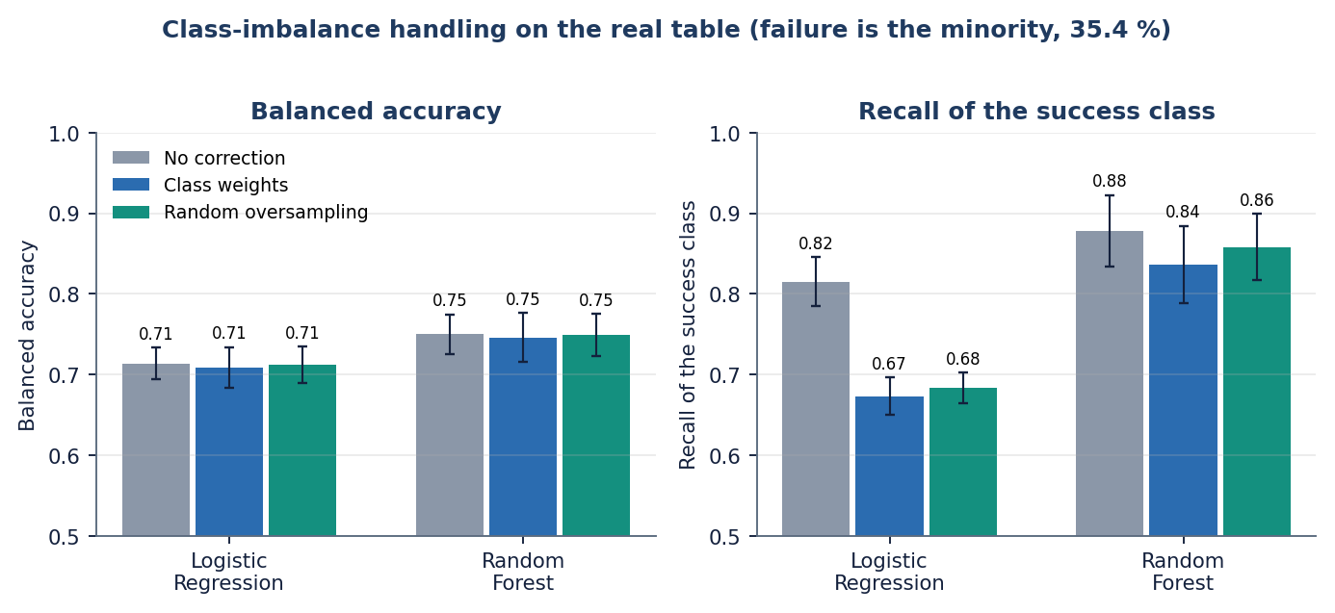
Confusion Matrix & Class-Imbalance Study
Random Forest, mean per fold of 185 test rows: 42.6 failures and 100.4 successes right; 22.4 failures called SUCCESS, 19.6 successes called FAILURE. Logistic Regression: 48.4 / 80.8 right, 39.2 successes missed.
Failure is the minority class here (35.4 %). Class weights and oversampling do not raise ROC-AUC (RF 0.820 none, 0.816 weighted, 0.816 oversampled); they trade recall of the majority success class for precision.
Dept. of CSE | Batch C10 | Final Review
18
Notes:
Rows are the true class. The imbalance in this table is the reverse of the batch objective's assumption: success is the majority.

Slide 19
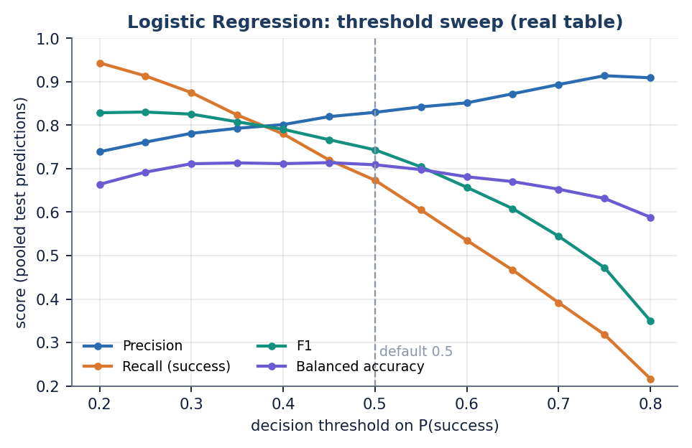
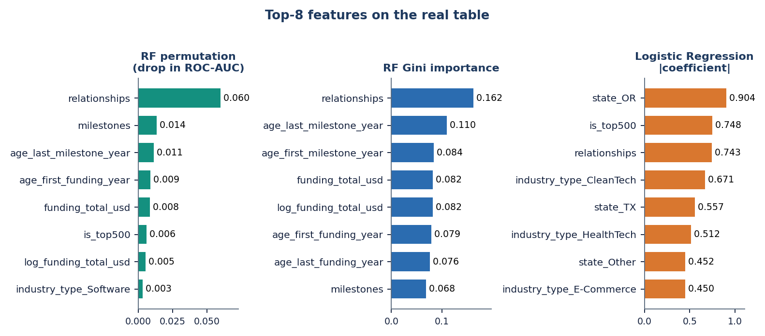
Threshold Analysis & Feature Importance
Logistic Regression threshold sweep: balanced accuracy is flat at about 0.71 between thresholds 0.30 and 0.50 (peak 0.714 at 0.45) while recall of success falls from 0.875 to 0.673 and precision rises from 0.781 to 0.830.
Random Forest ranks relationships first (Gini 0.162, permutation 0.060 AUC drop), then milestones, last-milestone age and funding amount; Logistic Regression weights are led by state, top-500 and industry dummies, so the two rankings disagree.
Dept. of CSE | Batch C10 | Final Review
19
Notes:
Threshold and feature analysis. The default 0.5 is not special; the choice moves recall and precision, not balanced accuracy.

Slide 20
Performance & Testing
148 ms
198 ms
3.0 ms
139 s
POST /predict, k=10, median (p95 594 ms)
POST /predict, k=50, median (p95 583 ms)
GET /api/health median; insights 14.5 ms
whole real-data study on CPU
Test layer | What it covers | Result
Unit tests (pytest) | health, dataset, preprocessing, embeddings and fusion, retrieval, predict, pages | 7 / 7 passed
Smoke test | running server: endpoints, login, token, predict, invalid input, pages | 15 / 15 checks
API edge tests | limits, k whitelist, empty body, unknown categories, forms, auth, tampered token | 29 / 29 checks
Total | automated checks | 51
Measured on 127.0.0.1 with a warm model on an Intel Core i5-12500 (CPU only); the first request pays the model-load cost.
Not tested: load or stress, multi-user use, a security audit, a user study, React component tests.
Dept. of CSE | Batch C10 | Final Review
20
Notes:
Inference is fast enough for interactive use; the MiniLM embedding dominates the predict latency. The tests cover the library and the API, not the browser.

Slide 21
Comparison with Base Papers (context only – different data)
Aspect | Base paper [1] | Maarouf et al. [2] | This project (VenturePulse)
Data | Crunchbase / Kaggle, size not stated | 4,034 Crunchbase startups, 35.15 % success | Real table 922 rows (64.6 % success); app on synthetic 1,400
Protocol | 70:30 split, ADASYN | 5 x 80/20 stratified, balanced accuracy | 5 x 80/20 (and 5 x 70:30), balanced accuracy, ROC-AUC
Models | LR, RF, SVM, Gradient Boosting | kNN-ICL (LLM) vs LR, RF, XGBoost | LR, DT, RF, XGBoost, HistGB + balanced retrieval
Reported | Accuracy 85-92 % (best ensembles) | Balanced acc. 0.713 vs 0.631 / 0.634 / 0.618 | RF / XGB balanced acc. 0.746, accuracy 0.773 / 0.775; RF 0.796 on 70:30
Compute | Flask, local or cloud | LLM prompts, no training | CPU only, local; predict median 148-199 ms
The ensemble ranking of [1] is reproduced, its 85-92 % accuracy is not (best 77.5 % on 80/20), but its data and table are unspecified. Datasets differ from [2] (their descriptions are text; the real table here has none) and from the temporal Crunchbase panel of [3] (AUROC 0.872 for exits), so the figures are context, not a ranking.
Dept. of CSE | Batch C10 | Final Review
21
Notes:
State plainly that the datasets and protocols differ; no superiority or inferiority claim is possible from these numbers.

Slide 22
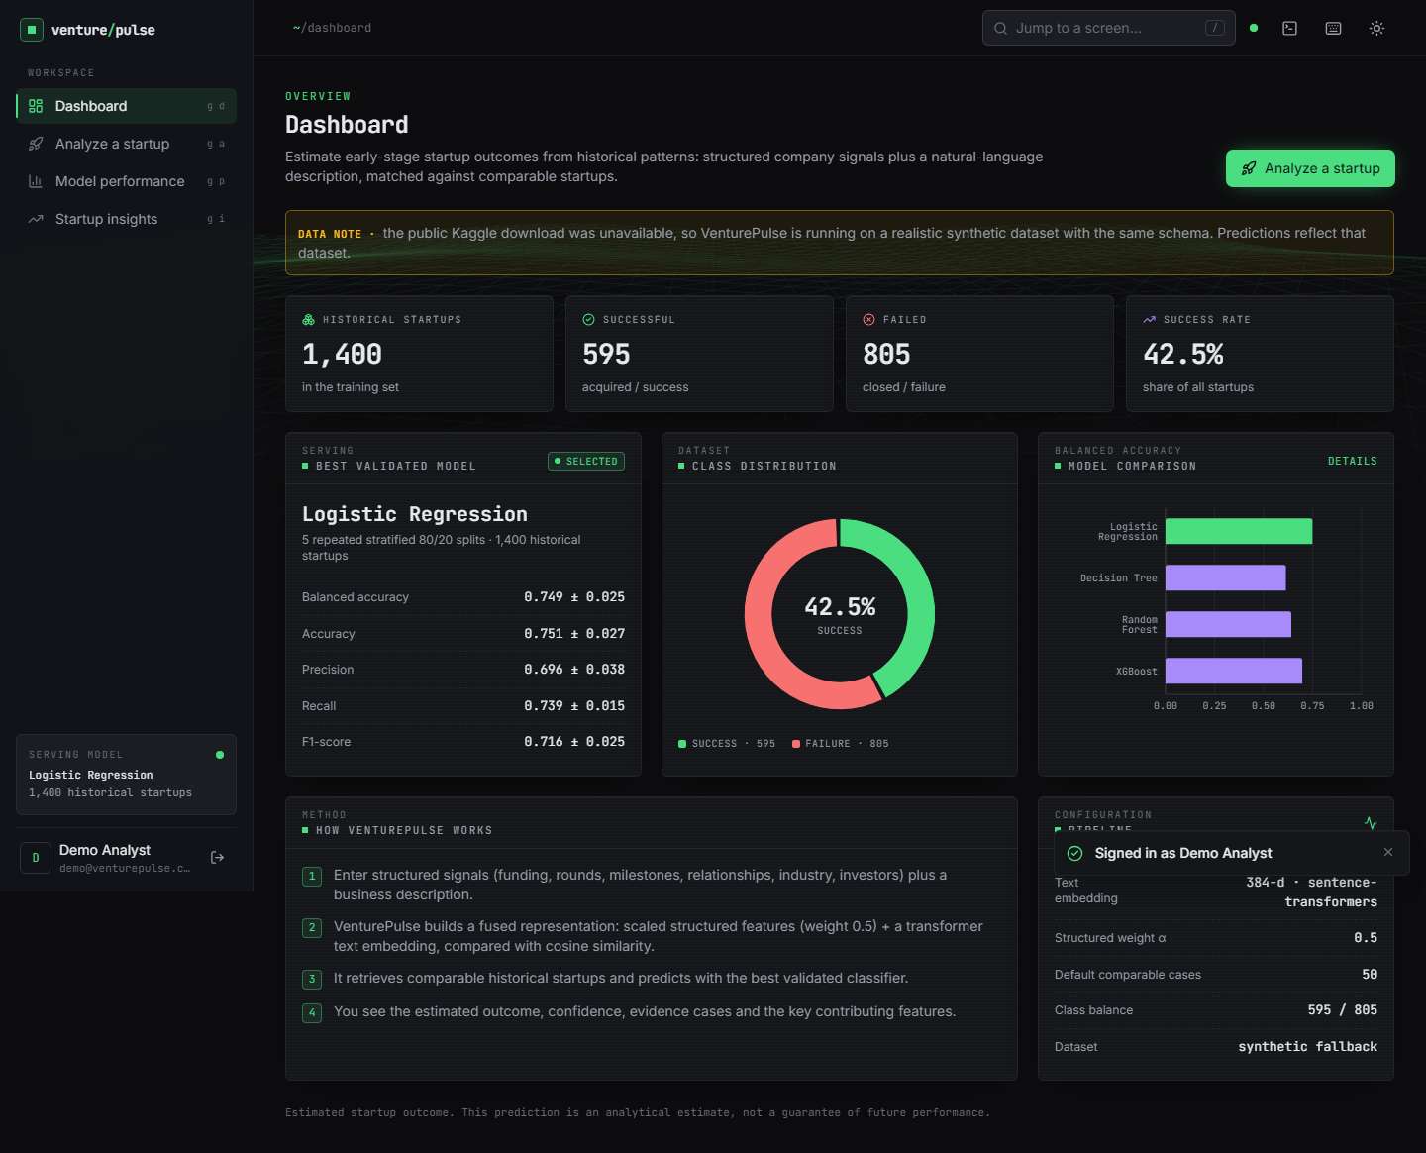
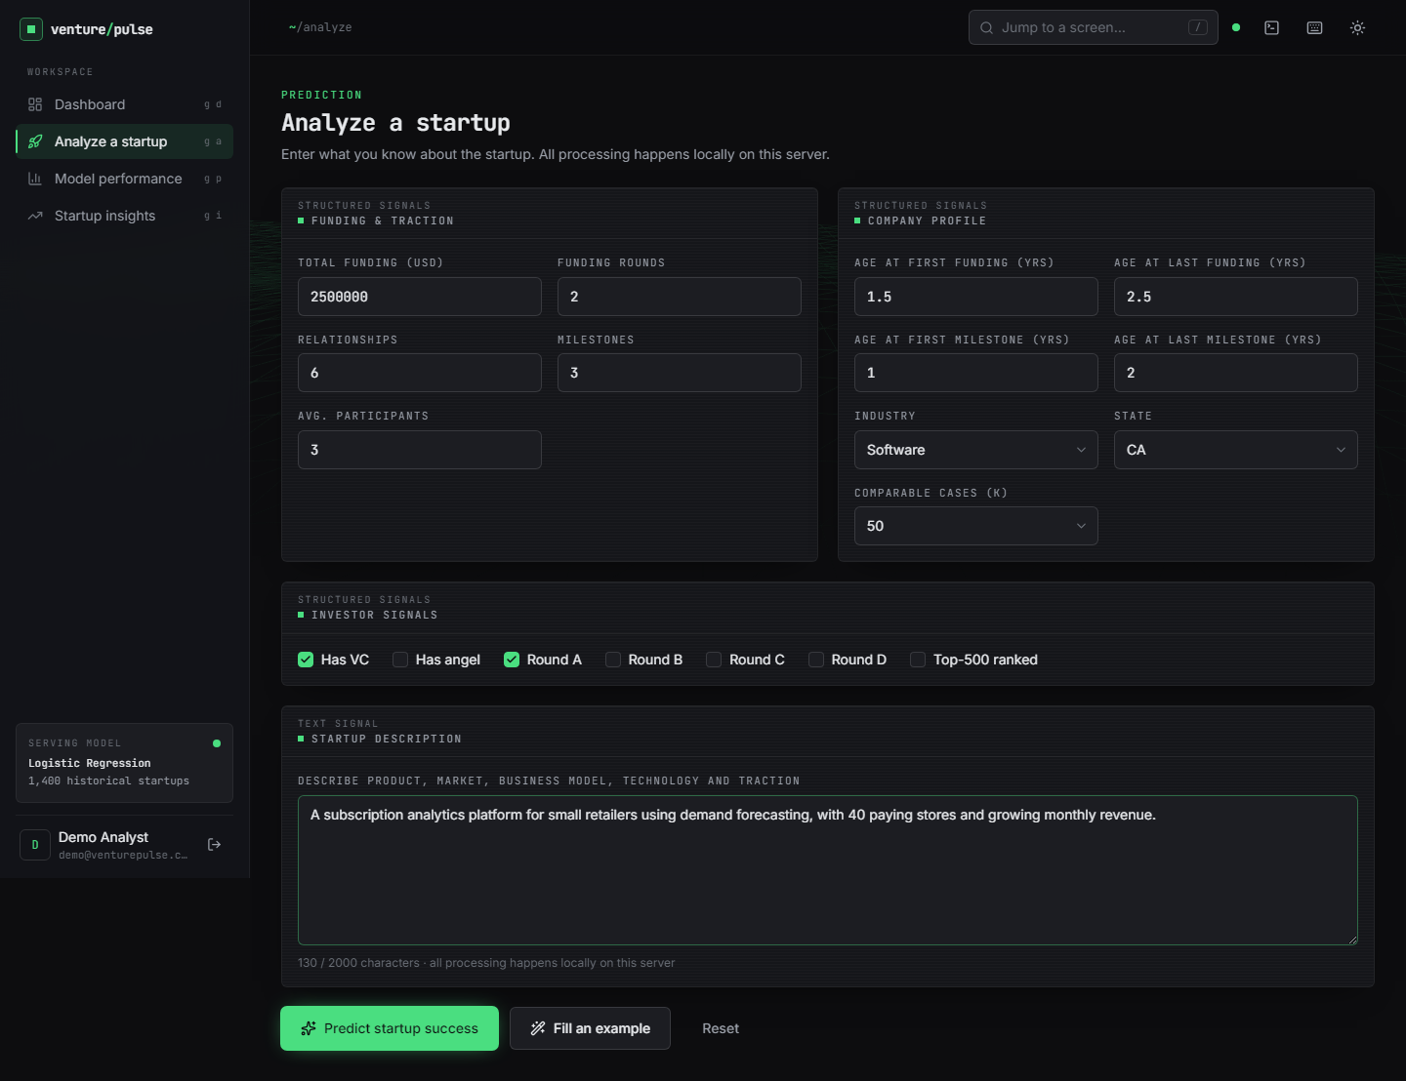
Output – Dashboard & Analyze Form
Left: the dashboard of the running app after demo sign-in: 1,400 historical startups (595 / 805), the best model and a data note that the synthetic fallback is in use. Right: the Analyze form filled with a real submission (software startup, CA, USD 2.50 M over 2 rounds, 6 relationships, 3 milestones, VC and round A).
Dept. of CSE | Batch C10 | Final Review
22
Notes:
Real screenshots from the running app. The data note on the dashboard tells the user that the synthetic fallback is in use.

Slide 23
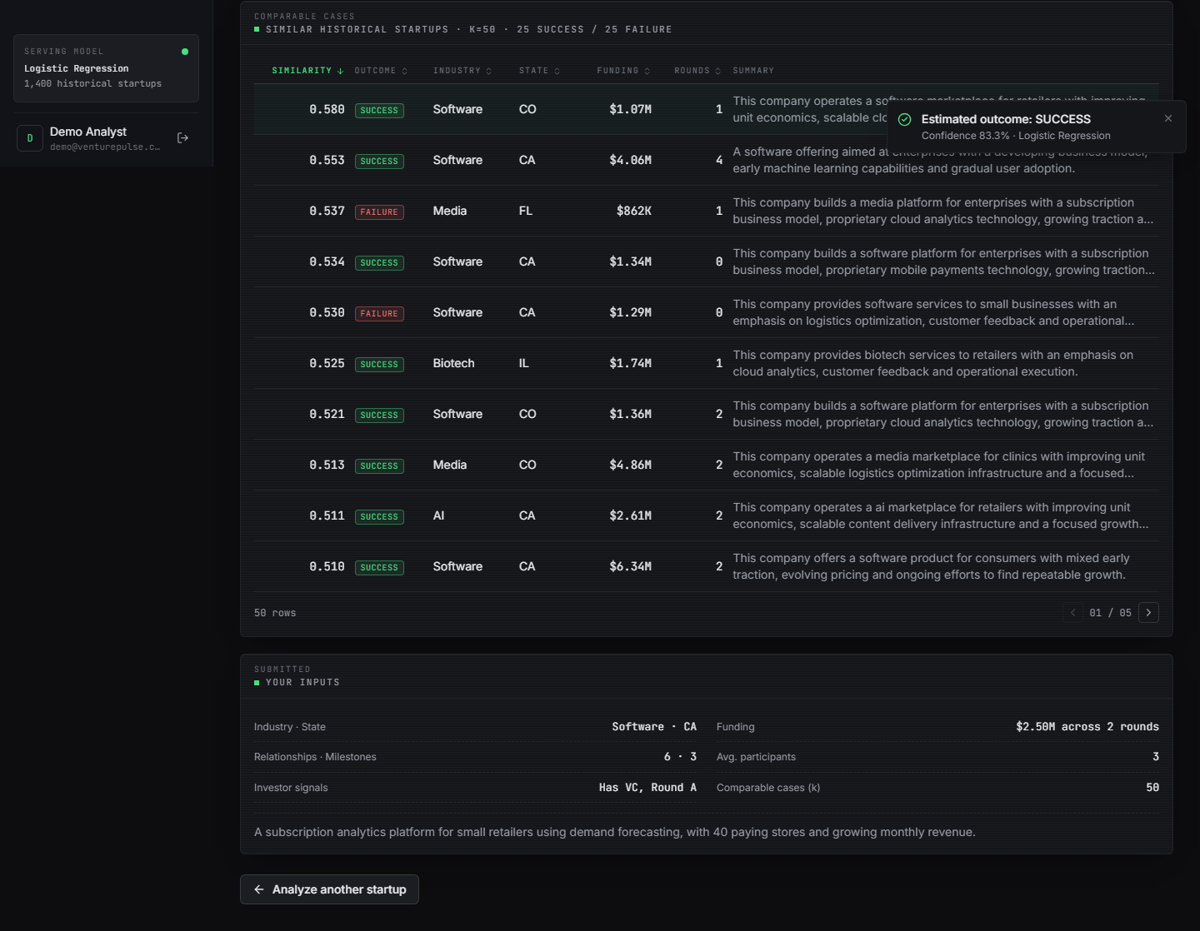
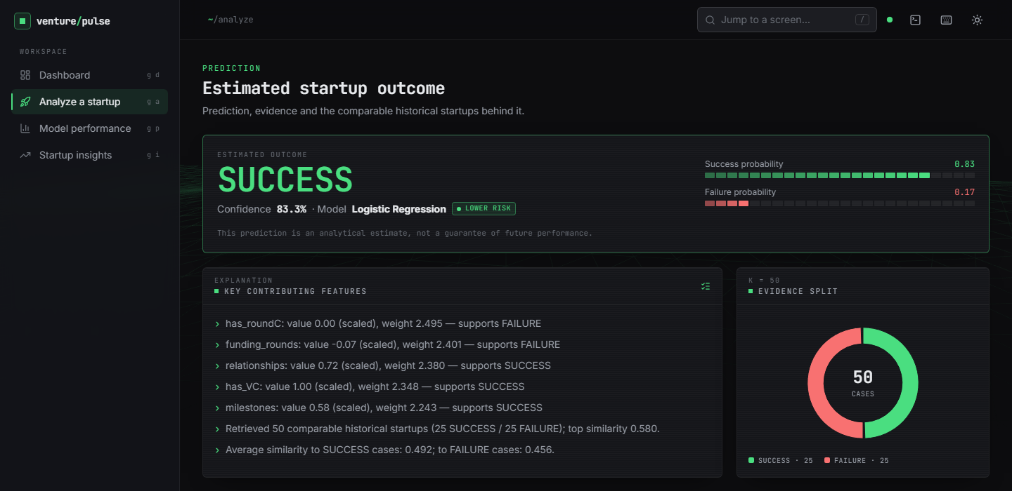
Output – Prediction Result
Left (top of the page): SUCCESS at 83.3 % confidence from Logistic Regression, labelled Lower risk, the signed key features and the 25 / 25 evidence split of k=50. Right (rest of the page): the comparable startups (top similarity 0.580) and the submitted inputs. The prediction is an analytical estimate from a model trained on synthetic data, not a guarantee.
Dept. of CSE | Batch C10 | Final Review
23
Notes:
One real prediction: outcome, drivers, evidence split and comparable startups. Say again that the model behind this screen was trained on the synthetic fallback.

Slide 24
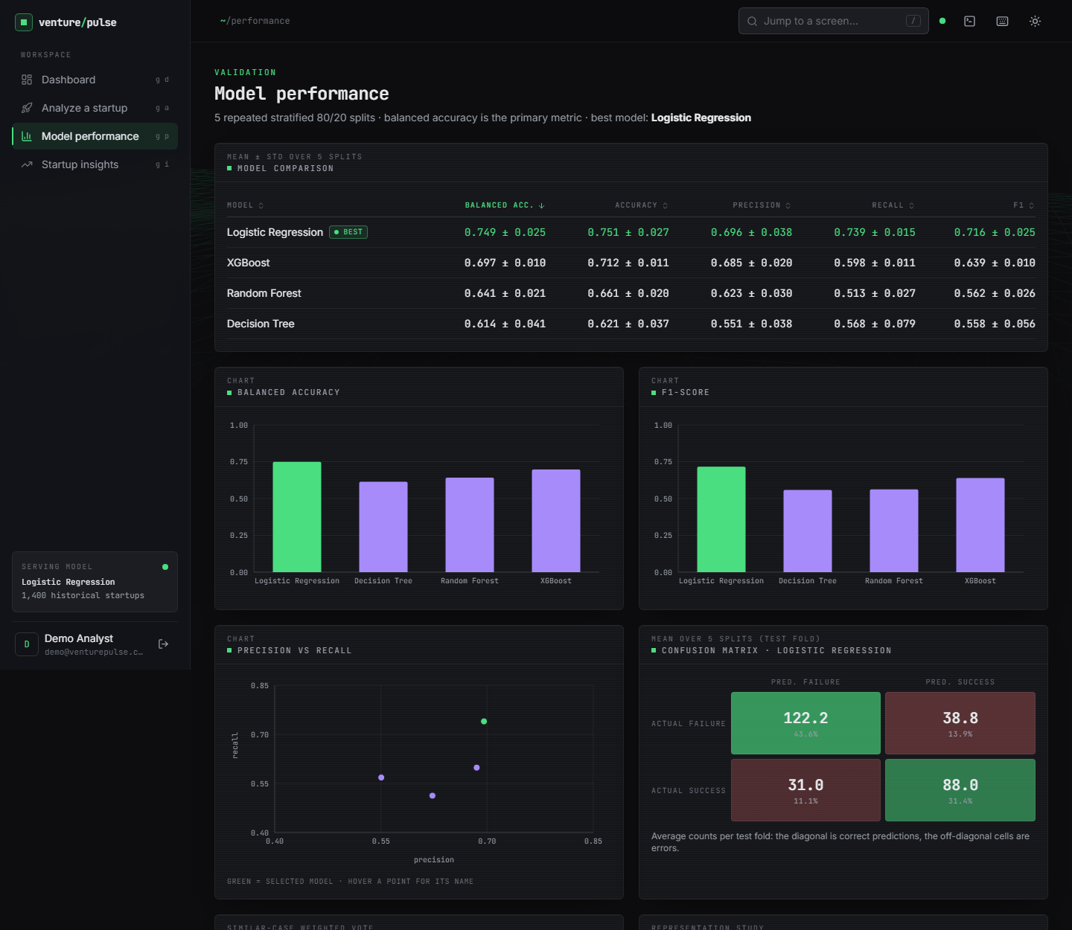
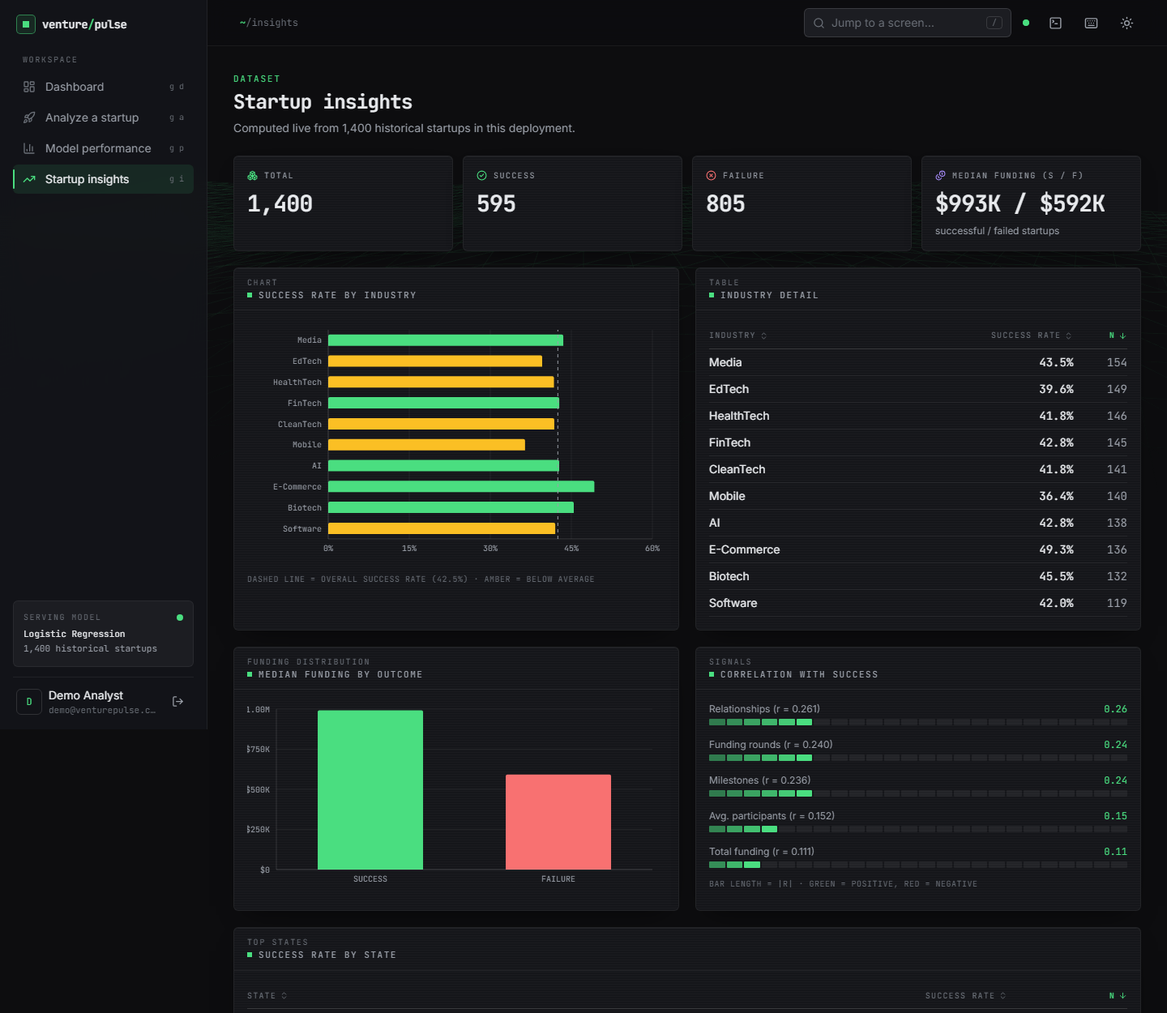
Output – Model Performance & Startup Insights
Left: the model comparison table, balanced-accuracy and F1 charts, precision-recall plot and confusion matrix of the served model (synthetic data: balanced accuracy 0.749 ± 0.025). Right: dataset insights, success rate by industry, median funding by outcome and correlations with success (top of each page).
Dept. of CSE | Batch C10 | Final Review
24
Notes:
Analytics screens read their numbers from the stored evaluation of the served model, so they show synthetic-data statistics.

Slide 25
Conclusion
Delivered: a working startup-outcome predictor: preprocessing, MiniLM text embedding, fused retrieval of comparable startups, four compared classifiers, explanations, a FastAPI service and a React app.
Measured (real table, structured features): RF / XGBoost balanced accuracy 0.746, ROC-AUC 0.816 / 0.806; ensembles beat Logistic Regression; 51 automated checks pass; predict median 148-199 ms.
Objectives: 3, 4, 5 and 6 met (6 with the caveat that ROC-AUC was not recorded for the shipped fused model); 1 and 2 only partly: no founder, team-experience or market data exist in either dataset.
Limits: the shipped model is trained on synthetic data; the text channel is untested on real data; post-hoc fields inflate AUC by about 0.1; no temporal split; 922 rows from one US table; not investment advice.
Dept. of CSE | Batch C10 | Final Review
25
Notes:
Be explicit: the system works; the real-data numbers are an upper bound and the 85-92 % level of the base paper was not reproduced.

Slide 26
Future Scope
Retrain the served model on the real table and re-run the study with a temporal split once dated records are available.
Collect founder-experience, team and market-context fields and real business descriptions to test the text half of the fusion properly.
Calibrate the probabilities, add SHAP-style explanations and report PR-AUC with confidence intervals and significance tests.
Add HistGradientBoosting and the retrieval-only classifier to the app, with a user-selectable decision threshold.
Replace the demo sign-in with real accounts, add load tests and a user study with investors or founders.
Dept. of CSE | Batch C10 | Final Review
26
Notes:
Concrete next steps; the first three follow directly from the findings.

Slide 27
References
[1] M. Panjwani, P. Shrivastava, P. Hande, G. Meshram, N. Verma and D. Gotmare, "Startup success prediction using machine learning and ensemble techniques," Int. J. Res. Appl. Sci. Eng. Technol. (IJRASET), vol. 14, no. IV, Apr. 2026, doi: 10.22214/ijraset.2026.80226.
[2] A. Maarouf, A. Bakiaj and S. Feuerriegel, "Predicting startup success using large language models: A novel in-context learning approach," arXiv:2601.16568, Jan. 2026.
[3] S. Mashhadi, A. Saghezchi and V. G. Kashani, "Interpretable machine learning for predicting startup funding, patenting, and exits," arXiv:2510.09465, 2026.
[7] M. Razaghzadeh Bidgoli, I. Raeesi Vanani and M. Goodarzi, "Predicting the success of startups using a machine learning approach," J. Innov. Entrepreneurship, vol. 13, 2024.
[9] K. Zbikowski and P. Antosiuk, "A machine learning, bias-free approach for predicting business success using Crunchbase data," Inf. Process. Manage., vol. 58, no. 2, 2021.
[16] L. Gius, "Disagreement predicts startup success: Evidence from venture competitions," Strategy Sci., vol. 10, no. 2, pp. 93-108, Jun. 2025, doi: 10.1287/stsc.2024.0169.
[17] I. B. Bhandari, "Impact of venture capital on startup success and economic growth in Nepal," Nepalese J. Finance, vol. 12, no. 1, Jan. 2025.
[18] L. Breiman, "Random forests," Mach. Learn., vol. 45, no. 1, pp. 5-32, Oct. 2001.
[19] T. Chen and C. Guestrin, "XGBoost: A scalable tree boosting system," in Proc. 22nd ACM SIGKDD Int. Conf. Knowl. Discovery Data Mining, San Francisco, CA, USA, 2016, pp. 785-794.
[21] F. Pedregosa et al., "Scikit-learn: Machine learning in Python," J. Mach. Learn. Res., vol. 12, pp. 2825-2830, 2011.
[22] H. He and E. A. Garcia, "Learning from imbalanced data," IEEE Trans. Knowl. Data Eng., vol. 21, no. 9, pp. 1263-1284, Sep. 2009.
[25] N. Reimers and I. Gurevych, "Sentence-BERT: Sentence embeddings using Siamese BERT-networks," in Proc. Conf. Empirical Methods Natural Lang. Process. (EMNLP-IJCNLP), Hong Kong, 2019, pp. 3982-3992.
[29] S. Kaufman, S. Rosset, C. Perlich and O. Stitelman, "Leakage in data mining: Formulation, detection, and avoidance," ACM Trans. Knowl. Discovery Data, vol. 6, no. 4, Art. no. 15, 2012.
[32] M. KC, "Startup success prediction," Kaggle dataset (public domain), https://www.kaggle.com/datasets/manishkc06/startup-success-prediction.
Dept. of CSE | Batch C10 | Final Review
27
Notes:
Selected references with their report numbers; the complete numbered list is in the report.

Slide 28
THANK YOU
Questions & Suggestions
Dept. of CSE | Batch C10 | Final Review
28
Notes:
Invite questions.

