Slide 1
SHEGUARD
REVIEW 2 · DESIGN, METHODOLOGY AND PROGRESS
AI Powered Women's Safety Platform
Presented by
Under the guidance of
CH.AARTHI 23K91A6741
D.PRANATHI 23K91A6748
BALA VIGNESH 23K91A6717
A.VISHAL 23K91A6704
[GUIDE NAME], [DESIGNATION]
Department of Computer Science and Engineering (Data Science)
[COLLEGE NAME] · Batch A7 (CSE-DS, Section A) · [ACADEMIC YEAR]
Notes:
Review 2 covers the design, methodology and progress of SHEGUARD.

Slide 2
Contents
01
02
03
04
Recap
Architecture
Methodology
Dataset
05
06
07
08
Data preparation
Model and configuration
Decision logic
Data flow, modules, database
09
10
11
12
Technology stack
Progress
Preliminary results and screens
Testing, challenges, next steps
Notes:
Twelve parts: recap, architecture, methodology, data, preparation, model, decision logic, data flow and database, technology, progress, results and screens, testing and next steps.

Slide 3


Recap: problem and proposed system
Problem
Proposed system
Women face harassment on isolated and crowded streets. Safety apps need a manual SOS press, mostly send one alert, choose routes for speed and rarely keep evidence.
A safety platform: risk-scored routes, SafePhrase or one-tap SOS, a live guardian link, hashed evidence and a Gemini assistant. Built as a React PWA with FastAPI and SQLite.
Trip, phrase or tap
District risk tiers, OSRM routes
SOS session + alerts
Live location, evidence
Guardian link, cancel
Notes:
Recap of Review 1. The base paper [1] (SafeRoutes) clusters regions for safe paths; SHEGUARD adopts that idea and adds the emergency features. The batch abstract names Flutter and Supabase; the implemented stack is React, FastAPI and SQLite.

Slide 4
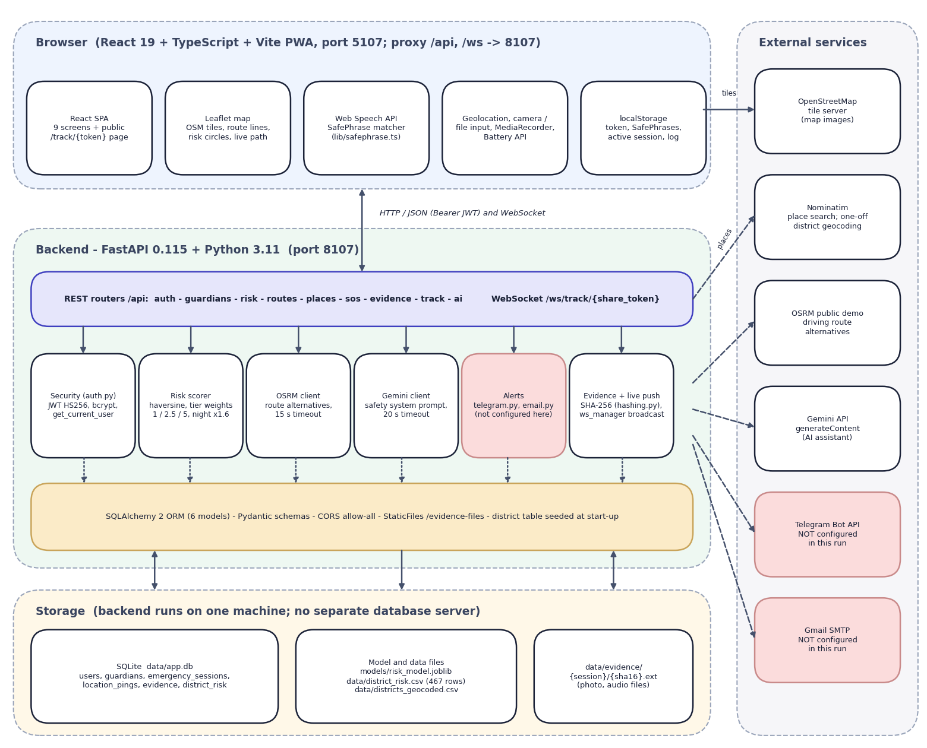

System architecture
Client: React 19 + TypeScript + Vite (port 5107), installable PWA; Leaflet map, Web Speech API, geolocation, MediaRecorder.
API: FastAPI (port 8107), 20 endpoints (19 HTTP + 1 WebSocket); JWT login, per-user queries.
Services: route scorer, OSRM and Nominatim clients, SHA-256 hashing, Gemini client, Telegram and Gmail senders.
Data: SQLite (6 tables), evidence folder, risk_model.joblib and district_risk.csv.
Alert channels are coded but not configured in this run.
Notes:
The browser talks to the Vite server, which proxies /api and /ws to FastAPI. Outside services: OSRM demo server, Nominatim, Gemini, Telegram Bot API and Gmail SMTP.

Slide 5
Methodology: end-to-end workflow
District crime data 2001-2012
Sum 7 crimes per reporting year
Geocode: 467 of 827 districts
K-Means k=3 on crime rate
Evaluate: indices, k sweep
Score OSRM routes by tier
Serve: FastAPI + React
Cluster, not classify
Tested around the model
Reproducible
There are no safe/unsafe labels, so districts are clustered on one number and named low, medium, high.
Alternative tierings, seed stability, route sensitivity and the SafePhrase matcher were measured separately.
Fixed seed 42; scripts/run_experiments.py regenerates experiments/study/metrics.json.
Notes:
Seven-step workflow from crime tables to a served application. The model is trained once, in under a second on the CPU, and its output table is loaded into the database at start-up.

Slide 6
Dataset and input sources
Source | Size | Use
Crime in India district file [23] (CC0) | 8,597 rows, 827 districts, 12 years | Risk feature
Nominatim geocodes | 467 of 827 districts (56.5 %) | Map position
State-year file 2001-2021 [24] (CC0) | 736 rows | Not used by any feature
OSRM, Nominatim (live) | Public demo servers | Routes, place search
Demo database | Demo account + registered users | Walk-through
Notes:
All inputs are real public data; there is no synthetic data in this project. They are old (2001-2012), district-level counts and only 56.5 % of districts could be geocoded.

Slide 7



Data preparation and features
Crime table
Geocoding and join
Run-time inputs
Drop TOTAL roll-up rows (9,017 to 8,597); sum the 7 crime columns; divide by the years a district reported (638 of 827 reported all 12). Feature: crimes per reporting year.
Nominatim once, 1 request per second; 467 of 827 kept, the rest dropped not guessed. No geocoded district for Uttar Pradesh, West Bengal, Delhi and 8 other states/UTs. StandardScaler on the feature; score 0-100 by min-max.
Route polyline sampled at every 8th point, nearest district by haversine (no distance limit). SafePhrase transcript lowercased, punctuation removed, matched in a word window.
Notes:
Preparation = turning the crime table into one number per district, giving each district a position, and turning a route or a transcript into inputs for the scorer or matcher.

Slide 8
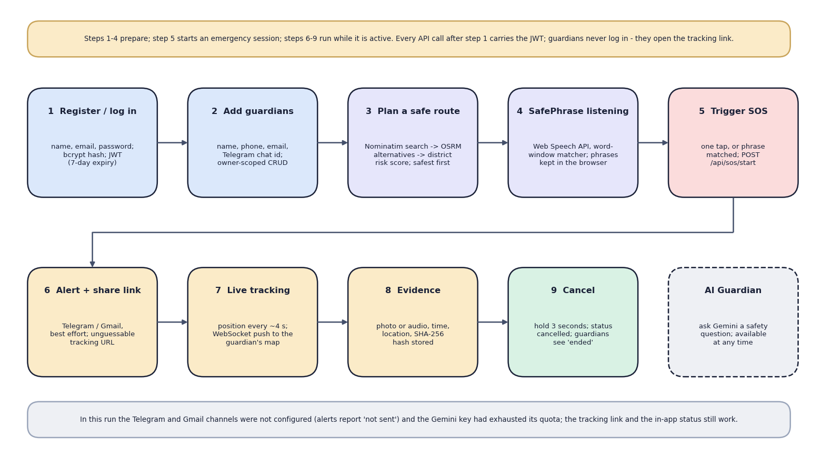

Models and decision rules
Component | Detail
Risk model | K-Means, k=3, one feature
Tier weights | low 1.0, medium 2.5, high 5.0
Night factor | x 1.6 (about 20:30-05:30 IST)
SafePhrase | word-window match, 4 levels
Classical clustering on the CPU; no deep network and no GPU.
Notes:
The abstract speaks of an AI-powered platform; the only trained model is a three-cluster K-Means. The route scorer and the SafePhrase matcher are transparent rules.

Slide 9
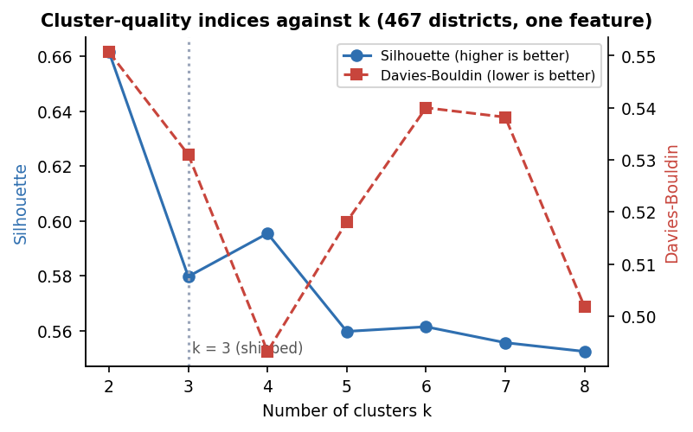

Training configuration
Setting | Value
Data | 467 districts, 1 feature
Algorithm | K-Means, k=3, seed 42, n_init 10
Scaling | StandardScaler
Split | none (unsupervised, all 467)
Fit time | under 1 s on CPU
Quality | silhouette 0.580, DB 0.531
Tiers | 278 low, 148 medium, 41 high
Cut-offs | 213.75 and 529.83 crimes/year
Silhouette and Davies-Bouldin for k = 2 to 8: k=3 is a UI choice, not the optimum
Notes:
Silhouette is 0.662 at k=2, 0.580 at k=3 and 0.596 at k=4; Davies-Bouldin is 0.531 at k=3 and 0.493 at k=4. Three tiers were chosen for the interface. Thirty single-initialisation runs agree with the shipped tiers with an adjusted Rand index of at least 0.66 (mean 0.79).

Slide 10
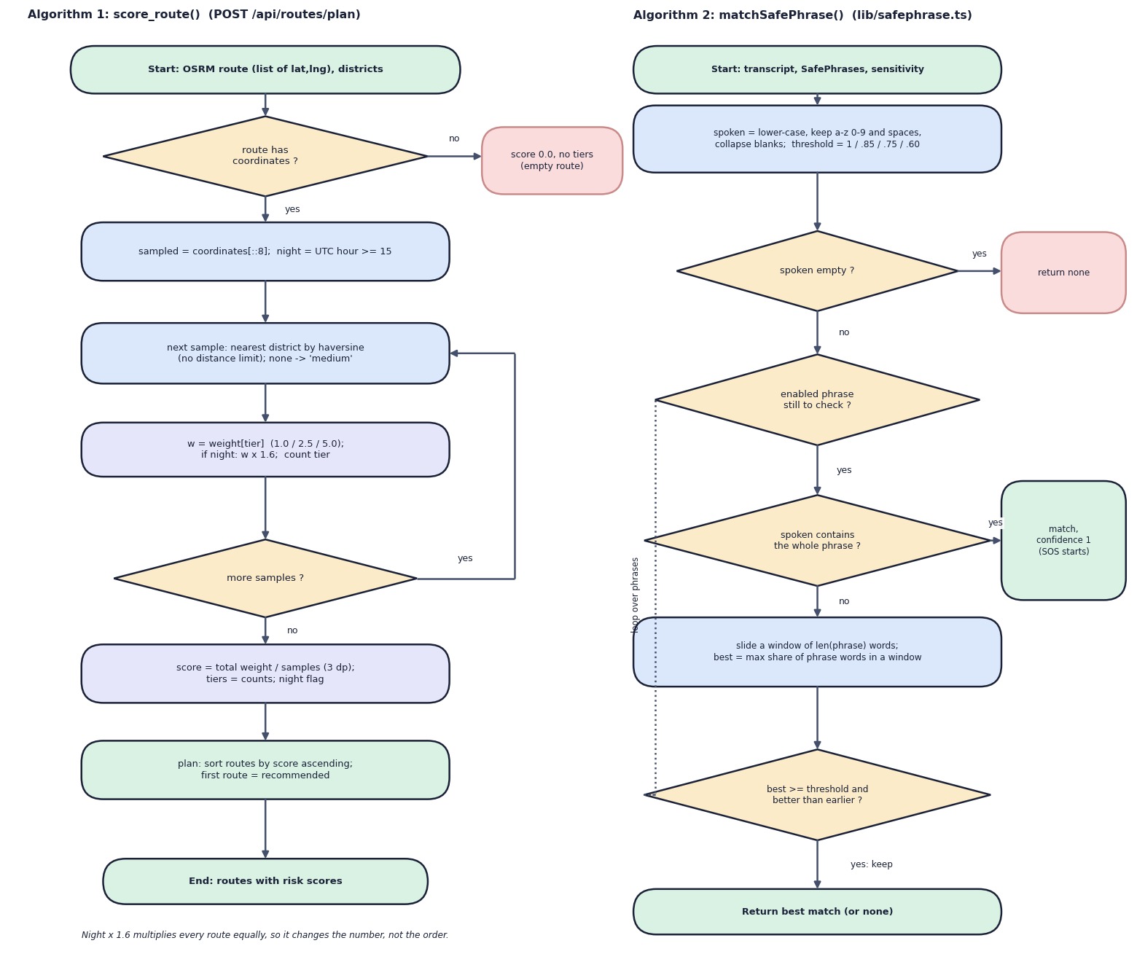

Decision logic
Route score
Every 8th point: nearest district tier weight; mean x 1.6 at night; lowest score is recommended.
SOS trigger
One tap, or a SafePhrase match; start session, alert guardians, stream location; 3-second hold cancels.
SafePhrase level
Medium (default) 54 % recall, 0 of 80 false triggers; Ultra 100 % recall, 10 % false triggers.
Notes:
Decision logic. The night factor multiplies every route by the same 1.6, so it changes the displayed score but never the recommended route (16 of 16 tested city pairs keep their order). SafePhrase figures are from written transcripts only; no audio or speech recogniser was measured.

Slide 11
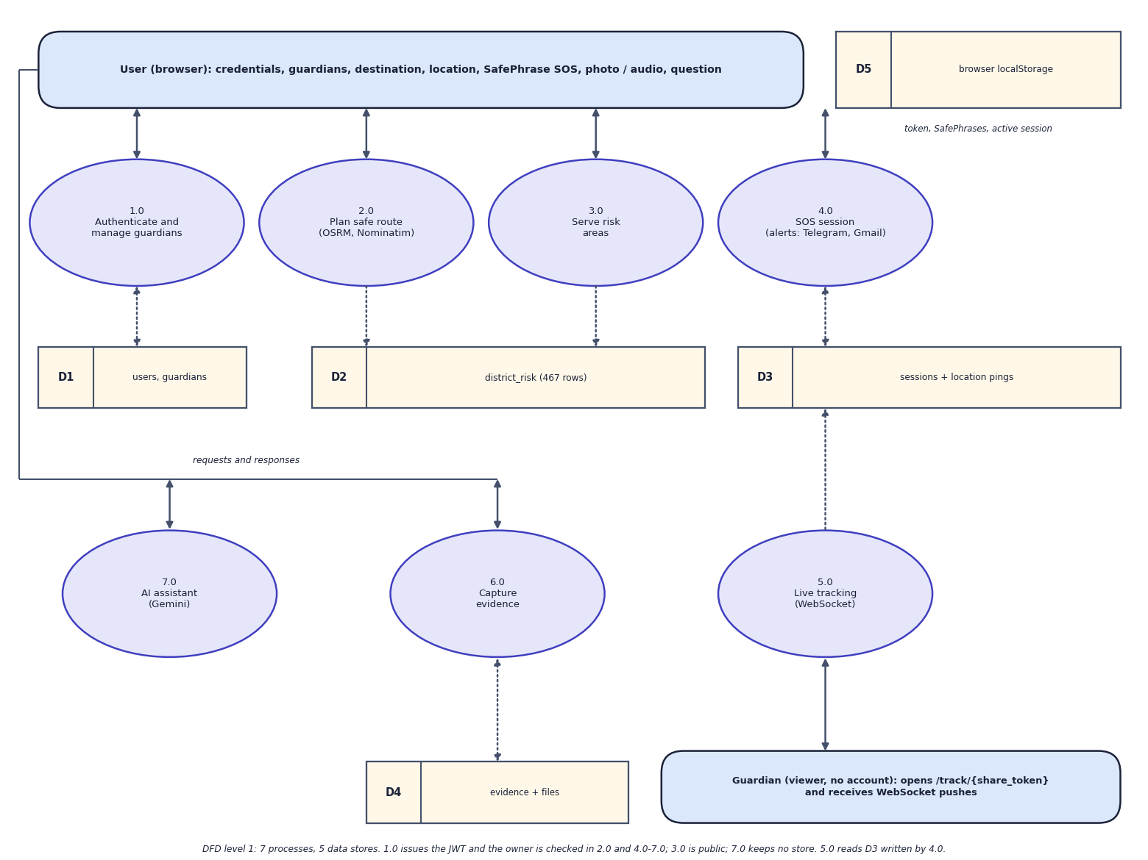
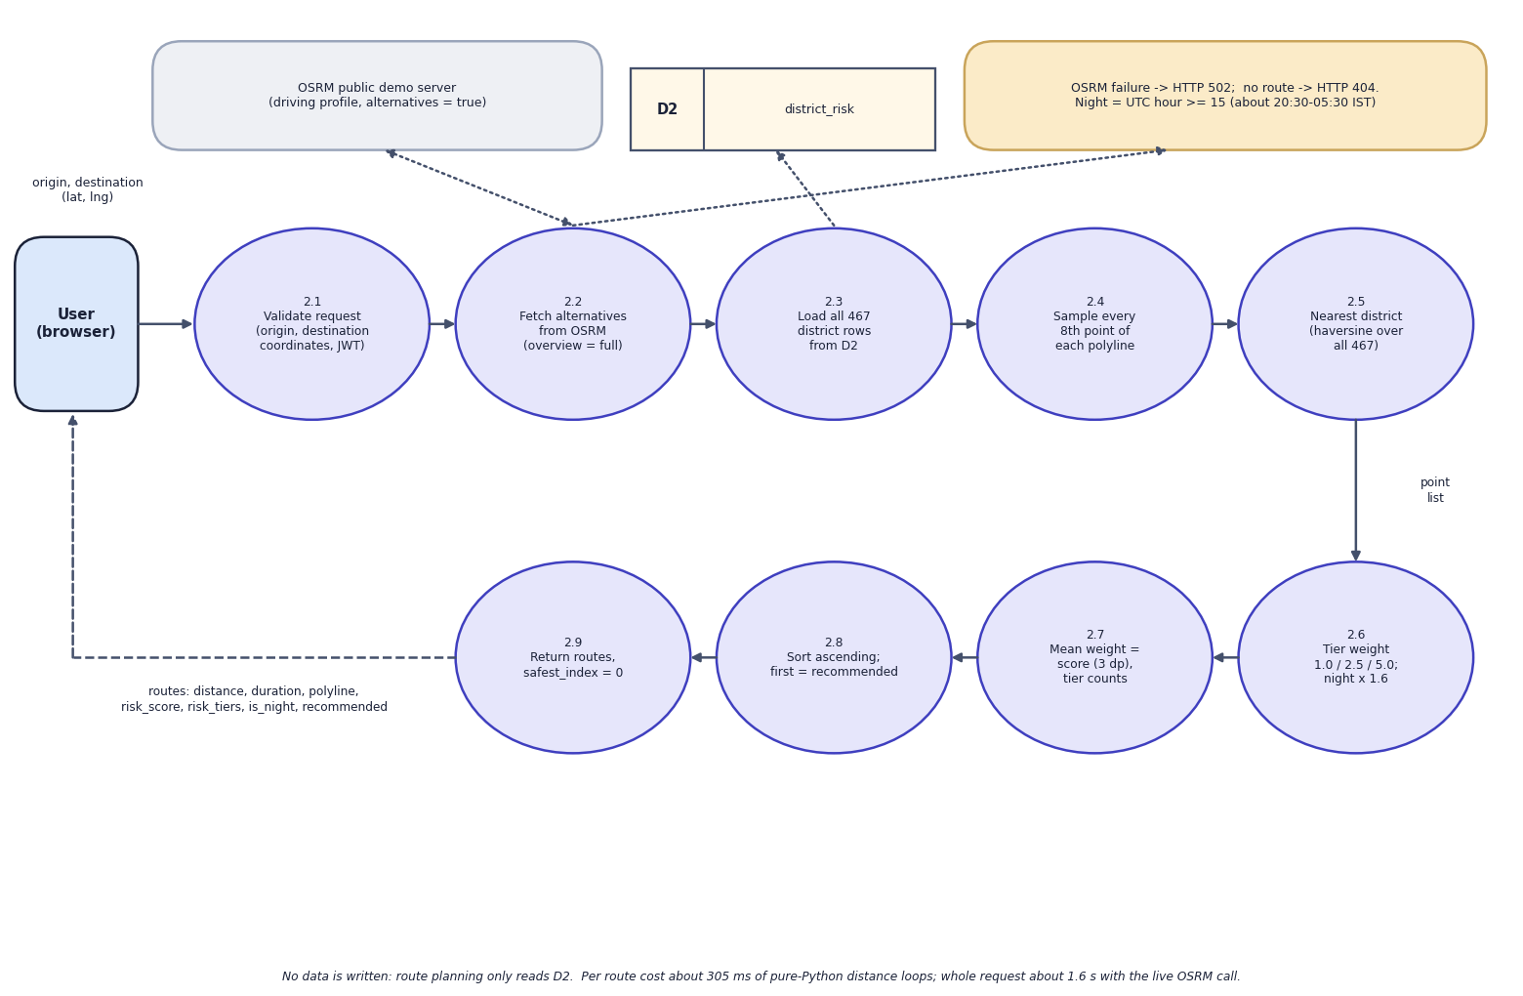

Data flow and modules
DFD level 1 (left) and level 2 expansion of 'Plan safe route' (right)
Module | Responsibility
Routes and risk | OSRM alternatives, nearest-district scoring, risk areas for the map layer
SOS and tracking | session, location pings, WebSocket push, public share-token page, cancel
Evidence, assistant, access | photo/audio with SHA-256; Gemini question endpoint; JWT and owner scoping
Notes:
Level 1 splits the system into processes and data stores; level 2 opens the route-planning process.

Slide 12
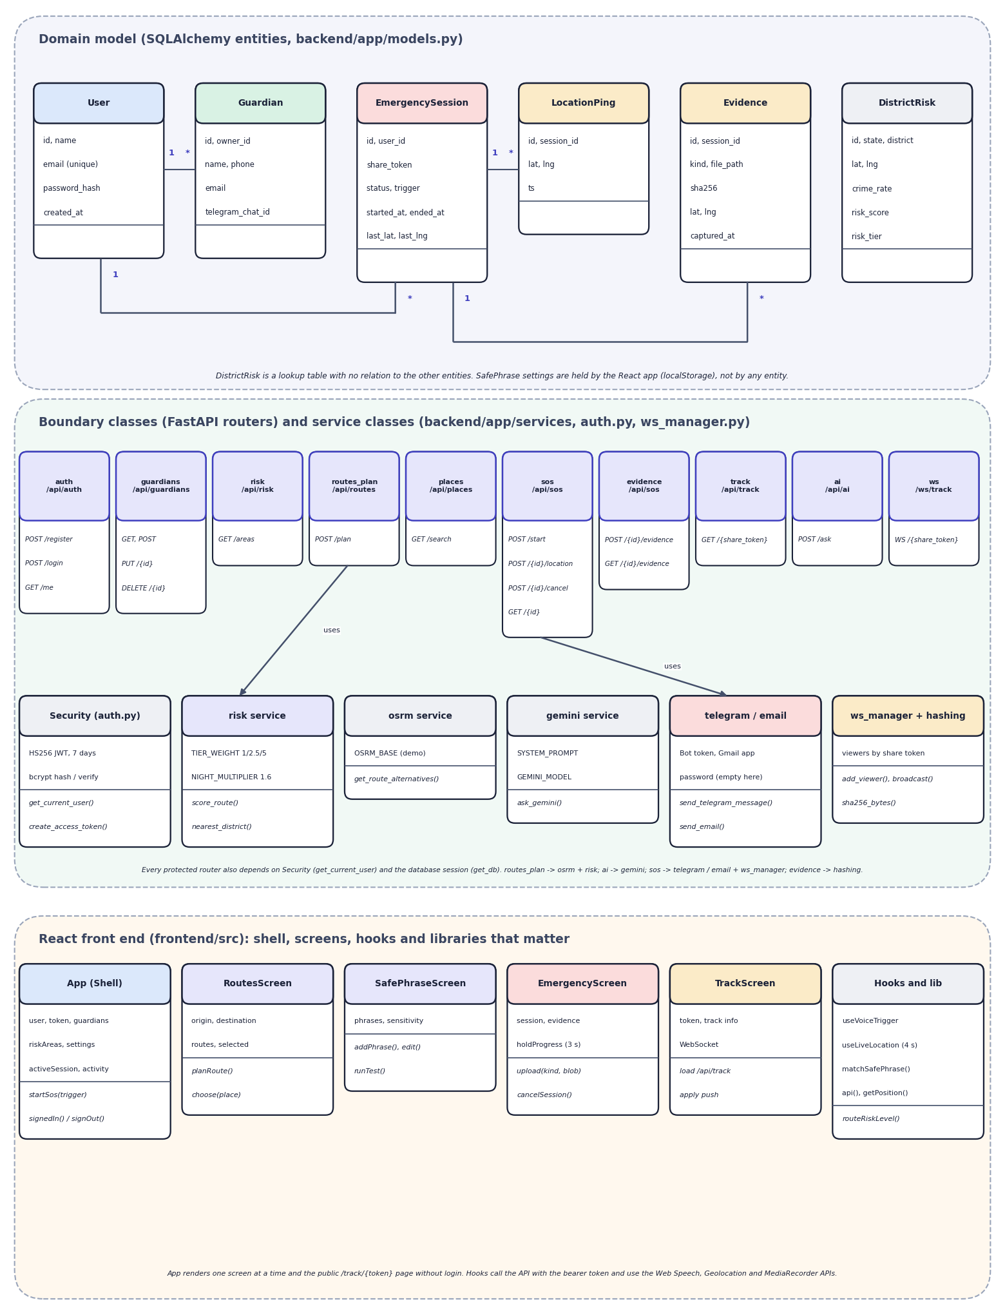
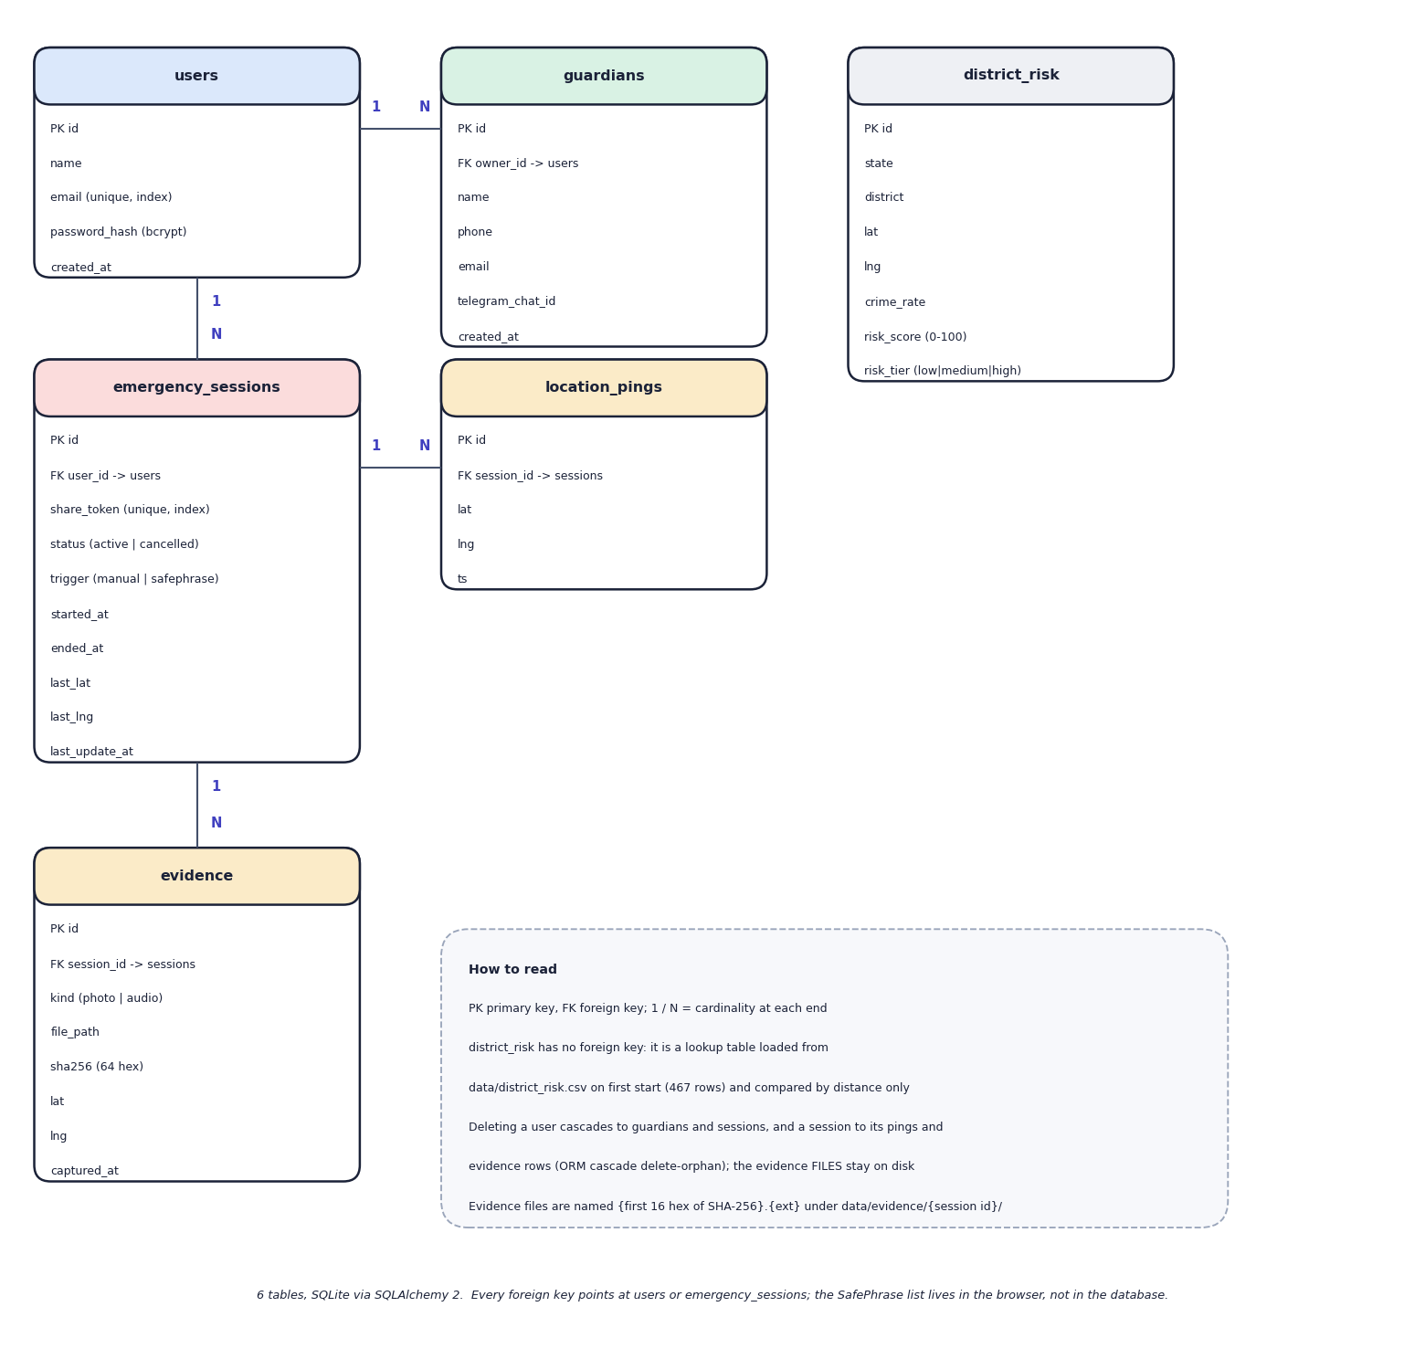

Database design and UML
Table | Key fields | Relations
users, guardians | email, password hash; owner_id | 1:N guardians, sessions
emergency_sessions | share_token, status, trigger | 1:N pings, evidence
location_pings, evidence | lat, lng, ts; kind, sha256 | N:1 session
district_risk | district, lat, lng, tier | seeded from CSV (467)
ER diagram, 6 tables (left) and UML class diagram (right)
Notes:
Six SQLite tables created by SQLAlchemy. Guardian rows belong to a user; a guardian has no login and sees only a session's share-token page. SafePhrase settings live in the browser, not in the database.

Slide 13






Technology stack
Language
Machine learning
Maps and services
Python 3.11, TypeScript 5.8
scikit-learn 1.5.2 (K-Means), pandas 2.2.3, NumPy 2.1.3, joblib
OSRM, Nominatim, OpenStreetMap tiles, Leaflet 1.9, Gemini API
Backend
Frontend
Storage and tests
FastAPI 0.115, SQLAlchemy 2.0, PyJWT, bcrypt, WebSocket, Telegram and Gmail senders
React 19, Vite 6, Tailwind CSS 4, Web Speech API, PWA plugin
SQLite, evidence folder, pytest (51 pass, 6 expected fail), Playwright captures
Notes:
Versions are those pinned in requirements.txt and package.json or reported by the installed packages. The abstract's Flutter and Supabase were not used.

Slide 14
Implementation progress
Component | Status
Accounts, guardians, per-user data scoping | Completed
K-Means district risk and route scoring | Completed
SOS, live location, WebSocket tracking page | Completed
Evidence capture with SHA-256 | Completed
SafePhrase: speech + matcher | Completed; recogniser not measured
Alerts: Telegram, Gmail | Coded, never delivered
Gemini assistant | Coded; quota error in test
Real-device, field and user testing | Not done
20
API endpoints (19 HTTP + 1 WebSocket)
6
database tables
51
tests pass; 6 expected failures
Notes:
The core flow works end to end. Guardian alerts could not be verified because the Telegram and Gmail credentials are empty, and the Gemini key's quota was exhausted during testing.

Slide 15
Preliminary results: SafePhrase matcher and risk model
0.580
silhouette of the 3 tiers (Davies-Bouldin 0.531)
149 km
Hyderabad to its nearest district in the table
16 / 16
city pairs where the night factor keeps the route order
Notes:
Silhouette measures cluster separation on one number, not real safety. Coverage: 40 city centres were checked; the nearest district is a median of 8.1 km away but up to 231 km (Lucknow); 7 cities are more than 100 km from any district. SafePhrase numbers come from hand-written transcripts, not speech audio.

Slide 16
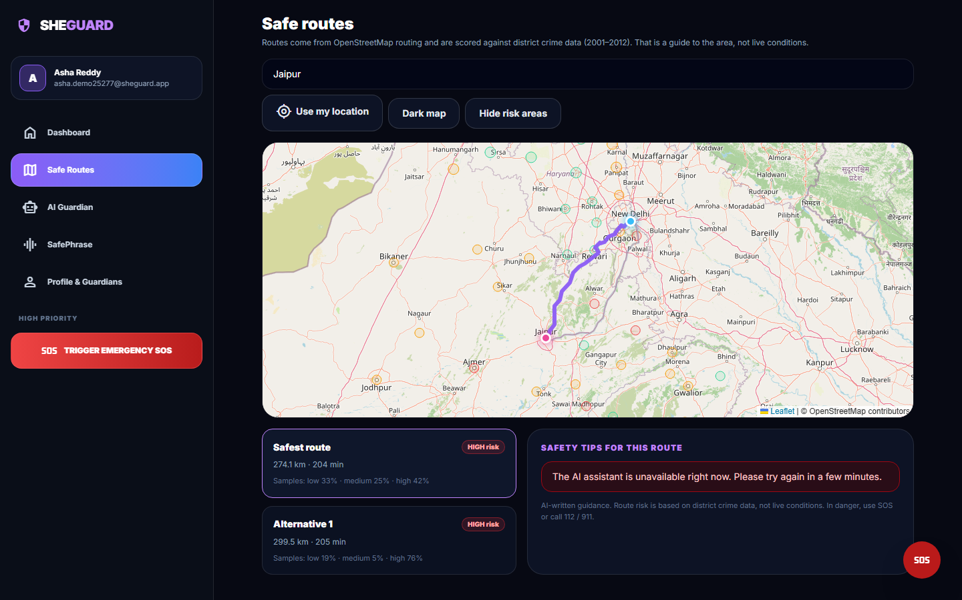
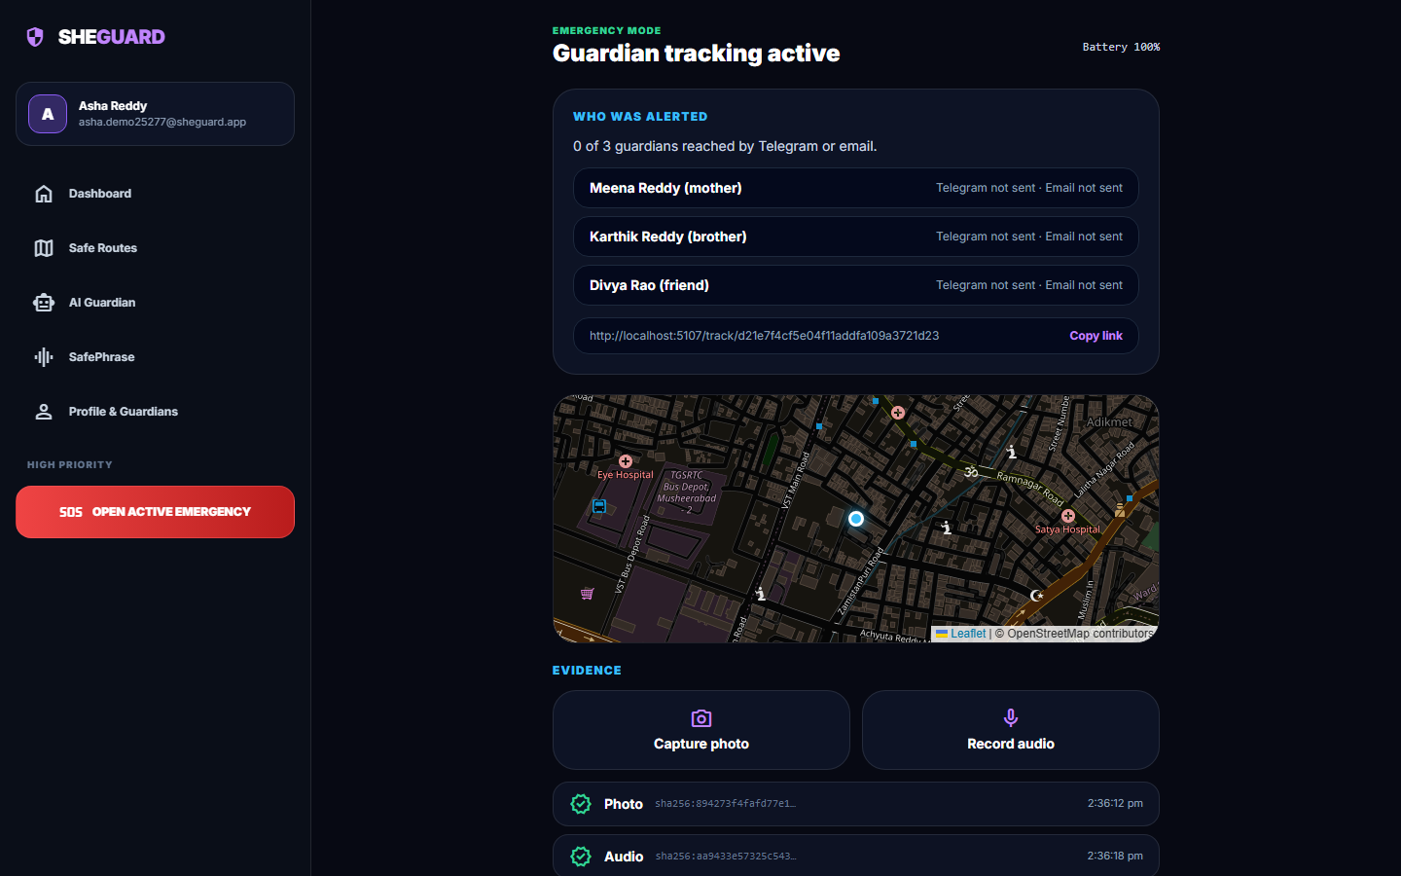


Output screens
Delhi to Jaipur: two real OSRM routes, both HIGH risk
Emergency: photo and audio saved with SHA-256; 0 of 3 guardians reached (no channel set)
Notes:
Real captures of the running application. Location was set by the test browser to a Delhi and a Hyderabad city centre; the AI tips panel shows the unavailable message because the assistant's quota was exhausted.

Slide 17
Testing and observations
Test group | Tests | Result
Authentication, guardians | 14 | 14 passed
Risk data, route planning | 6 | 6 passed
SOS, tracking, WebSocket | 7 | 7 passed
Evidence | 6 | 6 passed
AI endpoint, places search | 6 | 6 passed
Scorer and model files | 12 | 12 passed
Known defects | 6 | 6 expected fail
51 pass in about 14 s; 6 tests assert hardened behaviour and fail today: Gemini timeout gives 500, latitude 999 accepted, any trigger string, WebSocket accepts any token, no upload size limit, .html evidence served as HTML.
API median times: health 2.1 ms, SOS start 34 ms, location push 15 ms, login 279 ms (bcrypt), live route plan 1.6 s; WebSocket push 13 ms.
Stored evidence files are readable without login by URL.
Not done: real alert delivery, real device, user and load testing.
Notes:
Expected-fail tests are reported as such rather than hidden. Latencies were measured on 127.0.0.1 on an i5-12500, one client at a time.

Slide 18



Challenges and corrective actions
Old, coarse data
One-feature model
Coverage gaps
2001-2012 district counts, not per population; 56.5 % of districts geocoded.
Tiers are two cut-offs (213.75, 529.83); k=4 scores better than the chosen k=3.
No district for Uttar Pradesh, West Bengal, Delhi; Hyderabad is 149 km from the nearest.
Night factor is a no-op
Alerts and AI unverified
Open evidence URLs
x 1.6 on every route: ranking unchanged in 16 of 16 pairs.
Telegram and Gmail not configured; Gemini quota 429 and a timeout returns 500.
Files readable without login; no size limit; found by the security probes.
Notes:
Six challenges and findings, each backed by a measurement in REPORT_FACTS.md.

Slide 19
Next steps
Better risk data
Fix the findings
Real-device test
Final report and demo
Use population-normalised, newer data and cover the missing states; cap the distance to the nearest district.
Handle provider timeouts, validate coordinates, authenticate the WebSocket, protect evidence files, cap uploads.
Configure Telegram and Gmail and test delivery on a phone; measure speech recognition; run a small user trial with real users.
Complete the report and the final demonstration.
Notes:
What remains: better data and the hardening items found in testing, then real-device checks, then the report and final demonstration.

Slide 20
Thank you
Questions and suggestions are welcome.
Notes:
Thank you. Questions are welcome.

