Slide 1

SHEGUARD: AI Powered Women's Safety Platform
Final Review
Team Details : Batch A7
Under the Esteemed Guidance of
[GUIDE NAME]
[DESIGNATION], Department of CSE (Data Science)
23K91A6741 CH.AARTHI
23K91A6748 D.PRANATHI
23K91A6717 BALA VIGNESH
23K91A6704 A.VISHAL
DEPARTMENT OF COMPUTER SCIENCE AND ENGINEERING (DATA SCIENCE) · Academic Year [ACADEMIC YEAR]
Notes:
Final review of SHEGUARD: a women's safety web app with district-risk safe routes, SafePhrase and one-tap SOS, live guardian tracking, hashed evidence and an AI assistant.

Slide 2
Table of Contents
Abstract
Base Paper & Literature Survey
Research Gap & Problem Statement
Objectives
Proposed System & Architecture
Methodology & Pipeline
Design & Implementation
Results, Parameter Analysis, Testing & Comparison
Output Screens
Conclusion & Future Scope
References
Dept. of CSE | Batch A7 | Final Review
2

Slide 3
Abstract
Women face harassment on isolated and crowded streets; most safety apps need a manual SOS press and stop at sending one alert.
SHEGUARD is a working web app (React PWA + FastAPI + SQLite) covering before, during and after an emergency: safe-route scoring, SafePhrase and one-tap SOS, live guardian tracking and SHA-256 evidence capture.
Area risk: K-Means (k=3) on 467 districts of 2001-2012 crime counts - silhouette 0.580, Davies-Bouldin 0.531; OSRM routes are scored against it.
Measured: 51 automated tests pass (6 documented defects), WebSocket push 15 ms, SafePhrase matcher recall 54 % with no false trigger at the default level.
Honest limits: the model is two cut-offs on one number; no districts for Uttar Pradesh, West Bengal or Delhi; the Gemini key hit its quota; Telegram and Gmail were not configured, so alerts were never delivered; no field trial.
Keywords: women's safety, safe route, clustering, SOS, live tracking, evidence integrity.
Dept. of CSE | Batch A7 | Final Review
3
Notes:
Abstract: problem, approach, headline measurements and the honest limits. The abstract mentions Flutter and Supabase; the shipped system uses React and FastAPI with SQLite.

Slide 4
Base Paper
K. Agrawal, A. Srivastava, K. Sharma, S. K. Satapathy, S.-B. Cho, S. Mishra, A. Chowdhury, and A. Pal, "SafeRoutes: Charting a secure path - A holistic approach to women's safety through advanced clustering and GPS integration," IEEE Access, vol. 12, pp. 166368-166378, 2024, doi: 10.1109/ACCESS.2024.3488784.
Task: data-driven safe zones for women's safety. Seven data.gov.in datasets (district crimes 2013, population, literacy, per-capita expenditure, police strength, forest cover) feed imputation, scaling, Pearson and Spearman analysis.
Method: K-Means and Gaussian mixture models, 3-4 clusters; Silhouette, Calinski-Harabasz, Davies-Bouldin, BIC and a Ward dendrogram select the number; dummy 'safest city' data scores the clusters.
Travel part: maps API and cab integration with a 1.96x safety buffer and deviation alerts - designed, not implemented or evaluated.
Results are 'anticipated outcomes' (correlation matrices, cluster tables); k=3 in its tables: Davies-Bouldin 0.970, Calinski-Harabasz 221.0, silhouette 0.416. No accuracy figures.
We adopt its safe-route idea and add SafePhrase, one-tap SOS, live guardian link, hashed evidence and an assistant.
Dept. of CSE | Batch A7 | Final Review
4
Notes:
Read from Documentary/Base paper 2.pdf. Its tables are on multi-feature 2013 data; ours are on one feature, so the indices are not comparable.

Slide 5
Literature Survey
Author / Year | Methodology | Dataset | Key Results | Limitations
Agrawal et al., 2024 (base) [1] | K-Means, GMM, cab-vendor alerts | data.gov.in district data, 2013 crimes | Cluster tables; anticipated outcomes | Travel part not built or tested
Farooq et al., 2023 [2] | Systematic review of IoT devices for women's safety | Studies from 2016 to 2022 | Pulse and pressure sensors most used; GPS, GSM, Raspberry Pi; logistic regression, HMM, decision trees | Calls for auto-activation with less human interaction
Thawale et al., 2025 [6] | Android app, ESP32-CAM, Firebase, crime-zone classes | Historical crime data, test locations | Reports 93 % zone accuracy; SOS in 4-6 s | Needs extra hardware; own test locations
Shinde et al., 2025 [7] | Safe-route app: SOS, heatmap, voice commands, safety check | Crime reports, traffic, crowd density (design) | System design described | Not examined for measured results
Sangeeta et al., 2026 [8] | ExtrAnom video-anomaly benchmark | 1,001 videos, 5 crime types | Existing datasets insufficient for women-centric events | Video, not a safety app
Batch survey [3], [4], [5] | Mobile alert, shake-to-alert, cross-platform app | Not retrieved | Not retrieved | Listed only; nothing quoted
Dept. of CSE | Batch A7 | Final Review
5
Notes:
[1], [2], [6], [7], [8] were read from PDFs; [3]-[5] could not be retrieved so no results are claimed for them.

Slide 6
Research Gap
Author / Paper | Research Gap
Base paper [1] | Zones and route deviation for cabs only; no hands-free activation, live guardian link or evidence capture; its travel integration is not implemented
IoT review [2], ESP32 app [6] | Extra hardware (wearables, camera module); the review itself asks for auto-activation with less human interaction
Route app [7], mobile alert apps [3]-[5] | SOS and location sharing; safe-route scoring, voice activation and evidence preservation are rarely joined
Existing practice (batch survey) | Manual SOS that is hard to press in an emergency; routes chosen for speed; evidence rarely kept securely; one-time alerts, not live updates
All reviewed work | No single platform joins safe-route prevention, hands-free activation, live guardian tracking and evidence preservation. SHEGUARD prototypes it - without yet proving the risk model on real incidents
Dept. of CSE | Batch A7 | Final Review
6
Notes:
The gap follows the batch literature survey (research gap) and the papers read. The prototype closes the integration gap, not the evidence gap.

Slide 7
Problem Statement
Women face safety threats in isolated and in crowded public places.
Existing apps need a manual SOS press, which is difficult for a frightened user.
Most solutions stop at sending an alert; they do not help prevent risk or support follow-up.
Emergency evidence is rarely captured or stored securely.
Need: a platform that helps prevent risk, activates help with minimal effort, keeps guardians informed with live location and preserves evidence.
Dept. of CSE | Batch A7 | Final Review
7

Slide 8
Objectives
Safe-route guidance - partly met: OSRM routes scored against 467 district risk tiers (2001-2012 data, 56 % geocoded).
Quick activation (SafePhrase, Smart SOS) - partly met: one-tap SOS and voice matcher; no shake or automatic trigger.
Live location to guardians - met: WebSocket push, guardians need no account.
Evidence preserved securely - partly met: timestamp, location, SHA-256; files are publicly retrievable by URL.
AI assistance with Gemini - implemented, not demonstrated: the key's quota was exhausted (HTTP 429).
Protect data with role-based access and RLS - partly met: per-user query scoping, bcrypt, JWT; no RLS (SQLite) and one role only.
Dept. of CSE | Batch A7 | Final Review
8

Slide 9
Proposed System
Prevent - plan a route: OSRM alternatives are scored by the risk of the nearest district at every 8th point; the lowest score is recommended.
Activate - tap SOS, or say a SafePhrase (browser speech recognition + word-window matcher); cancel only by a 3-second hold.
Inform - a session with an unguessable share link; position streams every ~4 s over WebSocket to the guardian's read-only page.
Alert - Telegram message and email per guardian with the link (code complete; not configured in this run, so reported as 'not sent').
Preserve - photo or audio saved with time, location and a SHA-256 hash.
Assist - Gemini answers safety questions with an SOS-first system prompt (quota exhausted in this run).
Protect - bcrypt passwords, JWT, every query scoped to the owner.
Dept. of CSE | Batch A7 | Final Review
9

Slide 10
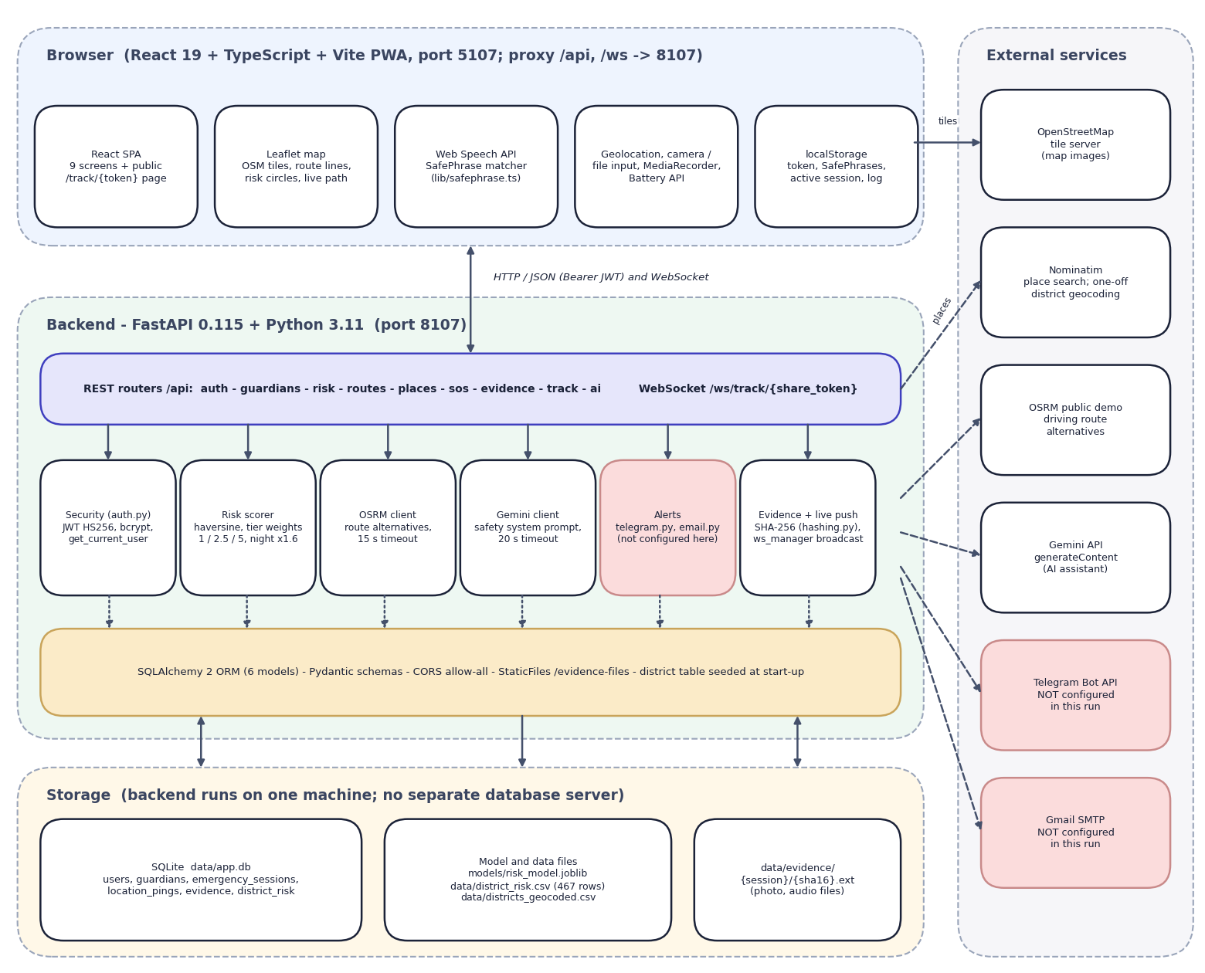
System Architecture
• React 19 + Vite + TypeScript PWA with Leaflet map, Web Speech API, geolocation and MediaRecorder
• FastAPI: 10 routers, 19 REST endpoints + 1 WebSocket, JWT + bcrypt, owner-scoped queries
• Services: OSRM routing, district-risk scorer, Gemini, Telegram, Gmail, SHA-256 hashing
• Storage: SQLite (6 tables), evidence folder, risk_model.joblib and district_risk.csv
• External: OSRM demo server, Nominatim, OSM tiles, Gemini API
Dept. of CSE | Batch A7 | Final Review
10

Slide 11
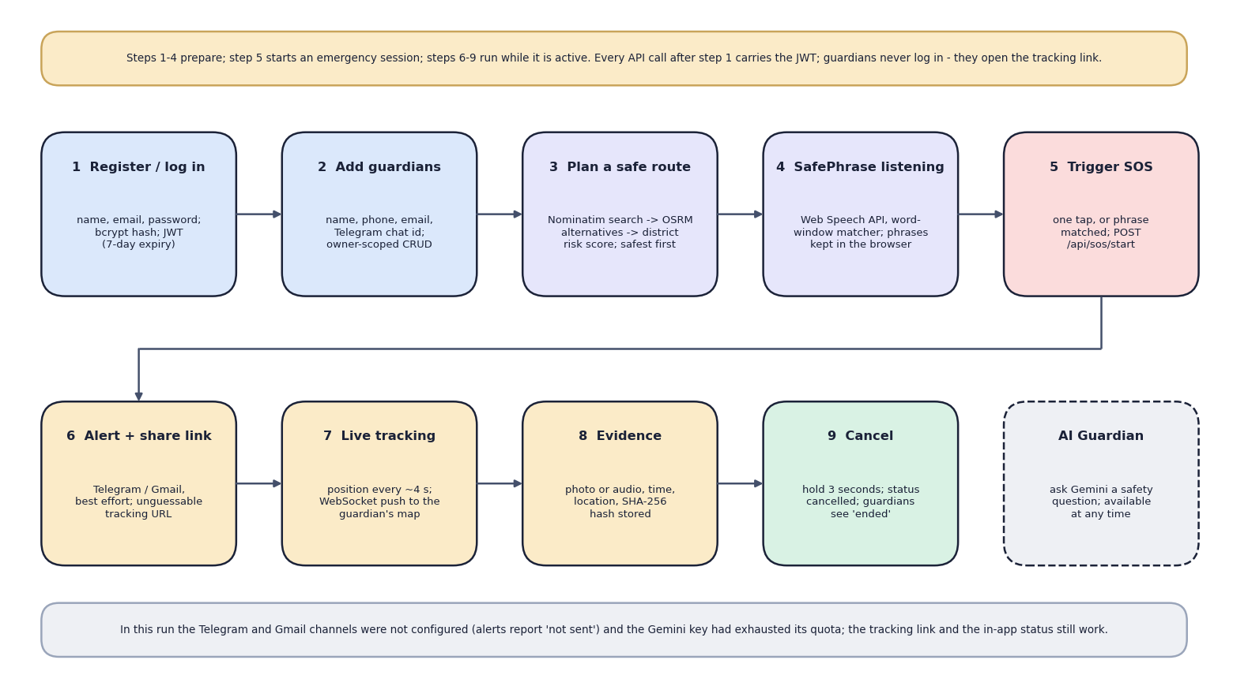
Methodology
End-to-end workflow: register, add guardians, plan a safe route or listen for a SafePhrase, SOS, alert and live tracking, evidence, cancel by 3-second hold
Dept. of CSE | Batch A7 | Final Review
11

Slide 12
Dataset, Features & Model
Crime data: Kaggle 'Crime in India' district file (CC0), 2001-2012: 9,017 rows, 8,597 after dropping TOTAL rows; 35 states/UTs; 827 district pairs; 7 crime columns.
Geocoding: Nominatim resolved 467 of 827 districts (56.5 %); the rest were dropped, not guessed. No geocoded district exists for Uttar Pradesh (77), West Bengal (30), Delhi (24) and 8 other states/UTs.
Feature: one number per district - crimes per reporting year (sum of 7 columns / years reported); a count, not a rate per population.
Model: StandardScaler + K-Means k=3 (random_state 42): tiers low 278 / medium 148 / high 41. Equivalent to two cut-offs at 213.8 and 529.8 crimes a year (100 % agreement).
Route score: every 8th point -> nearest district (haversine) -> weight 1.0 / 2.5 / 5.0 -> mean; night (about 20:30-05:30 IST) x 1.6. No train/test split: unsupervised, no ground truth.
Browser side: SafePhrase = share of phrase words inside a window of spoken words (100 / 85 / 75 / 60 %).
Dept. of CSE | Batch A7 | Final Review
12
Notes:
The 2001-2012 file and the district-level counts are old and coarse; the documents say so. The state-year 2001-2021 file is not used by any feature.

Slide 13
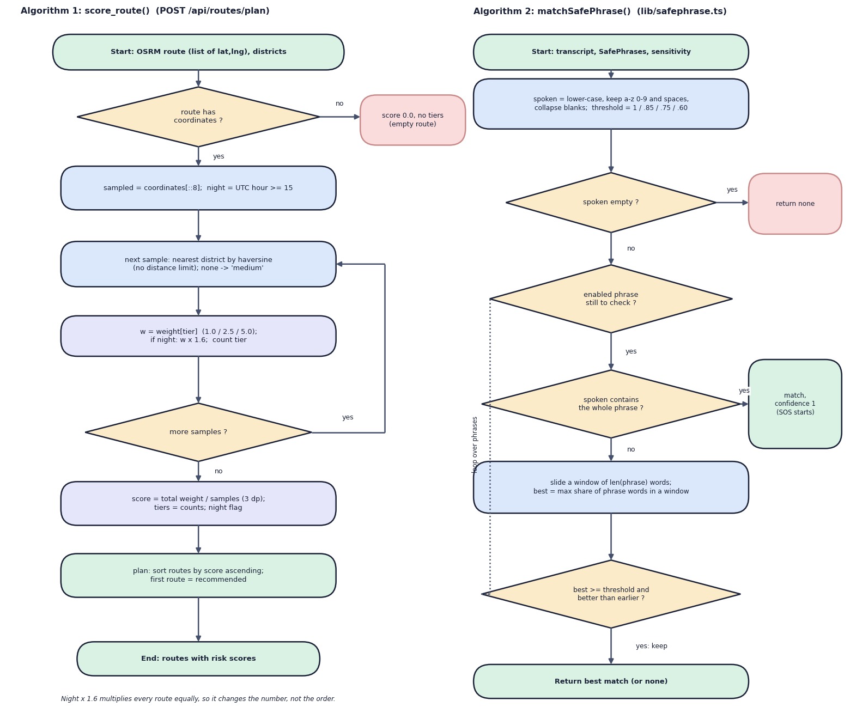
Decision Workflow
• Route scoring: OSRM alternatives -> sample every 8th point -> nearest district -> tier weight -> mean -> x1.6 at night -> sort -> first is recommended
• SafePhrase: normalise transcript -> exact substring hit, else best word share in a sliding window -> compare with the sensitivity threshold -> start SOS
• The night factor scales every route equally, so it never changes which route is recommended (16 of 16 test pairs)
Dept. of CSE | Batch A7 | Final Review
13

Slide 14
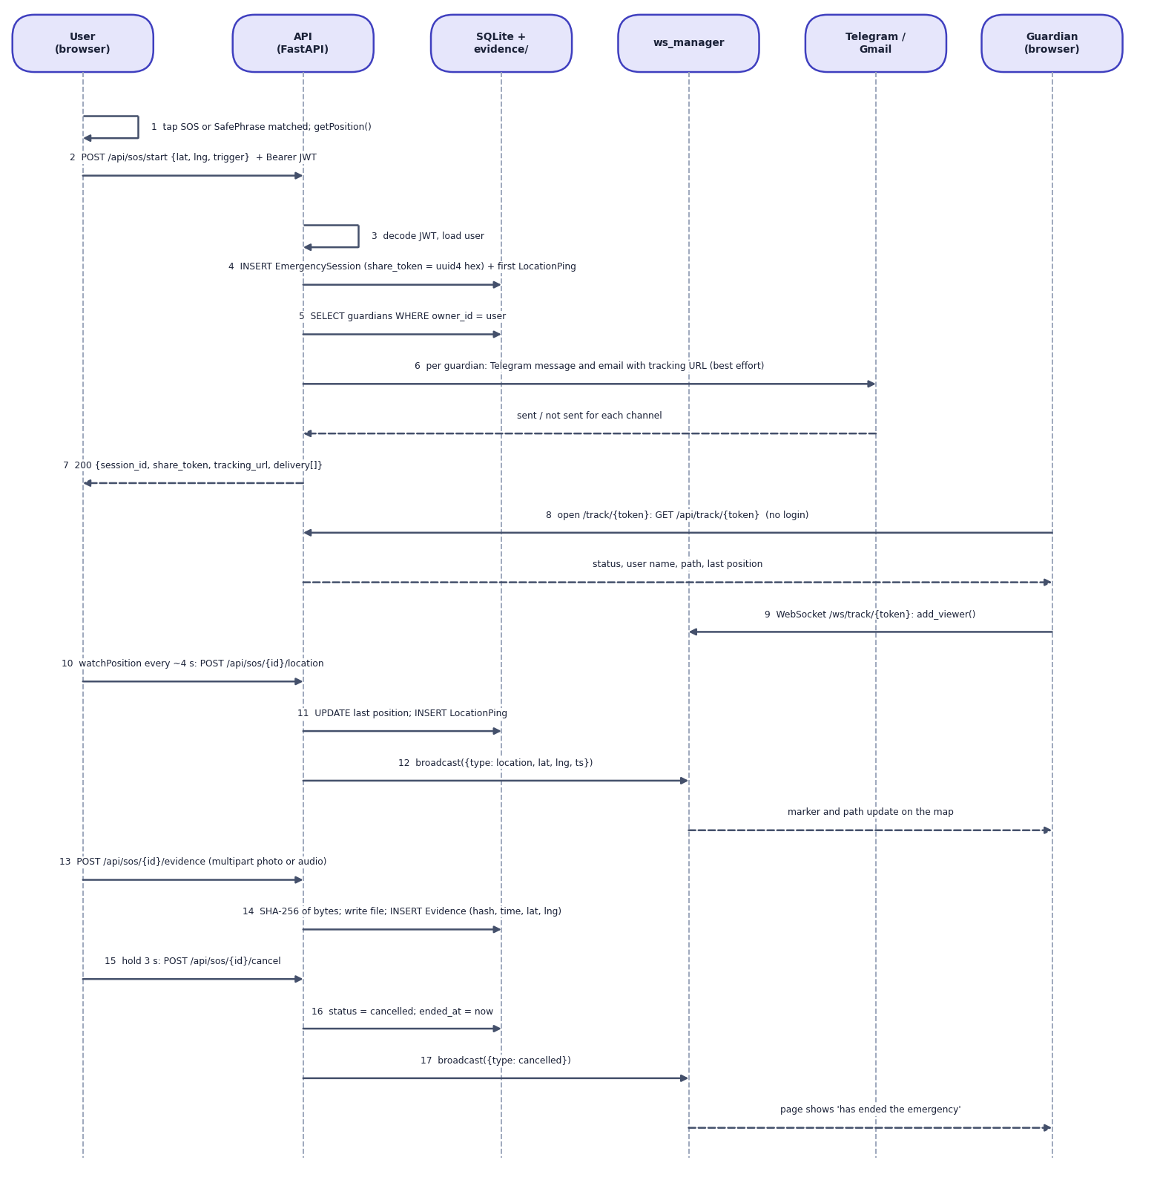
User–System Interaction
• The browser gets its position and calls POST /api/sos/start; the API stores the session, notifies each guardian and returns the tracking link
• While active, the device pushes its position about every 4 s; the API stores the ping and broadcasts it over the WebSocket
• Evidence uploads are hashed on the server; cancel is a 3-second hold and the guardian page changes to 'ended'
Dept. of CSE | Batch A7 | Final Review
14

Slide 15
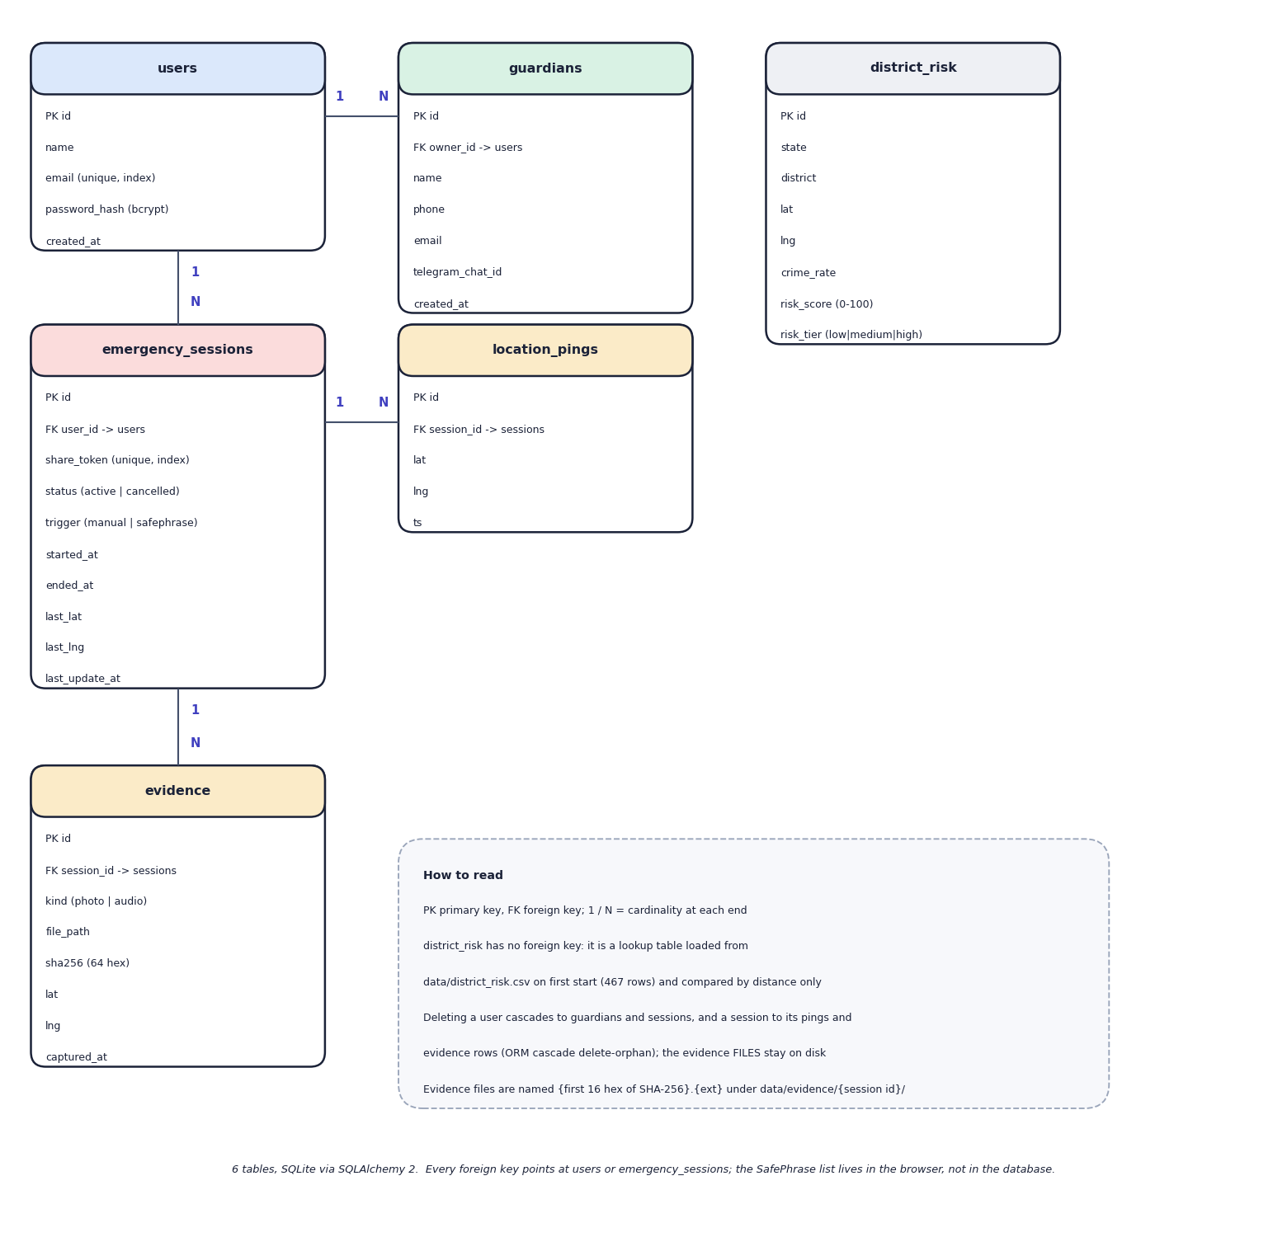
Database Design
• 6 SQLite tables: users, guardians, emergency_sessions, location_pings, evidence, district_risk
• A user owns guardians and sessions; a session holds many pings and evidence rows
• share_token is unique per session: the only key a guardian ever holds
• district_risk is loaded from data/district_risk.csv at start-up (467 rows)
Dept. of CSE | Batch A7 | Final Review
15

Slide 16
Implementation Highlights
Module | Implementation
Area risk | pandas + scikit-learn: per-district crimes per year, StandardScaler, K-Means k=3, risk_score 0-100, joblib model, CSV loaded into SQLite
Safe route | httpx call to OSRM (alternatives, full geometry), haversine nearest district in pure Python, weighted mean, sort; about 300 ms per route to score
SOS and tracking | FastAPI async routes, per-session share_token, WebSocket manager that broadcasts location and cancel messages to viewers
Evidence | multipart upload, server-side SHA-256, file saved as <hash prefix>.<ext>, row with kind, location and time
SafePhrase | Web Speech API in continuous mode, word-window matcher in TypeScript, phrases and fingerprints kept in the browser
Security and UI | bcrypt, JWT (7 days), owner checks on every query; React 19, Tailwind 4, Leaflet, installable PWA; 51 backend tests
Dept. of CSE | Batch A7 | Final Review
16

Slide 17
Results – Measured Performance
Measure | Result | Note
Cluster quality, k=3, 467 districts | silhouette 0.580; Davies-Bouldin 0.531 | Calinski-Harabasz 1155.4; one feature, no held-out set
Tiers low / medium / high | 278 / 148 / 41 | mean 97.8 / 327.9 / 720.9 crimes a year
Stability over 30 random inits | ARI min 0.659, mean 0.790 | districts near the cut-offs move
Geocoding coverage | 467 of 827 (56.5 %) | nearest district to 40 cities: median 8.1 km, max 231.3 km
16 real city pairs routed | 10 had 2 routes; safest = fastest in 11 | day and night order identical in 16 of 16
SafePhrase matcher (default level) | recall 54.2 %; 0 false triggers | 24 written transcripts; no audio
WebSocket push to guardian | mean 15.4 ms (p95 17.2) | localhost, 30 trials
Automated tests | 51 passed, 6 expected-fail | the 6 document real defects
Cluster indices measure separation of one number, not safety; there is no ground truth for risk. Alert delivery and the Gemini assistant could not be measured.
Dept. of CSE | Batch A7 | Final Review
17
Notes:
All values from experiments/study/*.json, last run. There is no accuracy figure for the risk model because there are no labels.

Slide 18
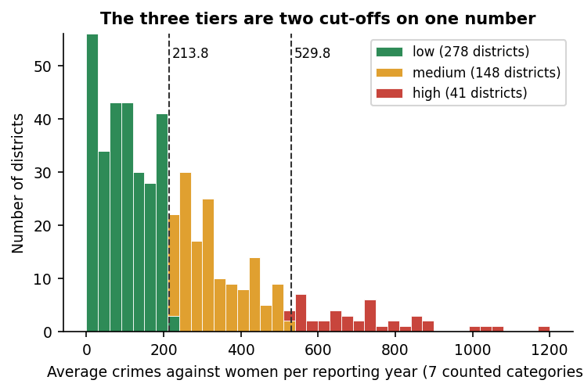
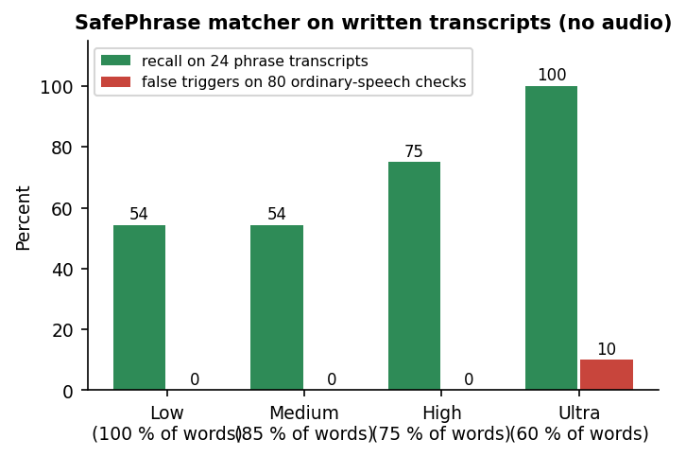
Tier Results & SafePhrase Trade-off
Tier-by-tier result: 278 low, 148 medium, 41 high districts - two cut-offs on one number
SafePhrase matcher: recall 54 % (Medium) to 100 % (Ultra); false triggers 0 % to 10 %
Dept. of CSE | Batch A7 | Final Review
18
Notes:
There is no classifier confusion matrix because the area-risk model is unsupervised. Left: how districts fall into tiers. Right: the matcher's recall against false triggers on written transcripts.

Slide 19
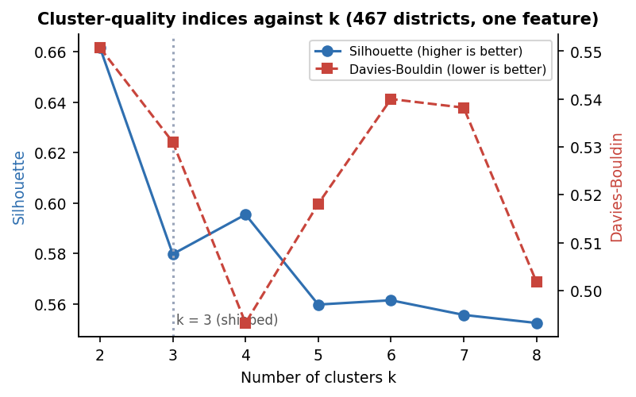
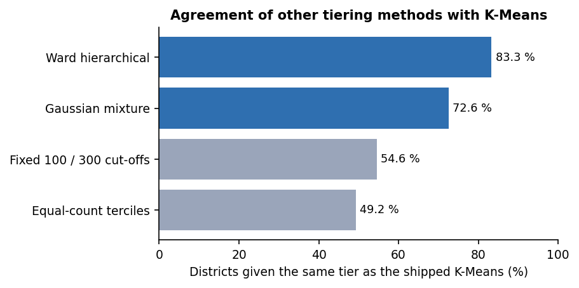
Parameter Analysis: k and Other Tierings
k sweep: k=2 has the highest silhouette, k=4 beats k=3 on both indices - k=3 is a three-tier UI choice
Other methods agree with K-Means on 83 % (Ward) to 49 % (terciles) of districts
Dept. of CSE | Batch A7 | Final Review
19
Notes:
Tier weights 1/2.5/5 were tested against 1/2/3 and 1/3/9: the recommended route changed in 0 of 10 pairs with alternatives; changing the sampling step changed it in 1 of 10.

Slide 20
Performance & Testing
Measurement | Result (median / 95th percentile)
API latency on 127.0.0.1 | health 2.1 / 4.1 ms; risk areas 31.1 / 81.3; location push 14.7 / 20.4; SOS start 34.2 / 137.4; evidence 1 MB 18.4 / 23.8, 5 MB 61.0 / 117.9; login (bcrypt) 279 / 315
Live route plan | 1.59 s median / 2.00 s p95 including the OSRM call; scoring one route about 300 ms
WebSocket push | 13.2 ms median with 1 viewer; mean 14.6 ms to 5 viewers
Automated tests | 51 passed, 6 expected-fail, 0 failed (57 tests, offline): auth, guardians, routes, SOS, evidence, WebSocket, scorer
Defects found | Gemini timeout gives HTTP 500; latitude 999 accepted; any WebSocket token accepted; no upload size limit; .html upload served as text/html; evidence files readable without login; no login lockout
Machine | Intel Core i5-12500, 15.7 GB RAM, no GPU; K-Means fits in under a second
Not measured | real alert delivery, Gemini answers, real GPS / microphone, load beyond 5 viewers, user study
Dept. of CSE | Batch A7 | Final Review
20
Notes:
Latencies are from the last run of scripts/measure_api.py on a live server; single client, sequential calls.

Slide 21
Comparison with Base Paper (context only – different datasets)
System | Task and data | Method | Reported / measured | Extras | Comparable?
Base paper [1] | District safe zones; seven data.gov.in datasets, 2013 crimes, many features | K-Means, GMM; Pearson, Spearman; cab alerts (designed) | k=3: DB 0.970, CH 221.0, silhouette 0.416; anticipated outcomes | Heatmaps, cab-vendor integration | -
Thawale et al. [6] | Android app with ESP32-CAM; historical crime data, test locations | Zone classification, GPS, Firebase | Reports 93 % zone accuracy; SOS in 4-6 s | Camera evidence, extra hardware | No: other task and data
SHEGUARD | Web app; 2001-2012 district counts, 467 geocoded districts, one feature | K-Means k=3 on one feature; OSRM route scoring; SafePhrase; WebSocket tracking | DB 0.531, CH 1155.4, silhouette 0.580; 51 tests pass; push 15 ms | SafePhrase, SOS, live link, SHA-256 evidence, assistant | No: different data and feature count
Different data, features and tasks: no numeric head-to-head is possible. Indices on one feature are not comparable with indices on many features.
Dept. of CSE | Batch A7 | Final Review
21
Notes:
State plainly: no claim that SHEGUARD is better than either paper; the comparison is of scope and approach. The base paper's results are anticipated outcomes.

Slide 22
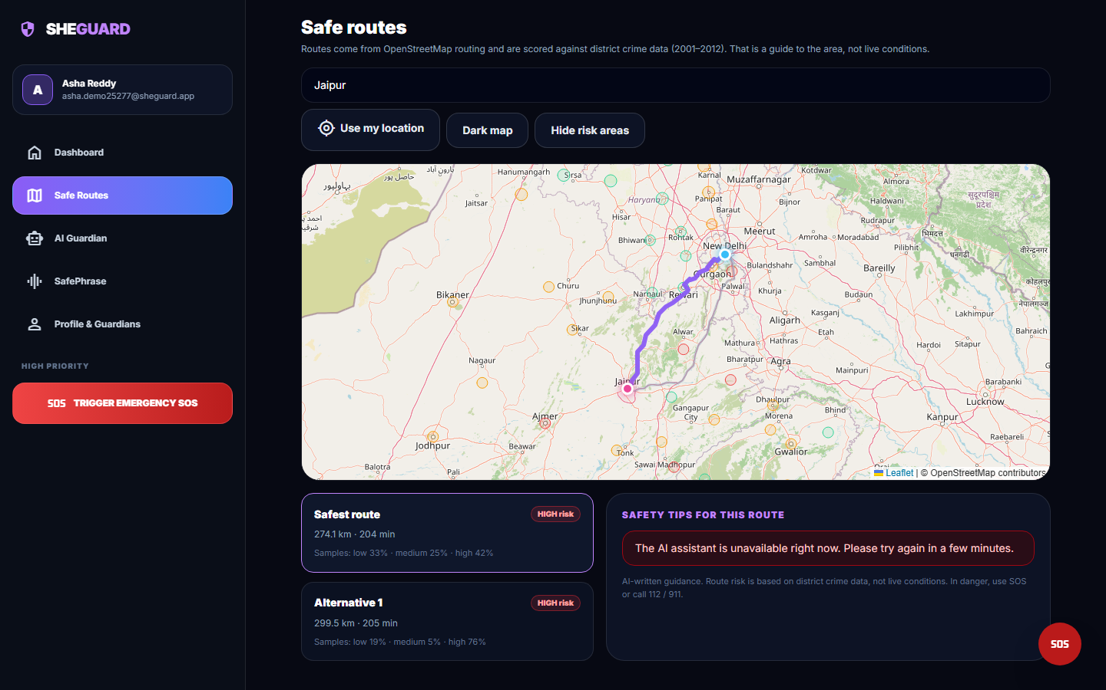
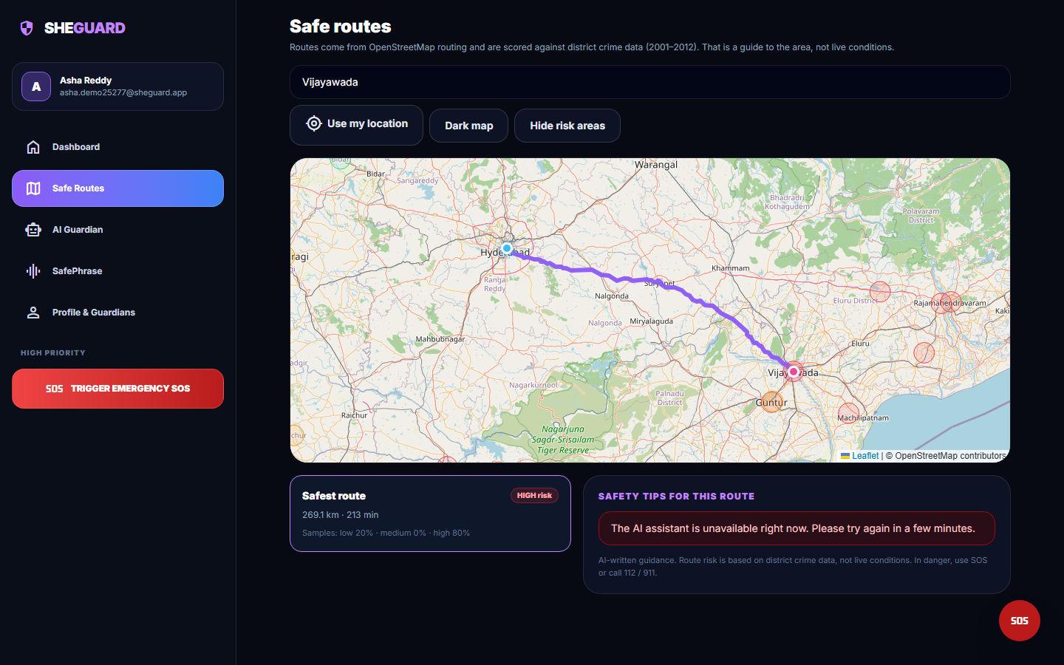
Output – Safe Route Planning
Delhi to Jaipur: two real OSRM routes (274.1 and 299.5 km), both HIGH risk, with district risk circles
Hyderabad to Vijayawada: one route, 269.1 km, HIGH (20 / 0 / 80 % low / medium / high samples)
Dept. of CSE | Batch A7 | Final Review
22

Slide 23
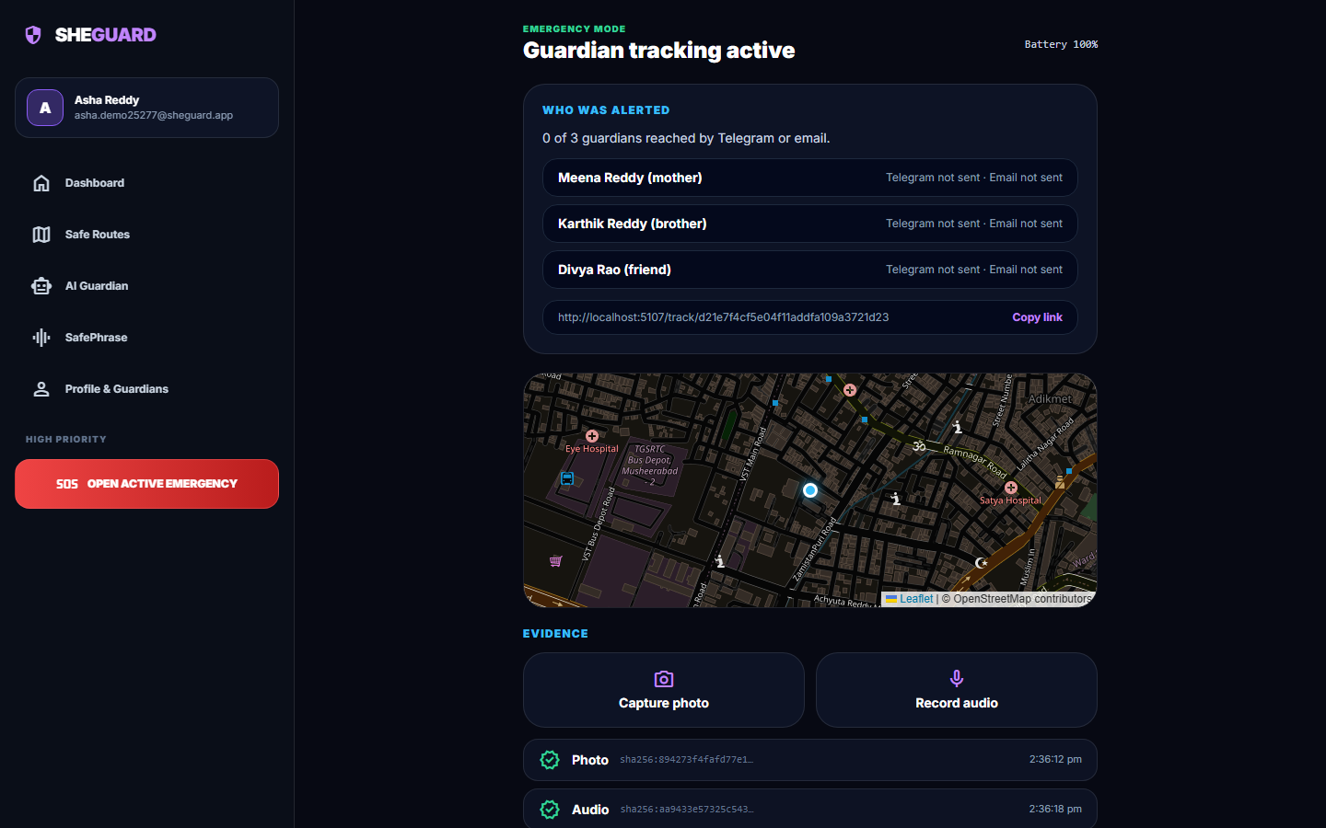
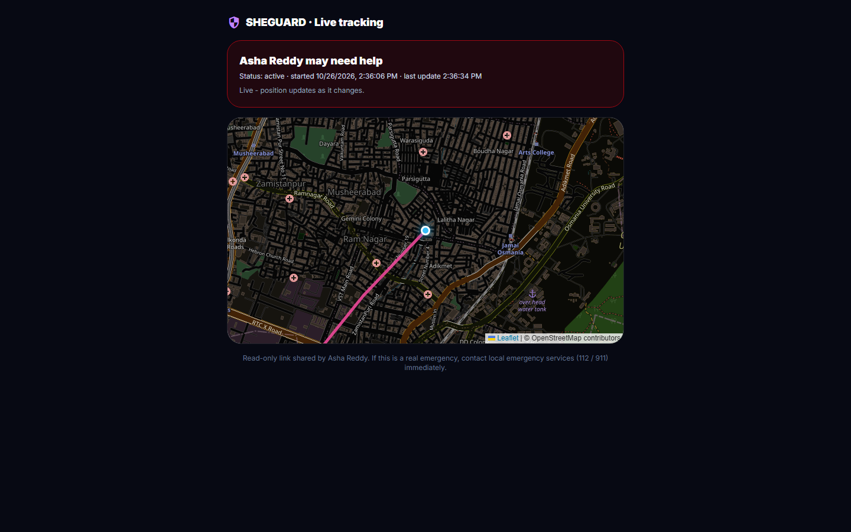
Output – Emergency, Evidence and Guardian View
Active SOS: tracking link, '0 of 3 guardians reached' (no channel configured), photo and audio with SHA-256
Guardian's page with no login: live position and path over WebSocket
Dept. of CSE | Batch A7 | Final Review
23

Slide 24
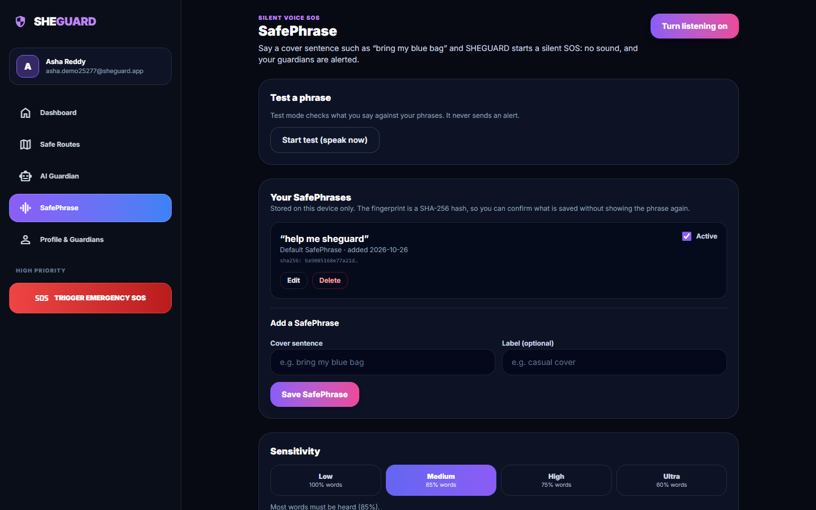
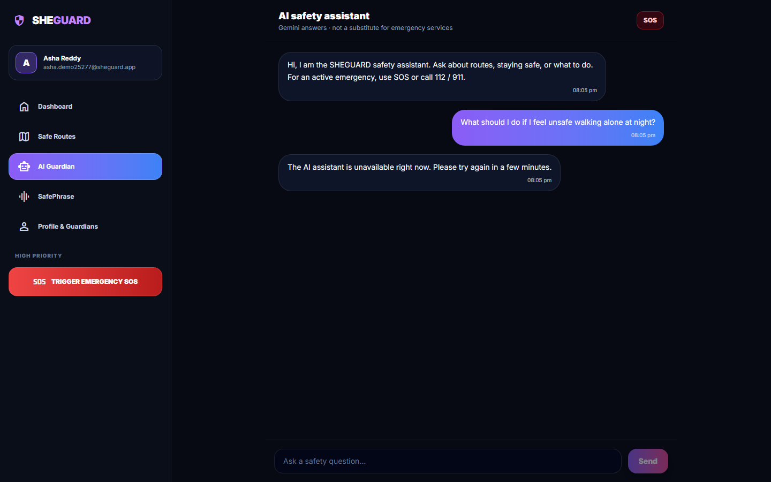
Output – SafePhrase and AI Assistant
SafePhrase settings: stored phrase, SHA-256 fingerprint, four sensitivity levels (default Medium)
AI assistant: the Gemini key's quota was exhausted, so the app shows its 'unavailable' message
Dept. of CSE | Batch A7 | Final Review
24

Slide 25
Conclusion
Built SHEGUARD: a working web platform with safe-route scoring, SafePhrase and one-tap SOS, live guardian tracking, SHA-256 evidence and an assistant.
Measured: silhouette 0.580 and Davies-Bouldin 0.531 for the risk tiers; 51 tests pass; WebSocket push about 15 ms; SafePhrase recall 54 % at the default level with no false trigger.
Key finding: the risk 'model' is two cut-offs on one old, un-normalised number; the night factor never changes a recommendation; major cities lie far from any district (Hyderabad 149 km).
Limits: Telegram / Gmail alerts and the Gemini answer were not demonstrated; evidence files are publicly retrievable; no field trial; built as a React PWA, not Flutter + Supabase.
Objectives: live tracking met; route, activation, evidence and access control partly met; assistant implemented but not demonstrated.
Dept. of CSE | Batch A7 | Final Review
25

Slide 26
Future Scope
Replace the one-feature tiers with population-normalised, multi-feature risk (police, infrastructure, recent years) and geocode the missing states.
Make the night factor change the ranking, cap the nearest-district distance and warn where there is no data.
Configure and test real Telegram / SMS / email delivery; move sending off the event loop; add shake or power-button triggers.
Fix the defects: Gemini timeout handling, input ranges, authenticated evidence files, upload limits, login throttling, WebSocket token check.
Field trial with real users on phones, a native or Flutter client, hosted database with row-level security, HTTPS and load testing.
Dept. of CSE | Batch A7 | Final Review
26

Slide 27
References
[1] K. Agrawal, A. Srivastava, K. Sharma, S. K. Satapathy, S.-B. Cho, S. Mishra, A. Chowdhury, and A. Pal, "SafeRoutes: Charting a secure path - A holistic approach to women's safety through advanced clustering and GPS integration," IEEE Access, vol. 12, pp. 166368-166378, 2024, doi: 10.1109/ACCESS.2024.3488784.
[2] M. S. Farooq, A. Masooma, U. Omer, R. Tehseen, S. A. M. Gilani, and Z. Atal, "The role of IoT in woman's safety: A systematic literature review," IEEE Access, vol. 11, pp. 69807-69825, 2023, doi: 10.1109/ACCESS.2023.3252903.
[3] "A mobile-based women safety application with real-time emergency alert and location tracking," Int. Scientific J. of Engineering and Management, 2026 (listed in the batch literature survey; not independently retrieved).
[4] "Shake-to-Alert: An automated mobile safety application for women with emergency notification via motion detection," in Proc. Int. Conf. IT Innovation and Knowledge Discovery (ITIKD), 2025 (listed in the batch literature survey; not independently retrieved).
[5] "Cross-platform women safety mobile application with real-time alert system and GPS tracking," in Proc. Int. Conf. Electronic Systems and Intelligent Computing (ICESIC), 2026 (listed in the batch literature survey; not independently retrieved).
[6] A. Thawale, H. Pal, M. Thakur, M. A. Bhave, P. Asokan, and M. Amnerkar, "Women safety mobile application using ESP32 camera and real-time crime data analysis," Int. J. Electrical, Electronics and Computer Systems, 2025.
[7] R. Shinde, H. Nerkar, T. Kad, V. Gayake, and K. Chobe, "SafeGuard - Safe route recommendation system," Int. Research J. Modernization in Engineering, Technology and Science (IRJMETS), vol. 7, no. 3, Mar. 2025.
[8] Sangeeta, M. S. Prajwal, D. P. Dogra, K. V. Thakare, H. Jung, I.-J. Kim, and H. Choi, "ExtrAnom: A VAD benchmark emphasizing the need for women's safety in society," arXiv:2605.25806, 2026.
[9] J. MacQueen, "Some methods for classification and analysis of multivariate observations," in Proc. 5th Berkeley Symp. Mathematical Statistics and Probability, vol. 1, 1967, pp. 281-297.
[10] S. P. Lloyd, "Least squares quantization in PCM," IEEE Trans. Information Theory, vol. IT-28, no. 2, pp. 129-137, 1982.
[11] P. J. Rousseeuw, "Silhouettes: A graphical aid to the interpretation and validation of cluster analysis," J. Computational and Applied Mathematics, vol. 20, pp. 53-65, 1987.
[12] D. L. Davies and D. W. Bouldin, "A cluster separation measure," IEEE Trans. Pattern Analysis and Machine Intelligence, vol. PAMI-1, no. 2, pp. 224-227, 1979.
[13] T. Calinski and J. Harabasz, "A dendrite method for cluster analysis," Communications in Statistics, vol. 3, no. 1, pp. 1-27, 1974.
[14] A. P. Dempster, N. M. Laird, and D. B. Rubin, "Maximum likelihood from incomplete data via the EM algorithm," J. Royal Statistical Society: Series B, vol. 39, no. 1, pp. 1-38, 1977.
[15] J. H. Ward, "Hierarchical grouping to optimize an objective function," J. American Statistical Association, vol. 58, no. 301, pp. 236-244, 1963.
[16] F. Pedregosa et al., "Scikit-learn: Machine learning in Python," J. Machine Learning Research, vol. 12, pp. 2825-2830, 2011.
[17] D. Luxen and C. Vetter, "Real-time routing with OpenStreetMap data," in Proc. 19th ACM SIGSPATIAL Int. Conf. Advances in Geographic Information Systems, 2011, pp. 513-516.
[18] M. Haklay and P. Weber, "OpenStreetMap: User-generated street maps," IEEE Pervasive Computing, vol. 7, no. 4, pp. 12-18, 2008.
[19] M. Jones, J. Bradley, and N. Sakimura, "JSON Web Token (JWT)," RFC 7519, Internet Engineering Task Force, May 2015.
[20] I. Fette and A. Melnikov, "The WebSocket protocol," RFC 6455, Internet Engineering Task Force, Dec. 2011.
[21] N. Provos and D. Mazieres, "A future-adaptable password scheme," in Proc. USENIX Annual Technical Conf., 1999, pp. 81-91.
[22] "Secure hash standard (SHS)," Federal Information Processing Standards Publication FIPS PUB 180-4, National Institute of Standards and Technology, Aug. 2015.
[23] rajanand, "Crime in India," Kaggle dataset (district-wise crimes against women, 2001-2012), CC0 public domain. [Online]. Available: https://www.kaggle.com/datasets/rajanand/crime-in-india
[24] balajivaraprasad, "Crimes against women in India 2001-2021," Kaggle dataset, CC0 public domain. [Online]. Available: https://www.kaggle.com/datasets/balajivaraprasad/crimes-against-women-in-india-2001-2021
[25] "Web Speech API," W3C Community Group specification. [Online]. Available: https://webaudio.github.io/web-speech-api/
[26] Google, "Gemini API: generateContent," Google AI for Developers documentation. [Online]. Available: https://ai.google.dev/gemini-api/docs
[27] S. Ramirez, "FastAPI," software documentation. [Online]. Available: https://fastapi.tiangolo.com
[28] V. Agafonkin, "Leaflet: an open-source JavaScript library for interactive maps." [Online]. Available: https://leafletjs.com
[29] Nominatim contributors, "Nominatim: open-source geocoding with OpenStreetMap data" and usage policy. [Online]. Available: https://nominatim.org
[30] Telegram, "Telegram Bot API." [Online]. Available: https://core.telegram.org/bots/api
Dept. of CSE | Batch A7 | Final Review
27

Slide 28
THANK YOU
Questions & Suggestions
Dept. of CSE | Batch A7 | Final Review
28
Notes:
Thank you. Questions are welcome.

