Slide 1
Fake News Detection System Using Feature Based Optimised MSVM Classification
REVIEW 2 · DESIGN, METHODOLOGY AND PROGRESS
A light PCA + Firefly + multi-class SVM pipeline with a PARTIALLY TRUE class, behind a FastAPI service and a React interface
Presented by
Under the guidance of
Neela Mojes 23K91A05H1
Noor Saniya 23K91A05H4
Malkajgiri Akshitha 23K91A05E2
Maravajhala Radha Sri Aashritha 23K91A05E7
K Rajasekhar Rao, [DESIGNATION]
Department of Computer Science and Engineering
[COLLEGE NAME] · Batch C6 (CSE-C) · [ACADEMIC YEAR]
Notes:
This review shows how the system is designed and built, what is implemented, the first measured results on real data, and the open items.

Slide 2
Contents
01
02
03
Recap and architecture
Methodology and dataset
Preprocessing and model
04
05
06
Training and decision logic
Data flow, database and UML
Technology stack
07
08
09
Implementation progress and results
Output screens and testing
Challenges and next steps
Notes:
Agenda for the design and progress review.

Slide 3
Recap: problem and proposed system
!
Problem
i
Proposed system
B
Base paper link
Fabricated news spreads faster than fact-checks, and high-dimensional text features make classifiers slow and prone to overfitting. Default SVM parameters are rarely optimal, and most detectors have only two classes.
TF-IDF and 25 stylometric features are reduced by PCA. The Firefly algorithm picks the PCA components and the SVM parameters. An RBF multi-class SVM returns REAL, PARTIALLY TRUE or FAKE with a confidence.
Saad et al. (2026) combine class weighting with transformer embeddings for Arabic, binary detection. We keep class weighting and baselines but use a cheap classical pipeline, English text, three classes and a CPU. Numbers are not comparable.
Notes:
One-minute recap of Review 1: the gap between heavy neural detectors and a light, tunable pipeline, and how the base paper relates (motivation and class weighting only).

Slide 4
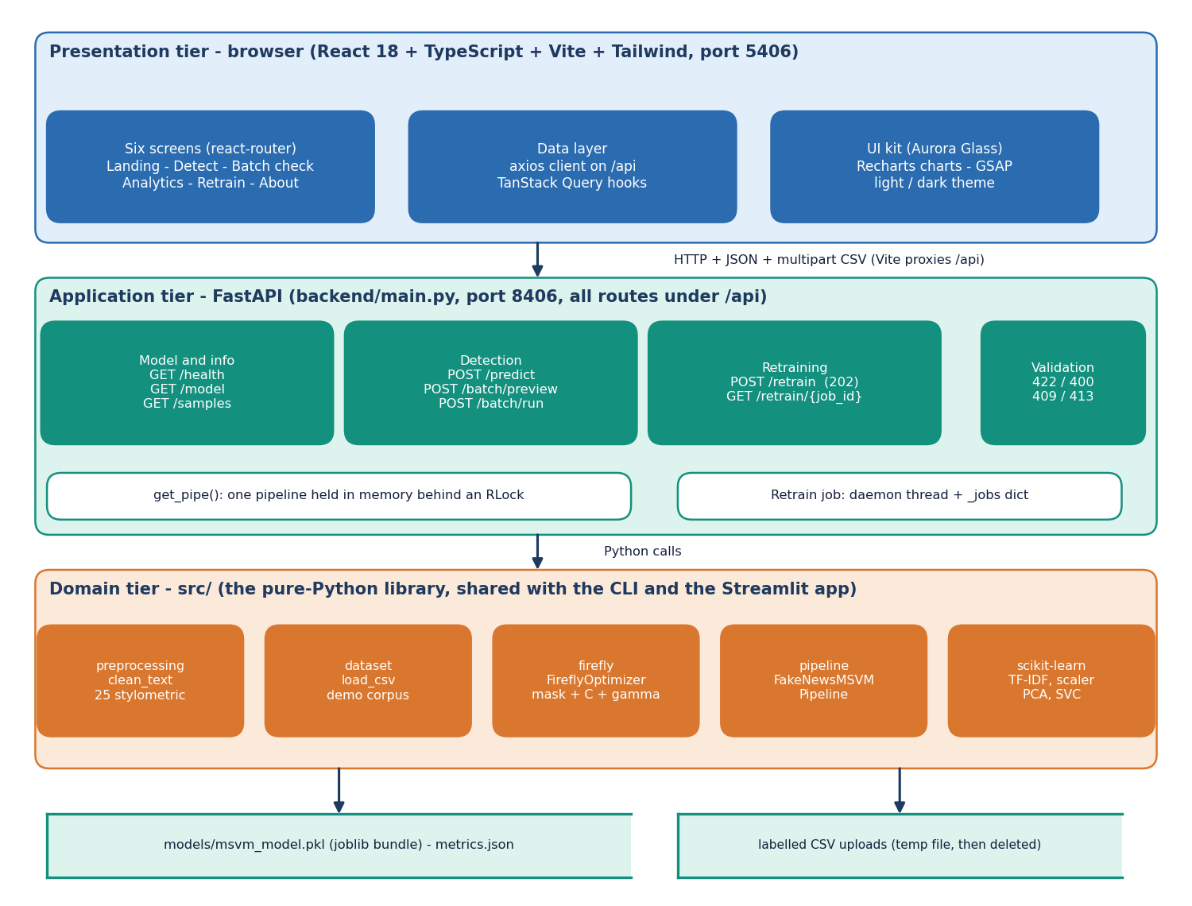
System architecture
Three tiers
Presentation: React 18 app (TruthGlow, port 5406) with six screens.
Application: FastAPI (port 8406), 8 endpoints under /api, one model held in memory.
Domain: the pure-Python library src/ (preprocessing, dataset, firefly, pipeline), shared with the CLI and the Streamlit app.
Storage: one joblib model bundle; no SQL database.
Notes:
The FastAPI layer calls the same library functions as the Streamlit app and the command line, so all three front ends use one pipeline and one model file.

Slide 5
Methodology: end-to-end workflow
Labelled text
Clean + TF-IDF + style
Scale + PCA
80/20 split
Firefly search
RBF MSVM
Evaluate + save
One fitted bundle
Class weighting
Reproducible
Vectorizer, scaler, PCA, component mask, C, gamma and classifier are saved together, so training and serving use identical transforms.
Class weights are balanced in the Firefly fitness and in the final SVM, as the base paper does for its imbalance.
scripts/run_experiments.py runs the real-data study; its JSON feeds every figure and number in the documents.
Notes:
The same workflow runs from train.py, the Streamlit app and the Retrain screen. The experiment script reuses the product's own pipeline class.

Slide 6
Dataset: LIAR2 and the demo corpus
18,369
2,297
2,296
3,000
training statements
validation statements
test statements
training subsample per run (3 seeds)
LIAR2 label | Project class | Statements (whole dataset)
true, mostly-true | REAL | 2,585 + 3,429
half-true | PARTIALLY TRUE | 3,709
barely-true, false, pants-on-fire | FAKE | 3,603 + 6,605 + 3,031
Test split: 602 REAL, 371 PARTIALLY TRUE, 1323 FAKE. Always answering FAKE scores accuracy 0.576 but macro-F1 0.244.
Only the statement text is used; speaker, justification and counts are left out because they leak the label.
Source: Hugging Face chengxuphd/liar2, Apache-2.0 [4].
Shipped demo corpus. 750 synthetic template sentences (250 per class) train the model that ships with the project. Its 1.000 scores only check the pipeline: the same model scores accuracy 0.192 and macro-F1 0.155 on real LIAR2 statements.
Notes:
LIAR2 is 18,369 / 2,297 / 2,296 PolitiFact statements with six labels, mapped to the project's three classes. Training uses a stratified 3,000-statement subsample because the Firefly search needs thousands of SVM fits on a CPU. The demo corpus is synthetic, so its perfect scores are not evidence of accuracy on real news.

Slide 7
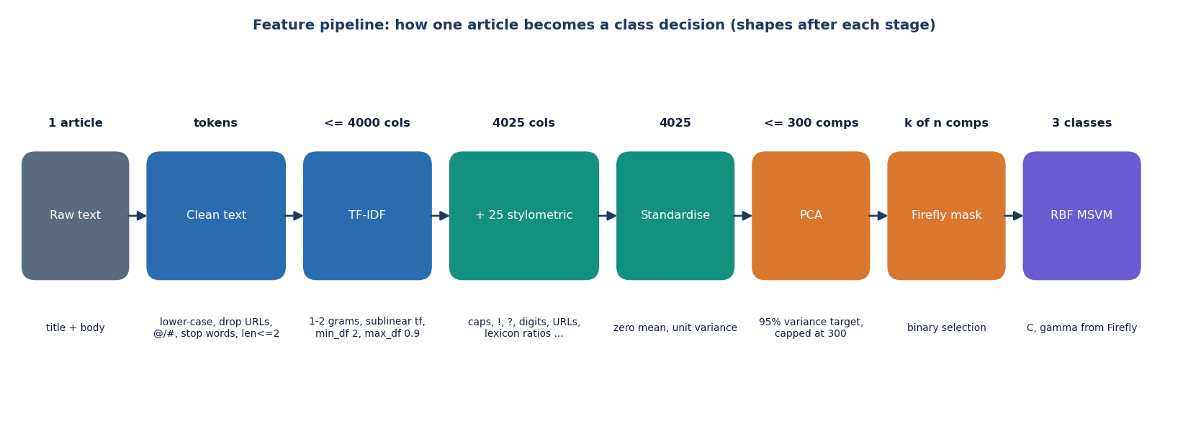
Data preprocessing and feature extraction
Cleaning
Lower-case, remove URLs, @mentions and #tags, keep letters only.
Remove stop words and tokens of 2 characters or fewer.
No stemming is implemented (objective 2 lists it).
Features
TF-IDF, 1-2 grams, sublinear tf, min_df 2, max_df 0.9, at most 4,000 columns.
25 stylometric signals: capitals, ! and ?, digits, URLs, lexicon ratios, word lengths.
StandardScaler, then PCA (95 % variance target, cap 300).
Notes:
The cleaning and the 25 stylometric features are in src/preprocessing.py. The scaler and PCA are fitted on the training subsample only and saved with the model.

Slide 8
Model: PCA, Firefly selection and MSVM
4,025
300
148
3
TF-IDF + stylometric features
PCA components (29.3% variance kept)
components kept by Firefly (mean of 3 seeds)
classes (one-vs-rest shape, RBF kernel)
Stage | What it does
PCA | Standardised features to at most 300 orthogonal components; the cap, not the 95 % target, is what binds on real text
Firefly | Chooses a component mask plus C in [0.1, 1000] and gamma in [1e-4, 10]; fitness is 3-fold CV macro-F1 minus 0.02 x selected share
MSVM | SVC with RBF kernel, balanced class weights, one-vs-rest decision shape, probability=True (Platt scaling)
A finding: with a 300-component cap PCA keeps only about 29 % of the variance of the standardised real-text features.
Notes:
The model is three fitted stages. The 25-feature stylometric block and the TF-IDF block are concatenated before scaling. Firefly's vector is 300 mask logits plus log10 C and log10 gamma.

Slide 9
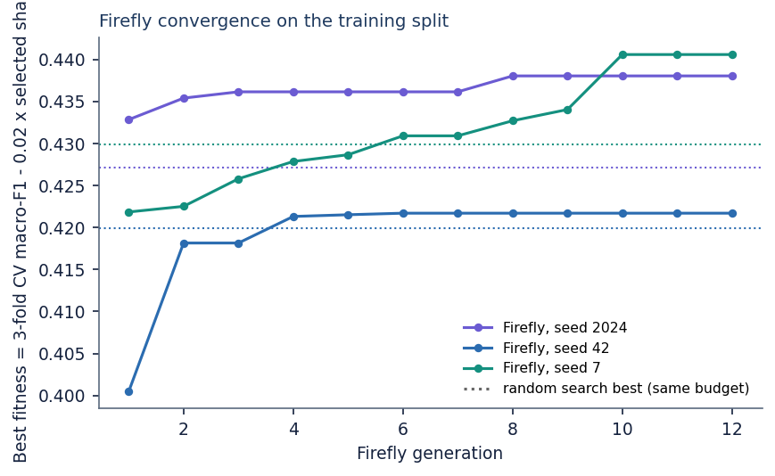
Training configuration
Setting | Value
Firefly | 10 fireflies, 12 generations, alpha 0.2 (decay 0.97), beta0 1, gamma 1; about 550 fitness evaluations
Fitness | 3-fold stratified CV macro-F1 minus 0.02 x (selected / total components)
Split | 80/20 stratified inside the 3,000-statement subsample; scored on the official validation and test splits
Final SVM | RBF, class_weight balanced, probability=True
Seeds | 7, 42, 2024; results are mean ± std
Hardware | CPU only, Intel Core i5-12500 (6 cores, 12 threads); one full fit takes 504 ± 75 s
Convergence: best fitness reaches 0.433 ± 0.010 against 0.426 ± 0.005 for random search with the same number of evaluations, most of the gain comes in the first generations, though one seed was still improving at generation 10. Firefly's hyper-parameters were not tuned.
Notes:
Settings come from src/firefly.py and src/pipeline.py. Training time is dominated by the Firefly search; random search with the same budget takes about as long.

Slide 10
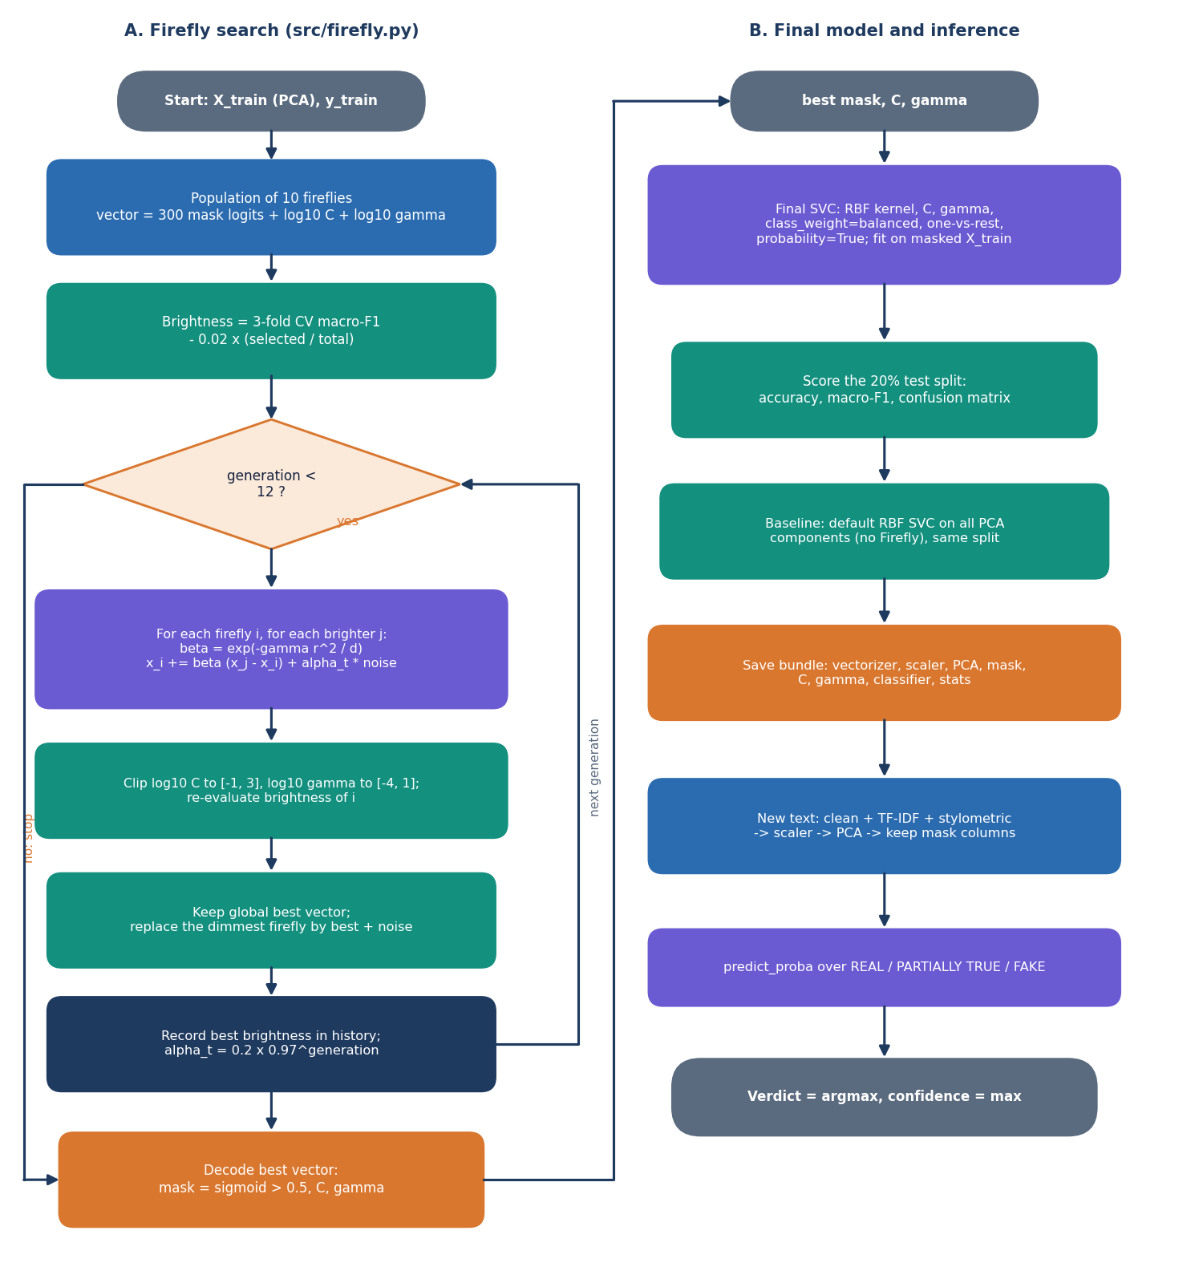
Decision logic: Firefly search and the verdict
Move. A dimmer firefly moves towards a brighter one with attraction exp(-gamma r² / d) plus decaying random noise.
Decode. Mask = sigmoid(logits) > 0.5; log10 C and log10 gamma are clipped to their ranges.
Verdict. The label is SVC.predict; REAL / PARTIALLY TRUE / FAKE probabilities come from Platt scaling.
Known mismatch. On 48.8% of test statements the verdict is not the highest-probability class, so the displayed confidence can belong to another class. Reported, not hidden.
Notes:
Left: the Firefly search and the final model. The mismatch arises because predict uses the class-weighted decision function while Platt scaling is fitted without that weighting; the demo model never showed it.

Slide 11
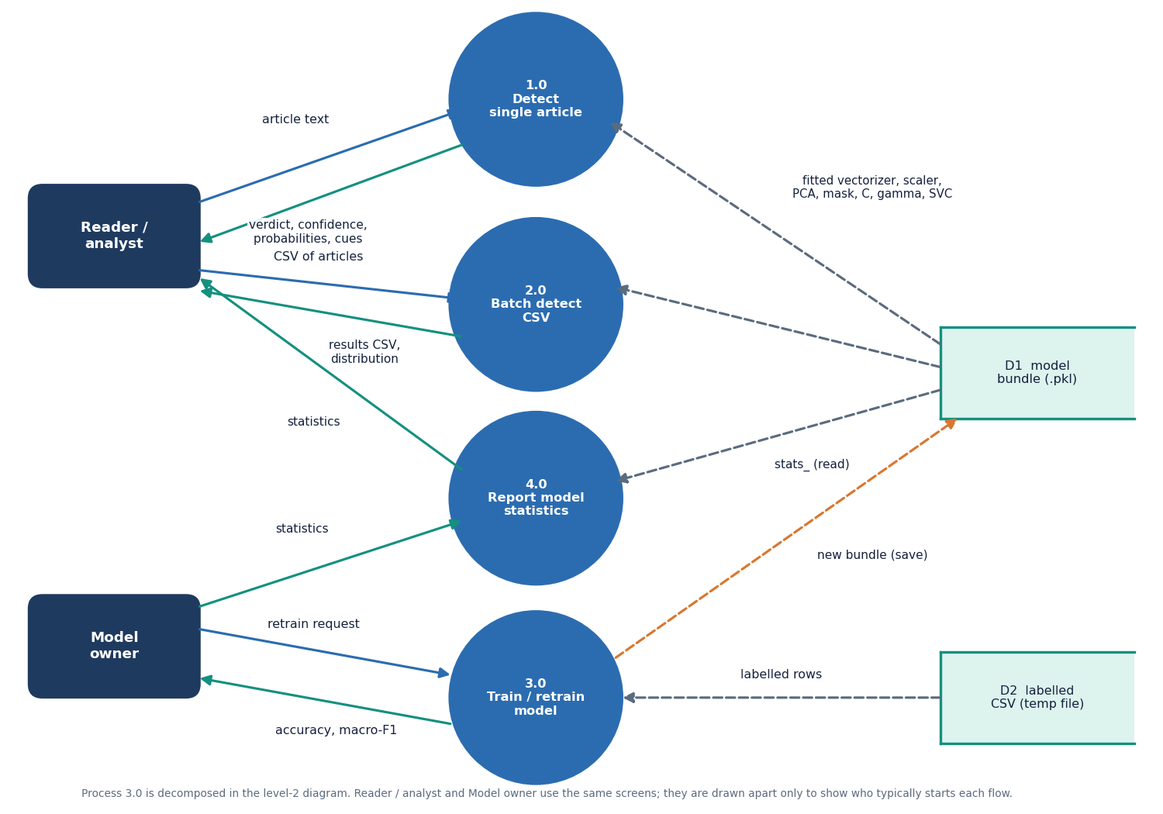
Data flow and modules
Module | Role
preprocessing.py | clean text, 25 style features
dataset.py | load CSV, demo corpus
firefly.py | mask + C + gamma search
pipeline.py | fit, predict, save, load
backend/main.py | FastAPI routes, retrain job
frontend/src | React screens and charts
train.py, predict.py | command-line entry points
app.py | Streamlit front end
Notes:
Level-1 data flow: detect, batch detect, train/retrain and statistics, with the model bundle and the temporary CSV as stores.

Slide 12
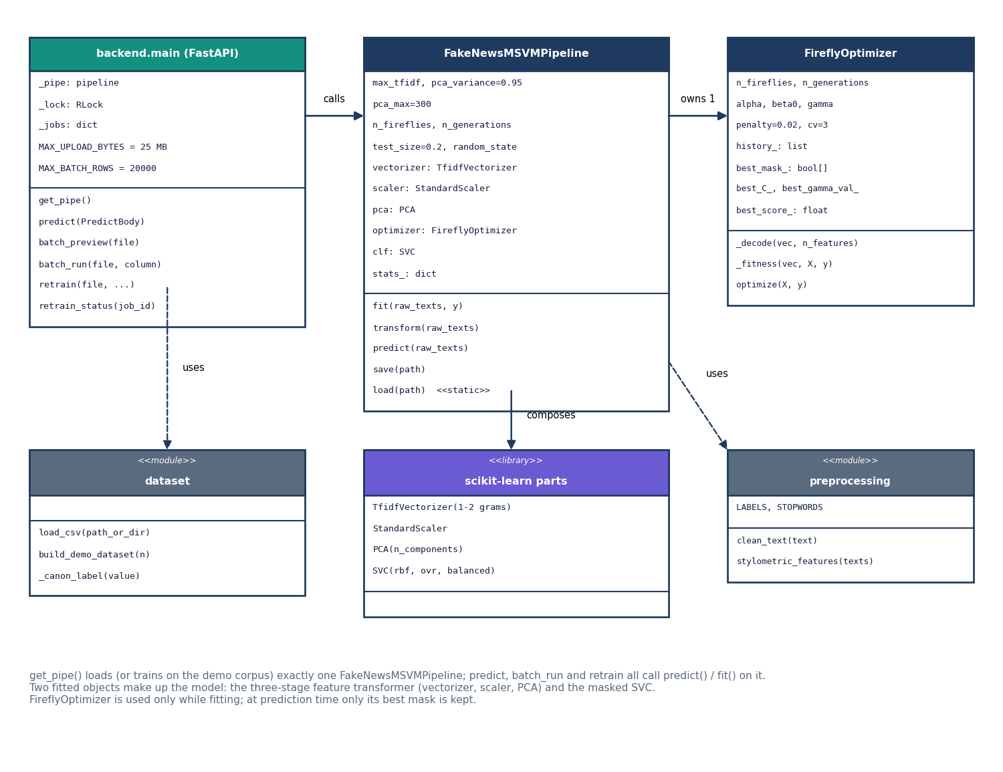
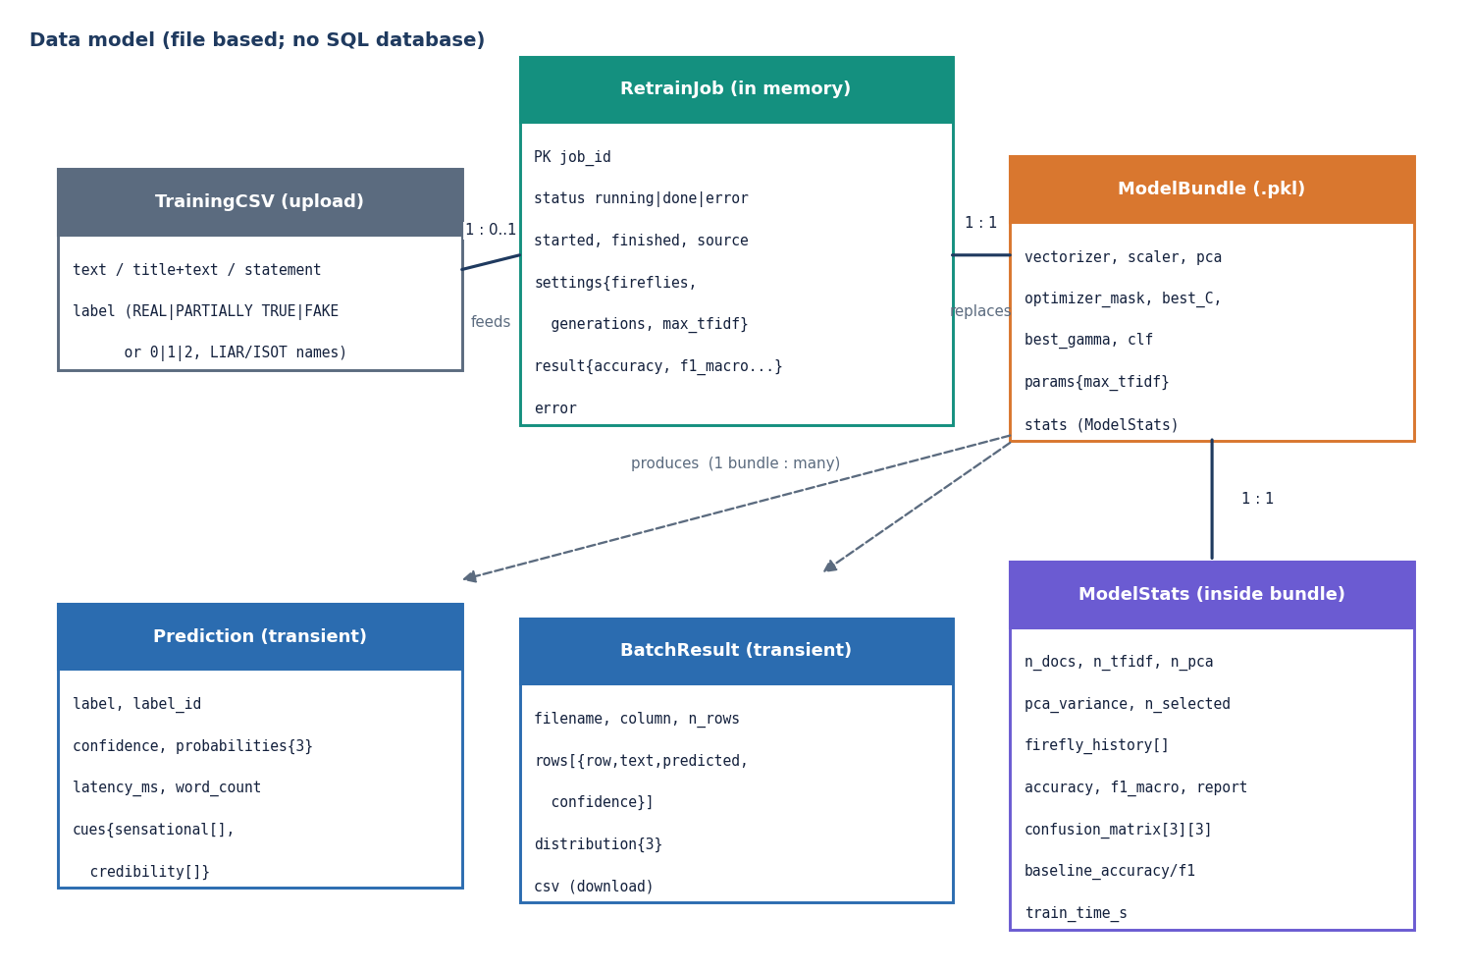
Database design and UML
There is no SQL database: the model bundle is a file, retrain jobs live in memory, uploaded CSVs are temporary. The ER diagram models these stores.
Notes:
The project stores files, not rows. The class diagram shows the real classes: the FastAPI module, the pipeline, the Firefly optimiser and the library modules.

Slide 13
Technology stack
Layer | Technology
Machine learning | Python 3.11, scikit-learn 1.9 (TF-IDF, PCA, SVC), NumPy, SciPy, pandas, joblib
Optimisation | Firefly algorithm written for the project (src/firefly.py)
API | FastAPI, uvicorn, python-multipart (port 8406)
Front end | React 18, TypeScript, Vite 8, Tailwind 4, TanStack Query, Recharts, GSAP (port 5406)
Other front ends | Streamlit app and command line (train.py, predict.py), unchanged
Testing | Python check scripts (smoke and unit/edge), Playwright for screenshots
Notes:
Everything is open source and starts with run.bat. The ML library runs without the web layers.

Slide 14
Implementation progress
Component | Status | Evidence
Preprocessing, PCA, Firefly, MSVM pipeline | Done | src/, train.py, predict.py
Real-data experiments on LIAR2 | Done | 3 seeds, experiments/liar2/*.json
FastAPI service (8 endpoints) | Done | 16 smoke + 33 API edge checks pass
React interface (6 screens) | Done | 17 documentation screenshots, build passes
Stemming (objective 2) | Not done | cleaning and stop words only
Better probabilities / calibration | Not done | verdict and probability mismatch known
Other datasets, user study, load test | Not done | stated as limits
Notes:
State of the code base. The honest gaps are stemming, calibration and evaluation beyond LIAR2.

Slide 15
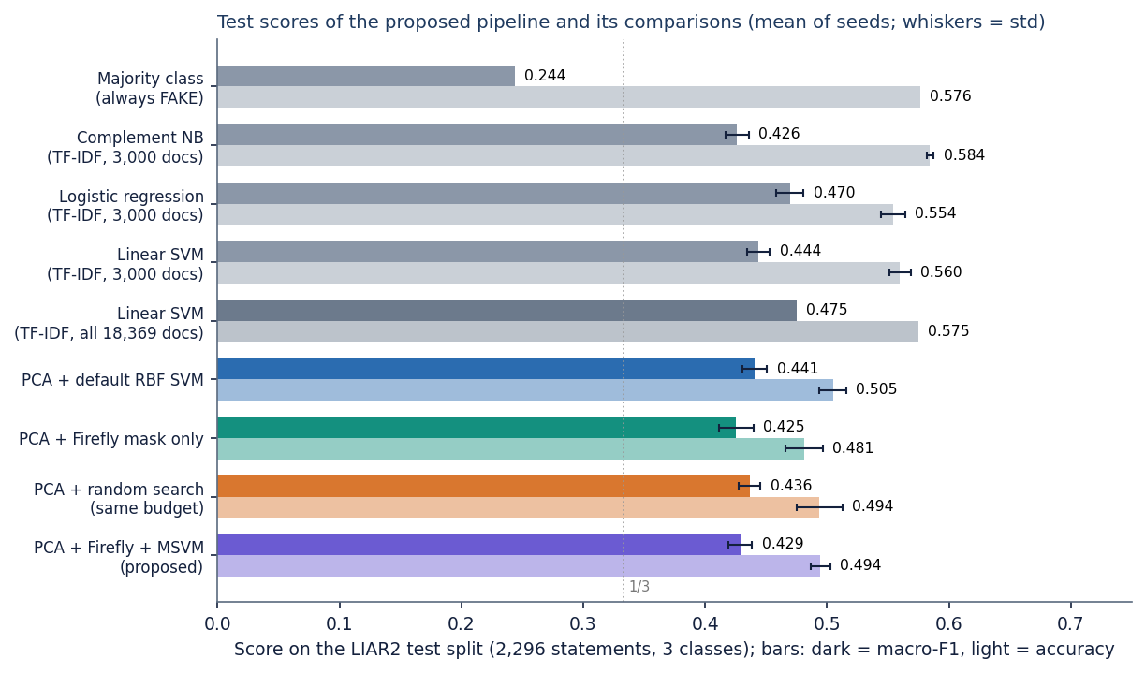
Preliminary results: LIAR2 test split (3 seeds)
0.494
0.429
0.441
0.500
accuracy (n = 2,296)
macro-F1
PCA + default SVM macro-F1
logistic regression, all data, macro-F1
i
Reading
Proposed macro-F1 0.429 ± 0.010; random search 0.436 ± 0.009; Firefly mask only 0.425 ± 0.014. The differences are within noise, so no gain from the optimiser is shown. PARTIALLY TRUE is the hardest class (F1 0.24), FAKE the easiest (0.63). Always answering FAKE gets accuracy 0.576 but macro-F1 0.244.
Notes:
Headline: macro-F1 about 0.43 and accuracy about 0.49, mean of three seeds. The optimiser does not clearly beat equal-budget random search or the default SVM, and TF-IDF linear models are better and far cheaper. The base paper's 95.5 % is for a different, binary Arabic task on a GPU and is not comparable.

Slide 16
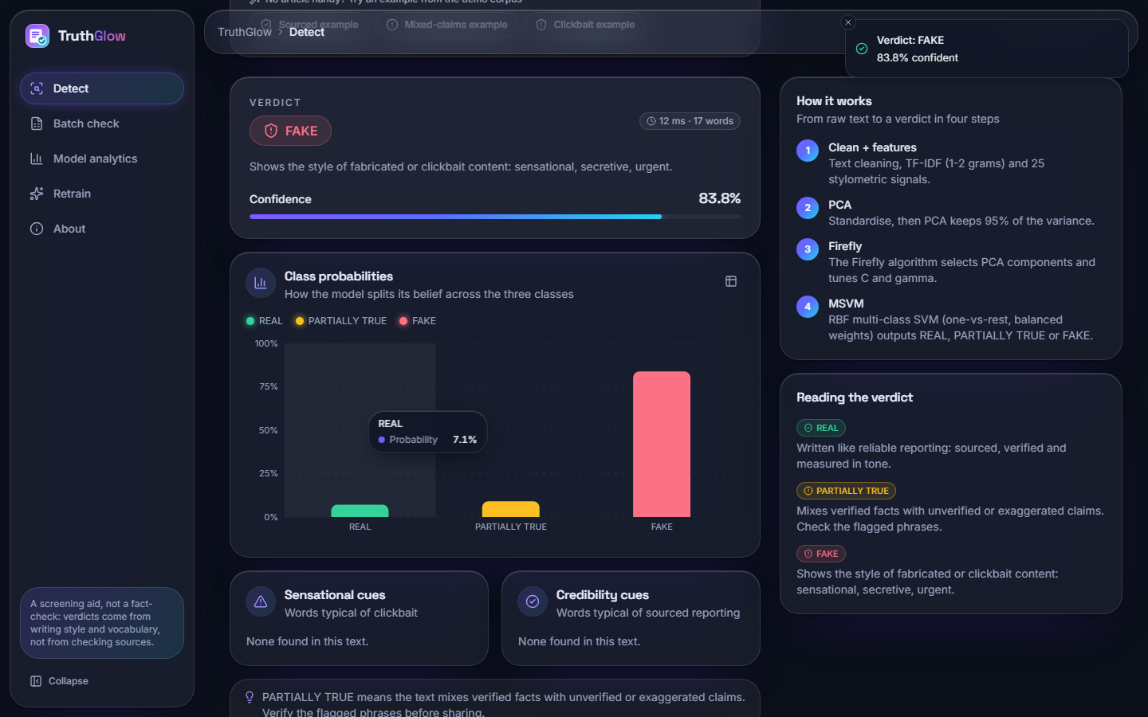
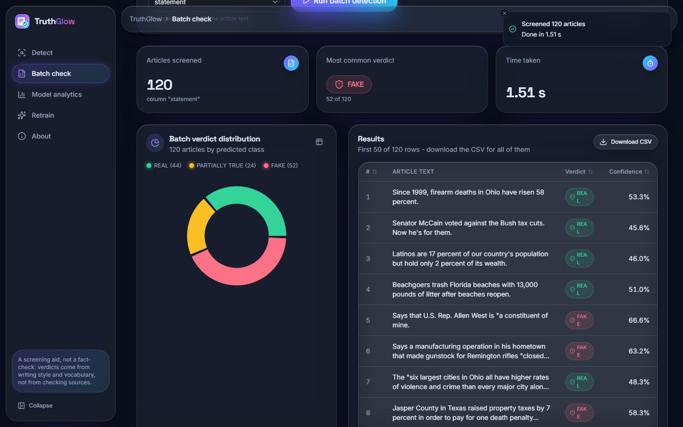
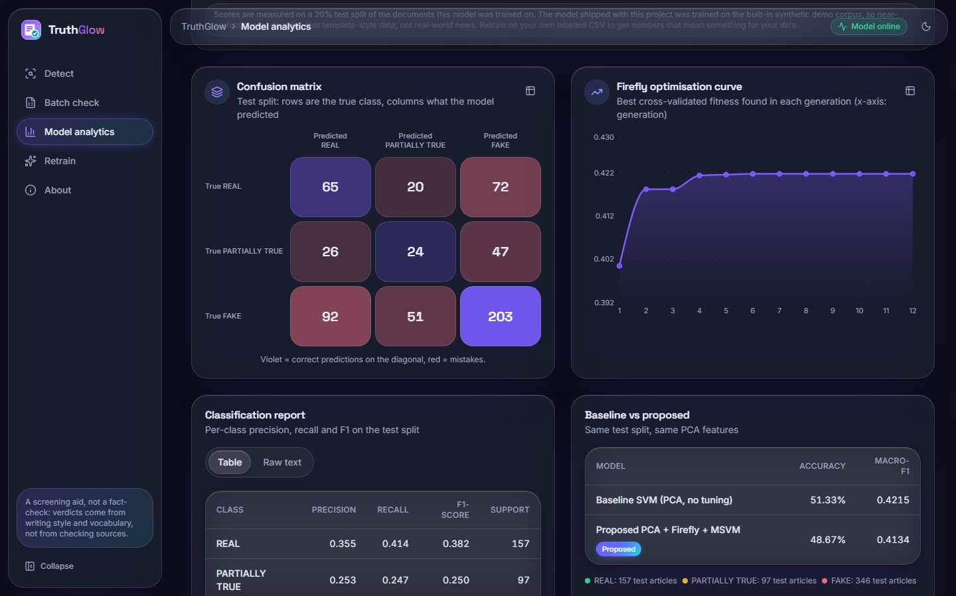
Output screens
Detect screen on a real LIAR2 test statement: verdict FAKE at 83.8 %, class probabilities and cue words. Right: batch check of 120 real statements, and the analytics screen (confusion matrix, Firefly curve, baseline table).
Notes:
Real screenshots of the running app with the model trained on LIAR2. The Detect example is a real test statement, not a mock-up.

Slide 17
Initial testing and observations
83
16
34 + 33
pass
automated checks passed
API smoke checks
library + API edge checks
frontend type-check and build
Observation | Action
Confidence is informative: accuracy 0.407 at 0.5-0.6, 0.681 at 0.6-0.7 | Shown on the Detect screen
A label column with only true/false is parsed as booleans by pandas and mislabelled | Recorded as a known issue
Server latency 3.7 ms per article; 1.2 s for 2,296 rows | Measured on 127.0.0.1, CPU idle
Notes:
16 smoke checks plus 34 library and 33 API edge checks. The observations shaped how results and limitations are reported.

Slide 18
Challenges and corrective actions
Challenge | Corrective action
No real labelled data shipped; the demo corpus gives a meaningless 1.000 | Ran experiments on LIAR2 and reported the demo score as a pipeline check only
Firefly needs thousands of SVM fits on a CPU | 3,000-statement training subsample; about 8 minutes per full fit
Optimiser shows no clear gain | Added random-search, mask-only and linear baselines; reported honestly
Verdict and probabilities disagree on real data | Documented with a screenshot; calibration listed as future work
PCA cap keeps about 29 % of the variance | Reported; larger cap or sparse methods planned
Notes:
Each challenge changed either the experiment design or how results are reported.

Slide 19
Next steps
1
Calibrate
2
Strengthen features
3
Evaluate wider
4
Tune the search
Make verdict and confidence agree, for example by calibrating on a held-out split with class-prior correction.
Try a larger PCA cap or truncated SVD, and compare with embeddings; add stemming.
More seeds with a significance test, ISOT and other datasets, and cross-dataset checks.
Tune Firefly settings and test other optimisers at equal budget.
Notes:
Plan to the final review. None of these items is claimed as done.

Slide 20
Thank you
Questions and suggestions are welcome.
Notes:
Likely questions: why the optimiser does not help here; why only three classes; how the verdict and probabilities can disagree; what the base paper's numbers mean for us (nothing directly).

