Slide 1

Fake News Detection System Using Feature Based Optimised MSVM Classification
Final Review · TruthGlow
Team Details : Batch C6
Under the Esteemed Guidance of
K Rajasekhar Rao
[DESIGNATION], Department of CSE
23K91A05H1 Neela Mojes
23K91A05H4 Noor Saniya
23K91A05E2 Malkajgiri Akshitha
23K91A05E7 Maravajhala Radha Sri Aashritha
DEPARTMENT OF COMPUTER SCIENCE AND ENGINEERING · [COLLEGE NAME] · Academic Year [ACADEMIC YEAR]
Notes:
Introduce the team and the project: TruthGlow, a fake news detector built on PCA, the Firefly algorithm and a multi-class SVM, with a complete web application.

Slide 2
Table of Contents
Abstract
Base Paper & Literature Survey
Research Gap, Problem Statement & Objectives
Proposed System & Architecture
Methodology, Dataset & Model
Firefly Workflow, Interaction & Data Design
Implementation Highlights
Results, Confusion Matrix & Parameter Analysis
Performance & Testing
Comparison with Base Paper
Output Screens
Conclusion, Future Scope & References
Dept. of CSE | Batch C6 | Final Review
2
Notes:
The agenda follows the report: problem, design, method, results, comparison, screens, conclusion.

Slide 3
Abstract
Fabricated news spreads faster than fact-checks, and detectors are often heavy neural models that report accuracy without their cost.
TruthGlow is a light pipeline: TF-IDF and 25 stylometric features are reduced by PCA, the Firefly algorithm selects the components and tunes C and gamma, and a multi-class SVM returns REAL, PARTIALLY TRUE or FAKE with a confidence.
On real fact-checked statements (LIAR2, 3,000 training statements, 3 seeds) it reaches macro-F1 0.429 ± 0.010 and accuracy 0.494 ± 0.008 on 2,296 test statements; the task is hard and PARTIALLY TRUE is the weakest class.
The optimiser gave no clear gain over PCA with a default SVM or random search, and simple TF-IDF linear models score higher at a tiny fraction of the cost.
A FastAPI service and React web app add batch checking, analytics and retraining; 83 automated checks pass.
Dept. of CSE | Batch C6 | Final Review
3
Notes:
Read the pipeline bullet, then give the headline number with its protocol, then say plainly that the optimiser's gain is not demonstrated.

Slide 4
Base Paper
M. Saad, S. Abdelrazek and I. R. Abdelmaksoud, "An algorithmic system for Arabic fake news detection using neural networks and transformer embeddings with class weighting," Scientific Reports, vol. 16, Art. no. 12226, 2026, doi: 10.1038/s41598-026-45653-4.
Aspect | Base paper (Saad et al., 2026)
Method | CAMeLBERT contextual embeddings as fixed features, a neural-network classifier, class weighting for imbalance; compared with AraBERT, AraELECTRA, MARBERTv2 and resampling (over, under, SMOTE)
Data | 7,474 Arabic news articles (2015-2025; trusted sources, unverified online content, part translated from LIAR and WELFake); Fleiss' kappa 0.80; binary real / fake; 80 / 20 split
Reported results | F1 96.19 %, accuracy 95.52 %, precision 95.48 %, recall 96.90 %; TF-IDF + NN baseline accuracy 90.97 %; LIME and SHAP explanations
Stated limits | Cross-domain generalisation and real-time deployment left for future work; trained on a Tesla T4 GPU
Dept. of CSE | Batch C6 | Final Review
4
Notes:
An Arabic, binary, transformer-based detector. We adopt its use of class weighting and its habit of reporting several metrics against baselines, not its model or data.

Slide 5
Literature Survey
Author / Year | Methodology | Dataset | Key Results | Limitations
Saad et al. 2026 [1] | CAMeLBERT embeddings + NN, class weighting | 7,474 Arabic articles, binary | F1 96.19 %, acc. 95.52 % | Arabic, binary, GPU transformer
Dell'Oglio et al. 2026 [2] | 12 approaches compared (ML, DL, transformers, LLMs) | 10 English datasets incl. LIAR-PLUS | LIAR-PLUS hardest: F1 0.56 (LR), 0.57 (SVM) | Binary labels hide half-truths
Huang et al. 2025 [3] | TF-IDF + Transformer / BiGRU + Bayesian optimisation | Fake / real news corpus | 99.73 % test accuracy | Binary; near-perfect score on easy data
Xu and Kechadi 2024 [4] | Fuzzy deep hybrid network; releases LIAR2 | LIAR2, 18,369 / 2,297 / 2,296 | Benchmark used here | Deep model; no cheap baseline
Ahmed et al. 2017 [19] | N-gram TF-IDF with classical classifiers | News article corpora | Linear SVM among the best classical | Binary, article level
Zhang et al. 2018 [25] | Firefly feature selection for classification | Benchmark datasets | Smaller feature sets at similar accuracy | Search cost; data dependent
Dept. of CSE | Batch C6 | Final Review
5
Notes:
Representative work with figures taken from the papers themselves. Four further 2024-2025 papers named in the project survey could not be verified and are listed in the report with that caveat.

Slide 6
Research Gap
Stated gap: The surveyed work applies neural and transformer models to fake news detection. The gap is a computationally light pipeline where feature reduction and metaheuristic parameter tuning deliver comparable accuracy at lower cost.
Middle verdict: binary detectors have no place for half-true claims, which are common in fact-checking.
Cost is rarely reported: training time and inference latency are seldom given next to accuracy.
Fair baselines: metaheuristic tuning is rarely compared with plain random search or with a linear model on the same data.
Usability: few works package the detector so that a non-expert can check text, screen a file and retrain.
Dept. of CSE | Batch C6 | Final Review
6
Notes:
Five gaps. We build for the first, second and fifth, and test the third and fourth honestly.

Slide 7
Problem Statement
Given the text of a news item or claim, assign it one of three verdicts - REAL, PARTIALLY TRUE or FAKE - with a confidence, using a computationally light pipeline (TF-IDF and stylometric features reduced by PCA, with the Firefly algorithm choosing the feature subset and the SVM parameters), and report honestly how accurate and how costly it is, through an application that a non-expert can run.
Input
Output
Evidence
News headline and text, one item or a CSV of items
REAL / PARTIALLY TRUE / FAKE, confidence, class probabilities, cue words
Held-out metrics, baselines, latency, tests, retraining on new data
Need: an optimised classifier that reduces dimensionality and tunes its own parameters to detect fabricated news accurately and efficiently.
Dept. of CSE | Batch C6 | Final Review
7
Notes:
The statement has three parts: classify into three verdicts, stay light, and report the evidence honestly.

Slide 8
Objectives
1. Assemble a labelled dataset of genuine and fabricated news articles.
2. Preprocess the text with tokenisation, stop-word removal, stemming and vectorisation.
3. Apply Principal Component Analysis to reduce feature dimensionality.
4. Use the Firefly algorithm to optimise feature selection and MSVM parameters.
5. Train a Multi-class Support Vector Machine classifier on the optimised feature set.
6. Evaluate accuracy, precision, recall and F1-score against unoptimised baselines.
Dept. of CSE | Batch C6 | Final Review
8
Notes:
The six objectives of the proposal. The conclusion reports which were met: stemming (objective 2) was not implemented and the accuracy/cost advantage in objective 4 and 6 was not demonstrated.

Slide 9
Proposed System
Text
TF-IDF + stylometric
Scaler + PCA
Firefly search
RBF MSVM
Clean text, TF-IDF over 1-2 grams (4,000 terms) plus 25 stylometric signals: capitals, exclamation marks, lexicon ratios, length.
PCA to 95 % variance (capped at 300 components); the Firefly algorithm jointly selects components and tunes C and gamma.
Multi-class RBF SVM with balanced class weights and an explicit PARTIALLY TRUE class; probabilities from Platt scaling.
FastAPI service over the library; React web app with Detect, Batch check, Analytics, Retrain and About screens.
Dept. of CSE | Batch C6 | Final Review
9
Notes:
The pipeline as a row of boxes, then four properties that matter.

Slide 10
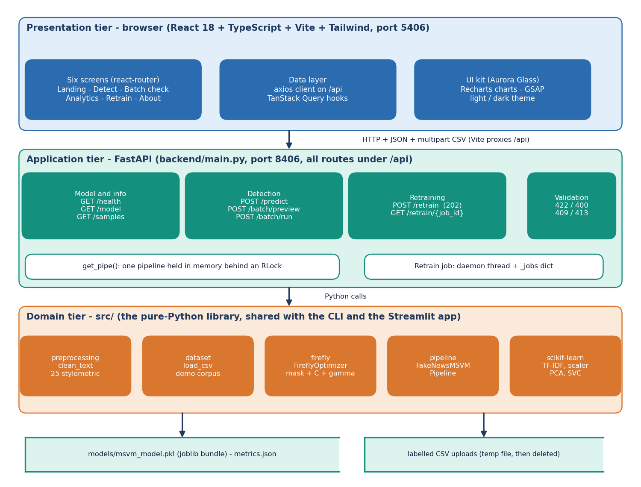
System Architecture
Presentation: React app, six screens
Application: FastAPI, 8 endpoints, one model held in memory
Domain: src/ library shared with the CLI and Streamlit app
Storage: one joblib model bundle; no database
Dept. of CSE | Batch C6 | Final Review
10
Notes:
Three tiers plus storage; the domain library is shared by the web app, the CLI and the original Streamlit app.

Slide 11
Methodology
LIAR2 statements
3-class mapping
Clean + features
Scaler + PCA
Firefly search
RBF MSVM
Test once
Real data: LIAR2 (Apache-2.0), PolitiFact statements; true and mostly-true = REAL, half-true = PARTIALLY TRUE, the rest = FAKE.
3,000 training statements drawn stratified from 18,369 (the Firefly search needs thousands of SVM fits); scored on the official validation and test splits.
Firefly: 10 fireflies x 12 generations, about 550 fitness evaluations; fitness = 3-fold CV macro-F1 - 0.02 x share of components kept.
Baselines on the same split: PCA + default SVM, Firefly mask only, equal-budget random search, TF-IDF linear models; seeds 7, 42, 2024.
Dept. of CSE | Batch C6 | Final Review
11
Notes:
The method and, as important, the fair comparisons we added around it.

Slide 12
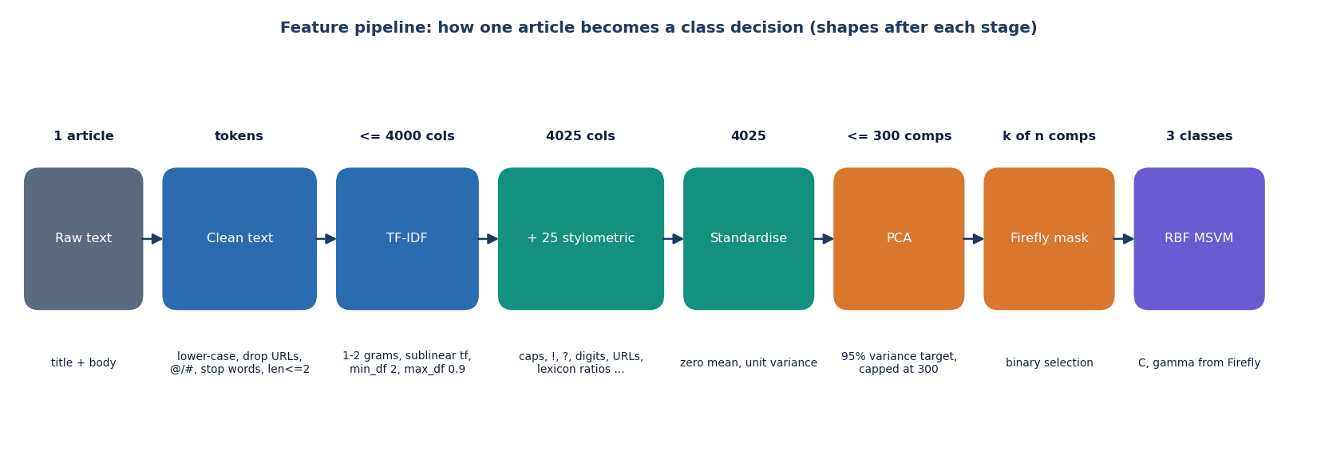
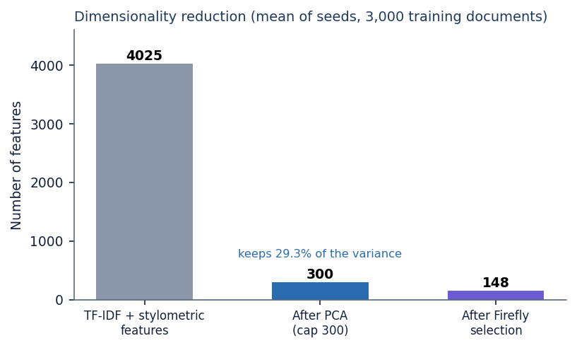
Dataset, Features & Model
18,369
LIAR2 train; 2,297 valid; 2,296 test
4,025
4,000 TF-IDF + 25 stylometric
300 → 148
PCA components → Firefly-selected (29.3% variance)
Test classes REAL / PARTIALLY TRUE / FAKE: 602 / 371 / 1323.
The PCA cap of 300 keeps under a third of the variance on real text.
RBF SVM, one-vs-rest shape, balanced class weights.
Means over three seeds; training subsample of 3,000 statements.
Dept. of CSE | Batch C6 | Final Review
12
Notes:
Dataset, feature pipeline and model. The funnel shows 4,025 features reduced to 300 PCA components, then to about 150 selected components.

Slide 13
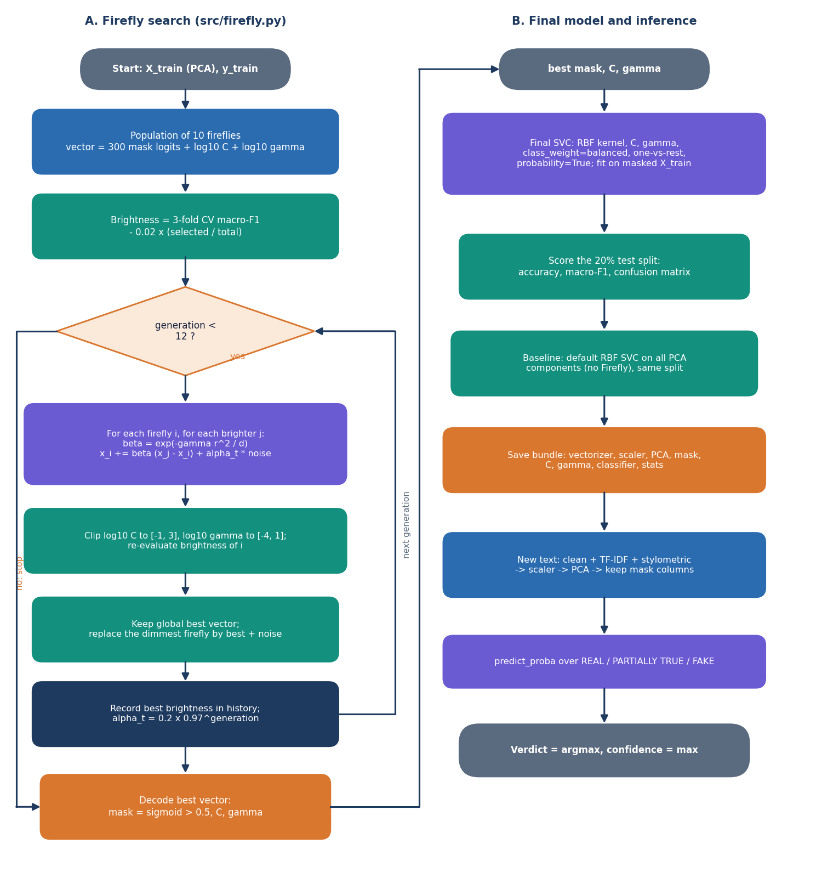
Decision Logic: Firefly Search
Each firefly is a vector: a mask over the PCA components plus log10 C and log10 gamma.
Brightness = 3-fold CV macro-F1 minus 0.02 x the share of components kept.
Dimmer fireflies move towards brighter ones with attractiveness beta0 exp(-gamma r^2); random step alpha decays by 0.97 per generation.
The best vector gives the final mask, C and gamma; the final SVC is fitted on the masked training data and scored once on the test split.
Verdict = class chosen by the SVC; confidence = highest Platt probability.
Dept. of CSE | Batch C6 | Final Review
13
Notes:
The core algorithm. Note the last bullet: the verdict and the confidence come from two different mechanisms, which matters on slide 19.

Slide 14
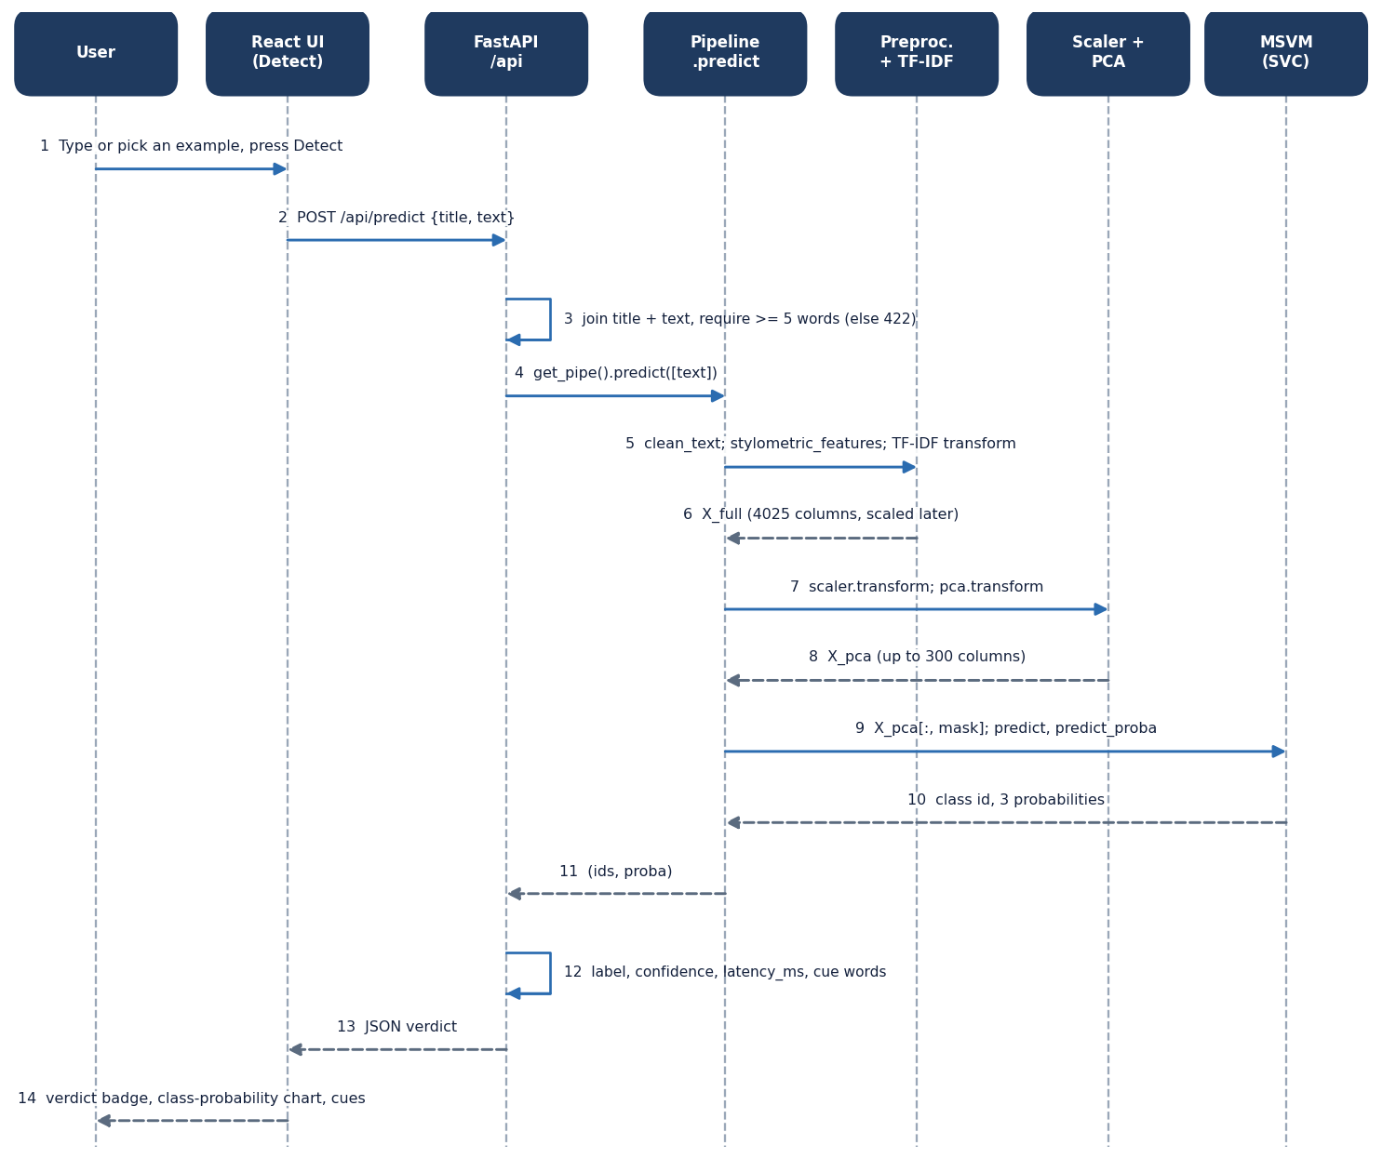
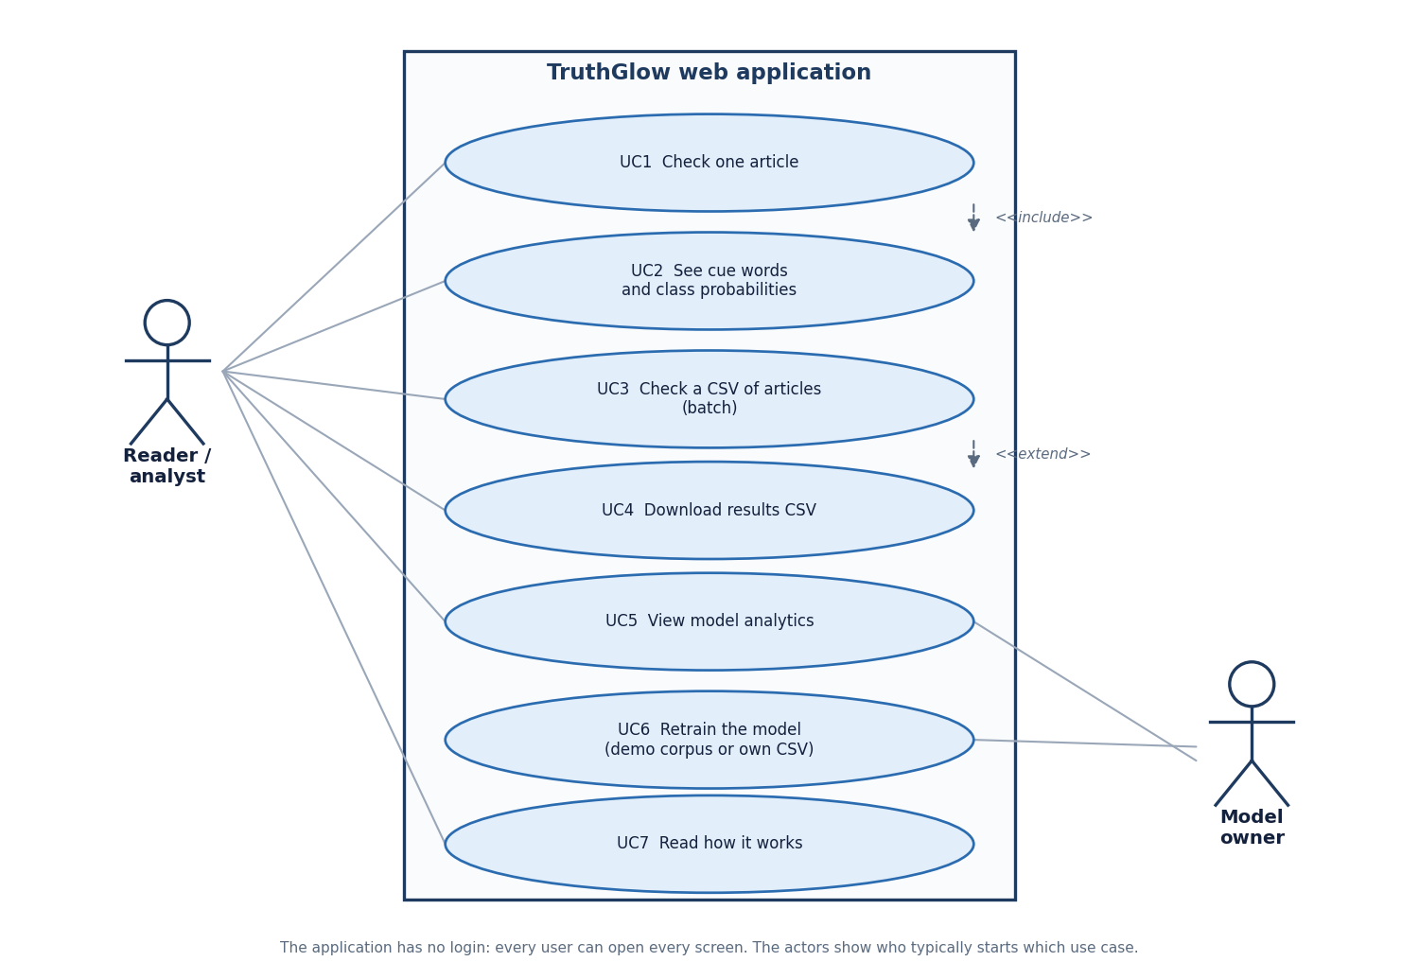
User – System Interaction
Dept. of CSE | Batch C6 | Final Review
14
Notes:
Sequence of one detection request and the use cases of the reader and the model owner. There is no login.

Slide 15
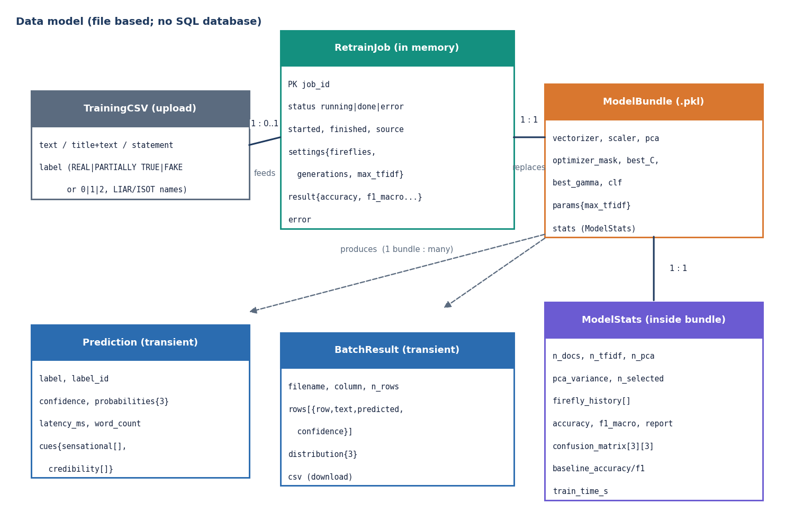
Data Design (file based)
Store | Content
models/msvm_model.pkl | shipped demo model bundle
models/liar2_msvm_model.pkl | model trained on LIAR2 (seed 42)
models/metrics.json | demo model statistics
experiments/liar2/ | seed runs, predictions, latency
uploaded CSV | temp file, deleted after use
memory: job table | retrain status
There is no SQL database: the diagram models the file and in-memory entities. Predictions are not stored.
Dept. of CSE | Batch C6 | Final Review
15
Notes:
Honest point: the product stores files, not rows.

Slide 16
Implementation Highlights
8
83
6
1
REST endpoints (+ /docs)
automated checks
React screens
command to start (run.bat)
The existing library is reused unchanged: the API calls the same fit and predict functions as the CLI and Streamlit app.
Validation: at least 5 words per article; CSV only, at most 20,000 rows and 25 MB; retrain limits (4-20 fireflies, 3-30 generations, 1,000-8,000 terms); one retrain at a time (409).
Retraining runs in a background thread; the new model is saved to a temporary file, swapped in atomically and used without a restart.
Each result shows verdict, confidence, class probabilities and the sensational or credibility cue words found.
Dept. of CSE | Batch C6 | Final Review
16
Notes:
Highlights: reuse of the library, input validation, background retraining and explained results.

Slide 17
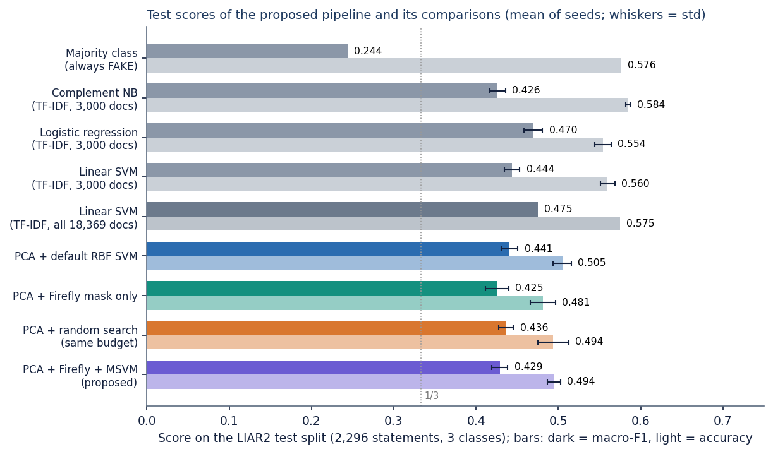
Results – Model Performance (LIAR2 test split)
0.429
0.494
0.500
504 s
macro-F1, ± 0.010 over 3 seeds
accuracy (majority class: 0.576)
macro-F1 of logistic regression, all data
training time of the pipeline
Majority class gets the best accuracy but macro-F1 0.244: accuracy alone misleads on this data.
PCA + default SVM, random search and Firefly are within about 0.01 macro-F1 of each other.
TF-IDF linear models are better; trained on all 18,369 statements logistic regression reaches 0.500.
Test = 2,296 statements never used for training or tuning.
Dept. of CSE | Batch C6 | Final Review
17
Notes:
Headline: macro-F1 0.43 and accuracy 0.49 for the proposed pipeline. Its optimiser gives no clear gain over its own simpler variants, and linear TF-IDF models do better.

Slide 18
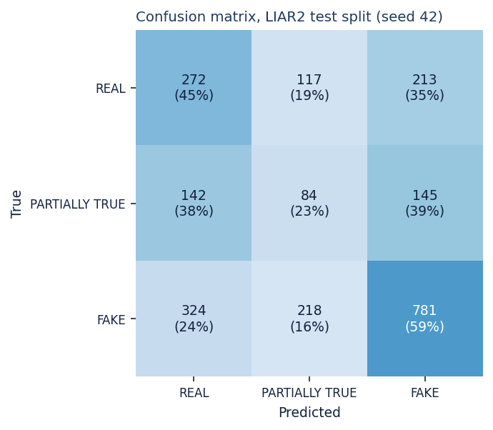
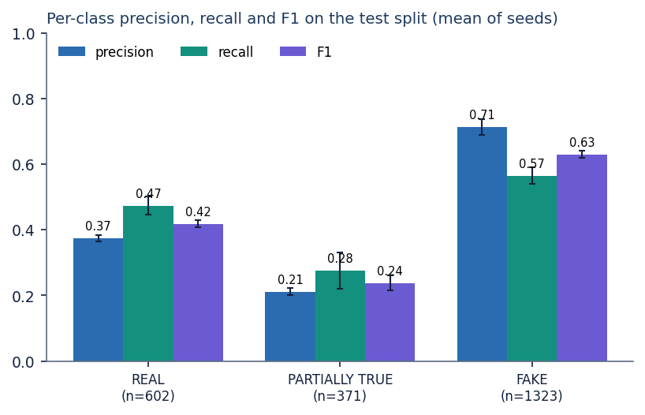
Confusion Matrix & Per-Class Results
F1 by class: FAKE 0.63, REAL 0.42, PARTIALLY TRUE 0.24 (hardest; recall 0.28).
Most frequent errors (seed 42): FAKE read as REAL 324, FAKE as PARTIALLY TRUE 218, REAL as FAKE 213.
Barely-true statements (labelled FAKE) are split across all three verdicts, so the classes overlap.
Seed 42; rows = true class, columns = predicted.
Dept. of CSE | Batch C6 | Final Review
18
Notes:
Rows are the true class. FAKE is recognised best because it is the majority class; PARTIALLY TRUE is recognised least, and confused with both neighbours.

Slide 19
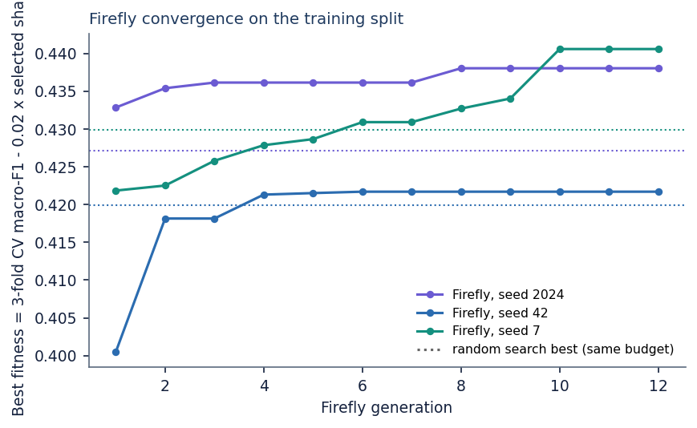
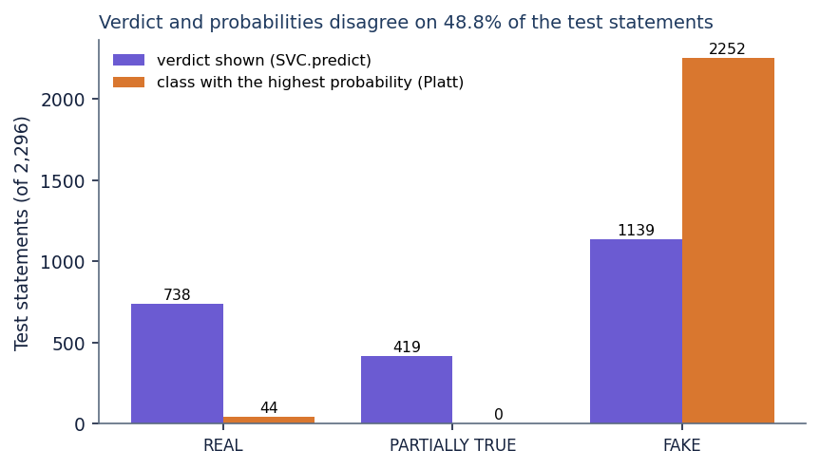
Parameter & Confidence Analysis
Firefly fitness per generation, 3 seeds (dotted = random search)
Accuracy by confidence bin (seed 42)
Verdict vs highest-probability class
No decision threshold exists in TruthGlow; the closest analogue is confidence: accuracy is 0.37 at confidence 0.4-0.5 and 0.68-0.79 at 0.6-0.8, so high confidence is informative.
Firefly keeps 148 ± 12 of 300 components (C 8.5, gamma 0.0010); its training fitness 0.433 beats random search 0.426, but test macro-F1 does not.
Verdict (SVC.predict) and probabilities (Platt) disagree on 48.8% of test statements; the probabilities almost always favour FAKE and never favour PARTIALLY TRUE.
Dept. of CSE | Batch C6 | Final Review
19
Notes:
Three analyses in place of a threshold sweep. The mismatch between verdict and probability is a defect found by this evaluation, not hidden.

Slide 20
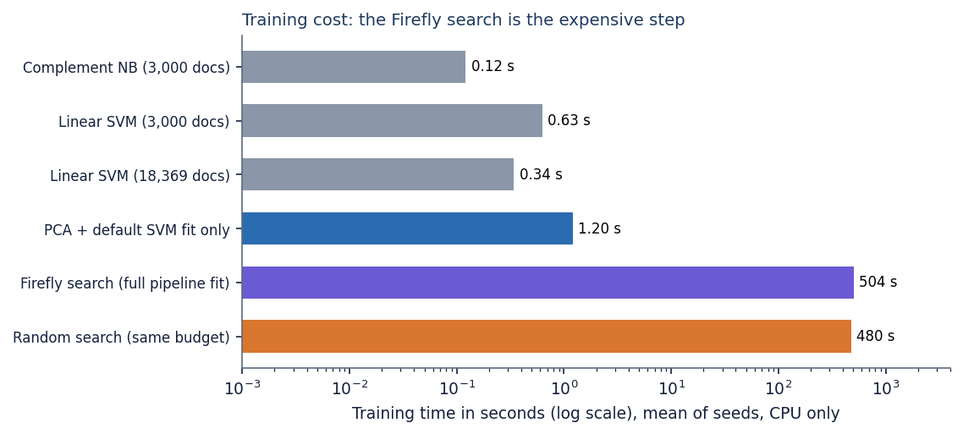
Performance & Testing
3.7 ms
6.5 ms
1.2 s
504 s
server time per article (mean)
round trip, median (p95 30 ms)
batch of 2,296 statements
training incl. Firefly (CPU)
Test layer | What it covers | Result
Smoke test | running server: all endpoints, retrain, errors | 16 / 16 checks
Unit tests | cleaning, features, labels, Firefly, pipeline, save/load | 34 / 34 checks
API edge tests | limits, empty or garbage input, non-English text, 413 / 422 / 400 | 33 / 33 checks
Build | npm run build (tsc + vite) | passes
Linear models train in 0.1-1 s on the same data, against about 500 s for the Firefly pipeline (random search alone: 480 s).
Measured on 127.0.0.1 on an Intel Core i5-12500 (6 cores, 12 threads) with the CPU idle. Not tested: load, a user study, React component tests; one known library issue (true/false-only label columns).
Dept. of CSE | Batch C6 | Final Review
20
Notes:
Inference is cheap; training with the Firefly search is the costly step. The tests cover the library and API, not the browser.

Slide 21
Comparison with Base Paper (context only – different task and data)
Aspect | Base paper [1] | This project (TruthGlow)
Language / data | Arabic, 7,474 articles, multi-source | English, LIAR2: 18,369 / 2,297 / 2,296 statements
Task | Binary real / fake | Three classes: REAL / PARTIALLY TRUE / FAKE
Features | CAMeLBERT contextual embeddings | TF-IDF 1-2 grams + 25 stylometric, PCA
Classifier | Neural network with class weights | RBF multi-class SVM, balanced weights, Firefly tuned
Reported | Accuracy 95.52 %, F1 96.19 % | Accuracy 49.4%, macro-F1 42.9% (3 seeds)
Compute | Tesla T4 GPU | CPU only; training about 500 s, inference about 4 ms
Different language, data, task (binary vs three classes), model family and hardware: the figures are context, not a ranking. The related binary LIAR-PLUS result in [2] (LR F1 0.56) shows how hard this kind of data is.
Dept. of CSE | Batch C6 | Final Review
21
Notes:
State plainly that the datasets and tasks differ; no superiority or inferiority claim is possible from these numbers.

Slide 22
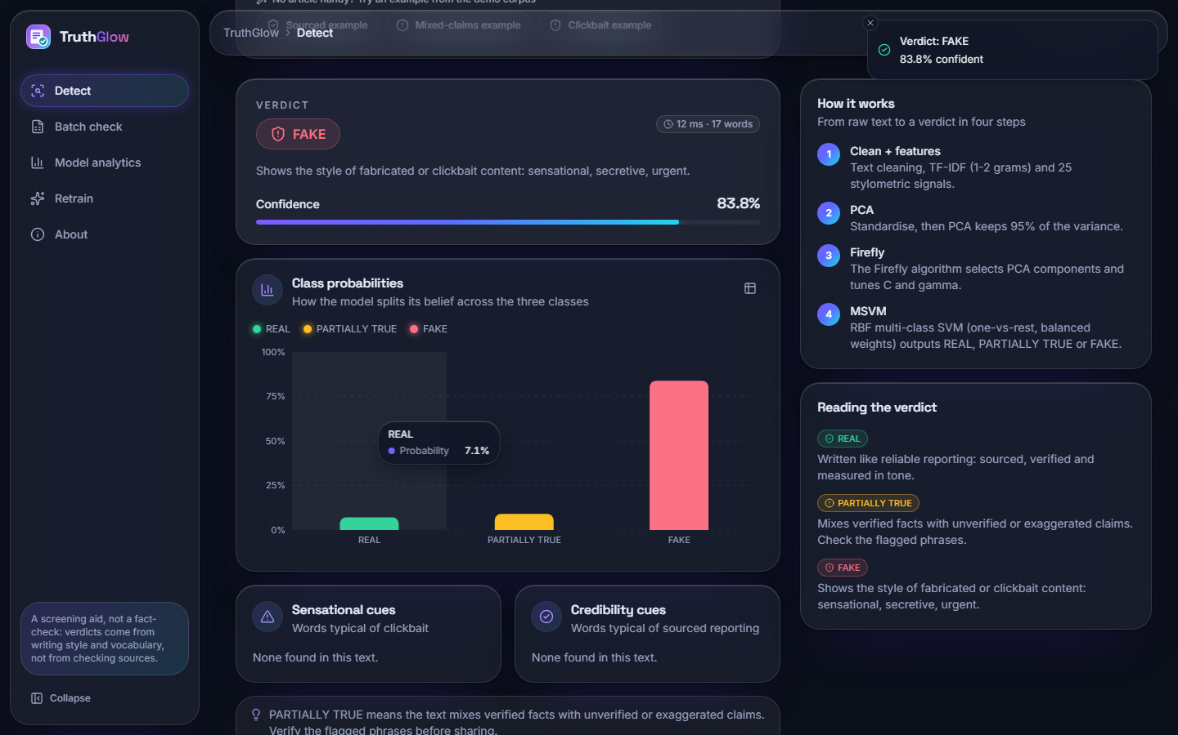
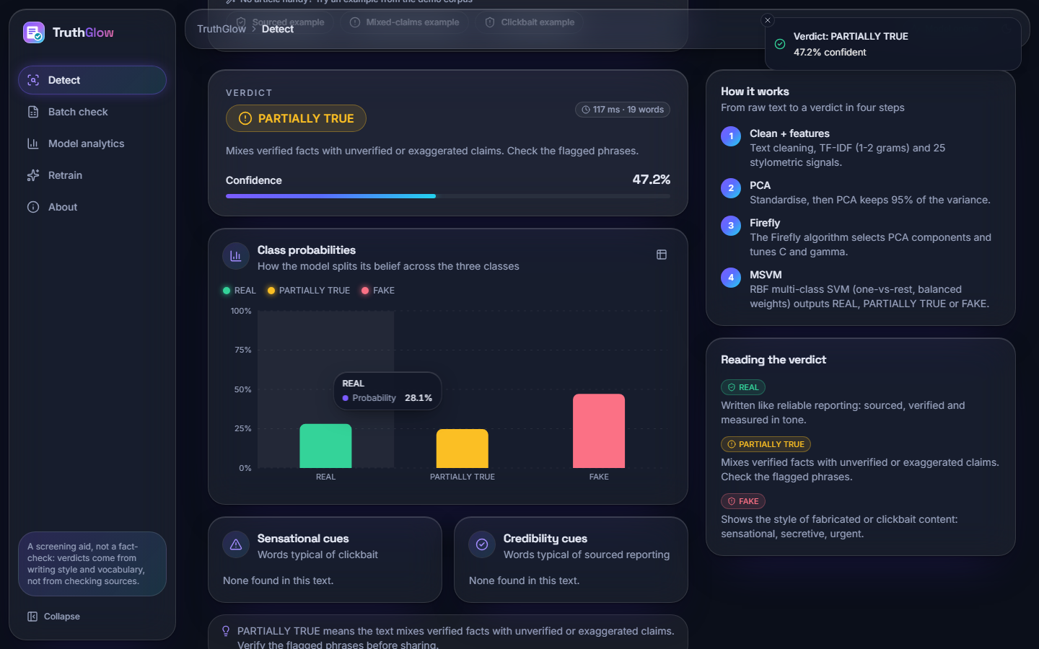
Output – Detect
Left: a real LIAR2 test statement (Ron DeSantis shirt photo, true label FAKE) judged FAKE with 83.8 % confidence. Right: a PARTIALLY TRUE verdict shown at 47.2 % while the FAKE bar is tallest: the verdict-probability mismatch of slide 19.
Dept. of CSE | Batch C6 | Final Review
22
Notes:
Real screenshots from the app running the LIAR2 model. The right-hand screen illustrates the verdict/probability disagreement.

Slide 23
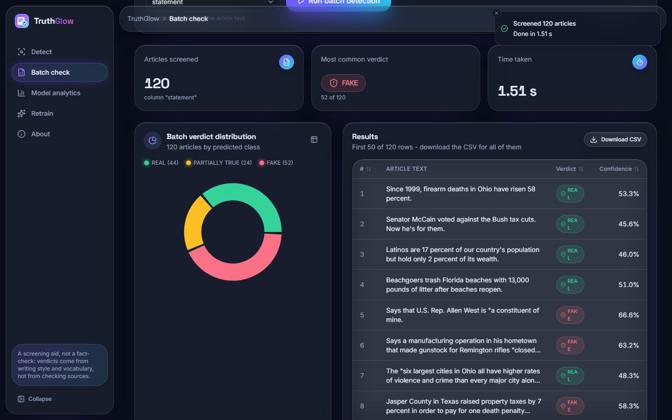
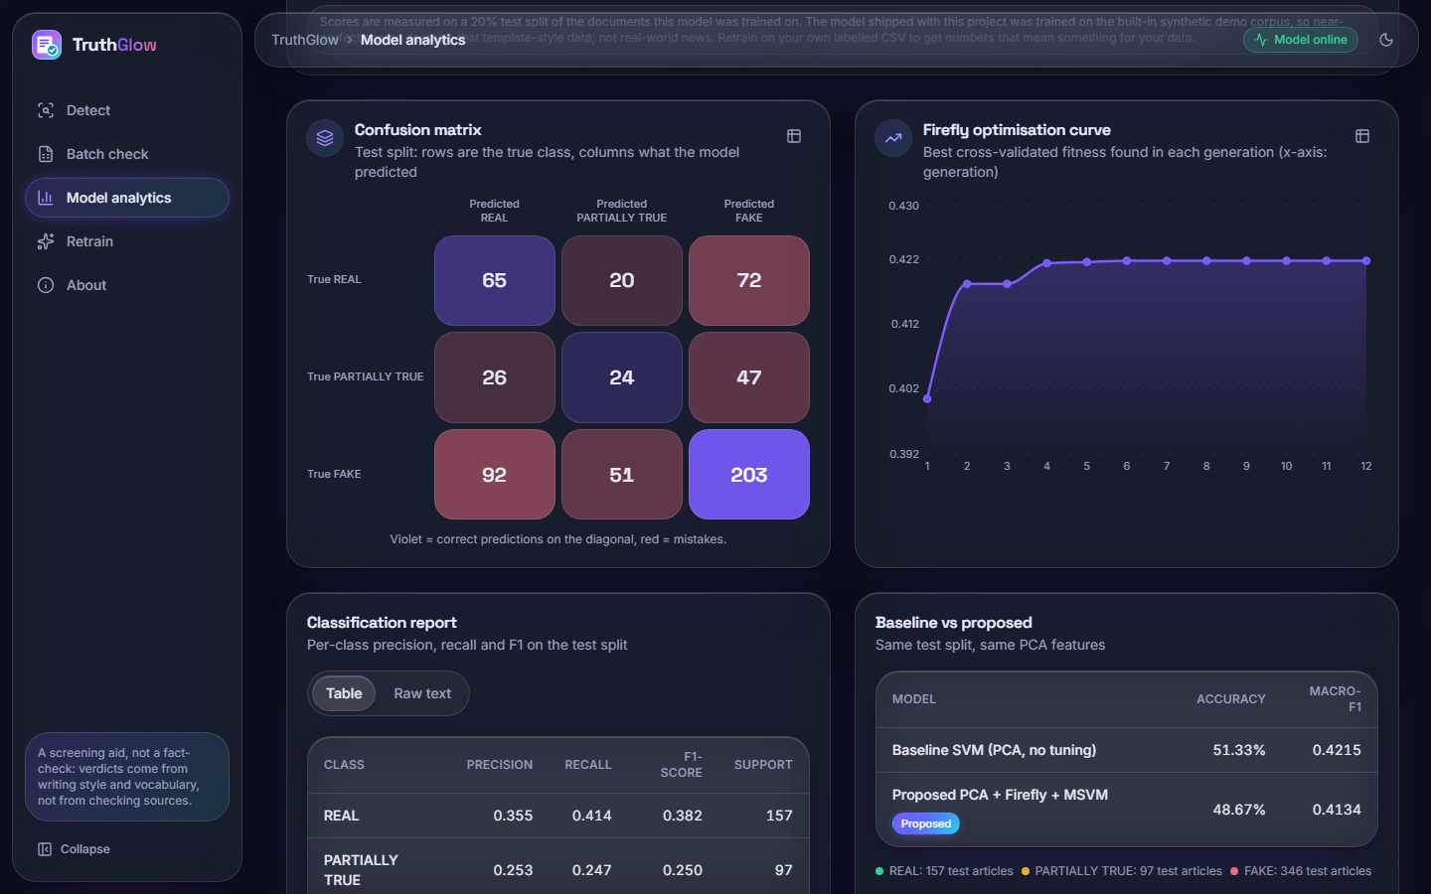
Output – Batch Check and Model Analytics
Left: 120 real test statements screened (44 REAL, 24 PARTIALLY TRUE, 52 FAKE); the 1.51 s shown was captured while another job was running; the idle server needed about 0.13 s per 100 rows. Right: confusion matrix, Firefly curve, class report and baseline-vs-proposed table of the loaded model.
Dept. of CSE | Batch C6 | Final Review
23
Notes:
The analytics screen reads its numbers live from the loaded model and shows the gain from optimisation honestly (negative on that seed).

Slide 24
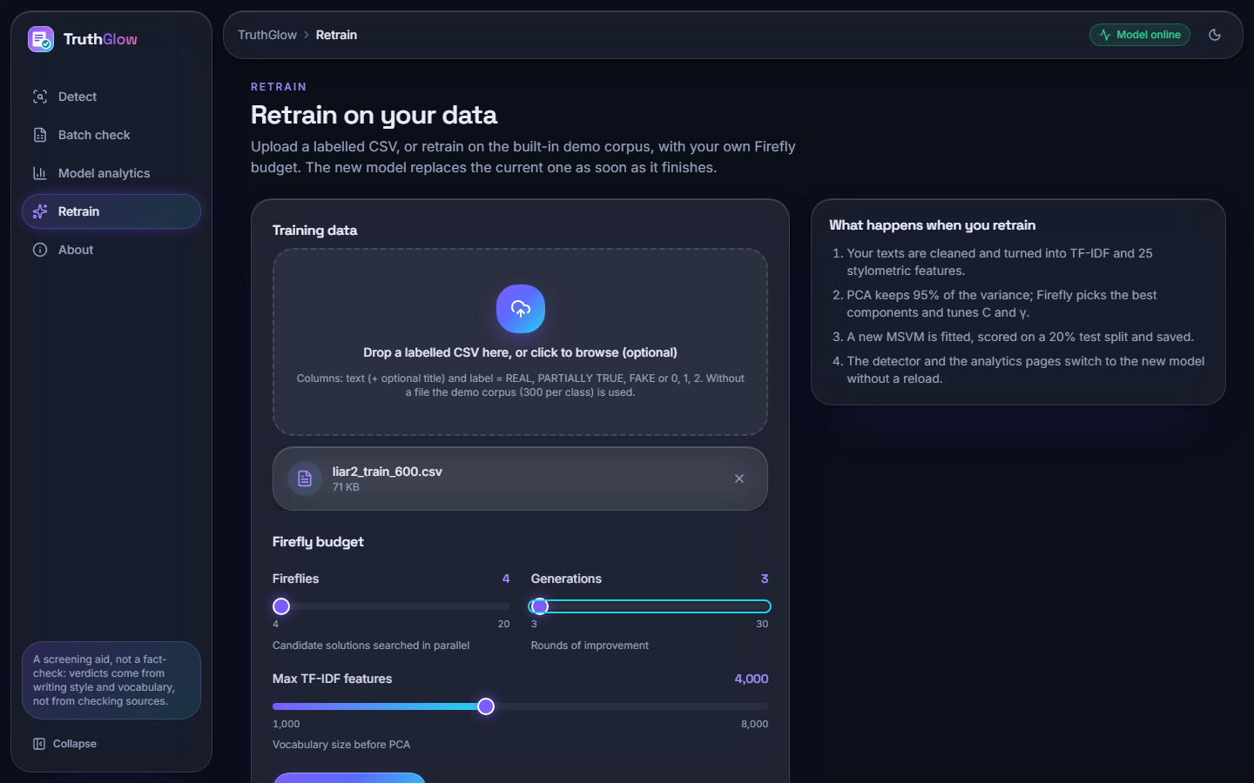
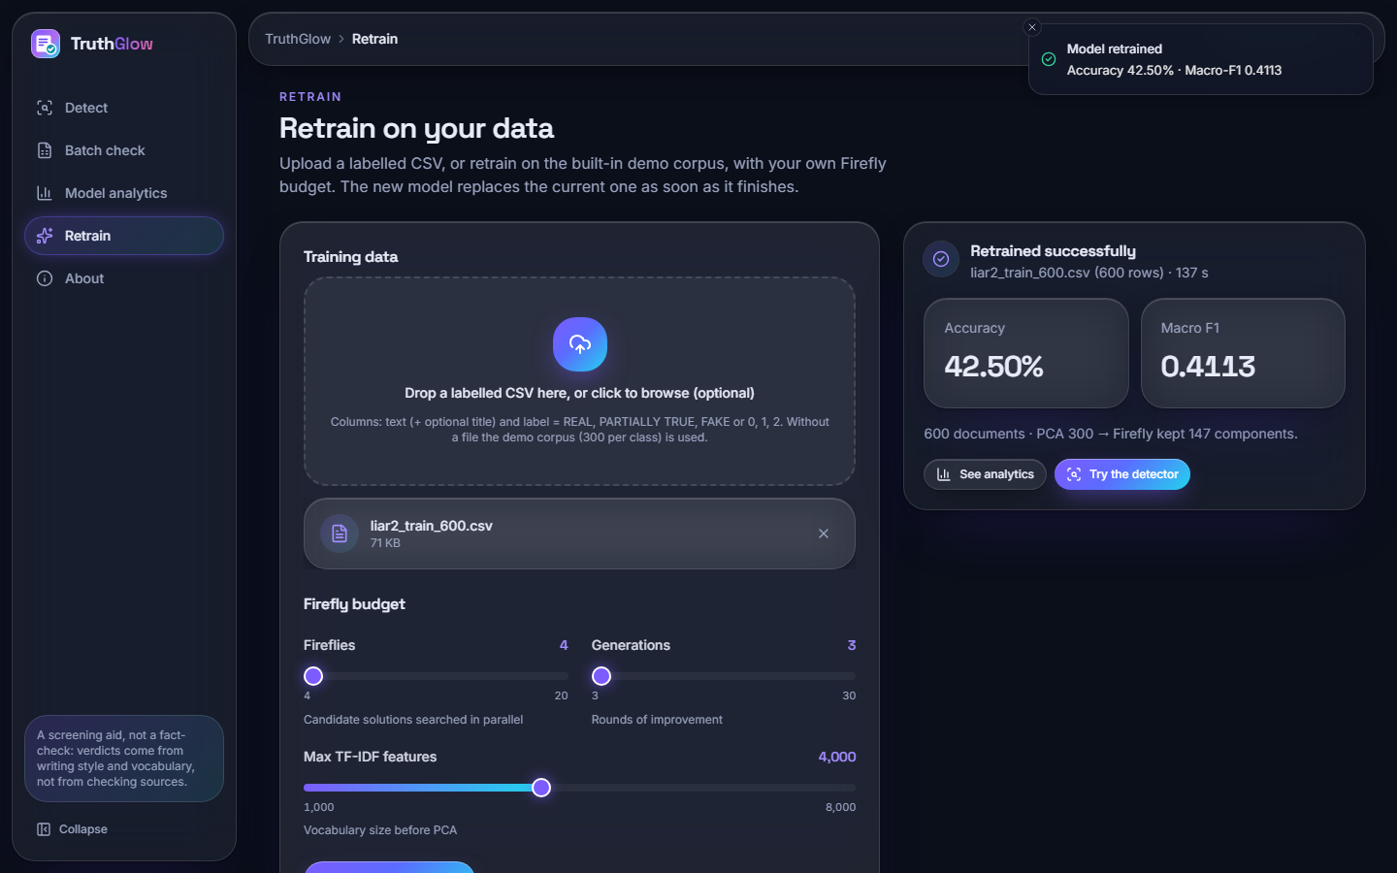
Output – Retrain
Left: a 600-statement LIAR2 CSV attached, 4 fireflies, 3 generations. Right: the finished job (137 s): accuracy 42.50 %, macro-F1 0.4113, 147 of 300 components kept; the new model replaced the one in memory without a restart (run on a copy of the model file).
Dept. of CSE | Batch C6 | Final Review
24
Notes:
Retraining on a user CSV from the browser. The small sample explains the lower scores.

Slide 25
Conclusion
Delivered: a working fake news detector: cleaning, TF-IDF + stylometric features, PCA, Firefly search, MSVM with a PARTIALLY TRUE class, a FastAPI service and a six-screen web app with batch checking, analytics and retraining.
Measured: macro-F1 0.429 ± 0.010 and accuracy 0.494 ± 0.008 on LIAR2; about 4 ms per article on the server; 83 automated checks pass.
Objectives: 1 (with LIAR2; the shipped demo corpus is synthetic), 3, 5 met; 2 partly (no stemming); 4 and 6 done but the expected benefit was not shown: Firefly tuning is within noise of random search and of a default SVM, and linear TF-IDF models score higher at far lower cost.
Limits: 3,000-statement training subsample, three seeds, PARTIALLY TRUE recognised poorly, verdict and probabilities disagree, no user study. Not a fact-checker.
Dept. of CSE | Batch C6 | Final Review
25
Notes:
Be explicit: the system works, the accuracy/cost advantage of the optimiser was not demonstrated on real data.

Slide 26
Future Scope
Make verdict and probability consistent: calibrate probabilities with class-prior correction, or derive the verdict from the calibrated scores.
Test PCA without the 300 cap, or sparse linear / Complement NB models with the Firefly feature search, against the same baselines.
Train on all 18,369 statements with a cheaper fitness; tune the Firefly parameters; add ISOT and cross-dataset tests and a significance test.
Add stemming (objective 2) and richer, fact-checking-aware features such as source and evidence cues.
User study with fact-checkers; update the fixed UI wording for non-demo models.
Dept. of CSE | Batch C6 | Final Review
26
Notes:
Concrete next steps, the first three follow directly from the findings.

Slide 27
References
[1] M. Saad, S. Abdelrazek and I. R. Abdelmaksoud, "An algorithmic system for Arabic fake news detection using neural networks and transformer embeddings with class weighting," Scientific Reports, vol. 16, Art. no. 12226, 2026, doi: 10.1038/s41598-026-45653-4.
[2] P. Dell'Oglio, A. Bondielli, F. Marcelloni and L. C. Passaro, "An experimental comparison of the most popular approaches to fake news detection," Information Sciences, 2026, doi: 10.1016/j.ins.2026.123407; arXiv:2603.25501.
[3] T. Huang, Z. Xu, P. Yu, J. Yi and X. Xu, "A hybrid transformer model for fake news detection: Leveraging Bayesian optimization and bidirectional recurrent unit," 2025, arXiv:2502.09097.
[4] C. Xu and M.-T. Kechadi, "An enhanced fake news detection system with fuzzy deep learning," IEEE Access, vol. 12, pp. 88006-88021, 2024, doi: 10.1109/ACCESS.2024.3418340.
[5] W. Y. Wang, "'Liar, liar pants on fire': A new benchmark dataset for fake news detection," in Proc. 55th Annu. Meeting Assoc. Comput. Linguistics (ACL), Vol. 2: Short Papers, Vancouver, Canada, 2017, pp. 422-426, doi: 10.18653/v1/P17-2067.
[6] X.-S. Yang, "Firefly algorithms for multimodal optimization," in Stochastic Algorithms: Foundations and Applications (SAGA 2009), Lecture Notes in Computer Science, vol. 5792. Berlin, Germany: Springer, 2009, pp. 169-178.
[8] C. Cortes and V. Vapnik, "Support-vector networks," Machine Learning, vol. 20, no. 3, pp. 273-297, Sep. 1995.
[10] I. T. Jolliffe and J. Cadima, "Principal component analysis: a review and recent developments," Phil. Trans. R. Soc. A, vol. 374, no. 2065, Art. no. 20150202, 2016.
[12] J. C. Platt, "Probabilistic outputs for support vector machines and comparisons to regularized likelihood methods," in Advances in Large Margin Classifiers. Cambridge, MA, USA: MIT Press, 1999, pp. 61-74.
[13] G. Salton and C. Buckley, "Term-weighting approaches in automatic text retrieval," Information Processing & Management, vol. 24, no. 5, pp. 513-523, 1988.
[14] F. Pedregosa et al., "Scikit-learn: Machine learning in Python," J. Mach. Learn. Res., vol. 12, pp. 2825-2830, 2011.
[15] H. He and E. A. Garcia, "Learning from imbalanced data," IEEE Trans. Knowl. Data Eng., vol. 21, no. 9, pp. 1263-1284, Sep. 2009.
[16] K. Shu, A. Sliva, S. Wang, J. Tang and H. Liu, "Fake news detection on social media: A data mining perspective," ACM SIGKDD Explorations Newsletter, vol. 19, no. 1, pp. 22-36, 2017.
[19] H. Ahmed, I. Traore and S. Saad, "Detection of online fake news using N-gram analysis and machine learning techniques," in Intelligent, Secure, and Dependable Systems in Distributed and Cloud Environments (ISDDC 2017), Lecture Notes in Computer Science, vol. 10618. Cham, Switzerland: Springer, 2017, pp. 127-138.
Dept. of CSE | Batch C6 | Final Review
27
Notes:
Selected references; the complete numbered list is in the report.

Slide 28
THANK YOU
Questions & Suggestions
Dept. of CSE | Batch C6 | Final Review
28
Notes:
Invite questions.

