Slide 1
Smart Alcohol Intoxication Detection and Prevention System Using AI
REVIEW 2 · DESIGN, METHODOLOGY AND PROGRESS
Smart Rider Impairment Warning System for Two-Wheelers: an explainable eye-closure and head-tilt warning with a FastAPI service and a React interface
Presented by
Under the guidance of
B PRANITHA 23K91A0522
BANTU KAVYA 23K91A0531
DASARI VIVEKA SARVESHWARI 23K91A0560
BEKKAM VAMSHI 23K91A0534
N. PADMAVATHI, [DESIGNATION]
Department of Computer Science and Engineering
TKR College of Engineering and Technology (Autonomous) · Batch A6 (CSE-A) · [ACADEMIC YEAR]
Notes:
Introduce the team. This review shows how the system is designed and built, what has been implemented, the first measured results and the open items. Say at the start: a camera cannot confirm alcohol, so the product is a drowsiness / impairment warning and we state exactly what it does and does not do.

Slide 2
Contents
01
02
03
Recap and architecture
Methodology and dataset
Preprocessing and model
04
05
06
Training and decision logic
Data flow, database and UML
Technology stack
07
08
09
Progress and preliminary results
Output screens and testing
Challenges and next steps
Notes:
Agenda for the design and progress review.

Slide 3
Recap: problem and proposed system
!
Problem
i
What we built
×
What it is not
Drink-driving and fatigued riding are hard to police continuously: breath tests are occasional and sensors can be bypassed. The batch asked for a contactless, camera-based check.
Webcam frames, MediaPipe eye landmarks, quality gates and explainable rules give Normal, Possible impairment or drowsiness, or Unable to assess, with the reason.
A camera cannot confirm alcohol. There is no deep-learning classifier, no intoxication dataset and no ignition or contact alert in this version.
Base paper link. Feng and Li, IEEE Access 2026: eye aspect ratio plus a personalised threshold for driver state. We reuse that idea with the conventional six-point EAR and transparent duration rules; we do not reproduce EAR-4, the voice interface or the fuzzy belief engine.
Notes:
One-minute recap of Review 1. The batch title says alcohol; the abstract says visual signs of intoxication. What we can honestly deliver and measure is an eye and head based warning for possible drowsiness or impairment. The third card says plainly what is missing.

Slide 4
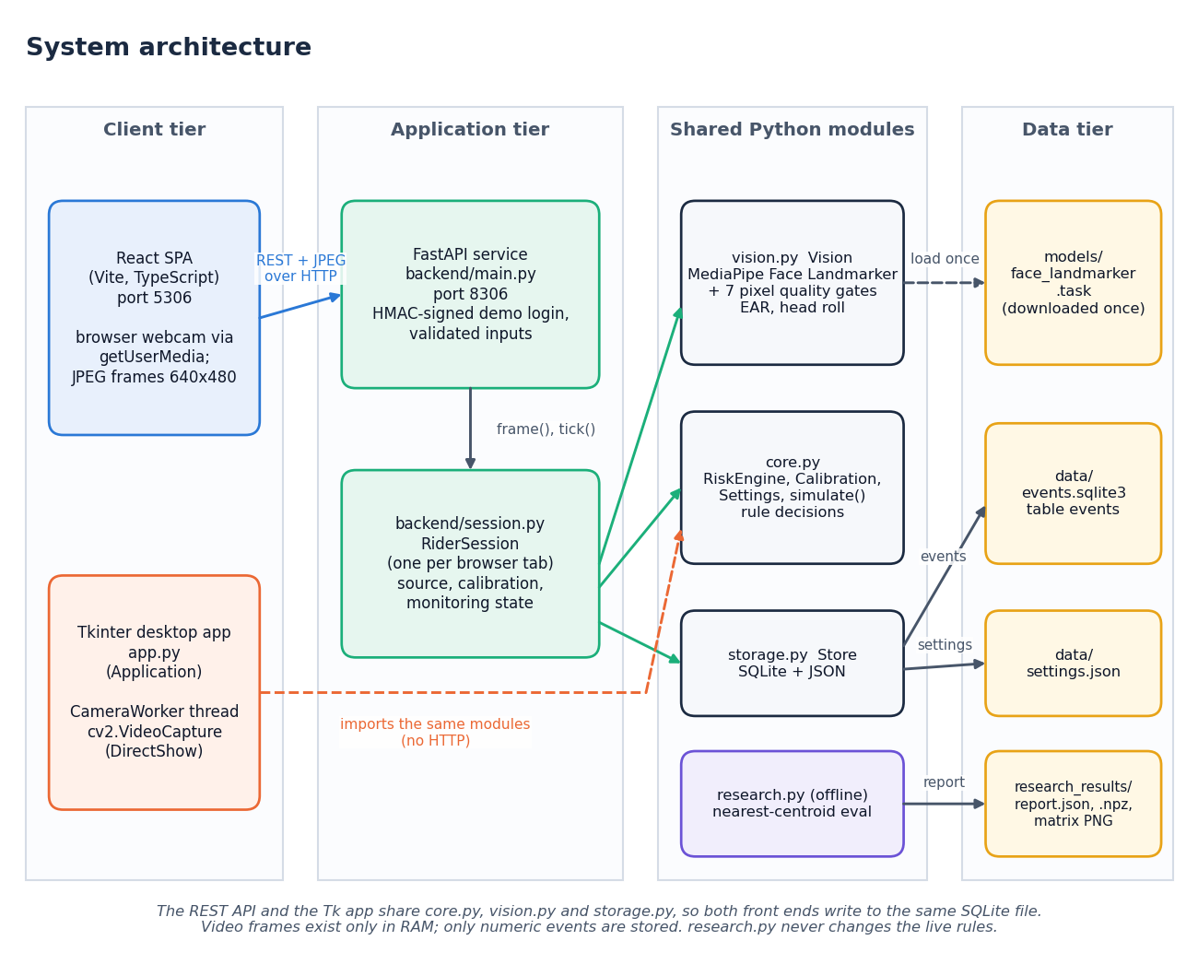
System architecture
Four tiers
Presentation: React app (port 5306) and the original Tkinter desktop app.
Application: FastAPI service (port 8306), signed demo login, input validation.
Core: core.py rules, vision.py landmarks, storage.py, research.py, shared by both front ends.
Data: SQLite event table, settings file, landmark model file.
Camera frames stay in RAM and are never saved.
Notes:
Four tiers. The web service wraps the original desktop modules rather than rewriting them, so both front ends give the same verdict. The browser sends a 640 x 480 JPEG frame; the server runs MediaPipe and the rule engine and returns the state and an annotated preview.

Slide 5
Methodology: end-to-end workflow
Camera frame 640 x 480
Quality gates
Eye landmarks, EAR, roll
Median + calibration
Rule engine
Verdict + reason
SQLite log, CSV
Explainable by design
Safe failure
One code path
Every warning states its reason: closure time, closed fraction or head tilt with low EAR. No hidden score.
A failed quality gate always wins: the answer is Unable to assess and the evidence is cleared, never a guess.
The desktop app and the web app use the same measurement, rule and storage modules.
The same pipeline serves browser camera frames and four scripted simulation scenarios: Normal, Prolonged eye closure, Missing face and Poor lighting.
Notes:
Six stages from frame to log. The method is deliberately transparent, because there is no labelled intoxication data to train a classifier on.

Slide 6
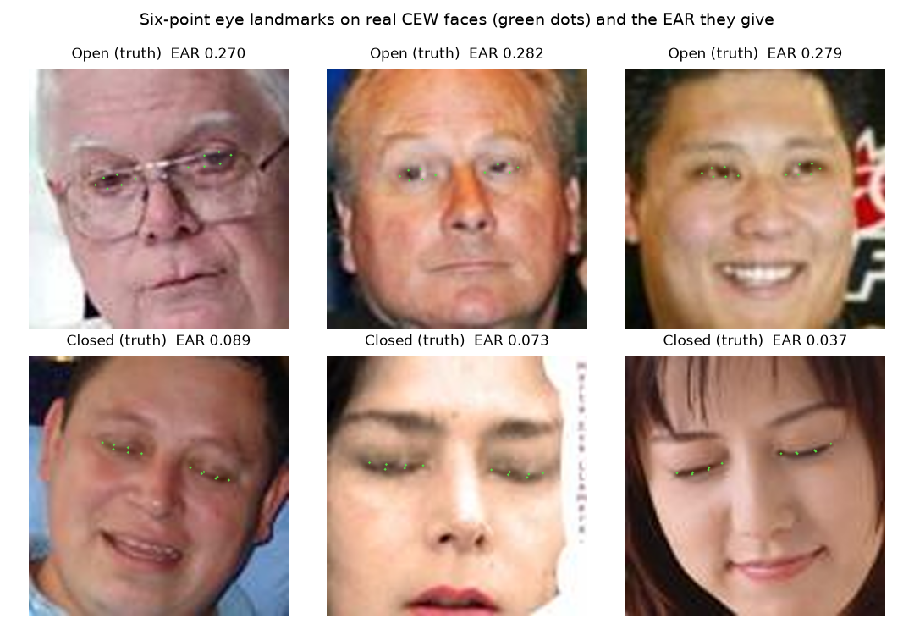
Dataset and evidence used
2,423
100 x 100
0
6 x 2 x 30 s
public CEW faces: 1,192 closed, 1,231 open
warped crops, used for the EAR check only
intoxication recordings available
synthetic CSV for the offline demo
Closed Eyes in the Wild (Song et al., 2014): Internet closed-eye faces and LFW open-eye faces; not stored in the repository.
No intoxication data: none was available, so no classifier was trained.
Synthetic CSV for the offline pipeline is flagged Synthetic data on screen; its metrics are not performance.
Live screenshots use one public-domain portrait as a fake webcam.
Notes:
CEW has 2,423 faces and is used only to test the eye open / closed measurement. It says nothing about alcohol. The synthetic CSV only proves the offline pipeline runs; the screen carries a Synthetic data banner.

Slide 7
Preprocessing: quality gates and measurements
1 Frame. 640 x 480, grayscale copy.
2 Gates. Any failed gate gives Unable to assess.
3 Landmarks. Six points per eye and both outer eye corners.
4 Measures. EAR (mean of both eyes), head roll, 3-sample median.
Gates are strict on purpose: halving the brightness already blocks assessment.
Quality gate | Fails when
Lighting | mean gray < 40 or > 225
Sharpness | Laplacian variance < 25
Motion | frame difference > 35
Face count | no face or more than one
Eye size / position | eye width < 14 px or outside image
Eye patch | mean < 35 or > 230, or sd < 8
Eye geometry | left-right EAR difference > 0.12
Timing | gap > 0.5 s or time not increasing
Measured on 272 open-eye faces
Sunglasses over both eyes: 270 of 272 answered Unable to assess.
One eye covered: 272 of 272 Unable to assess.
Brightness x0.5: only 1 of 272 still assessed.
Notes:
Seven pixel and geometry gates plus a timing check run before any verdict. They are heuristics, not proof of occlusion. Our degraded-image test shows they fail safe but are strict.

Slide 8
Model: pre-trained landmarks and a rule engine
Component | What it is | Role
Face Landmarker | Google MediaPipe, 478 landmarks, pre-trained | eye and head geometry
EAR | 6 points per eye, mean of both eyes | eye openness
Head roll | atan2 of outer eye corners, image plane | tilt
Median filter | 3 samples | suppress outliers
Rule engine | state machine, 3 outputs | live decision
Offline classifier | NumPy nearest centroid on 5 s windows | research only: Model not trained
478
face landmarks, not trained by us
41 µs
per rule-engine update
13 ms
median landmarking, CPU only
Notes:
There is no neural network trained by the team. MediaPipe supplies the landmarks; the decision is a small rule engine. The nearest-centroid classifier only runs offline on a consented labelled CSV, and none exists yet, so the screen says Model not trained.

Slide 9
Training configuration: calibration and defaults
Setting | Value
Calibration | 8-15 s eyes open; at least 40 accepted frames and 70 % accepted; EAR sd / median <= 0.15
Personal threshold | clip(0.72 x median EAR, 0.12, 0.32); default 0.21, bounds 0.08-0.40
Closure rule | continuous closed eyes >= 1.5 s (bounds 0.5-5 s)
Closed-fraction rule | >= 0.55 of the last 10 s, with at least 8 s of history
Tilt rule | head roll >= 25 degrees together with a low EAR
Persistence / cooldown | 1.0 s more evidence and 2 s reliable history; bell cooldown 15 s
Tuning | engineering defaults, not tuned on data; the CEW sweep later points to 0.17-0.18
Notes:
There is no training loop. What is configured is the calibration and the rule constants. They are adjustable within validated bounds. After the CEW sweep we know 0.21 is conservative; we kept it as the documented default and rely on calibration per rider.

Slide 10
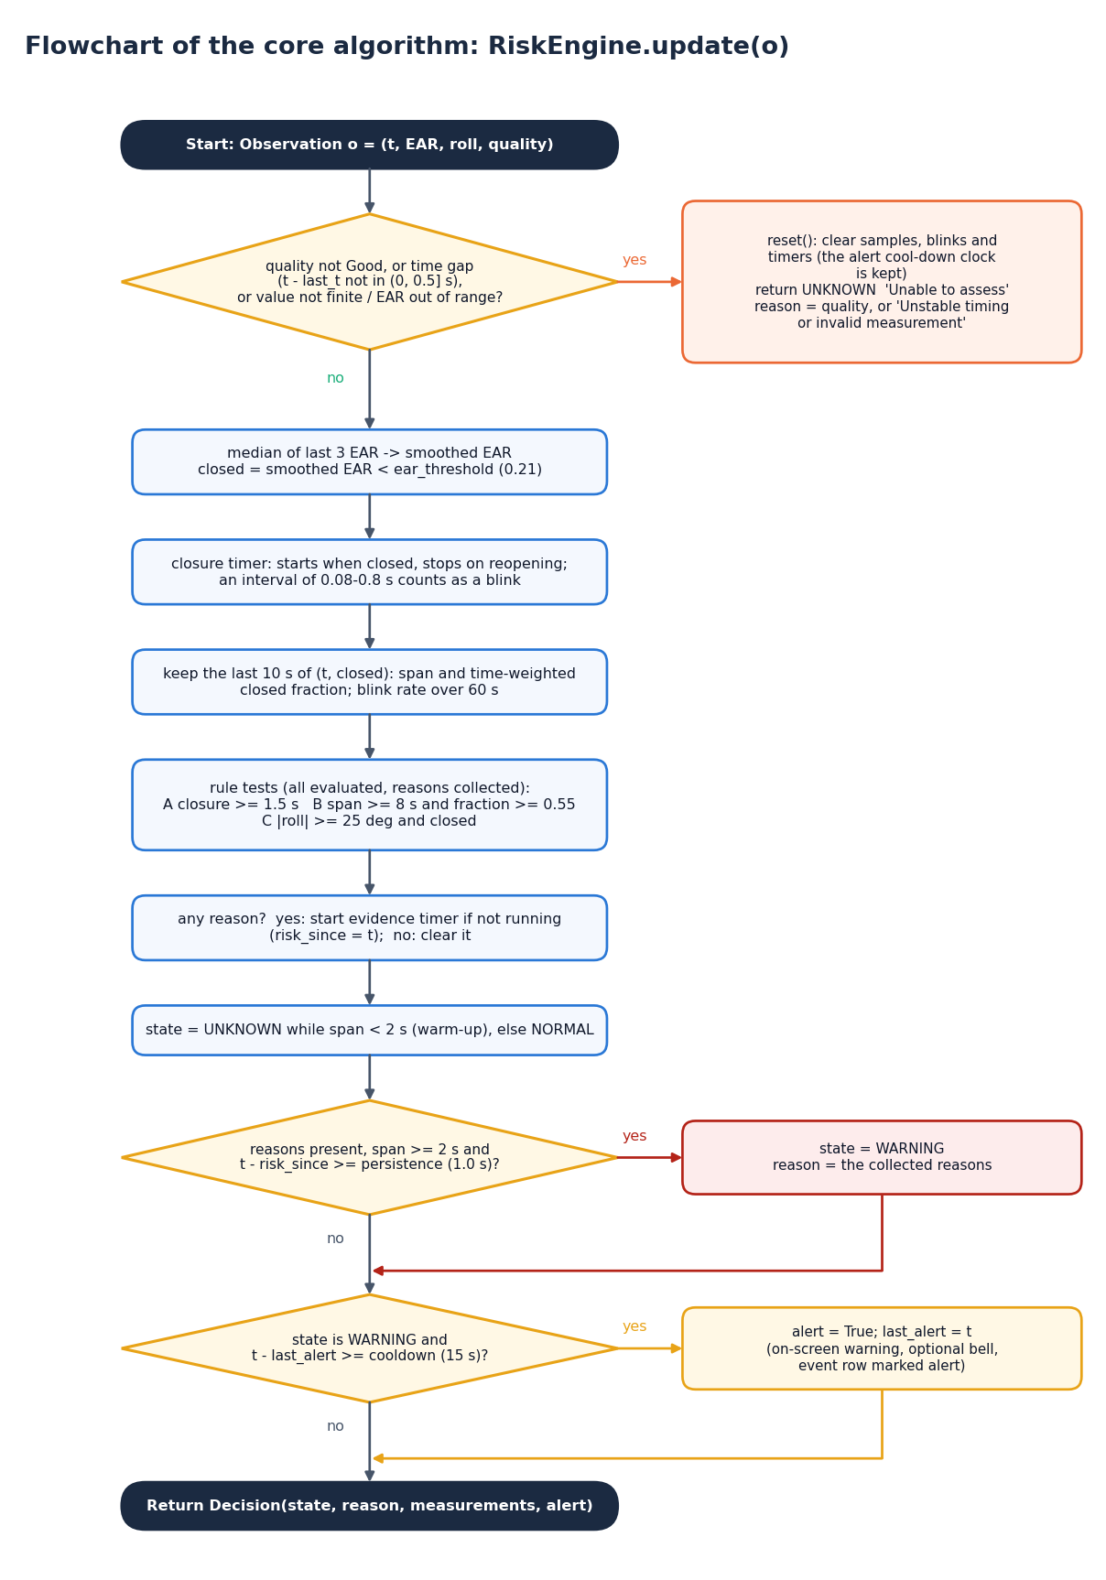
Decision logic
Quality first. A failed gate or timing gap gives Unable to assess and clears the evidence; the alert cooldown is kept.
Three rules, every frame. Closure >= 1.5 s; closed fraction >= 0.55 over 10 s; roll >= 25 degrees with low EAR.
Persistence. The evidence must last 1 s more, with 2 s of reliable history, before the warning shows.
Blinks. A closed interval of 0.08-0.8 s counts as a blink; blink rate is shown, never used alone.
Output. Normal, Possible impairment or drowsiness, or Unable to assess, with the reason; optional bell every 15 s at most.
Notes:
The flowchart is drawn from RiskEngine.update. All three rules are evaluated every frame and their reasons are joined in the warning text.

Slide 11
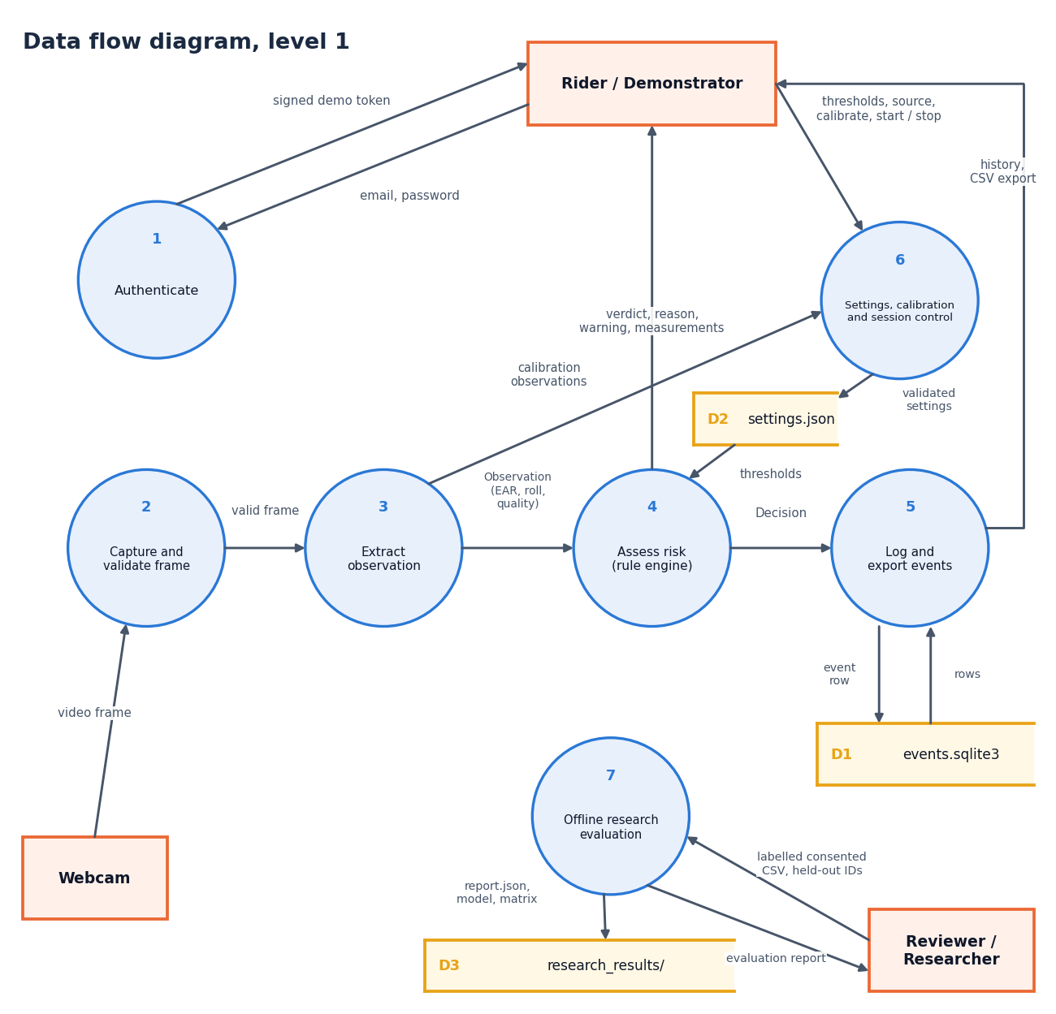
Data flow and modules
Module | Role
core.py | rules, calibration, scenarios
vision.py | landmarks and quality gates
storage.py | SQLite, CSV, settings
research.py | offline evaluation
backend/main.py | 22 API routes, login
backend/session.py | one session per tab
frontend/src | 8 React pages
Notes:
Level-1 data flow: seven processes and three stores. Levels 0 and 2 are in the report.

Slide 12
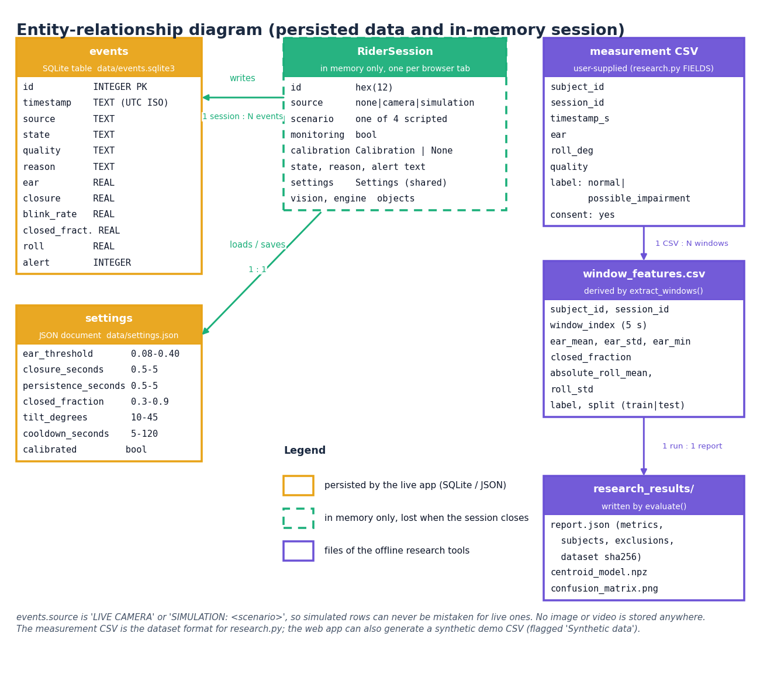
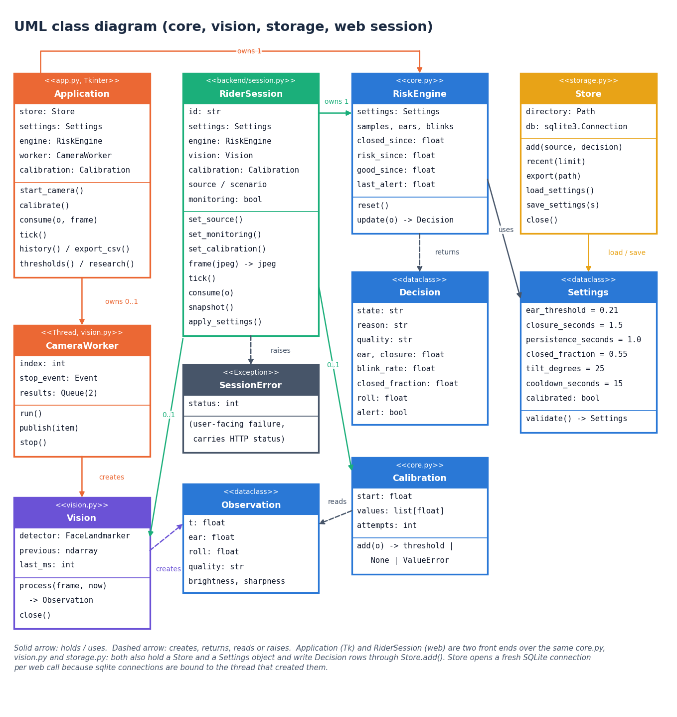
Database design and UML
One persisted table (events, 12 numeric columns), a settings file and the research CSV; sessions live in memory and no images are stored.
Notes:
Left: what is persisted and what is not. Right: the main classes. Settings, Observation, Decision, RiskEngine and Calibration are pure logic; Vision, Store and RiderSession are the parts that touch the outside world.

Slide 13
Technology stack
Layer | Technology
Vision | MediaPipe 1.0.1 (Face Landmarker, CPU), OpenCV contrib 5.0.0.93, NumPy 2.5.3
Charts and offline tools | Matplotlib 3.11.2, NumPy nearest centroid
API | FastAPI 0.162, Uvicorn 0.54, python-multipart; HMAC-signed demo token
Desktop | Tkinter (original prototype)
Database | SQLite and a JSON settings file
Front end | React 18, Vite 8, TypeScript, Tailwind 4, React Router 7, TanStack Query, Recharts
Testing | unittest, FastAPI TestClient, Playwright for screenshots
Run | Python 3.14.7 venv, run.bat (Windows), ports 8306 and 5306
Notes:
Everything is open source and runs on one laptop; run.bat rebuilds the environment and downloads the 3.7 MB landmark model if needed.

Slide 14
Implementation progress
Component | Status | Evidence
Eye and head measurement, 7 quality gates | Done | vision.py; measured on 2,423 CEW faces
Rule engine, calibration, thresholds | Done | core.py; 20 unit tests
FastAPI service and demo login | Done | 22 routes; 34 smoke checks
React interface, history, CSV export | Done | 8 pages; 15 desktop and 4 phone screenshots
Offline research pipeline | Built, not trained | synthetic demo only, flagged
Deep-learning sober / intoxicated model | Not done | no labelled intoxication data
Prevention action (ignition or contact alert) | Not done | on-screen warning and bell only
Gaze deviation | Not done | not measured
Notes:
State of the code base. The three Not done rows are objectives from the batch file that this version does not meet; the report says so in the objectives table.

Slide 15
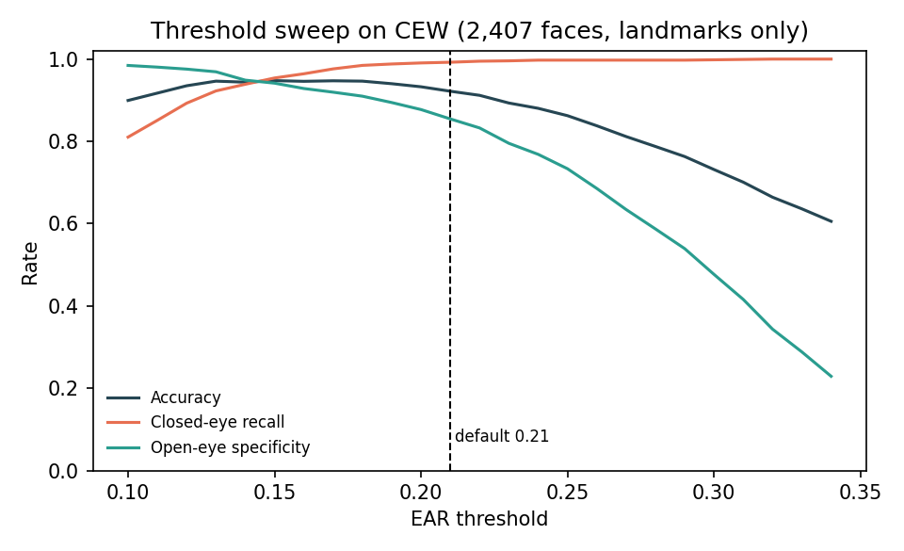
Preliminary results: eye state on CEW
92.2%
99.2%
85.5%
0.989
accuracy at threshold 0.21
closed-eye recall
open-eye specificity
ROC AUC of EAR
about 2.5 s
31 ms
closure needed to warn
API frame latency, median
Geometry only, 2,407 CEW faces, still images.
Threshold 0.21 calls 14.5% of open eyes closed; 0.17 does better (94.7%, chosen in-sample).
With the quality gates only 44.1% of these 100 px images are assessed.
Closed and open images come from different sources; scripted rule tests: closures up to 2.4 s never warn, 2.6 s always do.
Notes:
Numbers come from experiments/cew_ear and experiments/rule_engine. Accuracy 92.2% at the default 0.21 on 2,407 faces; the default is conservative. This tests only the eye open or closed measurement on still images, not intoxication. Closed faces come from the Internet and open faces from LFW, so separation may be optimistic. API frame latency: median 31.2 ms, 95th percentile 47.8 ms on this i5-12500.

Slide 16
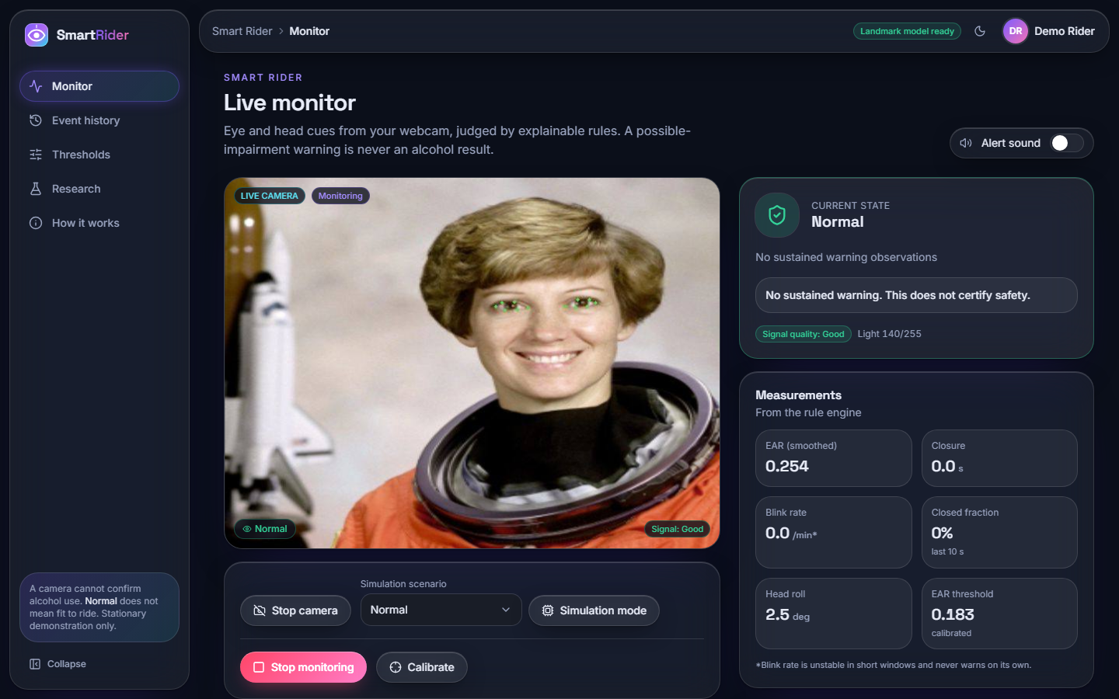
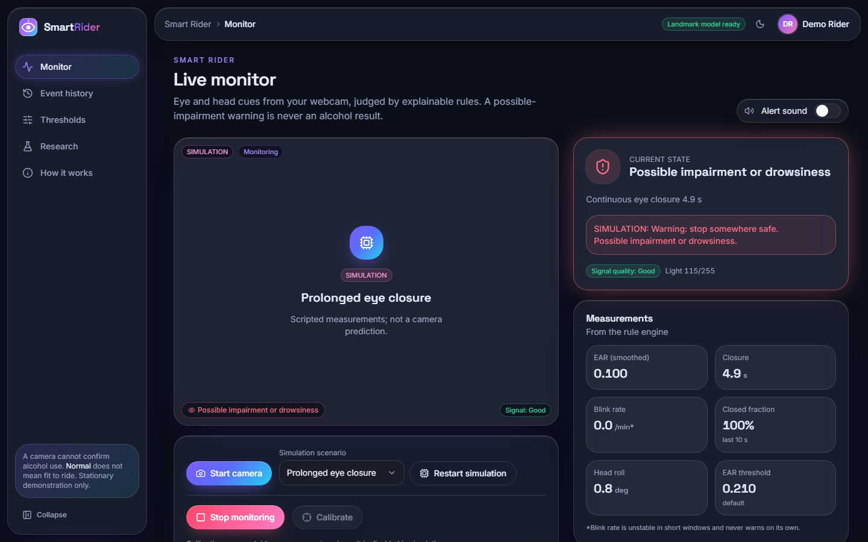
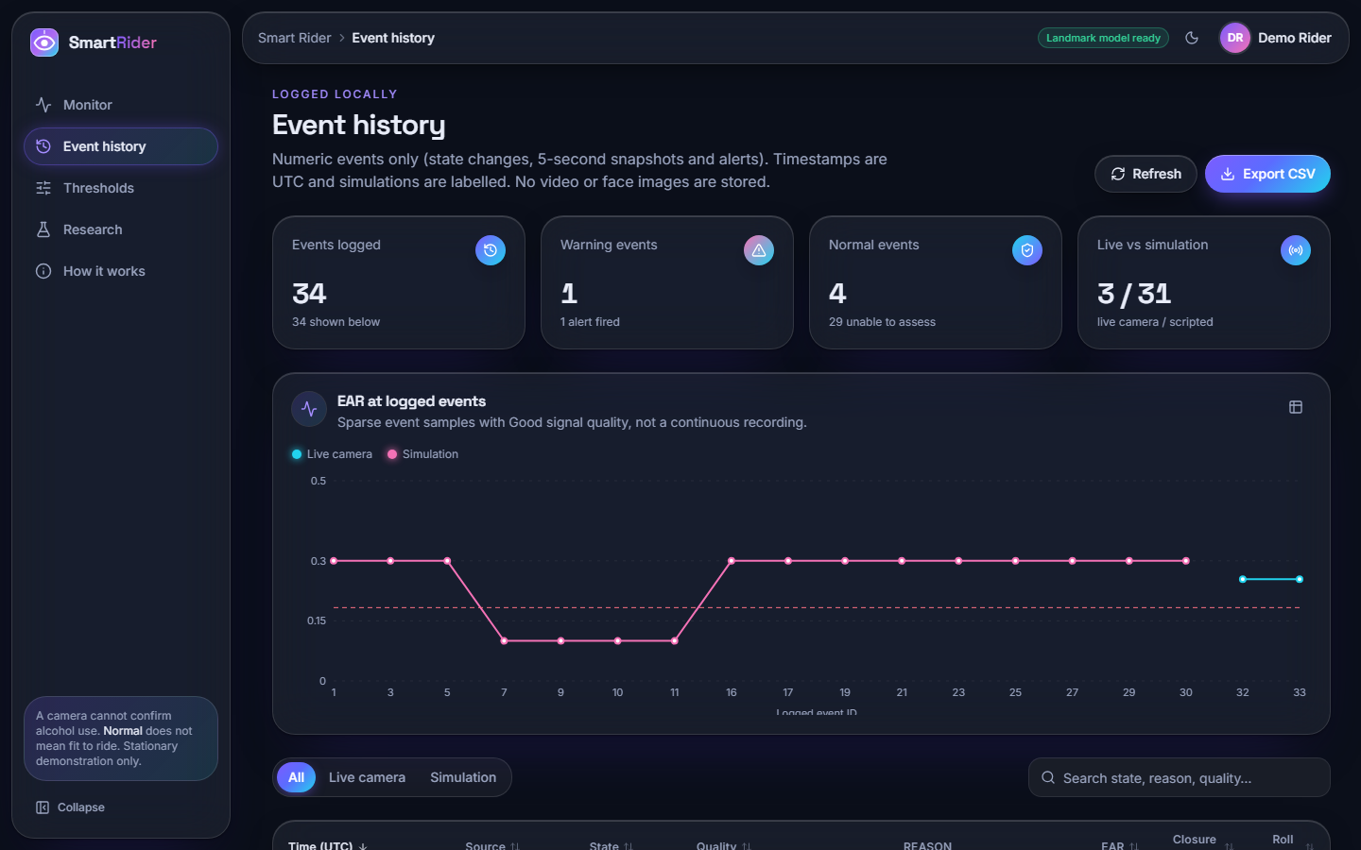
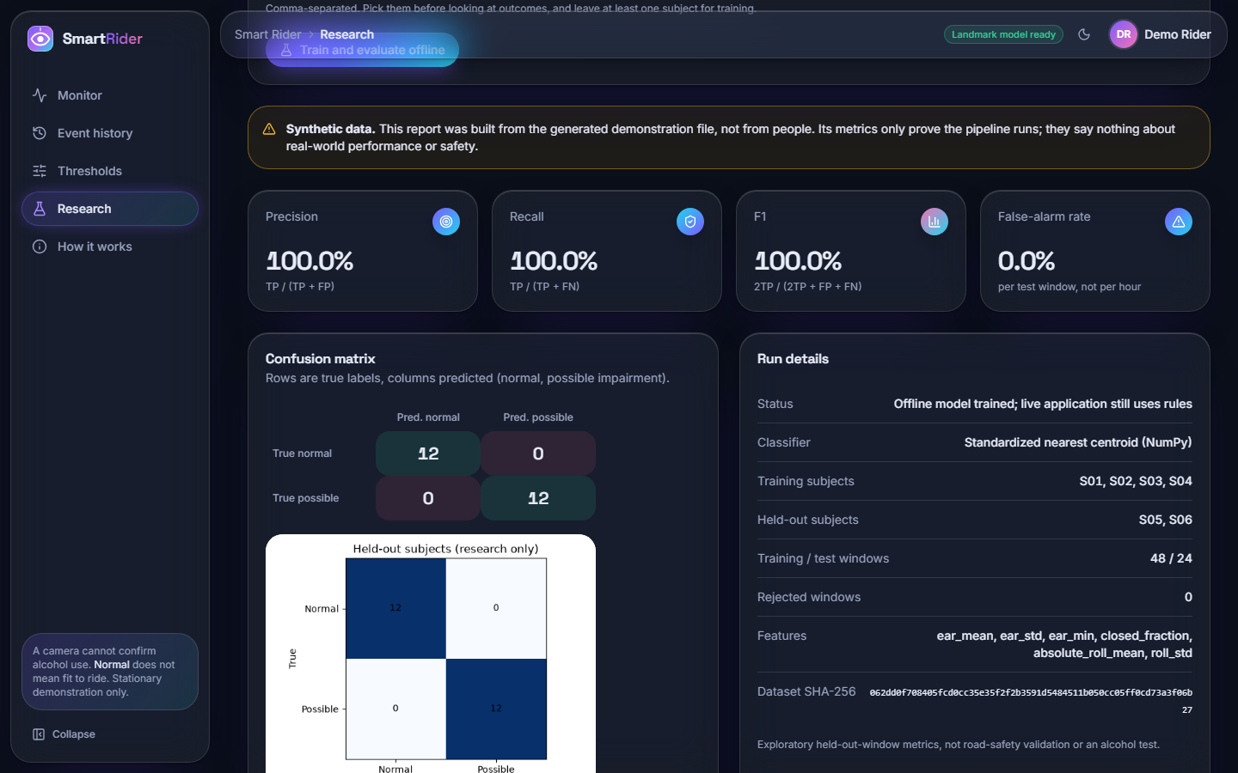
Output screens
What to look at
Verdict and reason beside the preview; the measurements come straight from the rule engine.
SIMULATION labels on scripted runs: they are not model predictions.
The 100 % research metrics come from a generated file and say nothing about riders.
Every screen is a real capture of the running app.
Live camera path: landmarks on a real face, Normal
Scripted closure raises the warning, with its reason
Event history: 34 events, EAR chart, CSV export
Research report on SYNTHETIC data: not performance
Notes:
Real screenshots from the running application. Top left uses one public-domain portrait as a fake webcam; EAR 0.254 against a calibrated threshold of 0.183. Bottom right is the offline evaluation screen on the generated demo file; it carries a Synthetic data banner.

Slide 17
Initial testing and observations
20 / 20
34 / 34
0 / 300
48 ms
unit tests passed
API smoke checks passed
scripted sessions with a false warning at normal blink rates
95th percentile frame latency
Observation | Action
Halving the brightness blocks assessment: gates are strict | Reported as a limitation; fails safe to Unable to assess
Default 0.21 calls 14.5% of open CEW eyes closed | Per-rider calibration; threshold sweep documented
Only 44 % of 100 px CEW images pass the sharpness gate | Reported; webcam frames are the intended input
Closure + persistence above 3 s misses a 3 s closure | Parameter trade-off measured and documented
Notes:
All suites use temporary storage and never touch the real history. The scripted blink streams are generated, not people. The observations on the right drove the limitations section of the report.

Slide 18
Challenges and corrective actions
Challenge | Corrective action
No labelled intoxication data exists for this project | Explainable rules; offline pipeline kept for future consented data
The batch title promises alcohol detection; a camera cannot confirm it | Output says possible impairment or drowsiness, never alcohol
Browser webcam needs localhost or https | Frames sent from the browser; MediaPipe runs on the server
Shipped virtual environment pointed at a missing Python | run.bat rebuilds it and downloads the 3.7 MB landmark model
Unrelated stills in MediaPipe video mode vary by about 2 points | Stated as a measurement caveat
The API sustains about 30 frames/s but the browser sends about 9 | Both figures reported
Notes:
Each challenge led to a concrete change or a plainly stated limitation.

Slide 19
Next steps
1
Document
2
Tune
3
Collect data
4
Extend (future)
Final report, paper and deck, every number regenerated from the metrics files.
Choose thresholds on training-only subjects; the CEW sweep points to 0.17-0.18.
If a consented labelled sober / intoxicated dataset is obtained, run the subject-disjoint offline pipeline.
Gaze features, helmet and visor robustness, vehicle integration for a prevention action, embedded deployment.
Until a labelled intoxication dataset exists, Smart Rider stays a possible-impairment or drowsiness warning, not an alcohol test.
Notes:
Plan to the final review. The right-hand card lists future work that is outside this submission.

Slide 20
Thank you
Questions and suggestions are welcome.
Notes:
Likely questions: why rules rather than a trained model; can it detect alcohol (no); what the measured limits are.

