Slide 1

Smart Alcohol Intoxication Detection and Prevention System Using AI
Final Review · Smart Rider Impairment Warning System for Two-Wheelers
Team Details : Batch A6
Under the Esteemed Guidance of
N. PADMAVATHI
[DESIGNATION], Department of CSE
23K91A0522 B Pranitha
23K91A0531 Bantu Kavya
23K91A0560 Dasari Viveka Sarveshwari
23K91A0534 Bekkam Vamshi
DEPARTMENT OF COMPUTER SCIENCE AND ENGINEERING · TKR College of Engineering and Technology (Autonomous) · Academic Year [ACADEMIC YEAR]
Notes:
Introduce the team and the title. Be upfront: the title says alcohol, but what we built is an explainable eye-closure and head-tilt impairment-and-drowsiness warning for a rider. It cannot confirm alcohol, and we say so throughout.

Slide 2
Table of Contents
Abstract
Base Paper & Literature Survey
Research Gap & Problem Statement
Objectives and their status
Proposed System & Architecture
Methodology, Dataset & Rules
Decision Workflow, Interaction & Database
Implementation Highlights
Results, Threshold Analysis, Robustness, Performance & Testing
Comparison with Base Paper
Output Screens
Conclusion, Limitations, Future Scope & References
Dept. of CSE | Batch A6 | Final Review
2
Notes:
The agenda follows the report: problem, design, method, results (with their limits), comparison, screens, conclusion.

Slide 3
Abstract
Impaired riding is hard to police continuously: breath tests are occasional and need an officer; a rider's face, however, shows eye closure and head posture all the time.
We built Smart Rider, a webcam system that measures the eye aspect ratio, closure time, closed-eye fraction and head roll, refuses to guess when the picture is poor, and shows one of three outputs with its reason: Normal, Possible impairment or drowsiness, Unable to assess.
Measured: on 2,423 public CEW faces the eye-aspect-ratio separates closed from open eyes with AUC 0.989 (92.2% accuracy at the default threshold); a closure must last about 2.6 s to warn; one camera frame takes 31 ms through the web API; 20 unit tests and 34 API checks pass.
Honest scope: it is not an alcohol detector. No deep-learning classifier was trained (no intoxication data existed), gaze is not measured, no ignition or contact action exists, and no study with riders was run.
Dept. of CSE | Batch A6 | Final Review
3
Notes:
Read the first two bullets, then the measured numbers, then stress the last bullet: what the batch objectives promised and what was and was not delivered.

Slide 4
Base Paper
C.-L. Feng and T.-H. S. Li, "Robust Driver State Assessment on an Embedded Platform Using a Fuzzy Belief Rule-Based Fusion of Eye Aspect Ratio and Voice Commands," IEEE Access, vol. 14, pp. 36158-36175, 2026, doi: 10.1109/ACCESS.2026.3670924.
Aspect | Base paper [1]
Method | Four-point EAR-4 and six-point EAR from MediaPipe; head pose; Whisper-tiny voice commands; fuzzy belief rule-based fusion; personal threshold from more than 300 frames
Data | NTHU-DDD: four subjects, 65,834 frames (29,804 open, 36,030 closed), 80/20 frame split; Random Forest and XGBoost
Reported results | EAR-4 recall 0.894 and F1 0.845 (Subject 2, Random Forest; six-point EAR 0.856 and 0.813); 25 FPS on a Jetson Orin Nano 8 GB
Stated limits | Targets drowsiness, fatigue and distraction, not alcohol; four subjects; subject-independent validation left as future work
Dept. of CSE | Batch A6 | Final Review
4
Notes:
This is the batch's base paper. It is about drowsiness on embedded hardware. We borrow the idea of eye aspect ratio plus personal calibration; we do not reproduce EAR-4, the voice interface or the fuzzy belief engine.

Slide 5
Literature Survey
Author / Year | Methodology | Dataset | Key Results | Limitations
Baroutian et al., 2025 [2] | Landmark graph attention network + 3D ResNet, fused | 202 YouTube videos (101 sober, 101 intoxicated) | Accuracy 95.82 %, precision 0.977, recall 0.97 | Scraped videos; GPU model; not a controlled study
Deuber et al., 2026 [3] | Smartwatch accelerometer + HRV; logistic regression and 1D CNN | Test-track study, 54 participants | AUROC 0.88 (any alcohol), 0.86 (above 0.05 g/dL) | Needs a worn device; preprint under review
Acharya, 2024 [5] | Thermal images; NasNetMobile, MobileNet | 50 volunteers, four drinking levels | NasNetMobile 85.10 %; MobileNet 74.07 % (sober vs drunk) | Needs thermal camera; abstract only read
Chai et al., 2025 [8] | Thermal facial patterns; CNN features; MLP, SVM, KNN, RF | Tufts Face Database + own thermal images | MLP about 90 % accuracy | Thermal camera; abstract only read
Soukupova and Cech, 2016 [9] | Eye aspect ratio from six landmarks | Three standard blink datasets | Comparable with the state of the art | Blink detection, not impairment
Song et al., 2014 [12] (CEW) | Eye-closeness detection from still images | 2,423 faces: 1,192 closed, 1,231 open | Used here as test data | Closed and open from different sources
Dept. of CSE | Batch A6 | Final Review
5
Notes:
Intoxication from facial video, thermal images or a smartwatch has been studied; eye aspect ratio is the standard cue for blinks and drowsiness. Only results we could read are shown. The DIF dataset [4] is cited in the report; many of its source videos are no longer reachable.

Slide 6
Research Gap
Batch survey: the surveyed work concentrates on drowsiness and embedded driver-state assessment; the gap is an intoxication-specific vision model coupled to a prevention action rather than a warning alone.
Cause is not separable: eye-closure and head-posture monitors work for drowsiness, but the cues overlap with alcohol impairment, so such a monitor cannot tell the cause.
Data: intoxication-specific video models need labelled intoxicated people; the best-known public set has partly disappeared and none suited this team.
Runnable path: few works give a complete, explainable route from webcam frame to logged warning, with quality checks that refuse to guess.
We address the third point and part of the first. We do not close the data gap or the prevention-action gap.
Dept. of CSE | Batch A6 | Final Review
6
Notes:
Four points from the survey. We built the complete explainable path and measured the eye-closure component; the data and prevention-action gaps remain open.

Slide 7
Problem Statement
Given a live camera view of a rider's face, decide continuously whether the visible eye and head behaviour shows a sustained pattern that may indicate impairment or drowsiness, say Unable to assess when the picture cannot be trusted, give the reason for every output and keep a numeric record, through an interface a non-expert can run.
Input
Output
Record
Webcam frames, 640 x 480, from the browser or the desktop app; kept in memory only
Normal, Possible impairment or drowsiness, or Unable to assess, with the reason
Numeric event history in SQLite, CSV export, editable thresholds, calibration
Dept. of CSE | Batch A6 | Final Review
7
Notes:
Classify, explain, record. A camera cannot confirm alcohol, so the output says possible impairment or drowsiness.

Slide 8
Objectives and Their Status
# | Objective (batch proposal) | Status | Evidence
1 | Capture facial video; detect face and landmarks in real time | Achieved | MediaPipe landmarks on 640 x 480 frames; 31 ms per frame through the API
2 | Extract eye closure, blink, gaze and head cues | Partly achieved | EAR, closure, closed fraction, blink rate, head roll; gaze not measured
3 | Train a deep-learning sober vs intoxicated classifier | Not achieved | No intoxication data; no model trained; live decisions are rules
4 | Run inference continuously; alert above a threshold | Achieved (as rules) | Three outputs with a reason, warning and optional bell; no learned score
5 | Integrate a prevention action (ignition warning, contact) | Not achieved | Warning and bell only; no ignition control, no contact notification
6 | Evaluate accuracy, false positives, low light, occlusion | Partly achieved | Public eye data, degraded images, scripted streams; no rider study
Dept. of CSE | Batch A6 | Final Review
8
Notes:
Two objectives achieved (one as rules), two partly, two not achieved: the deep-learning classifier and the prevention action. The full wording of each objective and its evidence is in Chapter 1 and Chapter 8 of the report.

Slide 9
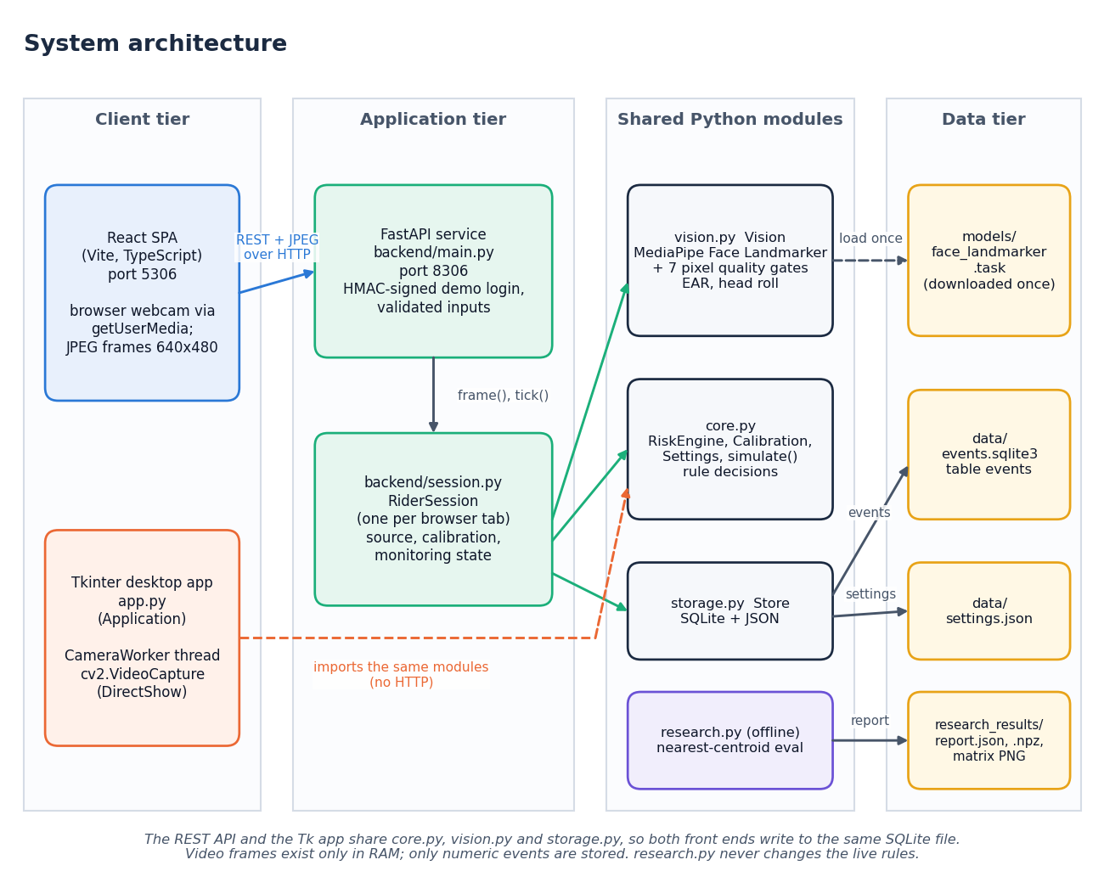
Proposed System & Architecture
Proposed: a webcam monitor that turns eye and head cues into one of three outputs, with the reason
Browser app (React, port 5306) and the original Tk app share the same Python modules
FastAPI (port 8306) holds one session per tab; frames stay in RAM
core.py rules, vision.py MediaPipe, storage.py SQLite
Quality gates always override the rules
Dept. of CSE | Batch A6 | Final Review
9
Notes:
The pipeline in one strip, then the four tiers. The decision logic is the same for the desktop and the web interface.

Slide 10
Methodology
Frame 640x480
Face landmarks
7 quality gates
EAR, roll, median
Rules + persistence
Verdict + log
Calibration: 8 to 15 s of open eyes; threshold = 0.72 x median EAR, clipped to 0.12 - 0.32.
Verification is layered: 20 unit tests, a 34-check API smoke test, and measurements on public eye data, degraded images and scripted streams.
The offline research pipeline (subject-disjoint, nearest-centroid) is built but has only run on a seeded synthetic file; it never drives the live decision.
Every number comes from seeded scripts: measure_cew.py, measure_rules.py, measure_api.py, make_figures.py.
Dept. of CSE | Batch A6 | Final Review
10
Notes:
Methodology: pipeline, calibration, the layers of verification and the fact that the research classifier is not used live.

Slide 11
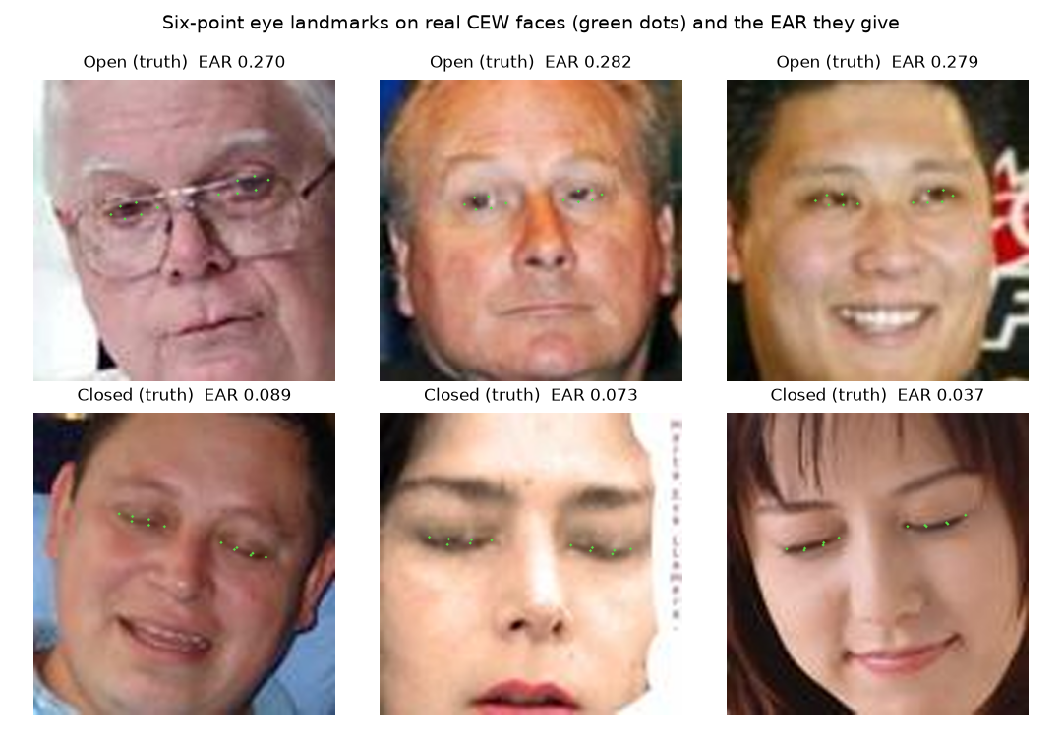
Dataset, Features & Rules
2,423
Rule | Default
Continuous eye closure | >= 1.5 s
Closed fraction, last 10 s | >= 0.55
Head roll with low EAR | >= 25 deg
Persistence before warning | 1.0 s
Alert cooldown | 15 s
CEW faces: 1,192 closed, 1,231 open
478
landmarks per face (pre-trained MediaPipe)
0.21
default EAR threshold (engineering heuristic)
No intoxication dataset was used. CEW (Internet closed-eye faces plus LFW open-eye faces) tests only the eye-open or closed component.
The research CSV demo is SYNTHETIC (seeded, 6 subjects x 2 labels) and shows the pipeline runs, not performance.
Dept. of CSE | Batch A6 | Final Review
11
Notes:
Dataset, features and rules. The landmark model is Google's, not trained by us. The rule values are demonstration choices, not tuned on data; the CEW sweep later suggested 0.17 but the default was left at 0.21.

Slide 12
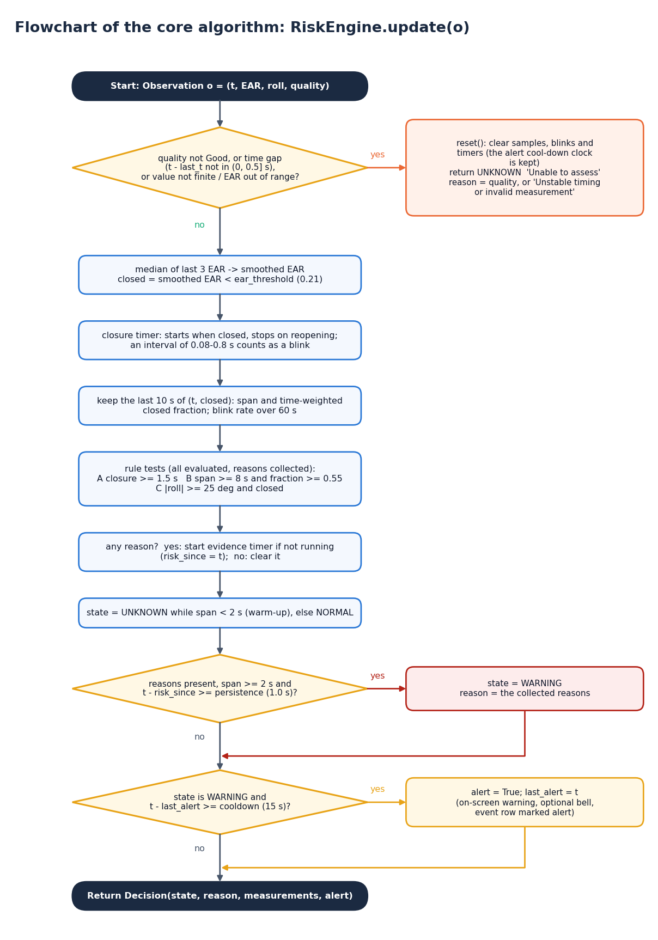
Decision Workflow
Gate first: a bad frame, a timing gap or an invalid value clears the evidence and gives Unable to assess.
Smooth: median of the last three EAR values; closed means below the threshold.
Three rules are checked every frame: closure time, closed fraction over 10 s, tilt with low EAR.
Persist: a rule must hold 1 s more, with 2 s of reliable history, before the warning shows its reasons.
Alert: the optional bell has a 15 s cooldown that survives signal loss.
Dept. of CSE | Batch A6 | Final Review
12
Notes:
The flowchart is drawn from RiskEngine.update in core.py. Blink rate is displayed but never warns on its own.

Slide 13
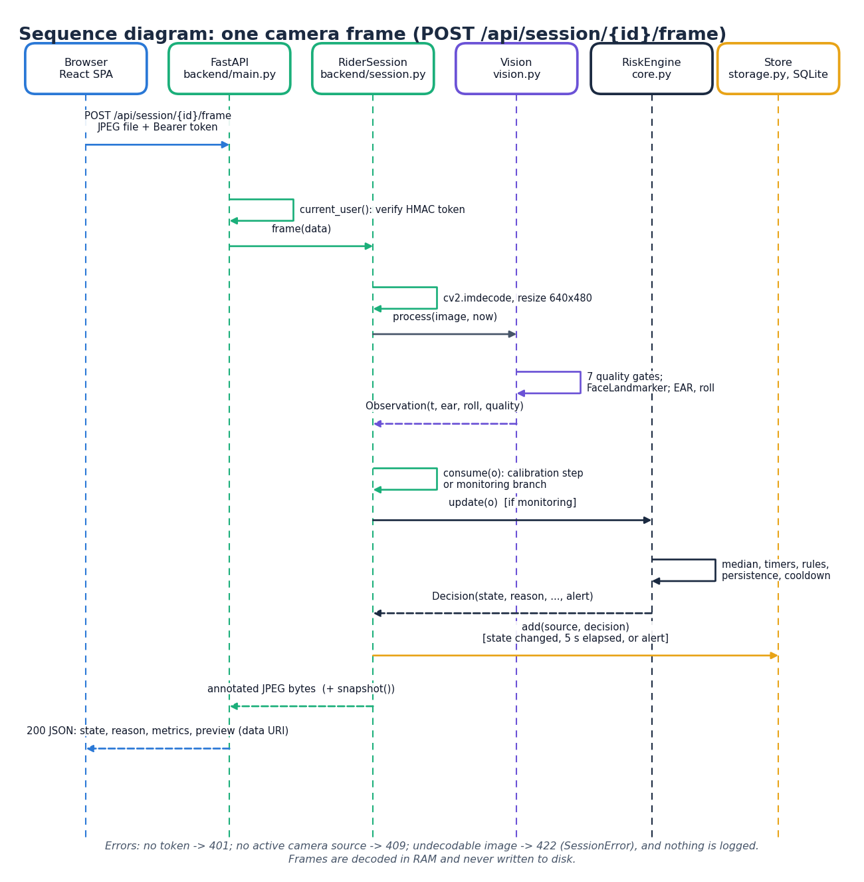
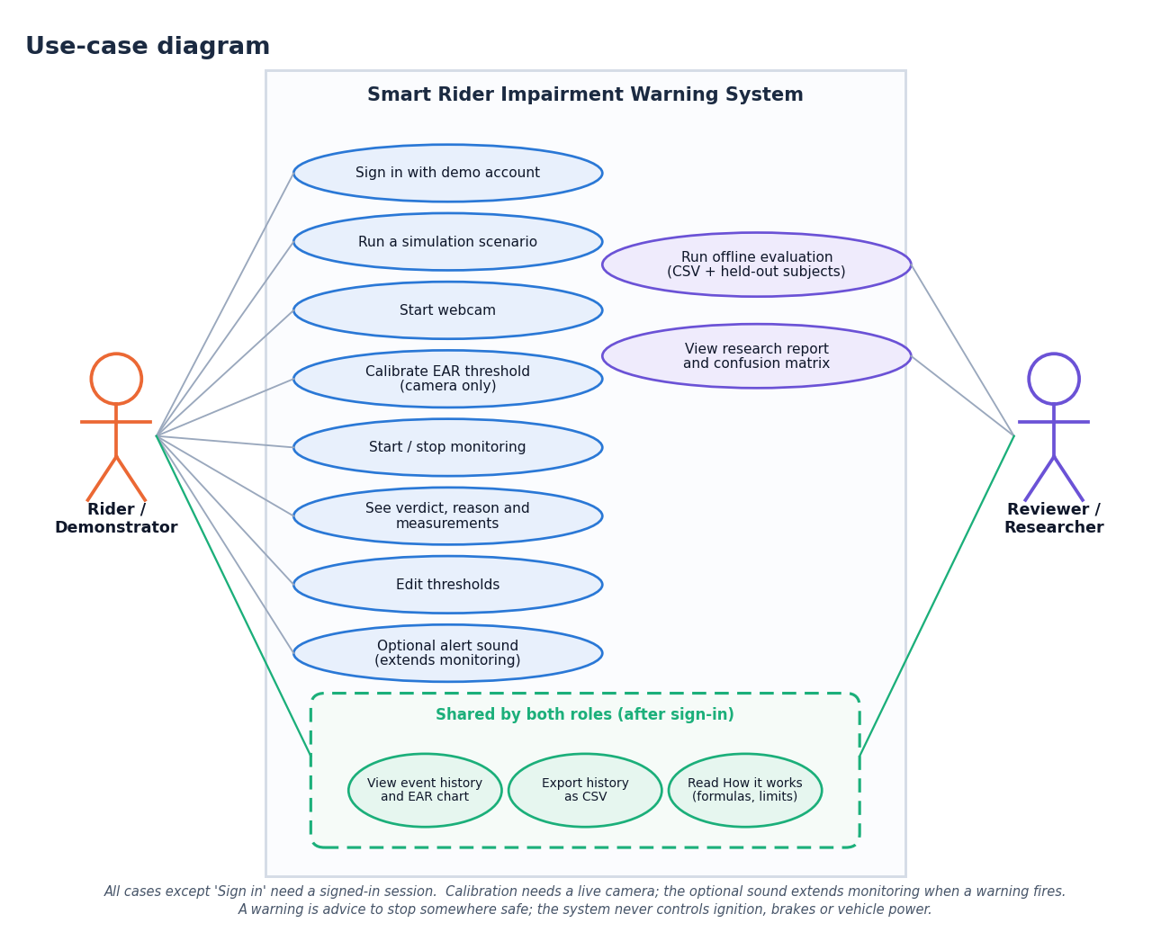
User – System Interaction
Dept. of CSE | Batch A6 | Final Review
13
Notes:
Left: one camera frame through the API. Right: what a rider or demonstrator and a researcher can do.

Slide 14
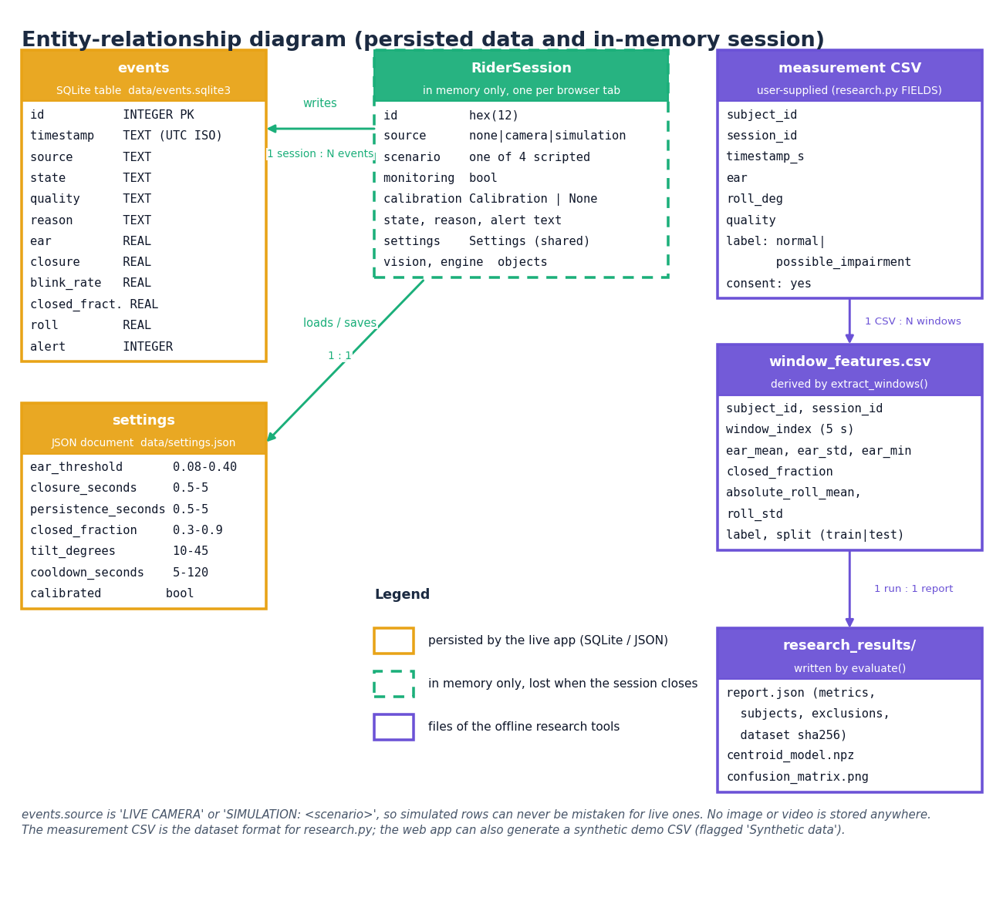
Database Design
Column | Type
id | INTEGER PK
timestamp | TEXT (UTC)
source | TEXT (LIVE CAMERA / SIMULATION)
state, quality, reason | TEXT
ear, closure, blink_rate | REAL
closed_fraction, roll | REAL
alert | INTEGER
One numeric events table plus settings.json; no video or face images are stored.
Dept. of CSE | Batch A6 | Final Review
14
Notes:
Only numbers are stored. Simulation rows are labelled so they can never be mistaken for rider data.

Slide 15
Implementation Highlights
20
34
8
31 ms
unit tests, all pass
API smoke checks, all pass
web pages (React)
median camera frame via API
HMAC-signed demo token (12 h), 401 on protected routes, validated thresholds (422), frames decoded in memory and never saved.
One RiderSession per browser tab mirrors the desktop logic; a fresh SQLite connection per call keeps threads safe.
Monitor screen: live landmarks, three outputs with reasons, calibration progress, alert sound, simulation scenarios for demonstrations without a camera.
History with filters and CSV export, threshold editor, research screen, How-it-works page; light and dark themes; checked at 360, 768 and 1440 px.
Dept. of CSE | Batch A6 | Final Review
15
Notes:
Implementation highlights. The web layer adds no decision logic; it wraps the original modules.

Slide 16
Results – Eye-state Classification on CEW
Pipeline (threshold 0.21) | Images assessed | Accuracy | Closed recall | Open specificity | AUC
Shipped, quality gates on | 1,068 of 2,423 (44.1%) | 94.9% | 100.0% | 89.8% | 0.993
Landmarks only, no gates | 2,407 of 2,423 | 92.2% | 99.2% | 85.5% | 0.989
Landmarks only | Predicted closed | Predicted open
Truly closed | 1167 | 9
Truly open | 179 | 1052
0.059
0.290
mean EAR, closed eyes
mean EAR, open eyes
Gates pass only 44.1 % because 100-pixel crops are soft (sharpness gate). Closed images come from the Internet and open ones from LFW, so separation may be optimistic; still images only; coverage varies about +/- 2 points between runs.
Dept. of CSE | Batch A6 | Final Review
16
Notes:
This is the measured result for one component: can the six-point EAR tell closed from open eyes. It is not an intoxication result. The default threshold falsely calls about 14.5 % of open eyes closed on this data and misses under 1 % of closed ones.

Slide 17
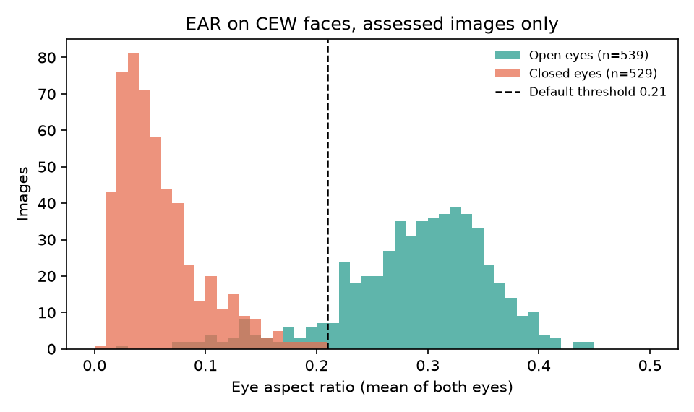
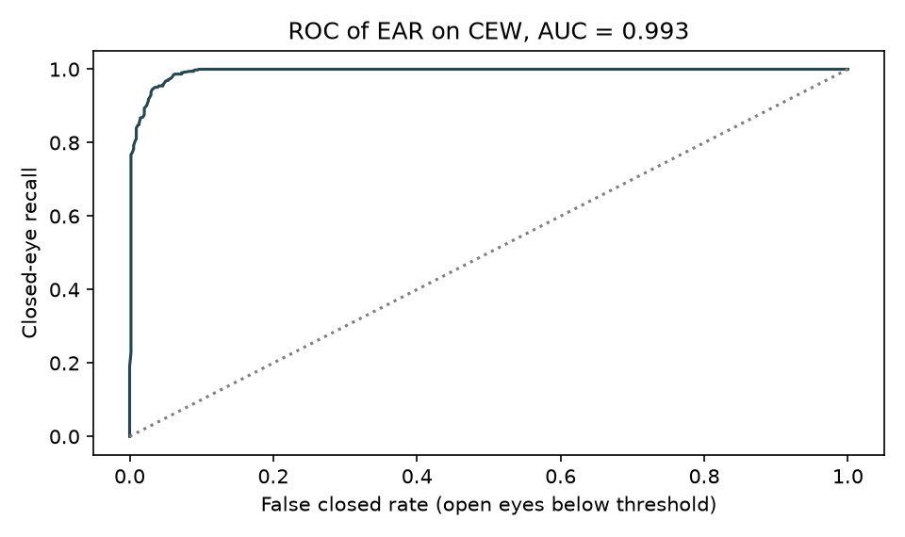
ROC Curve & EAR Distribution (equivalent of a confusion matrix)
EAR of the 1,068 images that passed the quality gates
ROC on the same images, AUC 0.993
No sober-versus-intoxicated confusion matrix exists because no intoxication data was available.
Dept. of CSE | Batch A6 | Final Review
17
Notes:
Closed eyes cluster near 0.06 and open eyes near 0.29, with overlap; hence the high AUC and the threshold trade-off on the next slide.

Slide 18
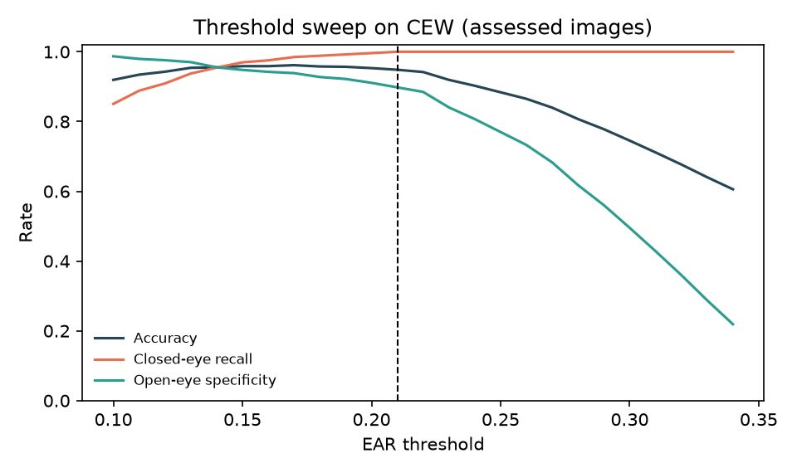
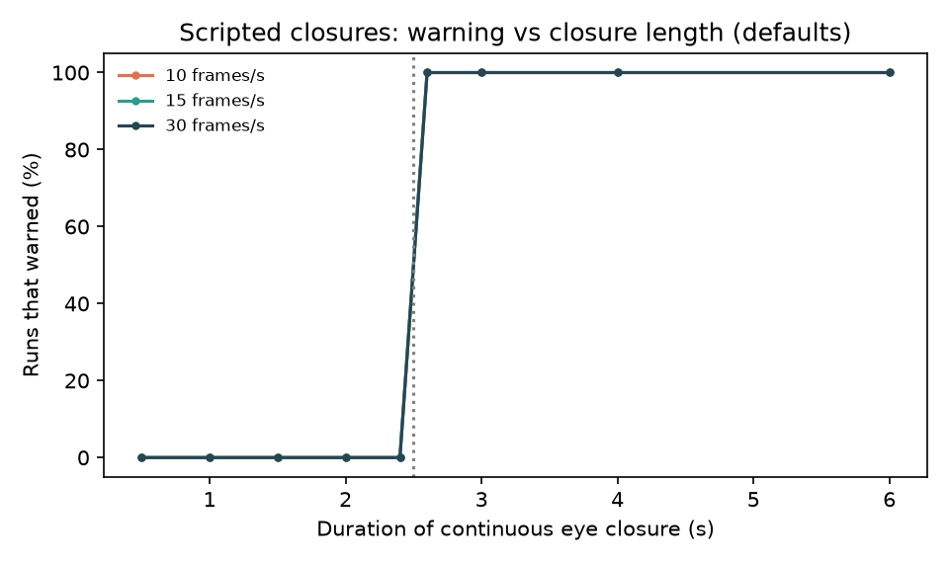
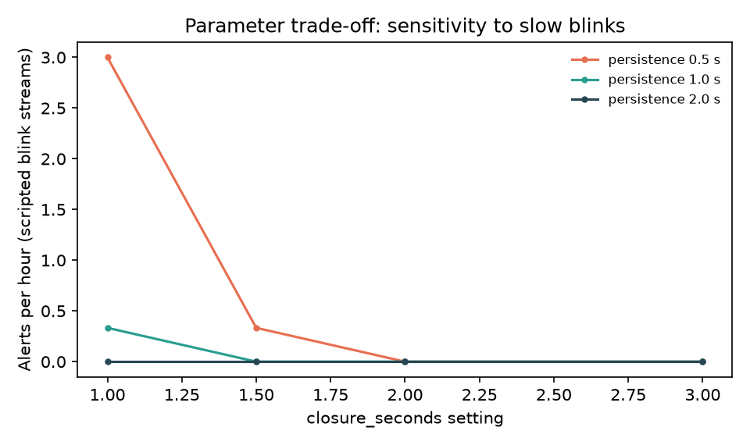
Threshold & Parameter Analysis
EAR threshold sweep on CEW
Closure length vs warning (scripted)
Slow-blink alerts per hour (scripted)
Best in-sample threshold is 0.17 (94.7% accuracy) against 92.2% at the default 0.21. The default was not changed after this sweep; per-rider calibration sets a personal value.
On scripted streams closures up to 2.4 s never warn and closures of 2.6 s or more always warn (30 of 30 runs); with 10 % slow blinks the default (1.5 s, 1.0 s) gives 0.0 alerts per hour, while (1.0 s, 0.5 s) gives 3.0.
Dept. of CSE | Batch A6 | Final Review
18
Notes:
Left: threshold sweep on real CEW images. Middle and right: scripted streams, generated by seeded code, showing how the rule parameters trade detection against false alerts. These show behaviour, not accuracy on people.

Slide 19
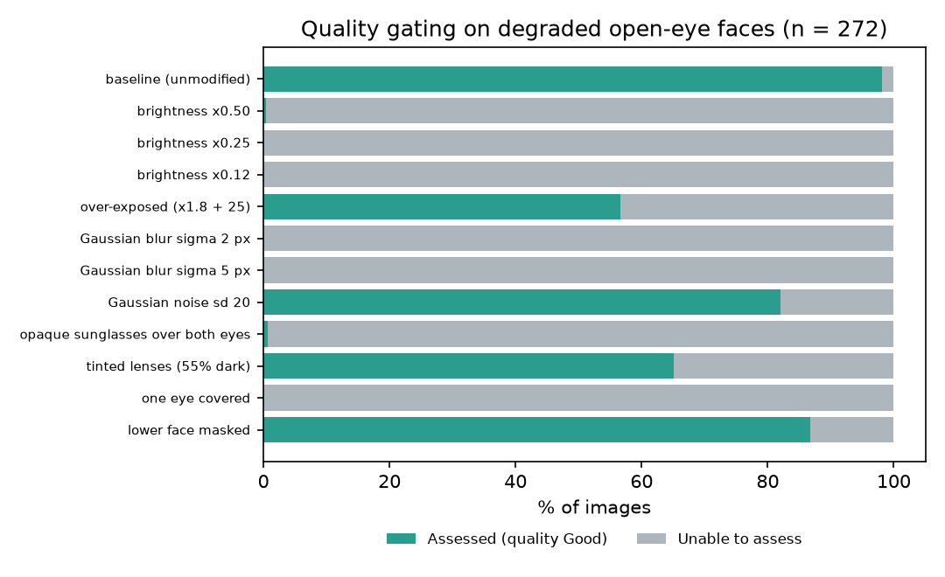
Robustness: Quality Gating under Degraded Images
Opaque sunglasses: 0.7% assessed
One eye covered: 0.0% assessed
Brightness x0.5: 0.4% assessed
Tinted lenses: 65.1%; noise: 82.0%; lower face masked: 86.8%
Gates fail safe (no verdict instead of a guess) but are strict: dim light already blocks assessment.
272 open-eye faces; low-resolution sources inflate the blur effect.
Dept. of CSE | Batch A6 | Final Review
19
Notes:
Objective 6 asked about low light and partial occlusion. The gates refuse to assess rather than guess, which is safe, but availability in dim light is poor.

Slide 20
Performance & Testing
31.2 ms
13.1 ms
40.6 us
2.6 ms
camera frame via API, median (p95 47.8)
landmarks + gates per frame, median
rule engine per observation
health check, median
Test layer | What it covers | Result
Unit tests | EAR geometry, roll, rules, calibration, settings, SQLite, research pipeline | 20 of 20 passed
API smoke test | login, 401/409/422 guards, simulation, blank frame, history, CSV, thresholds, research | 34 of 34 checks passed
Earlier desktop checks (23 Sep) | Tk smoke test, camera diagnostic (81 real frames, no accuracy claim) | passed
User acceptance | No user study was run | not done
Measured on 12th Gen Intel Core i5-12500 (6 cores, 12 threads), 15.7 GB RAM, CPU only, 127.0.0.1.
Dept. of CSE | Batch A6 | Final Review
20
Notes:
All timings are on a laptop CPU. The API sustains about 30 frames per second; the browser sends about 9 per second.

Slide 21
Comparison with Base Paper (context only – different data, hardware, target)
Aspect | Base paper [1] | This project
Target state | Drowsiness, fatigue, distraction | Possible impairment or drowsiness; not alcohol
Eye feature | EAR-4 (four upper-lid points) vs six-point EAR | Conventional six-point EAR
Decision | Fuzzy belief rule-based fusion of EAR, head pose, voice | Transparent duration rules: closure, closed fraction, tilt
Data | NTHU-DDD: 4 subjects, 65,834 frames; RF and XGBoost | CEW: 2,423 still faces for the EAR component; no rider data
Eye-state metric | EAR-4 recall 0.894, F1 0.845 (Subject 2, RF); six-point EAR 0.856, 0.813 | Six-point EAR at 0.21: recall 99.2%, specificity 85.5%, F1 0.925
Hardware / speed | Jetson Orin Nano 8 GB, 25 FPS | Laptop CPU, about 30 frames/s via the API (31 ms median)
Not like-for-like: different datasets, subjects, hardware and target state. The numbers are context, not a ranking.
Dept. of CSE | Batch A6 | Final Review
21
Notes:
State plainly that nothing here is directly comparable: different data, different hardware, and the base paper does not target alcohol either.

Slide 22
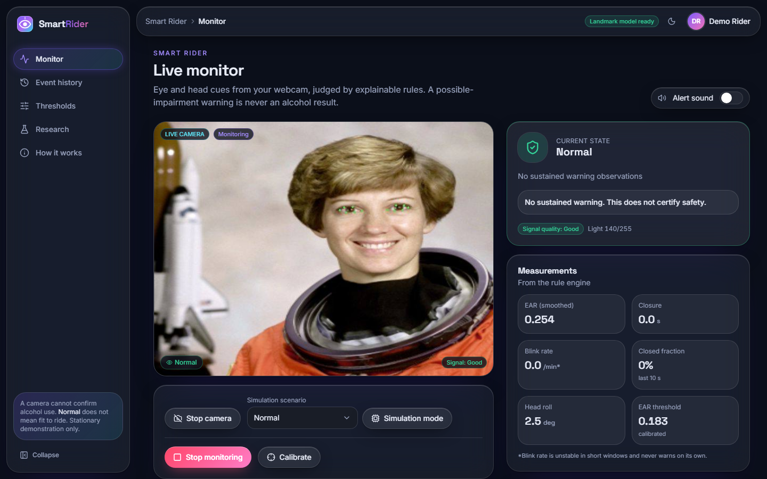
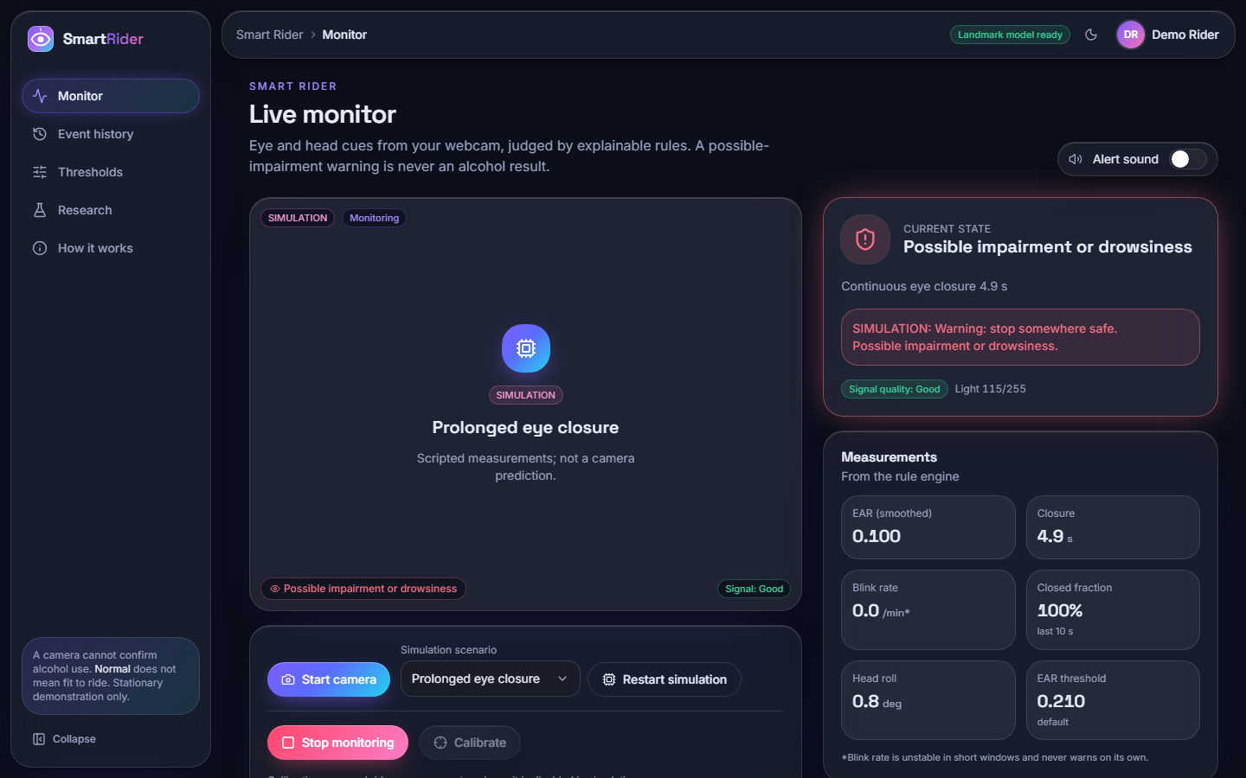
Output – Live Monitor: Normal and Warning
Live camera path on a public-domain face: landmarks on the eyes, Normal, EAR 0.254, calibrated threshold 0.183
Simulation 'Prolonged eye closure' raising Possible impairment or drowsiness, with the reason
Dept. of CSE | Batch A6 | Final Review
22
Notes:
Left: real camera path (a public-domain portrait played as a fake webcam). Right: the scripted simulation scenario, labelled SIMULATION on screen.

Slide 23
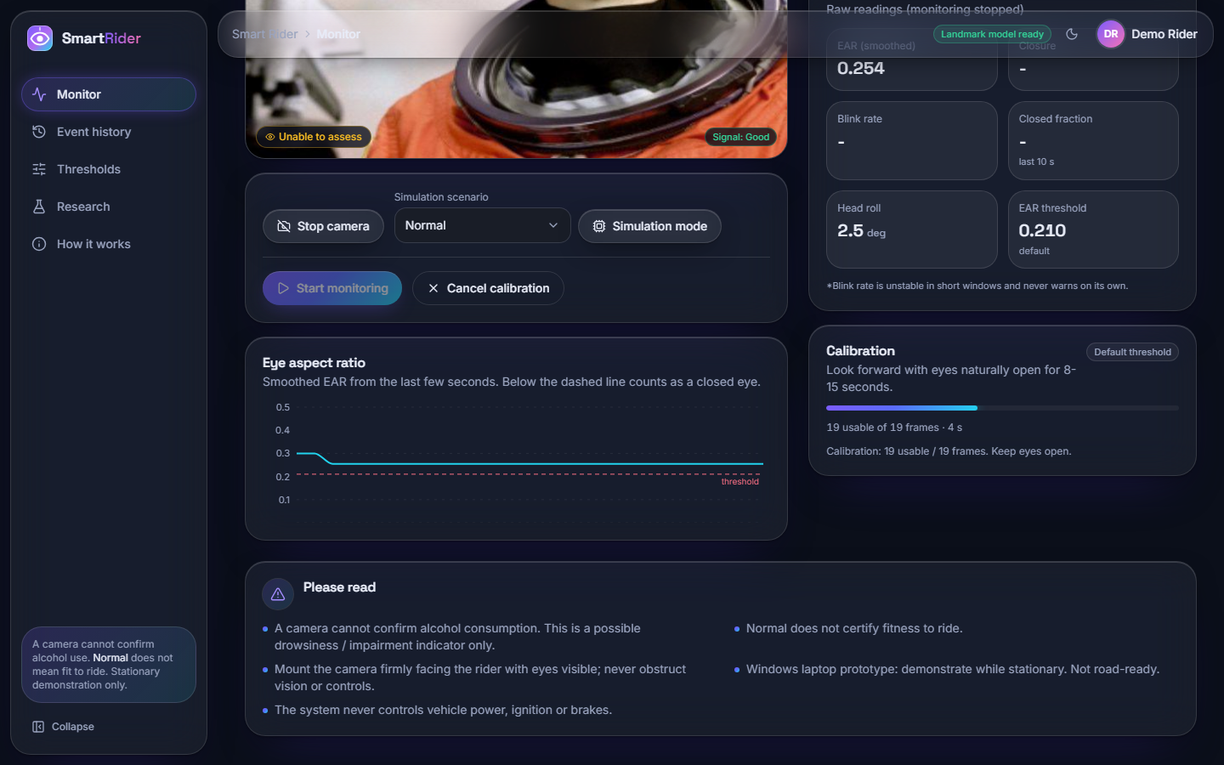
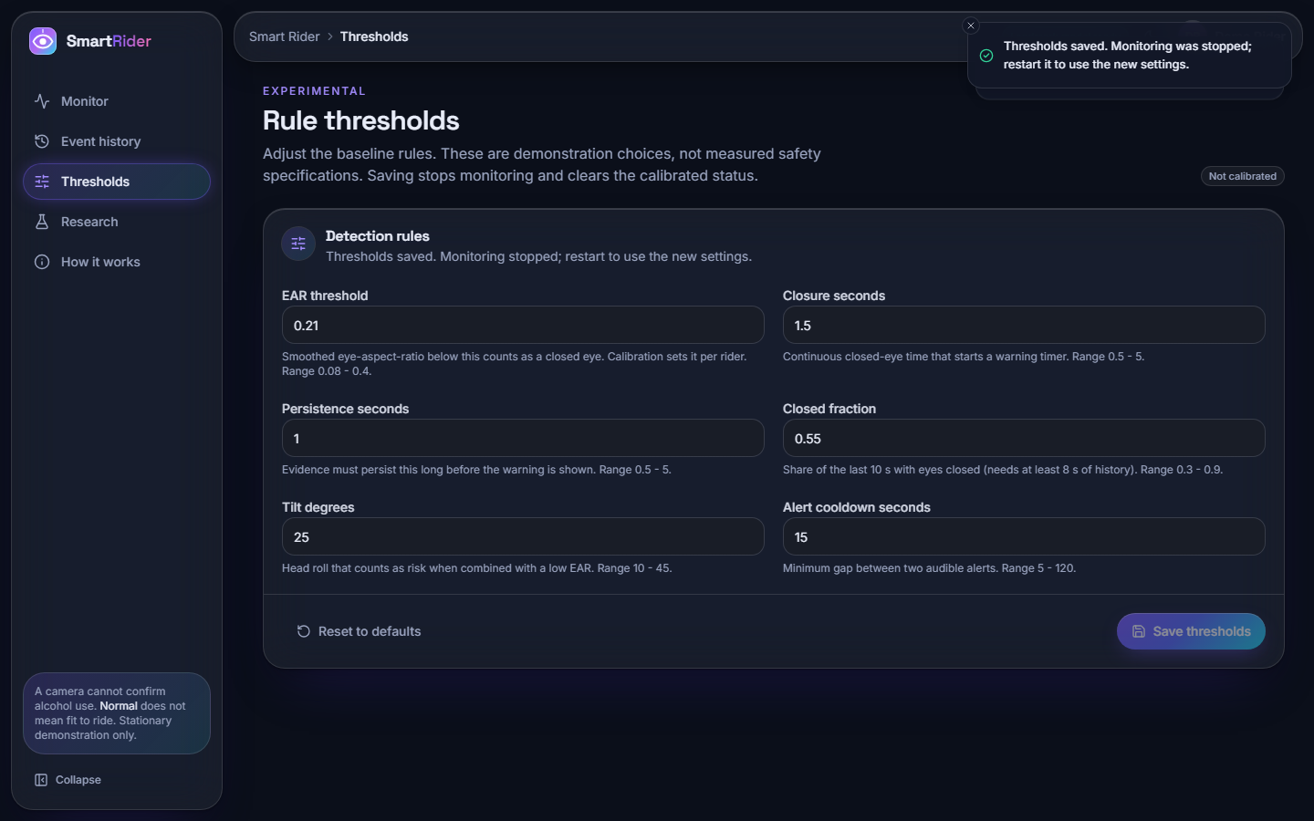
Output – Calibration and Thresholds
Calibration in progress (scrolled capture): EAR chart, 19 usable frames, default threshold 0.210
Six validated thresholds with their bounds; saving stops monitoring
Dept. of CSE | Batch A6 | Final Review
23
Notes:
Calibration sets a personal EAR threshold; the thresholds screen exposes the six rule values with validation.

Slide 24
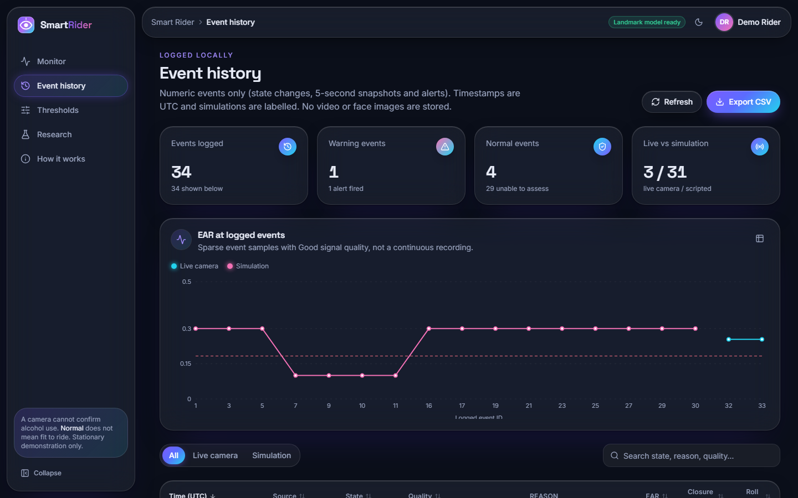
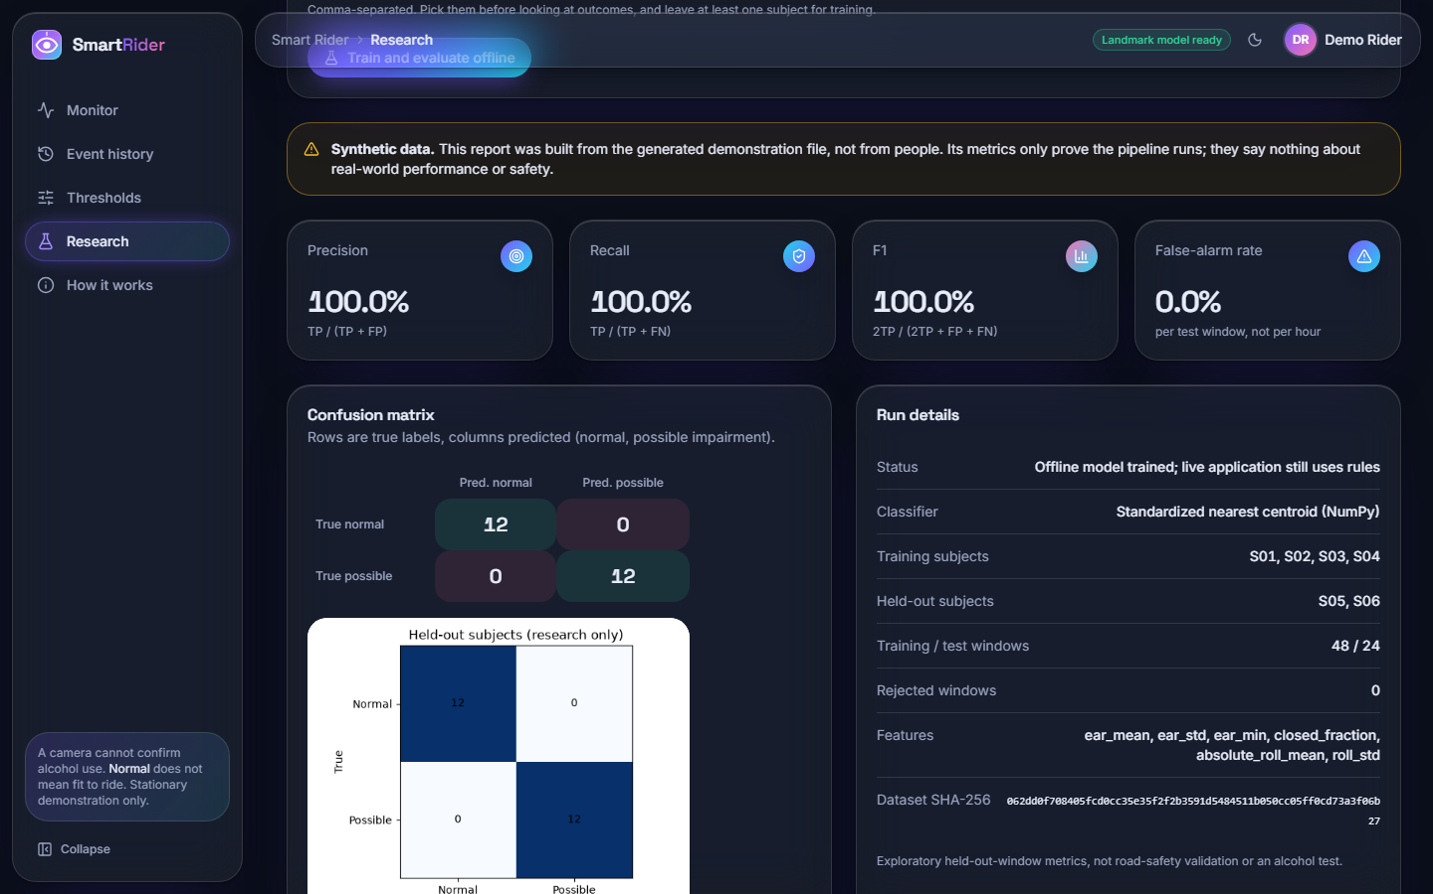
Output – History and Research (synthetic data)
Event history: 34 events at the time of capture (31 simulation, 3 live camera), EAR chart, CSV export
SYNTHETIC data only: the 100 % figures prove the pipeline runs, not performance
The research report on the right was built from a generated demonstration file and says nothing about real riders.
Dept. of CSE | Batch A6 | Final Review
24
Notes:
History is numeric only. The research screen carries a Synthetic data banner; do not read its 100 percent as a result.

Slide 25
Conclusion
Delivered: a complete, explainable path from webcam frame to a logged warning with a reason: landmarks, seven quality gates, calibration, a rule engine, a web and desktop interface, 20 unit tests and 34 API checks.
Measured: six-point EAR separates closed from open eyes on 2,423 public faces (AUC 0.989); the default 0.21 is conservative (14.5% of open eyes called closed); a closure must last about 2.6 s to warn; 31 ms per frame.
Finding: the quality gates fail safe but are strict; dim light, blur at low resolution, sunglasses or a covered eye give Unable to assess instead of a guess.
Not achieved: alcohol detection, a deep-learning classifier (no intoxication data), gaze, and the prevention action. Not a medical device or a road-safety system.
2
2
2
objectives achieved (1 and 4, the latter as rules)
partly achieved (2 and 6)
not achieved (3 and 5)
Dept. of CSE | Batch A6 | Final Review
25
Notes:
Two of six objectives met, two partly, two not. We would rather state the gap than present a number we cannot support.

Slide 26
Limitations, What Was Not Measured & Future Scope
Limitations and not measured
Future scope
No alcohol detection; cues also arise from tiredness
No intoxication data, no trained classifier, no gaze
No prevention action (no ignition or contact link)
No rider, helmet, visor, glasses, vibration or demographic study
Default threshold conservative; gates strict in dim light
Scripted streams show behaviour, not accuracy
Collect a consented, labelled sober vs intoxicated video dataset
Gaze and saccade features; a temporal model checked on held-out subjects
Tune thresholds on held-out riders; helmet-robust sensing
Vehicle integration for a prevention action, with safety review
Embedded deployment as in the base paper; formal user study
Dept. of CSE | Batch A6 | Final Review
26
Notes:
The limitations are the honest list; the future scope is what would turn this prototype into an intoxication-specific system.

Slide 27
References
[1] C.-L. Feng and T.-H. S. Li, "Robust driver state assessment on an embedded platform using a fuzzy belief rule-based fusion of eye aspect ratio and voice commands," IEEE Access, vol. 14, pp. 36158-36175, 2026
[2] B. Baroutian, A. Aghaei, and M. Ebrahimi Moghaddam, "Detection of intoxicated individuals from facial video sequences via a recurrent fusion model," arXiv:2512.04536, Dec. 2025.
[3] R. Deuber et al., "Detecting drunk driving using off-the-shelf smartwatches," arXiv:2605.23663, May 2026 (manuscript under review).
[4] V. Mehta, D. P. Yadav, S. S. Katta, and A. Dhall, "DIF: Dataset of perceived intoxicated faces for drunk person identification," arXiv:1805.10030, 2018 (revised 2019).
[5] L. P. Acharya, "Infrared deep learning system for non-invasive drunk detection and alcohol level classification," Iowa State Univ., Ames, IA, USA, Dec. 2024. [Online]. Available: https://dr.lib.iastate.edu/handle/20.500.12876/105973
[6] F. Deiana, J. Jackson, and C. Periago, "Development and verification of a testing methodology for driver alcohol intoxication detection systems," in Human Systems Engineering and Design (IHSED2026): Future Trends and Applications, AHFE Int., 2026
[8] C.-H. Chai, S. F. Abdul Razak, S. Yogarayan, and R. Shanmugam, "Drunk driver detection using thermal facial images," Information, vol. 16, no. 5, Art. no. 413, 2025.
[9] T. Soukupova and J. Cech, "Real-time eye blink detection using facial landmarks," in Proc. 21st Computer Vision Winter Workshop, Rimske Toplice, Slovenia, Feb. 2016.
[11] C. Lugaresi et al., "MediaPipe: A framework for building perception pipelines," arXiv:1906.08172, 2019.
[12] F. Song, X. Tan, X. Liu, and S. Chen, "Eyes closeness detection from still images with multi-scale histograms of principal oriented gradients," Pattern Recognit., vol. 47, no. 9, pp. 2825-2838, Sep. 2014
[13] G. B. Huang, M. Ramesh, T. Berg, and E. Learned-Miller, "Labeled faces in the wild: A database for studying face recognition in unconstrained environments," Univ. Massachusetts Amherst, Amherst, MA, USA, Tech. Rep. 07-49, Oct. 2007.
[14] C.-H. Weng, Y.-H. Lai, and S.-H. Lai, "Driver drowsiness detection via a hierarchical temporal deep belief network," in Computer Vision - ACCV 2016 Workshops (Lecture Notes in Computer Science). Cham, Switzerland: Springer, 2017, pp. 117-133
[15] Federal Motor Carrier Safety Administration, "PERCLOS: A valid psychophysiological measure of alertness as assessed by psychomotor vigilance," Tech Brief FHWA-MCRT-98-006, Washington, DC, USA, Oct. 1998.
[16] J. A. Stern, D. Boyer, and D. Schroeder, "Blink rate: A possible measure of fatigue," Human Factors, vol. 36, no. 2, pp. 285-297, 1994
[17] World Health Organization, "Global status report on road safety 2023," Geneva, Switzerland, Dec. 2023.
[24] Google AI Edge, "Face landmarker guide for Python," MediaPipe Solutions documentation. [Online]. Available: https://ai.google.dev/edge/mediapipe/solutions/vision/face_landmarker/python
Dept. of CSE | Batch A6 | Final Review
27
Notes:
Selected references; the complete numbered list is in the report.

Slide 28
THANK YOU
Questions & Suggestions
Dept. of CSE | Batch A6 | Final Review
28
Notes:
Invite questions.

