Slide 1


AI-DRIVEN E-COMMERCE RECOMMENDATION SYSTEM WITH DIGITAL TWIN SIMULATION
NAME REG.NO
1 A.PRAVALIKA 23K91A6708
2 G.LAXMILAVANYA 23K91A6758
3 D.ANUSHA 23K91A6751
4 A.ARAVIND 23K91A6707
Guide Name:
MRS. K. SAIDEEPTHI
(ASSISTANT PROFESSOR)
CSE (DATA SCIENCE)
BATCH : A11

Slide 2
CONTEXT
Introduction
Abstract
Existing system
Limitation of Existing system
Proposed System
System Architecture
Methodology
System Requirements
Conclusion
CSE (DATA SCIENCE)

Slide 3
INTRODUCTION
E-commerce platforms compete on how well they understand and serve individual customers.
Recommendation systems suggest products using purchase history, browsing, ratings and reviews.
Most recommenders rely on historical data and adapt slowly to changing interests.
Users rarely understand why a product is recommended, which limits trust.
Recommendation quality and response time drop during high-traffic shopping periods.
This project builds an adaptive recommendation system with digital twin simulation, explainable AI and traffic optimisation.
CSE (DATA SCIENCE)

Slide 4
ABSTRACT
Customers expect personalised product recommendations and fast service on e-commerce platforms.
Existing recommenders depend on historical data, adapt poorly in real time, lack transparency and slow down during peak traffic.
The project analyses views, clicks, searches, cart activity, purchases, ratings and reviews with big-data analytics and a multi-agent AI recommender.
A digital twin simulates recommendation strategies before they reach users, and explainable AI shows why each item is suggested.
A self-learning feedback engine updates the model continuously, and an AI traffic module manages requests during peak periods.
CSE (DATA SCIENCE)

Slide 5
Existing system
Collaborative filtering recommends items liked by similar users.
Content-based filtering recommends items similar to past purchases.
Hybrid systems combine both approaches using historical data.
Recommendations are deployed directly, without prior simulation or testing.
CSE (DATA SCIENCE)

Slide 6
Limitations of Existing system
Limited personalisation and heavy dependence on historical data.
Poor real-time adaptation to changing user behaviour.
Cold-start problems for new users and products.
No explanation of why items are recommended.
Performance drops during peak server traffic.
CSE (DATA SCIENCE)

Slide 7
Proposed System
Engagement signals such as views, clicks, searches, cart actions, purchases and reviews are processed with big-data analytics.
A multi-agent AI framework generates personalised recommendations from user behaviour.
A digital twin simulates recommendation strategies virtually before they are shown to users.
Explainable AI gives clear reasons for each recommendation.
A self-learning feedback engine updates the model, and AI-based traffic optimisation manages load at peak times.
CSE (DATA SCIENCE)

Slide 8
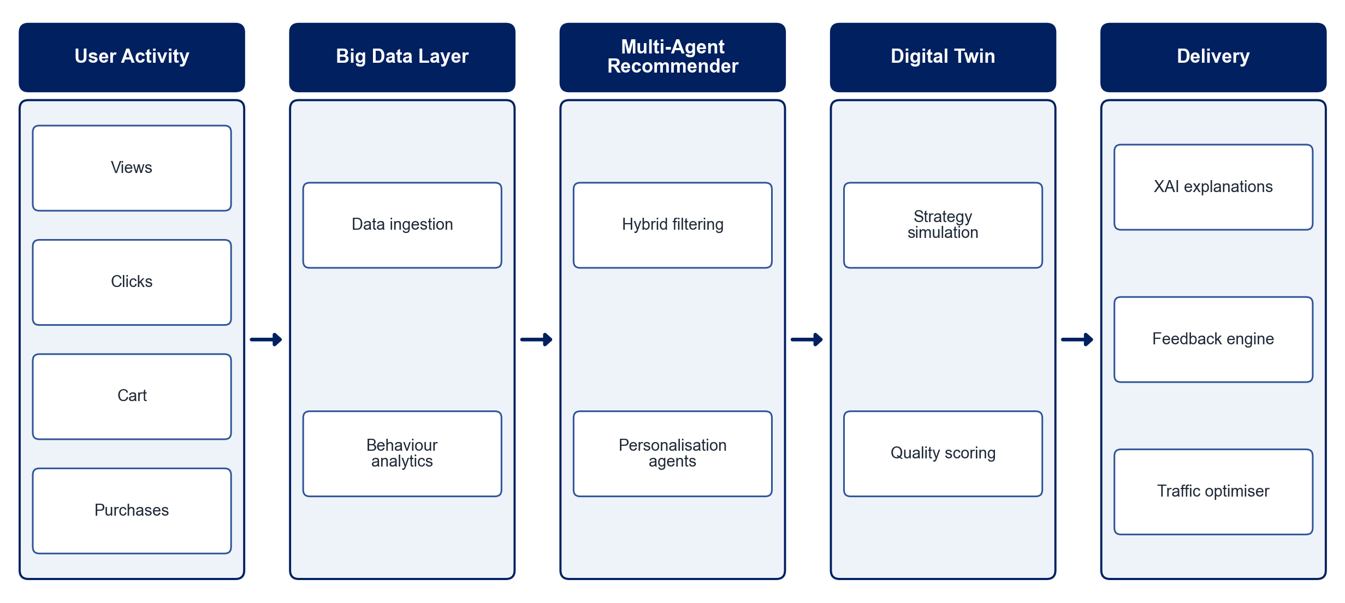
PROPOSED SYSTEM ARCHITECTURE
        Fig:- 1.1. System Architecture
CSE (DATA SCIENCE)

Slide 9
METHODOLOGY
Data Collection: Gather user interaction data such as views, clicks, searches, cart actions, purchases and ratings.
Big Data Processing: Clean and aggregate large interaction logs.
Recommendation Models: Build collaborative, content-based and hybrid recommenders within a multi-agent framework.
Digital Twin Simulation: Simulate user responses to candidate strategies before deployment.
Explainability: Generate reasons for each recommendation using XAI techniques.
Feedback Learning: Update the model continuously from new user interactions.
Traffic Optimisation: Monitor server load and schedule recommendation requests during peaks.
Evaluation: Measure precision, recall, F1-score and response time.
CSE (DATA SCIENCE)

Slide 10
SYSTEM REQUIREMENTS
Hardware Requirements
Processor: Intel Core i5 or equivalent
RAM: 8 GB or higher
Storage: 50 GB free space
Software Requirements
Language: Python
Big Data: Apache Spark / pandas
Machine Learning: scikit-learn, Surprise, TensorFlow
Explainability: SHAP / LIME
Backend: Flask / FastAPI
Frontend: React / Streamlit
Database: MongoDB / MySQL
CSE (DATA SCIENCE)

Slide 11
Conclusion
The system delivers personalised recommendations that adapt to real-time behaviour.
Digital twin simulation improves recommendation quality before users see it.
Explainable AI increases transparency and customer trust.
Traffic optimisation keeps the platform responsive during peak shopping periods.
CSE (DATA SCIENCE)

