Slide 1


ANALYSING MILLET SEED GERMINATION PREDICTION USING JEPA LLM TUNING MODELS AND CROP ANALYSIS
NAME REG.NO
1 A.ROHINI 23K91A6710
2 A.CHARAN 23K91A6709
3 B.PRAVEEN 23K91A6718
4 STUDENT NAME REG. NO
Guide Name:
GUIDE NAME
CSE (DATA SCIENCE)
BATCH : A12

Slide 2
CONTEXT
Introduction
Abstract
Existing system
Limitation of Existing system
Proposed System
System Architecture
Methodology
System Requirements
Conclusion
CSE (DATA SCIENCE)

Slide 3
INTRODUCTION
Millet is a nutritious crop that grows well in different climates and supports sustainable farming.
Seed germination capacity decides crop establishment and final yield.
Germination is normally tested manually by sowing samples and counting sprouts, which takes days.
Deep learning can predict germination from seed images, but labelled germination data is scarce.
Self-supervised JEPA learns image features from unlabelled seeds, and LLMs can explain results to farmers.
This project builds a millet seed germination prediction system that combines JEPA, crop analysis and an explainable LLM.
CSE (DATA SCIENCE)

Slide 4
ABSTRACT
Millet is a healthy, climate-resilient crop, and seed germination directly affects crop growth and yield.
Germination is usually checked manually, which is slow, error-prone and hard to scale to large seed batches.
JEPA learns useful features from millet seed images without needing large amounts of labelled data.
These features are combined with soil moisture, temperature, humidity, rainfall, soil pH and seed type to predict germination.
A fine-tuned LLM explains each prediction in simple language and suggests better seed selection and crop management through a web application.
CSE (DATA SCIENCE)

Slide 5
Existing system
Manual germination tests: seeds are sown and sprouted seeds counted after several days.
Visual seed inspection by experts based on size, colour and shape.
CNN models such as VGG19, ResNet50 and EfficientNet trained on labelled seed images.
Crop advisory systems that use soil and weather data without seed-level analysis.
CSE (DATA SCIENCE)

Slide 6
Limitations of Existing system
Manual tests are slow, labour-intensive and error-prone.
Large seed batches cannot be checked quickly.
Supervised CNNs need large labelled germination datasets.
Image-only models ignore soil and environmental conditions.
Predictions are not explained in a way farmers can act on.
CSE (DATA SCIENCE)

Slide 7
Proposed System
JEPA learns features from millet seed images using little labelled data.
Image features are combined with soil moisture, temperature, humidity, rainfall, soil pH and seed type.
A machine learning model predicts whether each seed will germinate.
A fine-tuned LLM explains the prediction and suggests better seed selection and crop management.
A web application lets users upload seed images, enter crop details and view predictions.
CSE (DATA SCIENCE)

Slide 8
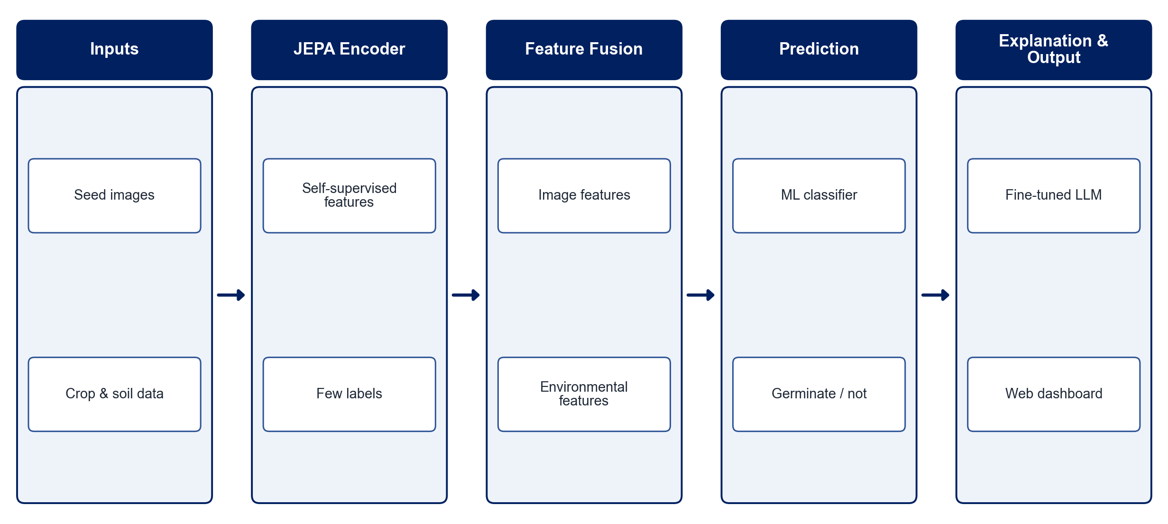
PROPOSED SYSTEM ARCHITECTURE
        Fig:- 1.1. System Architecture
CSE (DATA SCIENCE)

Slide 9
METHODOLOGY
Data Collection: Gather millet seed images with germination labels, plus crop and environmental records.
Preprocessing: Resize, normalise and augment seed images; clean and scale the tabular features.
JEPA Pre-training: Train a JEPA encoder self-supervised on unlabelled seed images.
Feature Fusion: Combine JEPA embeddings with soil moisture, temperature, humidity, rainfall, soil pH and seed type.
Prediction Model: Train an ML classifier to predict germination.
LLM Explanation: Fine-tune an LLM to explain predictions and suggest seed and crop management actions.
Evaluation: Measure accuracy, precision, recall, F1-score and the confusion matrix.
Web Application: Build pages to upload images, enter crop details and view results.
CSE (DATA SCIENCE)

Slide 10
SYSTEM REQUIREMENTS
Hardware Requirements
Processor: Intel Core i5 or equivalent
RAM: 16 GB recommended
GPU: NVIDIA GPU or Google Colab for training
Storage: 30 GB free space
Camera: Smartphone / digital camera for seed images
Software Requirements
Language: Python
Deep Learning: PyTorch (JEPA / ViT)
Machine Learning: scikit-learn, XGBoost
LLM: Hugging Face Transformers with LoRA
Image Processing: OpenCV
Web App: Flask / Streamlit
CSE (DATA SCIENCE)

Slide 11
Conclusion
The system predicts millet seed germination from images and crop conditions.
JEPA reduces the need for large labelled seed datasets.
LLM explanations turn predictions into practical advice for farmers.
It offers a fast, low-cost way to check seed quality, improve yield and reduce seed wastage.
CSE (DATA SCIENCE)

