Slide 1

Secure Data Transmission in Cloud Computing using Encryption and Machine Learning
Final Review · CipherGuard Shield
Team Details : Batch A5
Under the Esteemed Guidance of
CH. Prabhakar
[DESIGNATION], Department of CSE
23K91A0520 AVUTI SANDHYA
23K91A0530 BANOTHU INDU
23K91A0559 DASARI SRITEJA
23K91A0533 BEJUGAM VAISHNAVI
DEPARTMENT OF COMPUTER SCIENCE AND ENGINEERING · TKR College of Engineering & Technology · Academic Year [ACADEMIC YEAR]
Notes:
Introduce the team and CipherGuard Shield: authenticated encryption plus machine-learning intrusion detection around one cloud data path.

Slide 2
Table of Contents
Abstract
Base Paper & Literature Survey
Research Gap, Problem Statement & Objectives
Proposed System & Architecture
Methodology, Dataset & Models
Scoring Workflow, Interaction & Data Design
Implementation Highlights
Results: Detection, Confusion Matrix, Real vs Synthetic
Performance & Testing
Comparison with Base Paper
Output Screens
Conclusion, Limitations, Future Scope & References
Dept. of CSE | Batch A5 | Final Review
2
Notes:
The agenda follows the report: problem, design, method, results, comparison, screens, conclusion.

Slide 3
Abstract
Data sent to a public cloud can be read, altered or attacked on the way. CipherGuard Shield puts two protections around one data path: authenticated encryption and a machine-learning intrusion detector.
SecureChannel: a fresh P-256 key pair per message, ECDH + HKDF-SHA256 to a 256-bit key, AES-256-GCM. All 6,000 tamper trials behaved as expected; 100 KB is encrypted in 0.54 ms.
ThreatSense Engine: XGBoost + 1D CNN stacked by logistic regression, with severity-graded alerts and a live React console.
Real UNSW-NB15: stacked ensemble 0.890 accuracy on the official 82,332-flow test set; XGBoost alone is better at 0.910. Base-paper protocol: 0.938.
The shipped default model is trained on synthetic data: its 97.33% is a property of the generator and drops to 0.660 on real flows.
One protected 100 KB transfer costs 5.7 ms; detection, not encryption, is 81% of it.
Dept. of CSE | Batch A5 | Final Review
3
Notes:
Give the problem, the two protections, then the numbers with their protocol. Say clearly that 97.33% is on synthetic data.

Slide 4
Base Paper
V. Kalyanasundaram, S. Raja and S. Kanthimathi, "Intrusion detection model using fused quantum NN-LeNet with improved elliptic curve cryptography based data security," IEEE Access, vol. 14, pp. 63767-63779, 2026, doi: 10.1109/ACCESS.2026.3686106.
Aspect | Base paper: intrusion detection with fused quantum-inspired NN-LeNet and improved ECC
Detector | FLPF with EVD-QNN (quantum-inspired, simulated on classical hardware) + LeNet; scores fused by DSMMN score-level fusion
Encryption | Enhanced Elliptic Curve Cryptography (EECC): non-intrusive data encrypted before transfer; the paper states no ECDLP-based security proof is given
Data | UNSW-NB15, 9,000 balanced samples (4,500 per class), stratified 70/15/15, 10 runs averaged
Reported | Mean accuracy 0.9487 (0.9564 in the ablation), precision 0.97, FPR 0.03; EECC encrypts in 0.39 s and decrypts in 0.26 s
Stated limits | Balanced subset only (imbalanced data left to future work); no formal security proof for EECC; baselines re-implemented by the authors
Dept. of CSE | Batch A5 | Final Review
4
Notes:
Kalyanasundaram et al., IEEE Access 2026. We keep its idea of detection plus encryption on one path, but use standard, analysed primitives and a classical ensemble; neither the quantum-inspired network nor EECC is reproduced.

Slide 5
Literature Survey
Work | Year | Approach | Finding / limitation
Kalyanasundaram et al. [1] (base) | 2026 | Quantum-inspired NN + LeNet, DSMMN fusion, EECC | UNSW-NB15, 9,000 flows; mean accuracy 0.9487; no EECC security proof
Kadry et al. [20] | 2023 | Optimised QNN (WOA features) + ECC | 98.5% accuracy for real-time detection, as cited in [1]
Mbaya et al. [23] | 2023 | SecFedIDM-V1: blockchain + BiLSTM-RNN on CIDDS | Web app that labels packets normal or attack, as cited in [1]
Rahman et al. [24] | 2024 | SYN-GAN: GAN-made synthetic data to train NIDS | 100% scores on BoT-IoT with synthetic training data, as cited in [1]
Batch survey [2] | 2024 | Encryption + anomaly detection for cloud storage and transmission | Title-level only; full text not reviewed
Batch survey [3] | 2024 | Automated data deletion for multi-cloud with an IDS | Title-level only; full text not reviewed
Batch survey [4] | 2026 | Federated attack detection + improved Blowfish in cloud | Title-level only; full text not reviewed
Batch survey [5] | 2026 | Hybrid-encryption privacy framework for cloud transmission | Title-level only; full text not reviewed
Dept. of CSE | Batch A5 | Final Review
5
Notes:
Work found in the batch survey and in the base paper's related-work section. Rows described as 'as cited in [1]' are second-hand; rows for [2]-[5] are title-level only.

Slide 6
Research Gap
The surveyed work treats cryptography and intrusion detection as separate concerns (batch literature survey).
Where both appear, the combined cost of encrypting and detecting on the same path is not reported.
The base paper's EECC has no formal security proof; standard ECDH + AES-GCM is analysed, standardised and available in common libraries.
Base-paper results use a 9,000-flow balanced subset; the temporally separated official partition and class imbalance are left to future work.
Synthetic or balanced evaluations hide domain shift: how a model trained on one data source behaves on another is rarely shown.
Dept. of CSE | Batch A5 | Final Review
6
Notes:
Five gaps. We address the first, second, third and fifth directly; the fourth we test with the official partition.

Slide 7
Problem Statement
Data placed in a public cloud is readable by the provider unless it is encrypted before upload.
Symmetric encryption alone leaves the key exchange vulnerable to interception.
Encryption cannot detect an attacker who already holds valid credentials.
Most academic systems address either cryptography or intrusion detection, rarely both together.
Need: encrypt with a hybrid scheme and monitor for intrusion with machine learning on the same path.
Input
Output
Record
Text (<= 1 MB), a file (<= 5 MB), one flow record or a CSV (<= 10,000 rows)
Authenticated envelope, verified plaintext or a rejection, attack verdicts with severity
Alert log, measured model metrics and benchmarks
Dept. of CSE | Batch A5 | Final Review
7
Notes:
Four problem points from the batch statement, then input, output and record.

Slide 8
Objectives
1. Design a hybrid encryption scheme using AES for the payload and RSA for key exchange.
2. Implement secure key generation, distribution and storage between sender and receiver.
3. Build a transmission module that encrypts before upload and decrypts after download.
4. Train a machine-learning classifier on a benchmark intrusion dataset to detect anomalous access.
5. Integrate the detection layer so suspicious sessions are flagged and logged during transfer.
6. Evaluate encryption and decryption time, throughput overhead and intrusion-detection accuracy.
Dept. of CSE | Batch A5 | Final Review
8
Notes:
The six objectives from the batch document. The conclusion slide gives the real status of each, including that ECDH replaced RSA.

Slide 9
Proposed System
Lane A - SecureChannel
Payload
Ephemeral P-256 key
ECDH + HKDF
AES-256-GCM
Envelope
Cloud verify
Lane B - ThreatSense Engine
Flow record
Preprocess
XGBoost + 1D CNN
LR stacking
Verdict
Alert log
A new key for every message gives forward separation between messages; GCM authenticates ciphertext, nonce and tag, so any change is rejected.
Detection scores flow records (one row or a CSV) and keeps an alert list with severity low / medium / high / critical.
The two lanes run side by side in one console; the API does not block a transfer on a verdict - the operator decides.
Dept. of CSE | Batch A5 | Final Review
9
Notes:
The proposed system as two lanes. Be explicit that detection is not wired to block transfers.

Slide 10
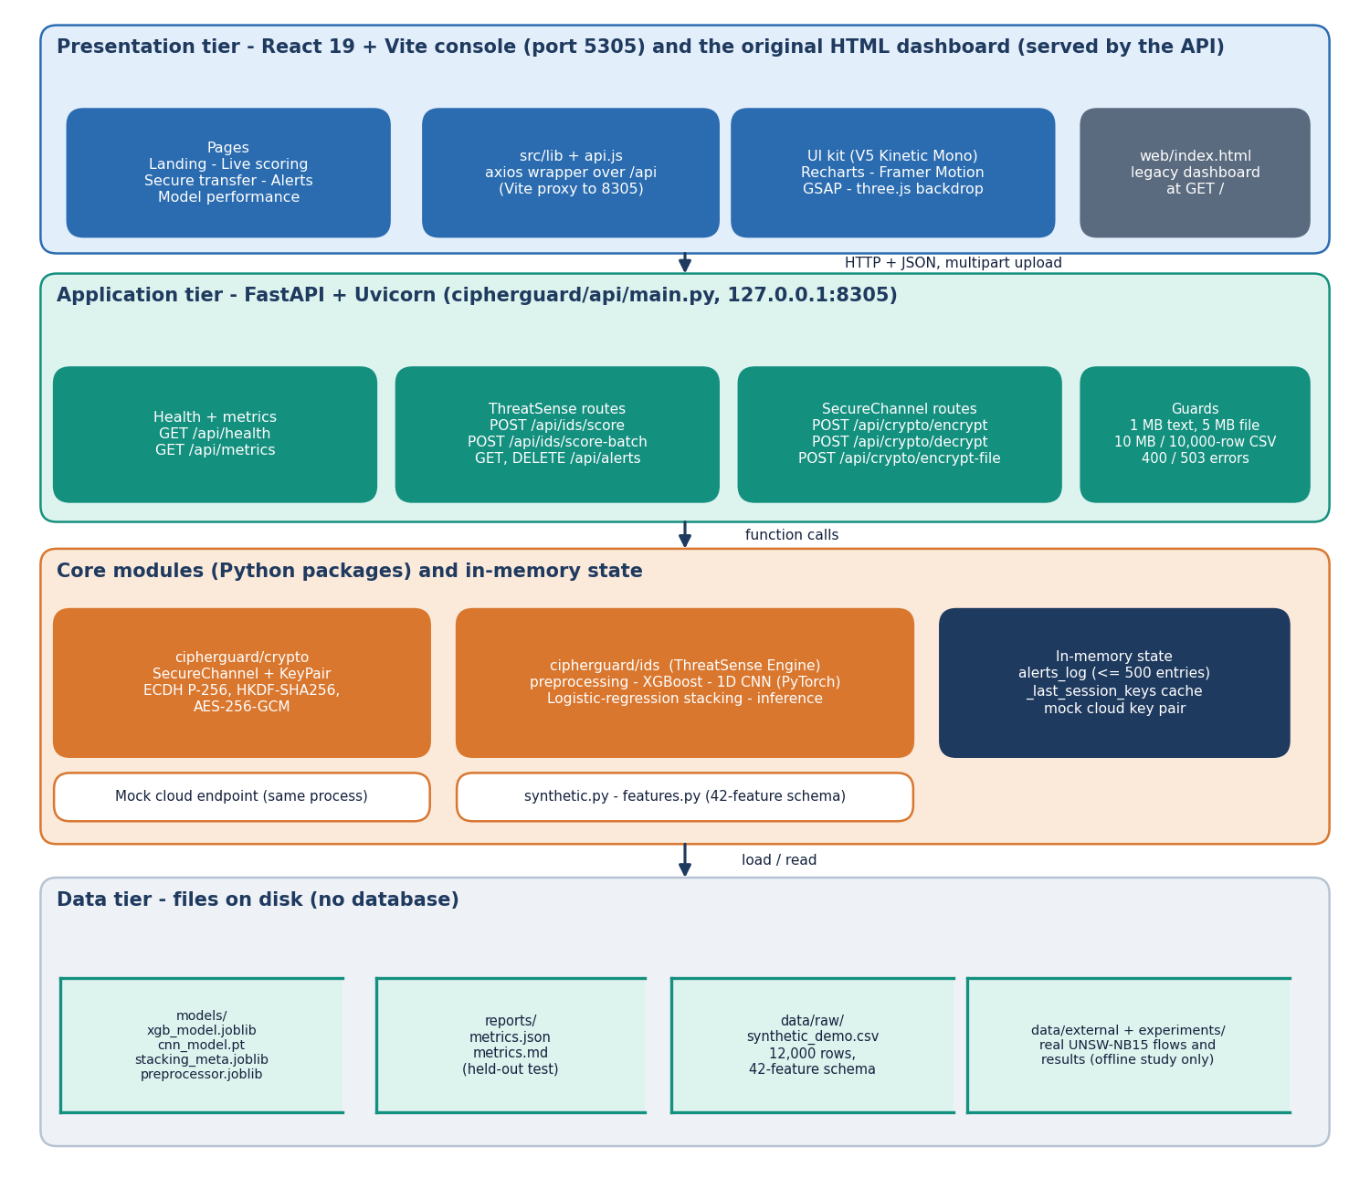
System Architecture
Console: React 19 + Vite on port 5305; legacy HTML dashboard
API: FastAPI + Uvicorn on port 8305, 9 JSON routes plus /docs
Core: cipherguard/crypto (SecureChannel) and cipherguard/ids (ThreatSense Engine)
State: alert list and session-key cache in memory; no database
Files: models/, reports/metrics.json, data/raw/synthetic_demo.csv
Dept. of CSE | Batch A5 | Final Review
10
Notes:
Four tiers. No database: alerts are an in-memory list capped at 500 entries.

Slide 11
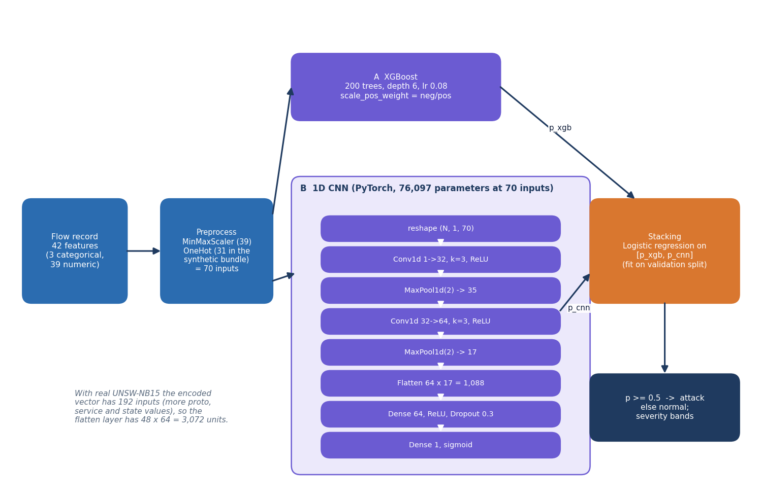
Methodology
Preprocess: MinMax on 39 numeric features, one-hot on proto, service, state.
XGBoost: 200 trees, depth 6, learning rate 0.08.
1D CNN: two conv + pool blocks, dense 64, dropout 0.3 (PyTorch, Adam, early stopping).
Stacking: logistic regression on the two probabilities, fitted on the validation split; threshold 0.5.
Measured on the official split (5 seeds), the base-paper protocol (10 runs) and a domain-shift test.
Dept. of CSE | Batch A5 | Final Review
11
Notes:
The model pipeline. The CNN loss is unweighted BCE in the PyTorch path that ran, although the README mentions balanced weighting.

Slide 12
Dataset & Models
175,341
Data | Rows | Used for
Synthetic demo CSV (generated) | 12,000 | shipped model; 70/15/15 split; 2.5% label noise
UNSW-NB15 official training set | 175,341 | fit 149,039 + validation 26,302
UNSW-NB15 official testing set | 82,332 | held-out test, later capture period
9,000 balanced flows (paper protocol) | 9,000 | 6,300 / 1,350 / 1,350, ten repetitions
official training flows (56,000 normal)
82,332
official test flows (55.1% attack)
42
flow features -> 192 encoded inputs
UNSW-NB15 (Moustafa & Slay, UNSW Canberra, 2015): ten classes - Normal, Generic, Exploits, Fuzzers, DoS, Reconnaissance, Analysis, Backdoor, Shellcode, Worms.
The shipped model never saw real traffic: its data is a generator with the UNSW-NB15 schema.
Licence: free for academic use; cite the original authors.
Dept. of CSE | Batch A5 | Final Review
12
Notes:
Official train and test are separated in time, so the test is harder than a random split. The synthetic CSV is only a demo.

Slide 13
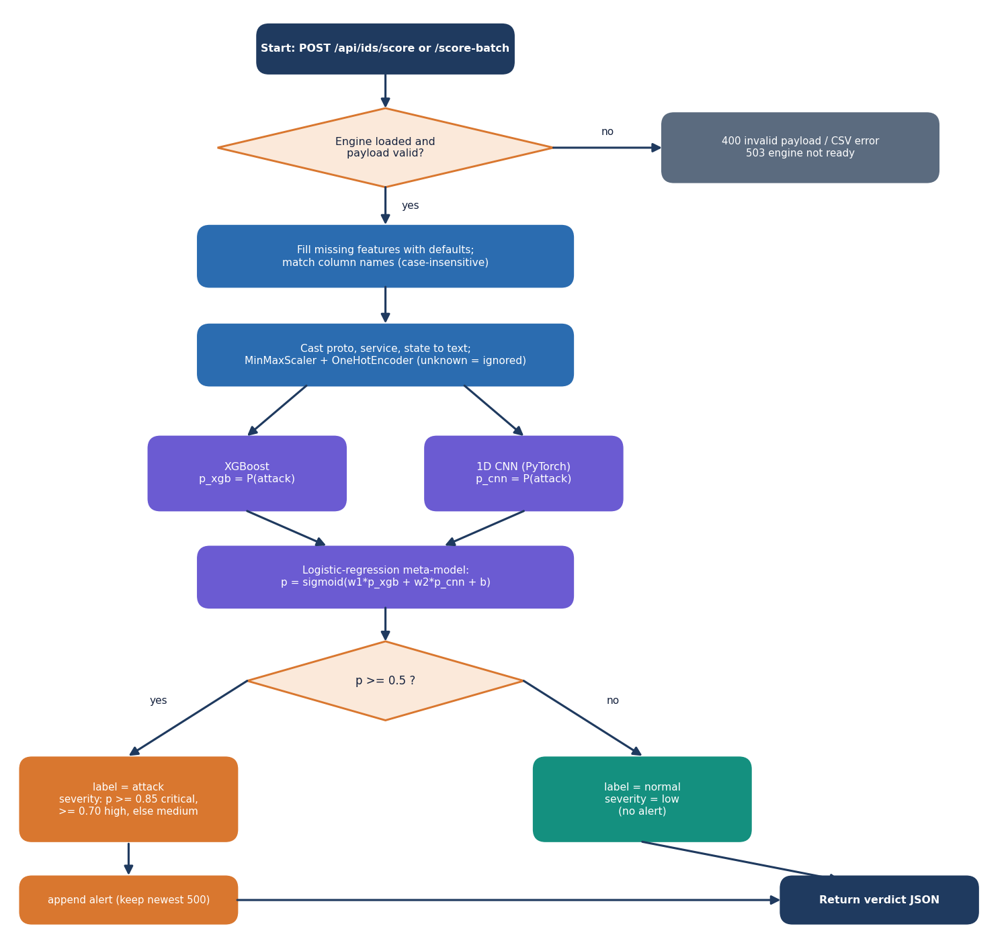
Scoring Workflow
Missing features get defaults; column names are matched case-insensitively.
Unknown protocols, services or states are ignored by the one-hot encoder, not crashed on.
p = sigmoid(w1 * p_xgb + w2 * p_cnn + b); attack when p >= 0.5.
Severity: p >= 0.85 critical, >= 0.70 high, otherwise medium; normal is low.
Shipped meta weights: 3.77 for XGBoost and 3.59 for the CNN.
Dept. of CSE | Batch A5 | Final Review
13
Notes:
The core algorithm of cipherguard/ids/inference.py as a flowchart.

Slide 14
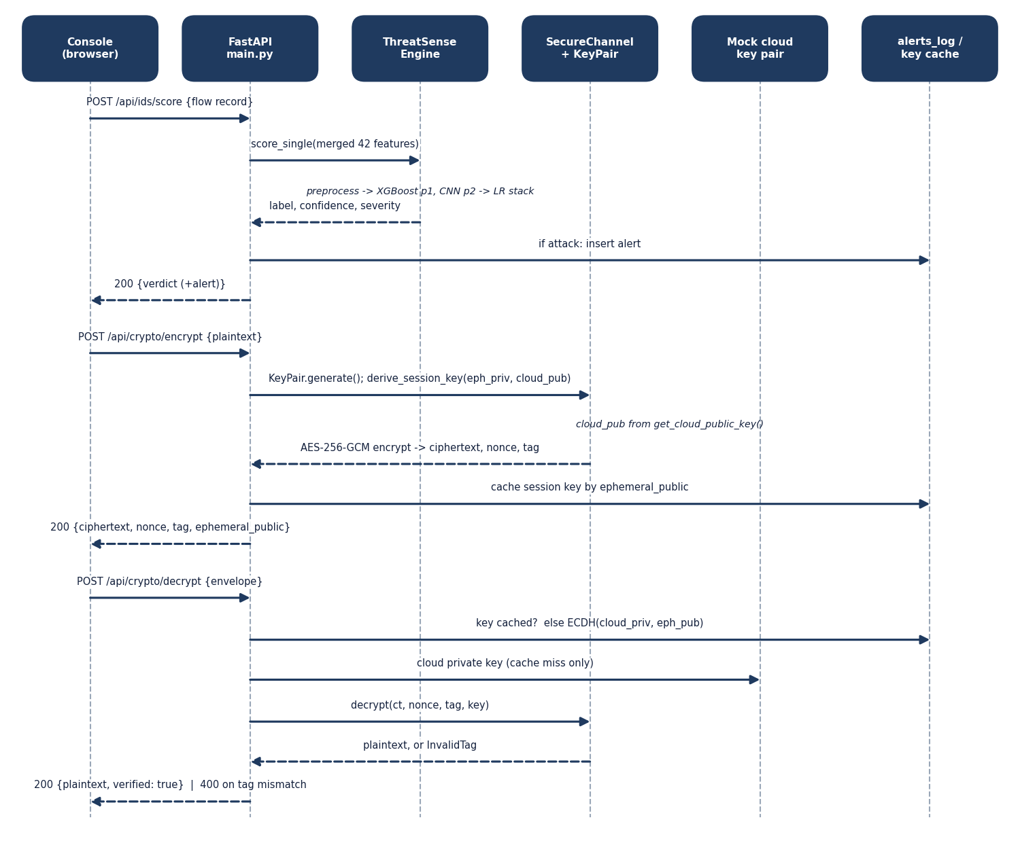
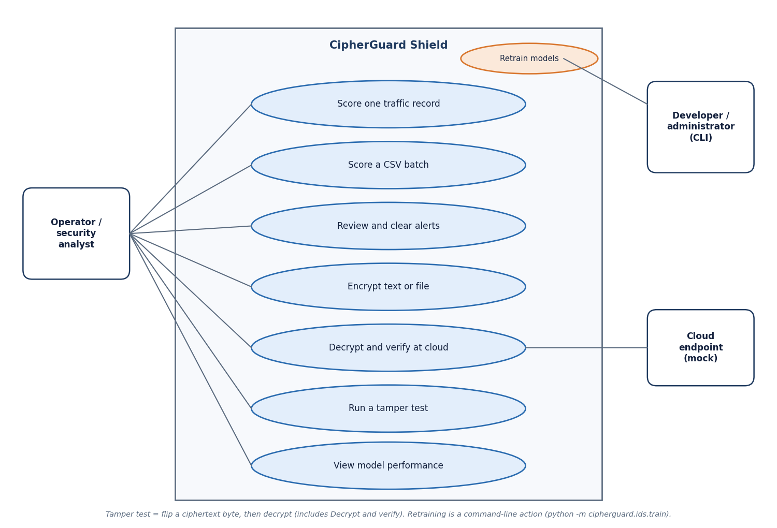
User – System Interaction
Dept. of CSE | Batch A5 | Final Review
14
Notes:
Sequence of score, encrypt and decrypt requests, and the use cases of the operator, the developer and the mock cloud.

Slide 15
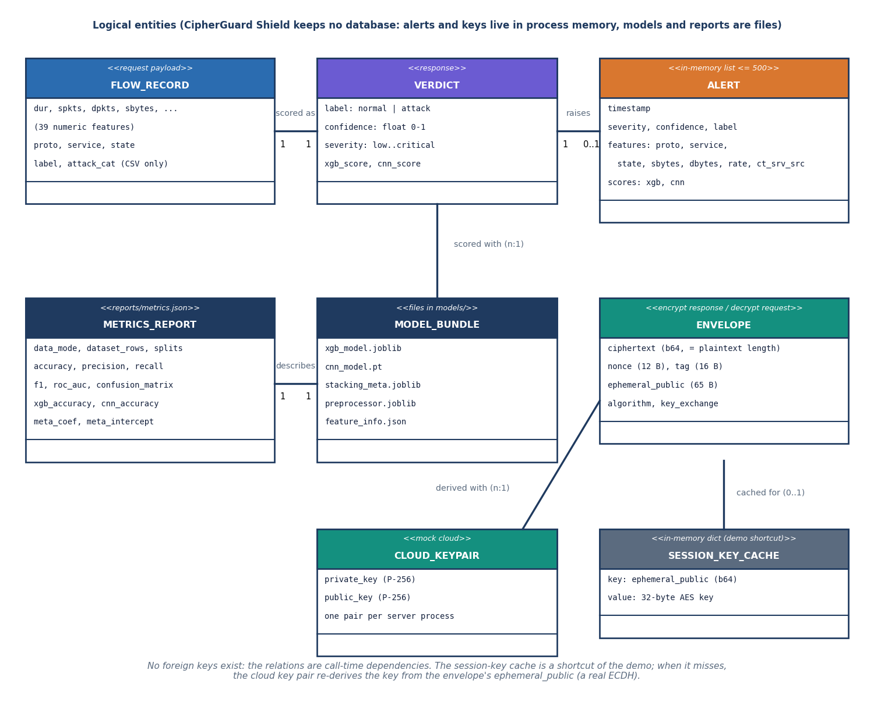
Data Design (no database)
Store | Content
alerts_log (memory) | last 500 attack alerts
_last_session_keys | ephemeral key -> AES key (demo cache)
cloud key pair | one P-256 pair per process
models/ | xgb, cnn, meta, preprocessor
reports/metrics.json | held-out test metrics
data/raw/ | synthetic demo CSV
No foreign keys and no persistence: alerts and keys are lost when the server restarts.
Dept. of CSE | Batch A5 | Final Review
15
Notes:
CipherGuard Shield has no database. The ER diagram shows logical entities.

Slide 16
Implementation Highlights
9
26 + 15
5
93 B
JSON routes (+ /docs)
pytest tests + smoke checks
React screens
fixed envelope overhead
Input limits: text 1 MB, file 5 MB, CSV 10 MB and 10,000 rows; empty, non-CSV and malformed base64 return 400; engine not ready returns 503.
Envelope = ciphertext + 12-byte random nonce + 16-byte tag + 65-byte ephemeral public key; HKDF-SHA256 with a fixed context string.
The cloud derives the key by real ECDH with its private key when the demo cache misses (tested).
Console: live scoring with CSV batch, secure transfer with tamper button, alerts, model performance; one command (run.bat) starts both servers.
Not present: authentication, TLS, rate limiting, persistent keys.
Dept. of CSE | Batch A5 | Final Review
16
Notes:
Highlights and honest absences.

Slide 17
Results – Detection on Real UNSW-NB15
0.890
0.907
0.984
0.910
stacked accuracy, official test (5 seeds)
stacked F1
stacked ROC-AUC
XGBoost alone: better
Five seeds, stacked accuracy std 0.0016; stacking beats the plain mean by only 0.002 and loses to XGBoost. Base-paper protocol (9,000 balanced flows, 10 runs): stacked 0.938, XGBoost 0.939, random forest 0.939: no gain from stacking. The test set is a later capture period than training.
Dept. of CSE | Batch A5 | Final Review
17
Notes:
The CNN lifts recall but doubles the false-alarm rate; XGBoost alone is the best single model on the temporally shifted test.

Slide 18
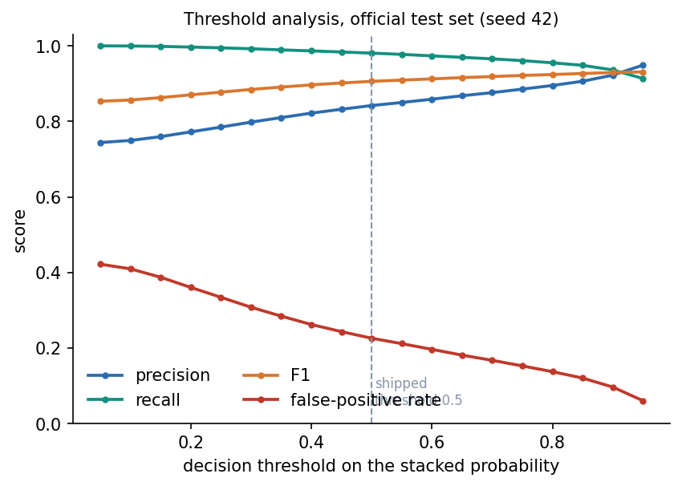
Confusion Matrix & Threshold Analysis
Stacked, official test (82,332), seed 42
XGBoost alone, same test set
Shipped model, its synthetic split (1,800)
pred normal
pred attack
pred normal
pred attack
pred normal
pred attack
actual normal
28,646
77.4% of row
8,354
22.6% of row
actual normal
31,244
84.4% of row
5,756
15.6% of row
actual normal
877
97.7% of row
21
2.3% of row
actual attack
877
1.9% of row
44,455
98.1% of row
actual attack
1,644
3.6% of row
43,688
96.4% of row
actual attack
27
3.0% of row
875
97.0% of row
Stacked at 0.5: recall 98.1%, FPR 22.6% (8,354 of 37,000 normal flows raise a false alarm).
Raising the threshold to 0.9: accuracy 0.921, precision 0.922, recall 0.936, FPR 9.6%.
Best-F1 point of the sweep is 0.95; the sweep was run on the test set, so it shows the trade-off rather than a tuned result.
The shipped threshold stays 0.5.
Dept. of CSE | Batch A5 | Final Review
18
Notes:
Rows are the actual class. Most errors are normal traffic flagged as attack; the threshold trades missed attacks for fewer false alarms.

Slide 19
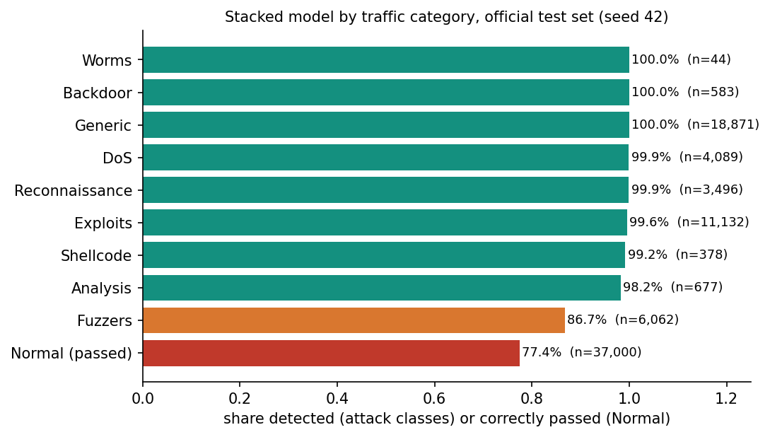
Results – Real vs Synthetic Data, by Category
The shipped 97.33% is on synthetic data; 2.5% injected label noise caps accuracy near 97.5% and XGBoost, CNN and stack all score the same. On the 82,332 real flows the same model scores 0.660 (AUC 0.657); real-trained models on the synthetic CSV score 0.373.
Detected: Generic 100.0%, DoS 99.9%, Exploits 99.6%; Fuzzers only 86.7%; normal traffic correctly passed 77.4%. sttl dominates feature importance (a known dataset artefact).
Dept. of CSE | Batch A5 | Final Review
19
Notes:
The most important finding: where the training data comes from decides everything. Synthetic accuracy says nothing about real traffic.

Slide 20
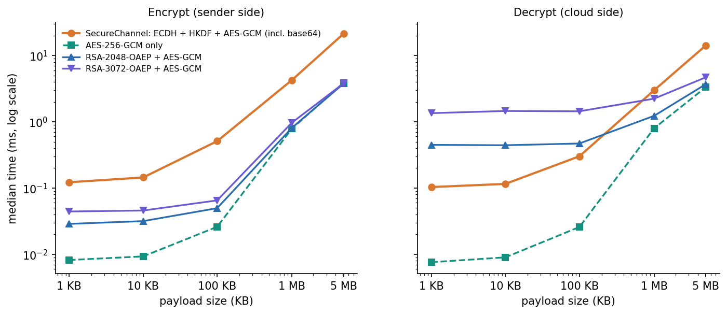
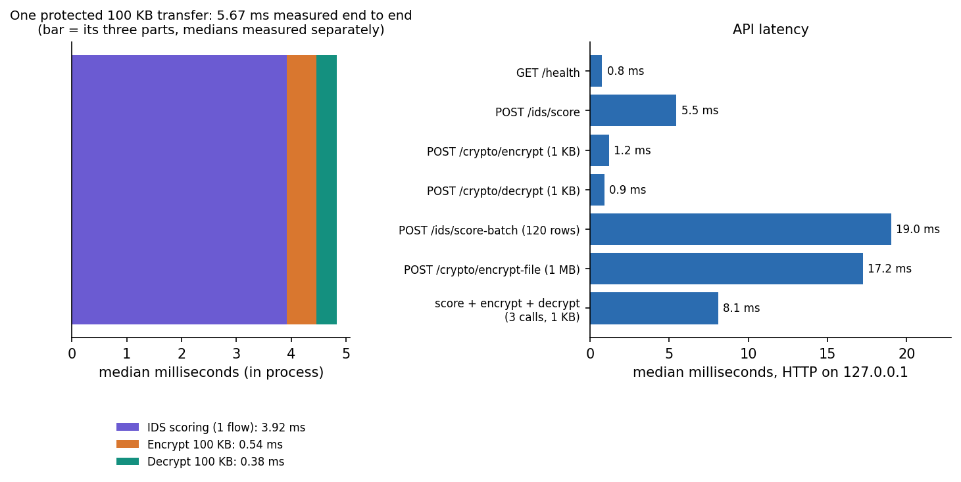
Performance & Testing
3.92 ms
0.54 ms
0.38 ms
5.67 ms
score one flow (in process)
encrypt 100 KB
decrypt 100 KB
protected transfer; IDS 81%
Check | Result
pytest (crypto 10, IDS engine 6, API 10) | 26 of 26 passed in 2.9 s; smoke test 15 of 15
Tamper tests: ciphertext, tag, nonce, truncation, wrong key | 6 cases x 1,000 trials: 6,000 of 6,000 as expected
Nonce uniqueness | 20,000 encryptions of one text: 20,000 distinct nonces and ciphertexts
Not tested | load, concurrency, Docker, other browsers, adversarial evasion of the IDS
Dept. of CSE | Batch A5 | Final Review
20
Notes:
Medians on a shared i5-12500 (indicative). SecureChannel costs more than raw AES-GCM on large payloads because of base64 and ephemeral key work; RSA-OAEP decrypt costs 0.45 ms (2048-bit) versus 0.10 ms at 1 KB.

Slide 21
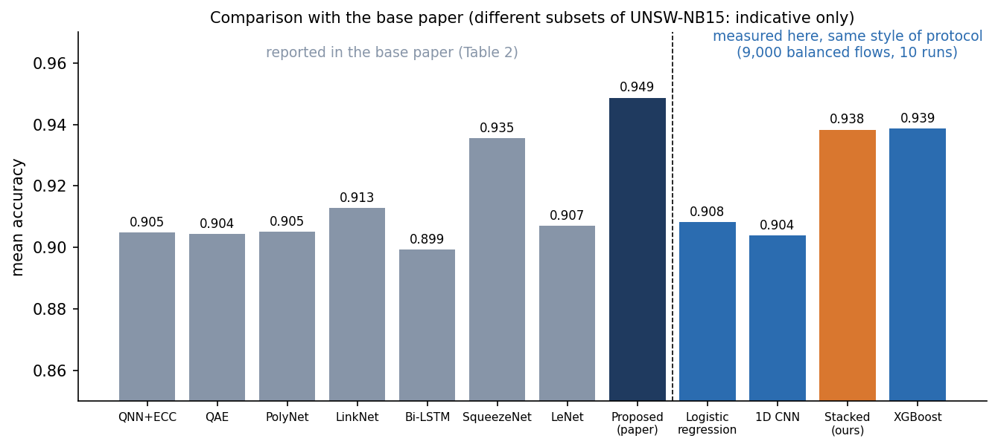
Comparison with Base Paper
Aspect | Base paper [1] | This project
Detector | Quantum-inspired NN + LeNet, DSMMN fusion | XGBoost + 1D CNN, LR stacking
Encryption | Enhanced ECC, no formal proof | ECDH P-256 + HKDF + AES-256-GCM
Data / protocol | 9,000 balanced UNSW-NB15 flows, 70/15/15, 10 runs | same style of protocol, 10 runs; plus official 175,341 -> 82,332 split
Accuracy | 0.9487 mean (0.9564 ablation) | 0.938 ± 0.007 (paper protocol); 0.890 ± 0.002 (official)
Precision / FPR | 0.97 / 0.03 | 0.934 / 0.067 (paper protocol)
Encrypt / decrypt | 0.39 s / 0.26 s (payload not stated) | 0.12 / 0.10 ms (1 KB); 0.51 / 0.30 ms (100 KB)
About one point below the paper's proposed model (0.949) and slightly above its best baseline (SqueezeNet 0.935).
Subsets, hyper-parameters and test fraction are not published: indicative only.
EECC and the quantum-inspired network are not reproduced; the shipped 97.33% (synthetic) is excluded.
Dept. of CSE | Batch A5 | Final Review
21
Notes:
State plainly that datasets differ. No superiority over the base paper is claimed.

Slide 22
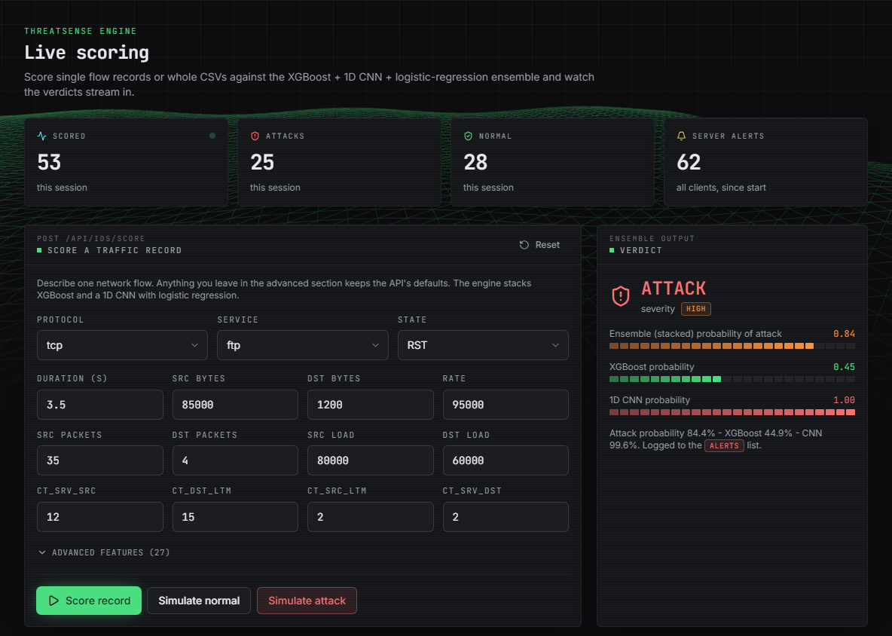
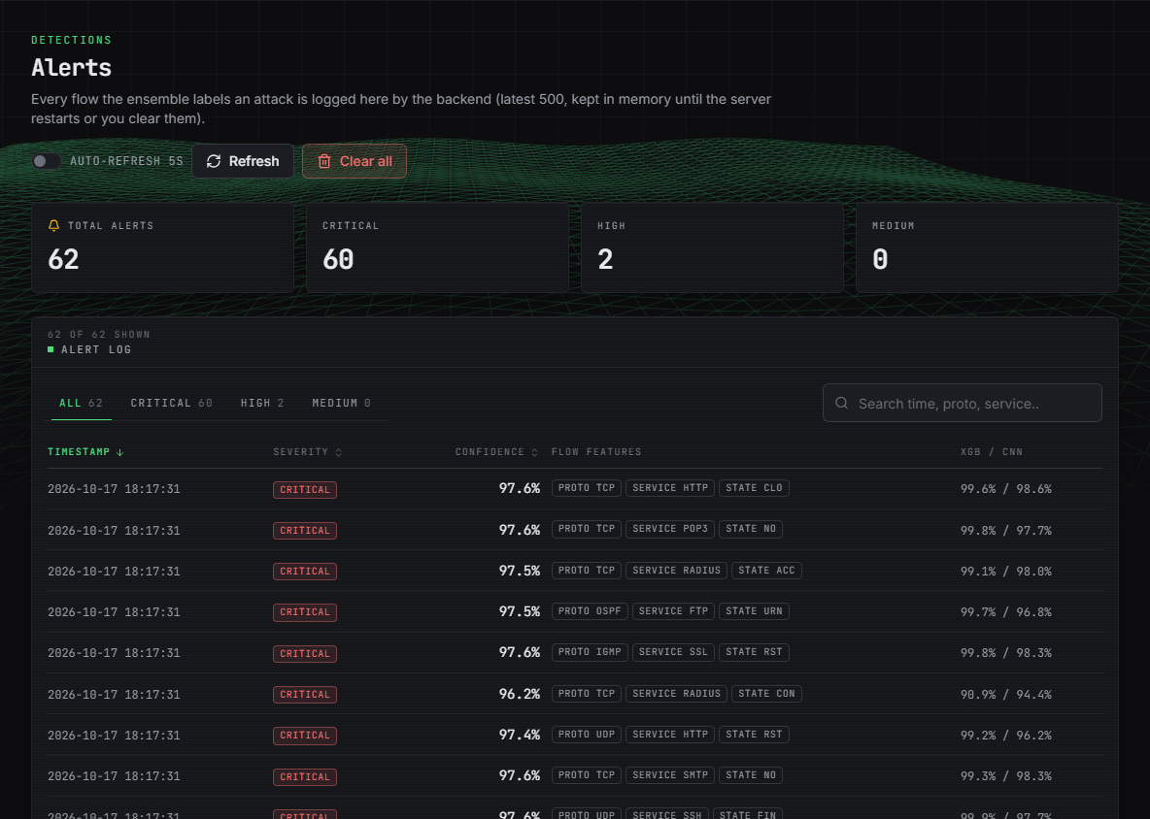
Output – Live Scoring and Alerts
Left: the attack preset scored as ATTACK, severity HIGH, ensemble 0.84 (XGBoost 0.45, CNN 1.00). Right: alerts raised by the 120-row sample batch. The bundled sample is synthetic, drawn from the demo CSV.
Dept. of CSE | Batch A5 | Final Review
22
Notes:
Real captures of the running console. Note the XGBoost and CNN disagree on this record; the stack decides.

Slide 23
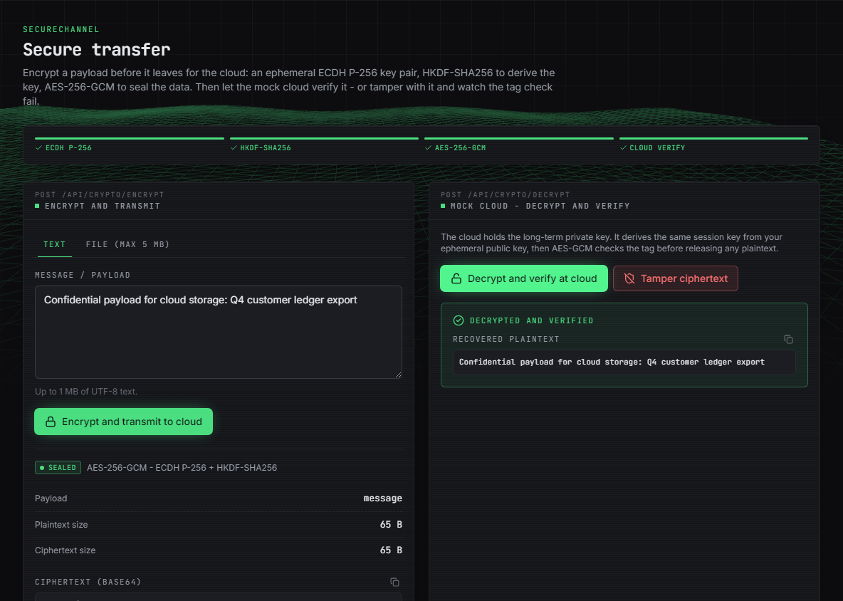
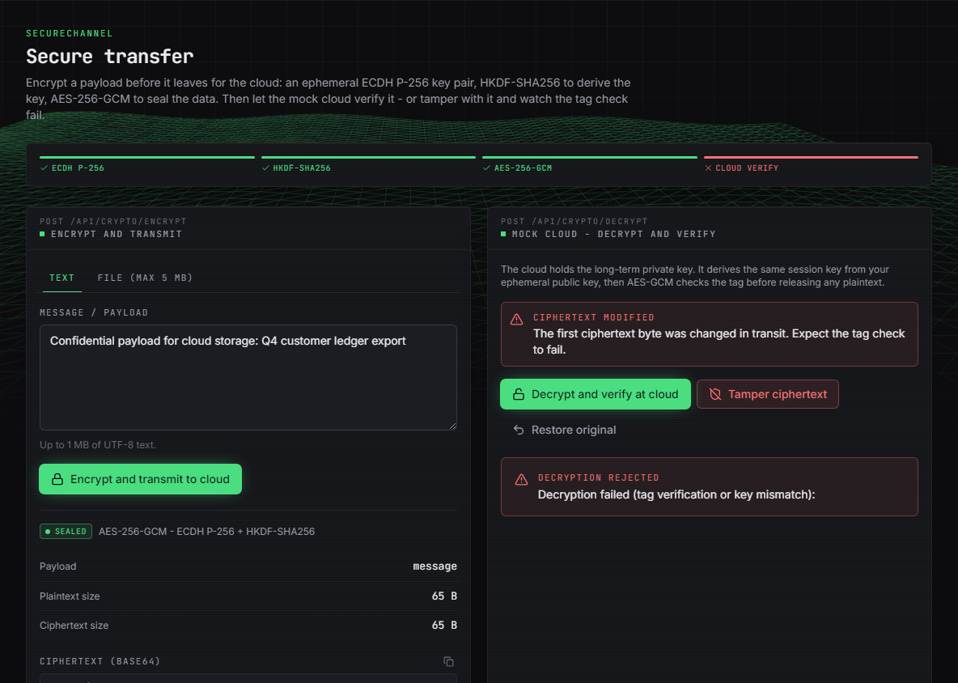
Output – Secure Transfer and Tamper Test
Left: text encrypted with a fresh ephemeral key, then decrypted and verified at the mock cloud (real ciphertext, nonce, tag, ephemeral public key). Right: one ciphertext byte flipped - the GCM tag check fails and the API answers 400.
Dept. of CSE | Batch A5 | Final Review
23
Notes:
Encrypt, decrypt-and-verify, and the tamper button.

Slide 24
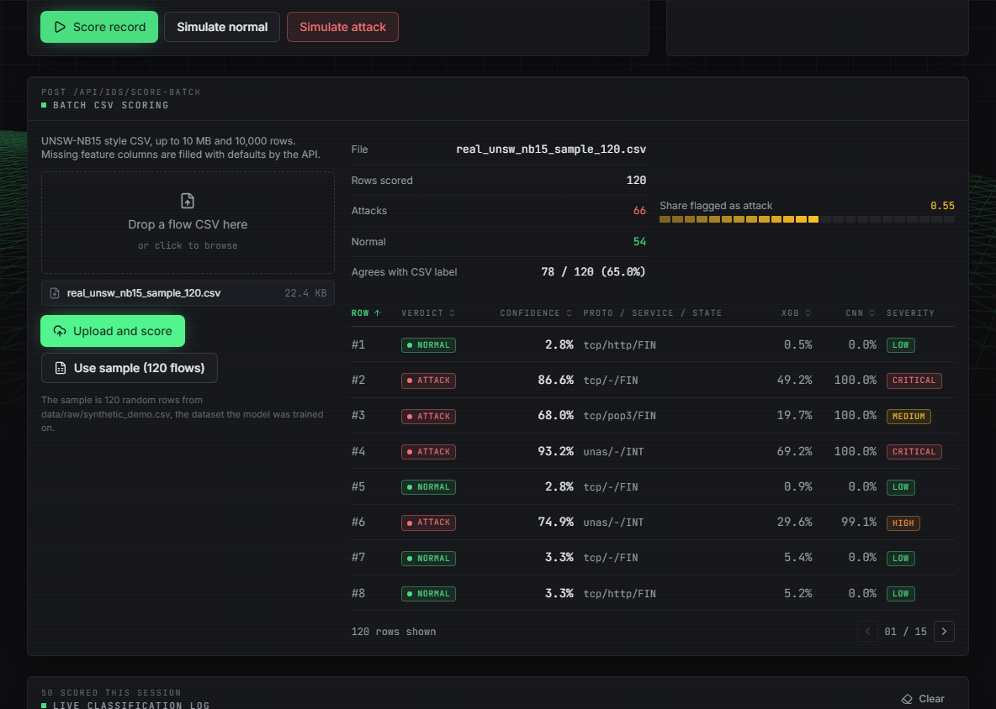

Output – Real UNSW-NB15 Flows: Shipped vs Real-Trained
The same 120 real flows (60 normal, 60 attack, official test set). Left: shipped synthetic-trained model agrees with the labels on 78 of 120 (65.0%). Right: real-trained bundle agrees on 101 of 120 (84.2%); its Model-performance page shows 88.79% on 82,332 flows.
Dept. of CSE | Batch A5 | Final Review
24
Notes:
The failure case and the fix side by side. The real-trained bundle is served with CIPHERGUARD_MODELS_DIR; it is not the default.

Slide 25
Conclusion & Objectives vs Outcomes
A working platform: standard authenticated encryption (6,000 of 6,000 tamper trials as expected) and a detector reaching 0.890 stacked / 0.910 XGBoost on real UNSW-NB15; 26 tests and 15 smoke checks pass.
Findings: detection, not encryption, is the overhead (81% of a protected transfer); stacking adds nothing over XGBoost; synthetic accuracy does not transfer.
# | Objective | Outcome
1 | Hybrid AES + RSA | Partly: ECDH + AES-256-GCM implemented; RSA-OAEP only benchmarked
2 | Key generation, distribution, storage | Generation and distribution met; storage not (keys in memory)
3 | Encrypt before upload, decrypt after download | Met against a mock cloud; no real provider
4 | Classifier on benchmark dataset | Met in experiments (real UNSW-NB15); shipped default is synthetic
5 | Flag and log suspicious sessions | Partly: alert log in memory, not coupled to transfers
6 | Evaluate time, overhead, accuracy | Met: crypto latency, per-transfer overhead, detection metrics
Dept. of CSE | Batch A5 | Final Review
25
Notes:
Be explicit about which objectives were met, partly met or not met.

Slide 26
Limitations & Future Scope
Known limitations
Future scope
Default model trained on synthetic data
22.6% false alarms on normal traffic at 0.5
No live packet capture; flows are records or CSV rows
Mock in-process cloud, no auth or TLS, keys in memory
No adversarial or load testing
EECC and quantum-inspired network not implemented
Timings from one shared machine
Ship the real-trained bundle as default; retrain on newer data
Calibrate the threshold on validation data; cut false alarms
Capture live traffic and gate transfers on the verdict
Real cloud storage, persistent key management, TLS, login
Evaluate evasion attacks and the CICIDS / multi-class setting
Explore standard post-quantum key exchange
Dept. of CSE | Batch A5 | Final Review
26
Notes:
Limitations first, then concrete next steps.

Slide 27
References
[1] V. Kalyanasundaram, S. Raja and S. Kanthimathi, "Intrusion detection model using fused quantum NN-LeNet with improved elliptic curve cryptography based data security," IEEE Access, vol. 14, pp. 63767-63779, 2026, doi: 10.1109/ACCESS.2026.3686106.
[2] H. Boye, "Strengthening cloud security through advanced encryption and anomaly detection techniques for secure data storage and transmission," FMDB Trans. Sustain. Comput. Lett., vol. 2, no. 3, pp. 153-163, 2024, doi: 10.69888/FTSCL.2024.000241.
[3] J. Singh and G. S. Bhathal, "An automated data deletion: a secure method for multi-cloud security with intrusion detection system," Int. J. Sci. Res. (IJSR), vol. 13, no. 8, pp. 213-217, Aug. 2024, doi: 10.21275/SR24730194843.
[4] M. B. Shinde and P. P. Ghadekar, "Federated learning-based attack detection and secure data transmission in cloud using improved Blowfish encryption," Eng. Appl. Artif. Intell., vol. 182, Art. no. 115975, 2026, doi: 10.1016/j.engappai.2026.115975.
[5] N. Pamarthi and N. Rao N, "A cloud-based data privacy framework using hybrid encryption algorithms for secure data transmission," Genet. Mol. Res., 2026, doi: 10.4238/mq5a9v31.
[7] N. Moustafa and J. Slay, "UNSW-NB15: a comprehensive data set for network intrusion detection systems (UNSW-NB15 network data set)," in Proc. Mil. Commun. Inf. Syst. Conf. (MilCIS), Canberra, Australia, 2015, pp. 1-6, doi: 10.1109/MilCIS.2015.7348942.
[9] T. Chen and C. Guestrin, "XGBoost: a scalable tree boosting system," in Proc. 22nd ACM SIGKDD Int. Conf. Knowl. Discovery Data Mining, San Francisco, CA, USA, 2016, pp. 785-794, doi: 10.1145/2939672.2939785.
[10] Y. LeCun, L. Bottou, Y. Bengio and P. Haffner, "Gradient-based learning applied to document recognition," Proc. IEEE, vol. 86, no. 11, pp. 2278-2324, Nov. 1998, doi: 10.1109/5.726791.
[11] D. H. Wolpert, "Stacked generalization," Neural Netw., vol. 5, no. 2, pp. 241-259, 1992, doi: 10.1016/S0893-6080(05)80023-1.
[12] M. Dworkin, "Recommendation for block cipher modes of operation: Galois/Counter Mode (GCM) and GMAC," NIST Special Publication 800-38D, Nov. 2007, doi: 10.6028/NIST.SP.800-38D.
[13] E. Barker, L. Chen, A. Roginsky, A. Vassilev and R. Davis, "Recommendation for pair-wise key-establishment schemes using discrete logarithm cryptography," NIST Special Publication 800-56A, Rev. 3, Apr. 2018, doi: 10.6028/NIST.SP.800-56Ar3.
[14] H. Krawczyk and P. Eronen, "HMAC-based extract-and-expand key derivation function (HKDF)," IETF RFC 5869, May 2010, doi: 10.17487/RFC5869.
[20] H. Kadry, A. Farouk, E. A. Zanaty and O. Reyad, "Intrusion detection model using optimized quantum neural network and elliptical curve cryptography for data security," Alexandria Eng. J., vol. 71, pp. 491-500, May 2023, doi: 10.1016/j.aej.2023.03.072.
[24] S. Rahman, S. Pal, S. Mittal, T. Chawla and C. Karmakar, "SYN-GAN: a robust intrusion detection system using GAN-based synthetic data for IoT security," Internet Things, vol. 26, Art. no. 101212, Jul. 2024, doi: 10.1016/j.iot.2024.101212.
Dept. of CSE | Batch A5 | Final Review
27
Notes:
Selected references; the complete numbered list is in the report.

Slide 28
THANK YOU
Questions & Suggestions
Dept. of CSE | Batch A5 | Final Review
28
Notes:
Invite questions.

