Slide 1

ResQAI: AI-Based Accident Detection, Severity Assessment and Intelligent Emergency Response System
Final Review · ResQAI
Team Details : Batch A2
Under the Esteemed Guidance of
Shirisha Reddy
[DESIGNATION], Department of CSE
23K91A0503 Adepu Meenakshi
23K91A0521 Ayila Shanmukha Sai
23K91A0552 Chekka Chandrashekhar
23K91A0519 Avula Sreeya
DEPARTMENT OF COMPUTER SCIENCE AND ENGINEERING · TKR College of Engineering & Technology · Academic Year [ACADEMIC YEAR]
Notes:
Introduce the team and the project: ResQAI, a web application that detects a crash from sensor readings, grades its severity, asks for confirmation and drafts a located alert.

Slide 2
Table of Contents
Abstract
Base Paper & Literature Survey
Research Gap, Problem Statement & Objectives
Proposed System & Architecture
Methodology, Dataset & Models
Detection Workflow, Interaction & Storage
Implementation Highlights
Results: Confusion Matrices, Baselines, Ablation
Threshold, Noise & Unseen Events
Performance & Testing
Comparison with Base Paper
Output Screens, Conclusion, Future Scope & References
Dept. of CSE | Batch A2 | Final Review
2
Notes:
The agenda follows the report: problem, design, method, results, comparison, screens, conclusion.

Slide 3
Abstract
Road accident victims often cannot call for help, and crash detection that only reports an impact gives responders no severity to prioritise by.
ResQAI scales eleven motion-sensor features, decides with a random forest whether an event is a crash, grades it None, Minor, Moderate or Severe with a second forest, asks the occupant to confirm within 15 seconds, and then locates the crash and drafts a dispatch message with the three nearest hospitals.
On 2,400 held-out synthetic events the detector scores 1.000 and the severity model 0.99958 accuracy (macro-F1 0.99866); over five seeds severity accuracy is 0.99875. The classes are separable by construction: one acc_magnitude threshold matches the detector.
Alert-path compute is 56 ms on loopback, plus the deliberate 15 s confirmation. 33 of 33 smoke checks and 47 of 55 further checks pass; the 8 failures are input-validation findings.
Not done: real phone sensors, real SMS or call delivery, and potholes and speed breakers (a probe flags about half of them as accidents, never as Moderate or Severe).
Dept. of CSE | Batch A2 | Final Review
3
Notes:
Read the problem, then the system in one breath. Give each number with its data and end on the honest limits: synthetic data, simulated sensors, nothing transmitted.

Slide 4
Base Paper
Y. Wang, Z. Liang and Y. He, "Multi-Task FT-Transformer: A high-performance and interpretable framework for traffic accident severity prediction," IEEE Access, vol. 14, pp. 21585-21606, 2026, doi: 10.1109/ACCESS.2026.3658687.
Aspect | Base paper: Multi-Task FT-Transformer for traffic accident severity prediction
Method | Feature-token transformer for tabular data with three task heads (injury, fatal, property loss), uncertainty-weighted loss, SHAP explanations
Data | Police-reported crashes of Dongguan, China, 2019-2023: 30,442 records (19,483 train, 4,871 validation, 6,088 test), proprietary
Task | Predict how severe a crash was from driver, vehicle, road and environment attributes, after the crash
Reported results | Accuracy 70.31 % (injury), 90.38 % (fatal), 80.79 % (property loss); F1 64.48 / 86.71 / 79.18 %; beats XGBoost, LightGBM, CatBoost and MT-CNN
Stated limits | One city, injury proxied by number of injured, no ordinal modelling, no training or inference cost comparison
Dept. of CSE | Batch A2 | Final Review
4
Notes:
Wang, Liang and He, IEEE Access 2026. It analyses recorded crashes; it does not sense, detect, locate or dispatch. We borrow severity grading and per-class metrics only.

Slide 5
Literature Survey
Work | Year | Approach | Data / finding / limitation
Wang et al. (base) [1] | 2026 | Multi-task FT-Transformer, SHAP | 30,442 Dongguan crashes; 70.31 / 90.38 / 80.79 % accuracy; after the event
GreenBox [6] | 2026 | Arduino, GSM/GPS, impact switches, MPU-6050 rollover; SMS | Alert 'in seconds'; no accuracy or latency numbers; no machine learning
CIRS [7] | 2025 | YOLOv11 on camera frames + video-language model | 5,200 + 4,800 frames; top-1 86.5 %, F1 0.861; fixed cameras
Karthik et al. [9] | 2023 | Arduino, GSM, vibration sensor, accelerometer; SMS (as described in [6]) | No machine learning; results not quoted
Sharma and Sebastian [12] | 2019 | Arduino, accelerometer, vibration, seat-belt heart-rate sensor, GPS/GSM | Sensor rules; results not quoted
Sameen and Pradhan [17] | 2017 | Recurrent neural network on recorded crashes | 73.76 % accuracy (as reported in [1])
Chen and Chen [16] | 2020 | Logistic regression, decision tree, random forest; 9,472 Taiwan crashes | Random forest most effective (as cited in [1])
Hamdan and Sipos [13] | 2025 | Review of ML severity models (RF, XGBoost, SVM) | No numeric result in the abstract
Dept. of CSE | Batch A2 | Final Review
5
Notes:
Severity models use recorded data, IoT prototypes alert without grading, camera systems need infrastructure. Four more survey titles from the batch file could not be located and are not used for any claim.

Slide 6
Research Gap
Severity prediction in the literature works on recorded crash reports after the event, not on live sensor data.
Low-cost IoT prototypes alert contacts by SMS but add no severity grade and, in the work surveyed, report no accuracy figures.
Camera-based detection needs fixed cameras and still says nothing about how serious the crash is.
No surveyed work closes the loop: live sensing, then severity grading, then a located, prioritised alert with a hospital.
False alarms from braking, potholes and speed breakers are rarely quantified; a confirmation step is seldom evaluated.
Dept. of CSE | Batch A2 | Final Review
6
Notes:
The gap in one sentence: nothing surveyed closes the loop from live sensing through severity grading to a located, prioritised alert.

Slide 7
Problem Statement
Accidents on remote stretches often go unreported until a passer-by intervenes.
Existing crash detection reports only that an impact occurred, with no indication of how serious it is.
Without severity information, responders cannot prioritise between a minor scrape and a critical collision.
Dedicated in-vehicle crash hardware is costly and absent from most two-wheelers and older cars.
Input
Output
Safeguard
Eleven sensor features per event: acceleration, rotation, speed, jerk
Crash or not, severity grade, located alert with the nearest hospitals
A 15 s confirmation so a false alarm can be cancelled
Dept. of CSE | Batch A2 | Final Review
7
Notes:
The need is a smartphone-based system that detects, grades and dispatches, with a way to cancel false alarms.

Slide 8
Objectives
1. Collect and preprocess smartphone accelerometer, gyroscope, speed and GPS data for normal driving and collision events.
2. Train a classifier that distinguishes genuine accidents from potholes, speed breakers and hard braking.
3. Build a severity model that grades an impact as minor, moderate or severe.
4. Use GPS to locate the crash and identify a suitable nearby hospital.
5. Dispatch an automated alert carrying location and severity to emergency contacts and medical services.
6. Evaluate detection accuracy, false alarm rate and end-to-end alert latency.
Dept. of CSE | Batch A2 | Final Review
8
Notes:
The six objectives of the proposal. The conclusion states the real status of each: 1 and 5 partly, 2 partly, 3, 4 and 6 achieved at demonstration level.

Slide 9
Proposed System
Sensor reading
Scale
Detect
Grade severity
Confirm 15 s
Locate + dispatch
Two random forests of the same family: a detector (200 trees) and a severity grader (250 trees), both with balanced class weights.
The grader never overrides the detector: no accident means severity None.
Only Moderate or Severe starts the confirmation countdown; cancelling is logged as a false alarm.
After confirmation: browser GPS, haversine ranking of a 10-hospital directory, a drafted message with a map link, 112 and 108. A demonstration: nothing is transmitted.
Dept. of CSE | Batch A2 | Final Review
9
Notes:
The proposed system as a line of boxes and the design rules behind it.

Slide 10
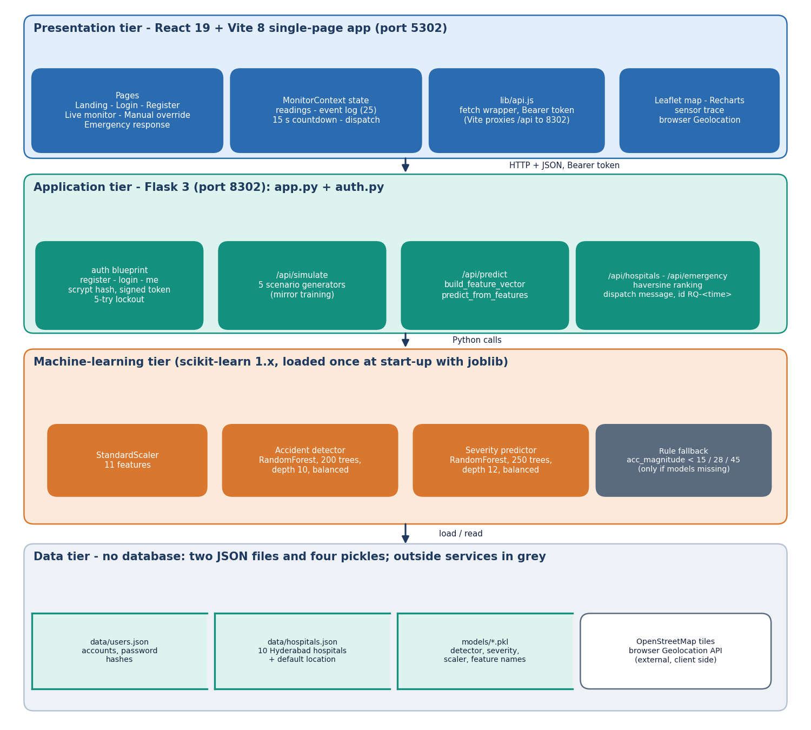
System Architecture
Console: React 19 + Vite 8, port 5302
API: Flask 3, port 8302, 10 routes
ML: scaler + two random forests, loaded once
Data: users.json, hospitals.json, four pickles; no database
Outside: OpenStreetMap tiles and the browser's location
Dept. of CSE | Batch A2 | Final Review
10
Notes:
Layers and storage. Readings, predictions and alerts are not stored.

Slide 11
Methodology
Generate
Split 80/20
Scale
Train 2 forests
Evaluate
Baselines
Stress tests
12,000 synthetic events from train_models.py (seed 42): 9,600 for training, 2,400 held out, stratified on the accident label.
The shipped pickles were checked against a fresh retrain: 100 % agreement on all 2,400 test events.
Added measurements: a five-seed repeat, four baselines, feature importance and ablation, a noise sweep, a threshold sweep and pothole / speed-breaker probes.
API latency measured on 127.0.0.1; 55 unit, edge and security checks plus the shipped 33-check smoke test.
Every number is written by scripts/measure_metrics.py, measure_api.py or run_tests.py to experiments/resqai_eval.
Dept. of CSE | Batch A2 | Final Review
11
Notes:
Workflow and the measurements added on top of the shipped training script, which has no validation split and no cross-validation.

Slide 12
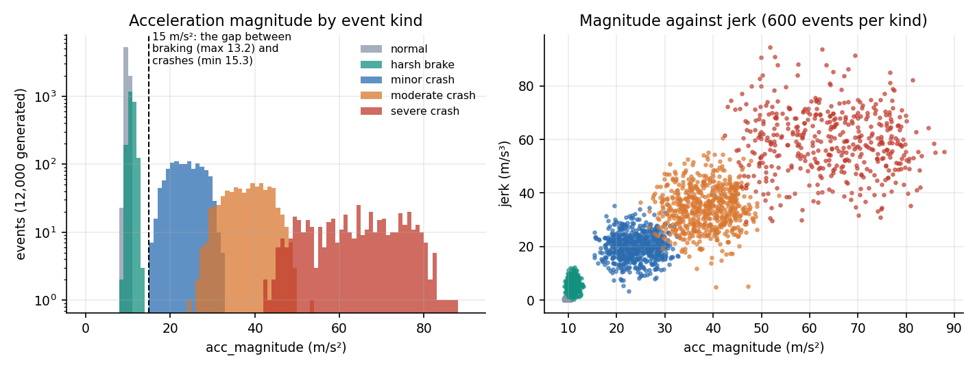
Dataset & Models
12,000
Component | Choice
Scaler | StandardScaler
Detector | RF, 200 trees, depth 10
Severity | RF, 250 trees, depth 12
Fallback | acc_magnitude 15 / 28 / 45
synthetic events, seed 42
11
features per event
19.9 %
Crashes start at 15.3 m/s² and harsh braking never exceeds 13.2: one gap separates the classes.
The generator has no potholes, speed breakers, phone drops or real sensor noise.
The same generator parameters drive the live simulator in the console.
crashes: minor 1,215, moderate 725, severe 447
Test split: 1,463 normal, 460 braking, 233 minor, 156 moderate, 88 severe events.
Dept. of CSE | Batch A2 | Final Review
12
Notes:
Be frank about the data: synthetic. It makes detection easy and the metrics optimistic, and it contains nothing like a pothole.

Slide 13
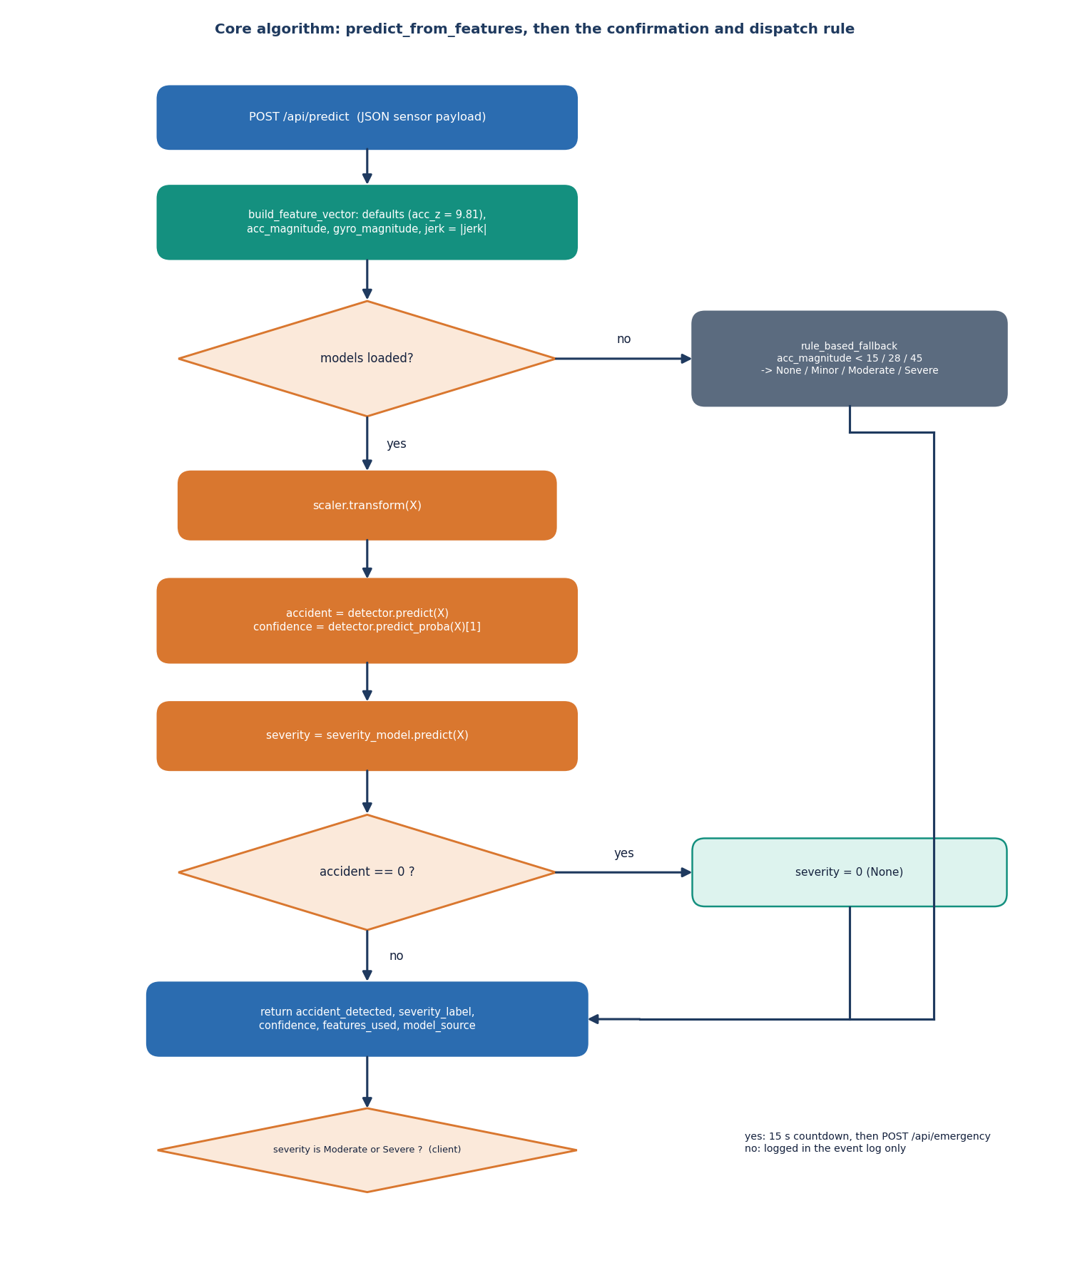
Detection Workflow
The payload is completed (acc_z defaults to 9.81) and magnitudes are derived.
The scaler uses the training mean and deviation; the detector returns the class and the probability of an accident.
The severity forest returns 0 to 3; an accident flag of 0 forces 0.
If the models cannot be loaded, three thresholds on acc_magnitude answer and the response says rule_based_fallback.
In the browser only Moderate or Severe opens the 15 s confirmation and pauses live monitoring.
Dept. of CSE | Batch A2 | Final Review
13
Notes:
The core algorithm is predict_from_features in app.py, plus the confirmation rule in MonitorContext.jsx.

Slide 14
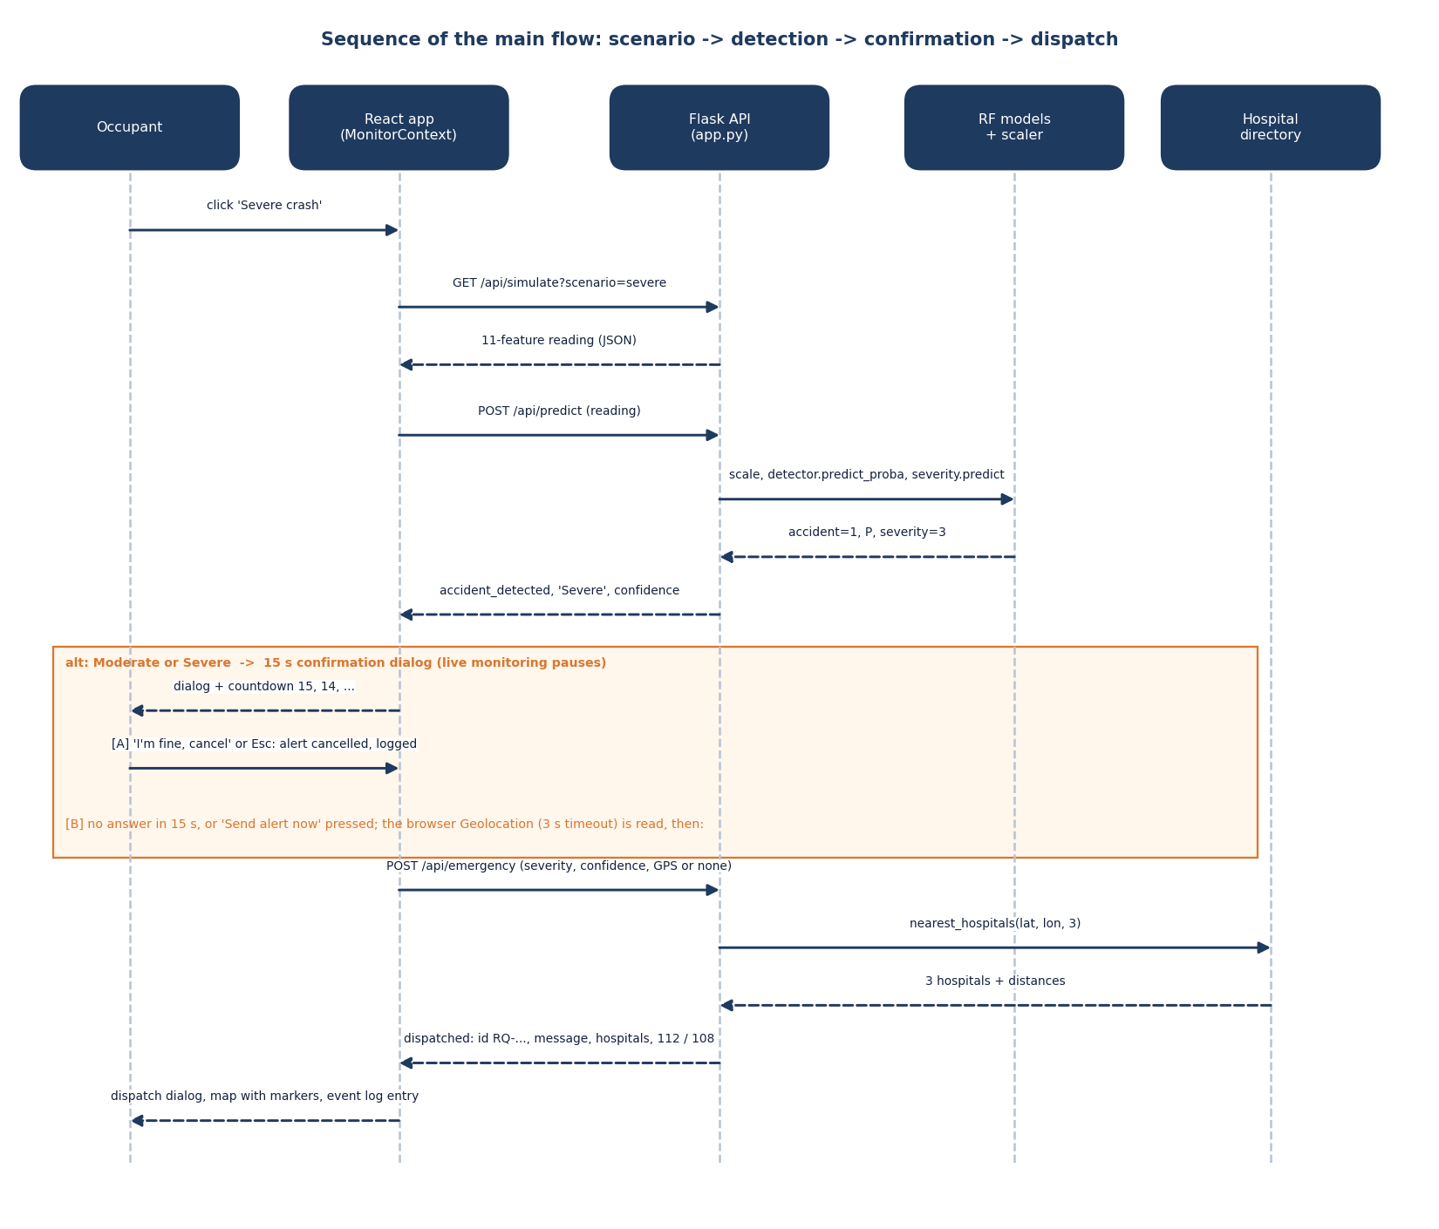
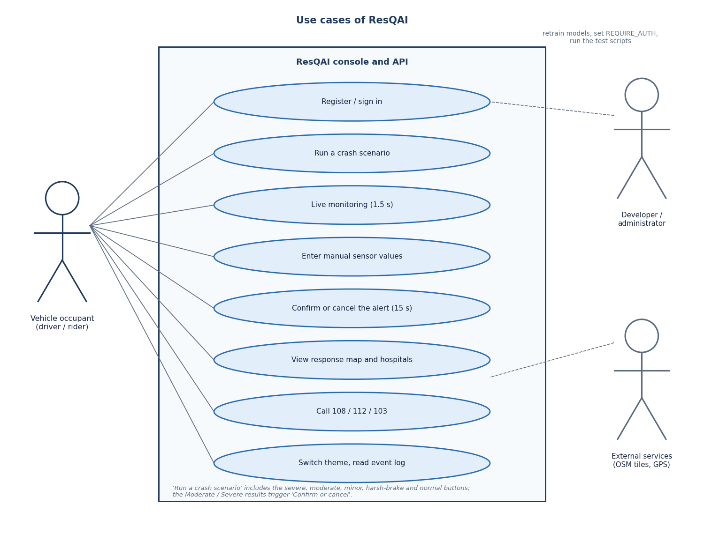
User – System Interaction
Dept. of CSE | Batch A2 | Final Review
14
Notes:
Sequence of one event, with the cancel and the send branches, and the use cases of the occupant.

Slide 15
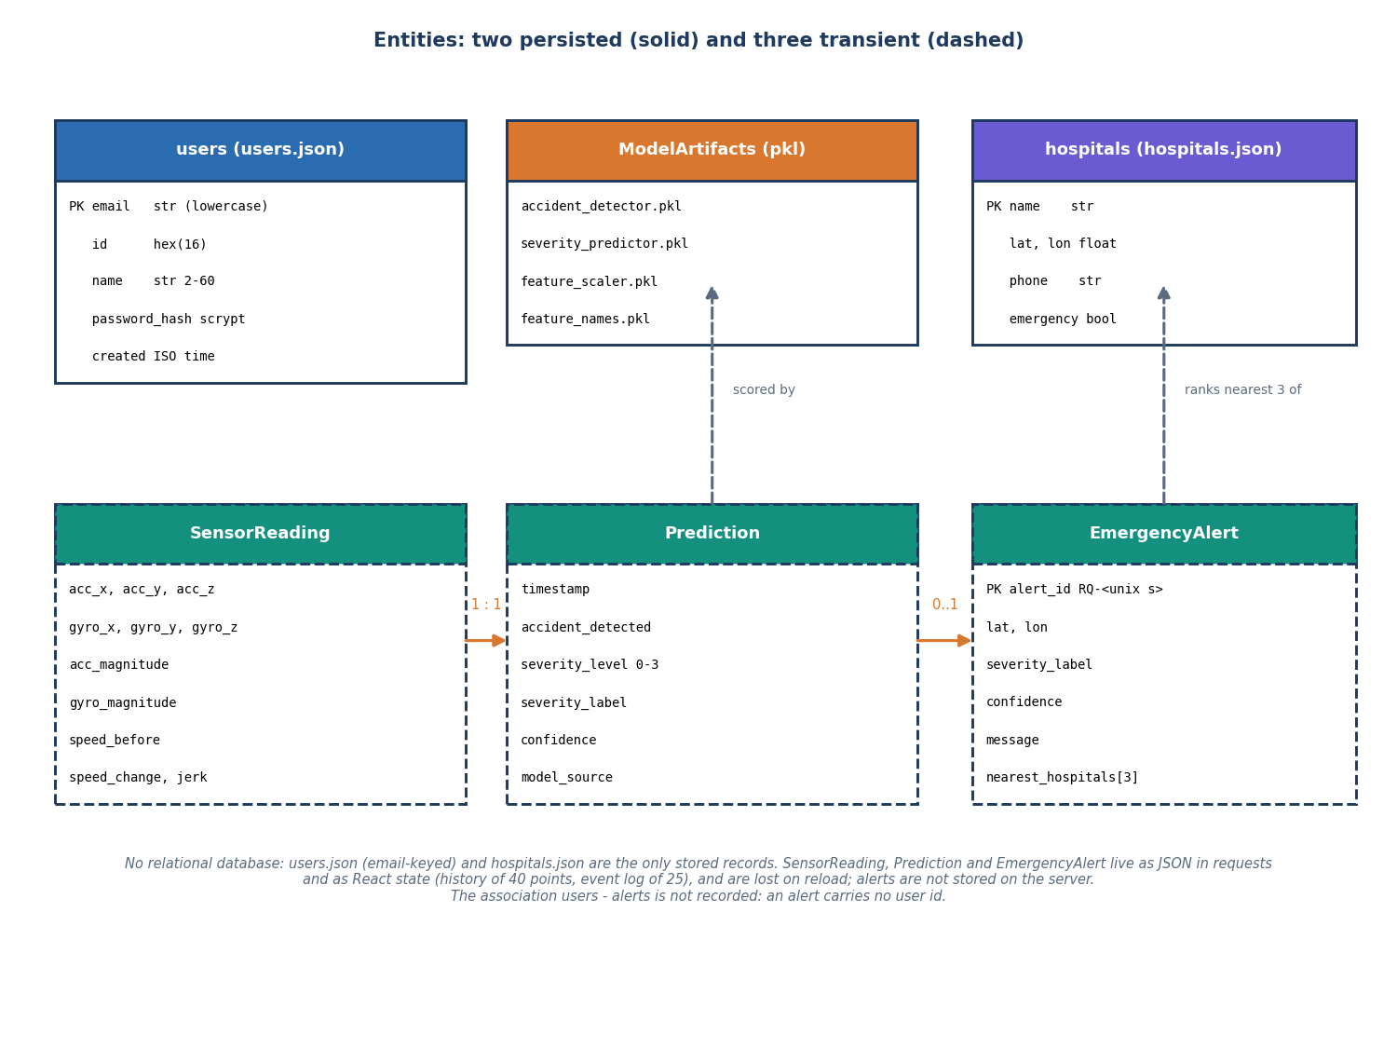
Storage & Data Design
Store | Content
users.json | id, name, unique e-mail, scrypt hash, created
hospitals.json | 10 Hyderabad hospitals + default location
accident_detector.pkl | 385 KB, 200-tree forest
severity_predictor.pkl | 2.6 MB, 250-tree forest
feature_scaler.pkl | StandardScaler, 11 features
feature_names.pkl | feature order
No relational database: readings, predictions and alerts are transient, and an alert carries no user id.
Dept. of CSE | Batch A2 | Final Review
15
Notes:
Two JSON files and four pickles; an honest simplification for a demonstration.

Slide 16
Implementation Highlights
10
33 + 55
6
672
REST routes
smoke + unit / edge / security checks
React screens, light and dark
lines of Python (app, auth, training)
Accounts: scrypt hashes, signed 12-hour tokens, e-mail case-insensitive, five failed logins lock an account for five minutes (429); REQUIRE_AUTH=1 guards every API route except /api/health.
Confirmation: 15-second countdown in the browser, cancel by button or Escape, live monitoring paused while it is open.
Location and dispatch: browser geolocation with a 3 s timeout, haversine ranking, message with a map link, alert id, 112 and 108 tap-to-call.
Known gaps: bad input can return HTTP 500, two alerts in one second share an id, requirements are not pinned.
Dept. of CSE | Batch A2 | Final Review
16
Notes:
Highlights and, in the last line, the defects the tests found. The product code was not changed during documentation.

Slide 17
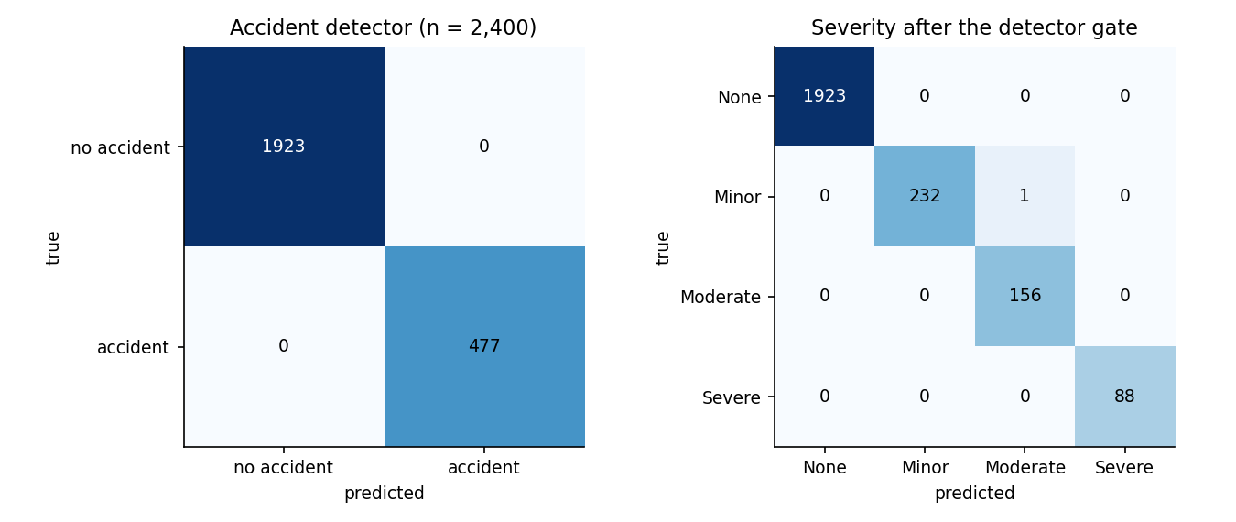
Results – Detector & Severity
1.000
0.99958
0.99866
0.996 / 1.000
detector accuracy, precision, recall, F1
severity accuracy after the gate
severity macro-F1
alert-trigger precision / recall
Class | Precision | Recall | F1 | n
None | 1.000 | 1.0000 | 1.0000 | 1923
Minor | 1.000 | 0.9957 | 0.9978 | 233
Moderate | 0.994 | 1.0000 | 0.9968 | 156
Severe | 1.000 | 1.0000 | 1.0000 | 88
Five-seed mean: severity accuracy 0.99875 (SD 0.00066), macro-F1 0.99501 (SD 0.00293); detector 1.000 in every run. One error in 2,400: a Minor crash graded Moderate.
2,400 held-out synthetic events; 1,923 non-accidents and 477 accidents.
Dept. of CSE | Batch A2 | Final Review
17
Notes:
The detector made no error; the severity model made one. These are synthetic-data results: they show the pipeline works, not that it would score this on real roads.

Slide 18
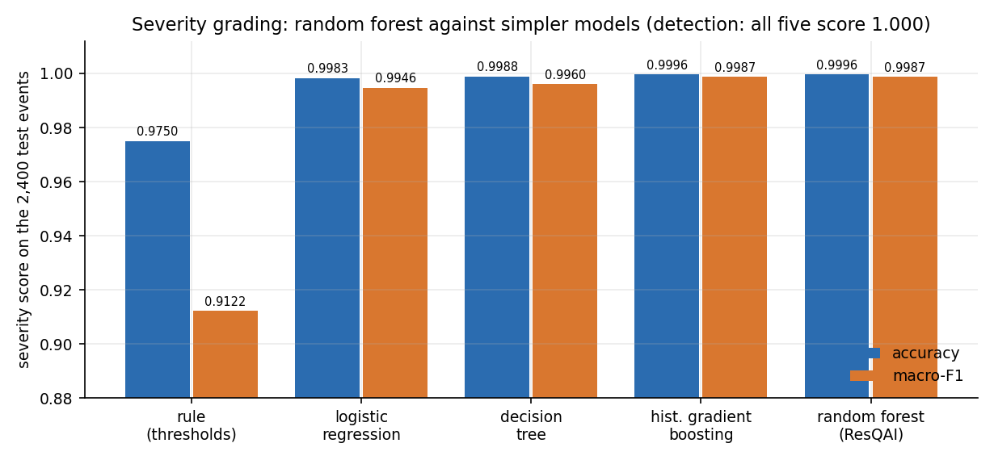
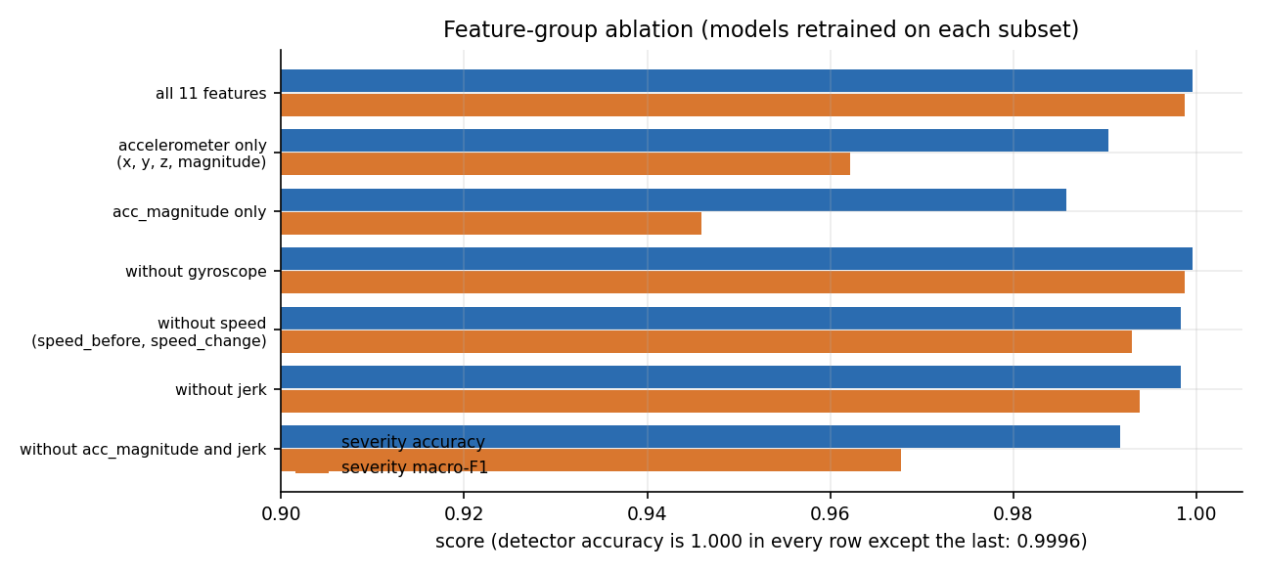
Results – Baselines & Ablation
A one-line acc_magnitude threshold detects crashes as well as the forest (1.000); the forest earns its place on severity: 0.9996 against 0.975 accuracy and 0.9987 against 0.912 macro-F1. HistGradientBoosting ties it.
acc_magnitude carries the detector (permutation F1 drop 0.80; every other feature 0.00); the gyroscope adds nothing measurable here; speed change and speed before matter for severity.
Dept. of CSE | Batch A2 | Final Review
18
Notes:
Honest reading of the comparison: on this data detection does not need machine learning; grading severity does.

Slide 19
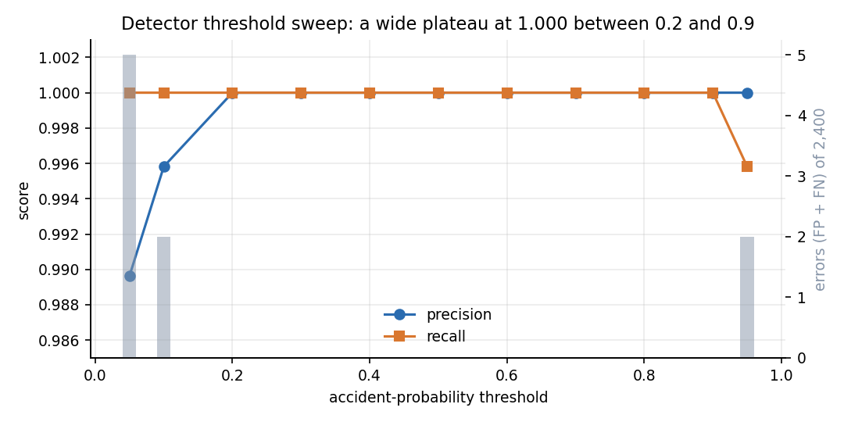
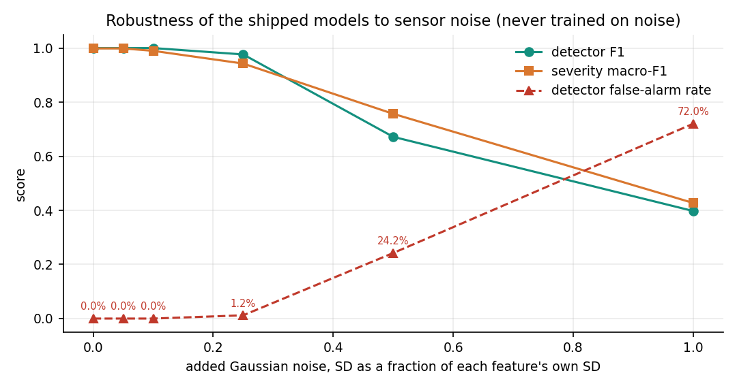
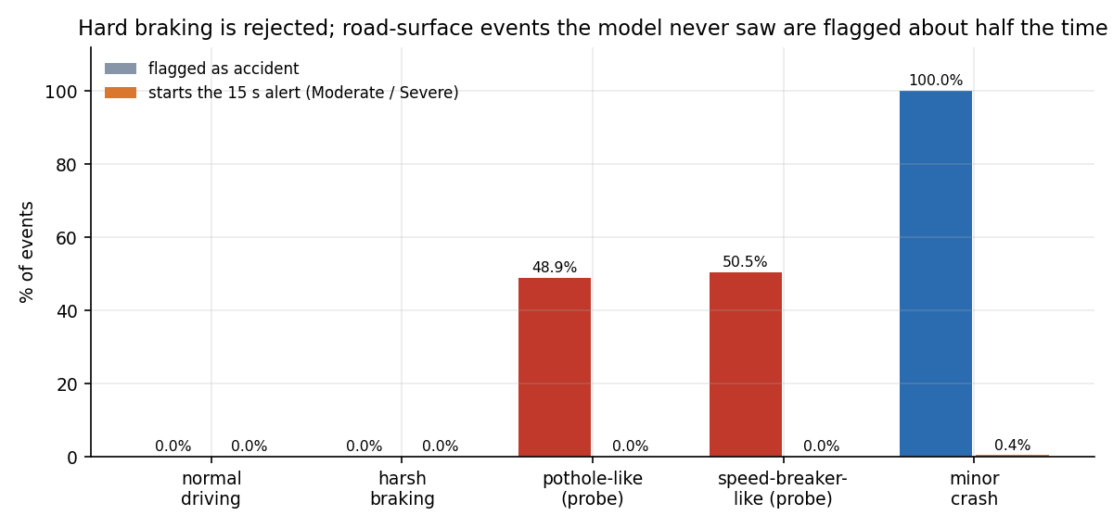
Threshold, Noise & Unseen Events
Threshold sweep: precision and recall stay at 1.000 from 0.2 to 0.9; 5 false alarms at 0.05, 2 missed crashes at 0.95. Not sensitive on this data.
Noise (never trained on): stable to 10 % noise; at 25 % the detector false-alarm rate is 1.2 %, at 50 % it is 24.2 %, at 100 % 72 %. Recall stays at 0.97 or more.
Unseen events (constructed probes, not real data): 48.9 % of pothole-like and 50.5 % of speed-breaker-like events flagged as accidents, none graded Moderate or Severe. Harsh braking: 0 of 460.
Dept. of CSE | Batch A2 | Final Review
19
Notes:
Three stress views. The unseen-event probes are our own construction, so they show a weakness rather than a rate: objective 2 is met for hard braking and not demonstrated for potholes and speed breakers.

Slide 20
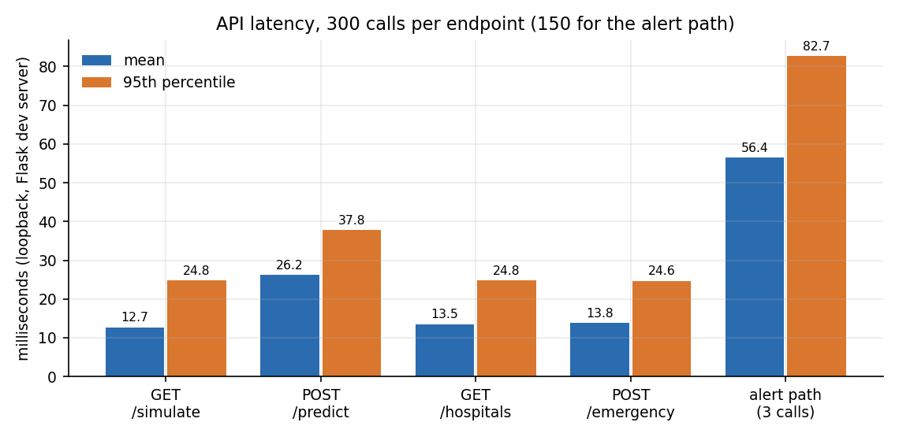
Performance & Testing
14 ms
26 ms
56 ms
34 / s
in-process prediction, mean (p95 19.7)
POST /api/predict, mean (p95 38)
alert path: simulate + predict + emergency
predict requests, one client
Smoke test: 33 of 33 checks pass.
Unit, edge and security: 47 of 55; unit 17 of 17, security 18 of 18, edge 12 of 20.
The 8 failures are input validation: non-numeric values give HTTP 500, k = -1 returns 9 hospitals, coordinates are not range-checked, same-second alert ids collide.
Plus the deliberate 15 s confirmation; real SMS or call delivery time was not measured.
Flask development server, loopback 127.0.0.1, i5-12500, 15.7 GB RAM under heavy memory pressure: conservative figures. No load test.
Dept. of CSE | Batch A2 | Final Review
20
Notes:
Compute is tens of milliseconds; the 15 second confirmation dominates the alert time by design. The failed edge checks are findings, left unfixed on purpose.

Slide 21
Comparison with Base Paper (context only – different data and task)
Aspect | Base paper [1] | This project (ResQAI)
Task | Severity of a past crash from recorded attributes | Detect a crash live, grade it, confirm, locate, dispatch
Data | 30,442 police-reported crashes, Dongguan, 2019-2023 | 12,000 synthetic sensor events; no real recordings
Models | Multi-task FT-Transformer; baselines RF, XGBoost, SVM ... | Two random forests; baselines threshold, LR, tree, boosting
Reported | Accuracy 70.31 / 90.38 / 80.79 % (three severity tasks) | Detector 1.000; severity 0.99958; macro-F1 0.99866
Explainability | SHAP at sub-class level | Gini and permutation importance, ablation
Live sensing, location, dispatch | None | Simulated feed, GPS, hospitals, drafted message (not sent)
Datasets, labels and tasks differ, and ours is synthetic and easily separable: the figures cannot be compared as like for like, and no superiority is claimed.
Dept. of CSE | Batch A2 | Final Review
21
Notes:
State plainly that the numbers are not comparable. The base paper's task is harder (real, noisy, five-class labels from police reports).

Slide 22
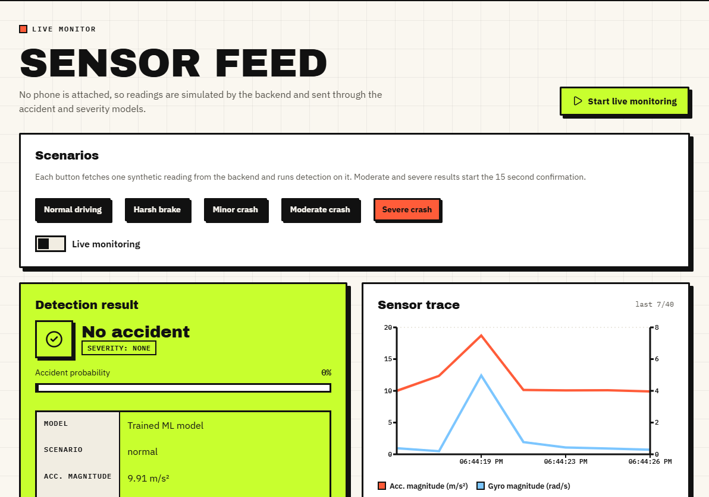
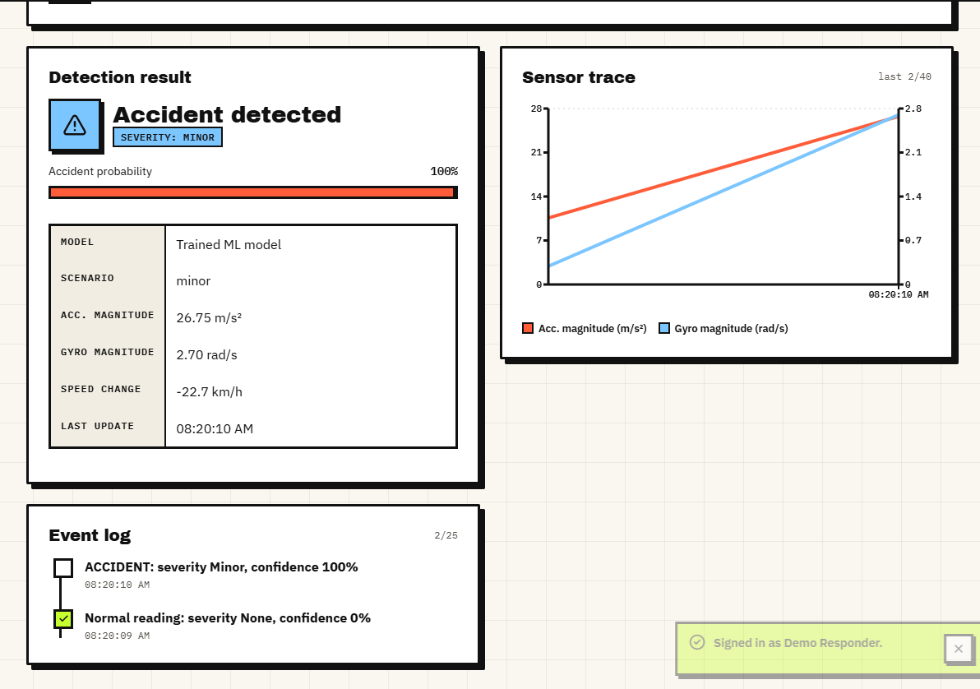
Output – Live Monitor
Left: a normal-driving reading, 0 % accident probability, sensor trace and scenario buttons. Right: a Minor crash: detected, graded Minor at 100 % probability and only logged in the event log, with no countdown.
Dept. of CSE | Batch A2 | Final Review
22
Notes:
Real screenshots from the running console. Sensor readings are simulated by the backend and pass through the real models.

Slide 23
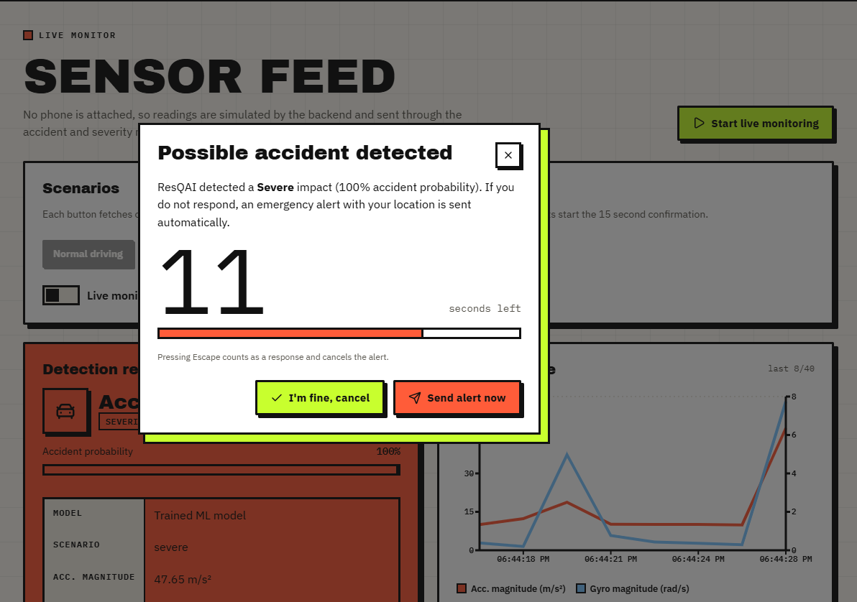
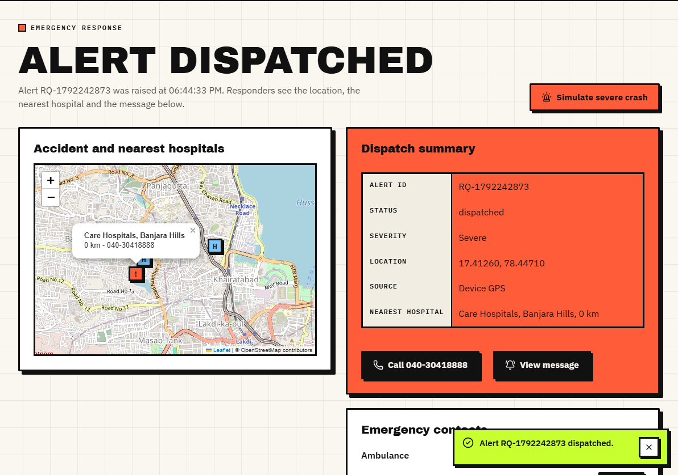
Output – Confirmation and Dispatch
Left: 'Possible accident detected' for a Severe crash, 11 seconds left, with 'I'm fine, cancel' and 'Send alert now'. Right: the dispatched alert with a map, the nearest hospital, the alert id and tap-to-call. The message is displayed; nothing is sent.
Dept. of CSE | Batch A2 | Final Review
23
Notes:
The confirmation is the only protection against false alarms in the live app. The dispatch summary shows the location, the nearest hospital and the alert id.

Slide 24
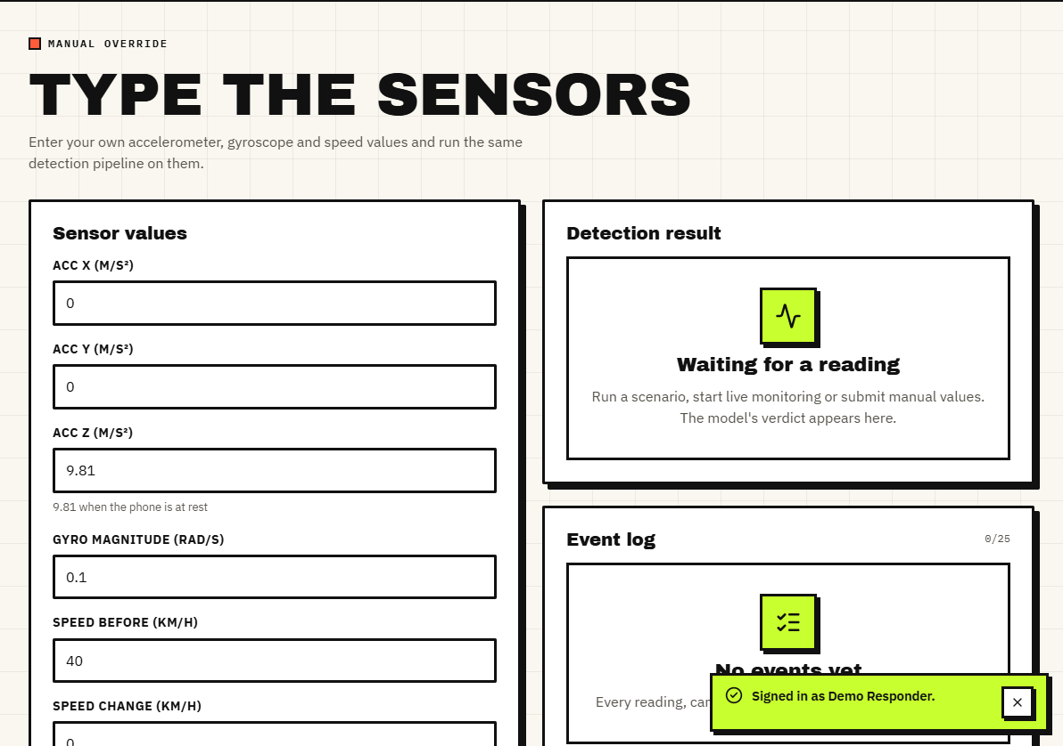
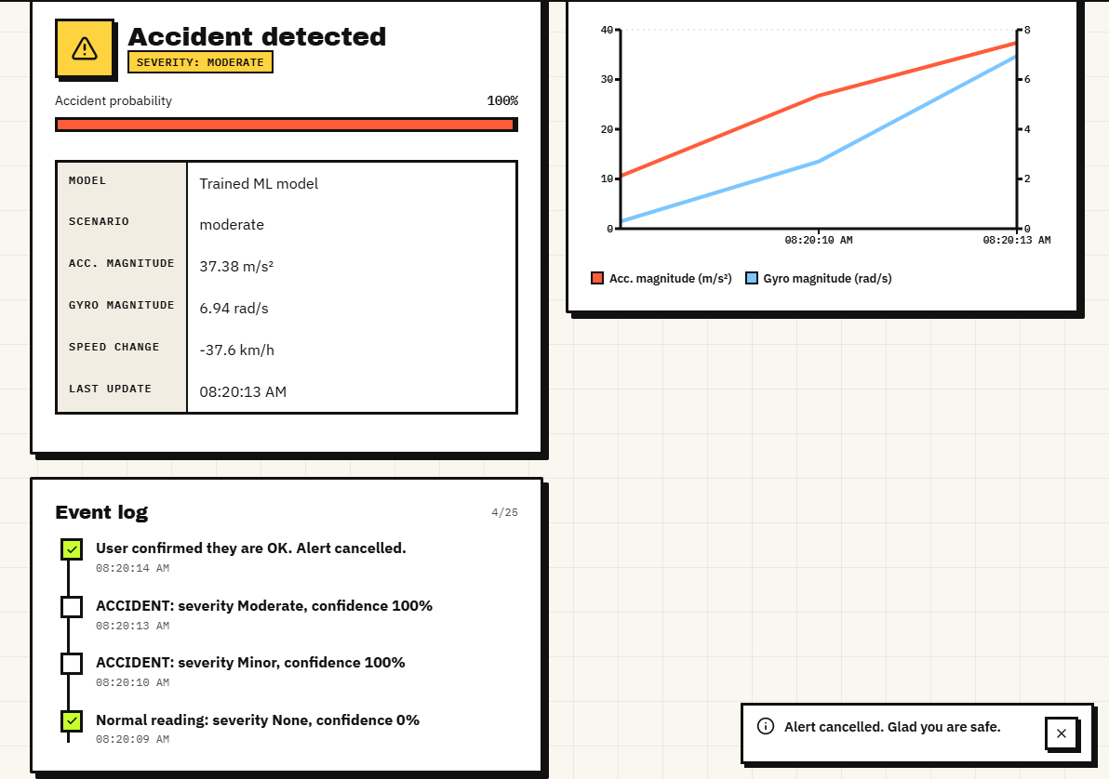
Output – Manual Override and Cancelled Alert
Left: manual override: type accelerometer, gyroscope, speed and jerk values and run detection. Right: a Moderate crash that the occupant cancelled; the event log records 'User confirmed they are OK. Alert cancelled.'
Dept. of CSE | Batch A2 | Final Review
24
Notes:
Manual values let a reader try any reading; the right screenshot shows the cancel branch of the confirmation.

Slide 25
Conclusion
Delivered: a working console and API from sensor reading to detection, severity, 15 s confirmation, location, nearest hospitals and a drafted alert; 33 of 33 smoke checks pass.
Measured (synthetic data): detector 1.000; severity accuracy 0.99958, macro-F1 0.99866; five-seed means 0.99875 / 0.99501; alert path 56 ms plus the 15 s confirmation.
Objectives: 3, 4 and 6 achieved at demonstration level; 2 partly (hard braking yes, potholes and speed breakers not shown); 1 and 5 partly (no real recordings; alert drafted, not sent).
Findings: a threshold matches the detector; noise robustness ends near 25 %; 8 input-validation failures; pickles written with a newer scikit-learn than pinned.
Position: a demonstration of the pipeline, not a validated safety system.
Dept. of CSE | Batch A2 | Final Review
25
Notes:
Be explicit about which objectives were met and which were not, and what was never measured.

Slide 26
Future Scope
Collect real accelerometer and gyroscope recordings on phones, including potholes, speed breakers, hard braking and low-speed impacts, and retrain with a validation split.
Add road-surface classes and report the false-alarm rate per event kind; add noise to training.
Connect an SMS or call gateway, store alerts per user and measure end-to-end delivery time.
Validate every input, use unique alert ids, pin library versions, and use a live hospital service with capacity and traffic.
Run on the phone itself, test battery cost, and evaluate with users and responders.
Dept. of CSE | Batch A2 | Final Review
26
Notes:
Concrete next steps, ordered by value.

Slide 27
References
[1] Y. Wang, Z. Liang and Y. He, "Multi-Task FT-Transformer: A high-performance and interpretable framework for traffic accident severity prediction," IEEE Access, vol. 14, pp. 21585-21606, 2026, doi: 10.1109/ACCESS.2026.3658687.
[6] J. Rocha, S. Soares, A. Valente and F. C. Pinto, "GreenBox: Prototyping of an automatic road accident detection system with real-time notification SMS," arXiv:2606.16468 [eess.SY], Jun. 2026.
[7] S. Ayesha, A. Aslam, M. H. Zaheer and M. B. Khan, "CIRS: A multi-agent machine learning framework for real-time accident detection and emergency response," Sensors, vol. 25, no. 18, Art. no. 5845, Sep. 2025, doi: 10.3390/s25185845.
[9] M. Karthik, L. Sreevidya, K. Vinodha, M. Thangaraj, G. Hemalatha and T. Viswak Sena, "Automatic messaging system by detecting the road accidents for vehicle applications," Mater. Today: Proc., vol. 80, pp. 3124-3128, 2023.
[12] S. Sharma and S. Sebastian, "IoT based car accident detection and notification algorithm for general road accidents," Int. J. Elect. Comput. Eng. (IJECE), vol. 9, no. 5, pp. 4020-4026, 2019.
[13] N. Hamdan and T. Sipos, "Advancements in machine learning for traffic accident severity prediction: A comprehensive review," Period. Polytech. Transp. Eng., vol. 53, no. 3, pp. 347-355, 2025, doi: 10.3311/PPtr.40369.
[16] M.-M. Chen and M.-C. Chen, "Modeling road accident severity with comparisons of logistic regression, decision tree and random forest," Information, vol. 11, no. 5, p. 270, May 2020.
[17] M. Sameen and B. Pradhan, "Severity prediction of traffic accidents with recurrent neural networks," Appl. Sci., vol. 7, no. 6, p. 476, Jun. 2017.
[18] M. Zheng, T. Li, R. Zhu, J. Chen, Z. Ma, M. Tang, Z. Cui and Z. Wang, "Traffic accident's severity prediction: A deep-learning approach-based CNN network," IEEE Access, vol. 7, pp. 39897-39910, 2019.
[19] Y. Gorishniy, I. Rubachev, V. Khrulkov and A. Babenko, "Revisiting deep learning models for tabular data," in Proc. Adv. Neural Inf. Process. Syst., vol. 34, Dec. 2021, pp. 18932-18943.
[20] A. Kendall, Y. Gal and R. Cipolla, "Multi-task learning using uncertainty to weigh losses for scene geometry and semantics," in Proc. IEEE/CVF Conf. Comput. Vis. Pattern Recognit. (CVPR), Jun. 2018, pp. 7482-7491.
[21] L. Breiman, "Random forests," Mach. Learn., vol. 45, no. 1, pp. 5-32, Oct. 2001.
[22] F. Pedregosa et al., "Scikit-learn: Machine learning in Python," J. Mach. Learn. Res., vol. 12, pp. 2825-2830, 2011.
[25] R. W. Sinnott, "Virtues of the haversine," Sky and Telescope, vol. 68, no. 2, p. 159, 1984.
Dept. of CSE | Batch A2 | Final Review
27
Notes:
Selected references; the complete numbered list, with four marked not verified, is in the report.

Slide 28
THANK YOU
Questions & Suggestions
Dept. of CSE | Batch A2 | Final Review
28
Notes:
Invite questions.

