Slide 1
Online Vehicle Parking Reservation System
REVIEW 2 · DESIGN, METHODOLOGY AND PROGRESS
Design, methodology and progress: advance parking reservation with a hold-back buffer, nearest-alternate re-allocation and a driver Trust Score
Presented by
Under the guidance of
Palle Yashaswini 23K91A05H9
Mohammed Muneeb Ahmed 24K95A0518
Kamasani Manisha 24K95A0513
Pothagani Nithyya Bhargava 23K91A05J6
V Pallavi, [DESIGNATION]
Department of Computer Science and Engineering
TKR College of Engineering & Technology · Batch C3 (CSE-C) · [ACADEMIC YEAR]
Notes:
This review shows how ParkSure is designed and built, what is implemented, the first measured results from our own tests and simulator, and the open items. Introduce the four team members and the guide.

Slide 2
Contents
01
02
03
04
Recap and architecture
Methodology and data
Input handling and engine rules
Configuration and decision logic
05
06
07
08
Data flow, modules, UML
Technology stack
Implementation progress
Preliminary results
09
10
11
12
Output screens
Testing
Challenges
Next steps
Notes:
Agenda for the design and progress review.

Slide 3
Recap: problem and proposed system
!
Problem
i
Proposed system
B
Base papers
Drivers circle for parking, operators keep manual registers with no live view, an arrival gives no guarantee of a bay, and cash collection leaves no usable record. Reservation systems add a new failure: the booked bay is still occupied by a vehicle that overstayed.
ParkSure lets drivers search live availability, reserve in advance, pay online and check in and out. An availability engine keeps a hold-back buffer, moves a driver to the nearest alternate when the lot is full on arrival, and prices by a driver Trust Score.
[1] Jemmali et al. (IEEE OJCS 2026) balance load across zones by passenger count. [2] Cabri et al. (arXiv 2026) propose a buffer of non-reservable bays and a star reputation, tested in simulation. ParkSure implements the ideas of [2] as a working web platform; the settings differ, so only relative findings are comparable.
Notes:
Recap of Review 1. The batch's registered base paper is the OJCS paper; the reservation buffer and star rules that ParkSure implements come from the arXiv paper. Our gap is a complete operating reservation platform that is measured honestly.

Slide 4
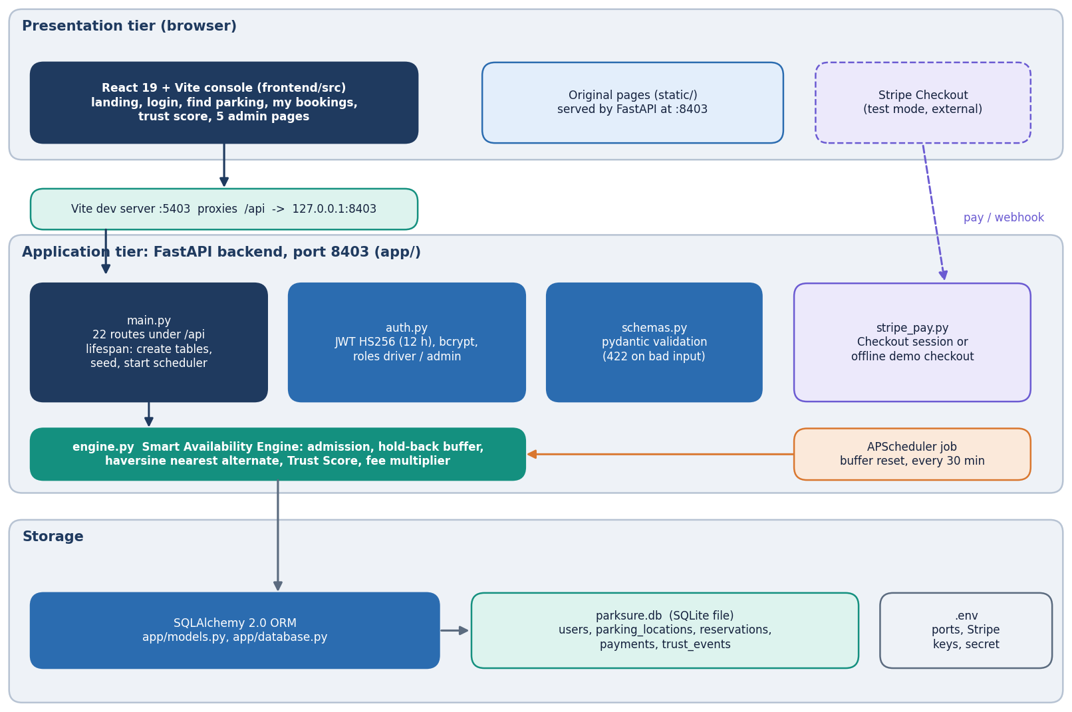
System architecture
Layered, one database file
Console: React 19 + Vite on port 5403: landing, login, three driver screens and five admin screens; /api is proxied to the backend.
API: FastAPI on port 8403, 22 routes in app/main.py with JWT roles driver and admin.
Engine: app/engine.py owns admission, buffer, haversine alternate, Trust Score and fees.
Storage: SQLAlchemy over SQLite (parksure.db, 5 tables); APScheduler resets buffers every 30 minutes; Stripe Checkout in test mode with a demo fallback.
Notes:
app/main.py is 440 lines and app/engine.py 141; the routes call the engine functions and keep no rules of their own.

Slide 5
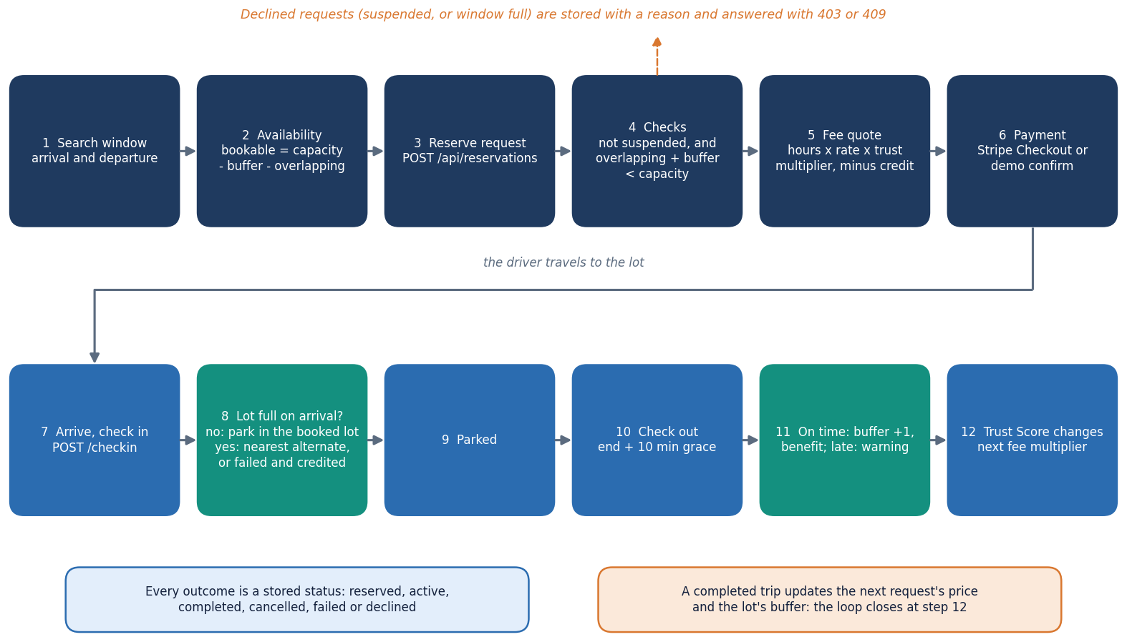
Methodology: search, reserve, pay, arrive, depart
Admit
A request is accepted only if overlapping bookings plus the buffer stay below capacity; otherwise it is declined with a reason.
Arrive
At check-in a full lot moves the driver to exactly one nearest alternate by haversine distance, or the booking fails and the fee is credited.
Learn
An on-time check-out grows the buffer and builds a benefit streak; a late one adds a warning. The score sets the next fee.
High-level workflow as implemented in the API.
Notes:
Every rule shown here is in app/engine.py and is exercised by the tests; the workflow diagram mirrors the routes.

Slide 6
Data: no ML dataset; a seeded demo history and a simulator
5
9
347
279
locations in the seeded demo (8 to 25 bays each)
users: 1 admin and 8 drivers (2 with overstay history)
reservations over 60 days: 279 done, 39 failed, 29 declined
payment records (demo provider)
 | Seeded demo history (app/seed.py) | Simulator scenario (scripts/parking_sim.py)
Origin | generated by the product itself with random seed 42: SYNTHETIC, not real parking data | re-creates the setting of base paper [2]: 8 areas x 10 bays, 80 to 110 vehicles
Content | 60 days of bookings plus 8 Friday-evening over-subscription peaks at Old Town Deck | each vehicle makes 10 parks of 1 to 3 h; 25 to 50 % overstay by 1 h
Use | gives Strategy Insights real contention to replay on a fresh install | 30 runs per cell (the paper used 5); 5 buffer policies; Trust Score on or off
Not available | no real parking-lot data, no licence issue, no split (there is no model to train) | not SUMO; arrival process and gaps are our assumptions, fixed before the runs
Notes:
ParkSure has no machine-learning model, so there is no training dataset. All reported results come from our own tests, a simulator that reproduces the base paper's scenario, and the synthetic seed that ships with the product.

Slide 7
Input handling and data preparation
pydantic validation
Times to UTC
30-day window limit
Overlap count
Fee quote
Reservation + payment
22
0.25 h
routes; request bodies and query parameters are typed with pydantic, and bad input returns 422 (our injection-style probes: 422, never 500)
minimum billed time; fee = hours x hourly rate x trust multiplier, rounded to cents
Registration: name 2 to 120 characters, valid email, password 6 to 128; passwords are stored as bcrypt hashes (cost 12), tokens are HS256 JWTs valid for 12 hours.
Locations: latitude -90 to 90, longitude -180 to 180, capacity 1 to 5,000, price 0.5 to 100, buffer 0 to 20.
Reservations: end must be after start, window at most 30 days, naive times are treated as UTC; account credit offsets the fee automatically.
Seeding: on an empty database the product creates 5 locations, 9 users and 60 days of bookings so the admin screens show data.
Known gap: a booking window in the past is accepted (found by our probe).
Notes:
There is no data cleaning because there is no uploaded dataset; the equivalent step is strict validation at the API boundary (app/schemas.py).

Slide 8
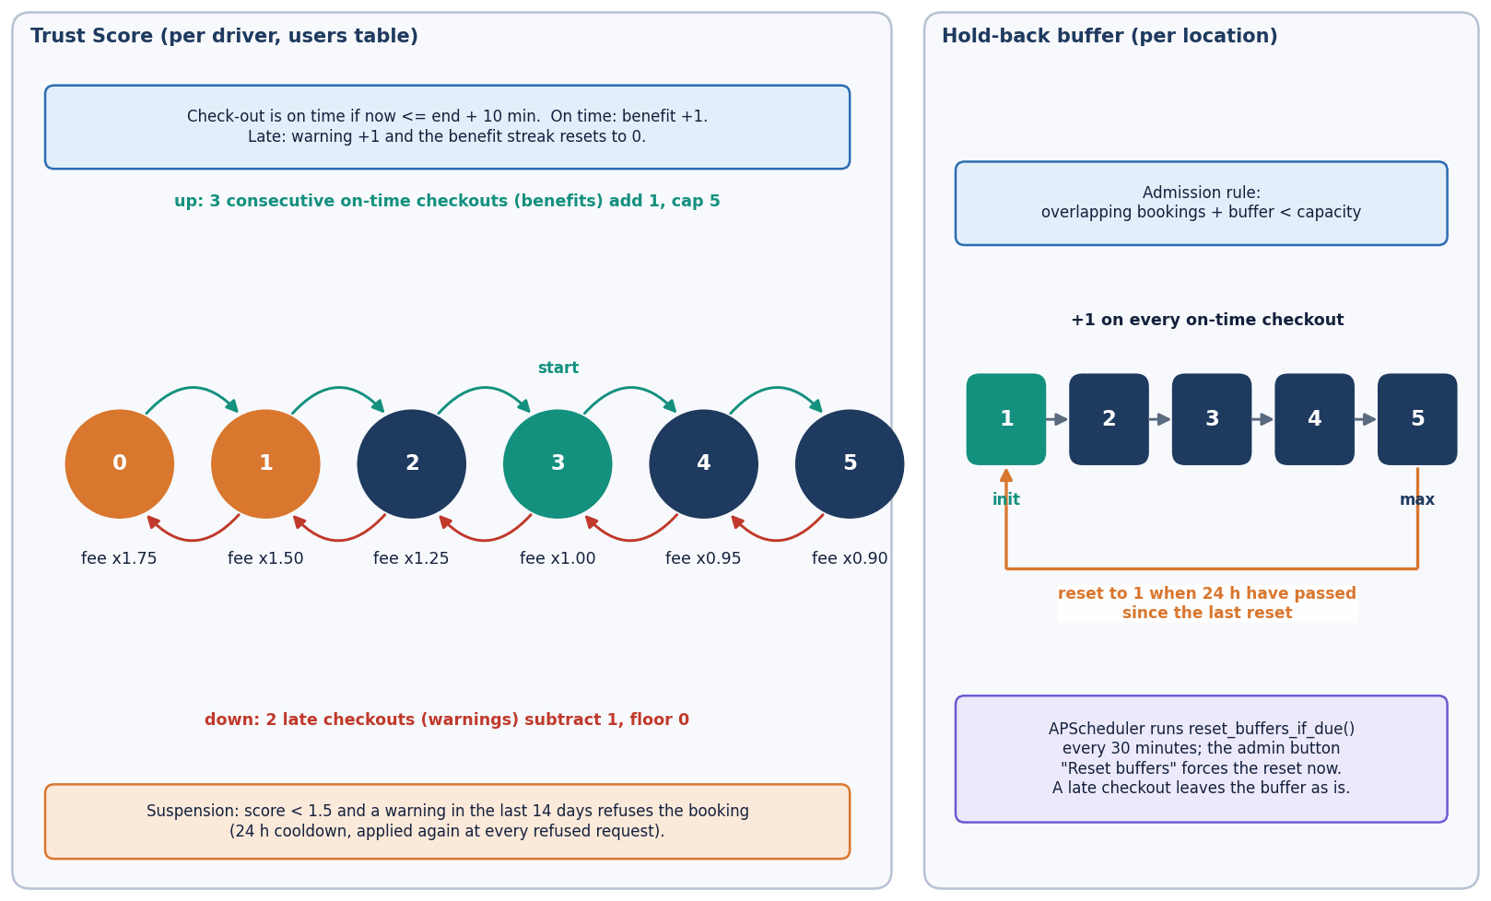
Engine rules: buffer and Trust Score
Admission: accept if overlapping bookings + buffer < capacity.
Buffer: starts at 1, +1 on every on-time check-out up to 5, reset to 1 every 24 h.
Trust Score 0 to 5, start 3: 3 on-time check-outs give +1, 2 late ones give -1; fee multiplier 1.75 down to 0.90.
Base paper [2] grows its buffer on late departures; the shipped code grows it on on-time ones. We measure both.
Trust Score and buffer policy, as coded in app/engine.py and app/config.py.
Notes:
The 'model' of this product is rule based, which makes every decision auditable. The direction of the buffer growth differs from the paper and is reported openly.

Slide 9
Policy constants and experiment configuration
Setting | Value
Buffer policy | initial 1, maximum 5, reset every 24 h by a job that runs every 30 minutes; +1 on an on-time check-out (end + 10 minutes of grace)
Trust Score | start 3, range 0 to 5; B = 3 benefits for +1, W = 2 warnings for -1; suspended below 1.5 with a warning in the last 14 days, 24 h cooldown
Fees | multiplier by rounded score: 1.75, 1.50, 1.25, 1.00, 0.95, 0.90; payments via Stripe test mode or the offline demo checkout
Simulator | 8 areas x 10 bays; 80 to 110 vehicles; 10 parks each of 1 to 3 h; overstay 1 h; 30 seeds per cell; static 0, 1, 3, dynamic (ParkSure), dynamic (paper rule)
Parity check | simulator against the real engine: 10,300 decisions, 0 mismatches
Latency runs | 200 sequential requests per endpoint on 127.0.0.1, one uvicorn process, SQLite file
Machine | Intel Core i5-12500 (6 cores), 15.7 GB RAM, Windows 11, Python 3.14.7, no GPU
Notes:
These are the constants in app/config.py and scripts/parking_sim.py. The simulator's unspecified parameters are listed in SIM_ASSUMPTIONS.

Slide 10
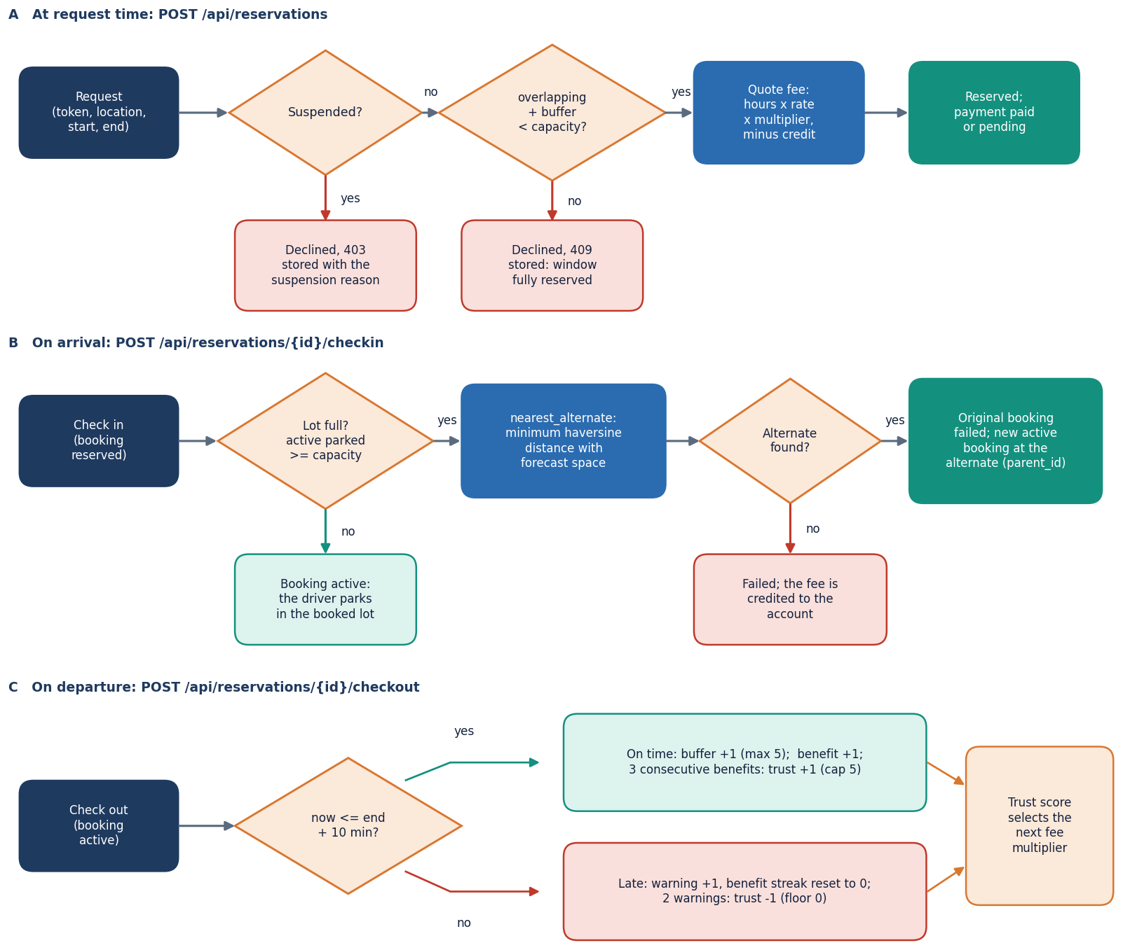
Decision logic: admission, arrival and departure
At request: suspended drivers are refused; otherwise overlapping + buffer < capacity decides, and a refusal is stored as a declined booking with its reason.
At arrival: if parked bays have reached capacity, the nearest other location with forecast space (haversine, R = 6,371 km) receives an active alternate booking; with none, the booking fails and the fee is credited.
At departure: more than 10 minutes late is a warning; on time grows the buffer and adds a benefit.
Limit: the alternate is booked without re-checking its physical bays.
Notes:
Alternate search costs about 0.4 ms per other location (18.6 ms over 49 locations); the admission check itself takes 0.33 ms.

Slide 11
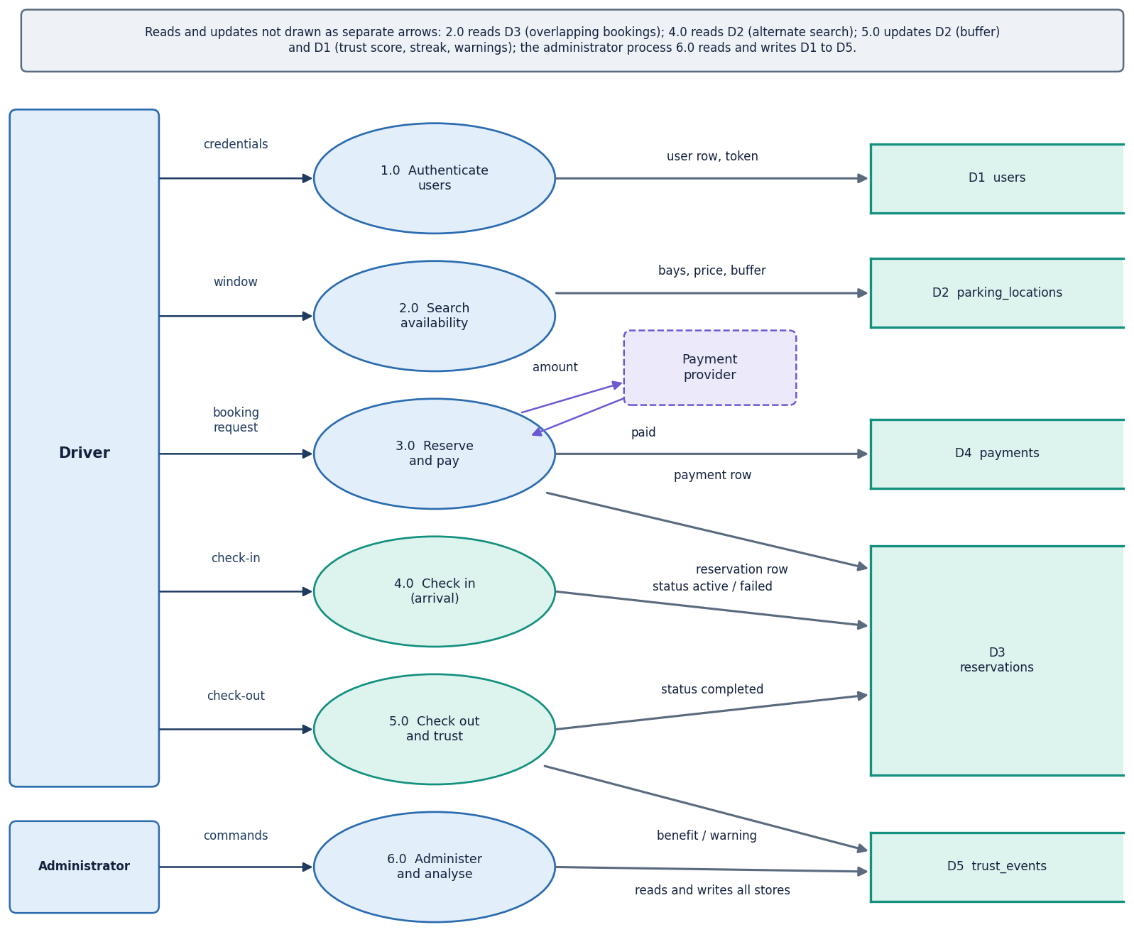
Data flow and modules
Module | Lines | Role
app/main.py | 440 | 22 routes, scheduler
app/engine.py | 141 | admission, buffer, trust, haversine
app/models.py | 93 | 5 SQLAlchemy tables
app/auth.py | 53 | bcrypt, JWT, role guards
app/schemas.py | 40 | pydantic validation
app/stripe_pay.py | 35 | Checkout / demo fallback
app/seed.py | 114 | synthetic demo history
scripts/parking_sim.py | 276 | discrete-event simulator
scripts/compute_buffer_ strategy_metrics.py | 119 | Strategy Insights replay
DFD level 1: six processes and the data stores.
Notes:
Line counts are taken from the files. The API layer is thin: it validates, calls the engine and shapes the JSON.

Slide 12
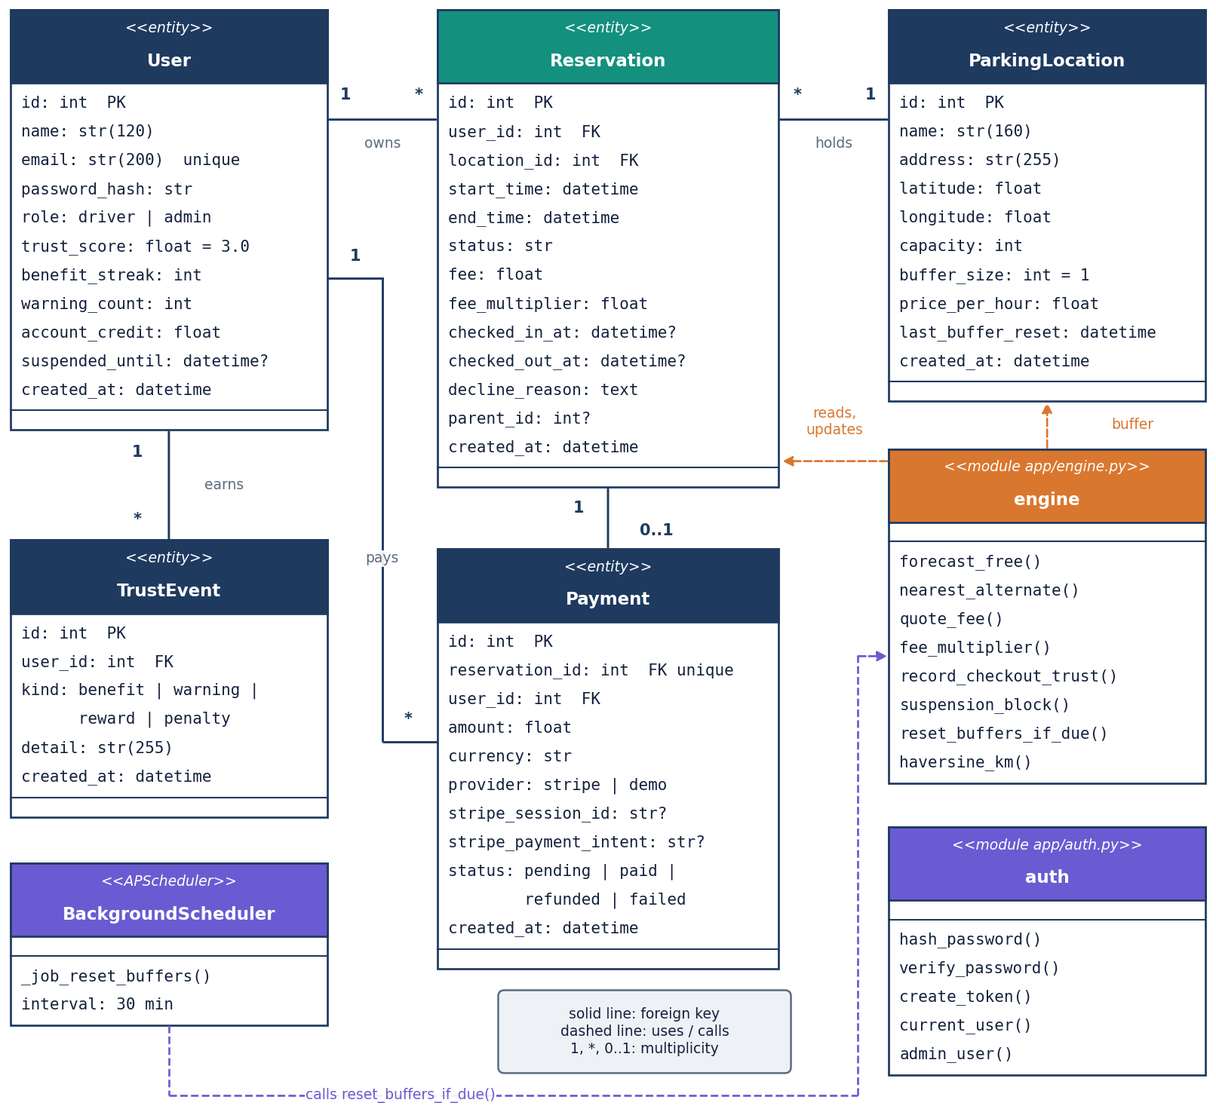
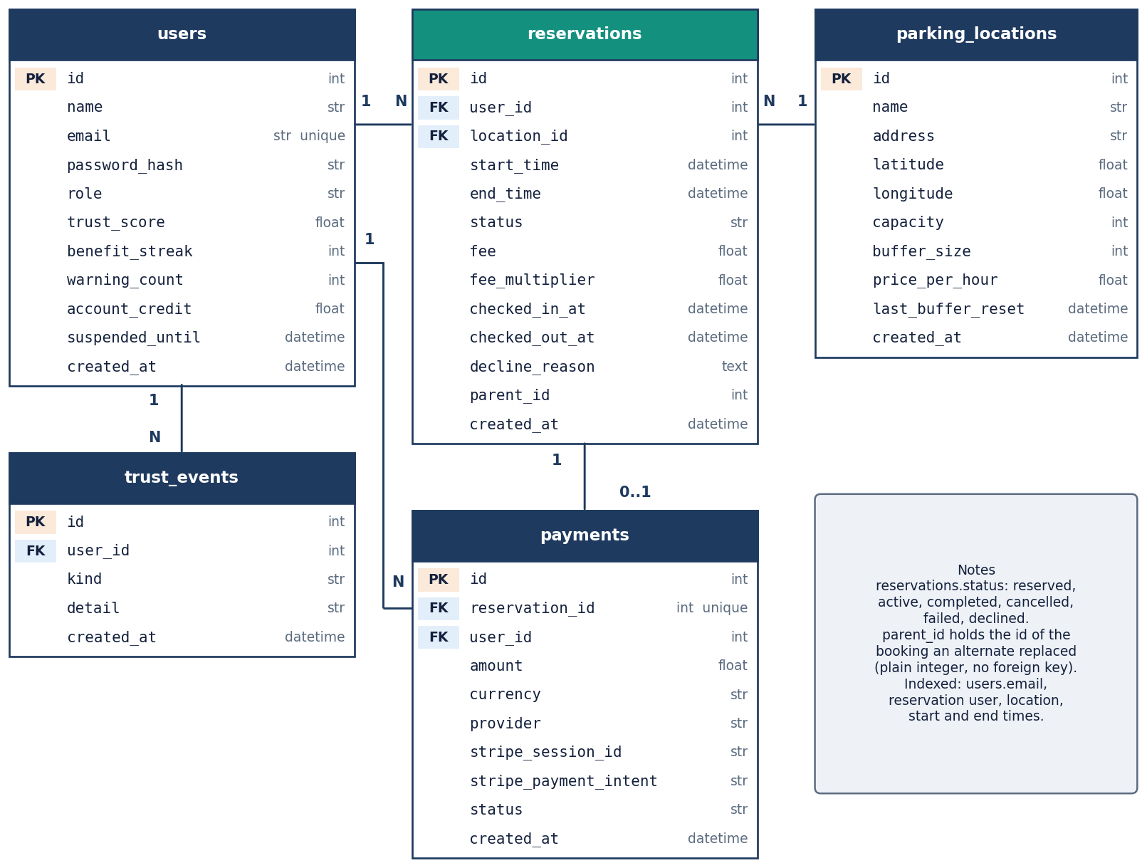
Database design and UML
UML class diagram: five entities, engine, auth and scheduler.
ER diagram of the SQLite database (parksure.db).
users 1-N reservations and trust_events; parking_locations 1-N reservations; reservations 1-1 payments; alternate bookings link to the replaced one by parent_id.
Notes:
parent_id is a plain integer, not a foreign key. Indexes exist on user, location, start and end columns used by the overlap query.

Slide 13
Technology stack
1
2
3
4
Python 3.14.7
FastAPI 0.141.1
SQLAlchemy 2.0.52
JWT + bcrypt
venv interpreter; the code needs 3.11 or newer
22 routes; uvicorn 0.52.4; pydantic 2.13.5
5 tables on SQLite; APScheduler 3.11.3 for the buffer job
python-jose 3.5.0 (HS256), bcrypt 5.0.0, cost 12
5
6
7
8
Stripe SDK 15.6.1
React 19 + Vite 8
pytest, Playwright
Own simulator
Checkout in test mode; offline demo fallback
react-router 7, Recharts, three.js hero
70 tests; screenshots from the real UI
pure Python discrete-event model, parity-tested against the engine
Everything runs on one machine on CPU; the only external service is Stripe, and it is optional.
Notes:
Versions are those installed in the project's virtual environment on the measuring machine.

Slide 14
Implementation progress
Component | Status | Evidence
Registration, login, roles | Done | JWT roles; bcrypt; cross-user access blocked (404)
Search, reserve, cancel | Done | search 5.7 ms, reserve 19.6 ms mean
Check-in, alternate move, check-out | Done | alternate by haversine; failed bookings credited; buffer and trust updated
Payments | Partly | Stripe test mode + demo; no receipt document; unauthenticated demo-confirm found
Admin console and Strategy Insights | Done | overview, locations, bookings, users, deterministic replay
Simulator and experiments | Done | 5 policies x 4 populations x 6 bad shares, 30 runs per cell
Vehicle profile | Not built | objective 1 asks for it; no table or screen exists
Concurrency safety | Open | 1 of 10 race trials accepted two bookings for one bay
Notes:
Honest status: the core flow and the admin side are complete; two objectives are only partly met (vehicle profile, digital receipt) and the admission check is not safe under simultaneous requests.

Slide 15
Preliminary results: simulator and response time
Endpoint | mean ms | p95 ms
Search availability | 5.7 | 6.6
Reserve | 19.6 | 28.2
Check in | 14.9 | 25.0
Check out | 14.6 | 15.7
Login (bcrypt) | 220.4 | 234.5
My bookings (N+1) | 180.1 | 207.4
Refused by admission out of 1,000 requests, 100 vehicles, 25 % overstaying, mean of 30 runs.
The shipped dynamic buffer refuses the most requests (277 against 30 with no buffer); the paper's late-departure rule refuses 165. The paper's 'dynamic is best' is not reproduced for the shipped rule.
'No park' stays rare under every policy (at most 1.4 per run) because the alternate step absorbs overflow; the Trust lockout causes more refusals than the buffer once 25 % of drivers overstay.
Simulator, not SUMO, and synthetic seed: relative findings only.
Notes:
Numbers are from experiments/buffer_population and api_latency. Population 100 is the middle case; the same ordering holds at 80, 90 and 110.

Slide 16
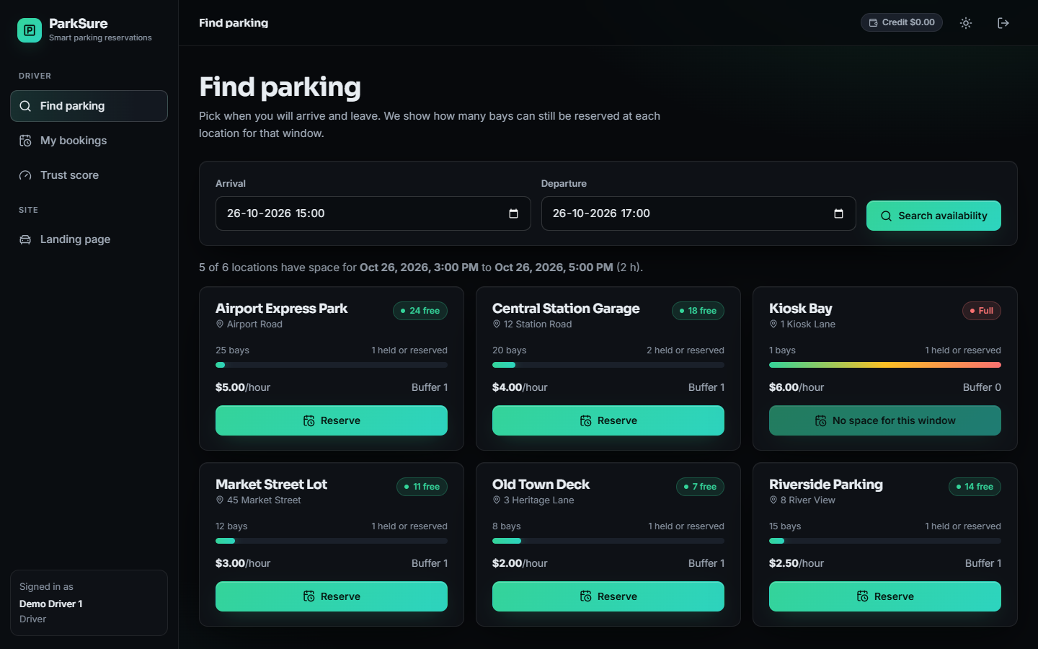
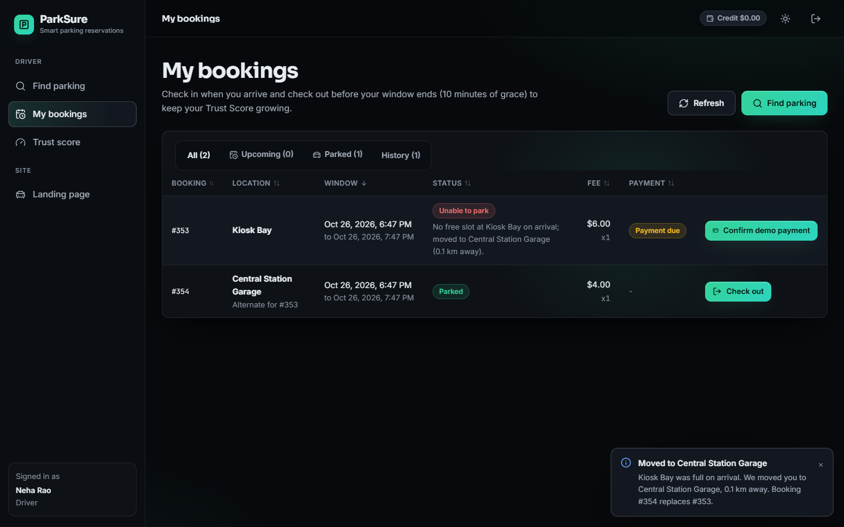
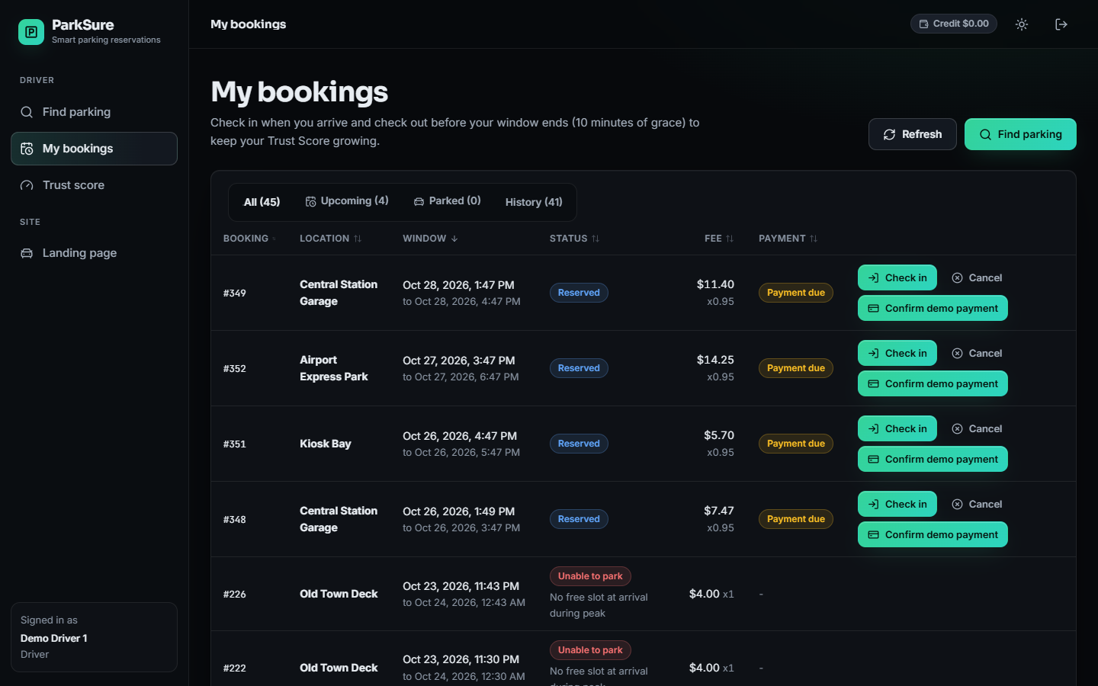
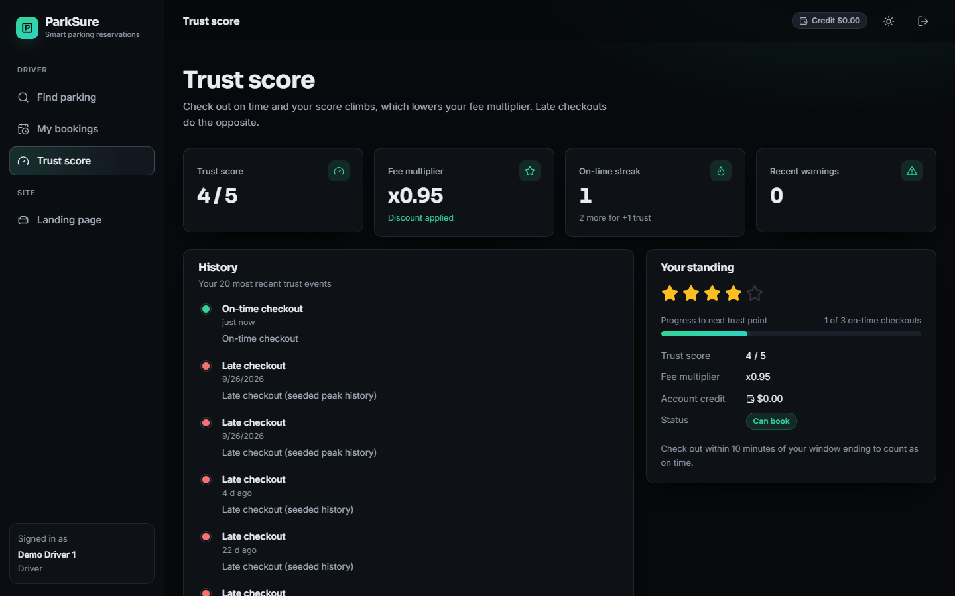
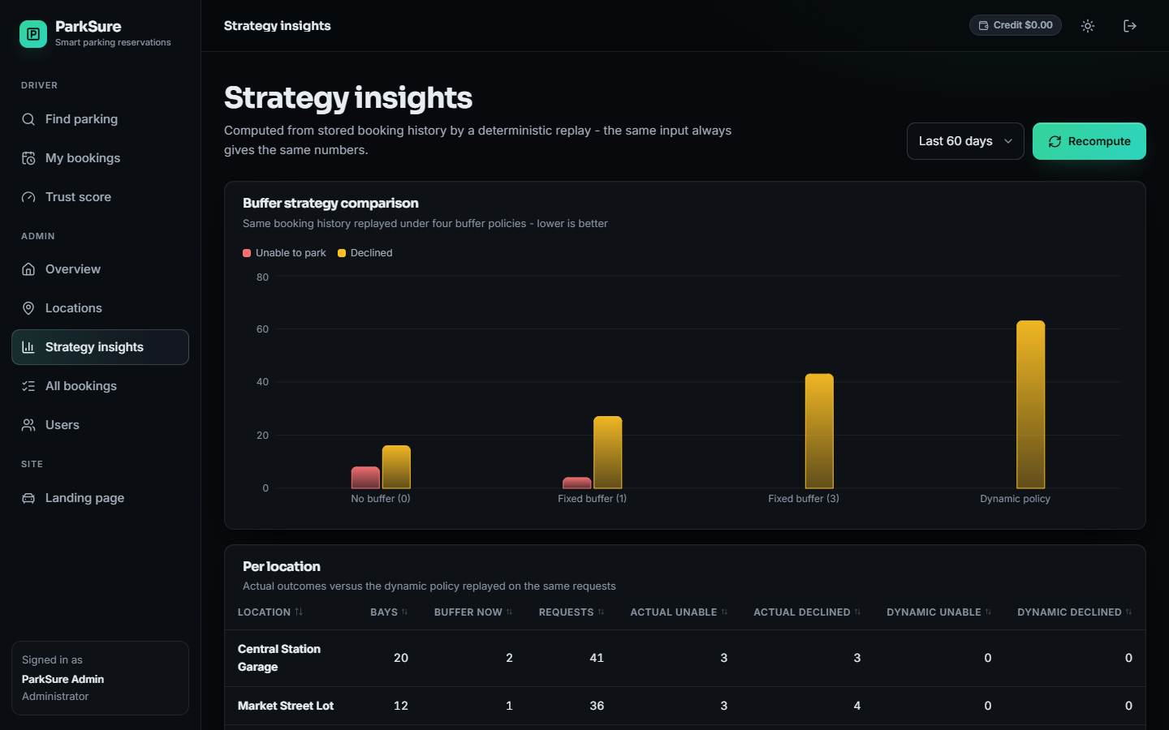
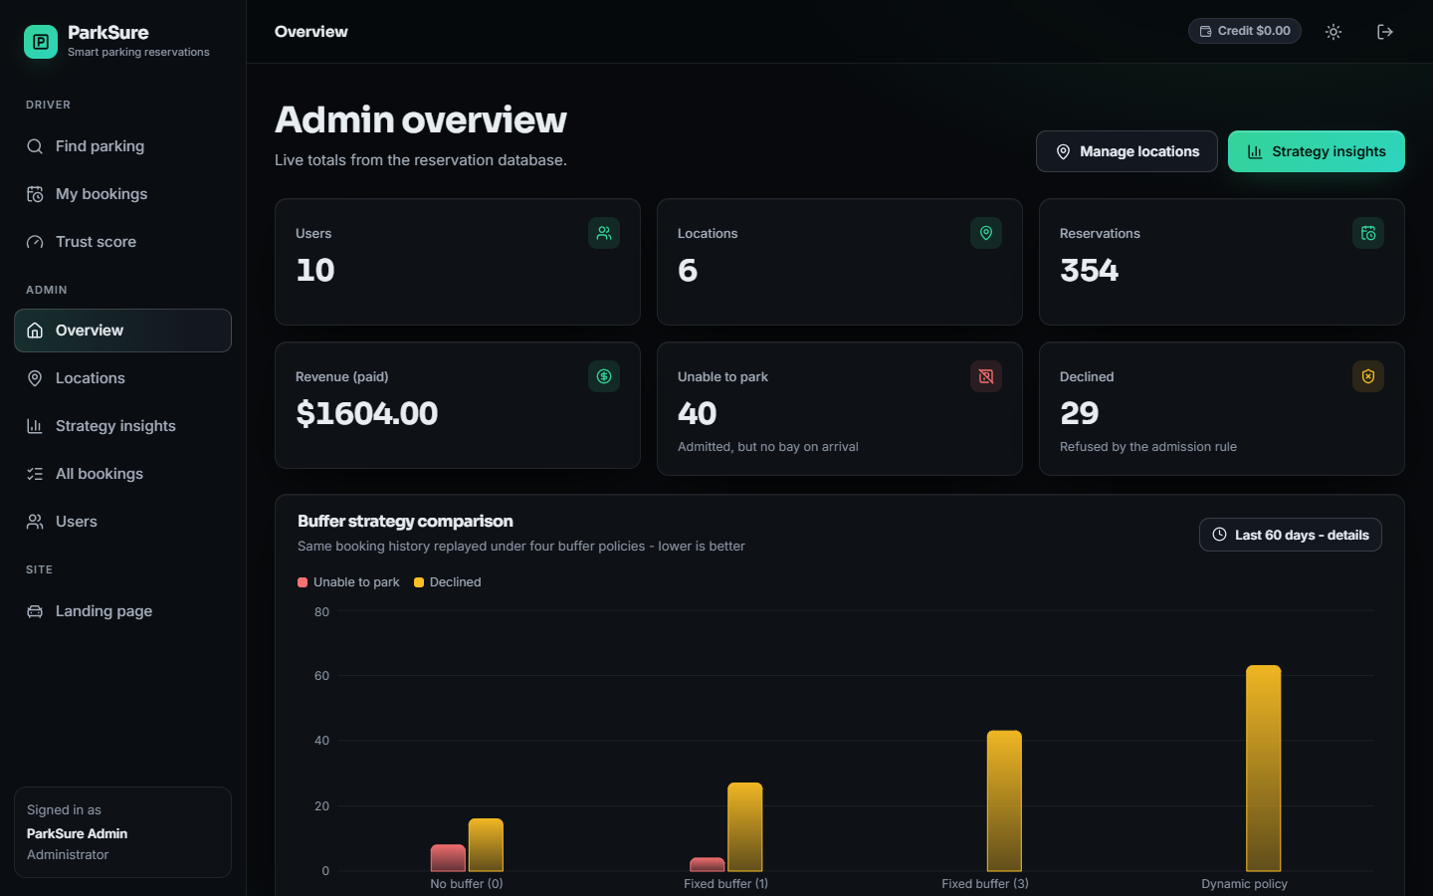
Output screens
Find parking: forecast bookable bays per location
Arrival at a full lot: moved to the nearest alternate (0.1 km)
My bookings with check-in, cancel and payment actions
Trust Score and event history
Admin Strategy Insights
Admin overview
Notes:
All screens are captures of the running application on a fresh seeded database; the alternate-move screen was produced by the real check-in flow.

Slide 17
Initial testing and observations
70 / 70
27 / 27
0 / 10,300
1 / 10
pytest tests pass (29 engine, 36 API, 5 parity)
end-to-end smoke checks on a throw-away database
simulator decisions that differ from the real engine
concurrency trials that over-booked one bay
Probe on our own system | Result
Payment confirm without login | marks a booking paid
Token forged with default secret | accepted
30 wrong passwords in a row | no lockout
Past booking window | accepted
Check-in 25 days early | accepted
SQL-injection style inputs | 422, no server error
Cross-user cancel | blocked (404)
What the tests cover: haversine, fees, admission, alternates, trust and suspension, buffer reset, every route group, role guards and the simulator's parity with the engine.
Found by the probes: five weaknesses that are documented as limitations, not fixed in this phase.
Not done: user study, load test beyond 8 threads, security audit, Stripe live mode.
Admission takes 0.33 ms in process.
Notes:
The probes were run against a throw-away database of our own system; none is a defect of the tests.

Slide 18
Challenges and corrective actions
Challenge | What we found | Action
No real parking data | Only synthetic seed data exists | Labelled it synthetic; added a simulator of the base paper's scenario
Buffer direction differs | Code grows the buffer on on-time check-outs, paper on late ones | Measured both; reported, product code unchanged
Refusals from lockout | Trust lockout refuses 271 requests per run at 50 % bad drivers (static 0) | Added a Trust-off ablation; lockout length is future work
Slow listings | My bookings 180 ms, admin bookings 273 ms (2 queries per row) | Documented; batch the queries
Over-booking race | 1 of 10 trials accepted two bookings for one bay | Documented; needs an atomic check
Payment confirm open | Demo-confirm route needs no login | Documented; disable outside demo mode
Objectives only partly met | No vehicle profile and no downloadable receipt exist | Reported as gaps; planned for the next phase
Notes:
Each challenge is a measured finding; the evidence is in docs/REPORT_FACTS.md.

Slide 19
Next steps
1
Harden
2
Complete
3
Deliver
Make the admission check atomic, close the unauthenticated payment route, require a real JWT secret, rate-limit login, reject past windows, and batch the listing queries.
Add the vehicle profile and a downloadable receipt (objectives 1 and 4), and decide the buffer direction and lockout length with the guide.
Finish the final report and IEEE paper from the measured results, rehearse the final demo, and keep every number tied to the metrics files.
Notes:
The open items are the ones identified by our own measurements and probes, in priority order.

Slide 20
Thank you
Questions and suggestions are welcome.
Notes:
Close the review and invite questions.

