Slide 1

Online Vehicle Parking Reservation System
Final Review · ParkSure
Team Details : Batch C3
Under the Esteemed Guidance of
V Pallavi
[DESIGNATION], Department of CSE
23K91A05H9 PALLE YASHASWINI
24K95A0518 MOHAMMED MUNEEB AHMED
24K95A0513 KAMASANI MANISHA
23K91A05J6 POTHAGANI NITHYYA BHARGAVA
DEPARTMENT OF COMPUTER SCIENCE AND ENGINEERING · TKR College of Engineering & Technology · Academic Year [ACADEMIC YEAR]
Notes:
Introduce the team and ParkSure: an advance-reservation parking platform with a hold-back buffer, nearest-alternate re-allocation and a driver Trust Score.

Slide 2
Table of Contents
Abstract
Base Papers & Literature Survey
Research Gap, Problem Statement & Objectives
Proposed System & Architecture
Methodology, Data & Engine Rules
Interaction & Data Design
Implementation, Performance & Testing
Results: Buffer Policies, Arrival Outcomes, Trust, Robustness
Comparison with the Base Papers
Output Screens
Conclusion, Future Scope & References
Dept. of CSE | Batch C3 | Final Review
2
Notes:
The agenda follows the report: problem, design, method, results, comparison, screens, conclusion.

Slide 3
Abstract
Drivers circle for parking and operators plan from paper registers. ParkSure is a web platform where drivers search live availability, reserve a bay in advance, pay online (Stripe test mode or demo checkout), check in and out, and administrators manage locations and see analytics. FastAPI + SQLite backend, React console, 22 API routes, 5 tables.
A Smart Availability Engine admits a booking only if overlapping bookings + buffer < capacity, keeps a hold-back buffer per location, moves a driver to the nearest alternate (haversine) when a lot is full on arrival, and scores drivers with a 0-5 Trust Score that sets fee multipliers.
Verified by 70 pytest tests and 27 smoke checks; a simulator matches the real engine on 10,300 decisions with 0 mismatches. Search takes 5.7 ms, a reservation 19.6 ms (127.0.0.1, 200 requests each).
Simulated buffer policies (80-110 vehicles, 30 runs): the shipped dynamic rule refuses the most reservations (277 of 1,000 at 100 vehicles against 30 with no buffer); 'no park' stays rare under every policy.
Honest limits: demo data are synthetic; probes found an over-booking race (1 of 10 trials), an unauthenticated payment-confirm route and no vehicle profile or receipt; no real-user study.
Dept. of CSE | Batch C3 | Final Review
3
Notes:
Product first, then the engine, the evidence and the honest limits.

Slide 4
Base Paper
M. Jemmali, L. K. B. Melhim, A. Ammar, T. R. Gadekallu and W. Boulila, "Smart parking for medical cities via passenger-aware allocation and fast grouping-permutation heuristics," IEEE Open Journal of the Computer Society, vol. 7, pp. 1106-1118, 2026, doi: 10.1109/OJCS.2026.3693801.
Aspect | Registered base paper (Jemmali et al.): passenger-aware allocation for medical cities
Problem | Allocate vehicles to parking spaces by the total number of passengers, not vehicle count, to balance the load between zones of a medical city
Method | Four-stage grouping procedure and six grouping-permutation heuristics; architecture with booking interface, IoT sensing, validation and a central allocation engine; QR-code booking
Evaluation | Nine instance classes, 2,790 generated test cases; best algorithm has the highest best-solution share (68.2 %); GVb matches or beats baseline MR on 1,547 instances (55.4 %), in sub-millisecond time
Stated gap | Existing systems optimise one vehicle or revenue; few use grouping criteria such as passenger count
Not covered | Payment, overstay handling, operator analytics, a working web product
Also used | Cabri et al. (arXiv:2605.17650): dynamic buffer of non-reservable slots and a 0-5 star reward system; this is what ParkSure's engine implements [2]
Dept. of CSE | Batch C3 | Final Review
4
Notes:
The registered base paper is Jemmali et al. (IEEE OJCS 2026). ParkSure does not implement its grouping heuristics. The reservation buffer and star ideas come from the Cabri et al. arXiv paper, which the report cites as the technical basis.

Slide 5
Literature Survey
Work | Approach | Result / limitation (as stated in the base papers)
Jemmali et al. [1] (base) | Passenger-count zone balancing; six heuristics | 2,790 generated instances; GVb ties or beats baseline MR on 55.4 %; one facility, needs IoT
Cabri et al. [2] | Buffer of non-reservable slots + star reward | SUMO, 80 spots / 8 areas: any buffer beats none, dynamic best trade-off; preliminary
Doulamis et al. [7] | Interval scheduling of requests | Accept or reject by time interval; no overstay handling described
Safitri et al. [10] | Mobile reservation, heuristic + haversine, occupancy display | Mobile client; no buffer or reputation
Somani et al. [11] | Part-payment confirms a booking | Deters false bookings, not overstays
Mejri et al. [12]; Kotb et al. [13] | Multi-objective ILP; iParker flexible times and pricing | Optimisation / pricing models; no operating web platform described
Rizvi et al. [5], [6]; Kokolaki [8] | Auction-based parking (agents, bidding) | Suit competitive allocation, not a fixed-price booking service
Batch survey [31]-[34] | Four reservation / smart-parking titles | Titles only; not found online, no result quoted
Dept. of CSE | Batch C3 | Final Review
5
Notes:
Only what the two base papers say about the related works is used. The four batch-survey titles could not be located online.

Slide 6
Research Gap
The registered base paper optimises allocation inside a large managed facility; it has no booking-to-payment service for ordinary urban parking.
The buffer and reward ideas (Cabri et al.) are shown only in a simulation of 80 spots; no operating product and no numeric table are reported.
Surveyed systems describe reservation components one at a time: booking, part-payment, mobile access, pricing, auctions.
Overstays are the known failure of reservation systems; few designs combine a buffer, a fallback alternate and a punctuality score.
Operators lack a way to replay their own booking history under different buffer policies and see the effect.
Gap: a general reservation platform with search, booking, payment, an overstay-aware engine and operator analytics, evaluated honestly on its own behaviour.
Dept. of CSE | Batch C3 | Final Review
6
Notes:
The gap statement from the batch literature survey, made concrete with the points the base papers leave open.

Slide 7
Problem Statement
Drivers circle repeatedly because there is no way to know which slots are free.
Operators manage occupancy through manual registers with no live view.
Without reservation, arriving at a facility gives no guarantee of a space.
Cash collection is slow at entry and leaves no usable records.
Need: a reservation platform that shows live availability, guarantees a slot in advance and handles payment digitally.
Input
Output
Record
Registration, search window, reservation, payment, check-in and check-out; admin location data
Availability per location, quote, booking status, payment record, Trust Score, admin overview and Strategy Insights
70 tests, simulator and latency metrics (JSON), 24 screenshots of the running app
Dept. of CSE | Batch C3 | Final Review
7
Notes:
The four problem points are taken from the batch problem statement.

Slide 8
Objectives
1. Build user registration, authentication and vehicle profile management.
2. Maintain real-time parking slot availability across registered parking facilities.
3. Implement slot search, advance reservation and booking cancellation.
4. Integrate secure online payment and generate digital receipts.
5. Provide an administrator dashboard for slots, bookings, occupancy and revenue.
6. Evaluate booking success rate, allocation efficiency and system response time.
Dept. of CSE | Batch C3 | Final Review
8
Notes:
The six objectives from the batch document. The conclusion slide gives the status of each.

Slide 9
Proposed System
Driver journey
Search window
Reserve + quote
Pay (Stripe / demo)
Check in
Park
Check out
Smart Availability Engine (app/engine.py)
Admission rule
Hold-back buffer
Nearest alternate
Trust Score
Fee multiplier
Strategy Insights
Admit only if overlapping bookings + buffer < capacity; refused requests are stored as 'declined' with the reason.
If the lot is physically full on arrival: exactly one nearest alternate with forecast space, else 'failed' and the fee is credited automatically.
On-time check-out (10 min grace) grows the buffer and the Trust Score; late check-out records a warning; the score changes the next fee.
Administrators replay the stored history under four buffer policies (Strategy Insights).
Dept. of CSE | Batch C3 | Final Review
9
Notes:
The proposed system as two chains: what the driver does, and what the engine decides.

Slide 10
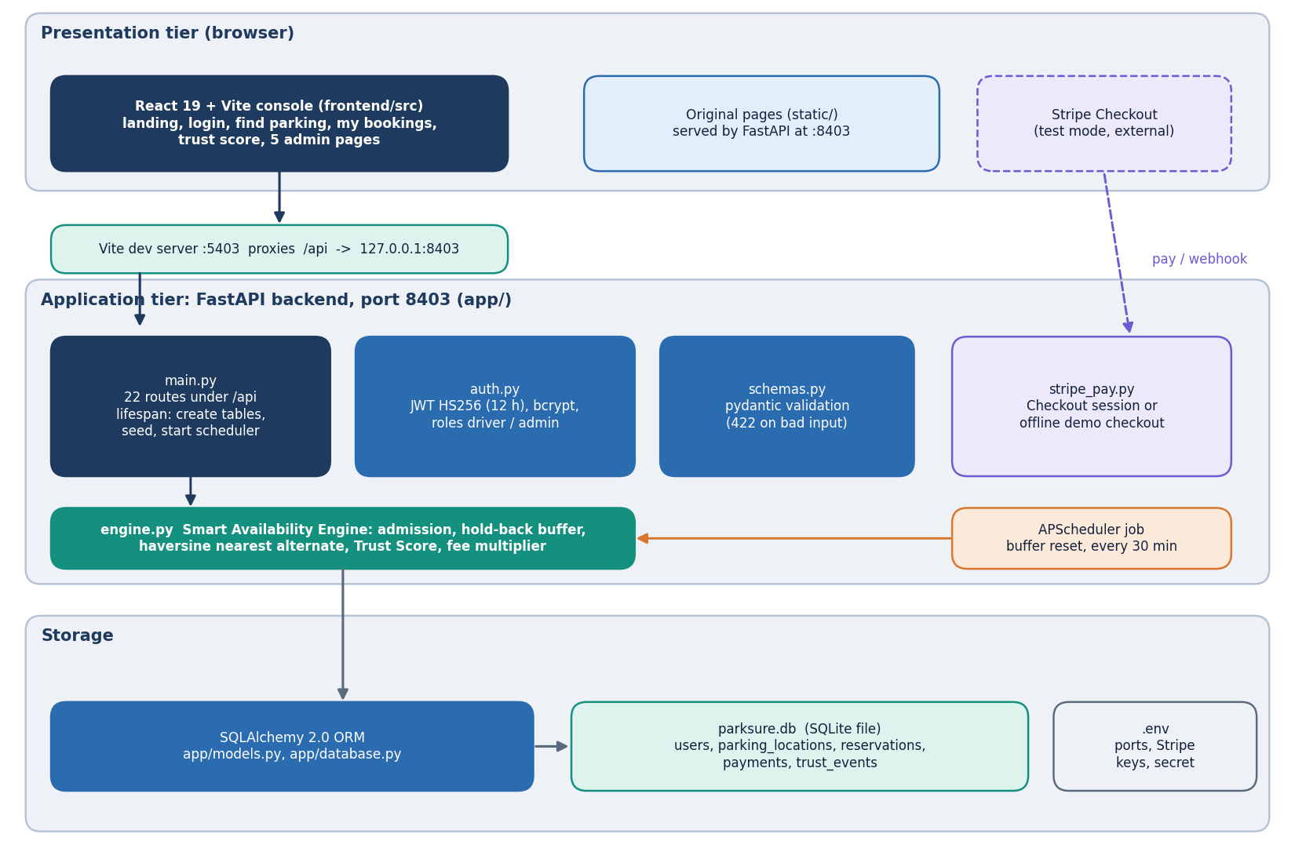
System Architecture
Console: React 19 + Vite, port 5403; landing, login, 3 driver pages, 5 admin pages
API: FastAPI, port 8403; 22 routes; JWT bearer, roles driver / admin
Engine: app/engine.py (admission, buffer, haversine, trust, fees)
Data: SQLAlchemy over one SQLite file, 5 tables; APScheduler resets buffers every 30 min
Payments: Stripe Checkout in test mode, offline demo fallback
Dept. of CSE | Batch C3 | Final Review
10
Notes:
Four tiers; the engine is a plain module of the backend, not a separate service.

Slide 11
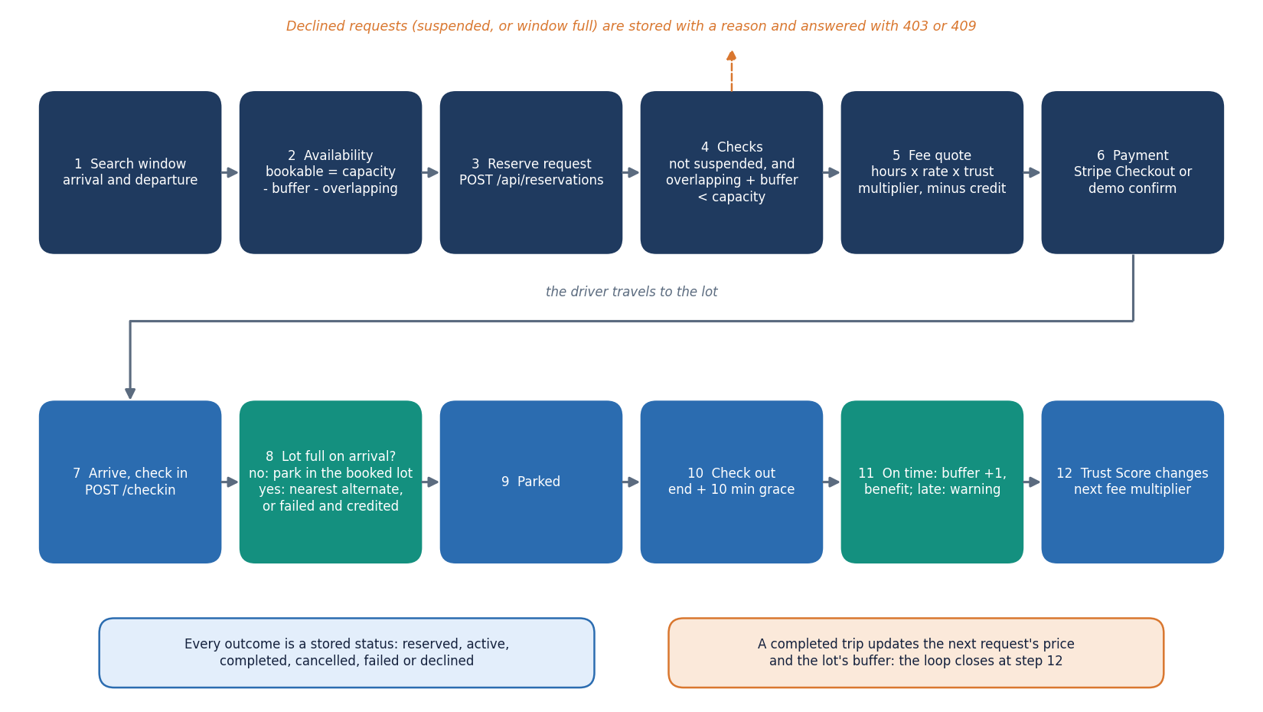
Methodology
Search counts bookable bays = capacity - buffer - overlapping bookings.
Fee = max(0.25, hours) x hourly rate x trust multiplier (0.90 to 1.75); account credit is applied first.
Buffer: start 1, +1 per on-time check-out, max 5, reset to 1 every 24 h.
Trust: start 3; 3 benefits = +1; 2 warnings = -1; below 1.5 with a warning in 14 days = 24 h suspension.
Evaluation: tests, a simulator parity-checked against the engine, API timing, probes.
Dept. of CSE | Batch C3 | Final Review
11
Notes:
Method in one picture and the four numeric rules that define the engine.

Slide 12
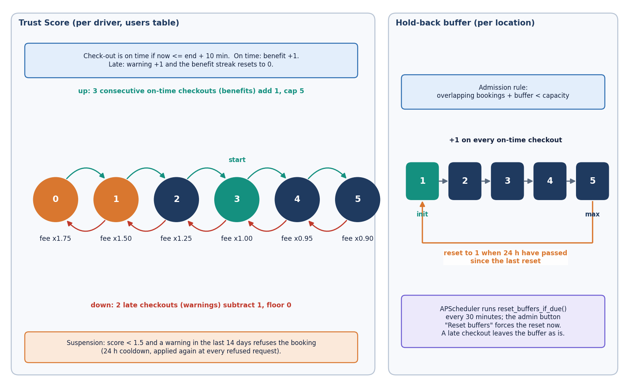
Data and Engine Rules
347
5 + 9
60 days
seeded reservations (synthetic)
locations + users seeded
history + 8 Friday peaks
Item | Detail
Source | app/seed.py, random.Random(42): no external dataset, no ML model
Statuses | 279 completed, 39 failed (unable to park), 29 declined
Locations | 5 lots, 8 to 25 bays, $2.00 to $5.00 per hour
Fee multiplier | score 0 / 1 / 2 / 3 / 4 / 5 = 1.75 / 1.50 / 1.25 / 1.00 / 0.95 / 0.90
Payments | Stripe test mode; demo checkout when keys are absent
Caveat | Synthetic data show the mechanism, not real demand
Trust Score machine and buffer policy as implemented in app/engine.py and app/config.py.
Dept. of CSE | Batch C3 | Final Review
12
Notes:
There is no ML dataset. All demo data are generated by the product itself, so every result built on them is labelled synthetic.

Slide 13
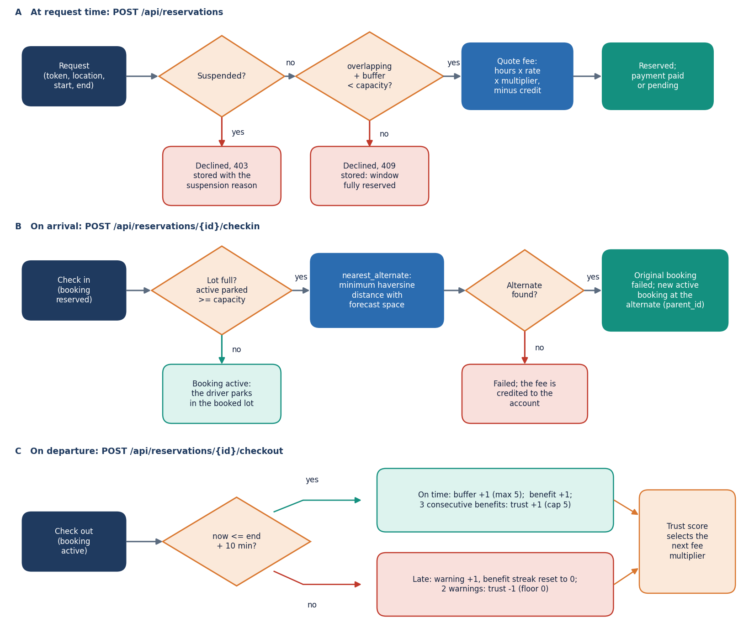
Core Algorithm: Admission, Alternate and Trust
Request time: suspended? refuse. overlapping + buffer < capacity? else decline. Quote and book.
Arrival: parked >= capacity? search other lots by haversine distance (R = 6371 km); book the nearest with forecast space; else failed + credit.
Departure: end + 10 min? late = warning, on time = buffer +1 and benefit.
Admission decision 0.33 ms; nearest-alternate over 49 lots 18.6 ms (in-process).
Dept. of CSE | Batch C3 | Final Review
13
Notes:
The two decisions the engine makes, in code order. Implemented in app/engine.py and the reservation routes in app/main.py.

Slide 14
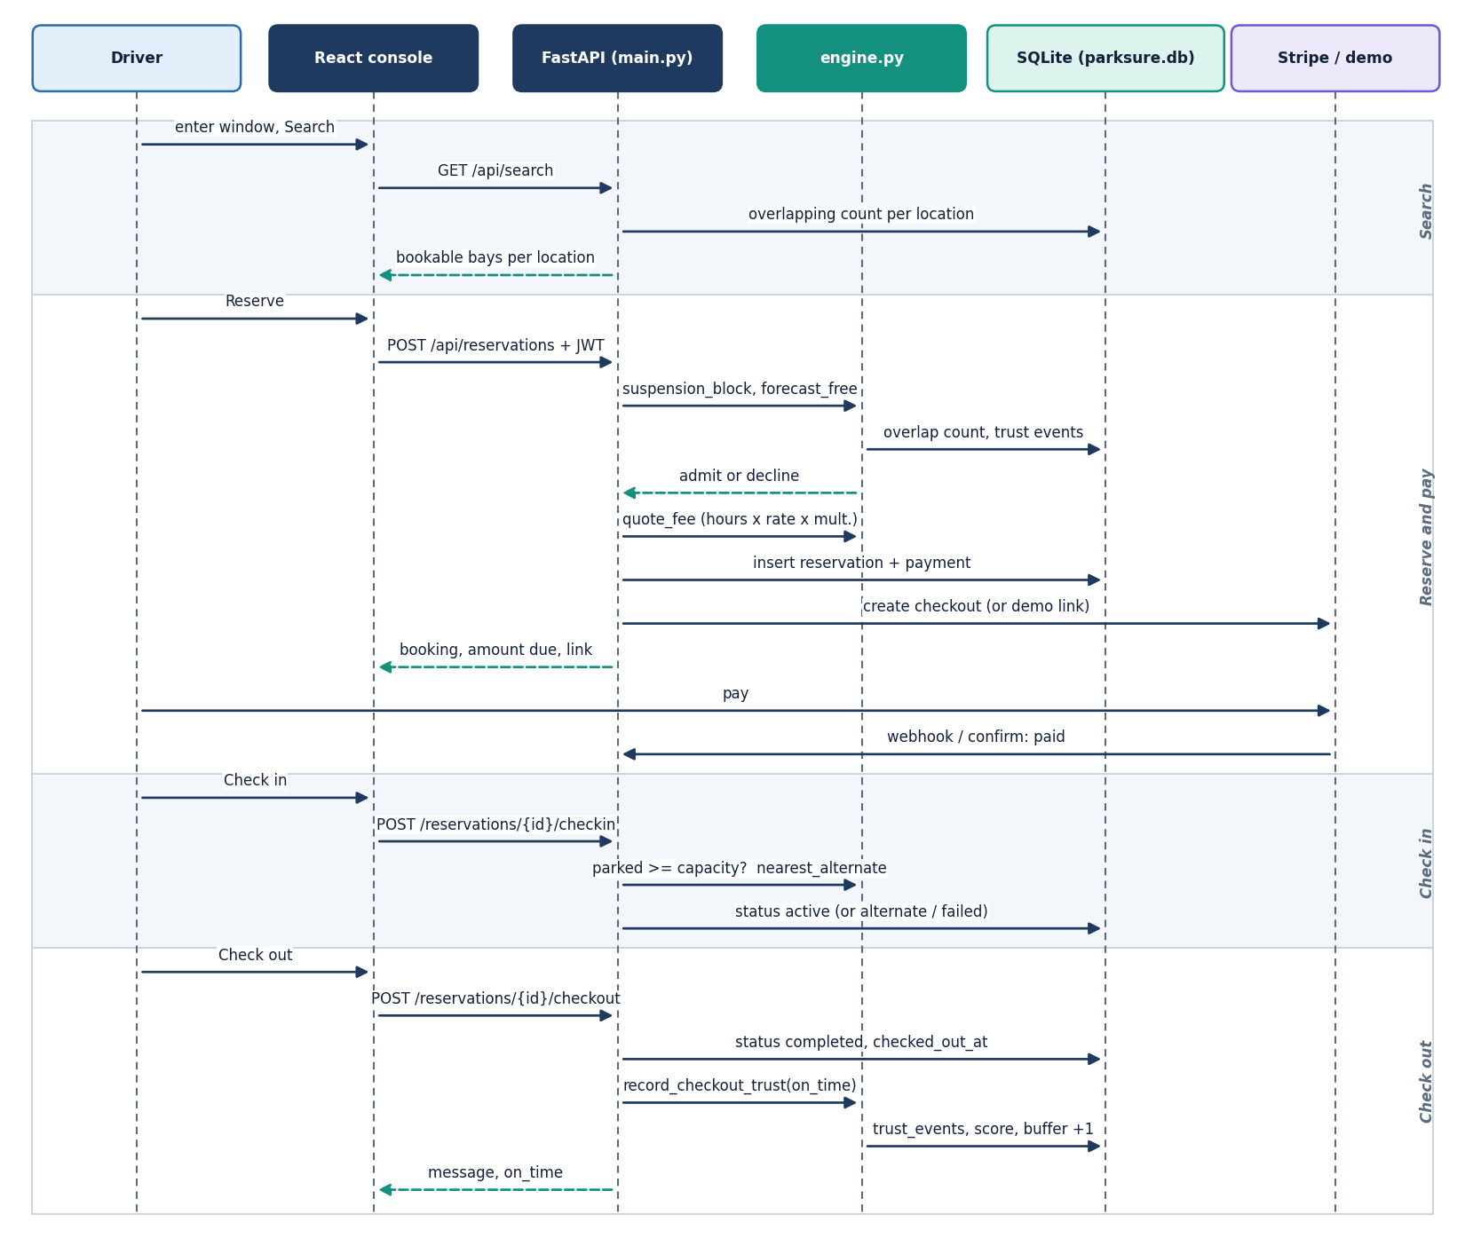
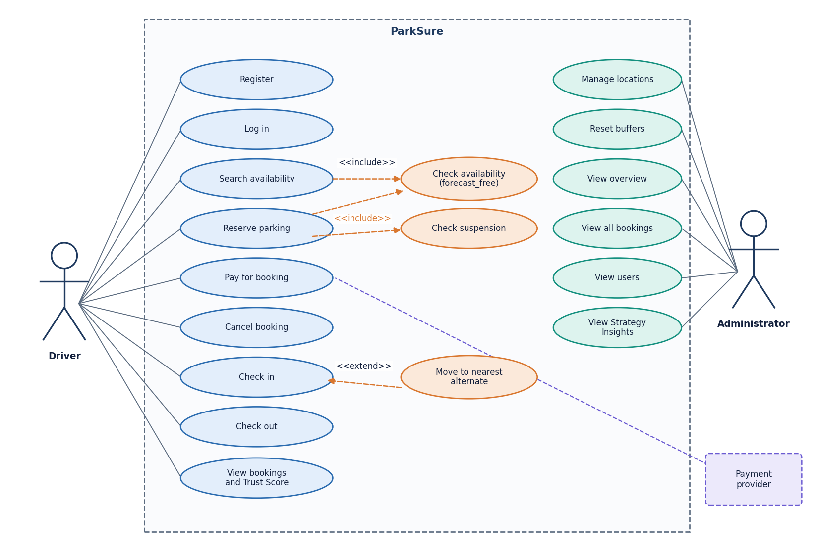
User - System Interaction
Dept. of CSE | Batch C3 | Final Review
14
Notes:
Sequence of one booking and the use cases of the driver, administrator and payment provider.

Slide 15
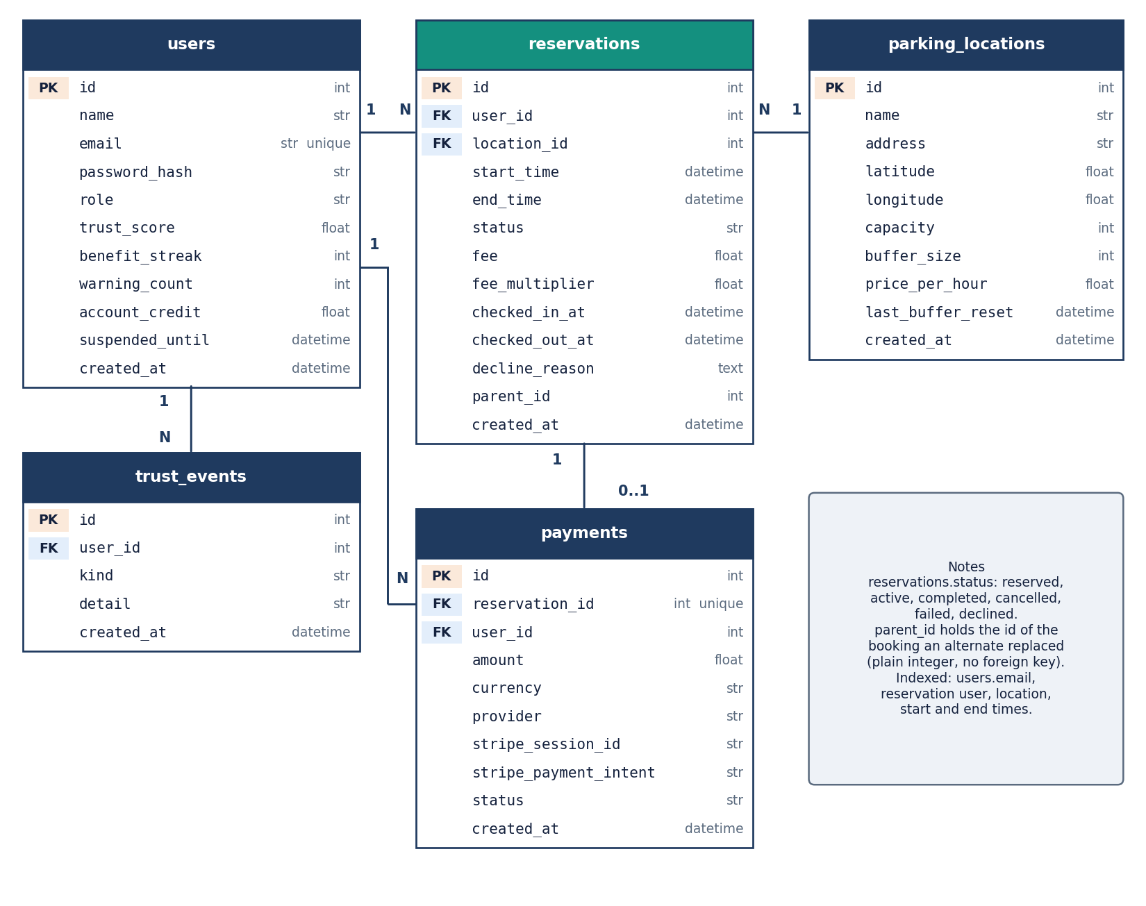
Data Design (5 tables)
Table | Content
users | role, trust score, streak, warnings, credit, suspension
parking_locations | coordinates, capacity, buffer, price, last reset
reservations | window, status, fee, multiplier, check times, parent_id
payments | amount, provider, Stripe ids, status
trust_events | benefit / warning / reward / penalty log
parent_id links an automatically created alternate booking to the booking it replaced; it is a plain integer, not a foreign key.
Dept. of CSE | Batch C3 | Final Review
15
Notes:
Five tables; one SQLite file; schema created by SQLAlchemy at start-up.

Slide 16
Implementation, Performance & Testing
22
70 + 27
10,300
5.7 ms
API routes, 5 tables
pytest tests + smoke checks, all pass
simulator vs engine decisions, 0 mismatches
mean availability search
Endpoint (127.0.0.1, 200 calls) | mean ms | p95 ms
Search availability | 5.7 | 6.6
Reserve | 19.6 | 28.2
Check in | 14.9 | 25.0
Check out | 14.6 | 15.7
Admin insights (60-day replay) | 60.3 | 70.8
Own bookings (N+1 queries) | 180.1 | 207.4
Admin bookings (N+1 queries) | 272.5 | 314.9
Login (bcrypt cost 12) | 220.4 | 234.5
29 engine unit tests (haversine, fees, admission, alternate, trust, suspension, reset), 36 API tests, 5 parity tests.
27-check smoke test on a throw-away database; 8-thread search throughput 131 req/s.
Measured on an i5-12500, 15.7 GB, Python 3.14.7, single uvicorn process, SQLite file.
Not tested: real load, many users, Stripe live mode, accessibility audit, other browsers.
Dept. of CSE | Batch C3 | Final Review
16
Notes:
Implementation facts and the testing that was actually run, with its limits. Own-booking lists are slow because each row issues two extra queries.

Slide 17
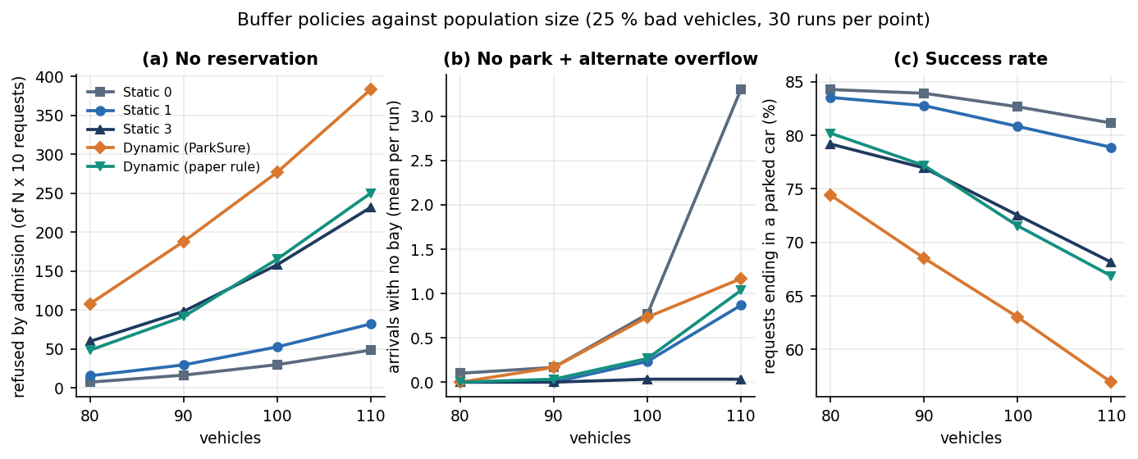
Results - Buffer Policies vs Population (25 % bad vehicles)
Policy (100 vehicles, 1,000 requests) | Refused | Suspended | No park | Success
Static 0 | 30 | 143 | 0.4 | 83%
Static 1 | 53 | 139 | 0.2 | 81%
Static 3 | 158 | 116 | 0.0 | 73%
Dynamic (ParkSure) | 277 | 92 | 0.7 | 63%
Dynamic (paper rule) | 165 | 119 | 0.2 | 72%
Refused = declined by the admission rule; Suspended = refused by the Trust lockout; means of 30 runs.
The shipped dynamic rule (+1 per on-time check-out) climbs to the maximum buffer and refuses the most.
The paper-literal rule (+1 per late check-out) refuses 165, close to static 3 (158).
Simulator, not SUMO: layout of the base paper, assumptions listed in the report.
Dept. of CSE | Batch C3 | Final Review
17
Notes:
The central measurement. Say plainly that this is a simulator built from the paper's scenario, with ParkSure's own rules, and that the paper's claim that the dynamic buffer is best is not reproduced for the shipped rule.

Slide 18
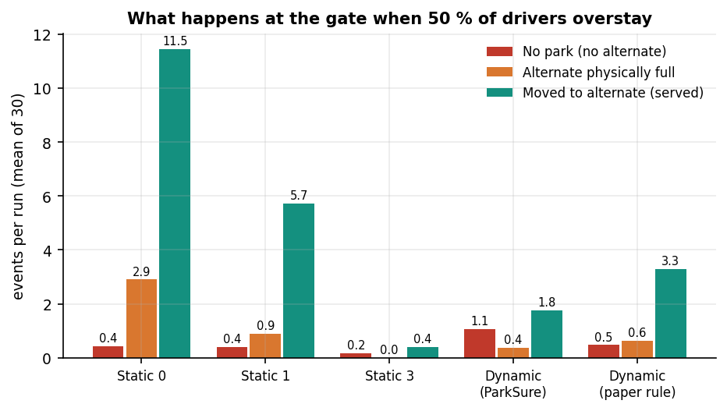
Arrival Outcomes at the Gate (50 % bad vehicles)
Policy | Parked directly | Moved to alternate | of which alt. full | No park | Refused (admission) | Suspended
Static 0 | 634 | 11.5 | 2.9 | 0.43 | 19 | 271
Static 1 | 631 | 5.7 | 0.9 | 0.40 | 34 | 265
Static 3 | 601 | 0.4 | 0.0 | 0.17 | 102 | 232
Dynamic (ParkSure) | 561 | 1.8 | 0.4 | 1.07 | 162 | 211
Dynamic (paper rule) | 578 | 3.3 | 0.6 | 0.47 | 136 | 218
Mean of 30 runs, population 80-110 (936 requests per run); this table plays the role of a confusion matrix.
'No park' is at most about 1 per run: the nearest-alternate step turns almost every full arrival into a served one.
The shipped code does not re-check the alternate's physical bays, so 'alt. full' counts drivers who would meet a full lot again (static 0: 2.9 per run).
Dept. of CSE | Batch C3 | Final Review
18
Notes:
Outcome table for the arrival stage. A driver who is moved to an alternate that is physically full is a hidden failure of the shipped design.

Slide 19
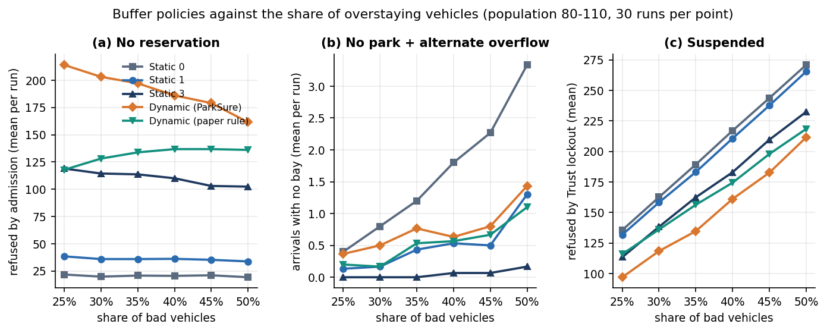
Parameter Analysis - Bad-Vehicle Share and Trust Score
Success rate at 50 % bad | Trust on | Trust off
Static 0 | 69% | 98%
Static 1 | 68% | 96%
Static 3 | 64% | 87%
Dynamic (ParkSure) | 60% | 78%
Dynamic (paper rule) | 62% | 80%
25 % to 50 % bad vehicles: shipped-dynamic success 67% to 60%; Trust-lockout refusals 136 to 271 per run (static 0).
With the Trust Score off, success is far higher: the lockout, not the buffer, is the largest source of refused requests.
The lockout lasts at least 14 days after the last warning (base paper: one session).
Buffer maximum, B = 3 and W = 2 were not varied.
Dept. of CSE | Batch C3 | Final Review
19
Notes:
Parameter analysis of the scenario variables. The Trust ablation shows how much of the refusal count comes from the lockout.

Slide 20
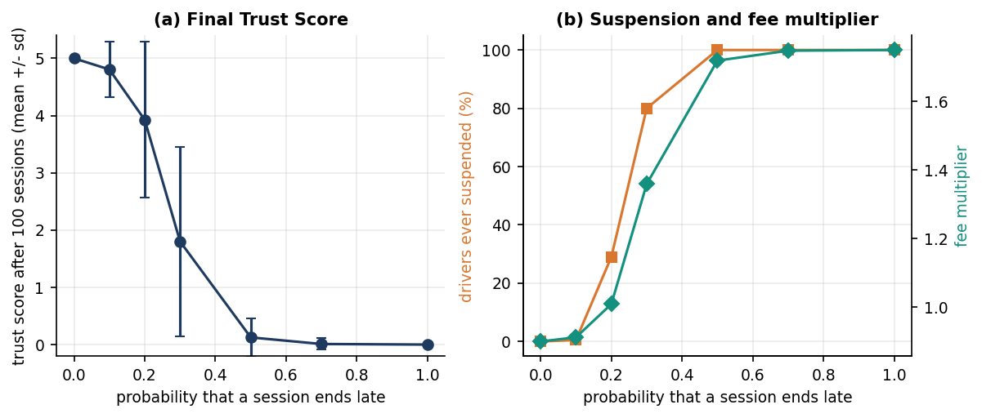
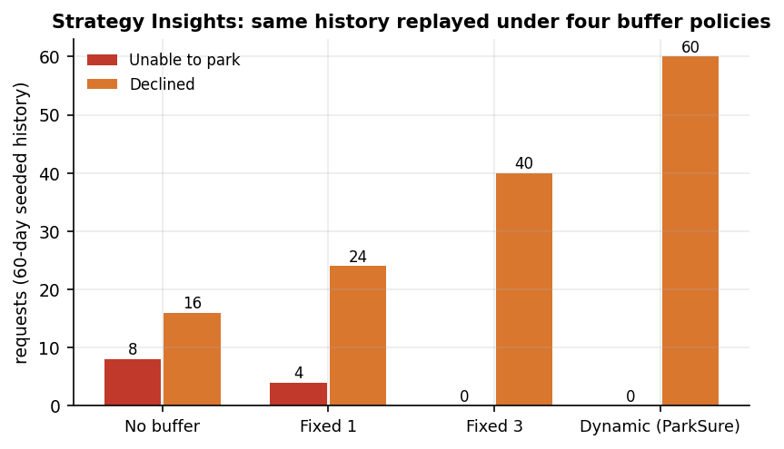
Trust Dynamics, Seeded Replay and Robustness Probes
A driver who ends 30 % of sessions late finishes at trust 1.8, fee x1.359; 80% are suspended at some point.
Seeded replay (synthetic): declined 16 / 24 / 40 / 60 for no buffer / 1 / 3 / dynamic.
Race: 1 of 10 trials accepted 2 bookings for 1 bookable bay (20 simultaneous requests).
Unauthenticated GET /api/payments/demo-confirm marks any booking paid; a token forged with the default JWT secret is accepted; no login rate limit.
Past-start bookings and 25-day-early check-ins are accepted; injection payloads returned 422; cross-user cancel blocked (404).
Dept. of CSE | Batch C3 | Final Review
20
Notes:
Trust dynamics, the synthetic replay and the defects found by the team's own probes. These are limitations, not achievements.

Slide 21
Comparison with the Base Papers (different problems and settings)
Aspect | Jemmali et al. (registered base) | Cabri et al. (rules implemented) | ParkSure (this work)
Problem | Zone load balancing by passenger count | Overstay-proof reservations: buffer + star reward | General reservation platform with the buffer, alternate and trust ideas
Setting | 9 instance classes, 2,790 generated cases | SUMO, 80 spots in 8 areas, 5 runs | Own simulator (same layout, not SUMO), 30 runs; synthetic 60-day history
Result | GVb ties or beats MR on 55.4 %; sub-millisecond | Any buffer beats none; dynamic best trade-off (figures only) | Shipped dynamic refuses most (277 vs 30 of 1,000); no park rare
Product | Architecture described (QR, IoT, engine) | Concept and simulation only | Working app: 22 routes, 70 tests, 24 screens
Speed | Sub-millisecond heuristics | Not reported | Admission 0.33 ms; reserve call 19.6 ms
Agreement | - | Partly: static 3 lowers no park (0.43 to 0.17 per run at 50 % bad); the shipped dynamic rule does not (1.07) | Dynamic-best claim not reproduced for the shipped rule
Different problems, data and simulators: no figure of ParkSure is claimed to beat either paper. Jemmali's grouping heuristics are not implemented; Cabri's SUMO runs were not repeated.
Dept. of CSE | Batch C3 | Final Review
21
Notes:
Say plainly that the problems and settings differ. Only the qualitative buffer claim can be compared, and it is not reproduced for the shipped rule.

Slide 22
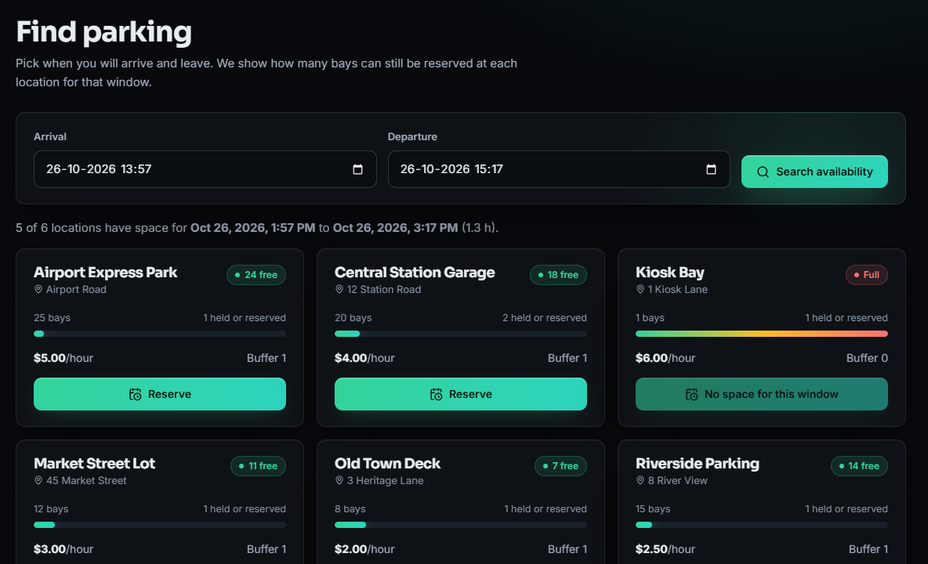
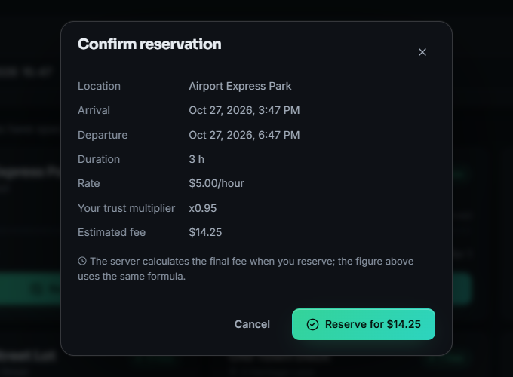
Output - Search and Reserve
Search for a 1 h 20 min window: Kiosk Bay (1 bay, buffer 0) is Full, five other locations show free bays
Reserve dialog: Airport Express Park, 3 h at $5.00/h, trust multiplier x0.95, estimated fee $14.25 (the server recalculates)
Dept. of CSE | Batch C3 | Final Review
22
Notes:
Real screens from the running app on a fresh seeded database.

Slide 23
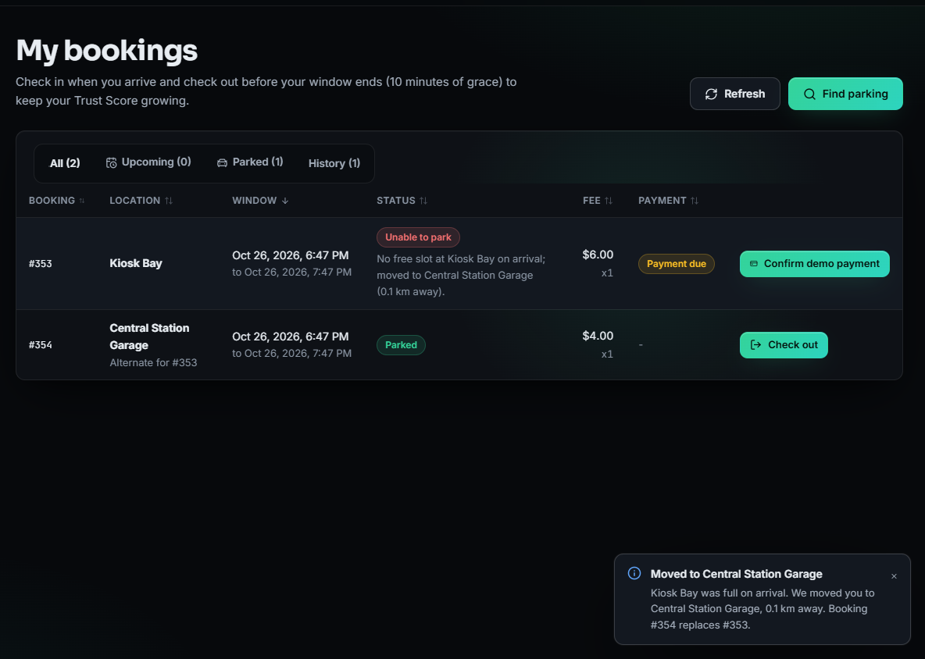
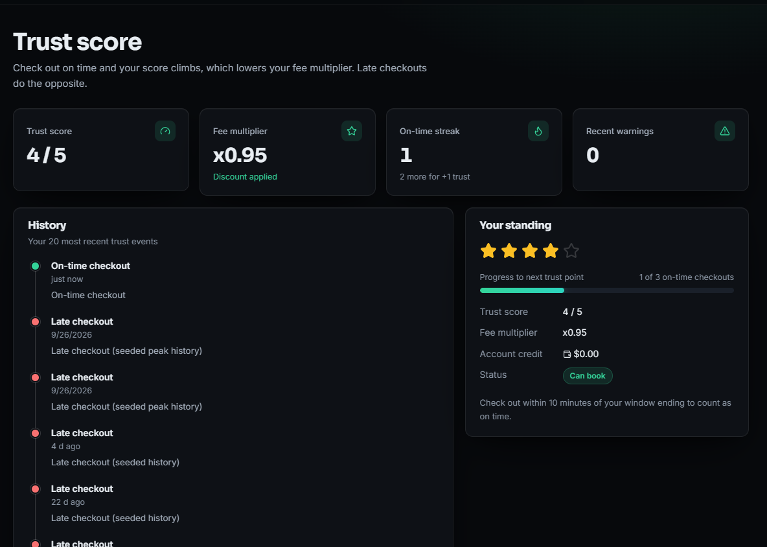
Output - Full Lot on Arrival and Trust Score
Second driver arrives at the full Kiosk Bay and is moved to Central Station Garage, 0.1 km away; booking #353 is marked Unable to park, #354 is parked
Trust Score page: 4 / 5, fee multiplier x0.95, on-time streak 1 of 3, history with the new on-time check-out
Dept. of CSE | Batch C3 | Final Review
23
Notes:
The alternate-move screen is produced by the real engine, not a mock-up.

Slide 24
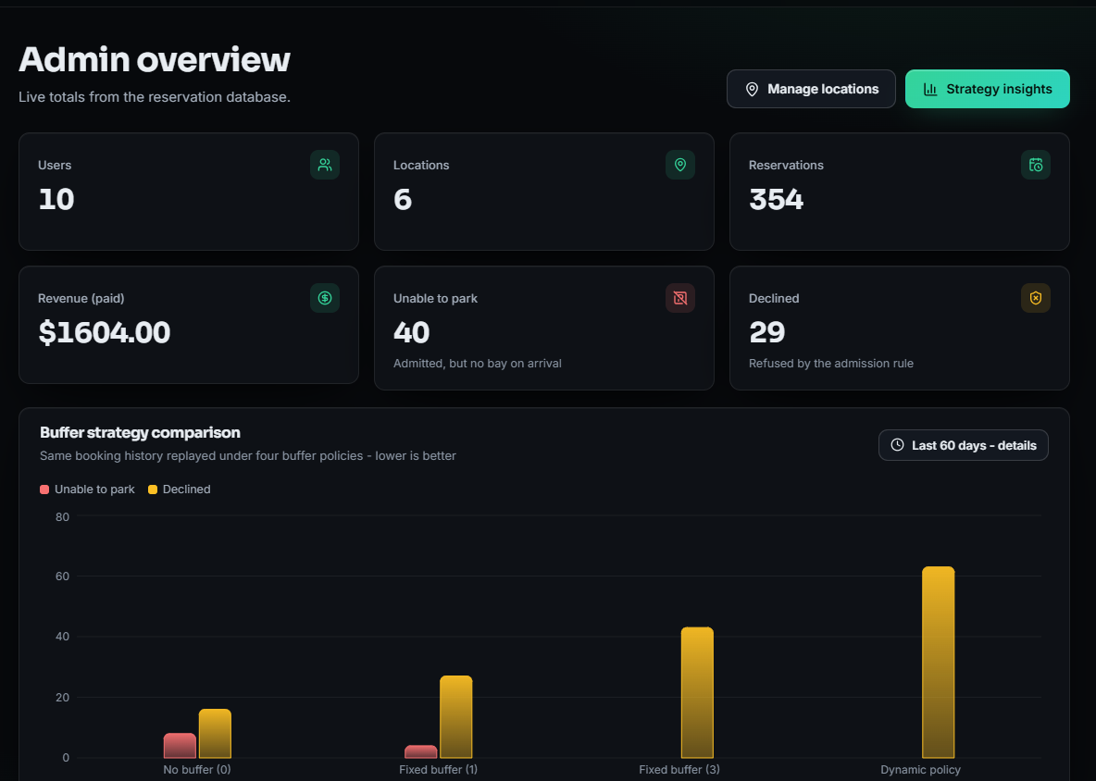
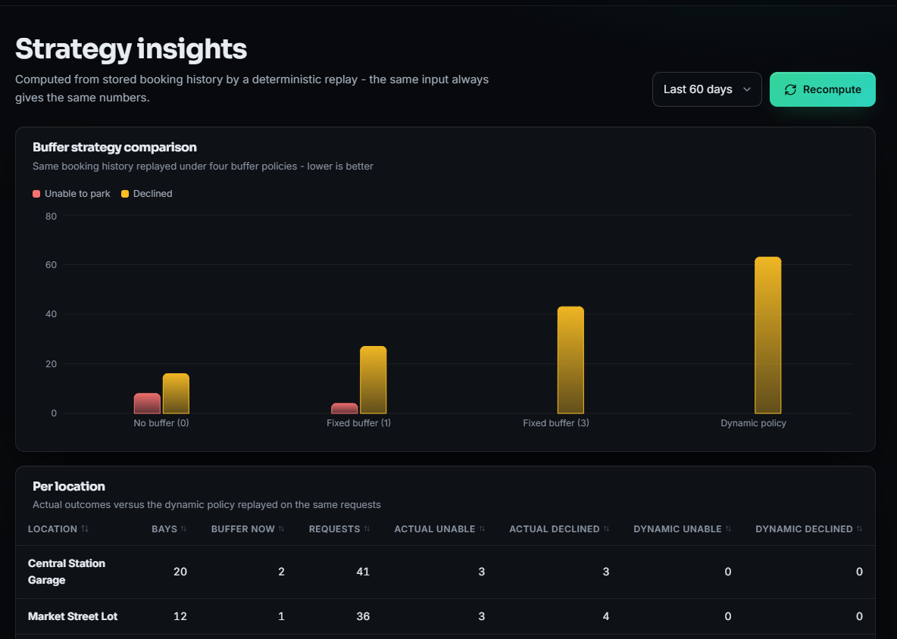
Output - Administrator
Admin overview: 10 users, 6 locations, 354 reservations, $1604.00 paid, 40 unable to park, 29 declined
Strategy insights: the same 60-day history replayed under four buffer policies; the dynamic policy declines the most
Dept. of CSE | Batch C3 | Final Review
24
Notes:
Overview and Strategy Insights; the numbers come from the seeded synthetic history plus the demo run.

Slide 25
Conclusion
ParkSure is a working, tested reservation platform whose own measurements show where its engine helps and where it falls short.
# | Objective | Outcome
1 | Registration, authentication, vehicle profile | Partly met: registration, JWT login, roles; no vehicle profile
2 | Real-time slot availability | Met as forecast bookable bays per window; no sensors
3 | Search, advance reservation, cancellation | Met: tested end to end
4 | Secure online payment, digital receipts | Partly met: Stripe test mode / demo; no receipt; demo-confirm route is open
5 | Administrator dashboard | Met: locations, users, bookings, revenue, Strategy Insights
6 | Success rate, efficiency, response time | Met by simulator, replay and timing; no real-user study
Key findings: the shipped dynamic buffer is the most conservative policy; no park is rare because of the alternate step; the Trust lockout drives most refusals; concurrency and payment-confirm defects remain.
Dept. of CSE | Batch C3 | Final Review
25
Notes:
Be explicit about which objectives were met, partly met or not met.

Slide 26
Limitations & Future Scope
Known limitations
Future scope
Demo data are synthetic; no real lot, no user study
Simulator, not SUMO; arrival-process assumptions are ours
Buffer grows on on-time check-outs (paper: on late departures)
Admission check and insert are not atomic (over-booking race)
Open demo-confirm route, default JWT secret, no rate limit
No vehicle profile, no receipt, no hardware or sensors
Own-booking lists are slow (N+1 queries)
Lock or transaction around admission; remove the open payment route
Test the paper-literal buffer rule and a short, session-based lockout
Re-check the alternate's physical bays before moving a driver
Vehicle profile and downloadable receipts; reject past windows
Replace the N+1 queries with joined loads
Run the scenario in SUMO and on real lot data; user study
Entry barriers or sensors, mobile client, PostgreSQL
Dept. of CSE | Batch C3 | Final Review
26
Notes:
Limitations first, then concrete next steps drawn from the measured defects.

Slide 27
References
[1] M. Jemmali, L. K. B. Melhim, A. Ammar, T. R. Gadekallu and W. Boulila, "Smart parking for medical cities via passenger-aware allocation and fast grouping-permutation heuristics," IEEE Open Journal of the Computer Society, vol. 7, pp. 1106-1118, 2026, doi: 10.1109/OJCS.2026.3693801.
[2] G. Cabri, M. Montangero, F. Muzzini and R. Wang, "Reservation based smart parking management," arXiv:2605.17650 [cs.MA], May 2026.
[3] M. Aljohani, S. Olariu, A. Alali and S. Jain, "A survey of parking solutions for smart cities," IEEE Transactions on Intelligent Transportation Systems, vol. 23, no. 8, pp. 10012-10029, 2021.
[5] S. R. Rizvi, S. Zehra, R. Mukkamala and S. Olariu, "ASAP: An agent-assisted smart auction-based parking system in Internet of Things," in Proc. 9th ACM Symp. on Design and Analysis of Intelligent Vehicular Networks and Applications, 2019, pp. 1-8.
[7] N. Doulamis, E. Protopapadakis and L. Lambrinos, "Improving service quality for parking lot users using intelligent parking reservation policies," in Proc. 27th Int. Conf. on Advanced Information Networking and Applications Workshops, IEEE, 2013, pp. 1392-1397.
[10] R. R. Safitri, A. Pratiarso and A. Zainudin, "Mobile-based smart parking reservation system with rate display occupancy using heuristic algorithm and haversine formula," in Proc. 2020 Int. Electronics Symp. (IES), IEEE, 2020, pp. 332-339.
[11] A. Somani, S. Periwal, K. Patel and P. Gaikwad, "Cross platform smart reservation based parking system," in Proc. 2018 Int. Conf. on Smart City and Emerging Technology (ICSCET), IEEE, 2018, pp. 1-5.
[12] N. Mejri, M. Ayari, R. Langar and L. Saidane, "Reservation-based multi-objective smart parking approach for smart cities," in Proc. 2016 IEEE Int. Smart Cities Conf. (ISC2), 2016, pp. 1-6.
[13] A. O. Kotb, Y.-C. Shen, X. Zhu and Y. Huang, "iParker - a new smart car-parking system based on dynamic resource allocation and pricing," IEEE Transactions on Intelligent Transportation Systems, vol. 17, no. 9, pp. 2637-2647, 2016.
[15] R. Chen, G. Gao, L.-J. Kang and L.-Y. Zhang, "Efficiency and equity analysis on parking reservation," Transportation Research Part E: Logistics and Transportation Review, vol. 187, art. no. 103606, 2024.
[21] P. A. Lopez, M. Behrisch, L. Bieker-Walz, J. Erdmann, Y.-P. Flotterod, R. Hilbrich, L. Lucken, J. Rummel, P. Wagner and E. Wiessner, "Microscopic traffic simulation using SUMO," in Proc. 21st IEEE Int. Conf. on Intelligent Transportation Systems (ITSC), 2018, pp. 2575-2582.
[23] R. W. Sinnott, "Virtues of the haversine," Sky and Telescope, vol. 68, no. 2, p. 159, 1984.
[25] M. Jones, J. Bradley and N. Sakimura, "JSON Web Token (JWT)," IETF RFC 7519, May 2015.
[26] N. Provos and D. Mazieres, "A future-adaptable password scheme," in Proc. USENIX Annual Technical Conf., FREENIX Track, 1999, pp. 81-91.
[27] M. Bayer, "SQLAlchemy," in The Architecture of Open Source Applications, Volume II, A. Brown and G. Wilson, Eds., 2012.
[29] Stripe, Inc., "Stripe Checkout and webhooks documentation," [Online]. Available: https://docs.stripe.com (accessed Oct. 2026).
The full numbered list of 34 references, including the batch survey titles [31]-[34] (not verified), is in the report.
Dept. of CSE | Batch C3 | Final Review
27
Notes:
Selected references; the complete numbered list is in the report.

Slide 28
THANK YOU
Questions & Suggestions
Dept. of CSE | Batch C3 | Final Review
28
Notes:
Invite questions.

